Slide 1
Day 3
BCS Level 4 Certificate in Security Technology Building Blocks Enhanced Syllabus
QAN 603/0884/9

Slide 2
Functions of a Proxy
Obscure client IP
Block malicious traffic
Block sites
Log activity
Improve performance

Slide 3
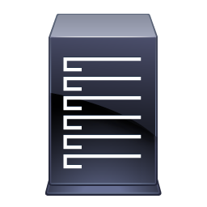
HTTP/80
Client 1
HTTP/80
HTTP/80
Proxy
Server
Client 2
HTTP/80
HTTP, SSL, FTP, and SOCKS proxies.
Client 3
Notes:
Server hides the identity of the client (typically ISP server)
Make a request on http port 80 to a server on the web
Server does not know which client has made the request
Benefits:
Anonymity
Caching
Blocking unwanted sites
Geofencing
HTTP, SSL, FTP, and SOCKS proxies.

Slide 4
Types of Proxy
Forward
Reverse

Slide 5
Forward Proxy Servers
Forward proxies send the requests of a client onward to a web server
Surf directly to a web proxy address or by configuring their Internet settings
Allow circumvention of firewalls and increase the privacy and security for a user
May sometimes be used to download illegal materials such as copyrighted materials or child pornography
Notes:
Forward proxies send the requests of a client onward to a web server
Users access forward proxies by directly surfing to a web proxy address or by configuring their Internet settings
Forward proxies allow circumvention of firewalls and increase the privacy and security for a user but may sometimes be used to download illegal materials such as copyrighted materials or child pornography

Slide 6
Reverse Proxy Server
Reverse proxies transparently handle all requests for resources on destination servers without requiring any action on the part of the requester
Reverse proxies are used to:
enable indirect access when a website disallows direct connections as a security measure
allow for load balancing between severs
stream internal content to Internet users
disable access to a site, for example when an ISP or government wishes to block a website
Notes:
Reverse proxies transparently handle all requests for resources on destination servers without requiring any action on the part of the requester.
Reverse proxies are used:
To enable indirect access when a website disallows direct connections as a security measure
To allow for load balancing between severs
To stream internal content to Internet users
To disable access to a site, for example when an ISP or government wishes to block a website

Slide 7
IDS vs. IPS
IDS are detection and monitoring tools
IPS is a control system
Both read network packets and compare the contents to a database of known threats
The control system accepts and rejects packets based on the ruleset
IDS are detection and monitoring tools
IPS requires that the database gets regularly updated with new threat data
IDS are detection and monitoring tools

Slide 8
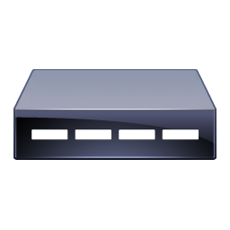
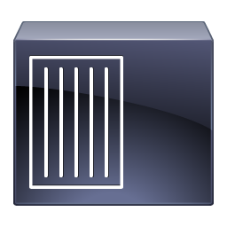
IDS
IPS
VS
Internet
Internet
IDS
Firewall
Firewall
Switch
Management
System
IPS
Corporate Network
Switch
Corporate Network
Management
System
Web
Server
E-Mail
Server
Web
Server
E-Mail
Server
Notes:
The main difference between an intrusion detection system (IDS) and an intrusion prevention system (IPS) is that an IDS is used to monitor a network, which then sends alerts when suspicious events on a system or network are detected. An IPS reacts to attacks in progress with the goal of preventing them from reaching targeted systems and networks. While IDS and IPS both have the ability to detect attacks, the main difference is in their responses to an attack. However, it’s important to note that both IDS and IPS can implement the same monitoring and detection methods.

Slide 9
Radius
Remote Authentication Dial-in User Service (RADIUS)
A network protocol that provides security to networks against unauthorized access
RADIUS secures a network by enabling centralized authentication of dial-in users and authorizing their access to use a network service
It manages remote user authentication, authorization and accounting (AAA)

Slide 10
Radius
Source Code
Credentials
RADIUS is an open protocol distributed as a source code
It is also used by independent or collaborating companies, which provide their own credentials to their own service users
Roaming
RADIUS is used by many companies to enable roaming between Internet service providers (ISPs), providing a single global set of credentials to be used on any public network

Slide 11
Diameter
Diameter is an authentication, authorization, and accounting protocol for computer networks
It evolved from the earlier RADIUS protocol
It belongs to the application layer protocols in the internet protocol suite.
It is a play on words, derived from the RADIUS protocol, which is the predecessor (a diameter is twice the radius)
Diameter Applications extend the base protocol by adding new commands and/or attributes, such as those for use with the Extensible Authentication Protocol (EAP)
Notes:
Diameter is an authentication, authorization, and accounting protocol for computer networks. It evolved from the earlier RADIUS protocol. It belongs to the application layer protocols in the internet protocol suite.
Diameter Applications extend the base protocol by adding new commands and/or attributes, such as those for use with the Extensible Authentication Protocol (EAP)

Slide 12
AAA
Authentication
Authorisation
Accounting
AAA is a term for a framework for intelligently controlling access
Refer to a family of protocols that mediate network access
Two network protocols providing this functionality are particularly popular: the RADIUS protocol, and its newer Diameter counterpart

Slide 13
Authentication
“
Authentication is the act of confirming the truth of an attribute of a single piece of data claimed true by an entity. In contrast with identification, which refers to the act of stating or otherwise indicating a claim purportedly attesting to a person or thing’s identity, authentication is the process of actually confirming that identity
…Wikipedia.com.
”

Slide 14
Authentication
There are four primary types of authentication
They use:
Static passwords (These do not change unless they expire or user changes them)
One-time password (OTP) such as personal Identification Numbers (PINs) delivered through SMS texts or otherwise
Digital certificates (x.509 and such)
Biometric credential

Slide 15
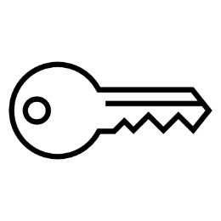
Authentication
Additionally there are three categories:
Something you know (such as a password)
Something you have (such as a key fob or mobile phone)
Something you are (such as your fingerprints, voice, or hand geometry)

Slide 16
Authentication
For more reliable Authentication, we employ Multi-Factor Authentication (MFA) which makes it difficult for someone to authenticate as another person
Using two passwords is not considered MFA because both passwords are considered “something you know”
Notes:
When one needs more reliable Authentication, we employ Multi-Factor Authentication (MFA) which makes it difficult for someone to authenticate as another person. For example, if a thief steals a mobile phone, he would also have to obtain the user’s password to access the code sent by an SMS text or possess the key fob that displays the code. Using two passwords is not considered MFA because both passwords are considered “something you know”. Many companies are moving toward Multi-Factor Authentication or Two-Factor Authentication (2FA) which leverages a static password and OTP or challenge question to strengthen security. Biometric authentication is being adopted as well. We will see more biometrics as technology becomes more cost effective.

Slide 17
Authentication
“
Authorization is the function of specifying access rights/privileges to resources related to information security and computer security in general and to access control in particular.
…Wikipedia.com.
”

Slide 18
After a user identifies himself and is authenticated to prove his identity, he must pass the authorisation rule to access system services, programs and data
Authorization determines what the user can access and what he cannot access
Authorisation
Notes:
After a user identifies himself and is authenticated to prove his identity, he must pass the authorization rule to access system services, programs and data. Authorization determines what the user can access and what he cannot access. An important concept to understand is the following: a user may authenticate but the resultant authorization could still be DENY ACCESS.
The Principle of Least Privilege requires that users and devices must only be granted sufficient access necessary to perform their required functions. Any frivolous authorization can result in accidental or malicious violations of security policy.

Slide 19
Accounting
The process that keeps track of a user’s activity while attached to a system
Includes:
the amount of time attached
the resources accessed
how much data transferred
Notes:
This is the process that keeps track of a user’s activity while attached to a system; the trail included the amount of time attached, the resources accessed, and how much data transferred. Accounting data is used for trending, detecting breaches, and forensic investigating. Keeping track of users and their activities serves many purposes. For example, tracing back to events leading up to a cybersecurity incident can prove very valuable to a forensics analysis and investigation case.

Slide 20
2.2 Describe the policy-based methods available for network protection and explain their purpose
• QoS;
• cross-domain components;
• DMZ;
• gateways;
• routing;
• traffic prioritisation;
• Anomaly and misuse detection.
A candidate should be able to:
• Explain the use of Demilitarised Zone (DMZ) in a firewall setting.
• Understand routing principles and policy based routing.
• Define the concept of quality of service (QoS) and corresponding service level agreement (SLA).
• Describe network security policy and acceptable user policy to find the best matches.
• Use network behaviour anomaly detection.

Slide 21
QoS
Quality of service (QoS) refers to any technology that manages data traffic to reduce packet loss, latency and jitter on the network
QoS controls and manages network resources by setting priorities for specific types of data on the network
QoS technology can manage resources by assigning the various types of network data different priority levels
Notes:
Define the concept of quality of service (QoS) and corresponding service level agreement (SLA).

Slide 22
QoS
QoS is usually applied on networks that cater to traffic that carry resource-intensive data like:
Video-on-demand
Voice over IP (VoIP)
Internet Protocol television (IPTV),
Streamed media
Video conferencing
Online gaming
These sorts of data need to be transmitted in the shortest amount of time to be consumable at the receiving end
Notes:
QoS is usually applied on networks that cater to traffic that carry resource-intensive data like:
Video-on-demand
Voice over IP (VoIP)
Internet Protocol television (IPTV),
Streamed media
Video conferencing
Online gaming
These sorts of data need to be transmitted in the shortest amount of time to be consumable at the receiving end

Slide 23
Cross-domain Components
Components facilitate the ability to send data between domains
Allows us to share browser data
Not the same as an API
Components can’t send or manipulate anything they want on the other domain just by being connected
To maintain security, a Cross-Domain Solution is required
Notes:
Describe network security policy and acceptable user policy to find the best matches
Use network behaviour anomaly detection

Slide 24
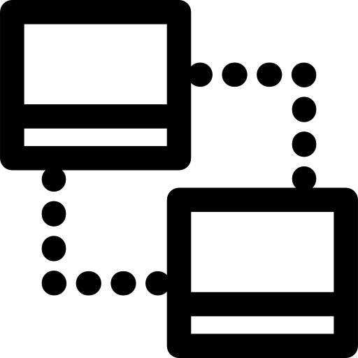
Cross-Domain Solution
An integrated information assurance system composed of specialised software, and sometimes hardware
Provides a controlled interface to manually or automatically enable and/or restrict the access or transfer of information between two or more security domains based on a predetermined security policy
CDSs are designed to enforce domain separation and typically include some form of content filtering, which is used to designate information that is unauthorized for transfer between security domains or levels of classification
1
2
3
Notes:
An integrated information assurance system composed of specialised software, and sometimes hardware, that provides a controlled interface to manually or automatically enable and/or restrict the access or transfer of information between two or more security domains based on a predetermined security policy.
CDSs are designed to enforce domain separation and typically include some form of content filtering, which is used to designate information that is unauthorized for transfer between security domains or levels of classification

Slide 25
CDS
The goal of a CDS is to allow a trusted network domain to exchange information with other domains, either one-way or bidirectionally, without introducing the potential for security threats that would normally come with network connectivity
The goal is 100% assurance
This is not possible in practice
CDS development, assessment, and deployment are based on comprehensive risk management
Notes:
The goal of a CDS is to allow a trusted network domain to exchange information with other domains, either one-way or bidirectionally, without introducing the potential for security threats that would normally come with network connectivity. Although the goal is 100% assurance, this is not possible in practice, thus CDS development, assessment, and deployment are based on comprehensive risk management

Slide 26
CDS
Data confidentiality
Most often imposed by hardware-enforced one-way data transfer
Data
integrity
Content management using filtering for viruses and malware; content examination utilities; in high-to-low security transfer audited human review
Three primary elements demanded from cross domain solutions are:
Data
availability
Security-hardened operating systems, role-based administration access, redundant hardware
Notes:
Three primary elements demanded from cross domain solutions are:
Data confidentiality; most often imposed by hardware-enforced one-way data transfer
Data integrity: content management using filtering for viruses and malware; content examination utilities; in high-to-low security transfer audited human review
Data availability: security-hardened operating systems, role-based administration access, redundant hardware, etc.

Slide 27
DMZ
A DMZ or demilitarized zone is a physical or logical subnetwork that contains and exposes an organization's external-facing services to an untrusted, usually larger, network such as the Internet
The purpose of a DMZ is to add an additional layer of security to an organization's local area network (LAN)
an external network node can access only what is exposed in the DMZ, while the rest of the organization's network is firewalled
The DMZ functions as a small, isolated network positioned between the Internet and the private network
Notes:
NOT the North Korean
In computer security, a DMZ or demilitarized zone (sometimes referred to as a perimeter network or screened subnet) is a physical or logical subnetwork that contains and exposes an organization's external-facing services to an untrusted, usually larger, network such as the Internet. The purpose of a DMZ is to add an additional layer of security to an organization's local area network (LAN): an external network node can access only what is exposed in the DMZ, while the rest of the organization's network is firewalled.[1] The DMZ functions as a small, isolated network positioned between the Internet and the private network

Slide 28
DMZ - Architecture
Two of the most basic methods are with a single firewall, also known as the three legged model, and with dual firewalls, also known as back to back. Th

Slide 29
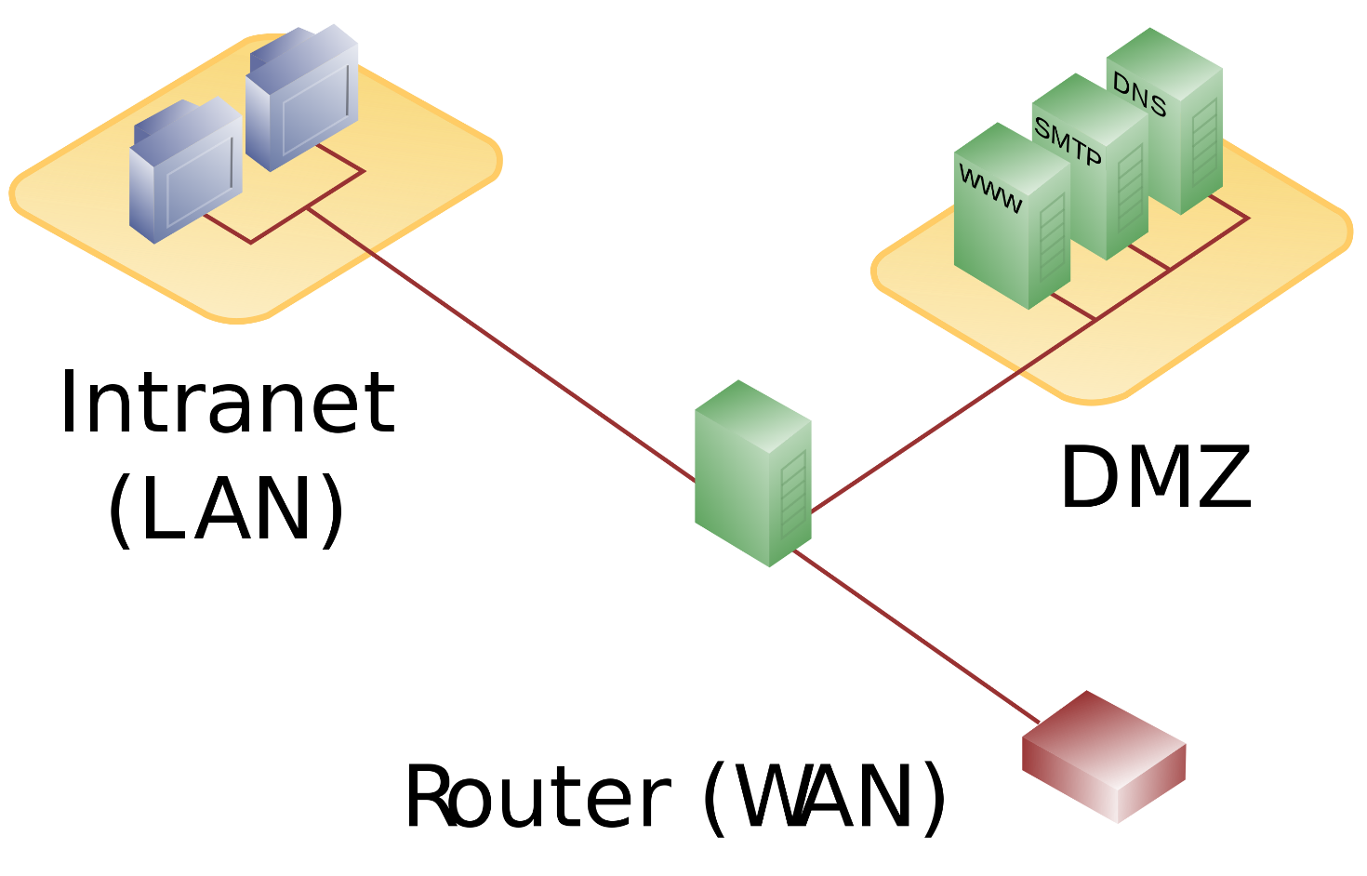
DMZ - Architecture
Single firewall
Has at least 3 network interfaces
Firewall becomes a single point of failure
Firewall must handle all the traffic to the DMZ as well as the internal network
Notes:
A single firewall with at least 3 network interfaces can be used to create a network architecture containing a DMZ.
The external network is formed from the ISP to the firewall on the first network interface, the internal network is formed from the second network interface, and the DMZ is formed from the third network interface.
The firewall becomes a single point of failure for the network and must be able to handle all of the traffic going to the DMZ as well as the internal network. The zones are usually marked with colours -for example, purple for LAN, green for DMZ, red for Internet (with often another colour used for wireless zones).

Slide 30
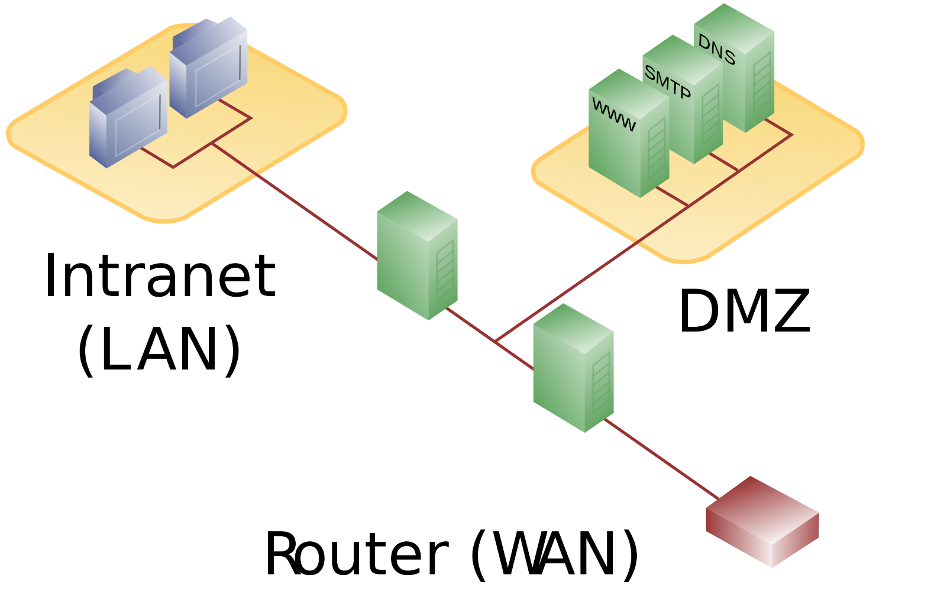
DMZ - Architecture
Dual firewall
Uses two firewalls
Front end or perimeter firewall must be configured to allow traffic destined for the DMZ only
Back-end or internal firewall only allows traffic to the DMZ from the internal network
Two devices would need to be compromised
Notes:
A dual firewall approach
The most secure approach is to use two firewalls to create a DMZ. The first firewall (also called the "front-end" or "perimeter“ firewall) must be configured to allow traffic destined to the DMZ only. The second firewall (also called "back-end" or "internal" firewall) only allows traffic to the DMZ from the internal network.
This setup is considered more secure since two devices would need to be compromised. There is even more protection if the two firewalls are provided by two different vendors, because it makes it less likely that both devices suffer from the same security vulnerabilities. For example a security hole found to exist in one vendor's system is less likely to occur in the other one.
One of the drawbacks of this architecture is that it's more costly, both to purchase, and to manage.

Slide 31
DMZ - Architecture
The practice of using different firewalls from different vendors is sometimes described as a component of a "defence in depth" security strategy

