Slide 2
ITIL Introduction
Information Technology Infrastructure Library
Notes:
Guidance/set of practices for ITSM to fill gap and stay in business

Slide 3
Course Administration
Foundation certificate in IT service management[ ITIL4]
60 Minutes
40 Questions, multiple choice
Pass Mark: 26/40 or 65%
Pass or Fail, no score recorded on official certificate
Exam Board: PEOPLECERT
Create account[if needed] at www.peoplecert.org

Slide 4
Monday
Unit 1
Unit 2
Tuesday
Unit 3
Unit 4
Wednesday
Unit 5
Unit 6
Thursday
Unit 7
Friday
Revision
Test 1
Test 2

Slide 5
Take 5 minutes
What is service management?
Prepare for a group discussion

Slide 6
ITIL
Vendor neutral
ITIL is “Best Practice”
Non- Prescriptive
ITIL is all about how to give the best service for IT in an organisation. A lot of this can be recognisable as to what you do at work.
But do not think about how you would do things at work as ITIL is a framework!

Slide 7
ITIL

Slide 8
Learning Objectives
By the end of this section, you will be able to:
[BL1] Define ITIL terms including
Service and service management
Consumer, stakeholder, customer, user, sponsor
Utility and warranty
[BL2] Describe concept of service management and value co-creation with services including
Value, utility, warranty
Outcomes, outputs, costs, risks
Products and service offerings
Service relationships
Service provisioning
Organizations
The ITIL service value system

Slide 9
Service and Service Management
Services are the means ,by which one party supports the needs of another party
-E.g. Enabling someone to get a haircut or receive an order by using a postal service
Purpose of ITIL4 is to provide comprehensive guidance for managing IT enabled services in the digital economy
-E.g. -Enabling the booking if a doctor's appointment at any time using web- enabled technologies or an app
It is intended to ensure an efficient , effective, flexible, co- ordinated system for the governance and management of IT services is established and improved

Slide 10
Service and Service Management
Service is defined as:
“A means of enabling value co-creation by facilitating outcomes that the customer wants to achieve without the customer having to manage specific costs and risks”
Service Management is defined as:
“ A set of specialized capabilities for enabling VALUE to CUSTOMERS in the form of SERVICES”

Slide 11
Services and Service Management
Services are facilitated increasingly by technology
Commonly used technologies which require management to ensure that business outcomes are delivered include:
Cloud Computing and Infrastructure as a service
Machine Learning and Artificial Intelligence
Blockchain
Every organization is a “service organization” and almost all services today are “IT enabled” services

Slide 12
Understanding and Defining Value
Value is defined as:
“The perceived benefits, usefulness and importance of something.”
In order to deliver value through services it is necessary to establish what the services management capability should look like. This requires understanding:
1 Nature and scope of stakeholders
2 The Nature of Value
3 How value is created through services
This Photo by Unknown author is licensed under CC BY.

Slide 13
Understanding and defining value
Value is made up of two elements:
UTILITY
“The functionality offered by a product or service to meet a particular need”
What the service does
Can be used to determine whether a service is ‘fit for purpose’
Requires that a service support the performance of the consumer or remove constraints from the consumer

Slide 14
Warranty
The assurance that a product or service will meet agreed requirements
How the service perform
Can be used to determine whether a service is ‘fit for purpose’
Typically addresses areas such as
Availability
Capacity
Security levels
Continuity of service
Requires that a service has defined and agreed conditions that are met

Slide 15
Value, Outcomes, Costs and Risks
All services must balance the outcomes that needs to be supported, the costs and risks removed against outcomes that may be impacted negatively and costs and risks that may be introduced as a result of its use.

Slide 16
Value
All services must balance the outcome the outcomes to be supported, the costs removed and risks removed against outcomes that may be impacted negatively and costs and risks that may be introduced as a result of its use

Slide 17
Facilitating Outcomes
Outputs and Outcomes are defined as:
“ Outputs are deliverable from an activity. They may be tangible, such as a document, or intangible such an enhanced reputation”
“Outcomes are the results enabled for the stakeholders by one or more outputs, such as processing a sale.”

Slide 18
Understanding Costs
Costs are defined as:
“The amount of money spent on a specific activity or resource. Costs can be expressed in non-monetary terms, such as time spent, people allocated, etc.”
There are two types of costs
Cost Removed from the consumer by the service, such as staff or technology cost[part of the value preposition]
Cost Imposed-on the consumer by the service, such as the price charged [if applicable], costs of training and making associated purchases in order to consume the service.

Slide 19
Understanding Risks
Risks are defined as:
“ Possible events that could cause harm or loss or make it more difficult to achieve objectives.”
Risks may be removed or reduced for the customer by the service
Risks may be added or imposed on the consumer by the service or the service provider
Risks are usually only removed completely if the activity is avoided. Most risks are managed in-line with the appetite and tolerance of the consumer.

Slide 20
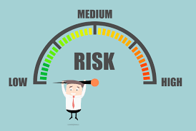
Understanding Risks
In value co-creation both the provider and the consumer worked together to create value. These activities will both add to and reduce risk.
Consumers can contribute towards reduction of risks by:
Actively participating in requirement definition, both for the service and outcomes required
Clearly communicating critical success factors and constraints that apply to the service
Ensuring the provider has the necessary access to resources through out the service relationship

Slide 21
Activity (10 minutes)
Describe services offered by your organisation in reference with Value, Cost, Risk and Outcomes.
Your suggestion / plan for a Co-Create Value with consumers.

Slide 22
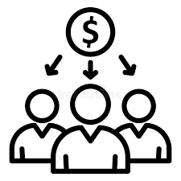
Stakeholders and Services
Stakeholder is defined as
“A person or organization that has an interest or involvement in an organization, product, service, practice, or other entity.”
Organization is defined as:
“ A person or group of people that has its own functions with responsibilities, authorities and relationships to achieve its objectives
Organization vary in size and complexity, how they relate legally to other organization and by how they share common objectives, relationships and authorities

Slide 23
Stakeholders in Service Management
There are 3 main stakeholders in ITIL
Users
Those who use the service on a day-to-day basis
Customers
Those who buy goods or services. The customer of an IT service provider is the person or group who defines and agrees the service level targets.
Suppliers
Third parties responsible for supplying goods or services that are required to deliver IT services.

Slide 24
Stakeholders and Services
Stakeholders take several forms including:
Service Providers, defined as:
“ A role performed by an organization in a service relationship to provide services to consumers.”
Service Consumers, defined as any of as appropriate:
“Customer– The role that defines requirements for services and take responsibility for outcomes from service consumptions.”
“User– The role that uses services.”
“Sponsor– The role that authorizes the budget for service consumption.”
Notes:
Broadband Example

Slide 25
Stakeholder and Services

Slide 26
Any Questions

Slide 27
Understanding Value Co-Creation
Traditionally organisations have seen value delivery as being ‘transactional’.
E.g. A fresh food company delivers a box with various ingredients and recipes to follow.
The value would have been in the delivery, regardless of what the consumer chose to do with the contents of the box.
This isn’t VALUE CO-CREATION

Slide 28
Understanding Value Co-Creation
Increasingly organization see value is CO-CREATED between providers and consumers.
It may also involve other organizations that are part of Service Relationships
E.g. The food box is delivered. The customer then uses it to create first class food for consumption.
VALUE id CO-CREATED when the consumer uses the provider’s delivery to create the required outcome.

Slide 29
Services and Products
Services are made up of a service provider products. There may be a single product or combination of products that are utilized.
A product is defined as
“ A configuration of resources, created by the organization, that will be potentially valuable for the customers”.
Products are typically complex, made up of many elements such as a network, and may not be customer-visible. The service the customer sees may not represent all the product elements to deliver and support it. Organization define which product component customers see and tailor them according the need of target consumers.

Slide 30
Service Relationships
Service Relationships exist when a service provider and a service consumer co-create value on an ongoing basis and according to agreed and available service offering.
Food delivery

Slide 31
Service Provisioning
Service provisioning is the activities performed by the provider in order to provide services
Management of provider resources configured to provide services
Provision of access to resources for users
Fulfilment of agreed service actions
Service performance management and continual improvement .

Slide 32
Service Consumption
Service consumption happens when the service consumer carries out activities to consume services
Management of consumer resources needed to consume services
Utilisation of the providers resources
Requesting that service actions be performed to fulfil requirements
Receipt of or acquisition of goods

Slide 33
Service offerings
Service offerings are defined as
“A description of one or more services, design to address the needs of a target consumer group. It may include goods, access to resources and service actions.”
Goods: Ownership is transferred to the customer and they take responsibility for its future use. E.g. purchasing a computer
Access to Resources : Ownership is Not transferred to the customer. Access is granted or licenced under agreed terms or conditions. E.g. access to cloud services
Service Actions : Performed by the service provider to address a consumer need and in as agreed with the consumer. E.g. Managing breaks in access to cloud services from the computer

Slide 34
Service Relationships
SERVICE
Resources
Products
Service Offering
Service Relationships
Resources are combined as required to create products
Product are utilised alone or in combination to create service offerings Service offerings are selected by consumers according to the outcomes they need to realise Service relationships exist when a consumer and provider work together on an on-going basis to co – create value.
The combination of Products Service Offerings and the Service Relationship are collectively the SERVICE. This is the part of the service offering which is delivering VALUE in the service relationship.
Notes:
Broadband example.

Slide 35
Service Relationships
Resources
Products
Service Offering
Service Relationships
Goods
Goods- “Produce for sale.”
Actions
Service Actions- Delivery to customer
Resources
Access to Resources
“The right product can be delivered whenever the customer needs it along with the right equipment to create and serve quality meals”
“Customer can prepare and serve what their consumers has ordered”

Slide 36
Service Relationships
Goods- Desktop computing equipment
Service Actions- “Data backup/ restore/ security .”
Access to Resources—“Cloud computing facilities”
“Creation And management of information regarding customers, online orders, products/ stock control and invoices/finance in a timely and secure manner.”
“Consumers can manage a customer order from logging to payment and shipping securely.”

Slide 37
Service Relationship Model
Service relationship model - “In order to deliver services, service providers are also service consumers”

Slide 38
Activity (20 min.)
Create a Service Relationship flowchart of service offered by your organisation.
Describe your role in Service relationship.
Suggestion to improve Service Relationships between consumers and service providers .

Slide 39
Any Questions

Slide 40
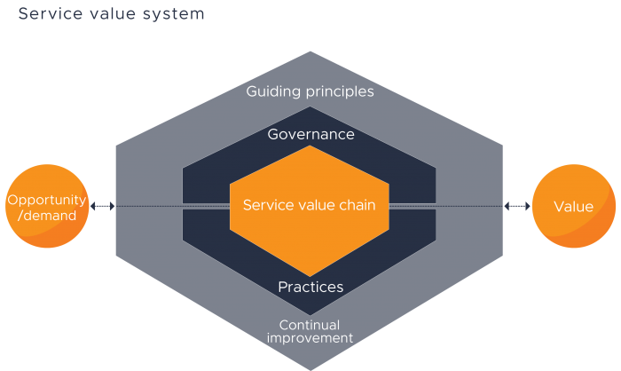
Service Value System (Purpose and Definition)
“The purpose of the service value system (SVS) is to ensure that the organisation continually co-creates value with all stakeholders through the use and management of products and services.”
SVS has been specifically designed architected to enable flexibility and discouraged siloed working.

Slide 41
Purpose and Definition
The ITIL service value system describes how all the components and activities of the organisation work together as a system to enable value creation.
These components and activities , together with the organisations resources, can be configured and reconfigured in multiple combinations in a flexible way as circumstances change, but this requires the integration and coordination of activities, practices, teams, authorities and responsibilities and all parties to be truly effective.

Slide 42
SVS – Inputs and Outputs
Input: Opportunities represent the options or possibilities to add value for stakeholders or otherwise improve the organisation. Demand is the need or desire for products and services among internal and external consumers.
Opportunity/ Demand
Value
Outputs: The outcome of the SVS is Value. The SVS can enable the creation of many different types of value for wide group of stakeholders.

Slide 43
SVS Components
Guiding Principles: Recommendations that can guide an organisation in all circumstances, regardless of changes in its goals, strategies, type of work or management structure.
Guiding principles
Opportunity/ Demand
Value
Opportunity/ Demand
Opportunity/ Demand
Continual improvement
Continual Improvement: A recurring organisational activity performed at all levels to ensure that organisation’s performance continually meets stakeholders’ expectations.

Slide 44
SVS Components
Governance : The means by which an organisation is directed and controlled.
Value
Value
Value
Opportunity/ Demand
Value
Opportunity/ Demand
Opportunity/ Demand
Opportunity/ Demand
Opportunity/ Demand
Opportunity/ Demand
Opportunity/ Demand
Governance
Practices
Practises : Sets of organisational resources designed for performing work or accomplishing an objective.

Slide 45
SVS Components
Service Value Chain : A set of interconnected activities that an organisation performs in order to deliver a valuable product or service to its customers and to facilitate value creation.

Slide 46
Learning Review
[BL1] Define ITIL terms including :
Service and service management
Consumer, stakeholder, consumer, user, sponsor
Utility and warranty
[BL2] Describe concepts of service management and value co-creation with services including :
Value, utility, warranty
Outcome, outputs, risks, costs
Product and service offerings
Service relationships
Service provision
Organisations
The ITIL Service Value System

Slide 47
Any Questions

Slide 48
Identify the missing word(s) in the following sentence: A service is a means of enabling value co-creation by facilitating [?] that customers want to achieve.
A. The warranty
B. Outcomes
C. The utility
D. Outputs
Notes:
B

Slide 49
What are the two types of cost that a service consumer should evaluate?
The price of the service, and the cost of creating the service
The costs removed by the service, and the costs imposed by the service
The cost of provisioning the service, and the cost of improving the service
The cost of software, and the cost of hardware
Notes:
B

Slide 50
Which ITIL concept describes governance?
The seven guiding principles
The four dimensions of service management
The service value chain
The service value system
Notes:
D

Slide 51
Which describes outcome?
Tangible or intangible deliverables
Functionality offered by a product or service
Results desired by stakeholder
Configuration of an organisation’s resources
Notes:
C—result for a stakeholder enabled by one or more outputs.

Slide 52
A service provided describes a package that includes a laptop with software, licences, and support. What is this package an example of?
Value
B. An outcome
Warranty
A service offering
Notes:
D

Slide 53
What is the definition of warranty?
A tangible or intangible deliverable that is produced by carrying out an activity
The assurance that our product or service will meet agreed requirements
A possible event that could cause harm or loss, or make it more difficult to achieve objectives
The functionality offered by a product or service to meet a particular need
Notes:
B

Slide 54
Activity
Create a chart of different roles and activities done by people in your organization.(CEO,CFO, Technician, Head operation etc)
Find out different role for you like what are the task you are responsible, accountable and who you consult and inform.

Slide 55
End Of Section

Slide 56
Learning objectives:
By the end of this section you will be able to:
[BL2] Describe the four dimensions of IT service management
People and organisations
Information and Technology
Partners and Suppliers
Value Streams and Processes

Slide 57
The 4 Dimensions of Service Management
The 4 Dimensions and Factors that Affect Them

Slide 58
The 4 Dimensions of Service Management
The 4 Dimensions

Slide 59
The 4 Dimensions of Service Management
Dimension 1 - Organisations and People
Formal Organisational Structures
Roles and Responsibilities
Required Staffing and Competencies
Culture

Slide 60
The 4 Dimensions of Service Management
Dimension 1 - Organisations and People
Organisations
Culture
Formal Organisational Structures
Culture
Required staffing and Competencies
Roles and Responsibilities
Shared value and attributes
leaders champion and advocate values
Communication
trust and transparency
Formal organisational structures and systems of authority aren't enough on their own to improve organisational effectiveness.
This won't be achieved without a culture that supports the organisations objectives only

Slide 61
The 4 Dimensions of Service Management
Dimension 1 - Organisations and People
People
Management and leadership styles
Broad knowledge, deep specialisation
Breaking down siloes
Communication and collaboration
Common objective: facilitating value creation
Updating skills and competencies

Slide 62
The 4 Dimensions of Service Management
Dimension 2 – Information and technology
Information and knowledge
Technologies
Relationships between the components

Slide 63
Dimension 2 – Information and technology
Technology
Technology that supports service Management:
Workflow management
Communications systems
Inventory systems
Mobile platforms
Cloud solutions
Knowledgebases
Analytical tools
Remote collaboration
Artificial intelligence
Machine learning
Technology that supports IT services:
IT architecture
Databases
Blockchain
Cognitive computing
Applications
Communication systems
Artificial intelligence
Cloud computing
Mobile applications

Slide 64
Dimension 2 – Information and technology
The governance and management of information is a key factor in Co creating value for consumers
This can include internal considerations, legislative requirements, security and industry stakeholder requirements amongst others
Criteria that should be considered in the management of information may include:
Timeliness
Availability
Accuracy
Reliability
Accessibility
Relevance

Slide 65
Dimension 2 – Information and Technology
Is it compatible with the existing architecture? (New Technology)
Does it raise regulatory, compliance or security issues?
Will it be viable into the foreseeable future? (Risk)
Does it align with service provider or consumer strategy?
Does the organisation have right support skills and capabilities?
Does it have sufficient automation capabilities for development, deployment and support?
Does it have other capabilities that can be leveraged for other products or services?
Does it introduce new risks or constraints to the organisation? ( e.g.- locking it into a specific vendor)
Notes:
Think and discuss.

Slide 66
Dimension 3 - Partners and Suppliers
Dimension 3 - Partners and Suppliers
Service provider/ service consumer relationships
Organisation’s partner and supplier strategy
Factors that influence supplier strategies
Service integration and management (SIAM)

Slide 67
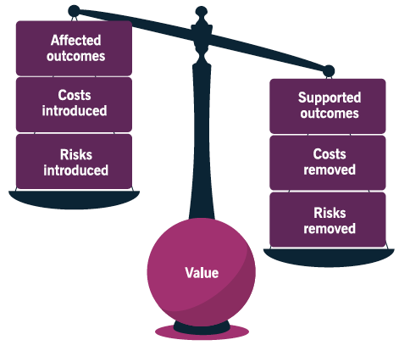
Dimension 3 - Partners and Suppliers
Service partnerships:
Share common goals and risks
Collaborate to achieve desired outcomes
Every organisation and every service depends to some degree on services provided by other organisations.
Examples of this may include :
Goods, such as computers, may need to be purchased.
Service actions such as data backup and recovery.
Access to resources such as application support.
Every service provider is also a service consumer
Value, Outcomes, Risks and Costs
Goods and Service Supply:
Formal contracts
Clear separation of responsibilities

Slide 68
Dimension 3 - Partners and Suppliers
Suppl. & Part.
SIAM
Service provider/ service consumer relationships
Service Integration and Management (SIAM)
Supplier A (external)
Supplier B (External)
Supplier C (Internal)
Factors that influence supplier strategies
Organisation’s partner and supplier strategy
Service integrator
Internal
External
Lead supplier
Hybrid
SIAM Involves a specialised capability, the service integrator to ensure supplier relationships are properly coordinated.
There are differing variations regarding how this capability is established but they all have the same goal – assure value creation for the consumer
Consumer

Slide 69
Dimension 3 - Partners and Suppliers
Organisation’s Supplier Strategy
Assure alignment of goals, culture and business environment
Strategic focus
Subject Matter Expertise
Corporate culture
Cost Concerns
Resource scarcity
Demand patterns
External Constraints

Slide 70
Activity (20)
Make a list of Partners and suppliers of your workplace.
Is it good/bad practice to outsource works/goods or core competencies or to retain full control over all important factors?

Slide 71
Dimension 4 – Value Streams and Processes
Dimension 4 – Value Streams and Processes
Activities the organisation undertakes
How activities are organised
How value creation is insured for all stakeholders efficiently and effectively

Slide 72
Dimension 4 – Value Streams and Processes
A value stream is a series of steps an organisation takes to create, develop and deliver products and services. A value stream combines value chain activities, which may come from many different processes or practises.
Optimising a value stream may include automating activities, using new technologies and re-organising the end-to-end order of activities to realise greater efficiency, enhance the user experience or enable the required value from the service.
It is not always possible or desirable to eliminate all steps in the value stream that don't in themselves add value.
Value Stream
Step 1
Step 2
Value Add
Non-Value Add (Waste)
Step 3
Outcome

Slide 73
Dimension 4 – Value Streams and Processes
Process
A process is a set of interrelated or interacting activities that take one or more inputs and transforms them into one or more outputs.
Process should have a specific, clearly defined objective that they are intended to achieve for their stakeholders.
Any well-defined process can improve productivity both within and across organisations.
Input(s)
Activities
Output(s)

Slide 74
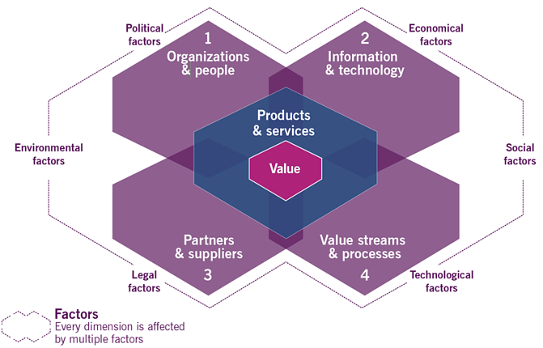
Dimension 4 – Value Streams and Processes
External factors that influence The 4 Dimensions
Notes:
PESTEL

Slide 75
Dimension 4 – Value Streams and Processes
External factors that influence the 4 Dimensions
The PESTLE model is useful as it describes factors that can influence or constrain how a service provider operates and how services can be delivered.
P olitical | Governmental considerations, such as party of government , policy on employment, nature of service provision in the public sector and incentivisation programmes .
E conomic | Monetary considerations, such as investment in services, interest rates for borrowing for services, cost of capability such as skills and financial health of the consumer.
S ocial | Population factors such as age of staff, work life balance, career attitudes, safety concerns and wider trends such as generational use of tech. (e.g baby-boomers vs. millennials)

Slide 76
Dimension 4 – Value Streams and Processes
External factors that influence the 4 Dimensions
The PESTLE model is useful as it describes factors that can influence or constrain how a service provider operates and how services can be delivered.
T echnology | Considerations about the way technology is used in service, such as the rate of change, automation, artificial intelligence, sourcing of technology and how technology drives innovation.
L egal | Specifically issues around the law and regulation, such as employment law, information handling, security and health and safety amongst others.
E nvironmental | Considerations around the way services impact the environment such as energy consumption, use of hazardous or un-ecologically sound materials and disposal of technology.

Slide 77
Learning review
You should be able to:
[BL2]Describe the four dimensions of IT Service management
People and Organisations
Information and Technology Partners and Suppliers Value Streams and Processes

Slide 78
Activity
Divide in groups to find out questions on following topics and ask to other group
People and Organisations
Information and Technology
Partners and Suppliers
Value Streams and Processes

Slide 79
Any Questions

Slide 80
Question
5) Which service management dimension is focused on activities and how these are coordinated?
A. Organisations and People
B. Information and Technology
C. Partners and Suppliers
D. Value Streams and Processes
Notes:
D

Slide 81
Question
35) Which is NOT a key focus of the ‘Information and Technology’dimension?
A. Security and compliance
B. Communication systems and knowledge bases
C. Workflow management and inventory systems
D. Roles And responsibilities
Notes:
D

Slide 82
End of Section

Slide 83
THE ITIL 4
Guiding Principles

Slide 84
Learning objectives
By the end of this section you will be able to:
[BL2]Describe the nature, use and interaction of each of the guiding principles

Slide 85
Service Value System and Guiding Principles
Guiding principles: Recommendations that can guide an organisation in all circumstances, regardless of changes in its goals, strategies, type of work or management structure.
Opportunity/ Demand
Value

Slide 86
Introducing the Guiding Principles
Guiding principle is defined as:
“A recommendation that guides an organization in ALL circumstances , regardless of changes in its goals , strategies, types of work or management structure. A guiding principle is universal and enduring.”
ITIL Has long embraced the Adopt and Adapt approach.
Adopt a ‘service management approach’ towards the delivery of service and co-creation of value.
Adapt ITIL Guidance and other sources of best practise in order to deliver on specific needs and address specific circumstances.
Guiding Principles can be applied to support organisations in almost any initiative as they seek to Adopt and Adapt service management.

Slide 87
Introducing the Guiding Principles
Guiding Principles encourage and support Continual Improvement :
at all levels of an organisation
with all stakeholders
in all initiatives
Consider the following when applying the principles:
Any and all of the principles may be applicable. Don't just focus on one or two of them when applying them
Not all principles will be relevant all of the time. They should all be reviewed for whether they are or should be applied but doesn't mean they will always be used.

Slide 88
The 7 Guiding Principles
Focus on value
Start where you are
Progress iteratively with feedback
Collaborate and promote visibility
Think and work holistically
Keep it simple and practical
Optimise and Automate

Slide 89
Principle-Focus on Value
“ Everything the organisation does should link back, directly or indirectly, to value for itself, customers and stakeholders.”
Understand and Identify the service customer
Understand the consumer’s perspective of value
Map value to intended outcomes, which change overtime
Understand the Customer Experience (CX) and/or the User Experience (UX)

Slide 90
Applying Focus on Value
“Everything the organisation does should link back, directly or indirectly, to value for itself, customers and stakeholders.”
Know how consumers use each service.
Encourage a focus on value among all staff.
Focus on value during operational activities as well as during improvement initiatives.
Include a focus on value in every step of any improvement initiative.
Notes:
Value changes over time and in different circumstances.

Slide 91
Principle-- Start where you are
“When engaged in any improvement initiative, do Not start over without first considering what is already available to be leveraged .”
When deciding on how to proceed consider the following:
Base decision on accurate information from direct observation, supported by appropriate and effective measurements.
Measurement should be used to support, not replace, direct observation.
Over reliance on data analytics and reporting can introduce biases and risk in decision-making
Measuring something affects the thing being measured
Metrics and targets drive behaviours so be wary of this when establishing them

Slide 92
Applying start where you are
“When engaged in any improvement initiative, do NOT start over without first considering what is already available to be leveraged”
Look at what exists as objectively as possible (fit for purpose)
1
Determine if successful practises or services can be replicated or expanded
2
Apply risk management skills in the decision-making process
3
Recognise that sometimes nothing from the current state can be reused
4

Slide 93
Progress Iteratively with Feedback
“Working in their time boxed, iterative manner with feedback loops Embedded into the process allows for greater flexibility, faster responses to customer and business need, the ability to discover and respond to fellow earlier and an overall improvement in quality
Iteration 1
Iteration 2
Iteration 3
Work should be organised into smaller, manageable sections
Can be sequential or simultaneous
Should be both manageable and managed
Should deliver tangible results and value
Should be delivered in a timely manner
Can be built on to create future improvement

Slide 94
Progress iteratively with feedback
“Working in a time boxed, iterative manner with feedback loops embedded into the process allows for greater flexibility, faster responses to customer and business need, the ability to discover and respond to failure earlier and an overall improvement in quality
A feedback loop is achieved when part of the output of an activities used as a new input into the same activity
The initiative and it’s component iteration must be continually re- evaluated to reflect changes in circumstances
Seek and use feedback before, during and after each iteration
Feedback loops between participants help them understand where work comes from, where it goes and how their actions affect outcomes
Iteration 1
Iteration 2
Iteration 3

Slide 95
Applying Progress Iteratively with Feedback
“Working In a time boxed , iterative manner with feedback loops embedded into the process allows for greater flexibility, faster responses to customer and business need, the ability to discover and respond to failure earlier and an overall improvement in quality.”
Comprehend the whole, but DO SOMETHING
The ecosystem is constantly changing so feedback is essential
Fast does NOT mean INCOMPLETE

Slide 96
Principle Collaborate and Promote Visibility
“When Initiatives involve the right people, in the correct roles, efforts benefit from better buy- in more relevance (because better information is available for decision-making ) and increased likelihood of long -term success.”
Information Sharing
Real Accomplishment
Trust
Understanding
Examples of stakeholders with differing prospective that can collaborate
Service provider Customers
Developers Operations
Suppliers Organisations

Slide 97
Principle Collaborate and promote visibility
“When Initiatives involve the right people, in the correct roles, efforts benefit from better buy in more relevance (because better information is available for decision-making )and increased likelihood of long- term success.”
Possible Risks based on “Lack of Transparency”
Work may not seem as a priority
Improvement work may be assigned a lower priority than daily or operation tasks
Poor understanding of the relative importance of current versus future work leading to lack of balance between the two
Insufficient visibility of work leads to poor decision-making
Understand the flow of work
Identify bottlenecks and excess capacity
Uncover waste in the system, such as over processing (good enough is good enough ) or un- or (Under utilised capacity )

Slide 98
Applying Collaborate and Promote Visibility
“When Initiatives involve the right people, in the correct roles, efforts benefit from better buy-in , more relevance (because better information is available for decision-making ) and increased likelihood of long- term success.”
Collaborate does NOT mean CONSENSUS
Communicate in a way the audience can hear
Decisions can only be made on visible data

Slide 99
Applying Collaborate and Promote Visibility
“When initiatives involve the right people, in the correct roles, efforts benefit from better buy in. more relevance (because better information is available for decision-making ) and increased likelihood of long- term success.”
Ensure value
Simplicity is the ultimate sophistication
Do fewer things but do them better
Respect the time of the people involved
Easier to understand, more likely to adopt
Simplicity is the best route to achieving quick wins

Slide 100
Principle Think and Work Holistically
“ A holistic approach to service management requires an understanding of how all the parts of an organisation work together in an integrated way .”
Service Provider
Customer Needs
Technical IT Assets
SerS
External Suppliers
Business Processes
Demand
Service Culture
Organisation Structure
Value
Consumer/Stakeholder

Slide 101
Applying - Think and Work Holistically
“ A holistic approach to service management requires an understanding of how all the parts of an organisation work together in an integrated way.”
Recognise the complexity of the system
Collaboration is key to thinking and working holistically
Where possible, look for patterns of interaction between system elements
automation can facilitate working holistically

Slide 102
Principle keep it simple and practical
“Always Use the minimum number of steps to accomplish and objective. Outcome based thinking should be used to produce practical solutions which deliver valuable outcomes while using the minimum number of steps needed.”
Establish a holistic view of the organization’s work
Don't try to produce a solution for every exception
Start with an uncomplicated approach and add later
Be mindful of competing objectives

Slide 103
Principle-Optimise and Automate
“Optimization means to make something as effective and useful as make sense. Before an activity can be affectively automated it should be optimised to whatever degrees possible and reasonable.”
1 Understand and agree to the context for optimization
2 Assesses the current state to understand where it can be improved
3 Focus on simplification and value when agreeing to the future state
4 Ensure the optimization has the appropriate level of stakeholder engagement
5 Execute the improvements in an iterative way, using metrics and other feedback to check progress, stay on track and adjust as necessary
6 Continually monitor to identify opportunity's to improve work methods

Slide 104
Principle –Optimise and Automate
“Automation is the use of technology to perform a step or series of steps correctly and consistently with limited or no human intervention.”
“Automating frequent and repetitive tasks help organisations scale up and allows human resources to be used for more complex decision making.”

Slide 105
Applying -Optimise and Automate
Simply and/or optimise before automating a process or activity
Define your metrics to understand whether the optimization and/or automation are having the desired effects
Use the other guiding principles when applying ‘Optimise and Automate’
Progress iteratively with feedback
Keep it simple and practical
Focus on value
Start where you are

Slide 106
Activity
Justify your answer with example that how important it is to work in agile way.
Justify your answer with example from your work where automation is better or vice-versa.

Slide 107
Learning Review
You will now be able to:
[BL2]Describe the nature, use and interaction of each of the guiding principles

Slide 108
Question
12)Which guiding principle recommends that the four dimensions of service management are considered?
A.Think and work holistically
B. Progress iteratively with feedback
C. Focus on value
D.Keep it simple and practical
Notes:
A

Slide 109
Question
16) Which guiding principle recommends collecting data before deciding what can be re –used?
A. Focus on value
B. Start where you are
C. Keep it simple and practical
D. Progress iteratively with feedback
Notes:
B

Slide 110
Question
18) Which describes the nature of the guiding principles?
A. Guiding principles can guide an organisation in all circumstances
B. Each guiding principles mandates specific actions and decisions
C. An organisation will select and adopt only one of the seven guiding principles
D. Guarding principles described the process that all organisations must adopt
Notes:
A

Slide 111
Question
29) Which guiding principle recommends organising work into smaller, manageable sections that can be executed and completed in a timely manner?
A. Focus on value
B. Start where you are
C. Progress iteratively with feedback
D. Collaborate and promote visibility
Notes:
C

Slide 112
Question
37) Which is a key consideration for the guiding principle ‘keep it simple and practical?
A. Try to create a solution for every exception
B. understand how each element contributes to value creation
C. ignore the conflicting objectives of different stakeholders
D. start with a complex solution, then simplify
Notes:
B

Slide 113
Question
38) What should be done first when applying the ‘focus on value’guiding principle ?
A. Identify the outcomes that the service facilitates
B. Identify all suppliers and partners involved in the service
C. Determine who the service consumer is in each situation
D. Determine the cost of providing the service
Notes:
C

Slide 114
End of Section

Slide 115
Activity
What are the 7 guiding principles?
Explain how applicable they are for IT help desk consultant.

Slide 116
Unit 3
ITIL4 Service Management Practices

Slide 117
Learning objectives
By the end of this section you will be able to:
[BL1]Recall purpose of the syllabus- specified practises
[BL1] Recall key terms related to and [BL2]to explain in detail the following practises :
Continual improvement
Change enablement
Incident management
Problem management
Service request management
Service desk
Service level management

Slide 118
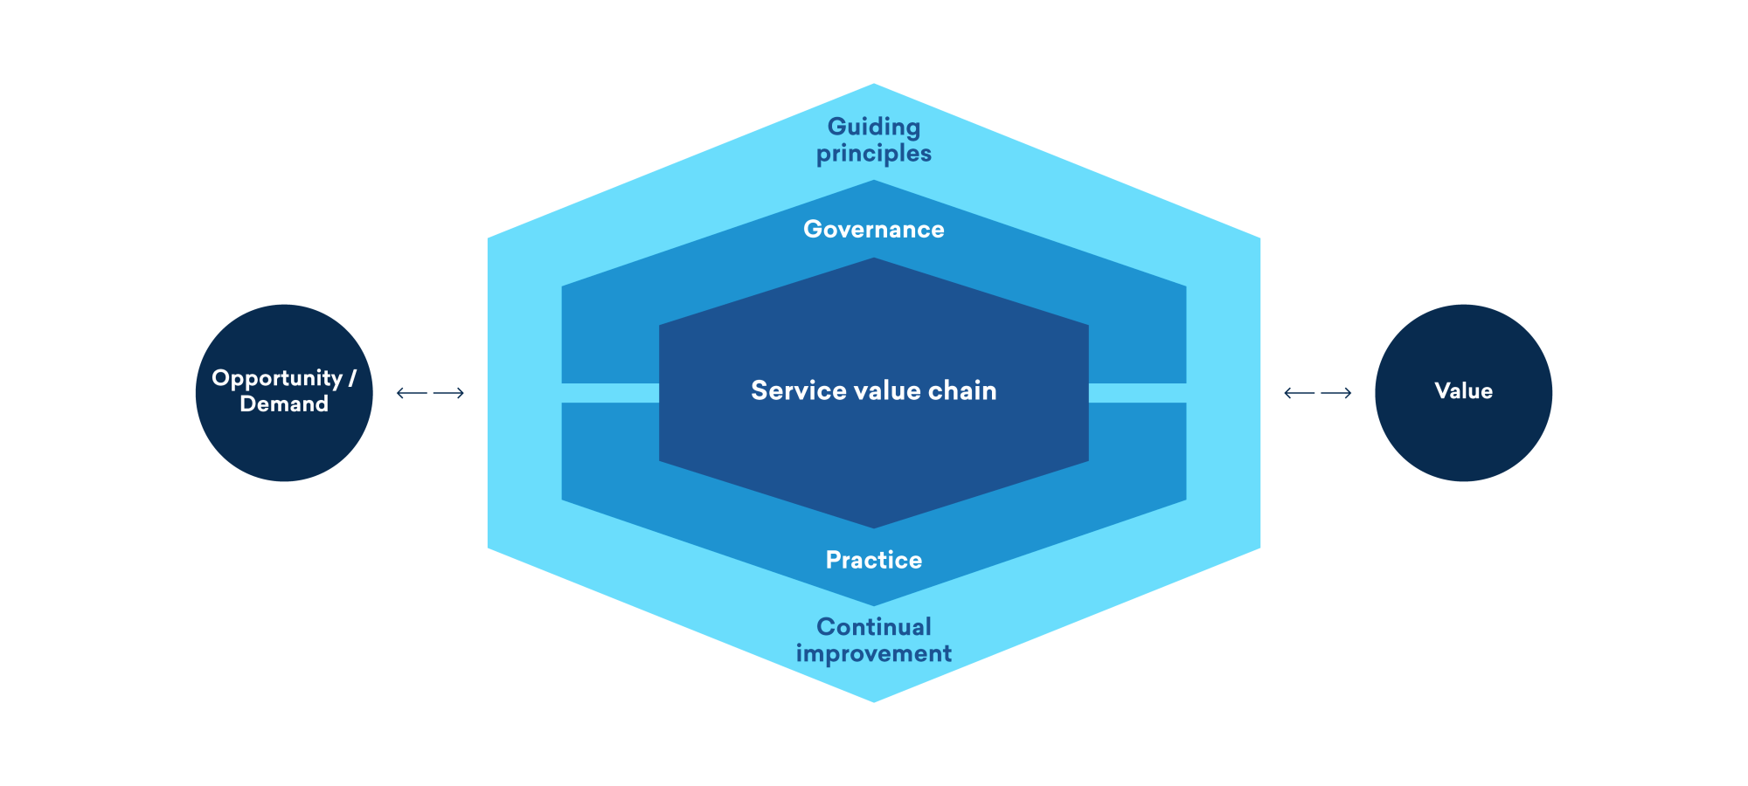
Service value system and service management practises
Governance: The means by which an organisation is directed and controlled.
Practices: Sets of organisational resources designed for forming work or accomplishing an objective

Slide 119
Understanding Practices
Practise is defined as:
“A set of organisational resources designed for performing work or accomplishing an objective. “
Each of the ITIL 4 practises:
-Support multiple service value chain activities. Value chains create value and support the realisation
of outcomes.
-Includes resources based on the 4 dimensions of service management.
There are 34 service management practises providing comprehensive coverage for organisations
Notes:
People and Organisation
Information and Technology
Partners and suppliers
Value Streams and Processes

Slide 121
Notes:
Total-34

Slide 122
Understanding Practices - General Management
Architectural management
Continual improvement
Information security management
Knowledge management
Management and reporting
Portfolio management
Organisational change management
Project management
Relationship management
Risk management
Service financial management
Strategy management
Supplier management
Workforce and talent management
Notes:
14, All these practices are closely linked with SVC.

Slide 123
Service Management
Availability management
Business analysis
Capacity and performance management
Change enablement
Incident management
IT assest management
Monitoring and event management
Problem management
Release management
Service catalogue management
Service configuration management
Service continuity management
Service design
Service desk
Service level management
Service request management
Service validation and testing
Notes:
Related to Service Mgt.

Slide 124
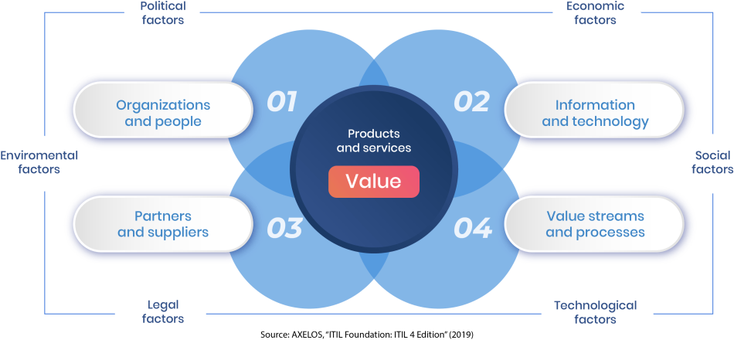
Practices and The 4 Dimensions
Practices : Sets of organisational resources designed for performing work or accomplishing an objective
Each practise is based on ALL of the 4 Dimensions , not just 1 . In order to create value streams using the ITIL 4 practices an understanding of how each of the 4 dimensions is represented in the practice is required

Slide 125
Service Management Practices
These practises have been developed in service management and ITSM industries
They have been adopted and adapted in wider industry before being documented as best practise.
NB - Practice is not examined but included to support coverage of other concepts .

Slide 126
Technical Management
Deployment management
Infrastructure and platform management
Software development and management

Slide 127
Deployment Management
Purpose
“ To move new or changed hardware , software , documentation , processes or any other component to live environments . It may also be involved in deploying components to other environments force testing or staging.”
Phased Deployment- Part of deployment like new version of app tested in Team
Continuous Delivery- Delivered to Customer but customer wants to do few changes. Make changes and deliver. Product is faster available and going through field testing.
Big Bang Delivery- Tested all parts together
Pull deployment-New and changed software is made available like window updates.

Slide 128
Infrastructure and Platform Mgmt.
Purpose
“ To oversees the Infrastructure and platforms used by an organisation. Enabling and monitoring of technology solutions available to the organisation and external service providers.”
Cloud Services Model
SaaS
PaaS
Iaas
Private/Public/Hybrid

Slide 129
Software Development and Management
Purpose
“ Application meet internal and external stakeholder needs in terms of functionality, reliability , ability, compliance and auditability.”
Solution architecture
Solution design (user interface)
Software development
Software testing

Slide 130
Architecture Management
Business architecture
Service architecture
Information system architecture
Data and application architecture
Technology architecture
Environmental architecture

Slide 131
Information Security Management
Purpose
“To protect the information needed by the organisation to conduct its business . This includes understanding and managing risk to the confidentiality, integrity and availability of the information.”
Prevention
Detection
Correction

Slide 132
Knowledge Management
Purpose
“To maintain and improve the effective, efficient and convenient use of information and knowledge across the organisation.”
It ensure that stakeholders get the right information, in the proper format , at the right level and at the correct time according to their access level and other relevant policies

Slide 133
Measurement and Reporting
Purpose
“This practise support good decision-making and continual improvement by decreasing the level of uncertainty.”
These can be based on a number of areas :
Profit ,growth ,competitive advantage ,customer retention ,operational /public service
Reporting
data collected as metrics is usually presented in the form of reports or dashboards
reports are intended to support good decision-making so their content should be relevant to the recipient of the information

Slide 134
Organisational Change Management
Purpose
“To ensure that changes in an organisation are smoothly and successfully implemented ,and that lasting benefits are achieved by managing the human aspects of the changes.”
Clear and relevant objects
Strong and committed leadership
Willing and prepared participants
Sustained improvement

Slide 135
Portfolio Management
Purpose
“To ensure that the organisation has the right mix of programmes ,projects ,products and services to execute the organization’s strategy within its funding and resource constraints .”
To deliver a portfolio products, services , programmes , and projects in support of specific strategies and objectives

Slide 136
Project Management
Purpose
“To ensure that all projects in the organisation are successfully delivered . This is achieved by planning , delegating , monitoring and maintaining control of all aspects of a project , and keeping the motivation of the people enrolled .”
Waterfall method
Agile method

Slide 137
Relationship Management
Purpose
“To establish and nurture the link between the organisations and its stakeholders at strategic and tactical levels . it includes the identification , analysis , monitoring and continual improvement of relationship with the stakeholders .”
Stakeholders
Customers
Users

Slide 138
Risk Management
Purpose
“To ensure that the organisation understand and affectively handles risk . Managing risk is essential to ensuring the ongoing sustainability of an organisation and creating value for its customers .”
Identified
Assessed
Treated

Slide 139
Service Financial Management
Purpose
“To support organization’s strategies and plans for service management by ensuring that the organization’s financial resources and investments are being used affectively”
Budgeting /coasting
Accounting
Charging
Notes:
Blockchain

Slide 140
Strategy Management
Purpose
“To formulate the goals of the organisation and adopt the courses of action and allocation of resources necessary for achieving those goals . strategy management establishes the organisations direction, focuses effort, define or clarifies the organisation priorities, and provides consistency or guidance in response to the environment .”
Notes:
Good strategy create value

Slide 141
Supplier Management
Purpose
“To ensure that organisations suppliers and their performances are managed appropriately to support the seamless provision of quality products and services .This includes creating closer , more collaborative relationships with the key suppliers to uncover and realise new value and reduce the risk of failure .”
Creating a single point of visibility and control to ensure consistency
Maintaining his supplier strategies, policy and contract
Negotiating and agreeing contracts
Managing relationships with internal and external suppliers
Managing supplier performance

Slide 142
Service Management Practises
Availability management
“To ensure that services deliver agreed levels of availability to meet the needs of customers and users .”
Business analysis
“To analyse a business or some element of it , define its associated needs , and recommend solutions to address these needs and /or solve a business problem , which must facilitate value creation for stakeholders .”

Slide 143
Service management practises
Capacity and performance management
“ To ensure that services achieve agreed and expected performance ,satisfying current and future demands in a cost -effective way .”
Performance
A measure of what is achieved or delivered by a system , person , team , practise or service .

Slide 144
Practice - Incident Management
“ The purpose of incident management as a practise is to minimise the negative impact of incidents by by restoring normal service operation as quickly as possible.”
An incident is defined as :
“ An unplanned interruption to a service, or a reduction in the quality of service.”

Slide 145
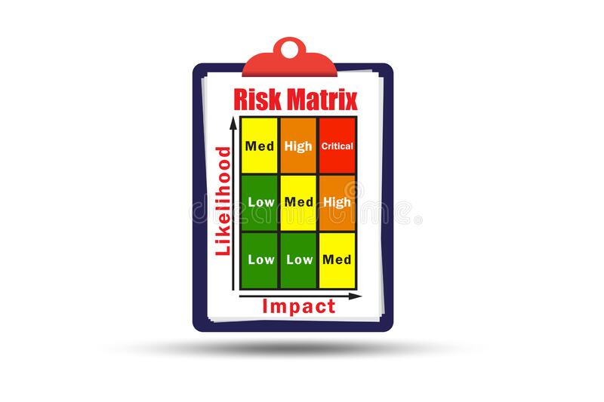
Practise – Incident Management
“ The purpose of incident management of the practises to minimise the negative impact of
incidents by restoring normal service operation as quickly as possible.”
All incident should be logged
Incident should be managed to meet agreed target resolution times (SLA)
Incident should be prioritised(Risk and Impact)
Notes:
Heat map of Incident—0-1-2-3(high)

Slide 146
Practice – Incident management
Incidents Diagnosis And Recovery
Incidents may be escalated to a support team for resolution
Routing for escalations is typically based on the incident category
Updates on the status of the incident should be timely and of suitable quality for the relevant stakeholders
High levels of collaboration are likely to be required
Cross Functional teams
User self help
Service desk
Disaster recovery
Support to you surprise
Suppliers/partner’s

Slide 147
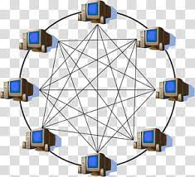
Practice – Incident Management
Incidents Swarming
When many stakeholders come together to work on an incident until it becomes clear what the way forward is and whether they can return to other work while the right team completes the resolution .
Swarming and collaboration may also facilitate knowledge sharing in addition to solving the incident in the best possible manner.
Old Model Streaming New Model Swarming
Level 1
Level 2
Level 3
Escalation based process Collaboration based process

Slide 148
Practise – Problem Management
“ The purpose of Problem Management is to reduce the likelihood and impact of incidents by identifying actual and potential causes of incidents, managing workarounds and known errors.”
Problem- “The cause or potential cause of one or more prior, current, or future incidents.”
Known Error – “A problem that has been analysed but not yet resolved”
Workaround- “A solution that reduces or eliminates the impact of an incident or problem where a full solution isn't available yet . Some workarounds reduces the likelihood of incident.”
Workarounds are documented in problem records. This can be done anytime it would be useful, analysis may not even be complete
Workaround documented early, such as in Problem Control, then it should be reviewed and improved after the analysis is complete

Slide 149
Practise – Problem Management
Three stages of problem management
Problem Identification | Problem Control | Error Control
Perform trend analysis Identify recurring incident and major incident Analyse supplier and partner information Performed by a range of stakeholders such as developers, testers , in projects etc. | Prioritise and manage based on the risk the problem represent Perform analysis of the problem from all four perspectives | Identify potential permanent solutions for the problem Re-assess the status of known errors Improve work arounds as an analysis is complete
Create Problem Record | Create Workarounds /Known Error | Create Change Record

Slide 150
Practise – Problem Management
Relationship between Problem Management and other Practices
problem management
Incident management
risk management
change enablement
knowledge management
continual improvement

Slide 151
Service Catalogue Management
Purpose
“ To provide single source of consistent information on all services and service offerings , and to ensure that it is available to the relevant audience .”
User view
Customer view
IT customer view

Slide 152
Practice – Service Request Management
“The purpose of Service Request Management is to support the agreed quality of a service by handling all agreed user-initiated service request in an effective and user-friendly manner.”
Service request – “ A request from a user or user’s authorised representative that initiated service action that has been agreed as a normal part of a service delivery .”
Service requests are predefined and pre agreed. they can usually be formalised with clear, standard processors
Fulfilment of service requests may require changes to services or their components. These are maybe standard changes
Service requests are a normal part of service delivery, notice failure or degradation of service. The latter would be handled as an incident.

Slide 153
Examples of Service Request
Request For Service Action – “Please can you change an application to do …”
Request for Information – “Please can you tell me the grid service hours for …”
Request for Provision of Service or Resources – “Please can I have ….”
Request for Access to a Service or Resource – “Please can I have an account for …”
Feedback , Compliments and Complaints
Initiation
Approval
Fulfilment
Management
Management

Slide 154
Service Request Management Principles
Request and their fulfilment should be standardised and automatic to the greatest degree possible
Opportunities for improvement should be identified and implemented to produce faster fulfilment times and take additional advantage of automation
Policies should be established regarding what service request will be fulfilled with the limited or even no additional approvals so that the practise can be streamlined
Expectations of users regarding fulfilment times should be clearly set, based on what the organisation can realistically deliver
Policies and work -flows are needed to redirect service request that should actually be managed as incidents or changes
Some service requests require authorisation according to financial, information security or other policies

Slide 155
Service Request Management Considerations
Service Request Management depends on well- designed processes and procedures, which are operationally executive through tracking and automation tools
The work- flows that are defined for service requests may be quite simple or complex as required by the Request itself.
Steps to fulfil Service Request should be well known and proven
The service provider can agree to fulfilment times and provide clear status communication to users
Some service request can provide a self-service experience – completely fulfilled by automation
Leverage existing workflow models whenever possible to improve efficiency and maintainability.

Slide 156
Service Validation and Testing
Purpose
“ To Ensure that knew or changed products and services meet defined requirements. “
Service validation
“ It focuses on establishing deployment and release management acceptance criteria which are verified through testing . Acceptance criteria can be either utility or warranty focused and are defined through understanding customer , regulatory , business , risk management and security requirements .”
Testing
Unit testing
System testing
Integration testing
Regression testing

Slide 157
Activity
Discuss and Revise with your peer
Incident management
Problem management
Service request management
Risk Management
Change Enablement

Slide 158
Questions
Sample paper 1:
Question 6, 9, 10, 13 , 17 ,31 ,36

Slide 159
Question 6
How does categorisation of incident assist the ‘incident management’ practise ?
1 It helps direct the incident to the correct support area
2 It determines the priority assigned to the incident
3 It ensures that incident are resolved in time scales agreed with the customer
4 It determines how the service provider is perceived
Notes:
A

Slide 160
Question 9
Which is a potential benefit of using an IT service management tool to support the incident management practice?
1 It may ensure that the cause of incident is identified within agreed times
2 It may provide automated matching of incident to problems or known errors
3 It may ensure that suppliers contracts are aligned with the needs of the service provider
4 It may provide automated resolution and closure of a complex incident
Notes:
B

Slide 161
Question 10
Which role submit service request?
1 The user, or their authorised representative
2 The customers,or their authorised representatives
3 The sponsors, order authorised representatives
4 The supplier, order authorised representative
Notes:
A

Slide 162
Question 13
Which would be supported by the ‘service request management’ practice?
1 A request to authorise a change that could have an effect on a service
2 A request from a user for something which is a normal part of service delivery
3 A request to restore service after a service interruption
4 A request to investigate the cause of multiple related incident
Notes:
B

Slide 163
Question 17
Which is NOT usually included as part of incident management?
1 Scripts for collecting initial information about incidents
2 Formalised procedures for logging incidents
3 Detailed procedures for the diagnosis of incident
4 The use of specialise knowledge for complicated incident
Notes:
C

Slide 164
Question number 31
What happens if a workaround becomes the permanent way of dealing with a problem that cannot be resolved cost effectively?
1 A change request is submitted to change enablement
2 Problem management restored the service as soon as possible
3 The problem remains in the known error status
4 The problem record is deleted
Notes:
C

Slide 165
Question 36
Which practises are typically involved in the implementation of a problem resolution?
1 Continual improvement
2 Service request management
3 Service level management
4 Change enablement
A 1 and 2
B 2 and 3
C 3 and 4
D 1and 4
Notes:
D

Slide 166
Change Enablement
“The purpose of Change Enablement is to maximise the number of successful IT changes by ensuring that risk have been properly assessed, authorising changes to proceed and managing a change schedule .”
The scope of change enablement is defined by each organisation. Typically, It will include IT infrastructure, applications, documentations, processes , supply relationships and anything else that might directly or indirectly impact a product or service.
Adverse effect of change
Beneficial effect of change
Change

Slide 167
Type and Scope of Changes under Change Enablement
Change – The addition, modification removal of anything that could have a direct or indirect effect on its services. The changes take one of three forms
Standard – Low risk, preauthorised. Implemented without additional authorization.
Normal – Changes that need to be assesses, schedule an authorised. Authorization based on change type by the most appropriate Change Authority
Low risk – Role empowered to make rapid decisions
Very major - Senior management or board may be required for authorization
Emergency – expedited assessment and authorisation. May be dealt with under separate change authority
STANDARD
EMERGENCY
NORMAL
Low Risk
Low Complexity
Low Cost
Current Higher
Risk to Service

Slide 168
Other change enablement considerations
Change Authority – The person or group that authorises a change is known as the Change Authoritiy
These may be assigned for each type of change or Change Model (a set of predefined rules for authorising a type of change )
In high velocity organisations it is common practise to decentralise change approval. This makes the peer review it top predictor of high performance
Change schedule – A tool used to help plan changes, assist in communication, avoid conflicts and planned resources

Slide 169
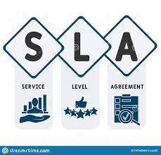
Service Level agreements
Service Level Agreement (SLA)- a documented agreement between a service provider and a customer that identifies service required and expected levels of service. it is a tool to measure the performance of services from the customer’s perspective .
Key requirement for SLA’s
Related to redefined service
Should relate to defined outcomes, not just operational metrics
Should reflect an agreement between service provider and service customer
Must be simply written and easy to understand for all parties

Slide 170
Information Sources
Customer Engagement
Initial listening
Discovery and information capture
Measurement and ongoing progress discussions
Asking simple open-ended questions
Customer Feedback
Surveys
Key business-related measures
Operational metrics
Business metrics

Slide 171
Practise – Service Level Management
“ The purpose of service level management is to set clear business- based targets for service performance so that delivery of a service can be properly assessed,monitored and managed against them.”
Service level management provides the end –to- end visibility of the organization’s services
Establishes a shared view of the services and target service level with customers
Collects, analyses , stores and reports relevant metrics to ensure service levels are met
Perform service reviews to ensure current services continue to meet the organization’s and it’s customer’s needs
Captures and reports on service issues, including performance against defined service levels

Slide 172
Service level management
Key capabilities for Service Level Management
Skills and competencies
Relationship Management
Business Analysis
Business Liaison
Supplier Management

Slide 173
Practice – Service Desk
“The purpose of service desk is to capture demand for incident resolution and service request. It should also be the entry point/single point of contact for the service provider with all of its users .”
Issues
Request
Queries
Acknowledge
Classify
Own
Act

Slide 174
Practice – Service Desk
Principles and goals of Service Desk
With increased automation and the gradual removal of technical debt the focus of service desk is to provide support for people and business rather than simply technical issues
Major influence on user experience and how the service provider is perceived by users .
Practical understanding of wider organisation the empathetic link between the service provider and the users.
The service desk can focus on excellent customer experience when personal contact is needed
Support and development team need to work in close collaboration with the service desk.

Slide 175
Practice-Service Desk Access Channels
Phone Call
E-mail
Social Media
Live Chat & Chat-Bots
Service Portal & Mobile Apps
Walk-in Service Desk
Forums
Public/Corporate discussion forums

Slide 176
Service Desk
Supporting Technologies for a centralise service desk –These technologies can help perform various tasks including Configuration Management tools for identifying affected components, ITSM incident tools helping to match incidents to existing known errors and workflow tools can help with controlling processes
Intelligent Telephony Systems
Knowledge Base
Configuration Management System
Workforce Management / Resource Planning systems
Dashboard and Monitoring tools
Remote Access Tools
Call Recording and Quality Control
Workflow Systems
Virtual service desk –Allows agent to work from multiple, geographically –dispersed locations. It requires more sophisticated technology, allowing access from multiple locations and complex routing an escalation

Slide 177
Skills for the Service Desk Practice
Excellent customer service skills
Ability to empathies with customers
Effective communication
Emotional intelligence
Incident analysis and prioritisation
Understand business priority
N.B.-the service desk may not need to be highly technical , although summer

Slide 178
Activity
1) Explain with experience that how important customer feedback is?
2) State few examples from your work.
3). What are the regulatory rules you need to comply with. They are a requirement for reaching the organizational goal of stock exchange entry. You need to find a way to comply with these rules.

Slide 179
Questions
Sample paper one
Question 2, 3, 4, 11, 19 ,25, 28, 30, 32

Slide 180
Question 2
Which practise includes the classification and ownership of queries and requests from users?
Service desk
Incident management
Change enablement
Service level management
Notes:
A

Slide 181
Question 3
Which practice identifies metrics that reflect the customers experience of a service?
Continual improvement
Service desk
Service level management
Problem management
Notes:
C

Slide 182
Question 4
What is the PRIMARY use of a change schedule?
To support incident management and improvement planning
To manage emergency changes
To plan changes and help avoid conflicts
To manage standard changes
Notes:
c

Slide 183
Question 11
Which practise provides a single point of contact for users?
Incident management
Change enablement
Service desk
Service request management
Notes:
C

Slide 184
Question 19
Which statement about a change authority is correct?
A single change authority should be assigned to authorise all types of change and change models
A change authority should be assigned for each type of change and change model
Normal changes of pre-authorised and do not need to change authority
Emergency changes can be implemented without authorization from a change authority
Notes:
B

Slide 185
Question 25
Which is the purpose of the service desk practise?
To reduce the likelihood and impact of incidents by identifying actual and potential causes of incidents
To maximise the number of successful IT changes by ensuring risks are properly assessed
To capture demand for incident resolution and service requests
To set clear business-based targets for service performance
Notes:
C

Slide 186
Question 28
Which is a recommendation of the service desk practise?
1 Service desk should avoid the use of automation
2 Service desk should be highly technical
3 Service desk should understand the wider organisation
4 Service desk should be a physical team in a single fixed location
Notes:
C

Slide 187
Question 30
What is your standard change?
1 A changed that is well understood,fully documented and pre –authorised
2 A change that needs to be assessed authorized,and schedule by a change authoritiy
3 A change that doesn't need a risk assessment because it is required to resolve an incident
4 A change that it assessed, authorized, and schedule as part of continual improvement
Notes:
A

Slide 188
Question 32
What is the definition of change?
1 To add, modify or remove anything that could have a direct or indirect effect on services
2 To ensure that accurate and reliable information about the configuration of services is available
3 To make new and change services and features available for use
4 To move new or change hardware or software or any other component to live environment
Notes:
A

Slide 189
Practise –IT Asset Management
“The purpose of IT asset management is to plan and manage the full life cycle of all IT assets.”
IT asset – Any valuable component that can contribute to the delivery of an IT product or service
IT asset Management should help the organisation to achieve the following :
Maximise value
Control costs
Manage risks
Support decision-making about purchase,reuse and retirement of assessed
Meet regulatory and contractual requirements

Slide 190
Practice-Monitoring and Event Management
“ The purpose of monitoring and event management is to systematically observe a service or service component and record and report selected changes of state identified as events.”
Event – any change of state that has significance for the management of a configuration team (CI) or IT service.
This practise identifies and prioritises infrastructure, services, business processes and information security events.
It establishes the appropriate response to those events, including responding to conditions that could lead to potential faults of incidents.

Slide 191
Practise – Availability management
“The purpose of availability management is to ensure service deliver agreed levels of availability to meet the needs of customers and users.”
Availability – The ability of IT service or other configuration item to perform its agreed functions when required
Primary Datacentre
Failover Datacenter
Failover Datacenter
Primary Datacentre
Normal Mode
Disaster Mode

Slide 192
Practice – Capacity and Performance Management
"The purpose of capacity and performance management is to ensure that services achieve agrees and expected performance, satisfying current and future demand in a cost-effective way"
Performance - a measure of what is achieved or delivered by a system, person, team, practice, or service.
Service performance - associated with the number of service actions performed in a time frame the time required to fulfil a service action at a given level of demand.
Service capacity - the maximum throughput that a configuration item or service can deliver.
Notes:
Satisfaction of customer is important

Slide 193
Practice – Service Continuity Management
“The purpose of Service Continuity Management is to ensure that the availability and performance of a service is maintained at a sufficient level in the event of a disaster."
The practise provides a framework for building organisational resilience with the capability of producing an effective response that safeguards the interests of key stakeholders and the organisation's reputation, brand and value-creating activities.
N.B. A disaster is a sudden, unplanned event that causes great damage or serious loss to the organisation and is not considered 'business as usual'.

Slide 194
Practice – Service Configuration Management
“The purpose of Service Configuration Management is to ensure that accurate and reliable information about the configuration of services and the configuration items (CI) that support them is available when and where it needed."
IT Services
SaaS component
Local application
Client app
IT Services
SaaS component
Local application
Client app
Cloud infrastructure
Supplier
Local server
Client device
User
Local server
Cloud infrastructure
Supplier
Local server
Client device
User
Local storage
Service Configuration Management enables the service provider to create a logical model of the physical infrastructure to better understand how CIs all related as opposed to simply knowing what components exist
Datacentre

Slide 195
Practice – Service Configuration Management
“The purpose of Service Configuration Management is to ensure that accurate and reliable information about the configuration of services and the configuration items (CI) that support them is available when and where it needed."
Configuration Item (CI) - Any component that needs to be managed in order to deliver an IT service.

Slide 196
Practice – Release Management
" The purpose of Release Management is to make new and changed services and features available for use."
Traditional/ Waterfall - Release and planned and managed towards value creation in a single large release and deployment where all the CIs all released and deployed together.
Release Plan
New or changed software
New or changed infrastructure
Training and documentation
Deploy and release
Review

Slide 197
Practice – Release Management
" The purpose of Release Management is to make new and changed services and features available for use."
Agile/ DevOps - Smaller releases are deployed as they become available and are declared usable when the release is declared ready for use.
Release Plan
New or changed software
New or changed infrastructure
Training and documentation
Release
Deploy
Review
Deploy
Deploy

Slide 198
Technical Management Practices
Technical Management Practices
These practises have been adopted/ adapted for service management from technical management domains for service management purposes by expanding or shifting their focus from technology solutions to its services.

Slide 199
Practice – Deployment Management
“The purpose of Deployment Management is to move new or changed hardware, software, documentation, process is or any other component to live environments. It may also be involved in deploying components to other environments for testing or staging."
Release Plan
New or changed software
New or changed infrastructure
Training and documentation
Release
Deploy
Deploy
Review
Deploy

Slide 200
Activity
If a change has been approved at an earlier step in the process, does the technical update need approval before being put into production?
Explain with an example from your work -place.

Slide 201
1. Which practice is responsible for moving components to live environments?
A. Change Enablement
B. Release Management
C. IT Asset Management
D. Deployment Management
Notes:
D

Slide 202
20. Which practice has the purpose of making new and change services and features available for use?
A. Change enablement
B. Service request management
C. Release management
D. Deployment management
Notes:
C

Slide 203
33. What is the definition of an event?
A. Any changes state that has significance for the management of a service or other configuration item
B. Any component that needs to be managed in order to deliver an IT service
C. An unplanned interruption to a service or reduction in the quality of a service
D. Any financially valuable component that can contribute to the delivery of an IT product or service
Notes:
A

Slide 204
General Management Practices
These practices have been adopted/ adapted for service management from general business management domains.
They represent best practise not just in its service management but in the wider context of practices that any organisation may benefit from the adoption of.

Slide 205
Service value system and continual improvement
Guarding Principles
Continual Improvement
Continual Improvement: A recurring organisation activity performed at all levels to ensure that organisation's performance continually meets stakeholder's expectations

Slide 206
Practice- Continual Improvement
" The purpose of continual improvement is to align the organisations practises and services with changing business needs through the ongoing identification and improvement of services, service components, practises or any element involved in the efficient and effective management of products and services."
Key Activities
Encouraging continual improvement across the organisation
Securing time and budget for continual improvement
Identifying and logging improvement opportunities
Assessing and prioritising improvement opportunities
Making business cases for improvement action
Planning and implementing improvements
Measuring and evaluating improvement results
Co-ordinating improvement activities across the organisation
ACT
PLAN
CHECK
DO

Slide 207
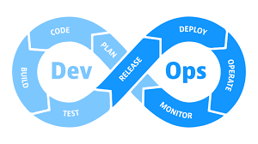
Practice- Continual Improvement
Methods, Models and Techniques
- Identify and select a few key methods which are appropriate to the organisation
LEAN- Methods associated with reducing waste by systematically identifying where waste exists and proposing ways in which it can be reduced or eliminated.
Multiphase Project- Implementing improvements following the ‘Progress iteratively with feedback' principle where improvements are broken up into manageable work packages and delivered in line with business need.
Maturity Assessments- Used to identify organisational capability and identify areas for improvement
DEVOPS- the practise of operations and development engineers participating together in the entire service life cycle, from design through the development process to production support.
Notes:
Waste-overproduction, unused talent, defects

Slide 208
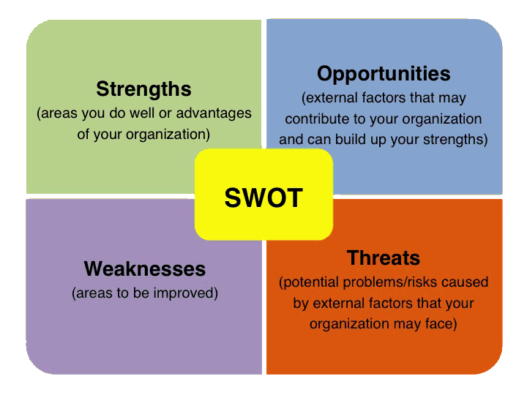
Practice - Continual Improvement
METHODS, MODELS and TECHNIQUE
Identify and select a few key methods which are appropriate to the organization
Balanced Scorecard - an approach to measurement which assures all appropriate perspectives, not just one view are taken into account when identifying improvements.
Incremental Agile Improvements – Apply agile thinking to delivering improvements in manageable work packages.
Quick Wins – Identify what can be improved most for the least effort in order to demonstrate achievement and create buy-in.
SWOT Analysis – Analytical method to identify aware improvements may be possible based on understanding internal and external factors.

Slide 209
Practice - Continual Improvement
Continual Improvement Register
[Dimension: Information and Technology ]
A database or structured document to track and manage improvement areas from identification through to final action. An extract from a possible CIR can be seen below.
Notes:
KPI- key performance index

Slide 210
Practice - Continual Improvement
Continual Improvement in the Organisation
[Dimensions: People and Organisations, Suppliers and Partners]
Leaders
Continual Improvement team
Everyone in the Organisation
Active participation in continual improvement is a core part of everyone's job
Leading efforts and advocate practice across the organisation
Embedding continual improvement into the working practices and thought processes of the organisation and its people
Partners and Suppliers
Contract should include how they measure, report and improve

Slide 211
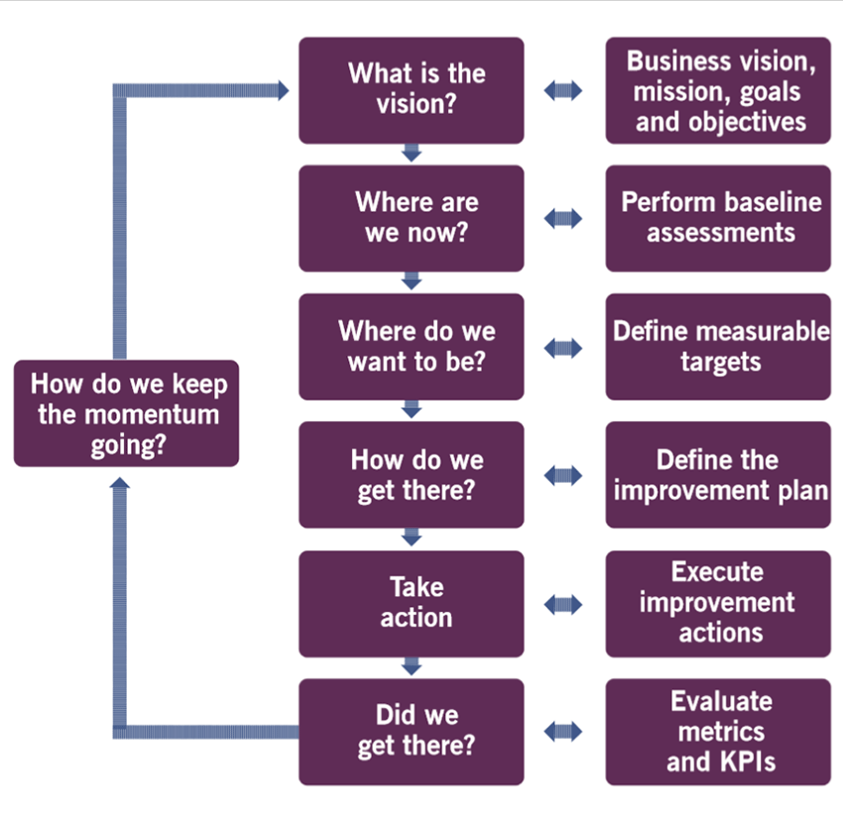
Practice - Continual Improvement
Continual Improvement approach
[Dimension: Value Streams and Processes]
A structured approach to delivering improvements which can be used to help establish projects.
It supports number of the guiding principles such as ‘work iteratively with feedback’.
Notes:
Baseline-set a target and compare with current state. Look for changes and improve.

Slide 212
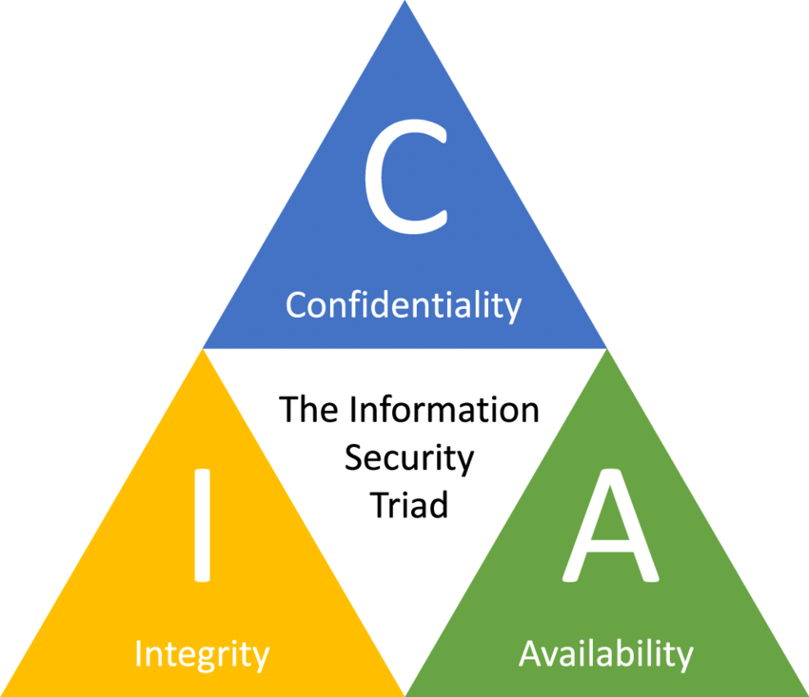
Practice – Information Security Management
“The purpose of information security management as a practise is to protect the information needed by the organisation to conduct its business.”
This includes understanding risks in the following areas:
Confidentiality – information is only accessible to those with the rights to access it.
Integrity – information is trustworthy, unaltered or corrupted and therefore can be used safely by the organisation.
Availability – information is available in a timely manner to support organisational requirements.
Authentication – the user, action or information is genuine and can be shown to be so.
Non-repudiation – an action can be performed in such a way so it cannot be later successfully contested not to have been.

Slide 213
Practice – Relationship Management
“The purpose of Relationship Management is to establish a natural links between the organisation and its stakeholders at strategic and tactical levels.”
This includes performing the following activities with regards to relationships at these levels, both with and between stakeholders:
Identifying
Analysing
Monitoring
Continual improvement

Slide 214
Practice – Supplier Management
“ The purpose of Supplier Management is to ensure that the organisations suppliers and their performance are managed appropriately to support the provision of seamless, quality products, services and components.”
This can include creating closer, more collaborative
relationships with key suppliers and realise new
value and reduce the risk of failure.
Supplier Management has responsibility for
contract establishment, management, renewal
all termination.

Slide 215
Learning Review
You will now be able to:
[BL1] Recall purpose of the syllabus-specified practices
[BL2] Recall key items related to and [BL1] explain in detail the following practises:
Continual improvement
Change enablement
Incident management
Problem management
Service request management
Service desk
Service level management

Slide 216
Any Questions

Slide 217
8).Which is a recommendation of the ‘continual improvement’ practice?
That should at least be a small team dedicated to leading ‘continual improvement’ efforts
All improvements should be managed as multi phase projects
‘Continual improvement’ should be isolated from other practises
External supplies should be excluded from improvement initiatives
Notes:
A

Slide 218
14).Which practice is the responsibility of everyone in the organisation?
Service level management
Change enablement
Problem management
Continual improvement
Notes:
D

Slide 219
15).Identify the missing word in the following sentence.
The purpose of the ‘information security management’ practice is to [?] the organization’s information.
Store
Provide
Audit
Protect
Notes:
D

Slide 220
23).What is the purpose of the ‘supplier management’ practise?
To ensure that the organisations suppliers on their performance are managed appropriately to support the seamless provision of quality products and services
To align the organisations practices on services with changing business needs through the ongoing identification and improvement of services
Show that the organisations suppliers underperformance are managed appropriately at strategic and tactical levels through coordinated marketing, selling, and delivery activities
To ensure that accurate and reliable information about the configuration of suppliers’ services is available when and where it is needed
Notes:
A

Slide 221
26).How should an organisation adopt continual improvement methods?
Use a new method for each improvement the organisation handles
Select a few key methods for the types of improvement that the organisation handles
Build the capability to use as many improvement methods as possible
Select a single method for all improvements that the organisation handles
Notes:
B

Slide 222
End of Section

Slide 223
Learning Objectives
By the end of this section you will be able to:
[BL1] Describe the interconnected nature of the service value chain and how this supports value streams
[BL2] Describe the inputs, outputs on purpose of each service value chain activity
[BL2] Understand the role that the following process is play in the service value chain activities:
Continual Improvement
Change Enablement
Incident Management
Problem Management
Service Request Management
Service Desk
Service Level Management

Slide 224
4. The ITIL4 Service Value Chain (SVC)

Slide 225
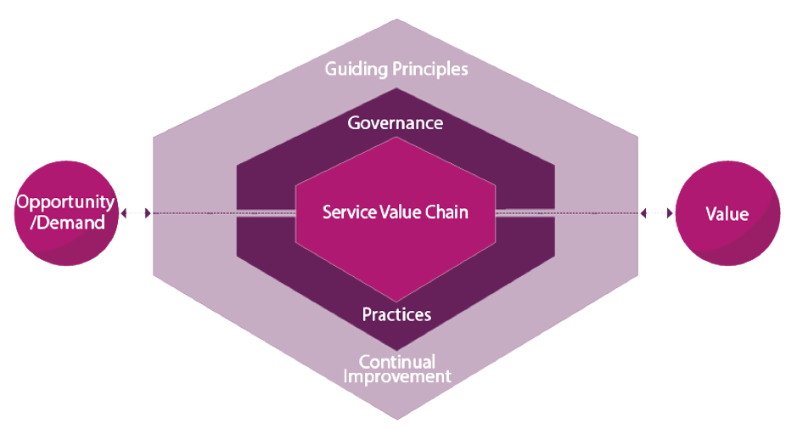
Service Value System and the Service Value Chain
Service Value Chain: A set of interconnected activities that an organisation performs in order to deliver a valuable product or service to its customers and to facilitate value creation.

Slide 226
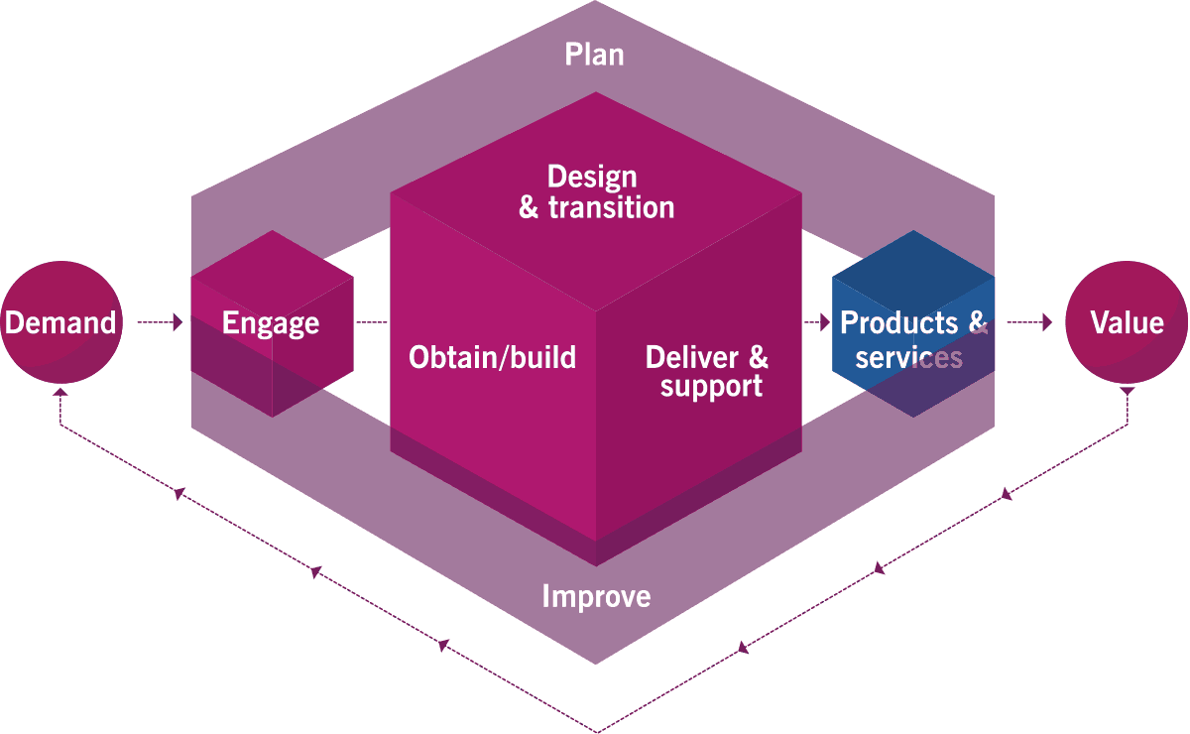
Service Value Chain (SVC)
Service Value Chain (SVC): The central element of the service value system, it is a set of interconnected activities that an organisation performs in order to deliver a valuable product or service to its customers and to facilitate value creation.
The Service Value Chain represents an operating model which outlines the key activities required to respond to demand and facilitate a value creation through creation and management of products and services.
Notes:
PIE DOD

Slide 227
Service Value Chain Inputs/Outputs
Service Value Chain Activities: Service Value Chain Activities represent the steps the organisation takes in the creation of value. Each activity contributes to the value chain by transforming specific inputs into outputs. In this example inputs from customers and other service providers may be used in the ‘engage’ phase to better understand value, contribute to planning or result in the retirement of a product or service.
Inputs from both inside and outside the service value chain
Outputs into the service value chain or beyond

Slide 228
SVC Activities - Plan
Plan: The purpose of plan is to ensure a shared understanding of the vision, current status and improvement direction for all four dimensions in all products and services across the organisation. Planning at all levels is performed via the plan activity.

Slide 229
SVC Activities - Improve
Improve: The purpose of improve is to ensure continual improvement of products, services on practices along all value chain activities and the four dimensions of service management. Improvements at all levels are initiated and managed via the improve activity.

Slide 230
SVC Activities – Engage
Engage: The Purpose of engage is to provide a good understanding of stakeholder needs, continual engagement with all stakeholders, transparency and good relations with all stakeholders. All incoming and outgoing interactions with parties external to the service provider are performed via the engage activity.

Slide 231
SVC Activities – Design and Transition
Design and Transition: The purpose of design and transition is to ensure that products and services continually meet stakeholder expectations for quality, costs and time to market. Works with obtain/build and deliver and support in a coordinated way to support services.

Slide 232
SVC Activities – Obtain/Build
Obtain/Build: The purpose of obtain/build is to ensure that service components are available when and where they are needed and need agreed specifications white with design and transition and deliver and support in a coordinated way to support services.

Slide 233
SVC Activities – Deliver and Support
Deliver and Support: The purpose of Deliver and Support is to ensure that services are delivered and supported according to agreed specifications and stakeholder expectations. Works with obtain/build and design and transition in a coordinated way to support activities.

Slide 234
Service Value Chain and Practices
Service Value Chain and Practices: Service Value Chain Activities utilise practises in order to achieve the desired value from the activity.
For example, if an incident were to arise in an operational service than the ‘engage’ activity may utilise Incident Management and Problem Management to log and better understand the incident these practises may also contribute to the ‘Deliver and Support’ activity as they bring the incident under control and restore service.
Practices and resources e.g:
Incident management
Problem management

Slide 235
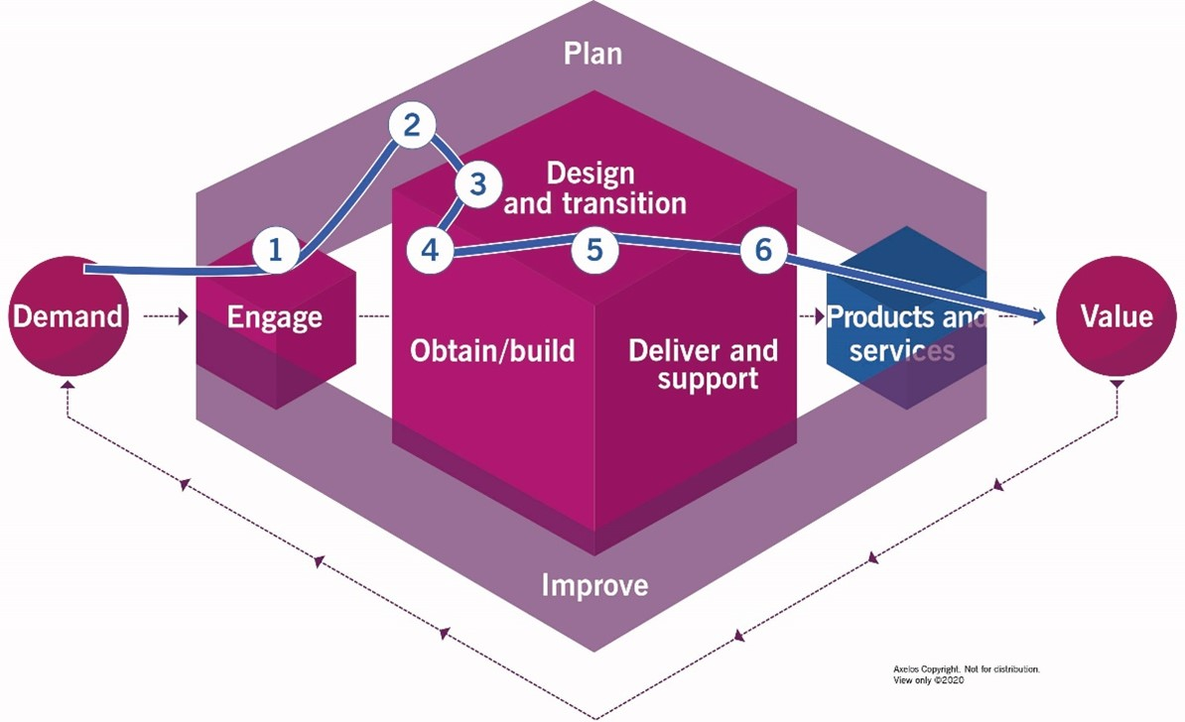
Service Value Chain In Operation
Value Stream: The series of steps that an organisation undertakes to create and deliver products and services to its customers.
Value streams included description of activities, capabilities and resources that flow through the service value chain to meet demand and co-create value.
Improving existing value streams or creating new value streams could be the basis for strategy, or in the example adjacent, creating a new service.

Slide 236
Service Value Chain and Practices
Service Value Chain and Practices : Service value chain activities utilise practises in order to achieve the desired value from the activity. For example, if an incident were to arise in an operational service then the ‘engage’ activity may utilise Incident Management and Problem Management to log and better understand the incident. These practices may also contribute to the Deliver and Support’ activity such as they bring the incident under control and restore service.
Value Stream Step 1
Value Stream Step 2
Value Stream Step 3
Activities of Practice A
Activities of Practice B
Activities of Practice N
Service
Practice D
Practice E
Practice Z
Practice Y

Slide 237
Service Value Chain and Practices
Service Value Chain and Practices: Service Value Chain Activities utilise practises in order to achieve the desired value from the activity. For example, if an incident were to arise in an operational service than the ‘engage’ activity may utilise Incident Management and Problem Management to log and better understand the incident these practises may also contribute to the ‘Deliver and Support’ activity as they bring the incident under control and restore service.
Define high-level activities (‘WHAT?’)
Identified High-level Activities
Log and Record Ticket
Categorise and Prioritise
Triage Ticket
Restore and Close Ticket
Log Further Actions
Map high-level activities to Service Chain Value (SVC) activities
Service Value Chain Activities
ENGAGE
DELIVER AND SUPPORT
DELIVER AND SUPPORT
DELIVER AND SUPPORT
IMPROVE
Map SVC activities to Practice Guidance and low-level procedures (‘HOW?’)
Practices that contribute advice and guidance to SVC activities
Incident
Service Desk
Problem
Incident
Service Desk
Incident
Service Desk
Continual Improvement
Incident
Service Desk
Incident
Service Desk
Service request

Slide 238
Service Value Chain & Practices
Service Value Chain & Practices-These activities utilise practices in order to achieve the desired value from the activity. For example, if an incident were to arise in an operational service then the ‘engage’ activity may utilise Incident Management. This may also involve Problem Management in identifying resolution and proposing improvement.
Problem Management Heat map for Involvement in resolving incident

Slide 239
Service Value Chain & Practices
Service Value Chain and Practices – Level of engagement by Practice and Activity
Business Management Practices | SERVICE VALUE CHAIN ACTIVITIES (Ranked on scale 0=None, 1=Low, 2=Medium, 3=High)
 | PLAN | IMPROVE | ENGAGE | DESIGN & TRANSITION | OBTAIN/BUILD | DELIVER & SUPPORT
BUSINESS MANAGEMENT PRACTICES
Architecture Management | 3 | 3 | 2 | 3 | 2 | 2
Continual Improvement | 3 | 3 | 3 | 3 | 3 | 3
Information Security | 3 | 3 | 3 | 3 | 3 | 3
Knowledge Management | 2 | 2 | 2 | 2 | 2 | 3
Measurement and Reporting | 3 | 3 | 3 | 3 | 3 | 2
Organisational Change Management | 2 | 3 | 2 | 2 | 1 | 1
Portfolio Management | 3 | 2 | 2 | 2 | 2 | 1
Project Management | 2 | 2 | 2 | 3 | 3 | 2
Relationship Management | 3 | 3 | 3 | 3 | 2 | 2
Risk Management | 3 | 3 | 3 | 3 | 3 | 3
Service Financial Management | 3 | 2 | 2 | 2 | 2 | 2
Strategy Management | 3 | 2 | 2 | 2 | 2 | 2
Supplier Management | 3 | 2 | 3 | 3 | 3 | 3
Workforce & Talent Management | 3 | 3 | 2 | 2 | 2 | 2

Slide 240
Service Value Chain & Practices
(Service Value Chain and Practices – Level of engagement by Practice and Activity)
Service Management Practices | SERVICE VALUE CHAIN ACTIVITIES (Ranked on scale 0=None, 1=Low, 2=Medium, 3=High)
 | PLAN | IMPROVE | ENGAGE | DESIGN & TRANSITION | OBTAIN/BUILD | DELIVER & SUPPORT
SERVICE MANAGEMENT PRACTICES
Availability Management | 3 | 2 | 1 | 2 | 2 | 2
Business Analysis | 3 | 3 | 3 | 3 | 3 | 2
Capacity & Performance Management | 2 | 3 | 1 | 2 | 2 | 2
Change Enablement | 1 | 3 | 1 | 3 | 3 | 3
Incident Management | 1 | 3 | 3 | 2 | 2 | 3
IT Asset Management | 2 | 1 | 1 | 3 | 3 | 2
Monitoring & Event Management | 0 | 2 | 1 | 2 | 1 | 3
Problem Management | 0 | 3 | 2 | 1 | 1 | 3
Release Management | 2 | 1 | 2 | 3 | 2 | 2
Service Catalogue Management | 1 | 1 | 3 | 2 | 1 | 2
Service Configuration Management | 1 | 2 | 1 | 3 | 3 | 2
Service Continuity Management | 2 | 2 | 1 | 2 | 2 | 2
Service Design | 2 | 2 | 1 | 3 | 3 | 1
Service Desk | 0 | 2 | 3 | 2 | 1 | 3
Service Level Management | 3 | 3 | 3 | 2 | 2 | 2
Service Request Management | 0 | 1 | 3 | 2 | 2 | 3
Service Validation & Testing | 0 | 2 | 1 | 3 | 3 | 1

Slide 241
Service Value Chain & Practices
Service Value Chain and Practices – Level of engagement by Practice and Activity
Technical Management Practices | SERVICE VALUE CHAIN ACTIVITIES (Ranked on scale 0=None, 1=Low, 2=Medium, 3=High)
 | PLAN | IMPROVE | ENGAGE | DESIGN & TRANSITION | OBTAIN/BUILD | DELIVER & SUPPORT
TECHNICAL MANAGEMENT PRACTICES
Deployment Management | 0 | 1 | 0 | 3 | 3 | 0
Infrastructure & Platform Management | 2 | 1 | 0 | 3 | 3 | 3
Software Development & Management | 1 | 2 | 1 | 2 | 3 | 3

Slide 242
21.Which value Chain activity ensures people understand the organization’s vision ?
Improve
Plan
Deliver and support
Obtain / build
Notes:
B

Slide 243
22.Which Comment about the value chain activities is correct ?
Every practice belongs to a specific value chain activity
A specific combination of value chain activities and practices forms a service relationship
Service value chain activities form a single workflow that enables value creation
Each value chain activity contributes to the value chain by transforming specific inputs into outputs
Notes:
D

Slide 244
Learning Objectives
By the end of this section you will be able to:
[BL2] Describe the ITIL Service Value System
[BL2] Describe the interconnected nature of the service value chain and how this supports value streams
[BL2] Describe the inputs, outputs on purpose of each service value chain activity
[BL2] Understand the role that the following process is play in the service value chain activities:
Continual Improvement
Change Enablement
Incident Management
Problem Management
Service Request Management
Service Desk
Service Level Management

Slide 245
End Of Section

