Slide 1
Networking
Days 1 and 2
UFCFDU-30-1

Slide 2
Introduction
Week 1
Week 2
Modules 1 – Local Area Networks
Module 2 – IP Addressing
Module 3 - Internetworking
Module 4 – Applications and Security
Module 5 – Operations and Infrastructure

Slide 3
Introduction – Module 1: Local Area Networks
Topologies and OSI model
Ethernet
Hubs, bridges and switches
Infrastructure and design
Policies and best practice

Slide 4
Introduction – Module 2: IP Addressing
Internet Protocol
IPv4 Addressing
IPv6 Addressing
DHCP and APIPA

Slide 5
Introduction – Module 3: Internetworking
Routing
TCP and UDP
Name resolution and IPAM
Monitoring and Scanning
Network troubleshooting

Slide 6
Introduction – Module 4: Applications and Security
Applications and Security
Virtualisation, SAN and Cloud Services
Network Security Design
Network Security Appliances
Authentication and Endpoint Security

Slide 7
Introduction – Module 5: Operations and Infrastructure
Network Site Management
Installed Cable Networks
Installing Wireless Networks
Installing WAN Links
Configuring Remote Access

Slide 8
Networking
UFCFDU-30-1
Module 1

Slide 9
Module 1 - Local Area Networks
Topologies and OSI model
Ethernet
Hubs, bridges and switches
Infrastructure and design
Policies and best practice

Slide 10
Topologies
Bus
Star
Ring
Mesh
Ad Hoc
Infrastructure
Wireless Mesh

Slide 11
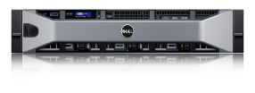
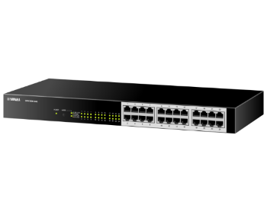
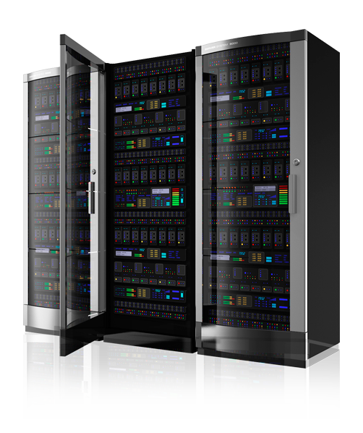
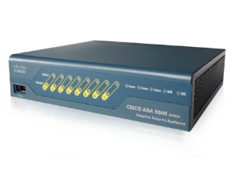
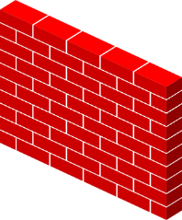
Before We Dive in …
Building 2
Subnet
192.168.3.0/24
Email
192.168.10.5
DB
192.168.10.7
Building 2 Switch
192.168.3.1
Core Switch
192.168.10.100
Core Router
10.1.10.1
Internet
Internet Router
10.1.1.1
Internet
Firewall
Building 1
Subnet
192.168.2.0/24
Building 1 Switch
192.168.2.1

Slide 12
Topologies
A term used in the description of the schematic depiction of the arrangement of a network
It is used to describe the various ways in which nodes are connected

Slide 13
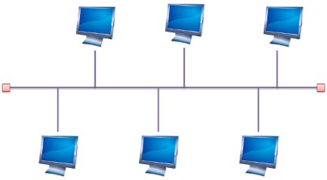
Topologies: Bus
A bus network is an arrangement in a local area network (LAN) in which each node (workstation or other device) is connected to a main cable or link called the bus
Simple and reliable
Transmission of data in only one direction
If one node fails to operate, all the rest can still communicate with each other
For a major disruption to take place, the bus itself must be broken somewhere
Bus networks are easy to expand
Additional nodes can be added anywhere along the bus

Slide 14
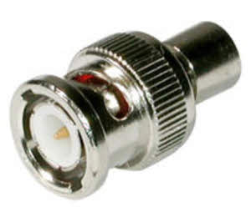
Topologies - Bus
There are several limitations to the bus network topology
The length of the bus is limited by cable loss
A bus network may not work well if the nodes are located at scattered points that do not lie near a common line
In situations like this, a ring network, mesh network, or star network may prove more flexible and more cost effective
Requires terminators
Limited to 10Mbps

Slide 15
Topologies - Bus
Advantages of the Bus Topology
The bus topology as we know it is very cost-effective
This topology system makes use of the least amount of cable, unlike the others
This is sufficient for small networks
A layperson can easily understand this system
You can also quickly expand on this network

Slide 16
Topologies - Bus
Disadvantages of the Bus Topology
Once there is a problem in one part of the cable, the whole network is down
At the advent of traffic on the network, the entire network will have a slowed-down performance
Collisions occur in the network resulting in packet loss
There is a limit to the strength of the cable
This topology is not as speed effective as the ring topology
It is difficult to isolate faults in the network

Slide 17
Topology - Bus
https://www.bbc.co.uk/bitesize/guides/z7mxh39/revision/6

Slide 18
Topologies: Star
Star topology (or ‘star network’) is the most widely used network for LANs
First popularized by ARCnet, before being adopted by Ethernet
Each node (such as a computer or printer) within the company or team is connected to one central network device (which could be a hub, a switch, or a computer) via a cable
When the nodes (or computers) want to communicate with each other, they pass the message on to the central server hub, which then forwards that message back on to the different nodes

Slide 19
Topologies: Star
Advantages of a Star topology
If one node or connection breaks, the rest of the network remains unaffected
Other computers and their connections can continue working with zero downtime
It’s highly scalable: new computers/machines can be added or removed without disturbing the whole network
Star networks can accommodate lots of different machines, which means it’s possible to create a large network
Star networks are safer in the event of a cyber attack
Notes:
Star networks are safer in the event of a cyber attack. Let’s say you run a bank with several branches. If one branch or office comes under attack, the server will be notified and prevent a second. One branch goes down, but the others continue running in complete safety

Slide 20
Topologies: Star
Disadvantages of a Star topology
Each cable is individually connected to the central node, which means you’re going to need A LOT of cables
The hub (central node) is a single point of failure, which means that if it stops, it brings the whole lot down
In reality, there are only so many machines you can connect to a central server before you start running out of cable length and ports
Notes:
Each cable is individually connected to the central node, which means you’re going to need A LOT of cables
And that doesn’t come cheap. Although it’s worth noting that the upfront cost of cables is a fraction of the cost of downtime in the event of a total system failure. Most network designers think this benefit far outweighs the cable cost.
The hub is a single point of failure, which means that if it stops, it brings the whole lot down.
In reality, there are only so many machines you can connect to a central server before you start running out of cable length and ports. One way to get around this is to extend the star topology into multiple stars with a new central server in the middle. In this situation, messages from each system are transferred to its star, which then transfers it to the core server, then back out to the star and then to the destination system.

Slide 21
Topologies: Ring
Computers are connected to each other in a circular format
Every device in the network will have two neighbours and no more or no less
Ring topologies were commonly used in the past but you would be hard pressed to find an enterprise still using them today
The first node is connected to the last node to link the loop together
As a consequence of being laid out in this format packets need to travel through all nodes on the way to their destination
Within this topology, one node is chosen to configure the network and monitor other devices
Ring topologies are half-duplex but can also be made full-duplex
To make ring topologies full-duplex you would need to have two connections between network nodes to form a Dual Ring Topology

Slide 22
Topologies: Ring
Disadvantages of a ring topology:
If any of the nodes fail, the ring is broken and data cannot be transmitted
It is difficult to troubleshoot a ring network topology
Because all nodes are wired together, the network must be temporarily stopped to add additional nodes

Slide 23
Topologies: Ring
Advantages of a ring topology:
Data passes around the network in one direction, there are no network collisions
Adding additional nodes has very little impact on bandwidth

Slide 24
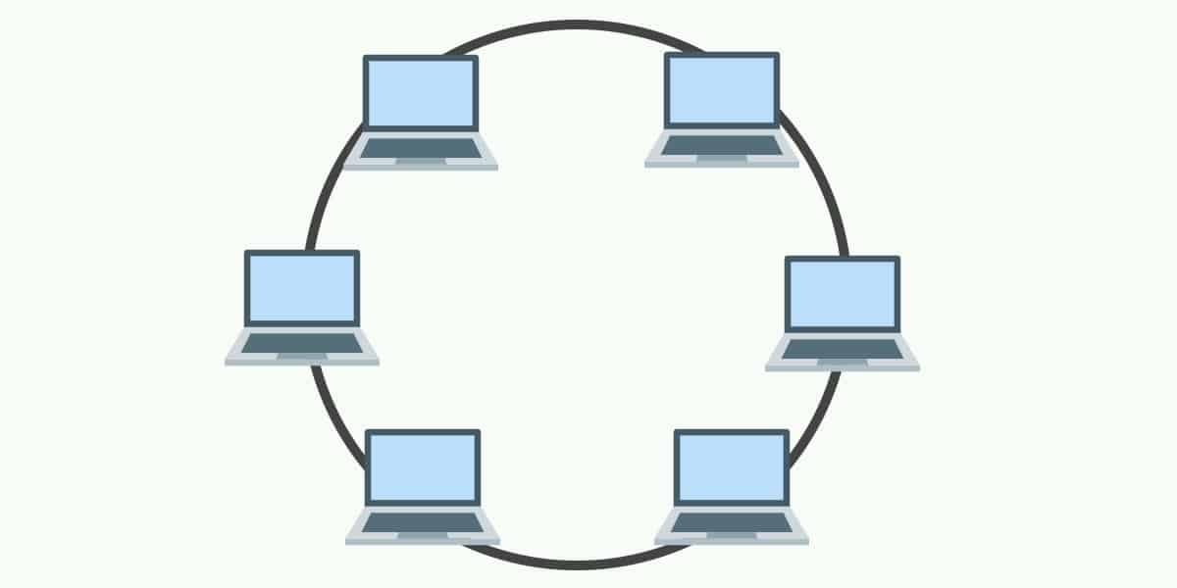
Topologies: Ring
Single – half-duplex
Dual – full-duplex

Slide 25
Topologies - Ring

Slide 26
Topologies: Mesh
Each computer and network device is interconnected with one another, allowing for most transmissions to be distributed even if one of the connections go down
It is a topology commonly used for wireless networks
Each node has a dedicated point-to-point link to every other node
A fully connected mesh network having ‘n’ number of nodes has a total of n(n-1)/2 number of links
Example: 6 nodes = (6(6-1))/2 = 15 links

Slide 27
Topologies - Mesh
Full Mesh
Every node has a circuit connecting it to every other node in the network
Yields greatest redundancy, so if one node fails, network traffic can be redirected to any of the other nodes
Usually reserved for backbone networks since it is very expensive

Slide 28
Mesh

Slide 29
Topologies - Mesh
Partial Mesh
Some nodes are organized in a full mesh scheme but others are only connected to 1 or 2 in the network
Common in peripheral networks connected to a full meshed backbone
Less expensive to implement
Yields less redundancy

Slide 30
Partial Mesh
Notes:
Nodes 1 and 2 are connected to every other node

Slide 31
Topologies: Ad Hoc or Hybrid
No pre-existing infrastructure
Devices communication amongst themselves
Can be a mixture of topologies
Multiple physical topologies are combined to form one large network
Each topology has its own strengths and weakness
Objective: total strength improves the network performance

Slide 32
Topologies: Infrastructure
All devices communicate through an access point
The most common wireless communication mode

Slide 33
Topologies: Wireless Mesh
Ad hoc devices work together to form a mesh “cloud”
Self form and self heal

Slide 34
Topologies: Wireless Mesh
Advantages
Scalability
Robustness
Redundancy
Notes:
. Scalability
One of the advantages of a mesh topology is that (in theory) you don’t need to add routers to the network, as each node can act as a router. If you’re working on a mesh network for the lighting in your office building, and you want to add a light in a particular room, you should be able to add the light and have it automatically connect to the network. There isn’t a lot of extra management that needs to happen, which makes the network scalable.
2. Robustness
Another benefit of a mesh network topology is that if one of the nodes goes down, it doesn’t necessarily bring the entire network down. The network can heal itself around a bad node if other nodes can complete the mesh. Additionally, if you need to get more range out of a mesh system, you can add another node and the messages can hop through the mesh back to the gateway—which is why some believe mesh networks are more robust.
Because all nodes in a mesh are receiving and translating information, there is some redundancy in a mesh topology; however, you can also gain speed with the excess bandwidth. If one route happens to be slow, a mesh network could potentially find a better route and optimize itself.

Slide 35
Topologies: Wireless Mesh
Disadvantages
Complexity
Network Planning
Latency
Power Consumption
Notes:
Disadvantages Of A Mesh Topology
1. Complexity
Each node needs to both send messages as well as act as a router, which causes the complexity of each node to go up pretty significantly. Let’s say you’re making a small, low-power device—like a room occupancy sensor—and you are looking to get better range out of your system. The nodes have to now keep track of messages from five or 10 of their ‘neighbors,” which exponentially increases the amount of data that node has to deal with in order to pass along a message. Thus, if you add additional sensors to the mesh just to benefit the range, you’re naturally making the system more complex.
2. Network Planning
As we mentioned previously, mesh networks are often considered highly scalable, and adding a node to the network typically isn’t very involved. But planning the network as a whole is a different story. Let’s say you have poor latency in one area of your building (which we’ll discuss below), and you need a particular light to turn on faster than it currently turns on. With a mesh network, you’d need to add a dedicated node that only forwards messages. But this complicates your network planning, because you now have to deploy a piece of equipment just to get your messages properly routed in a reasonable amount of time.
3. Latency
As mentioned, latency—the time it takes a message to get from a node to the gateway—can impact your mesh network planning. Interestingly, you may improve some latency by using a mesh network with a larger scale system with more bandwidth, memory, and power. But latency becomes an issue in smaller low power, wide-area networks (LPWANs) because it doesn’t have the processing capability to handle the messaging. Thus, if you have a WiFi mesh, messages will likely be translated much quicker than a ZigBee mesh. This is something to consider based on the protocol you’ll be using and the latency your application requires.
4. Power Consumption
Because each node in a mesh has to act as an endpoint and a router, it has to draw more power to operate. Thus, if you have battery-powered, low-power nodes, a mesh may be difficult to deploy without a lot of network planning.
Let’s say you have battery-powered nodes in windows and doors for your smart security system. The customer keeps the control panel in the basement, but all of the sensors are on the first and second floor. So while a second-floor window may be low power, because it only transmits messages, the sensors on the first floor will have to handle messages from the second floor windows and doors. In other words, you’re compounding the amount of data each node has to handle in a mesh, and so batteries on some nodes are likely to die faster.

Slide 36
Physical and Logical Topology
Physical topology defines how the systems are physically connected
Logical Topology - How devices are connected to the network through the actual cables that transmit data
The logical topology defines how the systems communicate across the physical topologies

Slide 37
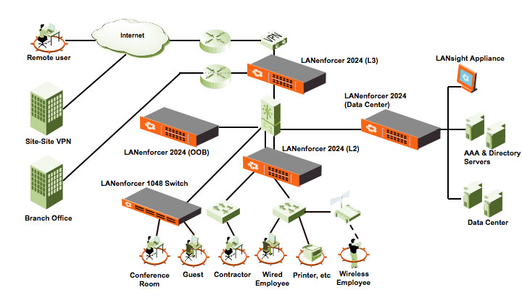
NETWORK TOPOLOGY (LOGICAL TOPOLOGY)

Slide 38
Physical – Logical Topology
Inside, the ports of the hub are wired in a circle. Data packets travels in a ring – not as a star!
Each computer connects
to the central hub

Slide 39
OSI Model

Slide 40
OSI model
Layer 7
Application
Open Systems Interconnection Reference Model
It’s a guide (thus the term “model”)
Don’t get wrapped up in the details
This is not the OSI protocol suite
Most of the OSI protocols didn’t catch on
There are unique protocols at every layer
You’ll refer to this model for the rest of your career
Layer 6
Presentation
Layer 5
Session
Layer 4
Transport
Layer 3
Network
Layer 2
Data Link
Layer 1
Physical
Notes:
All People Seem To Need Data Processing

Slide 41
OSI model
Layer 7
Application
Open Systems Interconnection Reference Model
Mnemonic
Please Do Not Throw Sausage Pizza Away
Layer 6
Presentation
Layer 5
Session
Layer 4
Transport
Layer 3
Network
Layer 2
Data Link
Layer 1
Physical

Slide 42
The OSI Layers
Application
The layer we see – Google Mail, Twitter, Facebook
Encoding and encryption
(SSL/TLS)
Presentation
Session
Communication between devices (Control protocols, tunnelling protocols)
The “post office” layer
(TCP segment, UDP datagram)
Transport
Network
The routing layer
(IP address, router, packet)
The switching layer
(Frame, MAC address, EUI-48, EUI-64, Switch)
Data Link
Signalling, cabling, connectors
(Cable, NIC, Hub)
Physical

Slide 43
OSI model

Slide 44
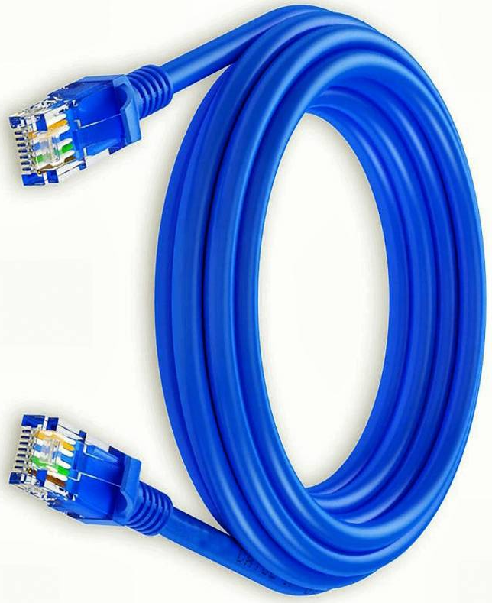
OSI Model – Layer 1: The Physical Layer
The physics of the network
Signalling, cabling, connectors
This layer isn’t about protocols
You have a physical layer problem
Fix your cabling, punch-downs, etc.
Run loopback tests, test/replace cables, swap adapter cards

Slide 45
OSI Model – Layer 1: The Physical Layer
From Data Link Layer
To Data Link Layer
110
1010101100001101
Physical Layer
110
1010101100001101
Transmission Medium
The physical layer is responsible for movements of individual bits from one hop (node) to the next

Slide 46
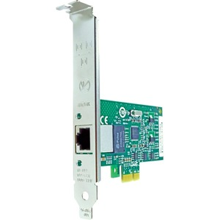
OSI Model – Layer 2: Data Link Layer
The basic network “language”
The foundation of communication at the data link layer
Data Link Control (DLC) protocols
MAC (Media Access Control) address on Ethernet
The “switching” layer
0
1
1
1
0
1
0
9C-35-58-5F-4C-D7
0C-9D-92-87-47-1E
Notes:
The Data Link Layer is referencing the MAC addresses that are communicating on the network.

Slide 47
OSI Model – Layer 2: The Data Link Layer
From Network Layer
To Network Layer
H2
Data
T2
H2
Data
T2
Data Link Layer
Data Link Layer
To Physical Layer
From Physical Layer
The data link layer is responsible for moving frames from one hop (node) to the next.
Notes:
H2 is the Header
Data is the packet from the network layer
The trailer includes error detection and the ending transmission data

Slide 48
Hop-to-Hop delivery

Slide 49
OSI Model - Layer 3: Network Layer
The “routing” layer
Internet Protocol (IP)
Fragments frames to traverse different networks

Slide 50
OSI Model - Layer 3: Network Layer
What is IP Fragmentation?
Fragments are always in multiples of 8 because of the number of fragmentation offset bits in the IP header

Slide 51
OSI Model – Layer 3: The Network Layer
From Transport Layer
To Transport Layer
H3
Data
H3
Data
Network Layer
Network Layer
To Data Link Layer
From Data Link Layer
The network layer is responsible for the delivery of individual packets from the source host to the destination host.
Notes:
H3 is the Header
Data is the packet from the transport layer

Slide 52
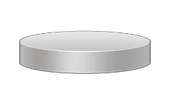
Source to Destination Delivery
Intermediate
system
Link
X
Link
Intermediate
system
C
D
Link
X
B
Intermediate
system
A
Link
X
Link
E
F
Hop-to-hop delivery
Hop-to-hop delivery
Hop-to-hop delivery
Data Link Layer
Source-to-destination delivery
A
B
E
F
Network
Network
Network
Data Link
Data Link
Data Link
Physical
Physical
Physical

Slide 53
OSI Model – Layer 4: Transport Layer
The “post office” layer
Parcels and letters
TCP (Transmission Control Protocol) and UDP (User Datagram Protocol)

Slide 54
Transport Layer
From Session Layer
To Session Layer
H4
Data
H4
Data
H4
Data
H4
Data
H4
Data
H4
Data
Transport Layer
Transport Layer
To Network Layer
From Network Layer
The transport layer is responsible for the delivery of a message from one process to another.

Slide 55
OSI Model – Layer 5: Session
Communication management between devices
Start, stop, restart
Half-duplex, full-duplex
Control protocols, tunnelling protocols

Slide 56
Session Layer
From Presentation Layer
To Presentation Layer
H5
H5
SYN
SYN
SYN
SYN
SYN
SYN
Session Layer
Session Layer
To Transport Layer
From Transport Layer
The session layer is responsible for dialog control and synchronization.

Slide 57
OSI Model – Layer 6: Presentation
Character encoding
Application encryption
Often combined with the Application Layer

Slide 58
OSI Model – Layer 6: Presentation
From Application Layer
To Application Layer
H6
Data
H6
Data
Presentation Layer
Presentation Layer
To Session Layer
From Session Layer
The presentation layer is responsible for translation, compression, and encryption.

Slide 59
OSI Model – Layer 7: Application
The layer we see - HTTP, FTP, DNS, POP3

Slide 60
OSI Model – Layer 7: Application
User:
Human or Program
User:
Human or Program
…
…
X.500
FTAM
X.400
X.500
FTAM
X.400
H7
Data
Message
H7
Data
Message
Application Layer
Application Layer
To Presentation Layer
From Presentation Layer
The application layer is responsible for providing services to the user.

Slide 61
Summary of Layers
Application
To allow access to network resources
To translate, encrypt and compress data
Presentation
Session
To establish, manage and terminate sessions
To provide reliable process-to-process message delivery and error recovery
Transport
Network
To move packets from source to destination; to provide internetworking
To organise bits into frames; to provide hop-to-hop delivery
Data Link
To transmit bits over a medium; to provide mechanical and electrical specifications
Physical

Slide 62
Next…
Physical Networks and Ethernet

Slide 63
Physical Networks
Transmission Media
Media Access Control
Broadcast Domains
Ethernet Frames
Ethernet Deployment Standards
MAC Addressing
Address Resolution Protocol
Packet Sniffers

Slide 64
Ethernet - History
Developed in 1973 by Xerox
Was based on a bus technology
Could transfer data at a rate of up to three million bits per second (Mbps)
In conjunction with DEC and Intel Xerox published the DIX standards in 1979
Screamed along at 10Mbps!!!
Notes:
DEC – Digital Equipment Corporation
Ethernet is entirely ubiquitous. It's not just the standard used for almost all modern wired LANs, but it's increasingly being used for telecommunications and storage networks, and even being increasingly adopted as a WAN technology. Even other common standards, such as Wi-Fi, incorporate technologies and standards originally developed as part of Ethernet.

Slide 65
Ethernet - History
They gave away the control of the Ethernet standard to the IEEE
They created the 802.3 (Ethernet) committee
Thus Ethernet became an open standard
Notes:
IEEE - Institute of Electrical and Electronics Engineers

Slide 66
Transmission Media
The physical channel through which signals travel to allow nodes to communicate
All use electromagnetic radiation of type or the other
Electrical
Light
Radio signals
Transmission media can be classified as:
Cabled
wireless

Slide 67
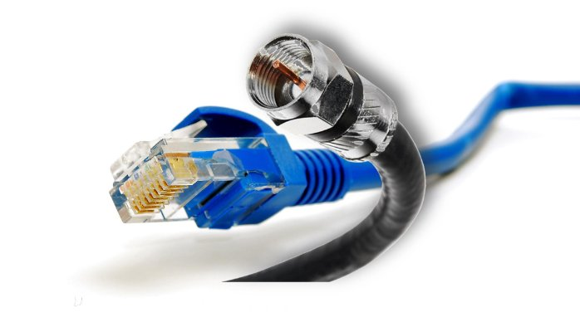
Transmission Media - Cabled
A physical signal conductor between two nodes
Cable types such as:
Copper
Fibre optic
Cabled media can also be described as bounded media

Slide 68
Transmission Media - Wireless
Uses free space between nodes
Types such as:
Microwave radio
Wireless media can also be described as unbounded media

Slide 69
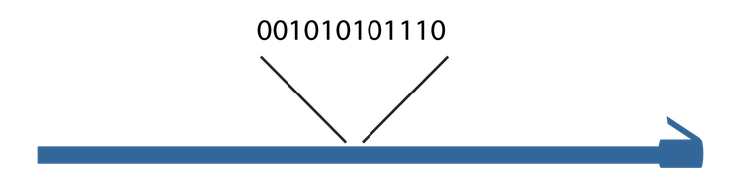
Signaling and modulation
Every kind of physical network needs to turn data into a signal that can be sent across the media.
The simplest way is by encoding it into a single binary signal and transmitting it along a wire or fiber optic cable
This is called digital baseband, or line coding, and is the method used by Ethernet cables among others
Notes:
Every kind of physical network needs to turn data into a signal that can be sent across the media. The simplest way is by encoding it into a single binary signal and transmitting it along a wire or fiber optic cable. This is called digital baseband, or line coding, and is the method used by Ethernet cables among others.
As you know, a cable, on which bits in the form of signals are transmitted, is busy with signals containing zeros and ones, and to distinguish between what bits are the actual travelled data and what bits are non-wanted noise is very difficult ; so a method to tell the difference is required. For that reason, control information is utilized. This information is in the form of zeros and ones that indicate where a frame start and where the frame ends.

Slide 70
Signaling and modulation (Cont.)
In other communication types, especially those used over long distances, data is combined with a signal called a carrier wave

Slide 71
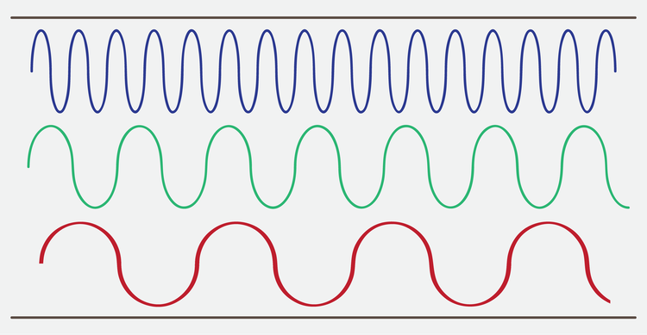
Signaling and modulation (Cont.)
Three channels in a broadband transmission

Slide 72
Signal Methods
Notes:
Three possible variations which are amplitude, frequency, and phase.

Slide 73
Bit rate and bandwidth
Bit rate, the number of bits carried per second
For example, the earliest popular Ethernet standards had a bit rate of ten megabits per second, abbreviated as 10 Mbps
Gross bit rate
Net bit rate or throughput
goodput
Notes:
Bandwidth means the amount of data that can be carried in a given amount of time; or, in other words, the capacity of a medium to carry data in a specific period of time. As stated previously, data transfer is measured using bits per second (bps). Thanks to the technological development, bandwidth is now commonly referred to in kilobits per second and megabits per second, and in case using highly sophisticated media, bandwidth can reach gigabits per second and terabits per second. These speeds can be achieved relying on the physical characteristics of media and the signalling method being applied. Thus if one is to calculate the bandwidth of a given medium, the physical properties as well as the signalling method must be taken into consideration.
Throughput can be defined as the real or actual data transfer rate in a given amount of time. We said that bandwidth is the capacity of a medium for data transmission, however, this capacity is hardly attained in real data transfer because of a variety of factors such as interference, noise, and errors in data transmission. For this reason, when we talk about bandwidth, we are actually taking about a theoretical rate of speed which is not same when data frames are really transmitted, whereas when we refer to the speed rate of a given medium using a throughput value, we are actually utilizing the real value at which data frames are carried. This means that throughput is bandwidth minus interference and errors, and therefore bandwidth is theoretical and throughput is practical.
Goodput denotes the transfer rate of the actual usable data bits; or, to put it another way, goodput measures the final data that the user benefits from or use, for data such as a picture, text, or video does not travel on media alone, but rather there is another control information, which is generally considered as data, or what is referred to as overhead. Its purpose is to make sure that data is safe, undamaged, unrepeated, and to guide data up to the destination. By and large, it can be said that goodput is throughput minus overhead traffic

Slide 74
Bit rate and bandwidth (Cont.)
A transmission using two-bit symbols

Slide 75
Multiplexing
Space-division multiplexing (SDM)
Frequency-division multiplexing (FDM)
Time-division multiplexing (TDM)
Notes:
Space-division multiplexing, also known as Space-division multiple access is the use of separate point-to-point electrical conductors for each transmitted channel. Examples include an analogue stereo audio cable, with one pair of wires for the left channel and another for the right channel, and a multi-pair telephone cable, a switched star network such as a telephone access network, a switched Ethernet network, and a mesh network.
Frequency-division multiplexing (FDM) is inherently an analogue technology. FDM achieves the combining of several signals into one medium by sending signals in several distinct frequency ranges over a single medium. In FDM the signals are electrical signals.
Time-division multiplexing (TDM) is a digital (or in rare cases, analogue) technology which uses time, instead of space or frequency, to separate the different data streams. TDM involves sequencing groups of a few bits or bytes from each individual input stream, one after the other, and in such a way that they can be associated with the appropriate receiver. If done sufficiently quickly, the receiving devices will not detect that some of the circuit time was used to serve another logical communication path.
Multiple low data rate signals are multiplexed over a single high data rate link, then demultiplexed at the other end

Slide 76
Media Access Control
Ethernet Media Access Control address
The “physical” address of a network adapter
The MAC address
Unique to a device
48 bits / 6 bytes long
Displayed in hexadecimal
00:0a:83
:
00:0a:83
Organisationally Unique Identifier (OUI)
Network Interface Controller-Specific
The manufacturer
The serial number
Notes:
A physical address corresponding to a particular network interface.
Ethernet's physical address format is a 48-bit number called a MAC address, MAC-48, or EUI-48.
MAC addresses are usually written as 12 hexadecimal digits. For readability, they're usually grouped into pairs, separated by dashes or colons; for example, 10:0D:7F:F3:CE:8F.
Sometimes you'll also see three groups of four separated by periods or full stops, such as 100D.7FF3.CE8F.

Slide 77
MAC addresses (Cont.)
MAC Address
0001101
00010000
01111111
00010010
11001110
00001101
0D
10
7F
12
CE
0D
0001101
00010000
01111111
11111111
11111110
00010010
11001110
00001101
0D
10
7F
FF
FE
12
CE
0D
EUI-64 Address

Slide 78
Unicast, broadcast, and multicast
An address corresponding to a specific recipient is called a unicast address
Unicast messages are sent from one source to exactly one destination
A broadcast address is intended to be read by any node that receives it.

Slide 79
Unicast, broadcast, and multicast (Cont.)
Multicast addresses are intended to go to multiple nodes but not everywhere on the network
0001101
00010000
01111111
00010010
11001110
00001101
0D
10
7F
12
CE
0D

Slide 80
Media Access Control - Duplex
Half-duplex
Full-duplex
A device cannot send and receive simultaneously
All LAN hubs are half-duplex devices
Switch interfaces can be configured as half-duplex, but usually only when connecting to another half-duplex device
Data can be sent and received at the same time
A properly configured switch interface will be set to full-duplex

Slide 81
Broadcast Domains
A broadcast domain represents a set of devices that can hear broadcast traffic from each other
ARP (Address Resolution Protocol) requests, which look to resolve a known IP address to an unknown MAC address of that device, are always broadcasts, and are heard by all devices on a network
Switches forward broadcasts out of all interfaces, except the interface on which the message originated
Routers, however, break up a broadcast domain, as they never forward broadcasts out of other interfaces to other networks

Slide 82
CSMA/CD
Older Ethernet networks that used half-duplex communications, where a node could only transmit or receive at one time (not simultaneously), used carrier sense multiple access with collision detection (CSMA/CD) to determine which computer should use the shared media at a given moment
Carrier sense means that each machine on the network examines the cable before sending a data frame
If another machine is using the network, the node detects traffic and waits until the cable is free. If the node detects no traffic, the node sends its data frame
Multiple access means that all machines have equal access to the wire. If the line is free, an Ethernet node does not have to get approval to use the wire—it just uses it

Slide 83
Collision Domains
When two nodes use the cable simultaneously, a collision occurs, and both of the transmissions are lost
When a collision occurs, both nodes detect the collision by listening to their own transmissions
By comparing their own transmissions with the signal they receive, they can determine whether another node has transmitted at the same time
If the nodes detect a collision, both nodes immediately stop transmitting and wait for a short, random period of time before retrying

Slide 84
Ethernet Frames
There have been four different Ethernet frame types defined over the years
Only the Ethernet II frame type is used today
Every version of 802.3 Ethernet uses the same Ethernet II frame
Using frames addresses two networking issues
Frames prevent any single machine from monopolizing the shared bus cable
The process of retransmitting lost data is more efficient
Notes:
An Ethernet frame is a data link layer protocol data unit and uses the underlying Ethernet physical layer transport mechanisms

Slide 85
Ethernet Frame
Ethernet Type II Frame
(64 to 1518 bytes)
A8 A1 59 1D 79 8F
A8 A1 52 1D 21 98
08 00
IP, ARP, etc.
01 20 13 3A
Destination MAC Address
Source MAC Address
EtherType
Payload
CRC Checksum
MAC Header
(14 bytes)
Data
(46 - 1500 bytes)
4 bytes
EtherType values:
0x0800 signals that the frame contains an IPv4 datagram 0x0806 indicates an ARP frame
0x86DD indicates an IPv6 frame
0x8100 indicates the presence of an IEEE 802.1 Q tag
Notes:
The MAC header has 14 bytes and the payload can have from 46 to 1500 bytes. The checksum is 4 bytes which means that the Type II frame can therefore have from 64 to 1518 bytes

Slide 86
Ethernet Deployment Standards

Slide 87
802.3 Standards
The 802.3 committee defines wired network standards that share the same basic frame type and network access method
Here’s a small selection of 802.3 standards:
802.3i 10 Mbps Ethernet using twisted pair cabling (1990)
802.3a 10BASE2 10 Mbit/s (1.25 MB/s) over thin Coax (1985)
802.3ab Gigabit Ethernet over twisted pair (1999)
802.3by 25 Gigabit Ethernet over fibre (2016)
802.3u 100BASE-TX, 100BASE-T4, 100BASE-FX Fast Ethernet at 100 Mbit/s (12.5 MB/s) (1995)
Notes:
802.3a (1985) 10BASE2 10 Mbit/s (1.25 MB/s) over thin Coax (a.k.a. thinnet or cheapernet)
802.3u (1995) 100BASE-TX, 100BASE-T4, 100BASE-FX Fast Ethernet at 100 Mbit/s (12.5 MB/s) with autonegotiation

Slide 88
Address Resolution Protocol
A protocol used by the Internet Protocol (IP) [RFC826], specifically IPv4, to map IP network addresses to the hardware addresses used by a data link protocol
The protocol operates below the network layer as a part of the interface between the OSI network and OSI link layer
It is used when IPv4 is used over Ethernet
For ARP, we are talking about layer 2
Notes:
ARP stands for Address Resolution Protocol. When you try to ping an IP address on your local network, say 192.168.1.1, your system has to turn the IP address 192.168.1.1 into a MAC address. This involves using ARP to resolve the address, hence its name.

Slide 89
Address Resolution Protocol
There are four types of ARP messages that may be sent by the ARP protocol
These are identified by four values in the "operation" field of an ARP message
The types of message are:
ARP-Request (Broadcast, source IP address of the requester)
ARP-Reply (Unicast to requester, the target)

Slide 90
Address Resolution Protocol
The format of an ARP message is shown below:
Hardware type
Protocol type
HW LEN
Protocol LEN
Operation
Sender Hardware Address (octets 0-3)
Sender Hardware Address (octets 4-5)
Sender IP Address (octets 0-1)
Sender IP Address (octets 2-3)
Target Hardware Address (octets 0-1)
Target Hardware Address (octets 2-5)
Target IP Address (octets 0-3)
Notes:
Hardware (HW) Type: 1 is for Ethernet
Protocol Type: 0800₁₆ = IP address
Hardware Length and Protocol length allows arbitrary networks to be used
Operation: 1 = ARP request, 2 = ARP response, 3 = RARP request, 4 = RARP response
ARP messages are sent directly to MAC layer
ARP message is 28 octets long

Slide 91
Packet Sniffers
A packet analyser (also known as a packet sniffer) is a computer program or piece of computer hardware
Can intercept and log traffic that passes over a digital network or part of a network
A "Packet Sniffer" is a utility that sniffs without modifying the network's packets in any way
Packet sniffers merely watch, display, and log this traffic
Notes:
A packet analyser (also known as a packet sniffer) is a computer program or piece of computer hardware (such as a packet capture appliance) that can intercept and log traffic that passes over a digital network or part of a network
A "Packet Sniffer" is a utility that sniffs without modifying the network's packets in any way
Packet sniffers merely watch, display, and log this traffic
By comparison, a firewall sees all of a computer's packet traffic as well, but it has the ability to block and drop any packets that its programming dictates

Slide 92
Computer A
Computer B
Computer C
Computer C
is the recipient
of the data packet
Hub
Hub broadcasts data packet to all network computers
Data packet sent to computer C
Broadcast
Computer
Passive sniffing
Notes:
Passive sniffing is intercepting packages transmitted over a network that uses a hub. It is called passive sniffing because it is difficult to detect. It is also easy to perform as the hub sends broadcast messages to all the computers on the network.

Slide 93
Computer A
Computer B
Computer C
Computer C
is the recipient
of the data packet
Switch
Switch maps IP/MAC addresses to physical ports
Data packet sent to computer C
Broadcast
Computer
Active sniffing
Notes:
Active sniffing is intercepting packages transmitted over a network that uses a switch. There are two main methods used to sniff switch linked networks, ARP Poisoning, and MAC flooding.

Slide 94
Networking
UFCFDU-30-1
Module 1

Slide 95
Hubs, bridges and switches
Layer 1 Devices
Physical layer devices such as repeaters and hubs operate only on Layer 1 of the OSI model

Slide 96
Repeaters
A repeater, sometimes also called an extender, is a device made to enable connections over longer distances.
Degraded Signal
Strong Signal
LAN
LAN
Building
Building
Repeater

Slide 97
Hubs
A hub is a Layer 1 device that connects multiple nodes into a star configuration.
Hub
Notes:
A HUB is an unsophisticated device in comparison with a switch.
It works by repeating transmissions received from one of its ports to all other ports

Slide 98
Collision domains
In the original Ethernet specification, a segment was a single coaxial cable
This meant three things:
The segment had a maximum total length, governed by the cable's attenuation.
Since a node contributes to attenuation, the segment could support a fixed number of total nodes.
The segment is a single collision domain - any two nodes on the segment transmitting at once causes a collision.
Notes:
The term network segment usually refers to a small part of a larger network, but it can mean different things depending on context. In the original Ethernet specification, a segment was a single coaxial cable. This meant three things.
The segment had a maximum total length, governed by the cable's attenuation.
Since a node contributes to attenuation, the segment could support a fixed number of total nodes.
The segment is a single collision domain - any two nodes on the segment transmitting at once causes a collision.

Slide 99
Layer 2 devices
A Layer 2 device doesn't pass data on blindly
It must be able to read the Data Link Layer frames that reach it to determine how to handle them
It must also be able to create new ones

Slide 100
Bridges
A bridge is a bit like a repeater
Creates a single aggregate network from multiple communication networks or network segments
STOP
Packet
Packet
Bridge
Hub
Notes:
Except, instead of linking two electrical segments, it links two or more Layer 1 segments, or collision domains, into a larger network

Slide 101
Bridges
A bridge has a MAC table in memory
Bridges only forward frames that are required to cross the bridge
Additionally, bridges reduce collisions by creating a separate collision domain on either side of the bridge
#2
#1
A
B
C
Bridge
#3
#4
Notes:
A bridge has a MAC table in memory: A list of MAC addresses on the network, and which side of the bridge they're on.
Bridges only forward frames that are required to cross the bridge
Additionally, bridges reduce collisions by creating a separate collision domain on either side of the bridge

Slide 102
Translating bridges
A translating bridge can even join segments using different layer 2 protocols, by translating frames from one format into the other.
W
E
E
Hub
W
Notes:
A type of bridge that interconnects two different types of LAN protocols, such as Ethernet and Token Ring. Translating bridges are generally very complicated devices

Slide 103
Switches
A Layer 2 switch is nothing more than a bridge with three or more ports, just like a hub is to a repeater.
Notes:
A type of network switch or device that works on the data link layer (OSI Layer 2) and utilizes MAC Address to determine the path through where the frames are to be forwarded
Can also be referred to as a multiport bridge

Slide 104
Broadcast domains
Switches transparently forward frames
Therefore any node on the network can still communicate directly to any other node using its MAC address
Can broadcast to the entire bridged network at once by using a broadcast address (FF:FF:FF:FF:FF:FF in MAC-based networks)
since bridges and switches automatically flood broadcast frames
This defines a Layer 2 segment, also known as the broadcast domain
Notes:
Since switches transparently forward frames, any node on the network can still communicate directly to any other node using its MAC address.
It can even broadcast to the entire bridged network at once by using a broadcast address (FF:FF:FF:FF:FF:FF in MAC-based networks), since bridges and switches automatically flood broadcast frames.
This defines a Layer 2 segment, also known as the broadcast domain.

Slide 105
Discussion: Comparing Layer 2 devices

Slide 106
Layer 3 devices
Layer 3 devices, such as gateways, routers, and multilevel switches are designed to overcome problems and link far larger, more complex networks than switches alone
They segment the larger network into multiple broadcast domains, and govern traffic between them
They have more advanced routing protocols
They also use logical addresses
Notes:
Layer 3 devices, such as gateways, routers, and multilevel switches are designed to overcome problems and link far larger, more complex networks than switches alone.
They segment the larger network into multiple broadcast domains, and govern traffic between them.
They have more advanced routing protocols, letting them find paths and share network information in ways Layer 2 switches cannot.
They also use logical addresses, which are tied to the network's structure; this means they can more easily pass data in the right direction without knowing the whole network.

Slide 107
Routers
A router is a networking device that forwards data packets between computer networks
Can be a physical or virtual appliance
Inspects a given data packet's destination Internet Protocol address (IP address), calculates the best way for it to reach its destination and then forwards it accordingly
192.168.1.200
192.168.1.214
MAC: 22:33:55:44
MAC: 22:35:55:65
192.168.1.159
192.168.1.156
Server
MAC: 22:33:30:84
192.168.1.153
192.168.1.137
Notes:
Routers sit at the boundaries between broadcast domains.
Using both physical and logical address information, they gather and store information about their surrounding network topology, use it to determine the best route between any two nodes, and then forward network layer packets along it.
Routers perform the traffic directing functions on the Internet
Data sent through the internet, such as a web page or email, is in the form of data packets

Slide 108
Routers (Cont.)
A packet is typically forwarded from one router to another router through the networks that constitute an internetwork
A router is connected to two or more data lines from different IP networks
When a data packet comes in on one of the lines, the router reads the network address information in the packet header to determine the ultimate destination
Using that information in its routing table or routing policy, it directs the packet to the next network on its journey.
Notes:
To keep the network running smoothly, those routers each have to know their surroundings and the quickest path to any particular subnet, so they constantly exchange information about changes in network conditions.
A packet is typically forwarded from one router to another router through the networks that constitute an internetwork (e.g. the Internet) until it reaches its destination node
A router is connected to two or more data lines from different IP networks
When a data packet comes in on one of the lines, the router reads the network address information in the packet header to determine the ultimate destination
Then, using information in its routing table or routing policy, it directs the packet to the next network on its journey.

Slide 109
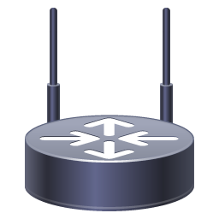
Gateways
A gateway is a node (router) in a computer network
A key stopping point for data on its way to or from other networks
With gateways, we can communicate and send data back and forth
The Internet wouldn't be any use to us without gateways
Internet
81.0.110.1
Router
192.0.2.1/24
198.51.100.1
192.0.2.2/24
198.51.100.0/24
192.0.2.104
192.0.2.148
198.51.100.104
198.51.100.10
My default gateway is
192.0.2.1
My default gateway is
198.51.100.1
Notes:
Joining two networks that use the same protocol but different addressing schemes.
Joining a LAN to a WAN, often along with related non-routing features in the same hardware device.
We could also be joining two networks that use different protocols.

Slide 110
Multilayer switches
A multilayer switch is a network device that has the ability to operate at higher layers of the OSI reference model, unlike the Data Link Layer (DLL) traditionally used by switches
A multilayer switch can perform the functions of a switch as well as that of a router at incredibly fast speeds
VLAN 3
VLAN 2
VLAN 1
VLANs 1, 2 3
Trunk
VLAN 3
VLAN 2
Multilayer
Switch
VLAN 1
Notes:
Switches that operate at higher levels of the stack are fairly common, and are called Layer 3 switches or multilayer switches depending on their exact function.
They filter and forward frames like a switch, but they can also look inside frames like a router to read network layer packets, and forward them between subnets like a router.
Some even have functions on higher levels of the stack. In short, a Layer 3 switch is one that can take over most of a router's duties.

Slide 111
Media
Electrical interference
Twisted-pair network cable standards
Twisted-pair connectors
Coaxial cable standards and connectors
How to troubleshoot physical connectivity on copper networks

Slide 112
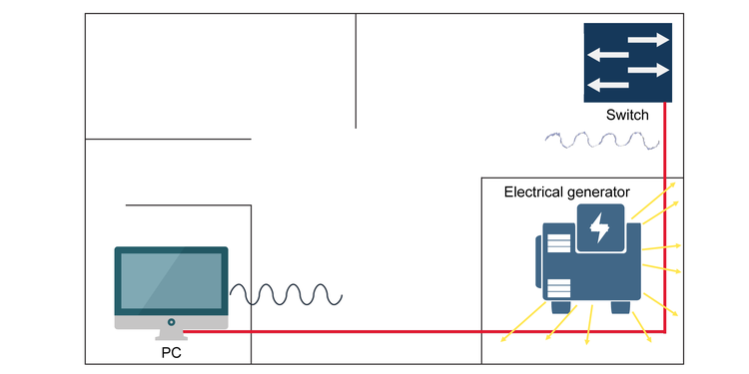
Electrical interference
Electromagnetic interference (EMI). Electrical currents, especially high-frequency, low-power signals such as those used in data networks, are subject to noise from electromagnetic sources in their environment, such as radio transmitters, electrical motors, or power cables

Slide 113
Electrical interference (Cont.)
Two signal cables alongside each other can even interfere with each other to cause crosstalk, which is especially a problem in large and complex networks when you might want to string many cables together
The second challenge is attenuation, which means the longer the line is, the weaker the signal becomes

Slide 114
Twisted-pair cables

Slide 115
Twisted-pair cable properties

Slide 116
Twisted-pair cable properties (Cont.)
Unshielded twisted-pair (UTP) is just like it sounds: It has no additional shielding and relies entirely on the twisted-pair effect to combat interference
Foil shielding uses a grounded foil wrap to provide additional electromagnetic shielding
Braided screening uses a braided copper jacket around the cable to provide shielding
Notes:
Unshielded twisted-pair (UTP) is just like it sounds: It has no additional shielding and relies entirely on the twisted-pair effect to combat interference.
Foil shielding uses a grounded foil wrap to provide additional electromagnetic shielding. The foil can be placed around each individual pair (U/FTP), around the outer cable (F/UTP), or both (F/FTP)
Braided screening uses a braided copper jacket around the cable to provide shielding. It can be used around otherwise unshielded cable (S/UTP) or in conjunction with foil shielding (S/FTP and SF/FTP).

Slide 117
F/UTP cable with the foil shielding unwrapped

Slide 118
Twisted-pair standards
The ISO/IEC 11801 standard defines several classes of cable
Each is able to support a given maximum transmission frequency over the distances used in most LAN installations
In practice, you usually hear these standards called by numbered categories, with a given category called "Cat" for short: Cat3, Cat5, Cat5e, etc.
Notes:
The ISO/IEC 11801 standard defines several classes of cable, each able to support a given maximum transmission frequency over the distances used in most LAN installations
In practice, you usually hear these standards called by numbered categories, with a given category called "Cat" for short: Cat3, Cat5, Cat5e, etc.

Slide 119
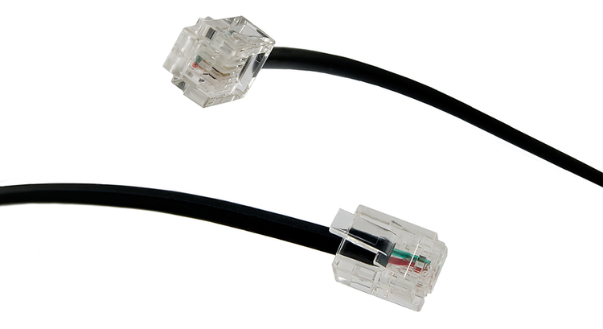
Twisted-pair connectors
Modular connectors are described by the number of positions (P) and contacts (C) they use. The number of positions determines the size of the connector, while the number of contacts determines how many wires can be connected.

Slide 120
Wiring standards

Slide 121
Wiring standards
Pin | T568A Pair | T568A Color | T568B Pair | T568B Color
1 | 3 | White/Green | 2 | White/Orange
2 | 3 | Green | 2 | Orange
3 | 2 | White/Orange | 3 | White/Green
4 | 1 | Blue | 1 | Blue
5 | 1 | White/Blue | 1 | White/Blue
6 | 2 | Orange | 3 | Green
7 | 4 | White/Brown | 4 | White/Brown
8 | 4 | Brown | 4 | Brown

Slide 122
Straight-through and crossover cables

Slide 123
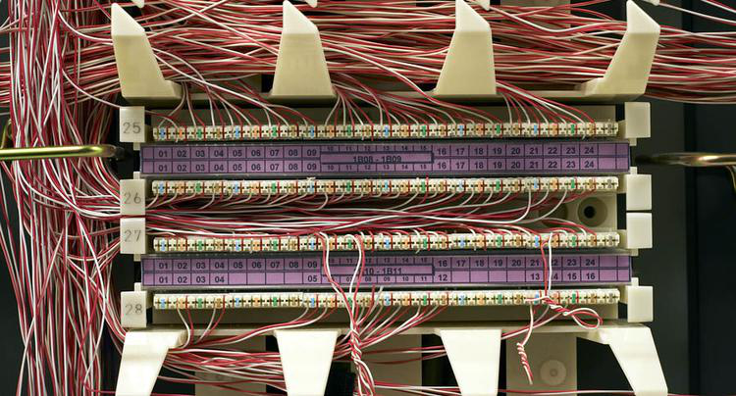
Centralized connections
All network and telephone cables are terminated to a common distribution frame
Usually on a device called a punchdown block
The block is so-named because a special tool is used to punch each wire down onto a bladed contact that punctures its insulation and holds it into place
Notes:
All network and telephone cables are terminated not with modular connectors, but to a common distribution frame, usually on a device called a punchdown block. The block is so-named because a special tool is used to punch each wire down onto a bladed contact that punctures its insulation and holds it into place.

Slide 124
Punch down Block

Slide 125
A patch panel alongside a switch
https://www.racksolutions.com/news/data-center-trends/cable-management/cable-management-strategies/

Slide 126
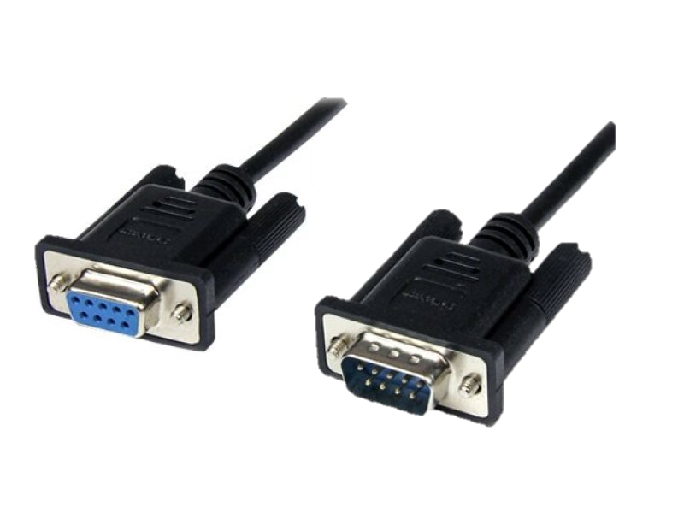
RS-232 connectors
On older PCs, RS-232 connections were simply called "serial ports"
Used for all sorts of peripheral devices like modems, printers, and mice.
RS-232 connectors use D-sub ports
Notes:
On older PCs, RS-232 connections were simply called "serial ports" and would be used for all sorts of peripheral devices like modems, printers, and mice.
RS-232 connectors use D-sub ports, easily recognizable by their D shape and metal shields.

Slide 127
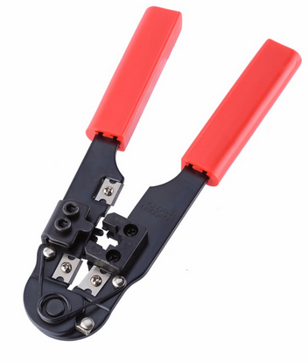
Termination tools
Snip
Crimp
Notes:
Snips
Wire stripper
Crimper
Punch down tool
A crimper with built-in snips and wire stripper.

Slide 128
Terminating twisted-pair cables
One of the most important things for you to know is how to terminate Cat5, Cat5e or Cat6 network cables with RJ45 connectors
Notes:
When you terminate a twisted-pair cable, the most important thing is that the wires are in the right order on both ends: otherwise, it won't work properly.
https://www.cableorganizer.com/learning-center/how-to/how-to-terminate-RJ45.htm

Slide 129
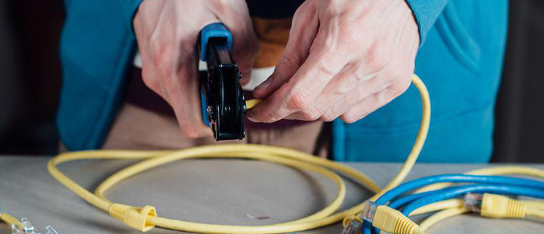
Terminating twisted-pair cables
One of the most important things for you to know is how to terminate Cat5, Cat5e or Cat6 network cables with RJ45 connectors
Notes:
When you terminate a twisted-pair cable, the most important thing is that the wires are in the right order on both ends: otherwise, it won't work properly.
https://www.cableorganizer.com/learning-center/how-to/how-to-terminate-RJ45.htm

Slide 130
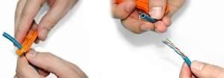
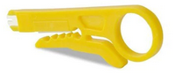
Terminating twisted-pair cables (Cont.)
Using a Crimping Tool, trim the end of the cable you're terminating, to ensure that the ends of the conducting wires are even
Being careful not to damage the inner conducting wires, strip off approximately 1 inch of the cable's jacket, using a modular crimping tool or a UTP cable stripper.

Slide 131
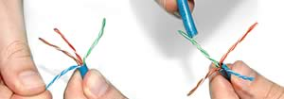
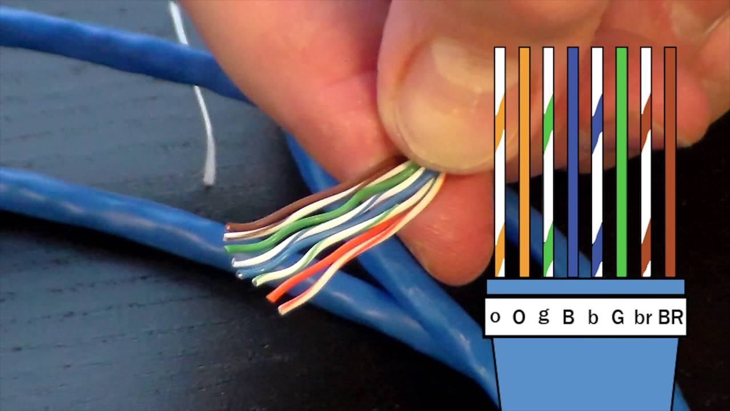
Terminating twisted-pair cables (Cont.)
Separate the 4 twisted wire pairs from each other, and then unwind each pair, so that you end up with 8 individual wires. Flatten the wires out as much as possible, since they'll need to be very straight for proper insertion into the connector.
Holding the cable with the wire ends facing away from you. Moving from left to right, arrange the wires in a flat, side-by-side ribbon formation, placing them in the following order: white/orange, solid orange, white/green, solid blue, white/blue, solid green, white/brown, solid brown.

Slide 132
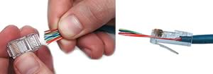
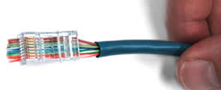
Terminating twisted-pair cables (Cont.)
Holding the RJ45 connector so that its pins are facing away from you and the plug-clip side is facing down, carefully insert the flattened, arranged wires into the connector, pushing through until the wire ends emerge from the pins. For strength of connection, also push as much of the cable jacket as possible into the connector.
Check to make sure that the wire ends coming out of the connector's pin side are in the correct order; if not, remove them from the connector, rearrange into proper formation, and re-insert. Remember, once the connector is crimped onto the cable, it's permanent. If you realize that a mistake has been made in wire order after termination, you'll have to cut the connector off and start all over again!If you're adding a cable boot, slide it on now and keep it out of the way.

Slide 133
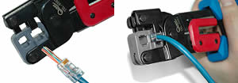
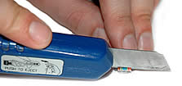
Terminating twisted-pair cables (Cont.)
Insert the prepared connector/cable assembly into the RJ45 slot in your crimping tool. Firmly squeeze the crimper's handles together until you can't go any further. Release the handles and repeat this step to ensure a proper crimp.
If your crimper doesn't automatically trim the wire ends upon termination, carefully cut wire ends to make them as flush with the connector's surface as possible. The closer the wire ends are trimmed, the better your final plug-in connection will be.

Slide 134
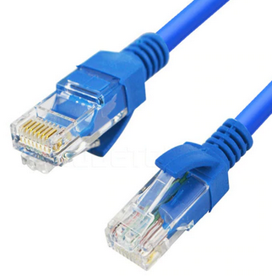
Terminating twisted-pair cables (Cont.)
After the first termination is complete, repeat process on the opposite end of your cable

Slide 135
Discussion: Twisted-pair connectors

Slide 136
Coaxial cables
An electrical cable which transmits radio frequency (RF) signals from one point to another
Mainly used to connect satellite antenna facilities to homes and businesses thanks to their durability and ease of installation
Notes:
Coaxial cable, sometimes known as coax cable, is an electrical cable which transmits radio frequency (RF) signals from one point to another.
The technology has been around since the early 20th century, with these cables mainly being used to connect satellite antenna facilities to homes and businesses thanks to their durability and ease of installation.

Slide 137
RG standards
Name | Core diameter | Outside diameter | Impedance | Uses
RG-59 | 0.64 mm | 6.1 mm | 75 ohms | Common for baseband video and older cable television systems. Not reliable for broadband network connections.
RG-6 | 1 mm | 6.86 mm | 75 ohms | Standard for newer digital cable, satellite, and cable modem connections. Essentially a higher-grade RG-59.
RG-11 | 1.63 mm | 10.5 mm | 75 ohms | Used for the same purposes as RG-6, but usually only for long distance drops and underground cables. Low loss for video
RG-8 | 2.17 mm | 10.3 mm | 50 ohms | Used by 10BASE5 "Thicknet" Ethernet, the first Ethernet standard. Now obsolete.
RG-58 | 0.81 mm | 5.0 mm | 50 ohms | Used by 10BASE2 "Thinnet" Ethernet, a cheaper but more limited alternative to Thicknet. Also obsolete.

Slide 138
RG Standards
RG-6 cables have larger conductors, so they provide better signal quality. They have thicker dielectric insulation
RG-59 cable is similar to the RG-6, but it has an even thinner centre conductor – domestic
RG-11 cable thicker than other types of coaxial cable. It offers a lower attenuation level than RG-6 or RG-59, meaning it can carry data for longer distances.
Notes:
Coaxial cable has a distinct thick, round shape because of its interior insulation layer. Its size makes it look very different to other types of cable, such as twisted pair or Ethernet cable. The most commons sizes of coaxial cable are RG-6, RG-11 and RG-59 – some of the size differences are demonstrated in the image.
Coaxial cables are available in a variety of colours including black, brown and white.
RG-6 cables have larger conductors, so they provide better signal quality. They have thicker dielectric insulation
RG-59 cable is similar to the RG-6, but it has an even thinner centre conductor mainly used in domestic
RG-11 cable is easily identifiable as it’s thicker than other types of coaxial cable, which can make it more difficult to work with. However, it offers a lower attenuation level than RG-6 or RG-59, meaning it can carry data for longer distances.

Slide 139
ISO/IEC 11801 standard
Common name | ISO/IEC 11801 name | Frequency | Description/Use
Cat 1 | Class A | 100 kHz | Low-speed cable used for older voice telephone installations. Not for use in data networks.
Cat 2 | Class B | 1 MHz | Used in older data networks like ARCnet and early Token Ring.
Cat 3 | Class C | 16 MHz | Used in early Ethernet; unsuitable for faster networks, but still used for voice telephone cables.
Cat 4 | Not standard | 20 MHz | Used by early Ethernet and some Token Ring networks but was never common.
Cat 5 | Class D | 100MHz | Widely used for Fast Ethernet and Gigabit Ethernet networks, also used for telephone and video. Superseded by Cat5e.

Slide 140
ISO/IEC 11801 standard (Cont.)
Common name | ISO/IEC 11801 name | Frequency | Description/Use
Cat 5e | Class D | 100 MHz | Category 5 Enhanced. Same overall properties as Cat5, but higher testing standards.
Cat 6 | Class E | 250 MHz | Stronger crosstalk specifications than Cat 5e. Popular for new Gigabit Ethernet installations and short distance 10 Gigabit Ethernet networks. Frequently shielded for additional EMI protection; if so, the shielding needs a grounded connection.
Cat 6a | Class Ea | 500 MHz | Augmented Category 6. Shielded and allows full distance 10 Gigabit Ethernet operation.
Cat 7 | Class F | 600 MHz | Similar to Cat6a but screened and shielded for higher noise resistance.
Cat 7a | Class Fa | 1000 MHz | Augmented Category 7. May be suitable for emerging 40 Gigabit Ethernet.

Slide 141
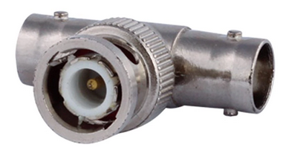
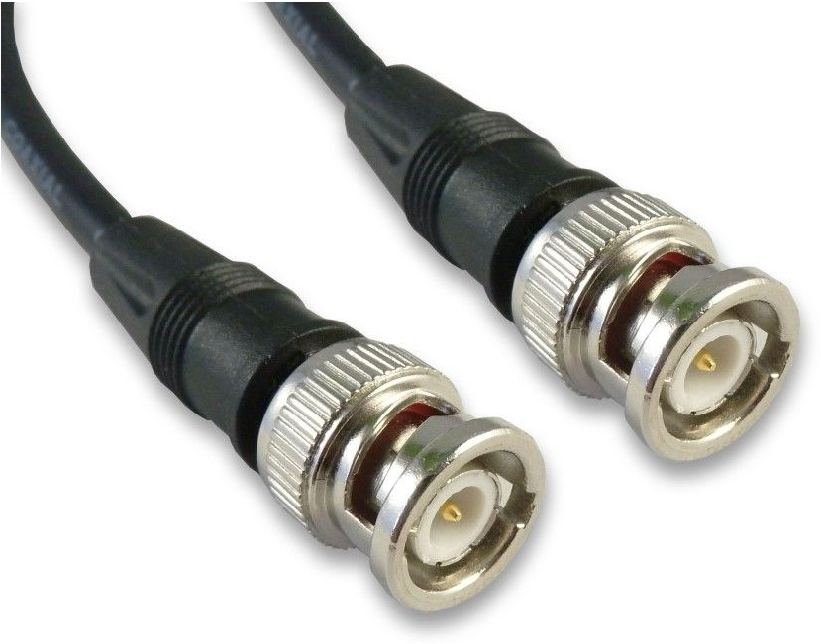
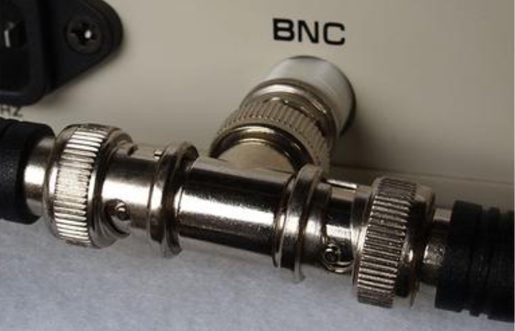
Coaxial connectors
A BNC connector, along with a T connector used for legacy Ethernet

Slide 142
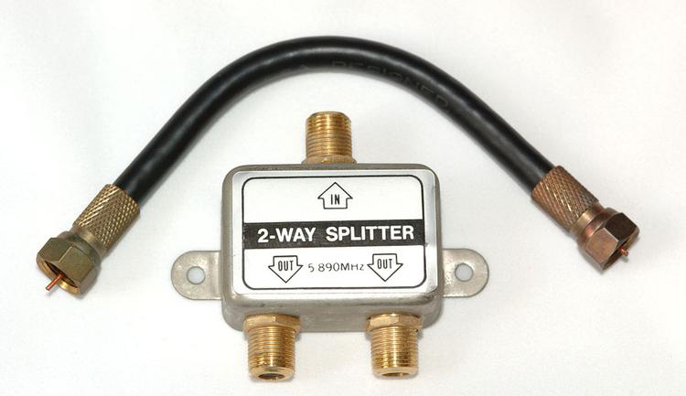
Coaxial connectors (Cont.)
A cable with F connectors, along with a splitter

Slide 143
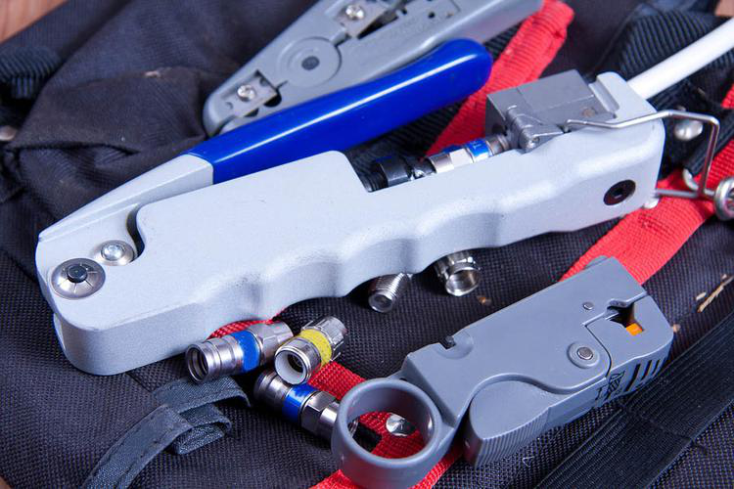
Terminating coaxial cables
Coaxial termination tools

Slide 144
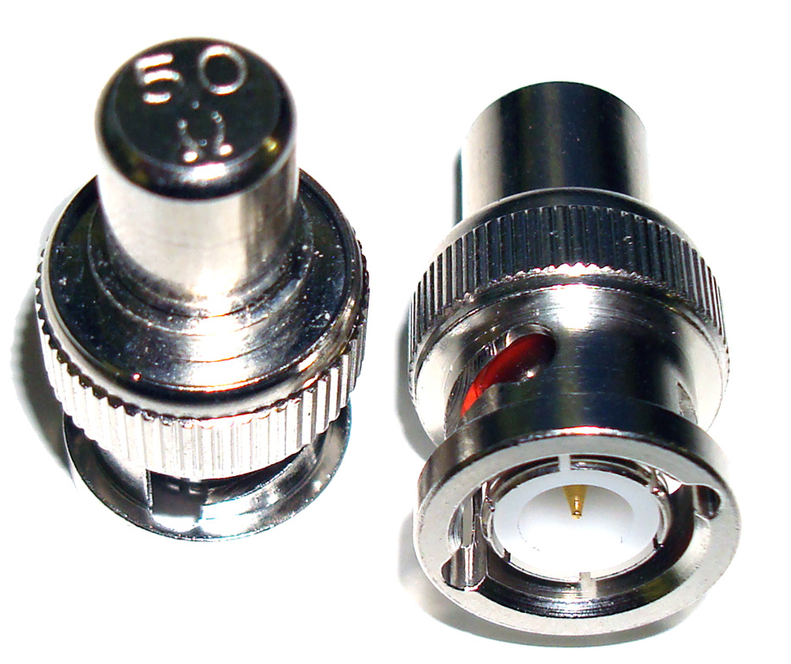
BNC Terminator
Usually 50 Ohm or 75 Ohm
The practice of ending a transmission line with a device that matches the characteristic impedance of the line
Notes:
Terminators are simple devices that electrically terminate RF coaxial ports. BNC terminator absorbs the electrical energy of the signal as it reaches the ends of cable and avoids reflection of signals.
The practice of ending a transmission line with a device that matches the characteristic impedance of the line. This is intended to prevent signals from reflecting off the end of the transmission line. Reflections at the ends of unterminated transmission lines cause distortion

Slide 145
Discussion: Coaxial media

