Slide 1
Deploying a web app and SQL Database to Azure

Slide 2
Set up Azure Account
You must use your student credits and student Microsoft account.
Ensure your account is free
Do not add you own payment card!!!!
You can run up a bill allocating servers very quickly, so ensure you set it to a minimal specification and keep an eye on your student subscription account.
You can download an csv spreadsheet to see the breakdown of your account.
With your student account you get £100 credits free

Slide 3
Tutorial
https://youtu.be/POWm4EfU9bA
Good tutorial to follow
Look at the one I created it is deployed on Azure
https://collegewebform.azurewebsites.net

Slide 4
You tube Tutorial - Note Dashboard is older version
Set up web app and create resource group
Set up server (be careful not to over allocate resources your balance will drain quickly)
Download SSMS - SQL Management Server database
Log in and create database
Then go into Visual studio and create app

Slide 5
SQL management Server
Download
SSMS
Download SQL Server Management Studio (SSMS) - SQL Server Management Studio (SSMS) | Microsoft Docs

Slide 6
Server Name copy your clipboard – log into SSMS

Slide 7
Remember
Don’t forget your login & Password
Firewall must be configured

Slide 8
Visual Studio
Follow tutorial and create webform
Don’t forget to click on design view and toolbox

Slide 9
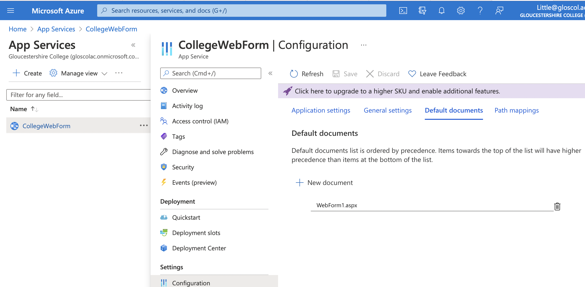
Visual Studio
Configuration setting for web.config file
Default Document <defaultDocument> | Microsoft Docs
This may not work, if it doesn’t delete it and ensure you set it in azure as the default document instead. See below screenshot

Slide 10
Common Errors
Proof read – look out for capital letters and ; and closing {}
In Azure make sure you set your webform to the default page. It will try to load another page
Take out {} in password in the connection string when you add your own
Make sure its version 4.8 when setting asp.net in azure

Slide 11
Tip to get the database data to pull back into the app
In toolbox look at grid view in DATA
This will add a grid and take you through a wizard to connect to your azure database and display the results

Slide 12
Grid view – Example code, but use the toolbox wizard instead it is easier. It generates the code for you.

