Slide 1
2.0 Infrastructure
18%
2.1 Given a scenario, deploy the appropriate cabling solution
2.2 Given a scenario, determine the appropriate placement of networking devices on a network and install/configure them
2.3 Explain the purposes and use cases for advanced networking devices
2.4 Explain the purposes of virtualization and network storage technologies
2.5 Compare and contrast WAN technologies

Slide 2
2.1 Given a scenario, deploy the appropriate cabling solution
Media types
Copper
UTP
STP
Coaxial
Fiber
Single-mode
Multimode
Plenum vs. PVC
Connector types
Copper
RJ-45
RJ-11
BNC
DB-9
DB-25
F-type
Connector types
Fiber
LC
ST
SC
APC
UPC
MTRJ

Slide 3
Twisted-pair cable properties

Slide 4
Twisted-pair cable properties (Cont.)
Unshielded twisted-pair (UTP) is just like it sounds: It has no additional shielding and relies entirely on the twisted-pair effect to combat interference
Foil shielding uses a grounded foil wrap to provide additional electromagnetic shielding
Braided screening uses a braided copper jacket around the cable to provide shielding
Notes:
Unshielded twisted-pair (UTP) is just like it sounds: It has no additional shielding and relies entirely on the twisted-pair effect to combat interference.
Foil shielding uses a grounded foil wrap to provide additional electromagnetic shielding. The foil can be placed around each individual pair (U/FTP), around the outer cable (F/UTP), or both (F/FTP)
Braided screening uses a braided copper jacket around the cable to provide shielding. It can be used around otherwise unshielded cable (S/UTP) or in conjunction with foil shielding (S/FTP and SF/FTP).

Slide 5
F/UTP cable with the foil shielding unwrapped

Slide 6
Twisted-pair standards
The ISO/IEC 11801 standard defines several classes of cable
Each is able to support a given maximum transmission frequency over the distances used in most LAN installations
In practice, you usually hear these standards called by numbered categories, with a given category called "Cat" for short: Cat3, Cat5, Cat5e, etc.
Notes:
The ISO/IEC 11801 standard defines several classes of cable, each able to support a given maximum transmission frequency over the distances used in most LAN installations
In practice, you usually hear these standards called by numbered categories, with a given category called "Cat" for short: Cat3, Cat5, Cat5e, etc.

Slide 7
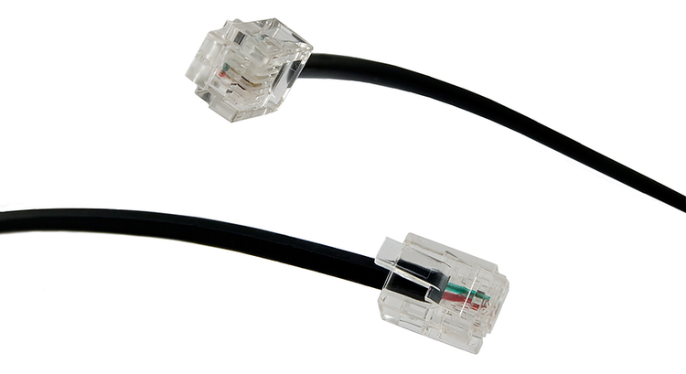
Twisted-pair connectors
Modular connectors are described by the number of positions (P) and contacts (C) they use. The number of positions determines the size of the connector, while the number of contacts determines how many wires can be connected.

Slide 8
Wiring standards

Slide 9
Wiring standards
Pin | T568A Pair | T568A Color | T568B Pair | T568B Color
1 | 3 | White/Green | 2 | White/Orange
2 | 3 | Green | 2 | Orange
3 | 2 | White/Orange | 3 | White/Green
4 | 1 | Blue | 1 | Blue
5 | 1 | White/Blue | 1 | White/Blue
6 | 2 | Orange | 3 | Green
7 | 4 | White/Brown | 4 | White/Brown
8 | 4 | Brown | 4 | Brown

Slide 10
Straight-through and crossover cables

Slide 11
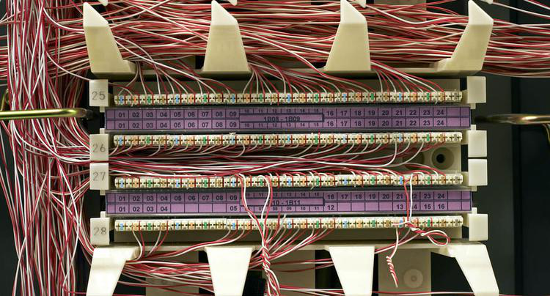
Centralized connections
All network and telephone cables are terminated to a common distribution frame
Usually on a device called a punchdown block
The block is so-named because a special tool is used to punch each wire down onto a bladed contact that punctures its insulation and holds it into place
Notes:
All network and telephone cables are terminated not with modular connectors, but to a common distribution frame, usually on a device called a punchdown block. The block is so-named because a special tool is used to punch each wire down onto a bladed contact that punctures its insulation and holds it into place.

Slide 12
Punch down Block

Slide 13
A patch panel alongside a switch
https://www.racksolutions.com/news/data-center-trends/cable-management/cable-management-strategies/

Slide 14
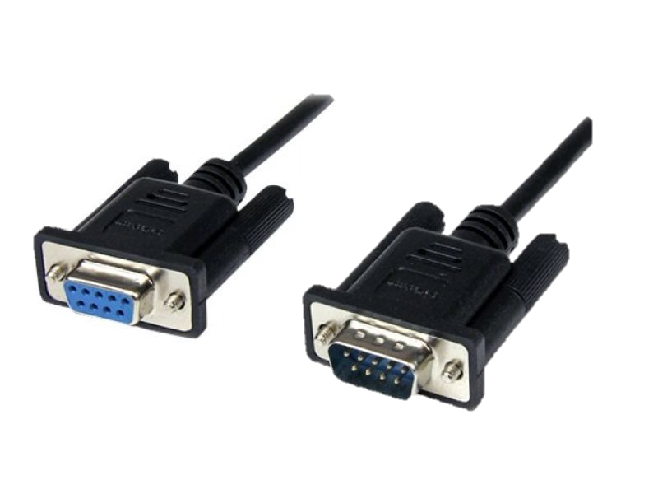
RS-232 connectors
On older PCs, RS-232 connections were simply called "serial ports"
Used for all sorts of peripheral devices like modems, printers, and mice.
RS-232 connectors use D-sub ports
Notes:
On older PCs, RS-232 connections were simply called "serial ports" and would be used for all sorts of peripheral devices like modems, printers, and mice.
RS-232 connectors use D-sub ports, easily recognizable by their D shape and metal shields.

Slide 15
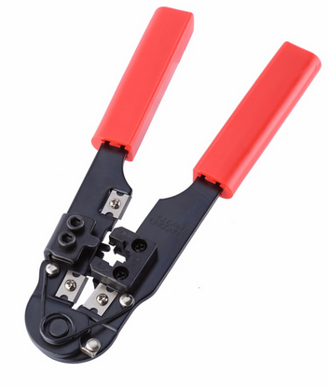
Termination tools
Snip
Crimp
Notes:
Snips
Wire stripper
Crimper
Punch down tool
A crimper with built-in snips and wire stripper.

Slide 16
Terminating twisted-pair cables
One of the most important things for you to know is how to terminate Cat5, Cat5e or Cat6 network cables with RJ45 connectors
Notes:
When you terminate a twisted-pair cable, the most important thing is that the wires are in the right order on both ends: otherwise, it won't work properly.
https://www.cableorganizer.com/learning-center/how-to/how-to-terminate-RJ45.htm

Slide 17
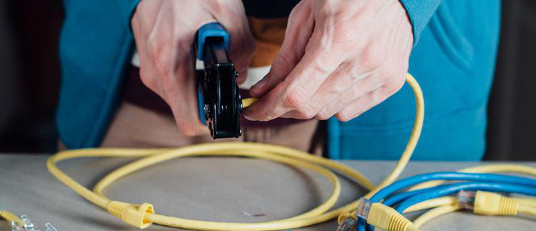
Terminating twisted-pair cables
One of the most important things for you to know is how to terminate Cat5, Cat5e or Cat6 network cables with RJ45 connectors
Notes:
When you terminate a twisted-pair cable, the most important thing is that the wires are in the right order on both ends: otherwise, it won't work properly.
https://www.cableorganizer.com/learning-center/how-to/how-to-terminate-RJ45.htm

Slide 18
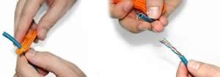
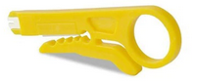
Terminating twisted-pair cables (Cont.)
Using a Crimping Tool, trim the end of the cable you're terminating, to ensure that the ends of the conducting wires are even
Being careful not to damage the inner conducting wires, strip off approximately 1 inch of the cable's jacket, using a modular crimping tool or a UTP cable stripper.

Slide 19
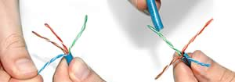
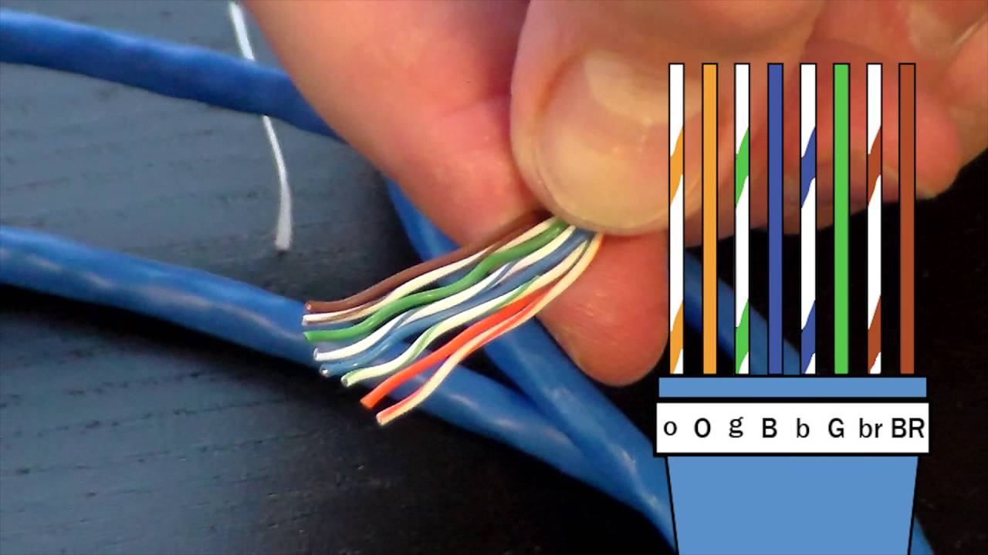
Terminating twisted-pair cables (Cont.)
Separate the 4 twisted wire pairs from each other, and then unwind each pair, so that you end up with 8 individual wires. Flatten the wires out as much as possible, since they'll need to be very straight for proper insertion into the connector.
Holding the cable with the wire ends facing away from you. Moving from left to right, arrange the wires in a flat, side-by-side ribbon formation, placing them in the following order: white/orange, solid orange, white/green, solid blue, white/blue, solid green, white/brown, solid brown.

Slide 20
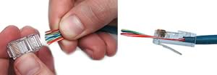
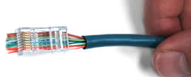
Terminating twisted-pair cables (Cont.)
Holding the RJ45 connector so that its pins are facing away from you and the plug-clip side is facing down, carefully insert the flattened, arranged wires into the connector, pushing through until the wire ends emerge from the pins. For strength of connection, also push as much of the cable jacket as possible into the connector.
Check to make sure that the wire ends coming out of the connector's pin side are in the correct order; if not, remove them from the connector, rearrange into proper formation, and re-insert. Remember, once the connector is crimped onto the cable, it's permanent. If you realize that a mistake has been made in wire order after termination, you'll have to cut the connector off and start all over again!If you're adding a cable boot, slide it on now and keep it out of the way.

Slide 21
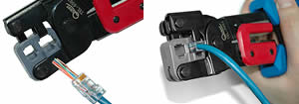
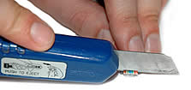
Terminating twisted-pair cables (Cont.)
Insert the prepared connector/cable assembly into the RJ45 slot in your crimping tool. Firmly squeeze the crimper's handles together until you can't go any further. Release the handles and repeat this step to ensure a proper crimp.
If your crimper doesn't automatically trim the wire ends upon termination, carefully cut wire ends to make them as flush with the connector's surface as possible. The closer the wire ends are trimmed, the better your final plug-in connection will be.

Slide 22
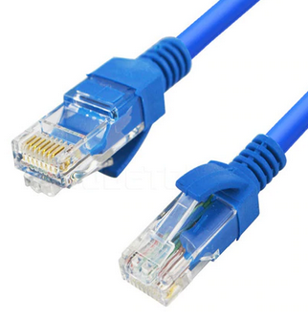
Terminating twisted-pair cables (Cont.)
After the first termination is complete, repeat process on the opposite end of your cable

Slide 23
Discussion: Twisted-pair connectors

Slide 24
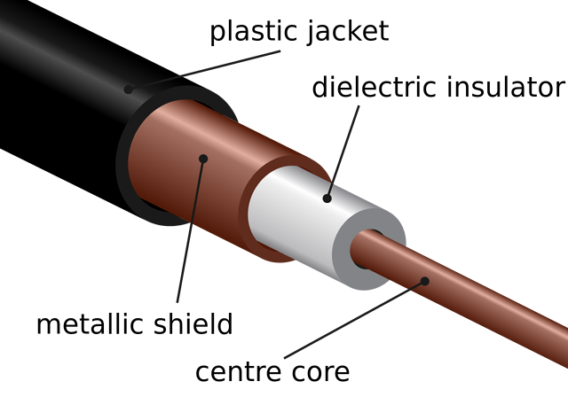
Coaxial cables
An electrical cable which transmits radio frequency (RF) signals from one point to another
Mainly used to connect satellite antenna facilities to homes and businesses thanks to their durability and ease of installation
Notes:
Coaxial cable, sometimes known as coax cable, is an electrical cable which transmits radio frequency (RF) signals from one point to another.
The technology has been around since the early 20th century, with these cables mainly being used to connect satellite antenna facilities to homes and businesses thanks to their durability and ease of installation.

Slide 25
RG standards
Name | Core diameter | Outside diameter | Impedance | Uses
RG-59 | 0.64 mm | 6.1 mm | 75 ohms | Common for baseband video and older cable television systems. Not reliable for broadband network connections.
RG-6 | 1 mm | 6.86 mm | 75 ohms | Standard for newer digital cable, satellite, and cable modem connections. Essentially a higher-grade RG-59.
RG-11 | 1.63 mm | 10.5 mm | 75 ohms | Used for the same purposes as RG-6, but usually only for long distance drops and underground cables. Low loss for video
RG-8 | 2.17 mm | 10.3 mm | 50 ohms | Used by 10BASE5 "Thicknet" Ethernet, the first Ethernet standard. Now obsolete.
RG-58 | 0.81 mm | 5.0 mm | 50 ohms | Used by 10BASE2 "Thinnet" Ethernet, a cheaper but more limited alternative to Thicknet. Also obsolete.

Slide 26
RG Standards
RG-6 cables have larger conductors, so they provide better signal quality. They have thicker dielectric insulation
RG-59 cable is similar to the RG-6, but it has an even thinner centre conductor – domestic
RG-11 cable thicker than other types of coaxial cable. It offers a lower attenuation level than RG-6 or RG-59, meaning it can carry data for longer distances.
Notes:
Coaxial cable has a distinct thick, round shape because of its interior insulation layer. Its size makes it look very different to other types of cable, such as twisted pair or Ethernet cable. The most commons sizes of coaxial cable are RG-6, RG-11 and RG-59 – some of the size differences are demonstrated in the image.
Coaxial cables are available in a variety of colours including black, brown and white.
RG-6 cables have larger conductors, so they provide better signal quality. They have thicker dielectric insulation
RG-59 cable is similar to the RG-6, but it has an even thinner centre conductor mainly used in domestic
RG-11 cable is easily identifiable as it’s thicker than other types of coaxial cable, which can make it more difficult to work with. However, it offers a lower attenuation level than RG-6 or RG-59, meaning it can carry data for longer distances.

Slide 27
ISO/IEC 11801 standard
Common name | ISO/IEC 11801 name | Frequency | Description/Use
Cat 1 | Class A | 100 kHz | Low-speed cable used for older voice telephone installations. Not for use in data networks.
Cat 2 | Class B | 1 MHz | Used in older data networks like ARCnet and early Token Ring.
Cat 3 | Class C | 16 MHz | Used in early Ethernet; unsuitable for faster networks, but still used for voice telephone cables.
Cat 4 | Not standard | 20 MHz | Used by early Ethernet and some Token Ring networks but was never common.
Cat 5 | Class D | 100MHz | Widely used for Fast Ethernet and Gigabit Ethernet networks, also used for telephone and video. Superseded by Cat5e.

Slide 28
ISO/IEC 11801 standard (Cont.)
Common name | ISO/IEC 11801 name | Frequency | Description/Use
Cat 5e | Class D | 100 MHz | Category 5 Enhanced. Same overall properties as Cat5, but higher testing standards.
Cat 6 | Class E | 250 MHz | Stronger crosstalk specifications than Cat 5e. Popular for new Gigabit Ethernet installations and short distance 10 Gigabit Ethernet networks. Frequently shielded for additional EMI protection; if so, the shielding needs a grounded connection.
Cat 6a | Class Ea | 500 MHz | Augmented Category 6. Shielded and allows full distance 10 Gigabit Ethernet operation.
Cat 7 | Class F | 600 MHz | Similar to Cat6a but screened and shielded for higher noise resistance.
Cat 7a | Class Fa | 1000 MHz | Augmented Category 7. May be suitable for emerging 40 Gigabit Ethernet.

Slide 29
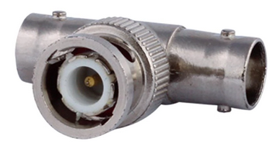
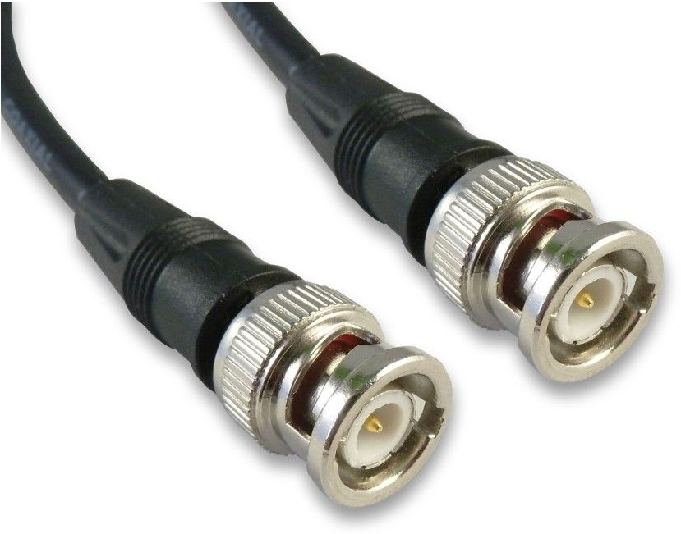
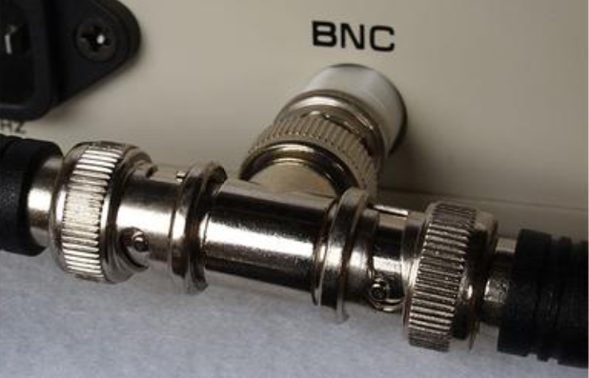
Coaxial connectors
A BNC connector, along with a T connector used for legacy Ethernet

Slide 30
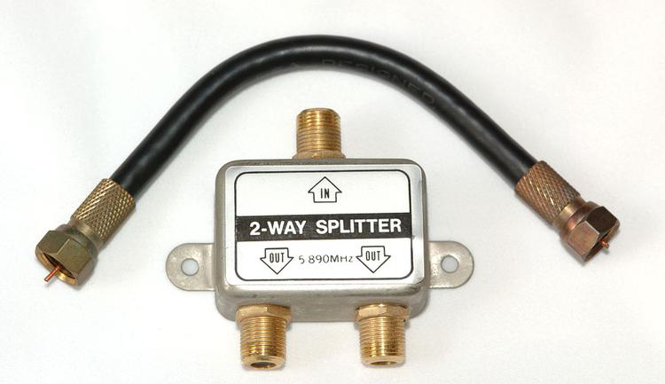
Coaxial connectors (Cont.)
A cable with F connectors, along with a splitter

Slide 31
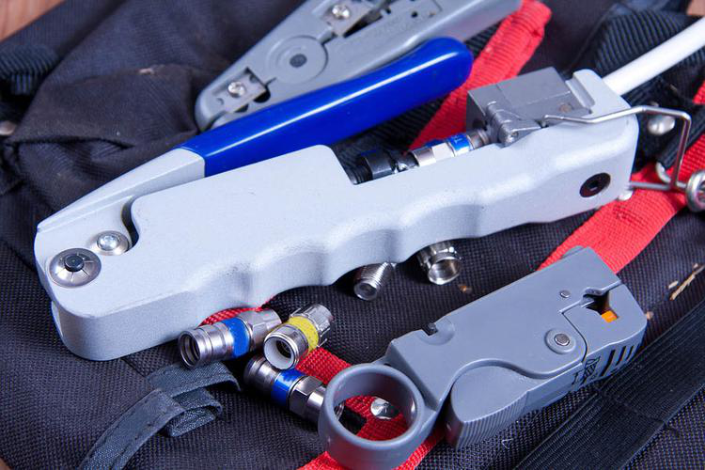
Terminating coaxial cables
Coaxial termination tools

Slide 32
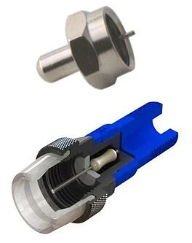
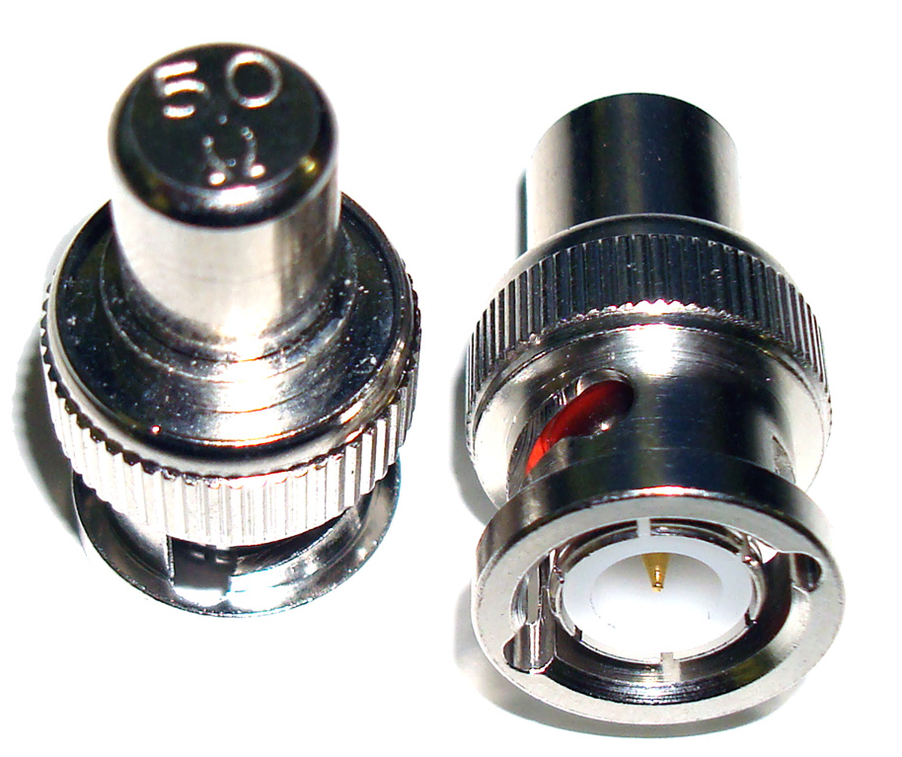
BNC Terminator
Usually 50 Ohm or 75 Ohm
The practice of ending a transmission line with a device that matches the characteristic impedance of the line
Notes:
Terminators are simple devices that electrically terminate RF coaxial ports. BNC terminator absorbs the electrical energy of the signal as it reaches the ends of cable and avoids reflection of signals.
The practice of ending a transmission line with a device that matches the characteristic impedance of the line. This is intended to prevent signals from reflecting off the end of the transmission line. Reflections at the ends of unterminated transmission lines cause distortion

Slide 33
Optical fibers

Slide 34
Fiber types
Notes:
SMF – Single mode Fibre
MMF – Multi-mode Fibre

Slide 35
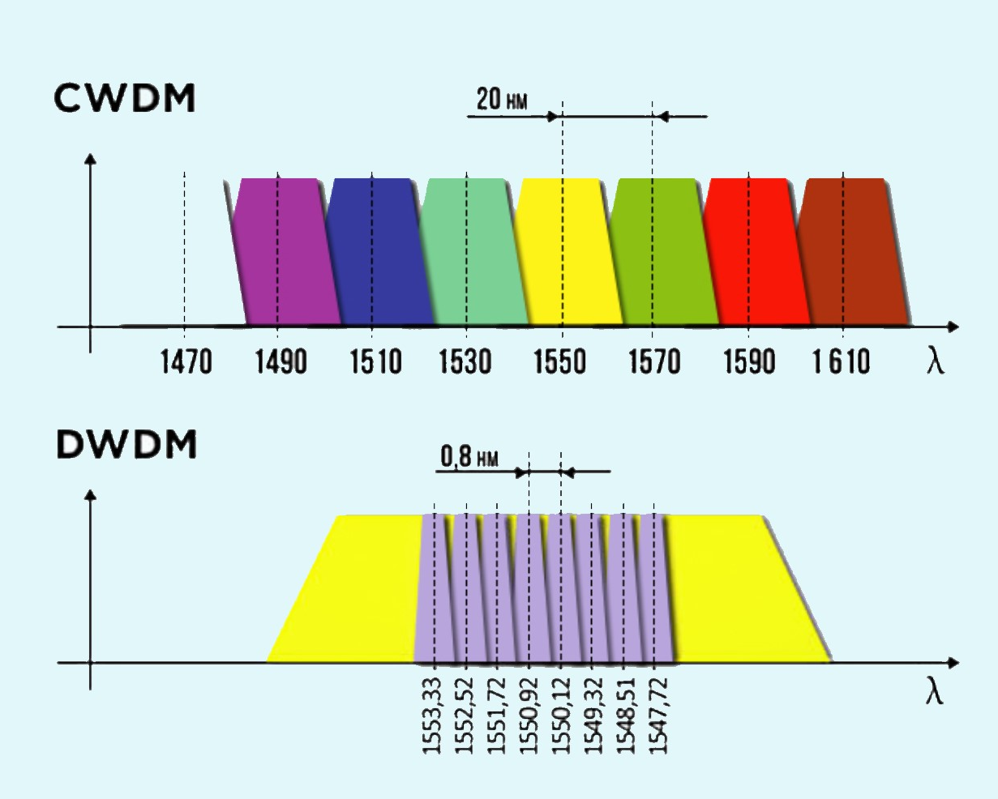
Wavelength-division multiplexing
Notes:
The two key WDM technologies are Coarse Wavelength Division Multiplexing, CWDM and Dense Wavelength Division Multiplexing, DWDM. Which solution is best suited to a given environment depends on the network and user requirements.
Coarse wavelength division multiplexing (CWDM) is a wavelength division multiplexing (WDM) technology that combines multiple signals at various wavelengths for simultaneous transmission over fibre cables.
CWDM supports up to 18 wavelength channels transmitted through a fibre at the same time. To achieve this, the different wavelengths of each channel are 20nm apart. DWDM, supports up to 80 simultaneous wavelength channels, with each of the channels only 0.8nm apart. CWDM technology offers a convenient and cost-efficient solution for shorter distances of up to 70 kilometres. For distances between 40 and 70 kilometres, CWDM tends to be limited to supporting eight channels.

Slide 36
CWDM and DWDM Statistics
 | DWDM | CWDM
Distance | 70km unamplified | 80km unamplified
 | 1000km+ amplified | Not applicable
Channels | 88 (Using interleaver) | 18 (Distances limited in the water peak)
Spacing | 0.8nm | 20nm
Protocols | All including 100G and beyond: 1/10/40/100GE and 8/16/32GFC | Up to 10GE and 8GFC (40G using 4x10G CWDM)

Slide 37
Optical fiber connectors
The industry standard connectors are rigid ferrule connectors and can be broken down into four categories:
Flat
PC
UPC
APC
Notes:
Fiber Optics Flat: Flat polish connector. These connectors are polished by the manufacturer typically have an attenuation of -30dB. Flat polish connectors control back reflection fairly well
Fiber Optics PC: Physical contact polish. These connectors are hand polished and typically have an attenuation of -30dB. PC refers to how the ferrule of the connector is polished. These connectors can cause back reflection into the ferrule and into the transmitter.
Fiber Optics SPC/UPC: SUPER POLISH CONTACT
Done by the manufacturer. -40db ULTRA POLISH CONTACT, done by the manufacturer. -50db These finishes are to help prevent back reflection into the transmitter.
Fiber Optics APC: Angled physical contact. This is done by the manufacturer, they cut the ferrule to an 8 degree angle to reduce back reflection. These connectors have an attenuation of -60dB and are used by CATV and Phone companies.

Slide 38
Optical Cable Assembly

Slide 39
Couplers and splitters
A fiber coupler is a type of splitter, where multiple fibers on one end are fused to join at a single core.
An optical coupler can be used just like a coaxial splitter, to send a single input to multiple outputs.
One thing you can't do is combine multiple inputs of the same wavelength to a single output, since they'll only interfere with each other.

Slide 40
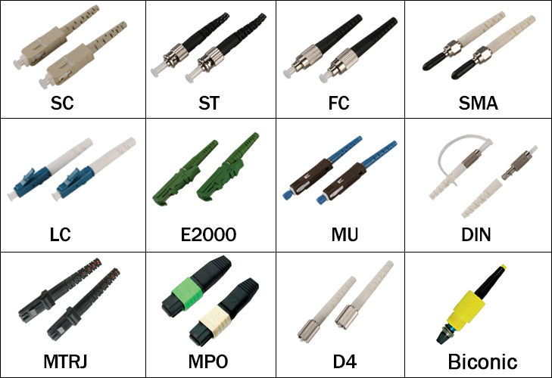
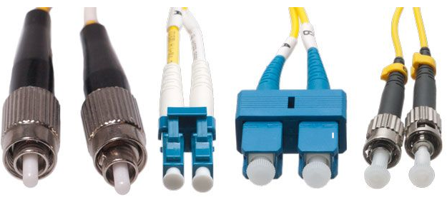
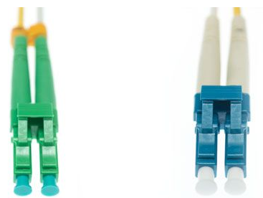
Optical connector standards
Notes:
From left to right: FC, LC, SC, and ST
A green color-coded APC connector (left) vs. a UPC connector (right)

Slide 41
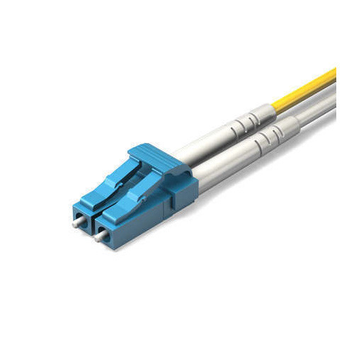
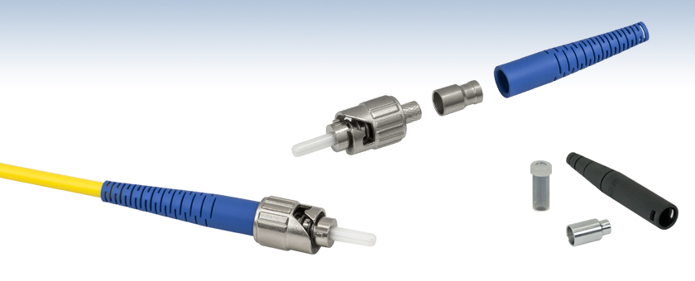
Most Common Connectors
ST
LC
SC
Notes:
SC – Subscriber Connector
The ST (straight tip connector) historically has been the most commonly used connector in the industry up to several years ago, it was not originally recognized by the standards but was added because of it’s prevalence in the industry.
The duplex SC (subscriber connector) was the first connector to be recognized by the TIA/EIA fibre standards because of it’s ease of inter-connectability and it represents a complete link (1 connector for TX the other for RX).
The new standard in fibre connectors is the LC (Lucent connector). These are small form factor (SFF) connectors that take up less space in a fibre panel.

Slide 42
2.1 Given a scenario, deploy the appropriate cabling solution
Transceivers
SFP
GBIC
SFP+
QSFP
Characteristics of fiber transceivers
Bidirectional
Duplex
Termination points
66 block
110 block
Patch panel
Fiber distribution panel
Copper cable standards
Cat 3
Cat 5
Cat 5e
Cat 6
Cat 6a
Cat 7
RG-6
RG-59

Slide 43
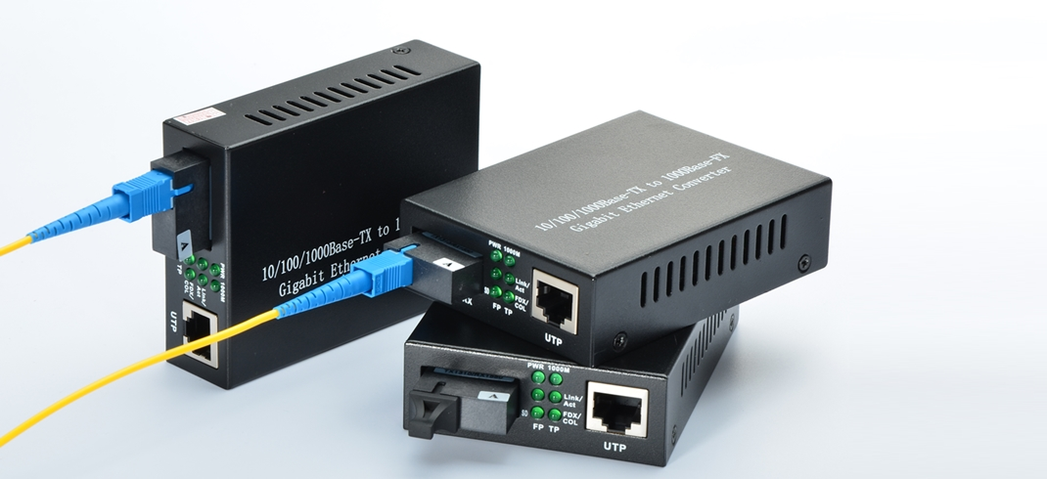
Media converters

Slide 44
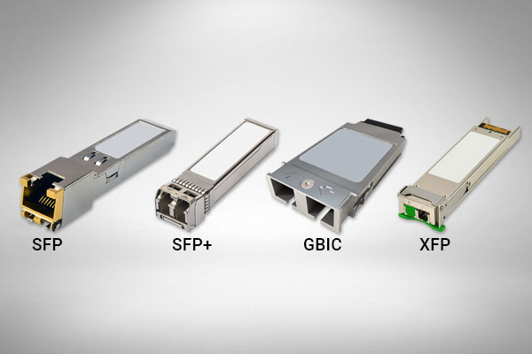
Modular transceivers
GBIC transceivers are visibly larger than those in the SFP family
GBIC
SFP
XFP
SFP+
QSFP
Notes:
A gigabit interface converter (GBIC) is a transceiver that converts electric currents (digital highs and lows) to optical signals, and optical signals to digital electric currents.
The GBIC is typically employed in fibre optic and Ethernet systems as an interface for high-speed networking.
A smaller variation of the GBIC called the small form-factor pluggable transceiver (SFP), also known as mini-GBIC, has the same functionality but in a smaller form factor. It largely made the GBIC obsolete.

Slide 45
2.1 Given a scenario, deploy the appropriate cabling solution
Copper termination standards
TIA/EIA 568a
TIA/EIA 568b
Crossover
Straight-through
Ethernet deployment standards
100BaseT
1000BaseT
1000BaseLX
1000BaseSX
10GBaseT

Slide 46
2.2 Given a scenario, determine the appropriate placement of networking devices on a network and install/configure them
Firewall
Router
Switch
Hub
Bridge
Modems
Wireless access point
Media converter
Wireless range extender
VoIP endpoint

Slide 47
Repeaters
A repeater, sometimes also called an extender, is a device made to enable connections over longer distances.
Degraded Signal
Strong Signal
LAN
LAN
Building
Building
Repeater

Slide 48
Hubs
A hub is a Layer 1 device that connects multiple nodes into a star configuration.
Hub
Notes:
A HUB is an unsophisticated device in comparison with a switch.
It works by repeating transmissions received from one of its ports to all other ports

Slide 49
Collision domains
In the original Ethernet specification, a segment was a single coaxial cable
This meant three things:
The segment had a maximum total length, governed by the cable's attenuation.
Since a node contributes to attenuation, the segment could support a fixed number of total nodes.
The segment is a single collision domain - any two nodes on the segment transmitting at once causes a collision.
Notes:
The term network segment usually refers to a small part of a larger network, but it can mean different things depending on context. In the original Ethernet specification, a segment was a single coaxial cable. This meant three things.
The segment had a maximum total length, governed by the cable's attenuation.
Since a node contributes to attenuation, the segment could support a fixed number of total nodes.
The segment is a single collision domain - any two nodes on the segment transmitting at once causes a collision.

Slide 50
Layer 2 devices
A Layer 2 device doesn't pass data on blindly
It must be able to read the Data Link Layer frames that reach it to determine how to handle them
It must also be able to create new ones

Slide 51
Bridges
A bridge is a bit like a repeater
Creates a single aggregate network from multiple communication networks or network segments
STOP
Packet
Packet
Bridge
Hub
Notes:
Except, instead of linking two electrical segments, it links two or more Layer 1 segments, or collision domains, into a larger network

Slide 52
Bridges
A bridge has a MAC table in memory
Bridges only forward frames that are required to cross the bridge
Additionally, bridges reduce collisions by creating a separate collision domain on either side of the bridge
#2
#1
A
B
C
Bridge
#3
#4
Notes:
A bridge has a MAC table in memory: A list of MAC addresses on the network, and which side of the bridge they're on.
Bridges only forward frames that are required to cross the bridge
Additionally, bridges reduce collisions by creating a separate collision domain on either side of the bridge

Slide 53
Translating bridges
A translating bridge can even join segments using different layer 2 protocols, by translating frames from one format into the other.
W
E
E
Hub
W
Notes:
A type of bridge that interconnects two different types of LAN protocols, such as Ethernet and Token Ring. Translating bridges are generally very complicated devices

Slide 54
Switches
A Layer 2 switch is nothing more than a bridge with three or more ports, just like a hub is to a repeater.
Notes:
A type of network switch or device that works on the data link layer (OSI Layer 2) and utilizes MAC Address to determine the path through where the frames are to be forwarded
Can also be referred to as a multiport bridge

Slide 55
Broadcast domains
Switches transparently forward frames
Therefore any node on the network can still communicate directly to any other node using its MAC address
Can broadcast to the entire bridged network at once by using a broadcast address (FF:FF:FF:FF:FF:FF in MAC-based networks)
since bridges and switches automatically flood broadcast frames
This defines a Layer 2 segment, also known as the broadcast domain
Notes:
Since switches transparently forward frames, any node on the network can still communicate directly to any other node using its MAC address.
It can even broadcast to the entire bridged network at once by using a broadcast address (FF:FF:FF:FF:FF:FF in MAC-based networks), since bridges and switches automatically flood broadcast frames.
This defines a Layer 2 segment, also known as the broadcast domain.

Slide 56
Discussion: Comparing Layer 2 devices

Slide 57
Layer 3 devices
Layer 3 devices, such as gateways, routers, and multilevel switches are designed to overcome problems and link far larger, more complex networks than switches alone
They segment the larger network into multiple broadcast domains, and govern traffic between them
They have more advanced routing protocols
They also use logical addresses
Notes:
Layer 3 devices, such as gateways, routers, and multilevel switches are designed to overcome problems and link far larger, more complex networks than switches alone.
They segment the larger network into multiple broadcast domains, and govern traffic between them.
They have more advanced routing protocols, letting them find paths and share network information in ways Layer 2 switches cannot.
They also use logical addresses, which are tied to the network's structure; this means they can more easily pass data in the right direction without knowing the whole network.

Slide 58
Routers
A router is a networking device that forwards data packets between computer networks
Can be a physical or virtual appliance
Inspects a given data packet's destination Internet Protocol address (IP address), calculates the best way for it to reach its destination and then forwards it accordingly
192.168.1.200
192.168.1.214
MAC: 22:33:55:44
MAC: 22:35:55:65
192.168.1.159
192.168.1.156
Server
MAC: 22:33:30:84
192.168.1.153
192.168.1.137
Notes:
Routers sit at the boundaries between broadcast domains.
Using both physical and logical address information, they gather and store information about their surrounding network topology, use it to determine the best route between any two nodes, and then forward network layer packets along it.
Routers perform the traffic directing functions on the Internet
Data sent through the internet, such as a web page or email, is in the form of data packets

Slide 59
Routers (Cont.)
A packet is typically forwarded from one router to another router through the networks that constitute an internetwork
A router is connected to two or more data lines from different IP networks
When a data packet comes in on one of the lines, the router reads the network address information in the packet header to determine the ultimate destination
Using that information in its routing table or routing policy, it directs the packet to the next network on its journey.
Notes:
To keep the network running smoothly, those routers each have to know their surroundings and the quickest path to any particular subnet, so they constantly exchange information about changes in network conditions.
A packet is typically forwarded from one router to another router through the networks that constitute an internetwork (e.g. the Internet) until it reaches its destination node
A router is connected to two or more data lines from different IP networks
When a data packet comes in on one of the lines, the router reads the network address information in the packet header to determine the ultimate destination
Then, using information in its routing table or routing policy, it directs the packet to the next network on its journey.

Slide 60
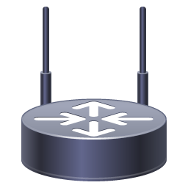
Gateways
A gateway is a node (router) in a computer network
A key stopping point for data on its way to or from other networks
With gateways, we can communicate and send data back and forth
The Internet wouldn't be any use to us without gateways
Internet
81.0.110.1
Router
192.0.2.1/24
198.51.100.1
192.0.2.2/24
198.51.100.0/24
192.0.2.104
192.0.2.148
198.51.100.104
198.51.100.10
My default gateway is
192.0.2.1
My default gateway is
198.51.100.1
Notes:
Joining two networks that use the same protocol but different addressing schemes.
Joining a LAN to a WAN, often along with related non-routing features in the same hardware device.
We could also be joining two networks that use different protocols.

Slide 61
Multilayer switches
A multilayer switch is a network device that has the ability to operate at higher layers of the OSI reference model, unlike the Data Link Layer (DLL) traditionally used by switches
A multilayer switch can perform the functions of a switch as well as that of a router at incredibly fast speeds
VLAN 3
VLAN 2
VLAN 1
VLANs 1, 2 3
Trunk
VLAN 3
VLAN 2
Multilayer
Switch
VLAN 1
Notes:
Switches that operate at higher levels of the stack are fairly common, and are called Layer 3 switches or multilayer switches depending on their exact function.
They filter and forward frames like a switch, but they can also look inside frames like a router to read network layer packets, and forward them between subnets like a router.
Some even have functions on higher levels of the stack. In short, a Layer 3 switch is one that can take over most of a router's duties.

Slide 62
2.3 Explain the purposes and use cases for advanced networking devices
Multilayer switch
Wireless controller
Load balancer
IDS/IPS
Proxy server
VPN concentrator
AAA/RADIUS server
UTM appliance
NGFW/Layer 7 firewall
VoIP PBX
VoIP gateway
Content filter

Slide 63
Placement of network devices on the network and installing/configuring them
Today, high performance TCP/IP networks augmented by additional technologies are increasingly displacing other options
Not only can the Internet be used to deliver voice and video directly, but wired and wireless providers alike are increasingly moving to all IP networks that reduce costs by combining data, voice, and media traffic into a single high-speed connection.
VOIP endpoints
IP telephones
Headsets
Conference phones

Slide 64
Network Security Appliances
A security appliance is any form of server appliance that is designed to protect computer networks from unwanted traffic.
Types of security appliances
Active devices block unwanted traffic. Examples of such devices are firewalls, anti virus scanning devices, and content filtering devices.
Passive devices detect and report on unwanted traffic, such as intrusion detection appliances.
Preventative devices scan networks and identify potential security problems (such as penetration testing and vulnerability assessment appliances).
Unified Threat Management (UTM) appliances combine features together into one system, such as some firewalls, content filtering, web caching etc.

Slide 65
VOIP PBX
There has been a massive move from landlines to Voice over IP (VoIP) for companies to save money
One of the biggest issues with the administration of this is security
By having both data and VoIP on the same line, they are both vulnerable in the case of an attack
Standard telephone systems should be replaced with a securable PBX

Slide 66
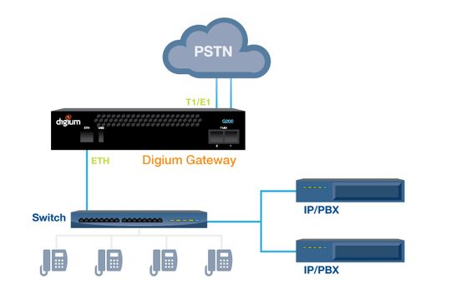
VOIP gateways
A VoIP gateway, also sometimes called a PBX gateway, can be used to convert between the legacy telephony connection and a VoIP connection using SIP (Session Initiation Protocol)
This is referred to as a “digital gateway” because the voice media are converted in the process

Slide 67
2.4 Explain the purposes of virtualization and network storage technologies
Virtual networking components
Virtual switch
Virtual firewall
Virtual NIC
Virtual router
Hypervisor
Network storage types
NAS
SAN
Connection type
FCoE
Fibre Channel
iSCSI
InfiniBand
Jumbo frame

Slide 68
About Virtualisation
There are many virtualisation technologies applying to different technology fields, but the underlying concept is the same:
changing the way users or software see and use a hardware platform by applying abstraction layers between the two

Slide 69
Virtual machines
Host
Virtual Machine (VM)
Hypervisor

Slide 70
Virtual Networking Components
Virtual switch
Virtual firewall
Virtual NIC
Virtual router
Hypervisor

Slide 71
Virtual Switch
A software program that allows one virtual machine (VM) to communicate with another
The virtual switch allows the VM to use the hardware of the host OS (the NIC) to connect to the Internet

Slide 72
Virtual Firewall
A virtual firewall (VF) is either a network firewall service or an appliance running entirely within the virtualized environment
Regardless of which implementation, a VF serves the same purpose as a physical one: packet filtering and monitoring
The firewall can also run in a guest OS VM
One key to a VF is to not overlook the contribution from Network Address Translation (NAT)
This allows an organization to present a single address (or set of addresses) to the Internet for all computer connections—it acts as a proxy between the local-area network (which can be using private IP addresses) and the Internet

Slide 73
Virtual NIC
On an isolated internal network: the VNIC is assigned an internal IP address, and can communicate only with the hypervisor and/or other VMs on the same host.
On an internal subnet: the VNIC is assigned an internal IP address, but the hypervisor performs NAT so the VM can connect to the outside network.
As a bridged adapter: the VNIC is assigned an external IP address and joined directly to the outside network. To outside observers, the VM and host will appear to be different network addresses even though they share a physical NIC.
At its most basic, the VNIC on a VM can be configured a few ways.

Slide 74
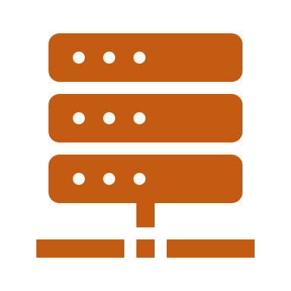
Virtual Router
A Virtual Router, or vRouter, is a software function that replicates in software the functionality of a hardware-based Layer 3 Internet Protocol (IP) routing, which has traditionally used a dedicated hardware device
vRouter is often used as a generic term for virtual routing, but it is also included in the name of several brand-name commercial products
Virtual routing is a form of network functions virtualization (NFV), in which the functions of traditional hardware-based network appliances are converted to software that can be run on standard commercial off-the-shelf (COTS) hardware

Slide 75
Hypervisor
App
Operating
System
App
App
Operating
System
Operating
System
App
Operating
System
Hardware
Hardware
App
Operating
System
App
Operating
System
Hardware
Before
Hardware
After
Notes:
Before: Three different servers for three different operating systems and services
After: Only one server required for three different servers and operating systems

Slide 76
Hypervisor
Two types of hypervisor
Type 1
Type 2

Slide 77
Type 1 Hypervisor
Hypervisors run directly on the system hardware – A “bare metal” embedded hypervisor
Operating
System
Operating
System
Operating
System
Application
Application
Application
Hypervisor
Host Hardware

Slide 78
Type 1 Hypervisors
VMware ESX and ESXi
Microsoft Hyper-V
Citrix XenServer
Oracle VM

Slide 79
Type 2 Hypervisor
Hypervisors run on a host operating system that provides virtualisation services, such as I/O device support and memory management
Operating
System
Operating
System
Operating
System
Application
Application
Application
Hypervisor
Operating System
Host Hardware

Slide 80
Type 2 Hypervisors
VMware Workstation/Fusion/Player
Microsoft Virtual PC – Windows 7 only
Oracle VM VirtualBox
Red Hat Enterprise Virtualization
KVM - virtualization infrastructure for the Linux kernel

Slide 81
Assessment: Virtual and cloud systems
What model would describe a cloud accounting service? Choose the best response.
IaaS
PaaS
SaaS
SDN
C

Slide 82
Assessment: Virtual and cloud systems
All else being equal, bare metal hypervisors are more efficient than hosted ones. True or false?
True
False
True

Slide 83
Assessment: Virtual and cloud systems
As long as the host machine has anti-malware protection, VMs are protected as well. True or false?
True
False
False

Slide 84
Assessment: Virtual and cloud systems
You want to host three virtual web servers on one host computer. Which VM adapter setting will allow both to appear as entirely different addresses from the outside? Choose the best response.
Bridged adapter
Internal subnet
Either, provided they're on the same subnet
Neither, unless you use special router configuration
A

Slide 85
Assessment: Virtual and cloud systems
What cloud model is likely to provide access to a software environment you can use to develop and host web-based applications, but not the applications themselves? Choose the best response.
IaaS
PaaS
SaaS
Any of the above
B

Slide 86
Assessment: Virtual and cloud systems
A cloud provider hosts your enterprise network, but you want to centrally manage all authentication, encryption, activity logging, and other security policies for connections between local computers and the cloud. What security solution would address these issues? Choose the best response.
On-premise policies
Private deployment
Security as a Service
Security broker
D

Slide 87
Network Storage Types
NAS
SAN

Slide 88
NAS
Offers file level access, and a client sees the shared storage as a file server
Network-attached Storage (NAS)
NAS is easier than SAN and uses TCP/IP

Slide 89
SAN
Storage Area Network
A SAN is block-based storage, leveraging a high-speed architecture that connects servers to their logical disk units (LUNs)
A LUN is a range of blocks provisioned from a pool of shared storage and presented to the server as a logical disk
SAN can be costly and difficult to implement and maintain
A SAN presents storage devices to a host such that the storage appears to be locally attached
This simplified presentation of storage to a host is accomplished through the use of different types of virtualization

Slide 90
SAN

Slide 91
SAN architecture

Slide 92
Network storage

Slide 93
Connection Types
FCoE
Fibre Channel
iSCSI
Infiniband

Slide 94
Fibre Channel and FCoE
Fibre Channel (FC) is an option providing a higher level of performance than anything else
It utilises FCP, the Fiber Channel Protocol, to do what needs to be done
Fiber Channel over Ethernet (FCoE) can be used in high-speed (10GB and higher) implementations
The big advantage of Fibre Channel is its scalability
FCoE encapsulates FC over the Ethernet portions of connectivity, making it easy to add into an existing network
As such, FCoE is an extension to FC intended to extend the scalability and efficiency associated with Fibre Channel

Slide 95
iSCSI
Internet Small Computer System Interface
An IP-based networking storage standard for linking and managing data storage facilities
iSCSI allows SCSI commands to be sent over IP networks, including LANs, WANs, and the Internet

Slide 96
iSCSI
Using iSCSI for a virtual environment gives users the benefits of a file system without the difficulty of setting up Fibre Channel
Because iSCSI works both at the hypervisor level and in the guest operating system, the rules that govern the size of the partition in the OS are used rather than those of the virtual OS (which are usually more restrictive)
The disadvantage of iSCSI is that users can run into IP-related problems if configuration is not carefully monitored

Slide 97
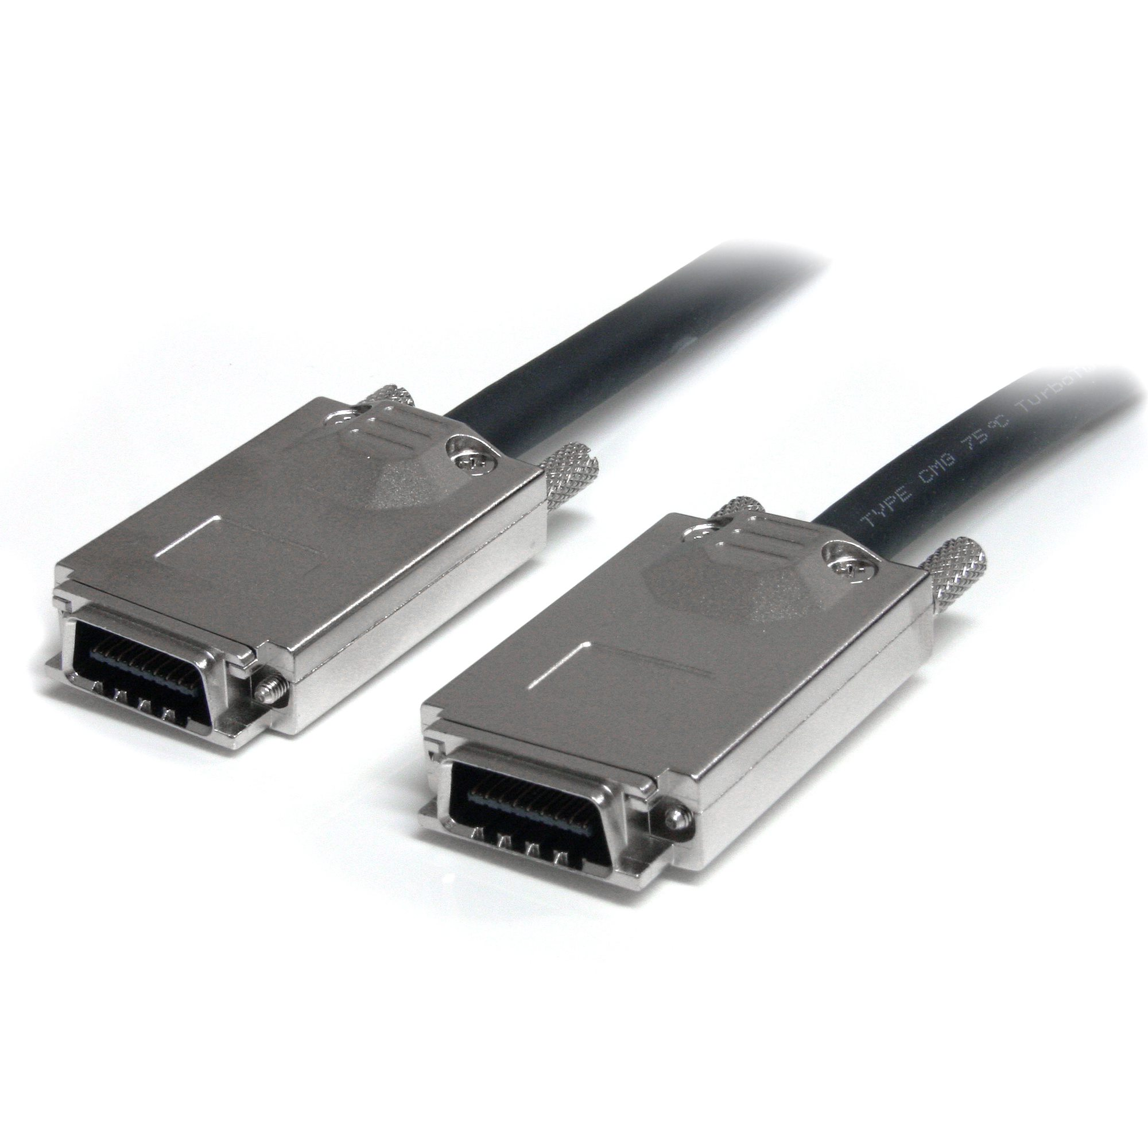
Infiniband
InfiniBand (IB), is supported by the InfiniBand Trade Association
Promises high throughput and low latency, making it ideal for use in high-performance computing connections (both within the computer and between computers)
Effectively addresses all the stated limitations of TCP and can provide seamless connectivity to applications designed to work with TCP

Slide 98
Jumbo Frames
One of the biggest issues with networking is that data of various sizes is crammed into packets and sent across the medium
Each time this is done, headers are created (more data to process), along with any filler needed, creating additional overhead
To get around this, the concept of jumbo frames is used to allow for very large Ethernet frames; by sending a lot of data at once, the number of packets is reduced, and the data sent is less processor intensive

Slide 99
2.5 Compare and contrast WAN technologies
Service type
ISDN
T1/T3
E1/E3
OC-3 – OC-192
DSL
Metropolitan Ethernet
Cable broadband
Dial-up
PRI
Transmission mediums
Satellite
Copper
Fiber
Wireless
Characteristics of service
MPLS
ATM
Frame relay
PPPoE
PPP
DMVPN
SIP trunk
Termination
Demarcation point
CSU/DSU
Smart jack

