Slide 1
OS Security &
Defensive
Programming
Week 1
Intro
Monday
01
02
Wednesday
03
04
Tuesday
05
06
Thursday
Friday

Slide 2
Today we will cover
Application Security
Fundamentals
Requirements
Design
Code
Testing & Deployment
Create an AppSec program

Slide 3
Refresher – the SDLC
There are many models of the SDLC, but for the purposes of our discussion, let’s focus on this particular model:
But I hear you ask
I forgot what all that means!
Can I have a 10 minute refresher?

Slide 4
Refresher – the SDLC
The Software development lifecycle is a model of how we develop iteratively.
We gather Requirements
We analyse those requirements in order to Design a solution
We Code that solution
We Test the code to check if it meets the client’s requirements. If it does not pass the test, the code is reworked.
We Release the code into production when the tests have been passed

Slide 5
Requirements
The requirements stage is when we gather inputs from stakeholders
The goal of this process is make sure we are building the right thing, the right way
This is an iterative process, like the SDLC itself
Usually there is a kick-off meeting where stakeholders gather together to ensure their voice is heard and the product being designed will meet their needs
There will often be negotiations and trade-offs as some requirements may be contradictory
Requirements engineers use specialist tools and techniques to elicit, record and analyse requirements.

Slide 6
Design
Designs of potential solutions are produced by
Developers
Architects
Business Analysts
Reviewed by stakeholders who select best-fit

Slide 7
Code
Application developers/Software Engineers then take the approved design and build the software required to meet the need, using whatever software engineering systems, standards and processes an organisation may employ

Slide 8
Testing
The Testing process can begin before or asfer the code is written.
If an organisation is using a Test Driven Development (TDD) approach then the development team would define and build a series of tests

Slide 9
Maintenance
During the maintenance stage of the SDLC, the app/system is assessed/evaluated to ensure it does not become obsolete. This is also where changes are made to initial software.
It is important to monitor application performance to ensure that it continues to meet security requirements, which will be continuously reviewed and updated

Slide 10
Application security

Slide 11
Why AppSec?
Increasing security in your applications by pushing the security process leftwards

Slide 12
Security fundamentals

Slide 13
Assume you’ve been breached
Start from a position of assuming you have been breached
If someone has compromised your systems, make sure they are starting from a position where you have made life as difficult as you can for them
Notes:
There are two types of companies: those that have been breached and those that don’t know they’ve been breached yet.

Slide 14
Insider threats
A user authorised to access your system performing malicious acts
Stealing sensitive date (CRM, Source Code etc)
Deleting data and backups on last day
Developers leaving a backdoor

Slide 15
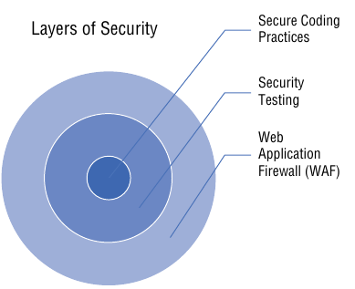
Defense in depth
The onion model
Tips
Have security requirements
Threat model
Secure coding methods
Nework security
IDS/IPS/SIEM
Physical security
Locked doors!
Notes:
SIEM – Security Information and Event Management (dashboard)

Slide 16
Least privilege
Give users/apps only the minimum access they require in order to fulfil their task
E.g.: service accounts to access appropriate system resources – does every application require admin access???

Slide 17
Supply chain security
The supply chain in software would include software frameworks such as Node.js or React
How do you know the veracity of upstream code?
https://securityreport.com/nodejs-malware-caught-exfiltrating-ips-username-and-device-information-on-github/
What steps does your organisation take to ensure the authenticity of code in your supply chain?
How would you secure your organisations software supply chain?
Is anyone an Arch user? What do you think about the AUR?

Slide 18
Security through obscurity
Can sometimes be useful as part of a defence-in-depth strategy
A common example would be a wi-fi router suppressing the SSID
DO NOT RELY ON SECURITY THROUGH OBSCURITY ON ITS OWN

Slide 19
Attack surface reduction
Reduce the potential of attacks by reducing the size of your apps
Make small, modular apps that contain less code (potential attack surface)
Never leave unused code inside an application
Refactor your apps to ensure they are lean and mean
Chain your apps together using secure API’s to replicate the functionality of monolithic apps
Smaller code modules chained together are far easier to update than large unwieldy monolithic code

Slide 20
Never trust – always verify
Never trust anything from outside your own application, always verify
If your app talks to an API, check it is the correct API with the correct authority to perform the task you are requesting
Always validate all inputs to your app/system, even from your own sources – they may have been compromised. Stored XSS attacks can originate from compromised databases
Use session management methods to continuously validate the user is who they say they are

Slide 21
Usable security
Make sure whatever security you enable it must be usable, or your users will look for creative ways around it.
Some usable methods of authentication to consider
Biometrics instead of passwords
Use memorable passphrases instead of passwords
Enforcing the use of password managers

Slide 22
Multifactor authentication
Make sure you enable multi-factor authentication (preferable to only two factor)
Something you have
Something you are
Something you know
Try to avoid
text messaging as it can be easily compromised
Security questions can be answered by Open Source Intelligence Gathering

Slide 23
Security in Requirements

Slide 24
Security in Requirements
Ensure someone from the security team is present in every project kick-off session – bake security into every project from day one
Can that person be assigned to work on that project? This is known as the partnership model – Netflix’ AppSec team adopt this approach
If they are not full time on the project, maybe they could work on it as part of a portfolio of projects they work with – cross-pollinate good ideas and practices
Have an SLA between development and security teams to manage expectations and alleviate frustrations

Slide 25
Requirements - Encryption
Always ensure you encrypt your data in transit and at-rest
Some projects even require data in encrypted while in memory
Can you think of a scenario where that might be required?
Good practice to flush memory of sensitive data when sessions ends

Slide 26
Requirements – Never trust system input
Any input could have been tampered with
Ensure your apps handle every kind of input gracefully, even bad input.
Validate every kind of input – perform tests to ensure
Input is appropriate and is expected
Sanitize input where possible/needed
Use the correct input types for fields, and sanitize inputs
If using APIs, ensure communication is encrypted between interfaces
Is your app using a memory-safe language? If not, what additional measures do you need? Think of IoT embedded systems here

Slide 27
Requirements – Encoding and Escaping
XSS is a common attack vector
Three popular mitigations are:
CSP – Content Security Policy header
https://cheatsheetseries.owasp.org/cheatsheets/Content_Security_Policy_Cheat_Sheet.html
The HTTP Content-Security-Policy response header allows web site administrators to control resources the user agent is allowed to load for a given page. With a few exceptions, policies mostly involve specifying server origins and script endpoints. This helps guard against cross-site scripting attacks (Cross-site_scripting).
https://developer.mozilla.org/en-US/docs/Web/HTTP/Headers/Content-Security-Policy

Slide 28
Requirements – Encoding and Escaping
XSS is a common attack vector
Three popular mitigations are:
Input Validation
“Input validation is performed to ensure only properly formed data is entering the workflow in an information system, preventing malformed data from persisting in the database and triggering malfunction of various downstream components. Input validation should happen as early as possible in the data flow, preferably as soon as the data is received from the external party.”
https://cheatsheetseries.owasp.org/cheatsheets/Input_Validation_Cheat_Sheet.html
Output Encoding
“Web services need to ensure that the output sent to clients is encoded to be consumed as data and not as scripts. This gets pretty important when web service clients use the output to render HTML pages either directly or indirectly using AJAX objects.”
https://cheatsheetseries.owasp.org/cheatsheets/Web_Service_Security_Cheat_Sheet.html#output-encoding

Slide 29
Requirements – Third Party Components
Use code verification tools to check that any third party software components/libraries/frameworks you have used in your project are not compromised
Perform regular scans and checks on your own organisation’s code repo’s daily/at-least-weekly
Scan before every release to production – new vulnerabilities are found all the time
Automate this process into your CI/CD pipeline
This process will catch *known* vulnerabilities at the time of release, not a guarantee new vulnerabilities won’t be found
Notes:
What does “known vulnerable” mean? When creating custom software, it is, by def-
inition, unique. Each piece of custom software is a snowflake, and thus, every new
vulnerability a person would find in it is unknown to the public. Software that is not
custom is often just called “software,” such as an operating system or COTS. (COTS
stands for Commercial/Customizable/Configurable Off The Shelf. It’s software that
anyone can purchase that is installed but also highly configurable. Examples include
SharePoint, WordPress, Microsoft Office, and Adobe Illustrator.) When a penetration
tester, security researcher, or other “hacker” finds a vulnerability in any software
(custom or not), ideally they would report it to whoever made the software (this is
called “coordinated disclosure”), or if there is a bug bounty program, they could
submit it as part of the program and potentially be paid. If it is not custom software,
once the bug is reported and a patch is issued (usually a software update from the
user/s perspective), the bug is published in several places online (such as Mitre’s CVE
database 13) for all to see, and thus it is considered to be a “known” vulnerability. The
version of the software with the vulnerability is then considered to be “known to be
vulnerable” and would usually be picked up by automated tools that scan for this.
After a bug is found in software, an operating system, or a COTS product, but
before a patch is issued, this bug is called a “zero day” or “0 day,” to make it clear there
is no known fix for the problem. Often security teams will refer to patches in terms of
days since they’ve been issued, for instance “this vulnerability is 90+ days old and we
still haven’t patched!”, hence why “zero” was chosen.

Slide 30
Requirements – Security Headers
A Security Header is a setting that tells the browser how to handle aspects of your web page
The OWASP Secure Headers Project describes HTTP response headers that your application can use to increase the security of your application. Once set, these HTTP response headers can restrict modern browsers from running into easily preventable vulnerabilities. The OWASP Secure Headers Project intends to raise awareness and use of these headers.
https://owasp.org/www-project-secure-headers/

Slide 31
Requirements - Comments
De=fine a commenting standard in your organisations coding standards, and ensure all developers follow it.
However, make sure dev’s are not oversharing information in their comments that may aid an attacker, hence the reason to standardise what is an acceptable comment.

Slide 32
Requirements – Technical Debt = Security Debt
Technical debt is a concept in software development that reflects the implied cost of additional rework caused by choosing an easy (limited) solution now, instead of using a better approach that would take longer.
Don’t put off until tomorrow what needs doing today

Slide 33
Requirements – Uploads = Assume the worst
If you must allow file uploads, always assume the worst
This is usually considered the most dangerous attack vector for web applications
What files pose a risk?

Slide 34
Requirements – Authorization & Authentication
Define RBAC’s (Role Based Access Controls) during the Requirements stage of your application design and resist changing them if at all possible.

Slide 35
Requirements – Least Privilege
Ensure your requirements capture the principle of least privilege
Use service accounts with the least privilege required to perform a task
Use different service accounts for different tasks/APIs, each with their own least privilege model
Limit your developers to accessing the least amount of code necessary top perform their role

Slide 36
Security in Design

Slide 37
Design – Flaws v Bugs
A design flaw is an error in the design of an app, allowing actions that should not be allowed
A bug is a problem with how the design (which is good) has been translated in code
Design flaws are introduced in the Design stage of the SDLC
Bugs are introduced in the Coding stage of the SDLC

Slide 38
Design – Flaws v Bugs
The further right you are in the SDLC process, the costlier it is to fix the issue
This is why we always with to push issue discovery further left

Slide 39
Design – Flaws v Bugs
The further right you are in the SDLC process, the costlier it is to fix the issue
This is why we always with to push issue discovery further left

Slide 40
Security Design Concepts
Protect sensitive data
Basics:
Make sure it is CIA - Confidential, Integrity, Available (but you all knew that)
Encrypt data in transit and at rest
Validate inputs
More-Sensitive data
Define process and policies for how to work with more-sensitive data
How long are you required to keep it? – bake it into your app
Automatically check that data has been destroyed
If super-sensitive data, try triple-encryption methods (Hash, Salt & Pepper)

Slide 41
Security Design Concepts
Never Trust, Always Verify
Only use server-side trusted data (properly validated) to make access control decisions
Deny by default
Fail closed or Fail Safe
Roll back transactions if not properly completed
Verify (authenticate) then authorize (access control)
Reverify on every page (session control)
Block access to all protocols, ports not in your app’s use on your server
One app per server/container

Slide 42
Security Design Concepts
Use Framework features, don’t reinvent the wheel
If the framework you are using has a security feature, use THAT one instead of implementing your own
If there is no such feature in the framework, can we buy an alternative rather than roll our own
Modularize code – break it down, separate out the security function from the business function of the app
Input validation in a separate class/object
Authentication and/or authorization in a separate application
Identity management performed by third party (e.g.: Microsoft for Azure)

Slide 43
Security Design Concepts
Continuing from above, isolate administration functionality from business functionality
Don’t use real-life production data for testing
Should you go open-source or closed source? – each has their advantages/disadvantages
threat model, Threat Model, THREAT MODEL!
Involve representatives from all stakeholders, find out how the system could be misused/abused/attacked
Document the process and, as always, get management sign-off on all decisions coming out of the process

Slide 44
Security Design Concepts
Rinse and repeat this process for each iteration of the development lifecycle
Ensure both Dev and Ops folks are officially involved

Slide 45
Security in Code

Slide 46
Choosing a language and/or framework
Try to choose a language and/or framework that s some level of professional support available – someone to go to for help/to blame
Open Source software can have many different vendors offering different levels of support
IBM/Red Hat Linux
Ubuntu Linux

Slide 47
Choosing a language and/or framework
Avoid Franeworks/Languages that are dying out or are unsupported
Similarly, before choosing a Framework and Languages that is known to have serious security implications concerning their use – C/C++, investigate alternatives such as Rust

Slide 48
Untrusted Data
As previously discussed, validate all data inputs
Wherever possible, do this on server-side code rather than client-side
Don’t be afraid to reject inputs that don’t meet your verification and validation requirements (e.g.: O instead of 0)
If you must accept special characters (!”£$%^& etc), then make sure you “escape” them using functionality built in to the framework or language you are using

Slide 49
Identity Management
Try to use centralised/third-party identity providers such as Google or Microsoft, they spend more resources on hardening this critical functionality than anyone else could ever hope to – don’t reinvent the wheel
It makes the authentication process relatively pain-free for your users and they are less likely to complain or try to avoid using it

Slide 50
Identity Management
Try to use centralised/third-party identity providers such as Google or Microsoft, they spend more resources on hardening this critical functionality than anyone else could ever hope to – don’t reinvent the wheel
It makes the authentication process relatively pain-free for your users and they are less likely to complain or try to avoid using it

Slide 51
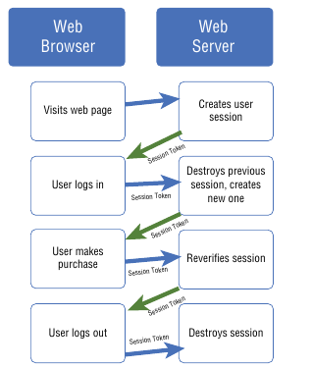
Session Management
Session tokens are passed between the browser and server to reverify the same user is logged-in
Sessions ID’s should be randomized, 128-bit or 256-bit characters long

Slide 52
Session Management
Use the built-in session management session in your framework
Always set your sessions to expire in a reasonably short time
Encrypt the session ID info in transit
Destroy sessions after user logs out
Web apps manage their own session IDs, not use/accept third party session IDs
Regenerate session IDs as authentication levels change

Slide 53
Logging and Monitoring
Record login fails and errors as well as successes
Do not include sensitive information
Log brute-force attempts
Log any and all security events
Logs should be used by dashboard (SIEM) tools
Record as much of who, what, where and how as you can
Logs must be retained as part of your audit process

Slide 54
Testing and Deployment

Slide 55
Testing your code – Code Reviews
Testing of your code/apps/APIs is done to ensure that your code meets your requirements, and nothing more.
Perform regular secure code reviews covering, but not limited to:
Authentication
Authorization
Security configurations
ID management systems
Session Management
Input Validation
Output Encoding

Slide 56
Testing your code – Code Reviews
Secure Code Reviews – what are you looking for?
Check there are appropriate controls in relevant places, according to your workflow. Consider Threat model outcomes as a place to start?
Code reviews are a tried and trusted practice in the industry, but try to ensure that your AppSec team/specialist(s) are involved in the process

Slide 57
Testing your code – Static Analysis
A static code analyser operates like a compiler, but instead of processing the source code to produce binary, it’s looking for vulnerabilities
Sometimes referred to as a SASTT
Static
Application
Security
Test
Tool (this last T is optional, often just SAST)

Slide 58
Testing your code – Static Analysis
What does a Static Analyser look for?
You configure it to be as strict, or as open as you need - up to you
If configured to pick up every conceivable vulnerability, expect a lot of false-positive results – this will slow down your release process and likely make you unpopular with the DevOps teams – be prepared!
Likewise, if you set it up to be open, expect false negatives – be warned!
Outcomes from Static Analysis can be a useful input to a code review, but they don’t replace a code review
Validate results before sharing with other teams – you could waste a lot of their time
You can learn more about these tools here:
https://owasp.org/www-community/Source_Code_Analysis_Tools

Slide 59
Testing your code – SCA
SCA – Software Composition Analysis
Uncommon for large organisation to have a complete SBoM (Software Bill of Materials) for all their projects
An SCA can keep track of every component used in a project/app and check the components for any published vulnerabilities
Ideally placed in your CI/CD workflow, can be automated, and should be run before any release is published to production
Some popular tools for your consideration:
https://owasp.org/www-community/Component_Analysis#tools-listing

Slide 60
Testing your code – Unit Testing
Modular programming has become very popular
Breaking large, monolithic applications into smaller more manageable modules that can be chained together has many benefits
Easier to test
Easier to update
Easier to understand
Promotes code reuse
Follows the OOP philosophy

Slide 61
Testing your code – Unit Testing
A unit is the smallest *testable* part of a piece of software
Typically has only one of a couple of inputs and outputs
Unit tests are usually written in your IDE, and are run by the developers before checking their code into source control (e.g.: Git/Hub/Lab)
Unit tests a generally positive tests in that they are looking to check something has occurred, but they can also be negative in that they check for something not happening too – like a memory leak or some other potential exploit.
Always work closely with developers when unit testing – it is common that the dev team own at least some of this unit testing process
We will look at unit testing more when we move on to the practical element of this module

Slide 62
Testing your Application – Browsers
A browser is the primary interface to a web app and a trained attacker can use a browser to locate many vulnerabilities
E.g.: Business logic issues are commonly found using browsers
“Does the web app do what it is supposed to do?”
Make use of the developer tools built in to modern web browsers
Chrome developer tools
Firefox developer edition
Edge developer tools

Slide 63
Testing your Application – Proxies
A proxy server can be a useful tool to aide testing, notably for XSS vulnerabilities
Sits between the browser and the web app
Allows you to monitor and tightly control interactions with the server/app
Can see how APIs respond in detail

Slide 64
Testing your Application – Fuzzing
A fuzzing attack involves throwing randomised inputs at an app until something – anything – has an unexpected effect.
Fuzzing can be used on any method of interacting with your app
User inputs
API inputs
URL manipulation

Slide 65
Testing your Application – DAST
Dynamic Application Security Testing (DAST) is an automated process to crawl through your app using spiders to perform a vulnerability analysis
DAST usually involves scanning infrastructure as well as your custom application.
Infrastructure, as the name suggests, scans the underlying infrastructure (OS, networking setup etc) and information about known vulnerabilities is provided by manufacturer (Patch Tuesday)
Custom Apps refer to your own application, which can be built using commonly available frameworks.
Result accuracy can vary, so results do need to be verified by other means (code analysis)

Slide 66
Testing your Application – Security Assessment
A Security Assessment could be some kind of vulnerability analysis or pen-test
Involves a professional trying to:
uncover every conceivable vulnerability
check every control is operating properly
check how your systems cope with your threat models
Results again require validation to ensure there is actually a vulnerability and if there is, an investigation to check no exploit has actually occurred.

Slide 67
Testing your Application – Stress & Performance Test
How much (users/traffic/”load”) can your app take before it falls over or behaves unexpectedly
Think of Zoom or MS Teams just as the pandemic happened and everyone began working from home?
Teams was never meant to scale as large as it did – hats off to Microsoft for reworking the app as quickly as they did
A stress test can demonstrate how well your system/app could cope with a DoS/DDoS attack
Make sure it is performed an a test system that exactly duplicates your production environment, or else your results will be invalid.
Run these tests before any update to production is performed.

Slide 68
Testing your Application – Integration Testing
Integrating units of your modular design and testing them to make sure no unexpected results are produced
Can be manual or automated process
In DevOps houses, these tests will form part of the CI/CD pipeline

Slide 69
Testing your Application – IAST
Interactive Application Security Testing runs along with your app in production and actively monitors for vulnerabilities as the code is used.
Can be thought of as similar in concept to an IDS/IPS
Finding an IAST tool that you want to use may dictate which app dev stack you choose, as you would need to find a stack that is supported by your IAST tooling choice.

Slide 70
Testing your Application – Regression testing
Whenever your developers fix an issue (flaw or bug) in their code, there is a chance they will introduce another.
The bigger the change, the bigger the risk of new issues
You must test all “bugfixes” as you would any newly developed code
All this testing can seem onerous, all the more reason to use modular programming to reduce the amount of code that needs testing and automate testing to increase your development velocity

Slide 71
Testing your Infrastrucutre
Done in conjunction with the Ops team, and DevOps if such a team exists
Checking all infrastructure for vulnerabilities
If using containers, consider the Centre for Internet Security guide to harden your containers – https://github.com/dev-sec/cis-docker-benchmark

Slide 72
Testing your Database
Treat Databases and their data like any other piece of infrastructure – harden it.
Regularly check for vulnerabilities using appropriate Vulnerability Assessment tools
Make data and database security requirements a core piece of your project’s requirements
Lots of guides freely available on considerations for hardening databases – your database vendor would be a good place to start

Slide 73
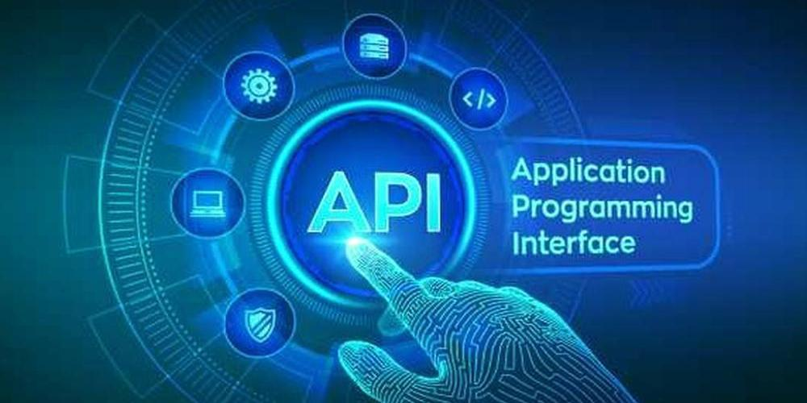
Testing your APIs and Services
Testing APIs is tricky, because they usually require an experienced developer to write/help write software to check how the API responds to different inputs.
APIs are frequently bespoke, automated test applications are not a great fit
APIs need to be tested as thoroughly as any other part of your application stack

Slide 74
Testing your Integrations
Whenever your app integrates with another system – TEST
Check authentication and authorization protocols are in place and working

Slide 75
End of Monday

Slide 76
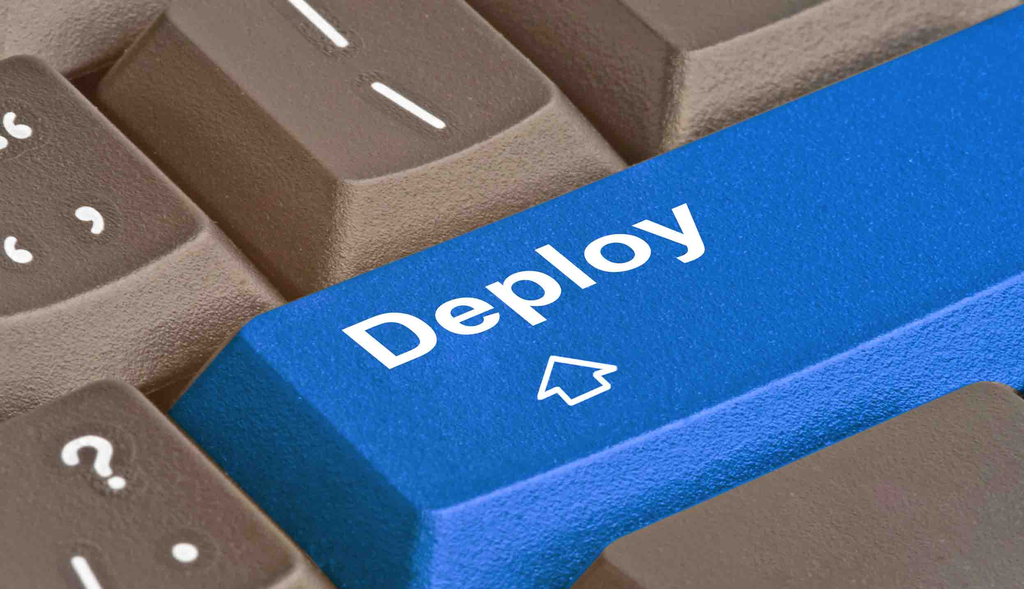
Deploying your application
The deployment process should be part of your requirements planning process
If there are any issues in the deployment process, ensure your app can roll-back to a known good sate quickly and cleanly
Try to automate deployment to make it a repeatable, trusted process.
Don’t deploy on a Friday afternoon 😉

Slide 77
Deploying your application
This is where the value of DevOps CI/CD comes in
It is a known, repeatable, trusted process
It supports business objectives – can anyone name a business that aims to be slow-to-market?

Slide 78
Create an AppSec program

Slide 79
What is an AppSec program?
Forms part of your core Cyber Security program
Takes ownership of your application portfolio and responsibility for ensuring the portfolio is safe
Preforms threat modelling and risk analysis on proposed changes to the application estate

Slide 80
AppSec Program Requirements?
*Ideally* run by a dedicated team
Security activities added to the SDLC
The AppSec team supports DevOps with
Resources
Education
Tooling
Guidance
Policies

Slide 81
AppSec Program Goals?
*Ideally* run by a dedicated team
Security activities added to the SDLC
The AppSec team supports DevOps with
Resources
Education
Tooling
Guidance
Policies

Slide 82
AppSec Program Goals?
Currently, no industry accepted standard way of running an AppSec program
Many organisations use OWASP SAMM (Software Assurance Maturity Model) or BSIMM (Building Security in Maturity Model) to get started
https://owasp.org/www-project-samm/
https://www.bsimm.com/about.html

Slide 83
AppSec Program – first steps
Create and maintain an Application inventory
Consider everything
Cloud apps
Developer Frameworks
APIs
COTS applications – MS Office

Slide 84
AppSec Program – first steps
Build a capability to find vulnerabilities in written, running and third-party code
Use DAST and SAST tools
DAST – Dynamic Application Security Testing – testing against a running application
SAST – Static Application Security Testing – testing against code
Use automated tools to find the vulnerability, then check the vulnerability manually

Slide 85
AppSec Program – first steps
Build expertise on how to fix vulnerabilities and share it
Promote an AppSec culture, build a Community of Practice to support good practice
Record and share Good Practice
Provide reference materials (e.g.: MSDN)
Run education workshops

Slide 86
AppSec Program – first steps
As we have seen, the earlier we find bugs and flaws in apps, the cheaper it is to fix them – Shifting Left/Pushing Left
Organisations need to invest in AppSec tooling to help push left
Formalise (bake-in) security process steps in each part of your SDLC
SDLC Phase | Security activity
Requirements | Make sure Security Requirements are mandatory
Design | Threat modelling to look for flaws
Coding | Unit testing to find bugs
Testing | Integration & penetration testing, DAST, SAST, SCA
Release/Maintenance | DAST, monitoring, logging, alerts incident response team – process!
Notes:
DAST = Dynamic
SAST = Static

Slide 87
AppSec Program – first steps

Slide 88
AppSec Program – first steps
Automate as much as you can
Form an Incident Response Team if you don’t already have one
Adopt a philosophy of continuous improvement
But how do you measure you improvement, or lack of?
Metrics
Experimentation
Feedback from stakeholders

Slide 89
Securing modern apps and systems

Slide 90
Securing modern apps and systems
In this section we will look at how we begin securing the following:
APIs and microservices
Online Storage
Containers and Orchestration
Cloud workflows
Serverless
Infrastructure-as-Code
Platform-as-a-Service
Infrastructure-as-a-Service
CI/CD
DevSecOps
Cloud
Cloud workflows

Slide 91
Securing APIs and Microservices
Use an API Gateway to prevent DoS style attacks
Use input validation
Try to use standard COTS technologies wherever possible to ease testing and adoption of patterns of good use
Authenticate first, then authorise
Consider adopting a service mesh architecture
Keep API error messages obscure or hidden

Slide 92
Securing Online Storage
Create secure default settings for all data
Classify all data according to sensitivity to aid first-responders in identifying how serious the breach is
Monitor all file access activity
A good practice is that online data sources can only be accessed by service accounts – keep people out

Slide 93
Securing Containers & Orchestration
Treat containers as you would a hardware server and apply similar access and security controls
Never run a container as ‘root’
Know where your container comes from! Is dockerhub secure enough for you?
Maybe keep your own sanitized internal dockerhub or similar?

Slide 94
Securing Serverless
Treat as you would any other server resource
Monitor
Log
Validate inputs
Authenticate and authorize
Encrypt data in transit and at rest
Consider an API Gateway

Slide 95
Securing Infrastructure-as-Code
Automates (and speed up) the deployment process as part of your CI/CD workflow
Makes your deployment process repeatable – everything is a known hardened state from initialization
Documents your configuration as you go – it is code after all
Immutable infrastructure – no in-place patching, just replace it with a newer, patched image

Slide 96
Securing Platform-as-a-Service
Outsourcing the problem!
Cloud provider (AWA/Azure/Google Cloud) take on the responsibility of securing the maintaining the platform
You retain responsibility for securing your app
Secure your app as you would if you owned the full stack

Slide 97
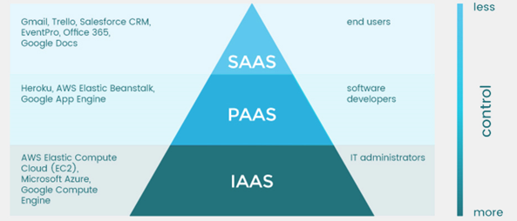
Securing Infrastructure-as-a-Service
IaaS is similar to PaaS but you retain responsibility for patching OS/infrastructure
Gives you more control, less cost
But more responsibility
Again, treat IaaS as you would any other piece of critical infrastructure and secure appropriately
Least privilege
Strong identity management
A&A
Assume you have been breached
Zero trust

Slide 98
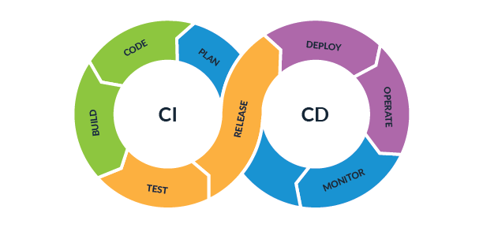
Securing CI/CD
CI/CD workflow means making small, incremental changes almost continually – essence of agile mindset
You are continuously coding, testing, deploying so you need to ensure your code security is 100% - you do not want to let anything get out of control
Almost always an automated process with little human input other that to kick it off initially and then to commit to production

Slide 99
Securing DevSecOps
Before DevSecOps, we have DevOps:
The First Way
Make your SDLC operate like a finely tuned machine
Get to the Dave Brailsford stage of incremental gains
Automate! Automate! Automate!
The Second Way
Fast feedback
Speed is of the essence – all about development velocity
The Third Way
Measure, experiment, improve
Take risks (in test environment!)
Try things out – don’t be afraid to change your process – the SDLC is a living beast

Slide 100
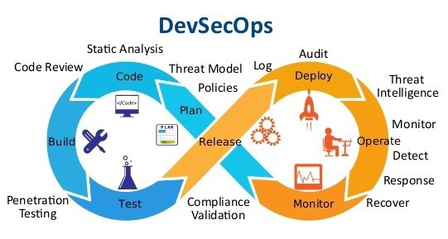
Securing DevSecOps
DevSecOps
Important Security is not perceived as a bottleneck in Development velocity
Provide quick feedback when required
Ask for feedback on your performance – proactively improve your relationships across teams
It not only important to be good, you need to be seen to be good
Try to adopt a positive mindset – be an enabler, not a gatekeeper

Slide 101
Securing the Cloud
https://www.reddit.com/r/aws/comments/lbqcos/my_forgotten_account_has_a_20000_bill_how_screwed/
https://www.reddit.com/r/aws/comments/kzsojh/my_account_was_compromised_and_i_suddenly_owe/
https://www.quora.com/My-AWS-account-was-hacked-and-I-have-a-50-000-bill-how-can-I-reduce-the-amount-I-need-to-pay
Be super-careful when working with any cloud service – enable 2fa and watch your usage like a hawk

