Slide 1
BCS Level 3 Certificate in Programming
QAN 603/1192/7

Slide 2
Syllabus
Implementing software code following a logical approach (17.5%, K3)
How code integrates into the wider project (10%, K2)
Developing software against a set of functional and non-functional requirements (15%, K2)
The end user context for software development (7.5%, K2)
Connecting code to data sources (5%, K2) Database normalisation (5%, K3)
Following good coding practices (12.5%, K2)
Principles of good interface design (10%, K2)
Building in security software (17.5%, K2)

Slide 3
Examination
Syllabus Area | Target number of questions
1. Implementing software code following a logical approach | 7
2. How code integrates into the wider project | 7
3. Developing software against a set of functional and non-functional requirements | 6
4. The end-user context for software development | 3
5. Connecting code to data sources | 3
6. Database normalisation | 2
7. Following good coding practices | 3
8. Principles of good interface design | 4
9. Building in security software | 5
Total | 40

Slide 4
Principles of good interface design (10%, K2)
8.1 Explain human computer interaction and understand the issues associated with interactive systems.
usability / ease of use and intuitive design;
graphical user interfaces (GUI) for different types of devices;
ergonomic design.
8.2 Describe the key concepts and processes of good user interface design.
design principles;
design patterns;
tools;
wireframes
Prototypes
•techniques and methods.
A/B testing
8.3 Explain the importance of usability when developing interactive systems.
8.4 Describe the fundamental considerations for developing an accessible system and the purpose of the Web Accessibility Initiative (WAI).

Slide 5
Usability / ease of use and intuitive design
The official ISO 9241-11 definition of usability is:
“the extent to which a product can be used by specified users to achieve specified goals with effectiveness, efficiency and satisfaction in a specified context of use.”

Slide 6
Usability outcomes
A usable interface has three main outcomes:
It should be easy for the user to become familiar with and competent in using the user interface during the first contact with the product
It should be easy for users to achieve their objective through using the product
It should be easy to recall the user interface and how to use it on subsequent visits.

Slide 7
User Interface Design
Consistency of signposting and pop up information
On screen help
Layout appropriate to task
Differentiation between user expertise
Clear navigational structure
Disabled people using computers

Slide 8
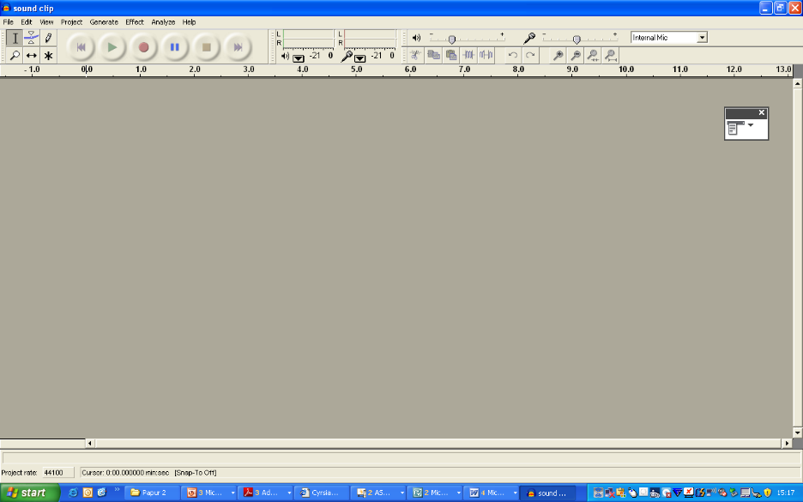
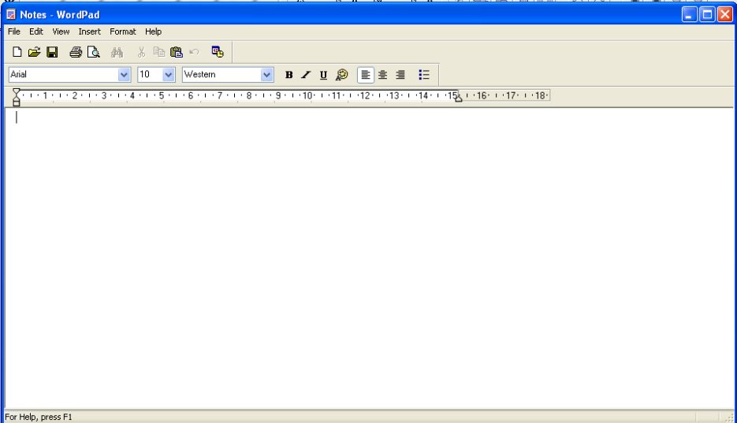
Consistency of signposting and pop up information
Good Interface design should have consistency. This means that buttons are located in the same place, colour schemes are similar, type and style of fonts. The user will be familiar with a consistent setup.
The examples show THREE different types of Software but all have consistency in layout.

Slide 9
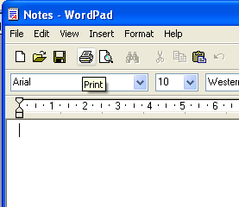
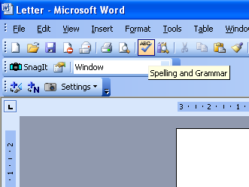
On screen help
Most software packages have ‘Help’ facilities. This enables the user to search for help when required.
SIGNPOSTING
Good design should include pop-up information to explain to the user what function buttons carry out

Slide 10
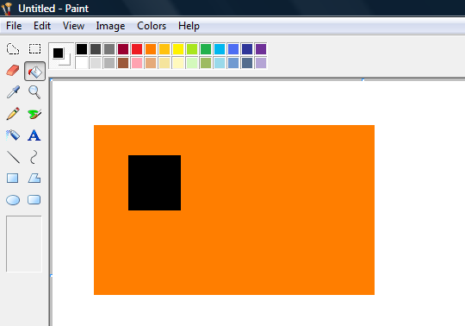
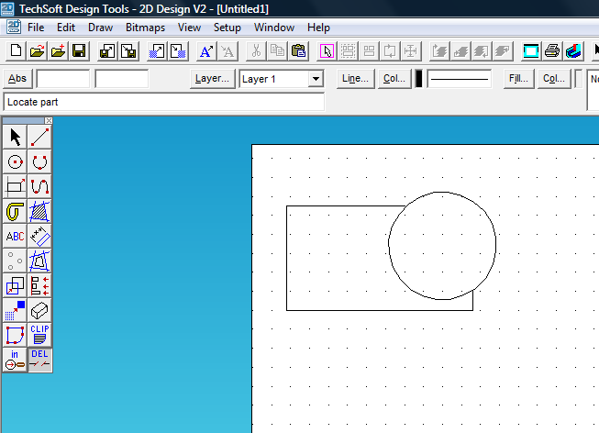
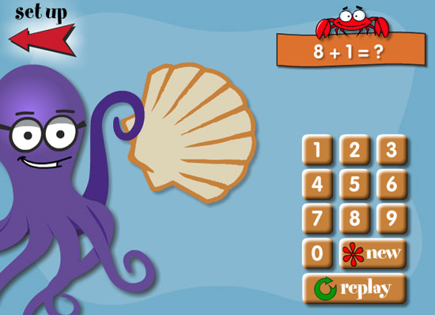
Layout appropriate to task
The layout of the interface would have to be appropriate for the type of task it is supposed to do. A paint or CAD package would have icons and menus appropriate for drawing tasks rather than layout for spreadsheet work. Software to help young children with Maths would have little text and lots of pictures.

Slide 11
Differentiation between user expertise
Design of interface should consider the expertise and needs of the users.
Users can range from novices with very limited knowledge of computers to experienced users who use a computer daily to experts who use computers to programme and create new software.

Slide 12
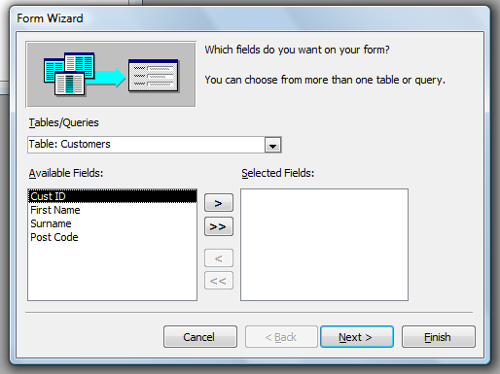
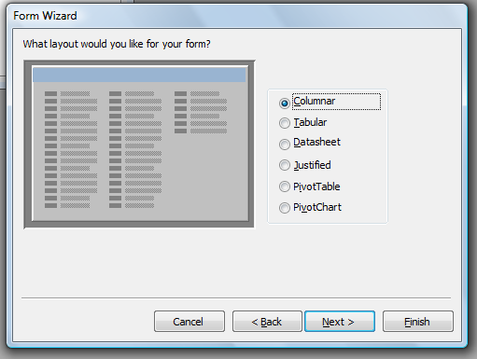
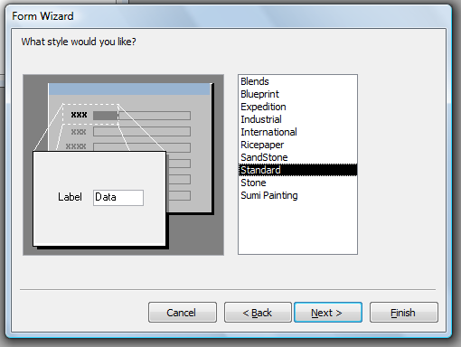
Clear navigational structure
User interfaces should be clear to the user so that tasks can be carried out easily without any confusion. Some packages have wizards to help with difficult tasks - creating forms or reports in database packages.
On websites navigation buttons are located in same position so that a user is able to find the required button in the same position on every page, this applies to most software packages where ‘File’ ‘Edit’ buttons are located on the interface.

Slide 13
Disabled people using computers
People with special needs should have access to computers so that they are not discriminated.
Some users can be disabled or elderly so the design of the interface should consider these factors.
Blind people could have help by using a ‘talking computer’ or using Voice Interfaces to input data into the computer. Blind people can use Braille keyboards to type in information.
Text can be increased in size to help visually impaired people,

Slide 14
Fitt’s Law - paraphrased
The farther away a target is and the smaller its size, then the more difficult it is for the user to correctly land on that target.

Slide 15
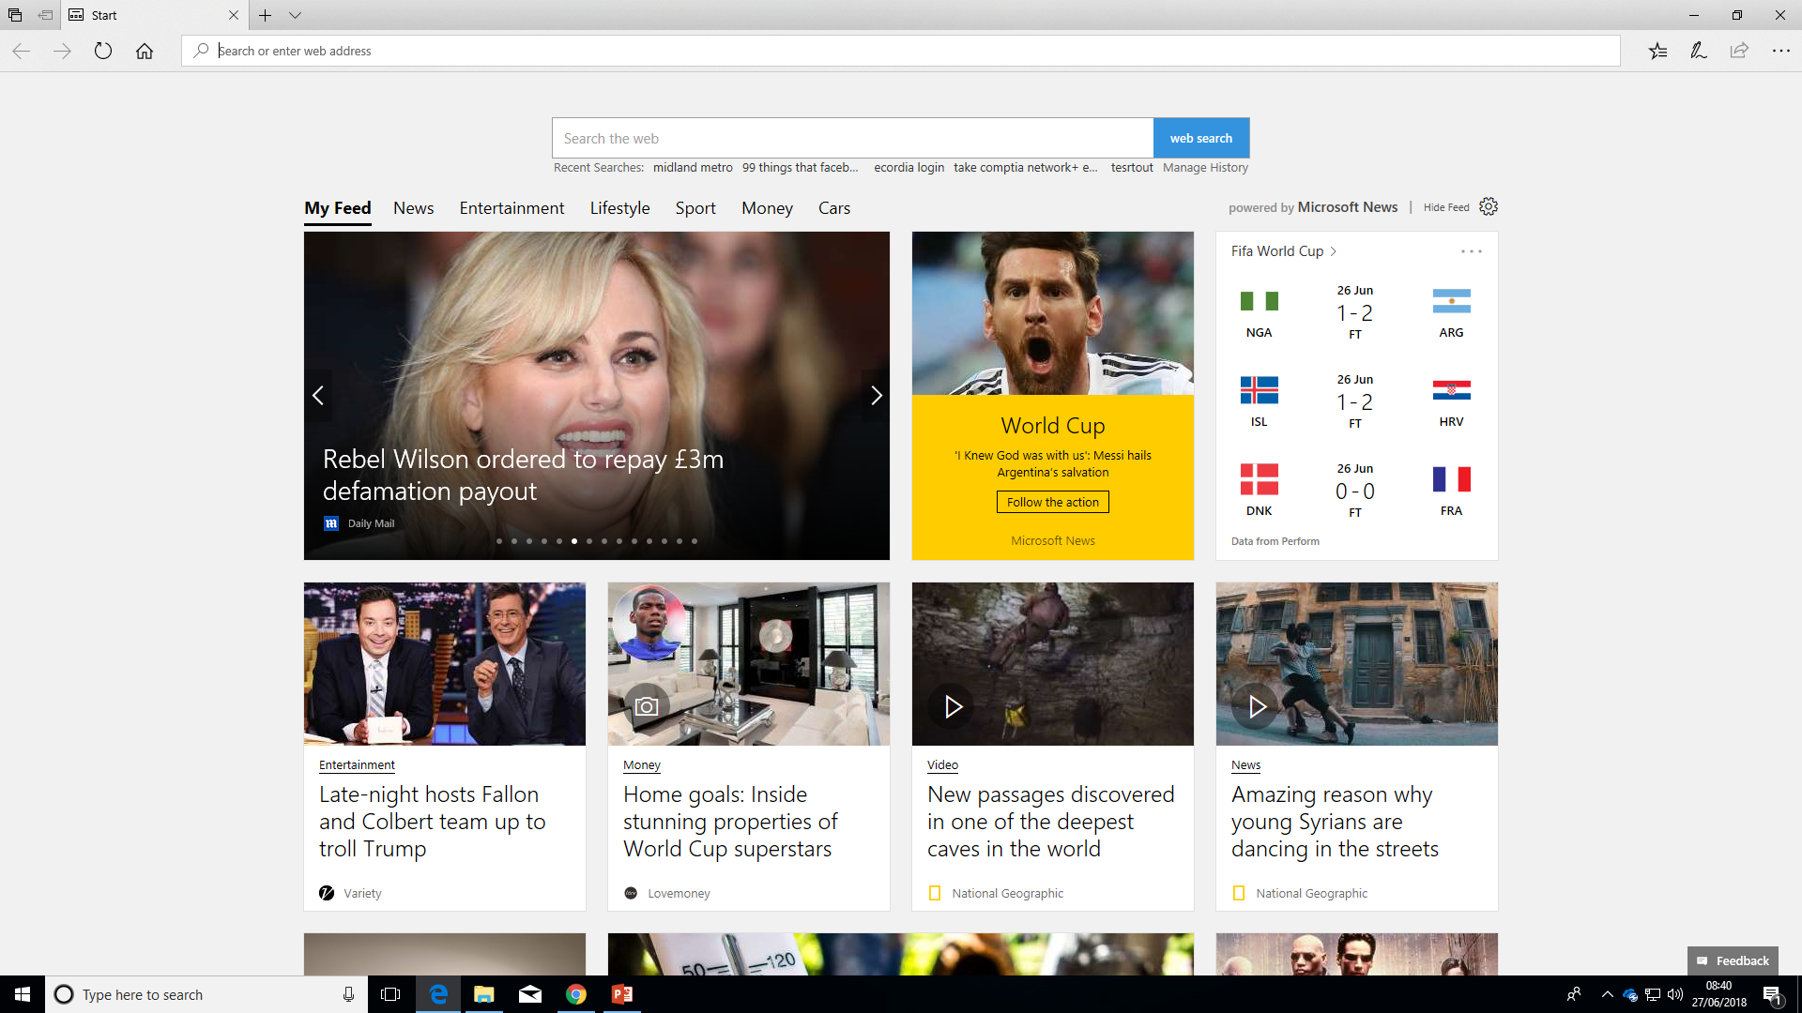
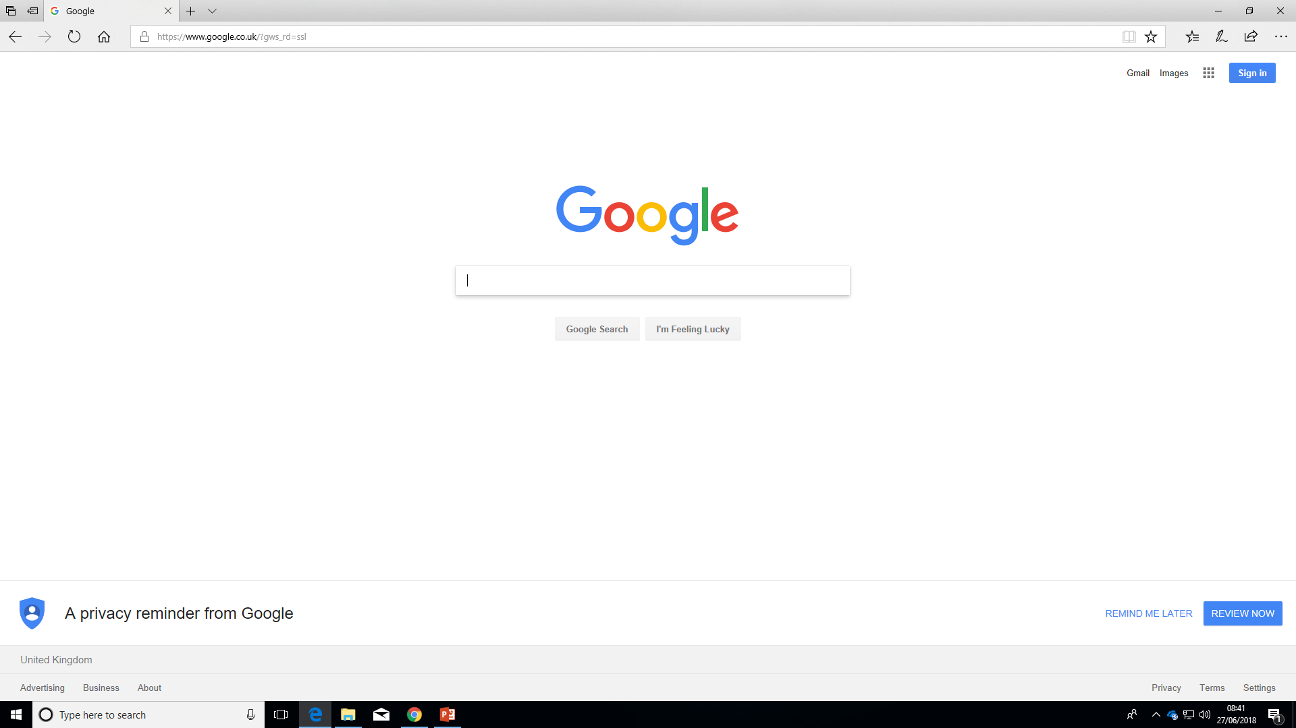
Hicks’ Law - paraphrased
The more choices you present your users with, the longer it will take them to reach a decision

Slide 16
Graphical User Interfaces
Touch or keyboard/mouse?
Target size?
Pixel precision?

Slide 17
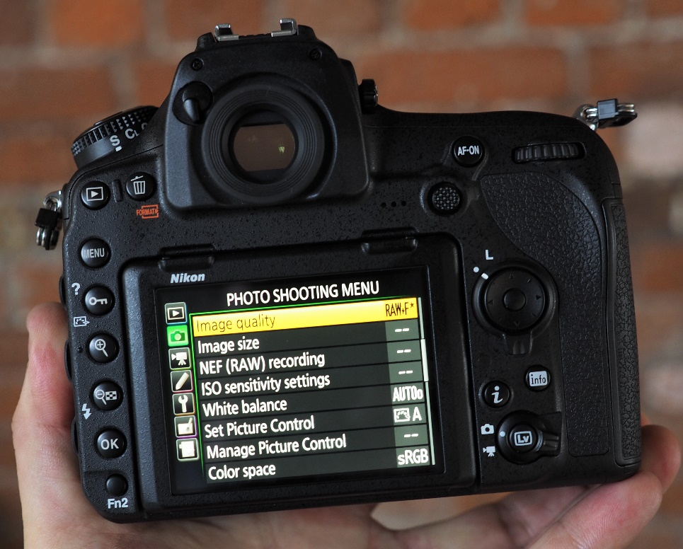
GUI - Screen size

Slide 18
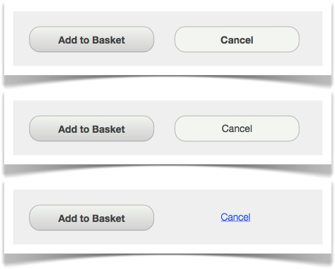
CRAP: Contrast, Repetition, Alignment, Proximity
Contrast helps direct the viewer’s eyes to what’s important and helps them focus on what to do next.

Slide 19
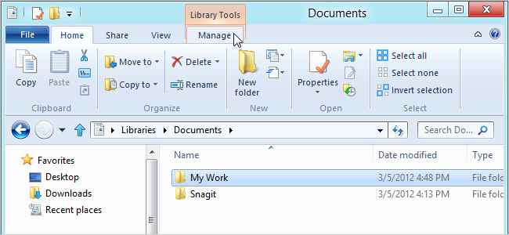
CRAP: Contrast, Repetition, Alignment, Proximity
Systems are more usable (and easier to learn) when similar stuff is presented in similar ways - repetition.
Internal consistency means using the same kind of fonts, icons, headings, links, list styles and page layout.
External consistency means using standard buttons, link colours and search results

Slide 20
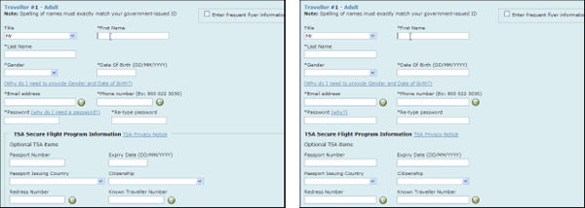
CRAP: Contrast, Repetition, Alignment, Proximity
Alignment simply means making sure that all elements of the design line up horizontally and vertically.

Slide 21
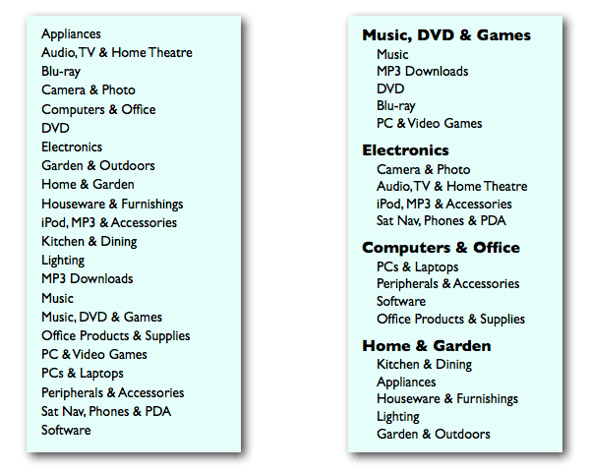
CRAP: Contrast, Repetition, Alignment, Proximity
Place elements in a user interface near to each other, to indicate that they are related

Slide 22
Design principles 1
Usefulness
The system should provide necessary utilities and address the real needs of users.
Relevance:
The information and functions provided to the user should be relevant to the user's task and context.
Consistency
Follow appropriate standards/conventions for the platform and the suite of products. Within an application (or a suite of applications), make sure that actions, terminology, and commands are used consistently.
Real-world conventions:
Use commonly understood concepts, terms and metaphors, follow real-world conventions (when appropriate), and present information in a natural and logical order.
Simplicity
Reduce clutter and eliminate any unnecessary or irrelevant elements.

Slide 23
Design principles 3
Help and documentation:
Ensure that any instructions are concise and focused on supporting the user's task.
Error Prevention and Handling
Allow reasonable variations in input. Prevent the user from making serious errors whenever possible, and ask for user confirmation before allowing a potentially destructive action.
Error recovery:
Provide clear, plain-language messages to describe the problem and suggest a solution to help users recover from any errors.
Undo and redo:
Provide "emergency exits" to allow users to abandon an unwanted action. The ability to reverse actions relieves anxiety and encourages user exploration of unfamiliar options.
Efficiency
Accommodate a user’s continuous advancement in knowledge and skill. Do not impede efficient use by a skilled, experienced user.

Slide 24
Design principles 4
Shortcuts:
Allow experienced users to work more quickly by providing abbreviations, function keys, macros, or other accelerators, and allowing customization or tailoring of frequent actions.
User control:
Make users the initiators of actions rather than the responders to increase the users’ sense that they are in charge of the system.
Workload Reduction
Make the user’s work easier, simpler, faster, or more fun. Automate unwanted workload.
Reduce memory load:
Keep displays brief and simple, consolidate and summarize data, and present new information with meaningful aids to interpretation. Do not require the user to remember information. Allow recognition rather than recall.
Free cognitive resources for high-level tasks:
Eliminate mental calculations, estimations, comparisons, and unnecessary thinking. Reduce uncertainty.

Slide 25
Design patterns 1
A design pattern is a proven design solution to a common design problem documented in a standard format. Design patterns support design by providing:
A shorthand way and common language for referring to common design problem/solution pairs
A means to initiate novices to the profession
A means for experienced professionals to record and share their insights
A means for a profession to build a repository of knowledge and encourage reuse of best practices.

Slide 26
Design patterns 2
Examples of widely used Web design patterns include:
Shopping cart: a solution for temporary storage of selected items on a site
Double tab: a navigation pattern that shows the two topmost levels of a site
Bread crumbs: a solution that shows users where they are in a hierarchical structure of the site (van Welie, 2005).
A typical design pattern is one half to two pages long and consists of sections such as:
A statement of the problem the design pattern addresses
A description of situations where the application of this pattern is appropriate
A detailed description of the solution
One or more examples of designs that illustrate the pattern

Slide 27
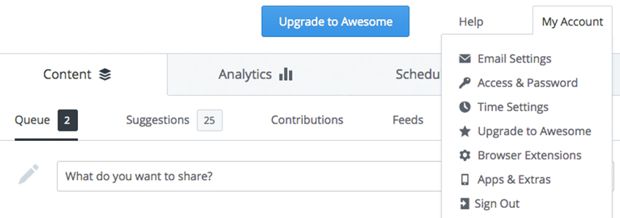
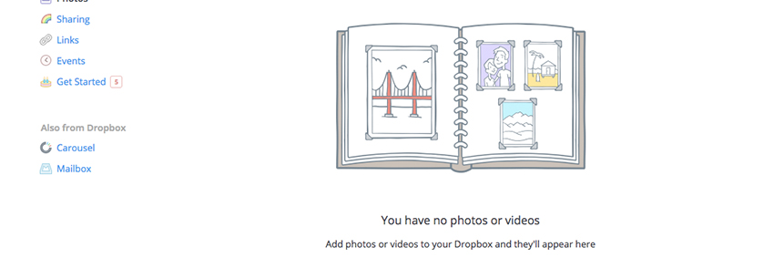
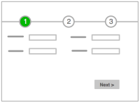
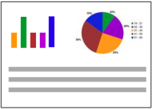
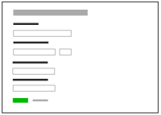
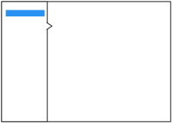
Design patterns 3

Slide 28
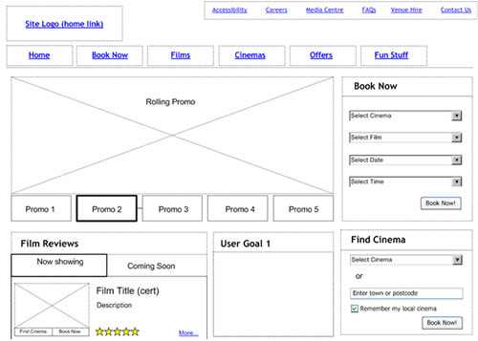
Wireframes
A wireframe is commonly used to lay out content and functionality on a page which takes into account user needs and user journeys.
Wireframes are used early in the development process to establish the basic structure of a page before visual design and content is added.

Slide 29
Prototypes 1
A prototype is a draft version of a product that allows you to explore your ideas and show the intention behind a feature or the overall design concept to users before investing time and money into development.
A prototype can be anything from paper drawings (low-fidelity) to something that allows click-through of a few pieces of content to a fully functioning site (high-fidelity).

Slide 30
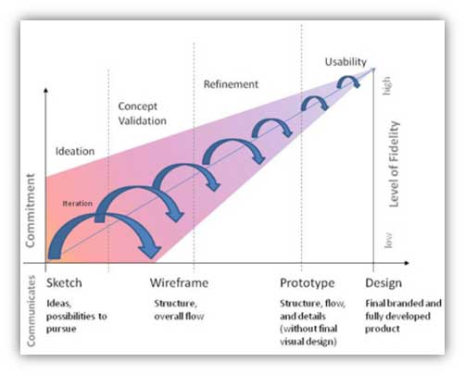
Prototypes 2

Slide 31
A/B testing
A/B Testing is when you have two different designs (A and B)
Both have certain benefits
The A/B test discovers which one has an edge over the other
Use an A/B test to determine, for example
“Which design results in the most click-throughs by users?”
“Which design layout results in more sales?”
“Which e-mail campaign performs better
The main advantage is that you can compare between two versions of the same product where the difference in design elements can be
As nominal as the color of a particular button
Or as massive as being completely different from each other.

Slide 32
Web Accessibility Initiative (WAI).
Home Page
https://www.w3.org/WAI
Principles
https://www.w3.org/WAI/fundamentals/accessibility-principles/

Slide 33
Tasks - HCI

Slide 34
Task 1
Fitts Law & Hicks Law
Explain in more detail what the concepts are including examples/different components
Fitts Law | Hicks Law

Slide 35
Task 2 - Web Accessibility Initiative (WAI).
Make your own notes on the key principles of WAI
Home Page
https://www.w3.org/WAI
Principles
https://www.w3.org/WAI/fundamentals/accessibility-principles/

Slide 36
Task 3
Evaluate the usability of the two websites below using the principles and metrics discussed on the previous slides
Examples websites you could evaluate are:
www.apple.co.uk
www.ecordia.co.uk

