Slide 1
Network Engineer L4 COMPTIA NETWORK+
N10-007 Days 3 and 4

Slide 2
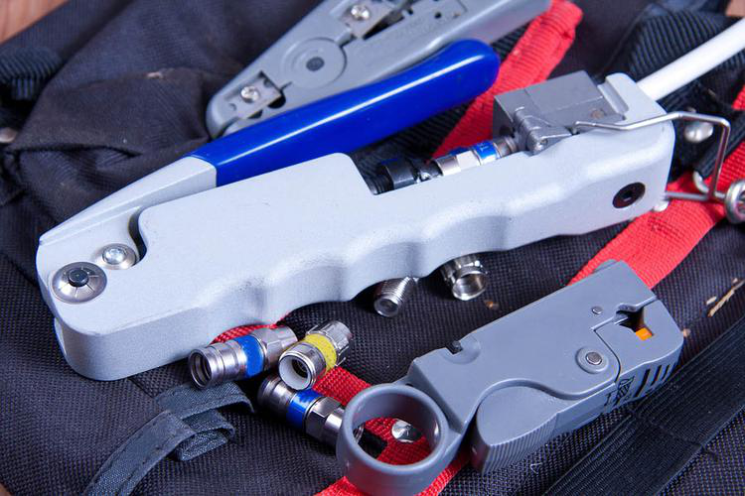
Terminating coaxial cables
Coaxial termination tools

Slide 3
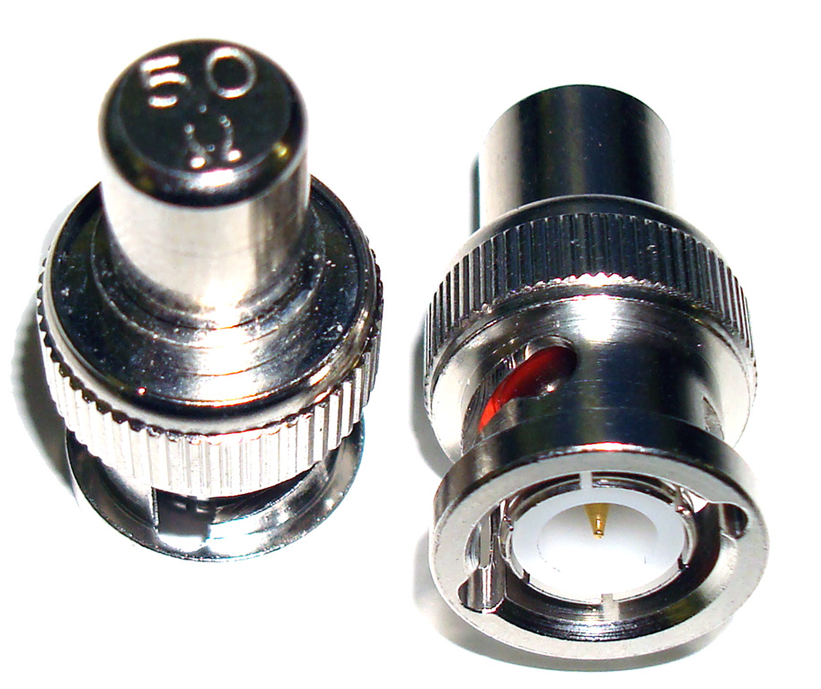
BNC Terminator
Usually 50 Ohm or 75 Ohm
The practice of ending a transmission line with a device that matches the characteristic impedance of the line
Notes:
Terminators are simple devices that electrically terminate RF coaxial ports. BNC terminator absorbs the electrical energy of the signal as it reaches the ends of cable and avoids reflection of signals.
The practice of ending a transmission line with a device that matches the characteristic impedance of the line. This is intended to prevent signals from reflecting off the end of the transmission line. Reflections at the ends of unterminated transmission lines cause distortion

Slide 4
Discussion: Coaxial media

Slide 5
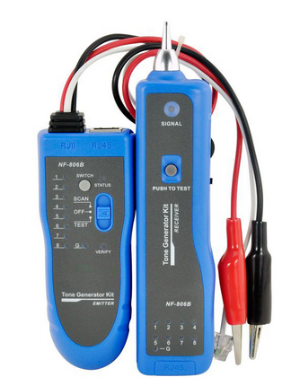
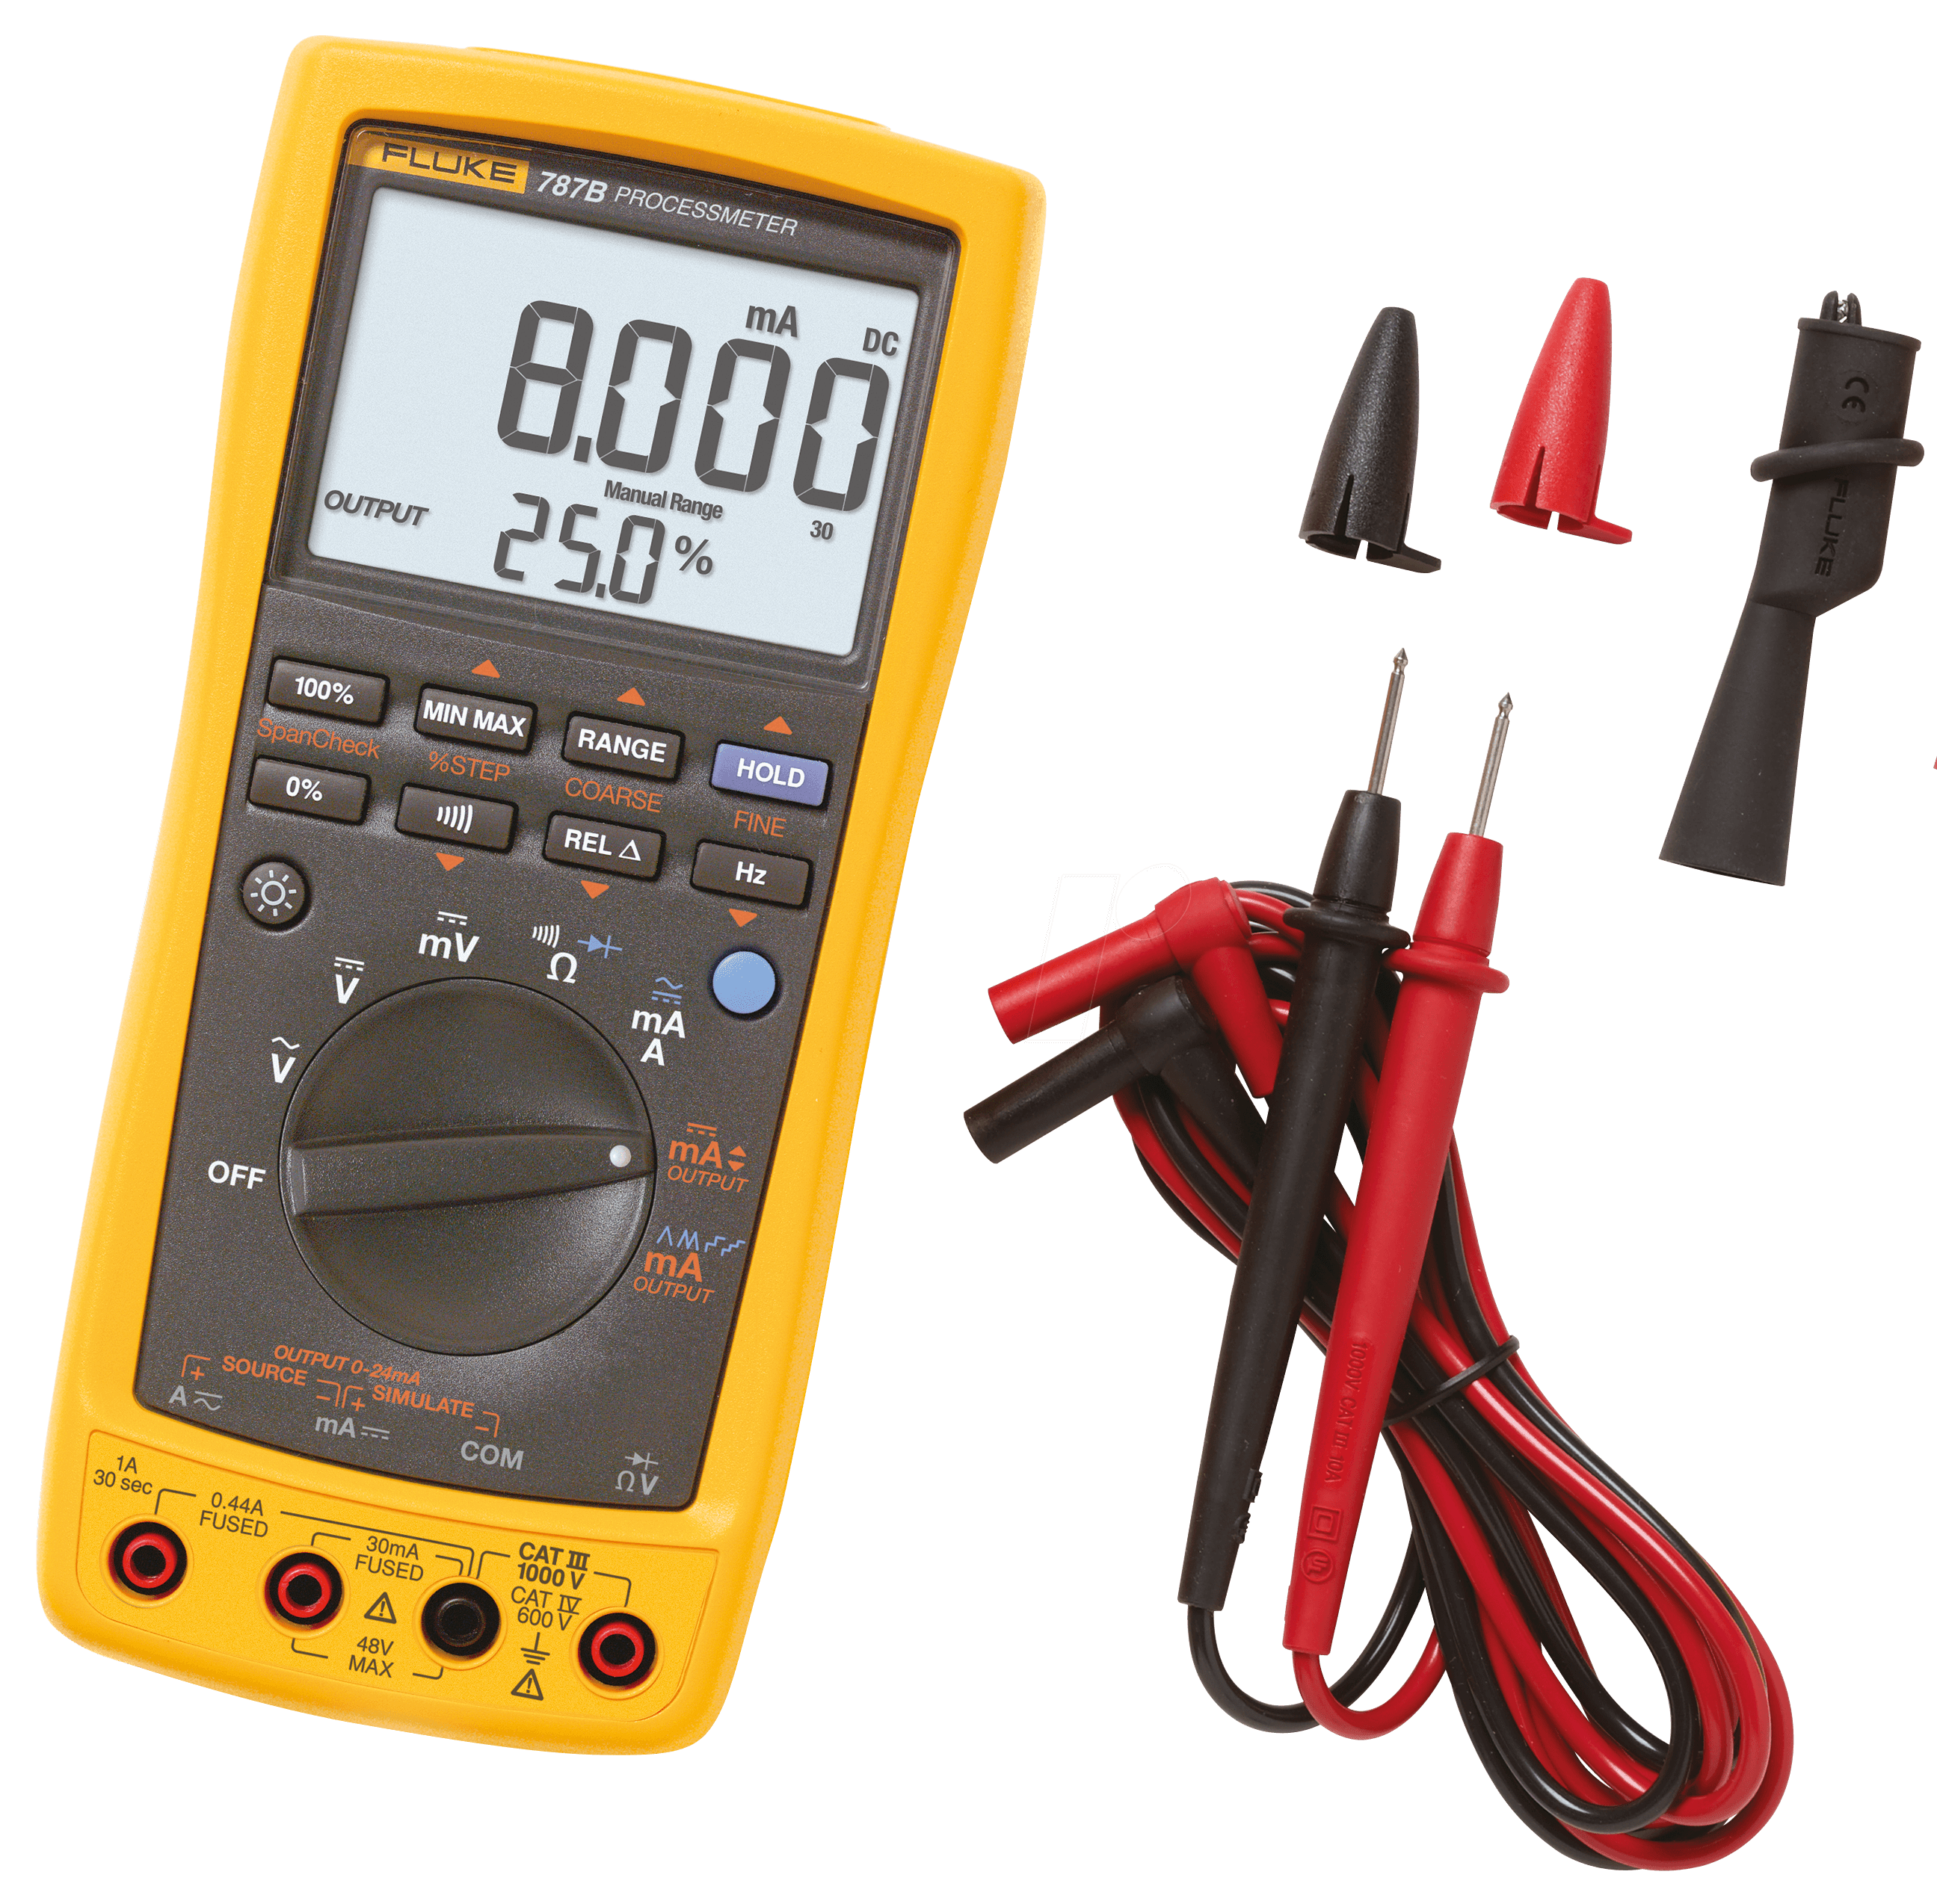
Cable testing tools
Multimeter
Tone generator

Slide 6
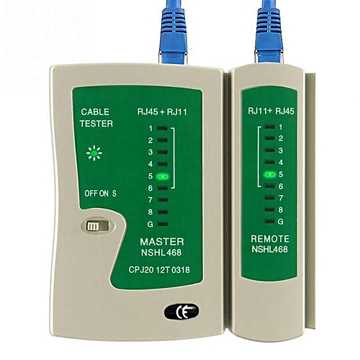
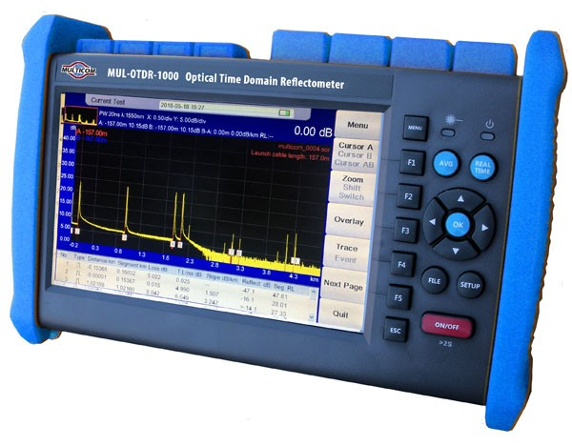
Cable testing tools (Cont.)
Cable tester
Time-domain reflectometer
Notes:
Cable tester
Network Cable Tester is a device designed to measure and test existing LAN connection or a network cable.
A time-domain reflectometer (TDR) is an electronic instrument used to determine the characteristics of electrical lines by observing reflected waveforms. It can be used to characterize and locate faults in metallic cables (for example, twisted pair wire or coaxial cable). It can also be used to locate discontinuities in a connector, printed circuit board, or any other electrical path.

Slide 7
Cable testing tools (Cont.)
Spectrum analyzer
Cable certifier
Loopback plug

Slide 8
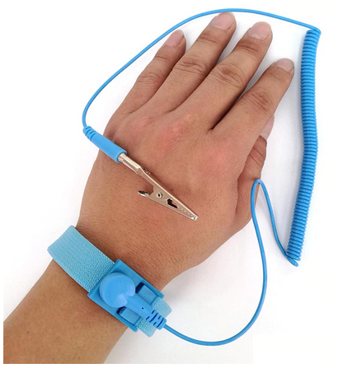
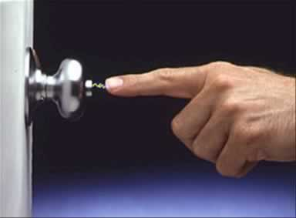
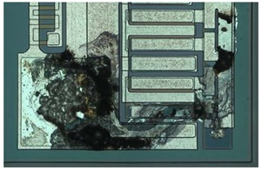
Electrical hazards
Static electricity is an imbalance of electric charges within or on the surface of a material
Notes:
Electrostatic shock can do permanent damage to sensitive electronics, even when it's not strong enough for a human to notice it. When you handle circuit boards or sensitive electronic connectors, especially in cool dry environments where it's easy for static to build, consider wearing an anti-static wrist strap to prevent damage.

Slide 9
Using multimeters
Multimeters may be analog or digital; either can measure current, voltage, or resistance.
Make sure the device is properly configured.
Set the multimeter to the appropriate test type.
If testing resistance, zero the meter by touching the leads directly together.
Touch the leads to either side of the circuit you're testing and read the display.

Slide 10
Using toner probes
Notes:
Turn on the tone generator
Bring the probe's tip over the generator's leads to verify that it's working
Connect the leads to the wire you're testing or plug in the modular jack
Move the probe closely over the cable bundle, patch panel, or punch down block you want to test
https://www.youtube.com/watch?v=Jz-gHbJz8sw

Slide 11
Copper connection troubleshooting
Breaks in cable continuity interrupt a signal
Internal or external interference cause noise, introducing errors
Cables terminated with the wrong wire order on one end carry the wrong signals and prevent a successful connection.
The same termination error made on both ends can cause noise if there are split pairs
Physical interfaces can fail too
Notes:
Breaks in cable continuity interrupt a signal. This can include damage along cables themselves, termination errors, or bent pins in a connector.
Internal or external interference cause noise, introducing errors that can make the connection slow or entirely unusable.
Cables terminated with the wrong wire order on one end carry the wrong signals and prevent a successful connection.
The same termination error made on both ends can cause noise if there are split pairs, where the wire pairs on the termination don't match the physical twisted pairs in the cable.
Physical interfaces can fail too: Not only does a jack or patch panel give another opportunity for improper termination, but a NIC, hub, or switch transceiver can fail.

Slide 12
Optical media
About optical fibers
About optical connector standards
How to troubleshoot optical networks

Slide 13
Optical fibers

Slide 14
Fiber types
Notes:
SMF – Single mode Fibre
MMF – Multi-mode Fibre

Slide 15
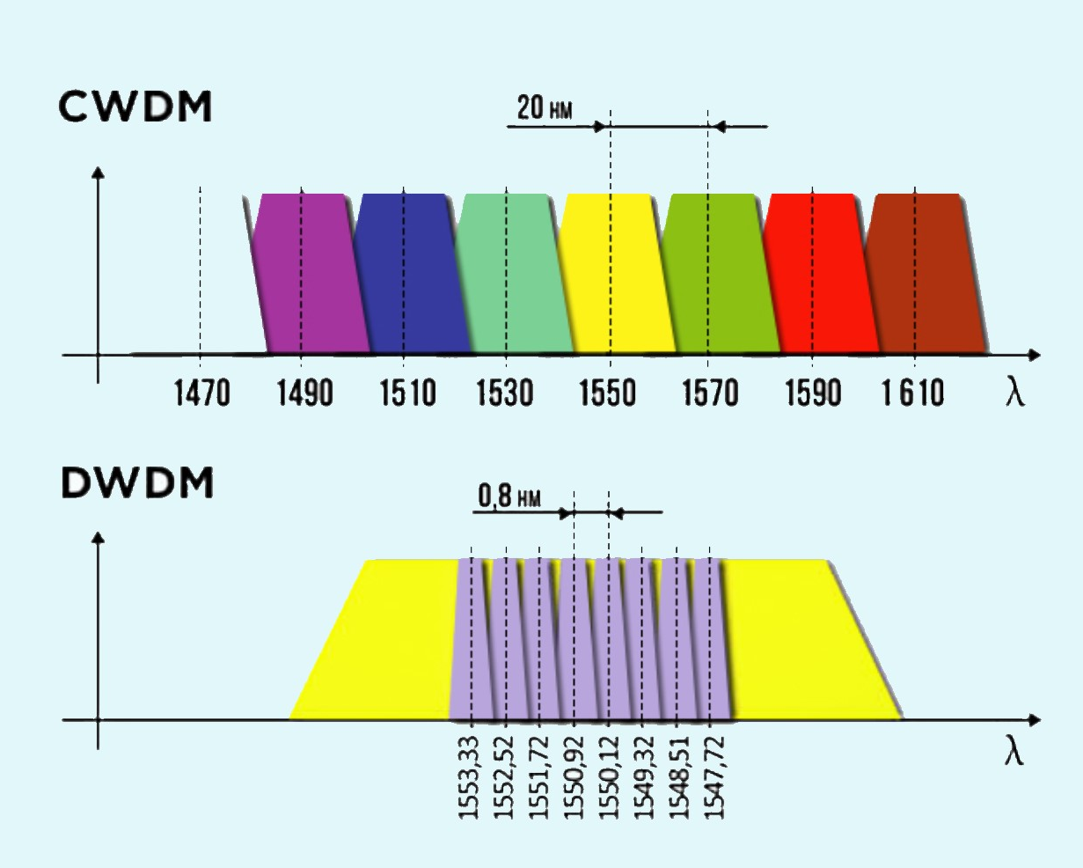
Wavelength-division multiplexing
Notes:
The two key WDM technologies are Coarse Wavelength Division Multiplexing, CWDM and Dense Wavelength Division Multiplexing, DWDM. Which solution is best suited to a given environment depends on the network and user requirements.
Coarse wavelength division multiplexing (CWDM) is a wavelength division multiplexing (WDM) technology that combines multiple signals at various wavelengths for simultaneous transmission over fibre cables.
CWDM supports up to 18 wavelength channels transmitted through a fibre at the same time. To achieve this, the different wavelengths of each channel are 20nm apart. DWDM, supports up to 80 simultaneous wavelength channels, with each of the channels only 0.8nm apart. CWDM technology offers a convenient and cost-efficient solution for shorter distances of up to 70 kilometres. For distances between 40 and 70 kilometres, CWDM tends to be limited to supporting eight channels.

Slide 16
CWDM and DWDM Statistics
 | DWDM | CWDM
Distance | 70km unamplified | 80km unamplified
 | 1000km+ amplified | Not applicable
Channels | 88 (Using interleaver) | 18 (Distances limited in the water peak)
Spacing | 0.8nm | 20nm
Protocols | All including 100G and beyond: 1/10/40/100GE and 8/16/32GFC | Up to 10GE and 8GFC (40G using 4x10G CWDM)

Slide 17
Optical fiber connectors
The industry standard connectors are rigid ferrule connectors and can be broken down into four categories:
Flat
PC
UPC
APC
Notes:
Fiber Optics Flat: Flat polish connector. These connectors are polished by the manufacturer typically have an attenuation of -30dB. Flat polish connectors control back reflection fairly well
Fiber Optics PC: Physical contact polish. These connectors are hand polished and typically have an attenuation of -30dB. PC refers to how the ferrule of the connector is polished. These connectors can cause back reflection into the ferrule and into the transmitter.
Fiber Optics SPC/UPC: SUPER POLISH CONTACT
Done by the manufacturer. -40db ULTRA POLISH CONTACT, done by the manufacturer. -50db These finishes are to help prevent back reflection into the transmitter.
Fiber Optics APC: Angled physical contact. This is done by the manufacturer, they cut the ferrule to an 8 degree angle to reduce back reflection. These connectors have an attenuation of -60dB and are used by CATV and Phone companies.

Slide 18
Optical Cable Assembly

Slide 19
Couplers and splitters
A fiber coupler is a type of splitter, where multiple fibers on one end are fused to join at a single core.
An optical coupler can be used just like a coaxial splitter, to send a single input to multiple outputs.
One thing you can't do is combine multiple inputs of the same wavelength to a single output, since they'll only interfere with each other.

Slide 20
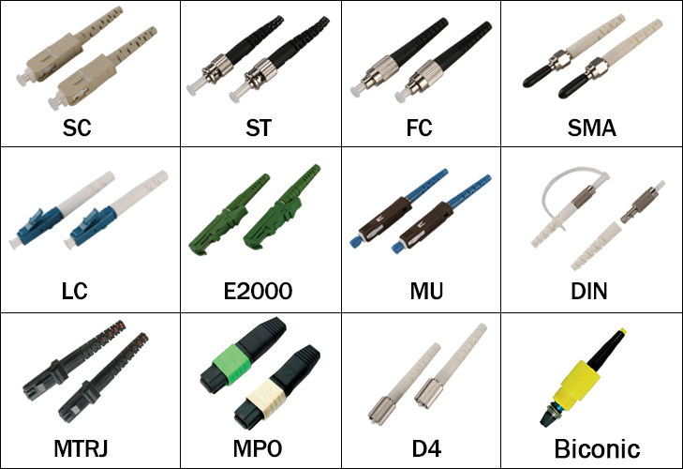
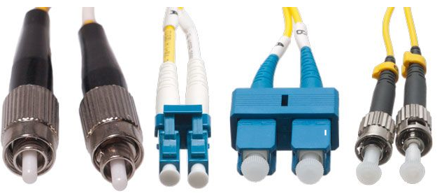
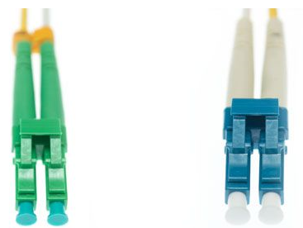
Optical connector standards
Notes:
From left to right: FC, LC, SC, and ST
A green color-coded APC connector (left) vs. a UPC connector (right)

Slide 21
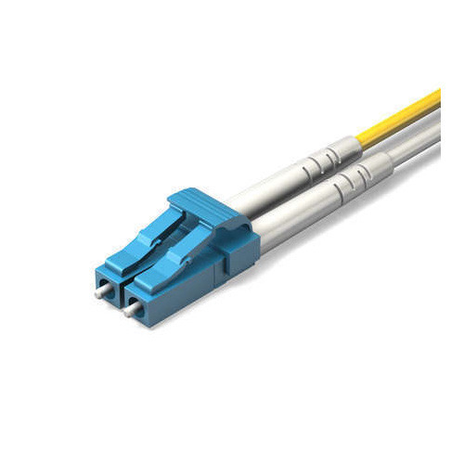
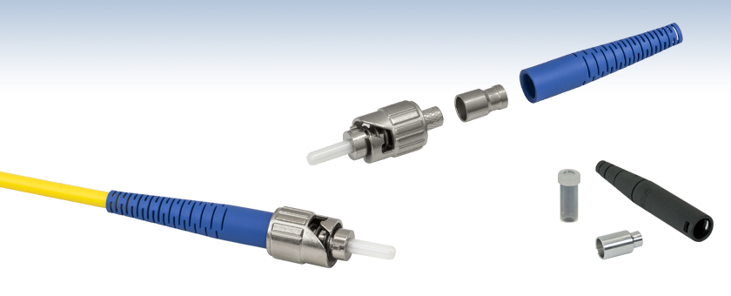
Most Common Connectors
ST
LC
SC
Notes:
SC – Subscriber Connector
The ST (straight tip connector) historically has been the most commonly used connector in the industry up to several years ago, it was not originally recognized by the standards but was added because of it’s prevalence in the industry.
The duplex SC (subscriber connector) was the first connector to be recognized by the TIA/EIA fibre standards because of it’s ease of inter-connectability and it represents a complete link (1 connector for TX the other for RX).
The new standard in fibre connectors is the LC (Lucent connector). These are small form factor (SFF) connectors that take up less space in a fibre panel.

Slide 22
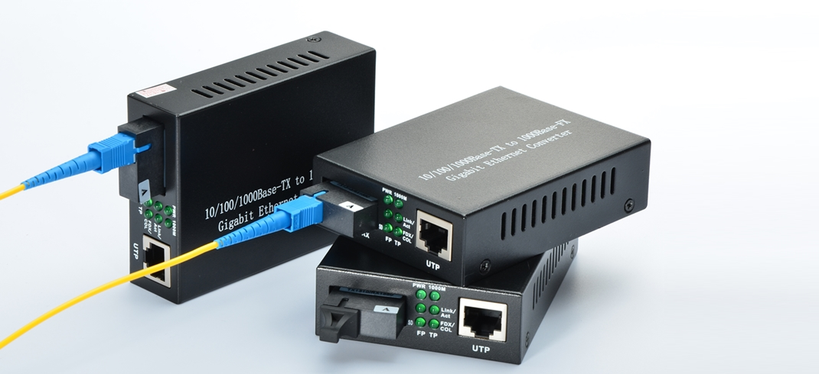
Media converters

Slide 23
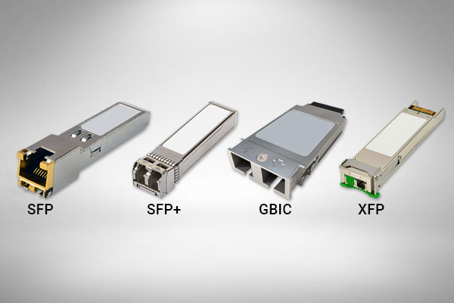
Modular transceivers
GBIC transceivers are visibly larger than those in the SFP family
GBIC
SFP
XFP
SFP+
QSFP
Notes:
A gigabit interface converter (GBIC) is a transceiver that converts electric currents (digital highs and lows) to optical signals, and optical signals to digital electric currents.
The GBIC is typically employed in fibre optic and Ethernet systems as an interface for high-speed networking.
A smaller variation of the GBIC called the small form-factor pluggable transceiver (SFP), also known as mini-GBIC, has the same functionality but in a smaller form factor. It largely made the GBIC obsolete.

Slide 24
Exercise: Identifying optical media

Slide 25
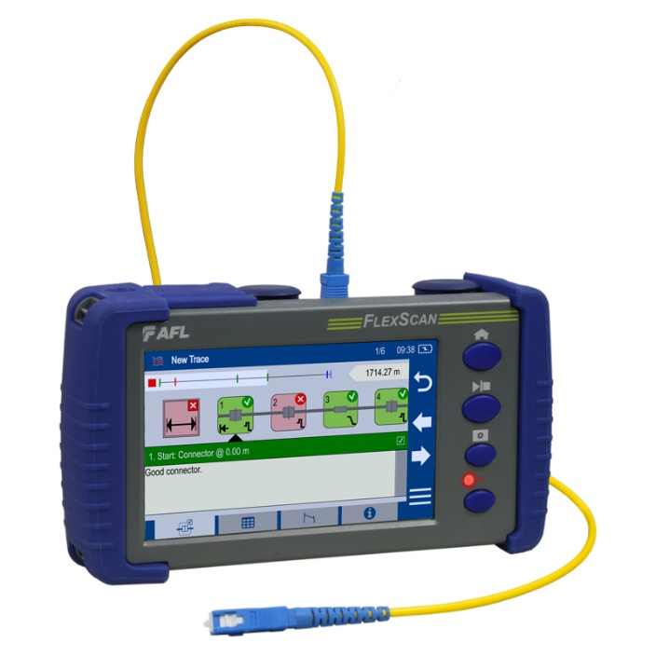
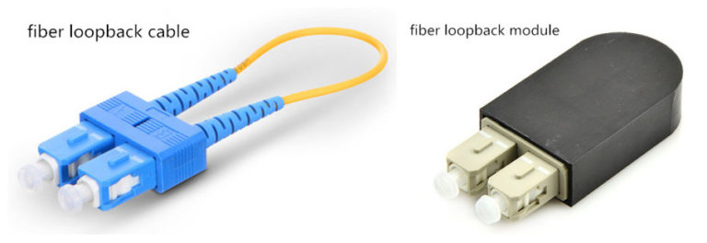
Optical cable testing tools
What you can use is a light meter, which checks cable continuity by shining a light source down an optical fiber and measures what comes out the other end.
There are optical cable testers and certifiers, optical time-domain refractometers (OTDRs), and even optical loopback plugs.

Slide 26
Optical connection troubleshooting
Problem | Impact | Description/cause | Solution
Attenuation | Noise | Cable too long, or cable flaws decreasing transparency. | Replace cable, use shorter cable, or insert repeaters.
Bad cable or connector | Noise or no signal | Flawed or damaged cable or connector. | Replace defective component.
Dirty connector | Noise | Connector ends must be kept very clean. | Clean and polish connectors, then reconnect.
Bend radius limitation | Noise | Tight bend or kinks can cause temporary or permanent damage | Straighten tight bends. Replace damaged cables.
Mismatched connection | Noise or no signal | Wrong connector type or shape. | Replace connector or module.
Mismatched wavelength | No signal | Wrong optical signal. | Replace incompatible optics.
Mismatched fiber type | No signal | MMF/SMF, or wrong fiber grade. | Replace incompatible cable.
Network hardware failure | No signal | Defective transceiver or power failure. | Diagnose or replace affected device.

Slide 27
Assessment
See assessment on…
https://forms.office.com/Pages/ResponsePage.aspx?id=fd3z5z4JJUuJnxRhvsd5lwPQkFjxXHtAr841nE0h0fZUOE5LV1VHVThLRVlXWEhPMFNYMUJLWk5NRi4u

Slide 28
Assessment: Optical media
You're at a meeting discussing whether to deploy single-mode or multimode fiber in a new installation. Which of the following arguments should you make? Choose all that apply.
Multimode is a better choice if you want to use WDM.
Multimode transceivers are less expensive.
Multimode works over longer distances.
Single-mode is a better choice if you want to use WDM.
Single-mode transceivers are less expensive.
Single-mode works over longer distances.
B, D, and F

Slide 29
Assessment: Optical media
What connectors are small form-factor types? Choose all that apply.
FC
LC
MT-RJ
SC
ST
B and C

Slide 30
Assessment: Optical media
You can use a coupler to join two optical inputs to one output, but only if they're the same wavelength. True or false?
True
False
False

Slide 31
Assessment: Optical media
While the optical cables in the closet are outwardly identical, some have green connectors, and some have blue. Which is likely true? Choose the best response.
Blue is APC, and green is UPC
Blue is MMF, and green is SMF
Blue is SMF, and green is MMF
Blue is UPC, and green is APC
D

Slide 32
Assessment: Optical media
You're setting up a new fiber-optic network using existing fiber that's been laid on your campus. You need SFP+ transceivers to plug into it, but you see there are both duplex and bidirectional transceivers available. Which should you keep in mind when planning your purchase? Choose the best response.
Bidirectional transceivers require fewer fibers but are more expensive.
Bidirectional transceivers require more fibers but give higher bandwidth.
Duplex transceivers require fewer fibers but are more expensive.
Duplex transceivers require more fibers but give higher bandwidth.
A

Slide 33
Ethernet standards
About common legacy Ethernet standards
About current Ethernet standards
About specialty Ethernet standards
How to configure advanced Ethernet features

Slide 34
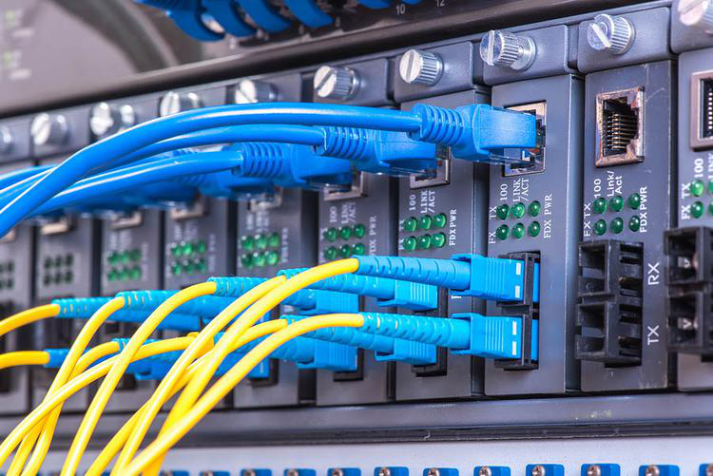
About Ethernet varieties
Both RJ-45 and SC connectors on a switch

Slide 35
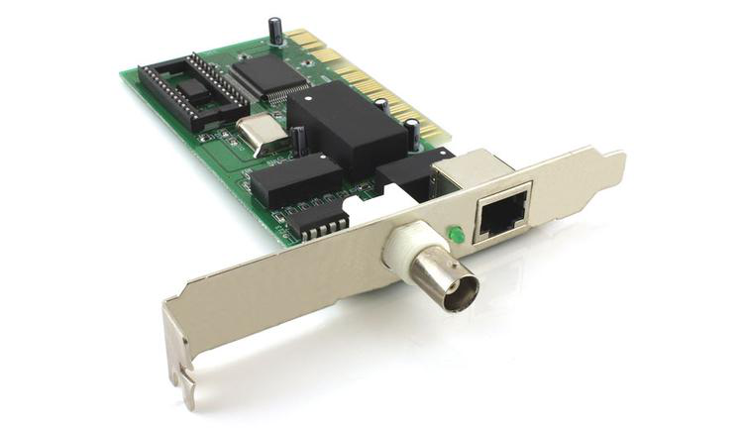
Legacy Ethernet
An older Ethernet card with 10BASE-T and 10BASE2 connectors

Slide 36
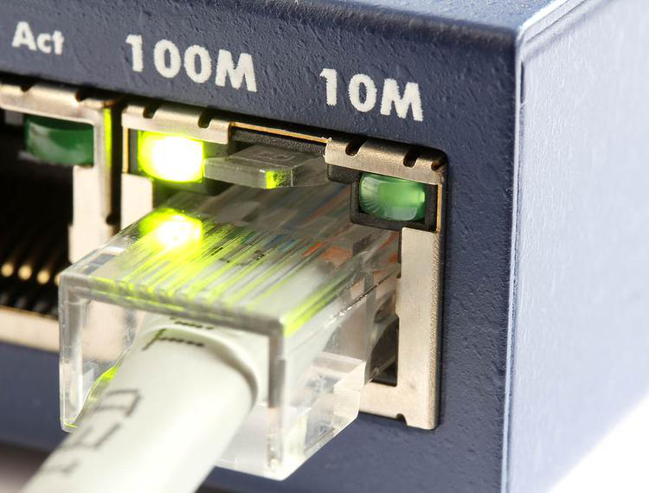
Fast Ethernet
100Mbps standards were developed, collectively called Fast Ethernet
A Fast Ethernet switch with speed indicator lights

Slide 37
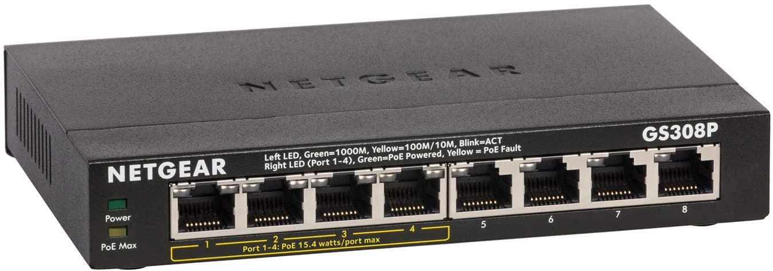
Gigabit Ethernet
Starting in 1999, Gigabit Ethernet became available, and it's still the dominant standard in consumer NICs and small network hardware.
1000BASE-T, works at up to 100m over Cat5 or higher cable. Unlike earlier standards, it requires all four pairs; two to send, two to receive

Slide 38
10 Gigabit Ethernet
10 Gigabit Ethernet is the fastest widely adopted standard today
The primary copper standard is 10GBASE-T, which has a 55m range over Cat6 cables, and 100m on Cat6a or higher
There is a wide range of 10 gigabit optical standards, varying by fiber type and wavelength
Notes:
10 Gigabit Ethernet is the fastest widely adopted standard today.
The primary copper standard is 10GBASE-T, which has a 55m range over Cat6 cables, and 100m on Cat6a or higher. There are also shorter-distance standards used on backplane-based blade servers.
There is a wide range of 10 gigabit optical standards, varying by fiber type and wavelength. For example, 10GBASE-SR operates at up to 400m over MMF at 850nm, while -ER operates at up to 40km over SMF at 1550nm.

Slide 39
Specialty Ethernet standards
IEEE 1905.1-2013 standard defines convergent networks carrying Ethernet traffic over multiple media types
Ethernet over power line is available in listed speeds up to the 1 Gbps range, but in practice speeds tend to be lower
Carrier Ethernet is usually used by ISPs on the neighbourhood or citywide level over Gigabit or faster optical links
Notes:
IEEE 1905.1-2013 standard defines convergent networks carrying Ethernet traffic over multiple media types.
Ethernet over power line is available in listed speeds up to the 1 Gbps range, but in practice speeds tend to be lower. It's still generally faster and longer range than home Wi-Fi networks while not needing any custom cabling.
Carrier Ethernet is usually used by ISPs on the neighborhood or citywide level over Gigabit or faster optical links. One standard used for Carrier Ethernet is 10GBASE-SW, which is similar to -SR but is carried by optical WAN networks using SONET (Synchronous optical networking).

Slide 40
Ethernet standards list
Name | Speed | Range | Media type | Notes
100BASE-T | 100 Mbps | 100m | Category 5 (2 twisted pairs) | Still a common speed in small networks.
100BASE-FX | 100 Mbps | 412m (half-duplex), 2 km (full-duplex) | MMF at 1300nm | Can also be used over single mode fiber with a 10km range.
1000BASE-T | 1 Gbps | 100m | Category 5 (4 twisted pairs) | Often incorrectly called 1000BASE-TX.
1000BASE-TX | 1 Gbps | 100m | Category 6 (2 twisted pairs) | Less common than 1000BASE-T
1000BASE-LX | 1 Gbps | 500m on MMF, 5km on SMF | MMF or SMF at 1300nm-1310nm | Can be used on both fiber types.
1000BASE-LX10 | 1 Gbps | 10km | SMF at 1310nm | Similar to -LX, but uses higher quality optics.
1000BASE-SX | 1 Gbps | 550m | MMF at 850nm | Range varies depending on specific cable grade.
10GBASE-T | 10 Gbps | 55m (Cat6), 100m (Cat6a) | Category 6/6A (4 twisted pairs) | 10 Gigabit standards no longer support half-duplex operation.
10GBASE-SR | 10 Gbps | 33m - 400m | MMF at 850nm | Range depends on cable grade.
10GBASE-ER | 10 Gbps | 40km | SMF at 1550nm
10GBASE-SW | 10 Gbps | 33m - 400m | MMF at 850nm | Used for transmission on SONET WAN equipment.

Slide 41
Advanced Ethernet options
Speed and duplex settings
MAC address
VLAN ID
QoS tagging
MTU
Offloading functions
Power settings
Wake-on-LAN

Slide 42
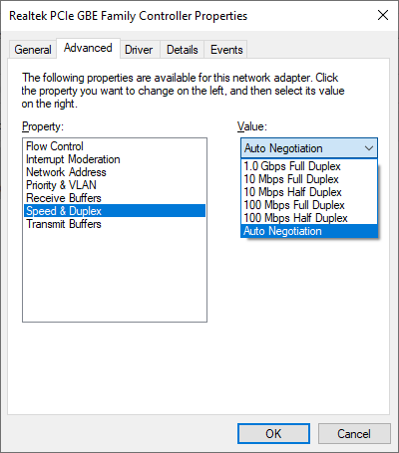
Configuring advanced Ethernet options
Advanced settings for a typical Gigabit Ethernet adapter in Windows 10

Slide 43
Exercise: Viewing Ethernet options

Slide 44
Assessment
See assessment on…

Slide 45
Assessment: Ethernet standards
What cable length is supported by most twisted-pair Ethernet standards? Choose the best response.
25m
50m
100m
200m
C

Slide 46
Assessment: Ethernet standards
Your Fast Ethernet card is showing a green light and an amber light. What does it mean? Choose the best response.
It is operating at 10Mbps
It is operating at 100Mbps
It is operating in full duplex mode
It is operating in half-duplex mode
B

Slide 47
Assessment: Ethernet standards
Which twisted-pair Ethernet standards require use of all four wire pairs? Choose all that apply.
10BASE-T
100BASE-TX
1000BASE-T
1000BASE-TX
10GBASE-T
C and E

Slide 48
Assessment: Ethernet standards
How large are jumbo frames? Choose the best response.
Over 500 bytes
Over 1500 bytes
Over 2500 bytes
Over 4500 bytes
B

Slide 49
Summary: Physical networks
You should now know how to:
About physical signaling, symbols, bit streams, bandwidth, and multiplexing
How to distinguish network infrastructure devices, including repeaters, hubs, bridges, switches, routers, and gateways
About copper cables and connectors, including both twisted pair and coaxial standards
The difference between SMF and MMF optical cables, and the connectors used for both
Common Ethernet standards, from early coaxial networks to modern 10 gigabyte backbones

Slide 50
Infrastructure and design
We define the structure of our networks based on the reach and functionality of the data flows
Here you’ll learn about WAN, MAN, LAN, WLAN, PAN, SCADA, and Medianet infrastructures.

Slide 51
WAN
Wide Area Network
A Wide Area Network (WAN) is where the workstations are 'further apart' from each other compared to a LAN
For example, the computers may be spread out over a town, a country or the world (like the Internet is).
WANs are usually a number of LANs that are connected up over some distance
The connections are frequently made using the normal telephone cables but they might involve fibre optic connections, wireless, microwave or satellite, for example

Slide 52
LAN
A Local Area Network (LAN) is a network where the workstations are 'close' together
It isn't strictly defined in terms of an exact distance but it is usually thought of as computers in the same room, or building or even in a number of buildings which are next to each other, such as a school or hospital
The different parts of the network might be connected together using wireless signals or they may be physically connected together using cables such as a type known as CAT 5 or using a fibre optic cable.

Slide 53
LAN
With computers and computer equipment connected together in a LAN, users can do a number of things:
They can log on using a login name and password - this stops unauthorised users from getting access to the network.
They can use any computer on the LAN, even if their most convenient one isn't working.
They can easily share files and resources with other users. You only need one printer for all the users, for example.
They can easily communicate with other users in their organisation by sending them email or by using an internal Internet known as an Intranet. Intranets are like the Internet but they are only accessible by people in the organisation. Using the Intranet, you can send messages, set up bulletin boards, web pages

Slide 54
Differences between LANs and WANs
LANs are spread over a smaller area whereas WANs are spread over a larger area
WANs are usually made up of LANs connected together
LANs are usually much faster than WANs
LANs can usually send much bigger volumes of data in a second (known as 'bandwidth') than a WAN
Users generally share hardware on a LAN
On a WAN, however, the focus is all on communicating and sharing data

Slide 55
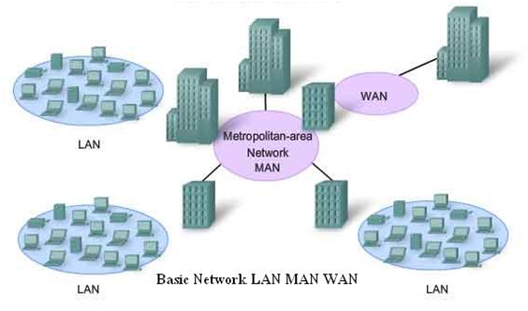
MAN
A metropolitan area network (MAN) is a computer network that interconnects users with computer resources in a geographic region of the size of a metropolitan area

Slide 56
WLAN
A wireless LAN (WLAN) is a wireless computer network that links two or more devices using wireless communication to form a local area network (LAN) within a limited area such as a home, school, computer laboratory, campus, or office building
This gives users the ability to move around within the area and remain connected to the network
Through a gateway, a WLAN can also provide a connection to the wider Internet
Most modern WLANs are based on IEEE 802.11 standards and are marketed under the Wi-Fi brand name
Wireless LANs have become popular for use in the home, due to their ease of installation and use
They are also popular in commercial properties that offer wireless access to their employees and customers

Slide 57
PAN
A PAN is a Personal Area Network
This is a network that revolves around one person or a small group of people
For example, it might involve just a laptop, a phone and perhaps some wearable technology
PANs can be wired but often, they are wireless networks
The most common wireless technology used to create a PAN is Bluetooth but other wireless technologies can be used, such as infra-red or NFC
The typical radius of a PAN is only about 10 metres so it is very much a network for use in a small area

Slide 58
SCADA
SCADA is an acronym for supervisory control and data acquisition, a computer system for gathering and analysing real time data
SCADA systems are used to monitor and control a plant or equipment in industries such as telecommunications, water and waste control, energy, oil and gas refining and transportation.

Slide 59
SCADA

Slide 60
MediaNet
A medianet is a network optimized for rich media - not only voice and video, but the mixing together of videos and documents, webpages, text, and many other forms of media
The applications must be able to query the network for services and information in order to offer users a better experience

Slide 61
Networking concepts
About network connectivity
About network components
About goals and challenges of network design

Slide 62
Connectivity
To allow two or more points to connect and exchange information.
Connectivity requires multiple conditions.
A physical connection between all points on your network.
Each system on the network must be able to transmit information to any other system it might want to communicate with.
The target system must be able to recognize, and act on, the data it receives.

Slide 63
Network components
Node
Host
Media
Data
Bit
Networking device

Slide 64
Physical vs. logical networks
The physical network is just what it sounds like: the network of interface cards, network hardware, cables, and so on that you can see when you look around the building.
The logical network is the information carried by the physical network, and the paths the information follows.
LAN
Repeater
LAN
Building
Building
Notes:
The physical network is just what it sounds like: the network of interface cards, network hardware, cables, and so on that you can see when you look around the building.
The logical network is the information carried by the physical network, and the paths the information follows.

Slide 65
Networking challenges - Availability
Provisioning un-interrupted and timely access to authorized subjects
Offers high level of assurance that data shall be available to authorized subjects
It includes
Usability
Accessibility
Timeliness
Threats
Device failure
Software error
Natural calamity
Power
Human error
oversight
Countermeasures
RAID
Redundant systems
Clustering
Access control
BCP/DR
Fault tolerance

Slide 66
Networking challenges - Reliability
Reliability is concerned with the ability of a network to carry out a desired operation such as "communication“
An unstable network structure can immediately impact your operations
Network reliability issues can be described in terms such as packet loss, bandwidth saturation, and latency

Slide 67
Networking challenges - Serviceability
Serviceability affects availability, as well
You can detect and repair failures more quickly in a serviceable system than in an unserviceable one, meaning you'll have less downtime per incident on average.

Slide 68
Networking challenges - Performance
Many reasons behind faulty network performance
Network problems can arise from faulty hardware such as routers, switches, and firewalls
They can also arise from unexpected usage patterns such as in the case of network bandwidth spikes that exceed their allocated bandwidth for users, or due to security breaches or changes in device configuration

Slide 69
Networking challenges - Security
What is meant by security?
Cyber security is the protection of internet-connected systems, including hardware, software and data, from cyber attacks
In a computing context, security comprises cybersecurity and physical security
Used by enterprises to protect against unauthorized access to data centers and other computerized systems
Information Security refers to the protection of data, programs, and information stored on disks, networks, hard drives, etc. and includes within itself the issues of privacy, ethics, and loss prevention

Slide 70
Networking challenges - Scalability
The ability of a process, network, software or organization to grow and manage increased demand
Ready to handle the influx of demand, increased productivity, trends, changing needs and even presence or introduction of new competitors

Slide 71
Networking challenges - Compatibility
Involves a trade off with performance

Slide 72
Networking challenges - Quality of Service (QoS)
Problems with QoS performance generally result from one of two categories of causes
The network may be experiencing generalized issues, such as saturated bandwidth, high latency or packet loss, that are affecting all traffic
There can be issues with the QoS settings for the traffic that is exhibiting problems

Slide 73
Assessment
See assessment on…

Slide 74
Assessment: Networking concepts
What sort of a device may or may not be a host, depending on context? Choose the best response.
A file server
A printer
A switch
A user workstation
B

Slide 75
Assessment: Networking concepts
The physical and logical network can't be totally separated from one another. True or false?
True
False
True

Slide 76
Assessment: Networking concepts
What qualities should a high-performance network have? Choose all that apply.
High latency
Low latency
High scalability
High throughput
B and D

Slide 77
Module B: Classifying networks
In this module, you'll learn:
About scope
About topology
About resource-sharing models

Slide 78
Scope
A network's scope is its physical extent; not in the sense of its number of nodes, but how far apart they are.
The most common scopes you'll see discussed are Local Area Networks and Wide Area Networks, both of which you likely use on a daily basis.

Slide 79
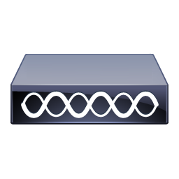
Local area networks
A Local Area Network (LAN) is confined to a fairly small area, usually within a single building.
Server

Slide 80
Wide area networks
A Wide Area Network (WAN) extends over a very large area, with nodes in multiple cities or countries.
WAN
Server
Server

Slide 81
Other scopes
Campus Area Network (CAN)
Metropolitan Area Network (MAN)
Personal Area Network (PAN)
Notes:
Campus Area Network (CAN)
A campus area network (CAN) is a network of multiple interconnected local area networks (LAN) in a limited geographical area. A CAN is smaller than a wide area network (WAN) or metropolitan area network (MAN). A CAN is also known as a corporate area network (CAN).
Metropolitan Area Network (MAN)
A metropolitan area network (MAN) is a network that interconnects users with computer resources in a geographic area or region larger than that covered by even a large local area network (LAN) but smaller than the area covered by a wide area network (WAN).
Personal Area Network (PAN)
A personal area network, or PAN, is a computer network that enables communication between computer devices near a person. PANs can be wired, such as USB or FireWire, or they can be wireless, such as infrared, ZigBee, Bluetooth and ultrawideband, or UWB. The range of a PAN typically is a few meters.

Slide 82
Policies and Best Practice
Electrical Safety
Physical/Installation Safety
Fire Safety
Emergency Procedures

Slide 83
Electrical Safety
The inherent danger of electricity,
Grounding
Static
Notes:
Electricity can shock you badly, damage you, or even kill you. Keep the networking closet or room clear of clutter. Never use frayed cords. Use the same skills you use to avoid getting shocked by electricity in everyday life. Use common sense.
Use properly grounded circuits. This is more a data safety issue than a personal safety issue. Poorly grounded circuits can create a ground loop—where a voltage differential exists between two parts of your network. This can cause data to become unreadable. Improper grounding also exposes equipment to more risk from power surges. Electrostatic discharge (ESD)—the passage of a static electrical charge from one item to another—can damage or destroy computing equipment. It’s important to wear a properly connected anti-ESD wrist strap when replacing a NIC or doing anything inside a workstation

Slide 84
Physical/Installation Safety
Avoid Trip hazards
Be aware of HOW you lift equipment
Installing equipment in Racks
Power
Mounting
Environment
Notes:
IT technicians live in a dangerous world. We’re in constant danger of tripping, hurting our backs, and getting burned by hot components. You also need to keep in mind what you wear (in a safety sense). Let’s take a moment to discuss these physical safety issues and what to do about them.
Installing components into a rack isn’t too challenging of a process. Standard 19-inch equipment racks are designed to accept a tremendous amount of abuse, making it sometimes far too easy for people to use them in ways where failure is almost a guarantee. In general, you need to keep in mind three big areas when using rack-mounted equipment: power, mounting, and environment.
Power Rack-mounted equipment has a number of special power needs. At an absolute minimum, start with a proper power source. A single small rack can get away with a properly grounded, 20-amp dedicated circuit. Larger installations will require larger, sometimes dedicated power transformers supplied by the local power grid.
Mounting Installing gear into a safe, electrically sound, stable rack is a well-established process. For components that connect directly to a rack, such as switches, routers, and patch panels, hold them in place and secure them with four screws
Environment Racks with servers, switches, routers, and such go into closets or server rooms and they dump heat. The environment within this space must be monitored and controlled for both temperature and humidity. Network components work better when cool rather than hot.

Slide 85
Fire Safety
Comply with local fire codes
Know what to do in the event of a fire

Slide 86
Emergency Procedures
Have proper emergency procedures in place before the emergencies happen
Exit signs should be posted strategically so people can quickly exit in a real emergency
Secured spaces, such as server rooms, need some default safety mechanism in case of an emergency
Notes:
A final step in managing risk in any company is to have proper emergency procedures in place before the emergencies happen. Exit plans need to cover building layout, fire escape plans, and the locations of emergency exits. Exit signs should be posted strategically so people can quickly exit in a real emergency. Secured spaces, such as server rooms, need some kind of default safety mechanism in case of an emergency. Locked doors need to fail open—doors default to open in case of emergency—or fail closed—doors lock in case of emergency.

Slide 87
Network Engineer L4 COMPTIA NETWORK+
N10-007
Module 2

Slide 88
Module 2 - IP Addressing
Internet Protocol
IPv4 Addressing
IPv6 Addressing
DHCP and APIPA

Slide 89
Internet Protocol
A set of rules governing the format of data sent over the Internet or other network
The Internet Protocol is the principal communications protocol in the Internet protocol suite for relaying datagrams across network boundaries
Its routing function enables internetworking, and essentially establishes the Internet

Slide 90
IPv4
Is a Network Layer Protocol
Provides logical host and network addressing, and routing
Provides a best effort delivery
Packet might be delivered out of sequence, lost entirely, duplicated, or delayed
Notes:
Internet Protocol version 4 (IPv4) is the fourth version of the Internet Protocol (IP). It is one of the core protocols of standards-based internetworking methods in the Internet and other packet-switched networks. IPv4 was the first version deployed for production in the ARPANET in 1983

Slide 91
IPv4 Address
The IP address is a unique identifier for each device on a network
IP provides
Specification of the exact format of all data
Performs routing functions
Includes a set of rules

Slide 92
IPv4 Address
A 32 bit numeric address divided into 4 parts
Each 8-bit block is known as an octet
Has a denary range of 0 to 255
IPv4 produces 4 billion unique addresses (4 x 10⁹)
Example: 192.168.1.5

Slide 93
IPv4 Address Conversion
.
.
.
8 Bits
8 Bits
8 Bits
8 Bits
When all bits are set to the value of 1 we get the sum of 255
.
.
.
11111111
1111111
1111111
11111111
2⁷ + 2⁶ + 2⁵ + 2⁴ + 2³ + 2² + 2¹ + 2⁰
128 + 64 + 32 + 16 + 8 + 4 + 2 + 1
=
255
Notes:
We have a representation of the format of IPv4
When all bits are set to the value of 1 we get the sum of 255

Slide 94
IPv4 Example
.
.
.
192
168
24
15
.
.
.
11000000
10101000
00011000
00001111
2⁷ + 2⁶ + 0 + 0 + 0 + 0 + 0 + 0
128 + 64
=
192

Slide 95
IPv4 Example
.
.
.
192
168
24
15
.
.
.
11000000
10101000
00011000
00001111
2⁷ + 0 + 2⁵ + 0 + 2³ + 0 + 0 + 0
128 + 32 + 8
=
168

Slide 96
IPv4 Example
.
.
.
192
168
24
15
.
.
.
11000000
10101000
00011000
00001111
0 + 0 + 0 + 2⁴ + 2³ + 0 + 0 + 0
16 + 8
=
24

Slide 97
IPv4 Example
.
.
.
192
168
24
15
.
.
.
11000000
10101000
00011000
00001111
0 + 0 + 0 + 0 + 2³ + 2² + 2¹ + 2⁰
8 + 4 + 2 + 1
=
15

Slide 98
IPv4 Datagram
20 to 65535 bytes
20 bytes
Header
Data

Slide 99
IPv4 Datagram
Header
Data
VER
4 bits
HLEN
4 bits
Service Type
8 bits
Total Length
16 bits
Identification (Fragment ID)
16 bits
Flags
3 bits
Fragmentation Offset
13 bits
Time to Live
8 bits
Protocol
8 bits
Header Checksum
16 bits
Source IP Address
Destination IP Address
Options
Notes:
The IP Version field (4 bits) contains the value 4, which in binary is “0100”
The Header Length field (4 bits) indicates how long the header is, in 32 bit “words”. The minimum value is “5” which would be 160 bits, or 20 bytes. The maximum length is 15, which would be 480 bits, or 60 bytes. If you skip that number of words from the start of the packet, that is where the data starts (this is called the “offset” to the data). This will only ever be greater than 5 if there are options before the data part (which is not common).
The Type of Service field (8 bits) is defined in RFC 2474, “Definition of the Differentiated Services Field (DS Field) in the IPv4 and IPv6 headers”, December 1998. This is used to implement a fairly simple QoS (Quality of Service). QoS involves management of bandwidth by protocol, by sender, or by recipient.
The Total Length field (16 bits) contains the total length of the packet, including the packet header, in bytes. The minimum length is 20 (20 bytes of header plus 0 bytes of data), and the maximum is 65,535 bytes (since only 16 bits are available to specify this). All network systems must handle packets of at least 576 bytes, but a more typical packet size is 1508 bytes. With IPv4, it is possible for some devices (like routers) to fragment packets (break them apart into multiple smaller packets) if required to get them through a part of the network that can’t handle packets that big. Packets that are fragmented must be reassembled at the other end. Fragmentation and reassembly is one of the messy parts of IPv4 that got cleaned up a lot in IPv6.
The Identification (Fragment ID) field (16 bits) identifies which fragment of a once larger packet this one is, to help in reassembling the fragmented packet later.
The next three bits are flags related to fragmentation. The first is reserved and must be zero. The next bit is the DF (Don’t Fragment) flag. If DF is set, the packet cannot be fragmented (so if such a packet reaches a part of the network that can’t handle one that big, that packet is dropped). The third bit is the MF (More Fragments) flag. If MF is set, there are more fragments to come. Unfragmented packets of course have the MF flag set to zero.
The Fragment Offset field (13 bits) is used in reassembly of fragmented packets. It is measured in 8 byte blocks. The first fragment of a set has an offset of 0.
The Time To Live (TTL) field (8 bits) is to prevent packets from being shuttled around indefinitely on a network.
The Protocol field (8 bits) defines the type of data found in the data portion of the packet. Protocol numbers are not to be confused with ports.
Some common protocol numbers are:
1 ICMP Internet Control Message Protocol (RFC 792)
6 TCP Transmission Control Protocol (RFC 793)
17 UDP User Datagram Protocol (RFC 768)
41 IPv6 IPv6 tunneled over IPv4 (RFC 2473)
83 VINES Banyan Vines IP
89 OSPF Open Shortest Path First (RFC 1583)
132 SCTP Streams Control Transmission Protocol
The Header Checksum field (16 bits). The 16-bit one’s complement of the one’s complement sum of all 16 bit words in the header.
The Source Address field (32 bits) contains the IPv4 address of the sender (may be modified by NAT).
The Destination Address field (32 bits) contains the IPv4 address of the recipient (may be modified by NAT in a reply packet).
Options (0 to 40 bytes) Not often used. Rarely if ever seen “in the wild”. These are not relevant here. If you want the details, read the RFCs.

Slide 100
IPv4 Limitations
Limited number of IP addresses (4 billion)
No provision for authentication
Security issues
No provision for routing
Does not work well with large networks
Notes:
4 billion addresses, but more than 7 billion people with multiple devices

Slide 101
Common Internet protocols
TCP/IP (Transmission Control Protocol/Internet Protocol) is a stream protocol.
Any data transmitted between these two endpoints is guaranteed to arrive, thus it is a so-called lossless protocol.
It is also called a peer-to-peer protocol.
HTTP (HyperText Transfer Protocol) is the protocol used to transmit all data present on the World Wide Web.
It is the protocol used to transmit HTML, the language that makes all the fancy decorations in your browser. It works upon TCP/IP.
FTP (File Transfer Protocol) is the protocol used to transmit files between computers connected to each other by a TCP/IP network, such as the Internet
TCP/IP
HTTP
FTP
UDP (User Datagram Protocol) is one of the core members of the Internet protocol suite.
UDP uses a simple connectionless communication model with a minimum of protocol mechanisms.
UDP
Notes:
TCP/IP (Transmission Control Protocol/Internet Protocol) is a stream protocol. This means that a connection is negotiated between a client and a server. Any data transmitted between these two endpoints is guaranteed to arrive, thus it is a so-called lossless protocol. Since the TCP protocol (as it is also referred to in short form) can only connect two endpoints, it is also called a peer-to-peer protocol.
HTTP (HyperText Transfer Protocol) is the protocol used to transmit all data present on the World Wide Web. This includes text, multimedia and graphics. It is the protocol used to transmit HTML, the language that makes all the fancy decorations in your browser. It works upon TCP/IP.
FTP (File Transfer Protocol) is the protocol used to transmit files between computers connected to each other by a TCP/IP network, such as the Internet
UDP (User Datagram Protocol) is one of the core members of the Internet protocol suite. UDP uses a simple connectionless communication model with a minimum of protocol mechanisms

Slide 102
The TCP/IP Protocol Suite
A protocol suite is a collection of protocols that are designed to work together
Application
SMTP, FTP, HTTP, POP3, IMAP4, SNMP
Presentation
Application
Session
Transport
Transport
TCP &UDP
Networking
Networking
IP
Datalink
Datalink and Physical
Physical
Ethernet
OSI
TCP/IP
Protocols
Notes:
Note: The OSI model is an idealised networking model, whereas the TCP/IP model is a practical implementation.
What is important to understand is that the interfaces between the interfaces are well defined so that it is theoretically possible to replace a particular protocol with another one that operates at that level.
For example you should theoretically be able to replace the IP networking protocol with the IPX networking protocol without affecting how the application e.g. POP3 works.
Although this doesn’t always apply the application protocols like SMTP ,POP3 etc will work Okay across different data link protocols like Ethernet,Token ring etc.

Slide 103
Internetworking
Internetworking is the process or technique of connecting different types of networks by using intermediary devices such as routers or gateway devices in order to exchange packets
Internetworking ensures data communication among networks owned and operated by different entities using a common data communication and the Internet Routing Protocol
An internetworking device is a widely-used term for any hardware within networks that connect different network resources
Key devices that comprise a network are routers, bridges, repeaters and gateways

Slide 104
IPv4 Addressing
IP addresses are 32-bit binary values: for readability purposes they're usually written as four octets in dotted decimal location
It's not just a serial number though: each address has two parts
The network ID identifies a unique subnet on the wider network, while the host ID identifies a specific host on that subnet.
192.168.
133.178
Network ID
Host ID
Notes:
IP addresses are 32-bit binary values: for readability purposes they're usually written as four octets in dotted decimal location. It's not just a serial number though: each address has two parts
The network ID identifies a unique subnet on the wider network, while the host ID identifies a specific host on that subnet.

Slide 105
IPv4 addresses (Cont.)

Slide 106
Classful and classless addressing
Class | First octet | First bits | # of subnets | # of hosts | Subnet mask | Mask prefix
A | 0.-127. | 0 | 128 | 16,777,216 | 255.0.0.0 | /8
B | 128.-191. | 10 | 16,384 | 65,536 | 255.255.0.0 | /16
C | 192.-223. | 110 | 2,097,152 | 256 | 255.255.255.0 | /24
D | 224.-239. | 1110 | * | * | * | *
E | 240.-254. | 1111 | * | * | * | *
Classless interdomain routing (CIDR)

Slide 107
Problems with class-based IP addressing
The old method of IP addressing came with inefficiencies that exhausted the availability of IPv4 addresses faster than it needed to
The classful routing system included classes A, B, and C:
Class A - Over 16 million host identifiers
Class B - 65,535 host identifiers
Class C - 254 host identifiers
Notes:
The problem would commonly occur when an organization required more than 254 host machines and therefore would no longer fall into class C but rather class B.
This means that the organization would use a class B license even though they had far less than 65,535 hosts.
Therefore if an organization only required 2,500 hosts, they would be wasting about 63,000 hosts by holding a class B license which would greatly decrease the availability of IPv4 addresses unnecessarily.

Slide 108
Classless interdomain routing (CIDR)
An IP addressing scheme that improves the allocation of IP addresses
It replaces the old system based on classes A, B, and C
This scheme also helped greatly extend the life of IPv4 as well as slow the growth of routing tables
Notes:
How does CIDR work?
CIDR is based on variable-length subnet masking (VLSM). This allows it to define prefixes of arbitrary lengths making it much more efficient than the old system. CIDR IP addresses are composed of two sets of numbers. The network address is written as a prefix, like you would see a normal IP address (e.g. 192.255.255.255). The second part is the suffix which indicates how many bits are in the entire address (e.g. /12). Putting it together, a CIDR IP address would look like the following:
192.255.255.255/12

Slide 109
Map of Regional Internet Registries

Slide 110
Variable-length subnet masking
The simplest way to subnet is to use fixed length subnet masking (FLSM), which divides a network into multiple subnets with the same mask prefix number.
The alternative is variable length subnet masking (VLSM), which allows you to subnet a network in multiple "passes", breaking it into subnets of variable size and thus variable subnet length.

Slide 111
Special IPv4 addresses
0.0.0.0 is a non-routable address which can either mean the current network, the default route, any address at all, or a specific error condition, depending on context.
255.255.255.255 is the broadcast address to the currently configured subnet.
The entire Class A network 127.0.0.0 is reserved for loopback addresses, which as the name implies simply point right back to the local host.

Slide 112
Special IPv4 addresses
Three private network ranges are defined for internal LANs.
10.0.0.0/8, or the single Class A network with addresses 10.0.0.0 - 10.255.255.255
172.16.0.0/12, or the 16 contiguous Class B networks with addresses 172.16.0.0 - 172.31.255.255.
192.168.0.0/16, or the 256 contiguous Class C networks with addresses 192.168.0.0 - 192.168.255.255.
The 169.254.0.0/16 network is reserved for link-local or automatic Private IP addressing (APIPA) addresses.

Slide 113
IPv4 subnetting
The main things to remember are that every IPv4 address is split into network ID and host ID, that each part consists of a contiguous series of bits in the binary address, and that both together are 32-bits
When you subnet an address, that means you borrow bits from the host ID portion, meaning fewer possible hosts, in exchange for making more subnets.

Slide 114
IPv6 Addressing
Internet Protocol v6 - 128-bit address
340,282,366,920,938,463,463,374,607,431,768,211,456 addresses (340 undecillion)
6.8 billion people could have 5,000,000,000,000,000,000,000,000,000 addresses each

Slide 115
IPv6 Address Compression
Your DNS will become very important!
Groups of zeros can be abbreviated with a double colon ::
Only one of these abbreviations allowed per address
Leading zeros are optional

Slide 116
IPv6
IPv6 uses a 128-bit address: this allows 2¹²⁸ addresses
It allows easier network configuration, more efficient routing and data flow, and even improved security
The primary drawback is that it's a much different protocol from IPv4 and isn't backwards-compatible

Slide 117
IPv6 addresses
Instead of dotted decimal, they're written as 32 hexadecimal digits, broken into eight groups of four separated by colons
fe80:0000:0000:0000:c249:3765:00c0:9b22

Slide 118
Ipv6 Rules
Leading zeros in a group don't need to be displayed, so :00c0: can be displayed as :c0: instead.
A group consisting entirely of zeros can be displayed as :0:
Once per address, multiple consecutive groups of zeros can be replaced with a double-colon.
This means :0000:0000:0000: can be written as :: instead.
Using this method, the same address could be written as follows:
fe80::c249:3765:c0:9b22

Slide 119
IPv6 Addresses (Cont.)
In a typical IPv6 address, the first 64 bits is the network prefix, while the last 64 bits is the device identifier
Network
Node
Global Routing Prefix
Subnet ID
Device Identifier
fe80 : d18 : 0000
: 12c0 :
5d18 : cffd : 0000 : fef3
16 bits
=
2 bytes
=
2 octets
128 bits = 16 bytes
Notes:
In a typical IPv6 address, the first 64 bits is the network prefix, while the last 64 bits is the device identifier.
This can be divided into:
a global routing prefix
A subnet ID
And a device identifier

Slide 120
IPv6 Address Types & Scope
Global Unicast Address
Unique Local
Link Local
Three
types
Scope Internet
Routed on Internet
Scope Internal
Network or VPN internally routable, but NOT routed on Internet
Scope network link
Not Routed internally or externally
Notes:
IPv6 addresses have three types:
Global Unicast Address –Scope Internet- routed on Internet
Unique Local — Scope Internal Network or VPN internally routable, but Not routed on Internet
Link Local – Scope network link- Not Routed internally or externally.

Slide 121
IPv6 Addressing - Global and Public Addresses
Global addresses are routable on the internet and start with 2001
These addresses are known as global Unicast addresses and are the equivalent of the public addresses of IPv4 networks
The Internet authorities allocate address blocks to ISPs who in turn allocate them to their customers
Notes:
Global and Public Addresses
Global addresses are routable on the internet and start with 2001:
These addresses are known as global Unicast addresses and are the equivalent of the public addresses of IPv4 networks.
The Internet authorities allocate address blocks to ISPs who in turn allocate them to their customers.

Slide 122
IPv6 Addresses - Internal Addresses
Start with fe80
Restricted to a link and are not routed on the Internal network or the Internet
Link Local addresses are self assigned i.e. they do not require a DHCP server
A link local address is required on every IP6 interface even if no routing is present
Meant to be used inside an internal network
They are routed on the Internal network but not routed on the Internet
The address space is divided into two /8 spaces: fc00::/8 for globally assigned addressing, and fd00::/8 for locally assigned addressing
For manually assignment by an organisation use the fd00 prefix
Two Internal Address Types
Link Local
Unique Local
Notes:
Internal Addresses- Link Local and Unique Local
In IPv4 internal addresses use the reserved number ranges 10.0.0.0/8, 172.16.0.0/12 and 192.168.0.0/16 and 169.254.0.0/16.
These addresses are not routed on the Internet and are reserved for internal networks.
IPv6 also has two Internal address types.
Link Local
Start with fe80
Restricted to a link and are not routed on the Internal network or the Internet
Link Local addresses are self assigned i.e. they do not require a DHCP server.
A link local address is required on every IP6 interface even if no routing is present
Unique Local
Meant to be used inside an internal network
They are routed on the Internal network but not routed on the Internet
They are equivalent to the IPv4 addresses are 10.0.0.0/8, 172.16.0.0/12 and 192.168.0.0/16
The address space is divided into two /8 spaces: fc00::/8 for globally assigned addressing, and fd00::/8 for locally assigned addressing
For manually assignment by an organisation use the fd00 prefix.

Slide 123
Using IPv6 Addresses in URLs
On IPv4 networks you can access a network resource e.g. a web page using the format http://192.168.1.21/webpage
URL’s don’t recognise colons
IPv6 addresses contain a colon as separator and so must be enclosed in square brackets
http://[IPv6 address]/webpage

Slide 124
IPv6 Loop Back
The IPv6 loopback address is ::1. You can ping it as follows:
ping ::1
Ping ::1 -6
Force IPv6

Slide 125
IPv6 migration
In dual stack operation, a host or router simply runs IPv4 along with IPv6, using the newer protocol when it can and the older when it must.
IPv4
IPv6
IPv4
IPv6
IPv4
IPv6
IPv4
Only
6
6
4
6
4
4
IPv4
IPv6
IPv4
Only
Router
IPv4 & IPv6

Slide 126
IPv6 migration (Cont.)
Translation uses gateway protocols like NAT64 to connect an IPv6 network to an IPv4 network, much like conventional NAT.
IPv6
IPv6
IPv6
IPv6
6
IPv4
WAN
6
6
>
4
IPv6
Router
NAT64
Notes:
NAT64 is an IPv6 transition mechanism that facilitates communication between IPv6 and IPv4 hosts by using a form of network address translation (NAT). The NAT64 gateway is a translator between IPv4 and IPv6 protocols,[1] for which function it needs at least one IPv4 address and an IPv6 network segment comprising a 32-bit address space. The "well-known prefix" reserved for this service is 64:ff9b::/96.
An IPv6 client embeds the IPv4 address it wishes to communicate with using the host part of the IPv6 network segment, resulting in an IPv4-embedded IPv6 addresses (hence the 32-bit address space in the IPv6 network segment), and sends packets to the resulting address. The NAT64 gateway creates a mapping between the IPv6 and the IPv4 addresses, which may be manually configured or determined automatically

Slide 127
IPv6 migration (Cont.)
Tunneling allows two IPv6 networks to communicate over an IPv4 network by means of tunnel brokers, devices which encapsulate IPv6 packets into IPv4 packets.
IPv6
IPv6
IPv6
IPv6
6
6
4
6
6
IPv6
IPv6
IPv6
IPv6
Tunnel
Broker
IPv4
WAN
Tunnel
Broker
Notes:
A tunnel broker is a service which provides a network tunnel. These tunnels can provide encapsulated connectivity over existing infrastructure to another infrastructure.
There are a variety of tunnel brokers, including IPv4 tunnel brokers, though most commonly the term is used to refer to an IPv6 tunnel broker as defined in RFC:3053.

Slide 128
Discussion: Discussing IPv6 addresses

