Slide 1
OS Security &
Defensive
Programming
Week 1
Intro
Monday
01
02
Wednesday
03
04
Tuesday
05
06
Thursday
Friday

Slide 2
Thursday’s Agenda
Intro to Design Patterns

Slide 3
Reading List 1
Dive into Design Patterns by Alexander Shvets
£13.95
https://refactoring.guru/design-patterns/book
If you club together, you can get it for a little less
Alternatively there are many resources out there on the web and YouTube that cover this topic.

Slide 4
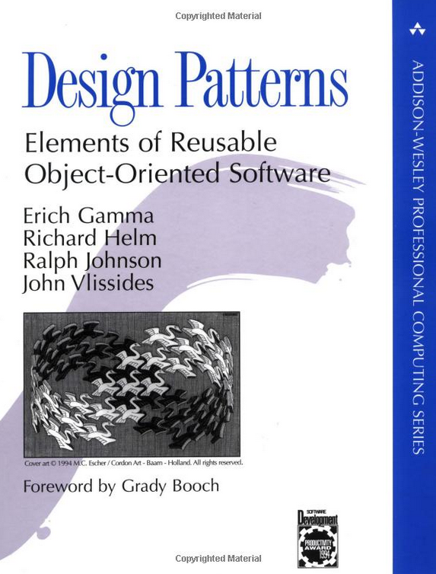
Reading List 2
Design patterns : elements of reusable object-oriented software
£14.56 (Kindle)
shorturl.at/nszC4
Alternatively there are many resources out there on the web and YouTube that cover this topic.

Slide 5
Reading List 3
Design patterns : elements of reusable object-oriented software
£30.39 (Kindle)
shorturl.at/auyGY
Alternatively there are many resources out there on the web and YouTube that cover this topic.

Slide 6
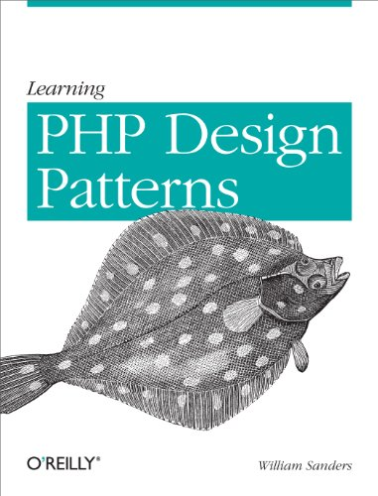
Reading List 4
Learning PHP Design Patterns
£22.24 (Kindle)
shorturl.at/knzJZ
Alternatively there are many resources out there on the web and YouTube that cover this topic.

Slide 7
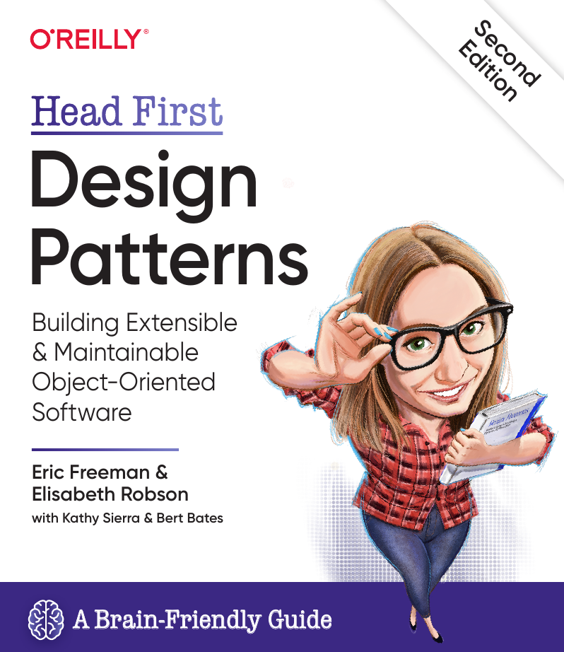
Reading List 5
Head First Design Patterns: A Brain-Friendly Guide: Building Extensible and Maintainable Object-Oriented Software
£33.86 (Kindle)
shorturl.at/mASTV
Alternatively there are many resources out there on the web and YouTube that cover this topic.

Slide 8
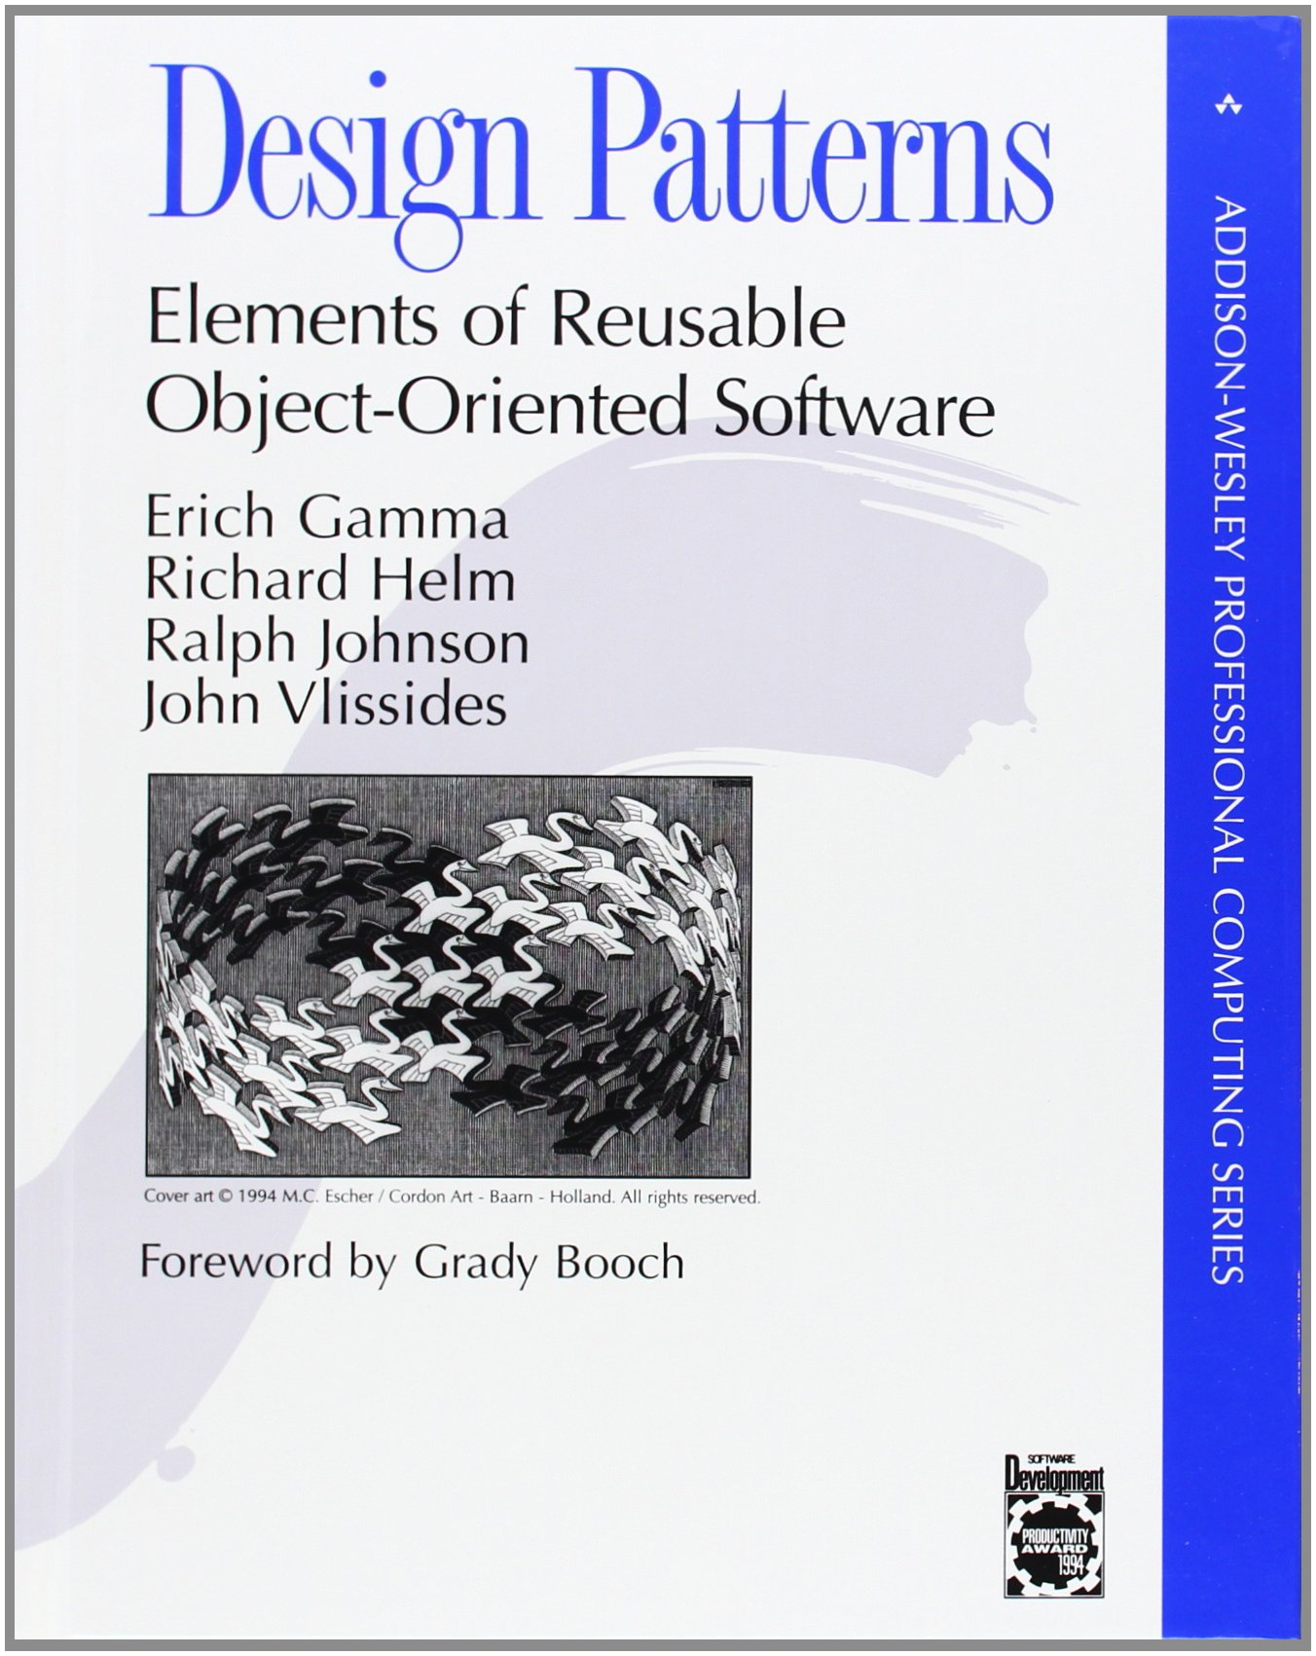
Design Patterns
There is no hard and fast set of Design Patterns, but you will see commonalities across many Design Pattern Catalogues
Popularized by the “Gang of Four” GoF
Erich Gamma
Richard Helm
Ralph Johnson
John Vlissides
Foreword by Grady Booch (my old boss!)
The GoF documented 23 design patterns, pertaining mainly to C++
Often criticised by essentially being workarounds for missing C++ language features

Slide 9
Design Patterns
For reference, the GOF Design Patterns are:
Creational Patterns
Abstract Factory
Builder
Factory Method
Prototype
Singleton

Slide 10
Design Patterns
For reference, the GOF Design Patterns are::
Structural
Adapter
Bridge
Composite
Decorator
Façade
Flyweight
Proxy

Slide 11
Design Patterns
For reference, the GOF Design Patterns are:
Behavioural
Chain of responsibility
Command
Interpreter
Iterator
Mediator
Memento
Observer
State
Strategy
Template Method
Visitor

Slide 12
Design Patterns Intro
You can learn more about the GOF and their Design Patterns beginning here:
https://en.wikipedia.org/wiki/Design_Patterns

Slide 13
What are Design Patterns?
Learning a programming language teaches you basic language constructs (selection, iteration, sequence)
Design Patterns can show you potential solutions developers commonly face
We are going to look at the following features of Software Design Patterns, with a focus on PHP
Pattern basics
Pattern structure
Pattern benefits

Slide 14
What are Design Patterns?
Simply put, a Design pattern helps you analyse a problem and come up with a good practice for its solution, based on the common experience of other developers
Usually formalised with four distinct parts
Name
The Problem
The Solution
Consequences

Slide 15
Criticism of Design Patterns
It has been observed that design patterns may just be a sign that some features are missing in a given programming language (Java or C++ for instance). Peter Norvig demonstrates that 16 out of the 23 patterns in the Design Patterns book (which is primarily focused on C++) are simplified or eliminated (via direct language support) in Lisp or Dylan.^{[28]}
Related observations were made by Hannemann and Kiczales who implemented several of the 23 design patterns using an aspect-oriented programming language (AspectJ) and showed that code-level dependencies were removed from the implementations of 17 of the 23 design patterns and that aspect-oriented programming could simplify the implementations of design patterns.^{[29]}
See also Paul Graham's essay "Revenge of the Nerds".^{[30]}
Inappropriate use of patterns may unnecessarily increase complexity.^{[31]}
Wikipedia: https://en.wikipedia.org/wiki/Software_design_pattern

Slide 16
Secure Design Patterns
Now, let’s turn our attention to design patterns that are focussed on security.
The SEI at Carnegie Mellon and CERT have done some work in this area.
This report describes a set of secure design patterns, which are descriptions or templates describing a general solution to a security problem that can be applied in many different situations. Rather than focus on the implementation of specific security mechanisms, the secure design patterns detailed in this report are meant to eliminate the accidental insertion of vulnerabilities into code or to mitigate the consequences of vulnerabilities. The patterns were derived by generalizing existing best security design practices and by extending existing design patterns with security-specific functionality. They are categorized according to their level of abstraction: architecture, design, or implementation.

Slide 17
Secure Design Patterns
4 Design Patterns You Should Know for Web Development: Observer, Singleton, Strategy, and Decorator
https://www.freecodecamp.org/news/4-design-patterns-to-use-in-web-development/

Slide 18
Secure Design Patterns
Security Design Patterns: Survey and Evaluation
Security design patterns have been proposed recently as a tool for the improvement of software security during the architecture and design phases.
Since the appearance of this research topic in 1997, several catalogs have emerged, and the security pattern community has produced significant contributions, with many related to design.
In this paper, we survey major contributions in the state of the art in the field of security design patterns and assess their quality in the context of an established classification.
From our results, we determined a classification of inappropriate pattern qualities. Using a six sigma approach, we propose a set of desirable properties that would prevent flaws in new design patterns, as well as a template for expressing them
shorturl.at/qxO09

Slide 19
Secure Design Patterns
The 5 Most Common Design Patterns in PHP Applications
If you think that the number one pattern is Singleton then you are fired! The Singleton pattern is already deprecated, and not wanted and even hated.
Let’s take a look at the 5 most commonly used designed patterns in the PHP world these days.
Factory
Strategy
Adapter
Observer
Decorator
shorturl.at/aeiH5

Slide 20
Secure Design Patterns
Security Patterns
Design patterns propose generic solutions to recurring design problems. Commonly, they present a solution in a well-structured form that facilitates its reuse in a different context.
Recently, there has been growing interest in identifying pattern-based designs for the domain of system security termed Security Patterns. Currently, those patterns lack comprehensive structure that conveys essential information inherent to security engineering.
This paper describes research into investigating an appropriate template for Security Patterns that is tailored to meet the needs of secure system development
shorturl.at/hsDGK

Slide 21
Secure Design Patterns
Object Oriented Programming is an expensive disaster which must end
shorturl.at/dhAC8

Slide 22
MVC
Model View Controller

Slide 23
MVC – Model View Controller
One of the most popular design patterns in PHP is the Model-View-Controller design pattern.
MVC is concerned with
Model - Connecting to our database and performing queries
Controller – gets inputs from the user
View - Displaying results to the users

Slide 24
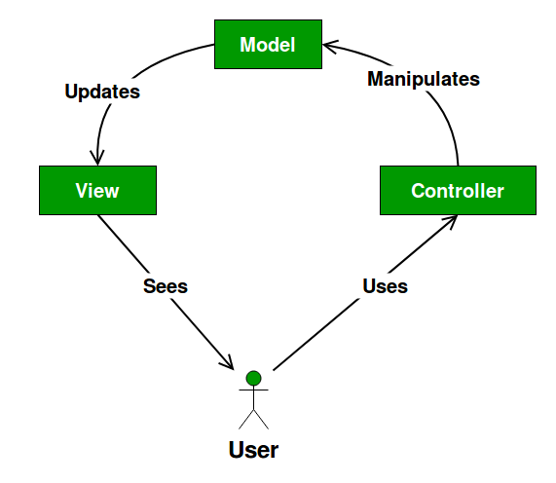
MVC Broken Down
Model
The model is responsible for managing the data of the application. It receives user input from the controller.
View
The view renders presentation of the model in a particular format.
Controller
The controller responds to the user input and performs interactions on the data model objects. The controller receives the input, optionally validates it and then passes the input to the model.
https://www.geeksforgeeks.org/mvc-design-pattern/
https://en.wikipedia.org/wiki/Model%E2%80%93view%E2%80%93controller

Slide 25
MVC considerations
As we will learn later, design patterns are not hard and fast rules for how to implement certain features in your code.
It would be better to think of them as an abstracted guide book to help point you in the right direction, based on the experiences of developers who have contributed to the design patterns.
With this being the base, there are many ways to implement the MVC design pattern – bear that in mind as you do your research!

Slide 26
Task
Using the resources provided, and with what you learned in Emma’s module last year, try to select two design patterns that seem like a good fit for use in your Web App portfolio assignment.
Remember, it isn’t enough to say why you’re picking two Design Patterns, you also have to explain why you are rejecting others.
I have included many links to security design patterns articles that I urge you to look at.

Slide 27
Task
Due to absence I don’t think pairing up would be a good strategy so let’s try this as an individual task.
Prepare a short presentation, ~10 minutes, covering what you have learned about design patterns and security patterns in particular.

