Slide 1
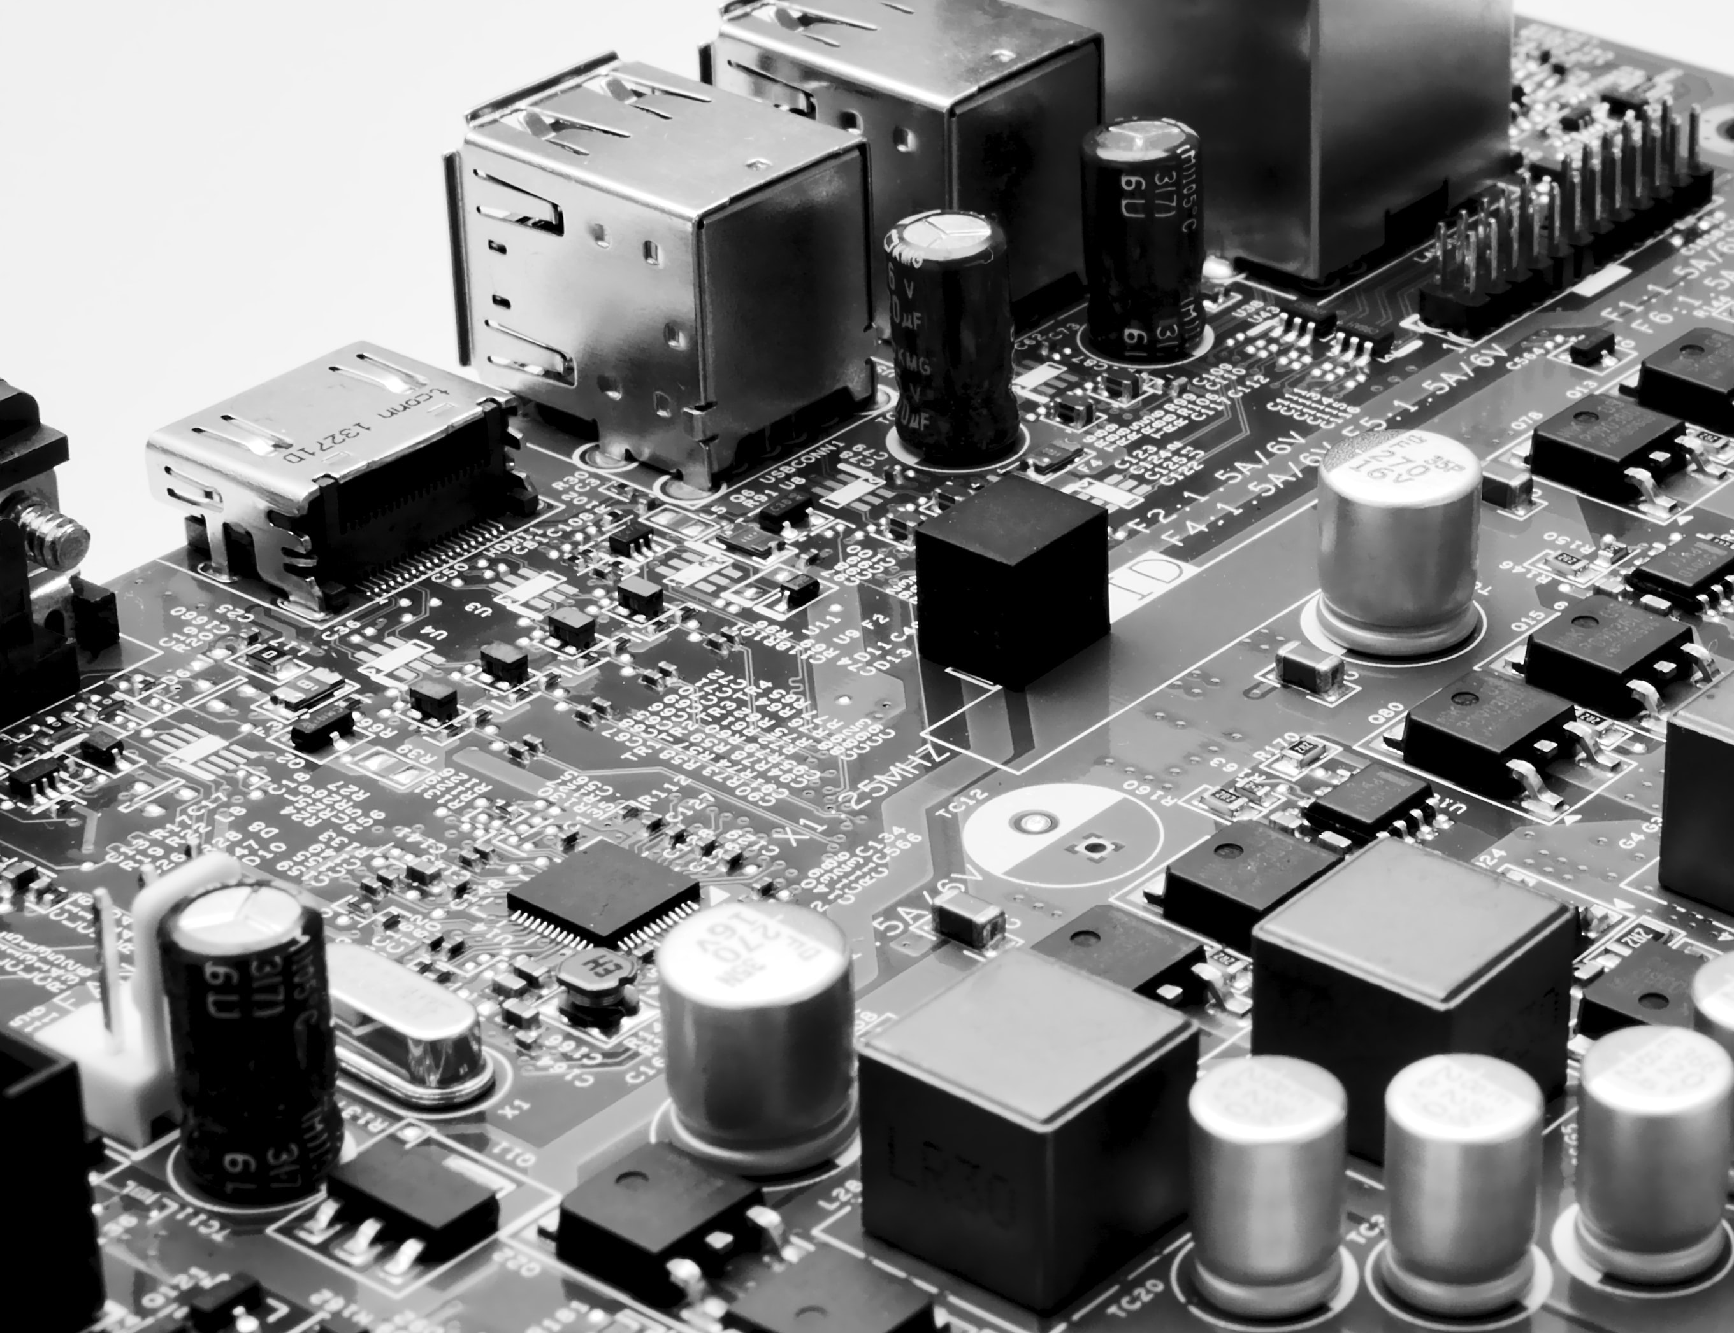
CY102 - Networking
Network Storage

Slide 2
Network Storage Types
NAS
SAN

Slide 3
NAS
Offers file level access, and a client sees the shared storage as a file server
Network-attached Storage (NAS)
NAS is easier than SAN and uses TCP/IP

Slide 4
SAN
Storage Area Network
A SAN is block-based storage, leveraging a high-speed architecture that connects servers to their logical disk units (LUNs)
A LUN is a range of blocks provisioned from a pool of shared storage and presented to the server as a logical disk
SAN can be costly and difficult to implement and maintain
A SAN presents storage devices to a host such that the storage appears to be locally attached
This simplified presentation of storage to a host is accomplished through the use of different types of virtualization

Slide 5
SAN

Slide 6
SAN architecture

Slide 7
Network storage

Slide 8
Connection Types
FCoE
Fibre Channel
iSCSI
Infiniband

Slide 9
Fibre Channel and FCoE
Fibre Channel (FC) is an option providing a higher level of performance than anything else
It utilises FCP, the Fiber Channel Protocol, to do what needs to be done
Fiber Channel over Ethernet (FCoE) can be used in high-speed (10GB and higher) implementations
The big advantage of Fibre Channel is its scalability
FCoE encapsulates FC over the Ethernet portions of connectivity, making it easy to add into an existing network
As such, FCoE is an extension to FC intended to extend the scalability and efficiency associated with Fibre Channel

Slide 10
iSCSI
Internet Small Computer System Interface
An IP-based networking storage standard for linking and managing data storage facilities
iSCSI allows SCSI commands to be sent over IP networks, including LANs, WANs, and the Internet

Slide 11
iSCSI
Using iSCSI for a virtual environment gives users the benefits of a file system without the difficulty of setting up Fibre Channel
Because iSCSI works both at the hypervisor level and in the guest operating system, the rules that govern the size of the partition in the OS are used rather than those of the virtual OS (which are usually more restrictive)
The disadvantage of iSCSI is that users can run into IP-related problems if configuration is not carefully monitored

Slide 12
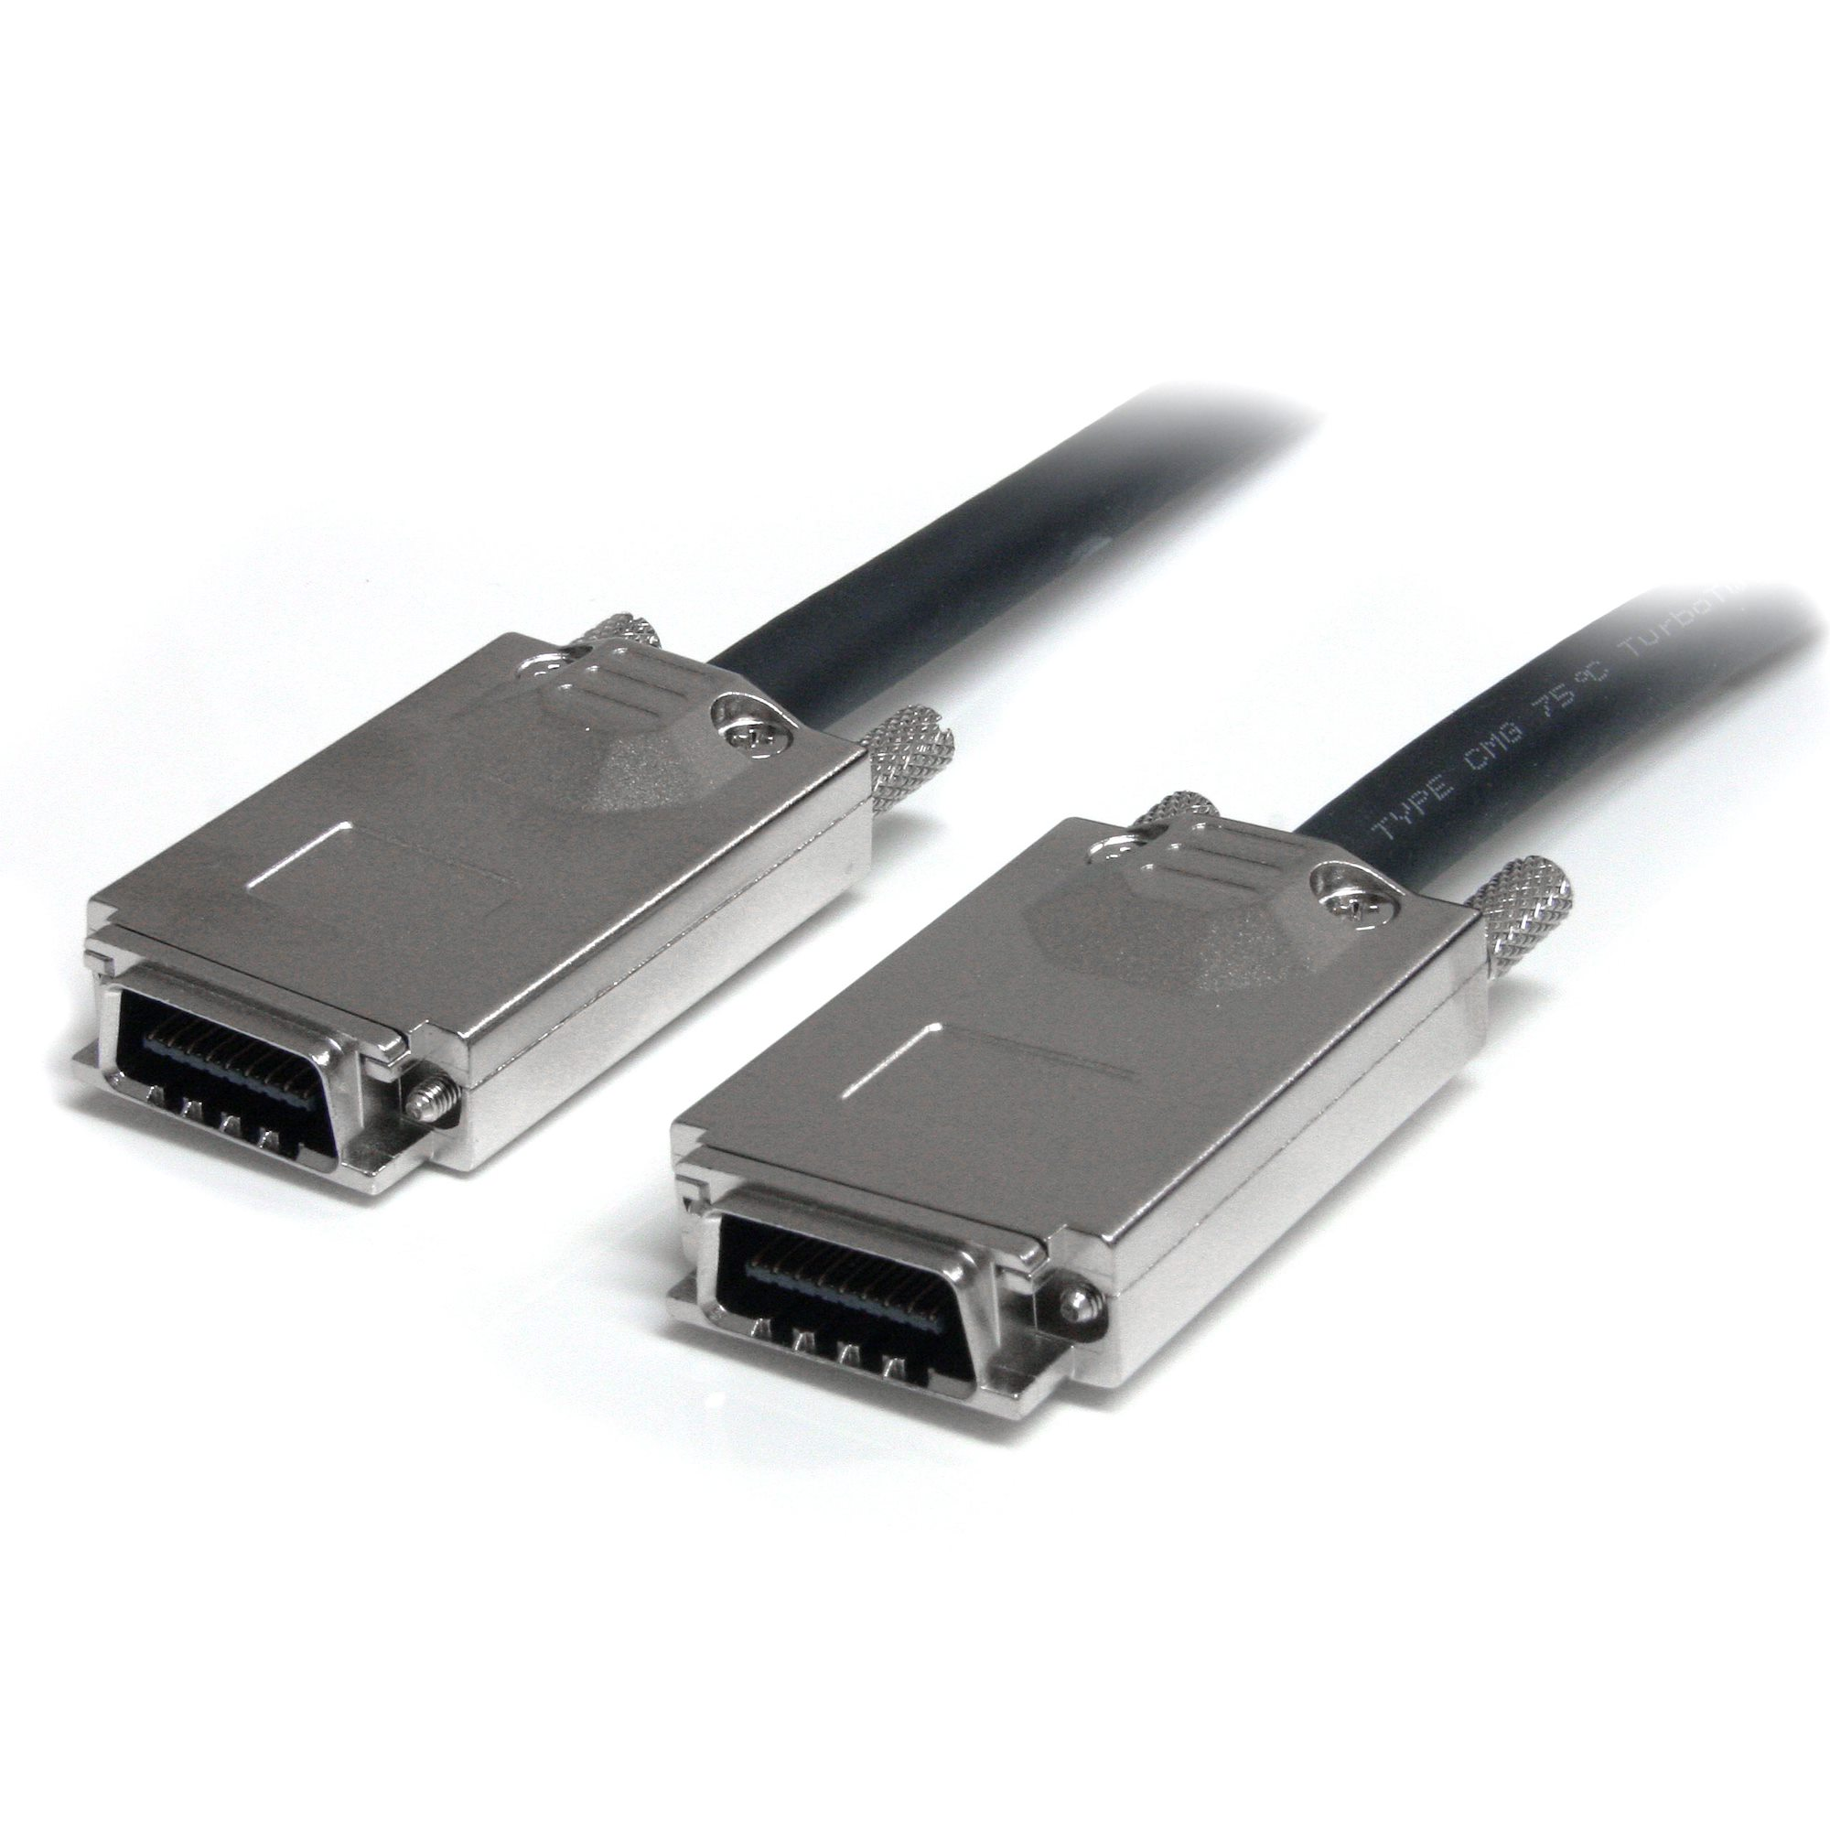
Infiniband
InfiniBand (IB), is supported by the InfiniBand Trade Association
Promises high throughput and low latency, making it ideal for use in high-performance computing connections (both within the computer and between computers)
Effectively addresses all the stated limitations of TCP and can provide seamless connectivity to applications designed to work with TCP

