Slide 1
OS Security &
Defensive
Programming
Week 1
Intro
Monday
01
02
Wednesday
03
04
Tuesday
05
06
Thursday
Friday

Slide 2
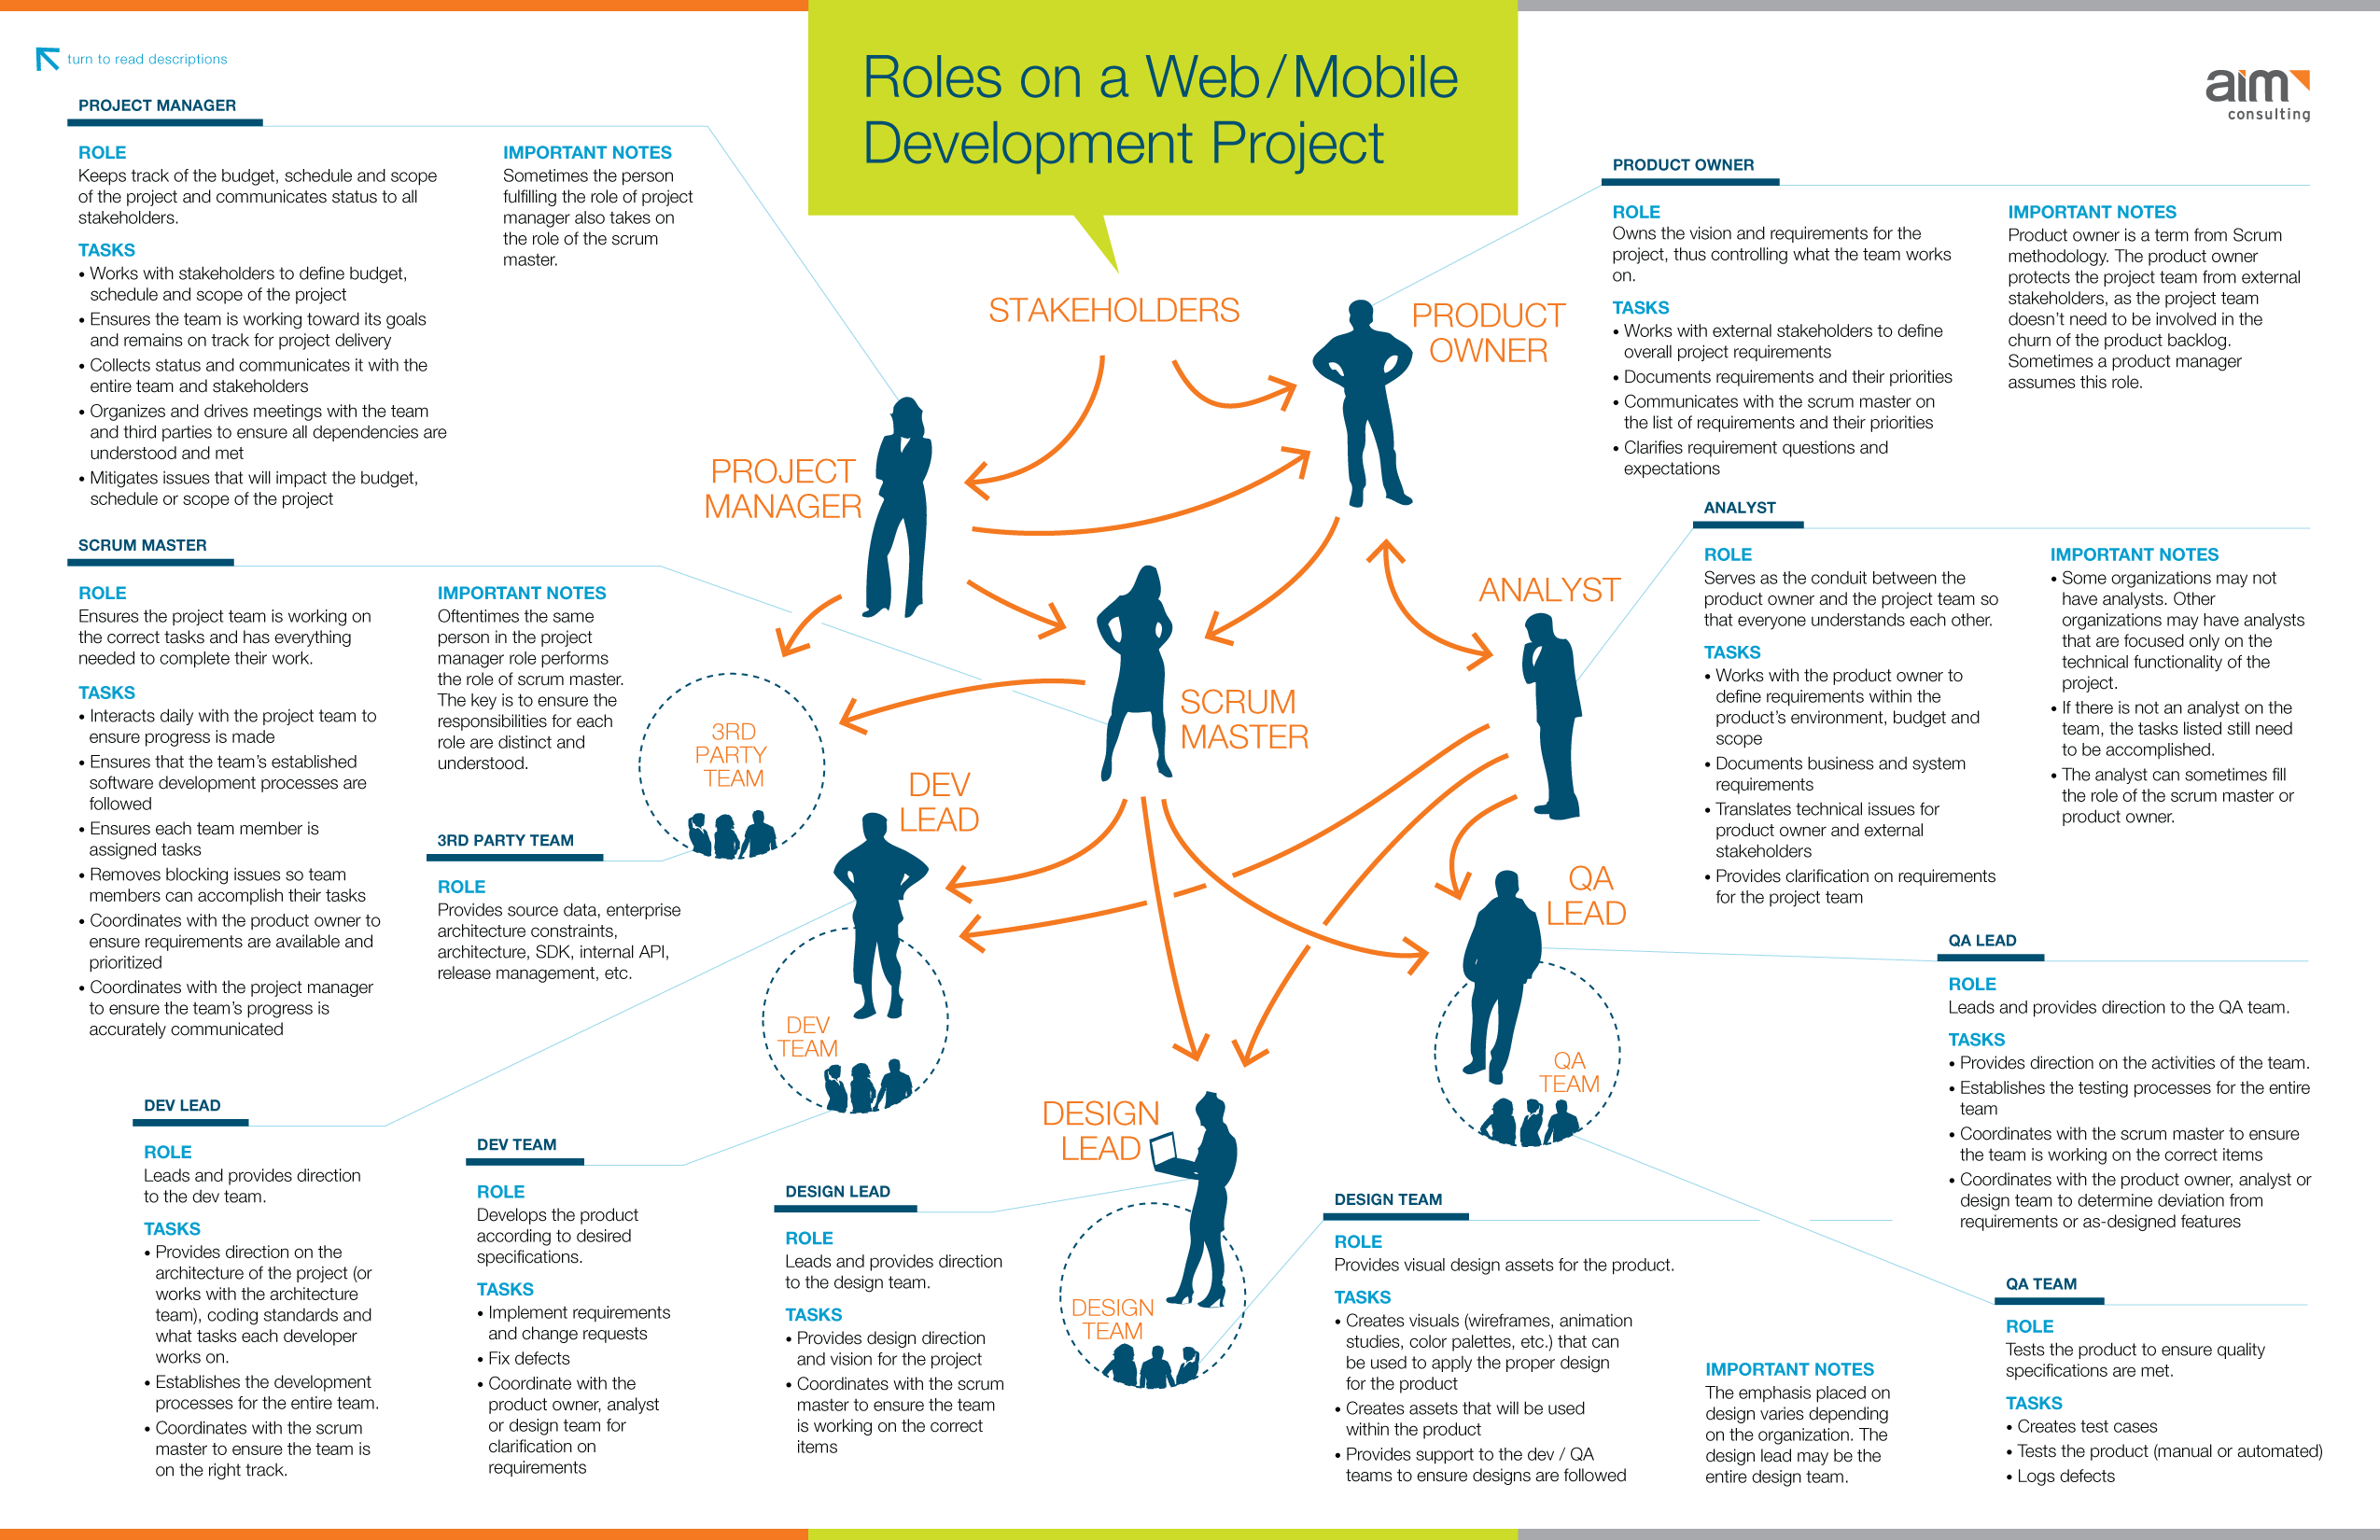

Slide 3
User Stories & Use Cases

Slide 4
User Stories
What is a User Story?
A user story is an informal, general explanation of a software feature written from the perspective of the end user. Its purpose is to articulate how a software feature will provide value to the customer.
Atlassian
It's tempting to think that user stories are, simply put, software system requirements. But they're not.
A key component of agile software development is putting people first, and a user story puts end users at the centre of the conversation.
These stories use non-technical language to provide context for the development team and their efforts.
After reading a user story, the team knows why they are building, what they're building, and what value it creates.
User stories are one of the core components of an agile program.
They help provide a user-focused framework for daily work — which drives collaboration, creativity, and a better product overall.

Slide 5
User Stories
User Stories stem from XP (eXtreme Programming), but have percolated through into other frameworks such as waterfall development.
A user story is an informal, general explanation of a software feature written from the perspective of the end user or customer.
The purpose of a user story is to articulate how a piece of work will deliver a particular value back to the customer.
Note that "customers" don't have to be external end users in the traditional sense, they can also be internal customers or colleagues within your organization who depend on your team.

Slide 6
User Stories
User stories are a few sentences in simple language that outline the desired outcome. They don't go into detail. Requirements are added later, once agreed upon by the team.
User Stories first, then requirements 😉
User stories are also the building blocks of larger agile frameworks like epics and initiatives.
Epics are large work items broken down into a set of stories, and multiple epics comprise an initiative.
These larger structures ensure that the day-to-day work of the development team (on stores) contributes to the organizational goals built into epics and initiatives.

Slide 7
User Stories
Why create user stories?
For development teams, user stories sometimes seem like an added step. Why not just break the big project (the epic) into a series of steps and get on with it? But stories give the team important context and associate tasks with the value those tasks bring.
User stories serve a number of key benefits:
Stories keep the focus on the user. A to-do list keeps the team focused on tasks that need to be checked off, but a collection of stories keeps the team focused on solving problems for real users.
Stories enable collaboration. With the end goal defined, the team can work together to decide how best to serve the user and meet that goal.
Stories drive creative solutions. Stories encourage the team to think critically and creatively about how to best solve for an end goal.
Stories create momentum. With each passing story, the development team enjoys a small challenge and a small win, driving momentum.

Slide 8
User Stories
Working with user stories
Once a story has been written, it’s time to integrate it into your workflow. Generally a story is written by the product owner, product manager, or program manager and submitted for review.
During a sprint or iteration planning meeting, the team decides what stories they’ll tackle that sprint. Teams now discuss the requirements and functionality that each user story requires. This is an opportunity to get technical and creative in the team’s implementation of the story. Once agreed upon, these requirements are added to the story.
Another common step in this meeting is to score the stories based on their complexity or time to completion. Teams use t-shirt sizes, the Fibonacci sequence, or planning poker to make proper estimations. A story should be sized to complete in one sprint, so as the team specs each story, they make sure to break up stories that will go over that completion horizon.

Slide 9
User Stories
How to write user stories
Consider the following when writing user stories:
Definition of “done” — The story is generally “done” when the user can complete the outlined task, but make sure to define what that is.
Outline subtasks or tasks — Decide which specific steps need to be completed and who is responsible for each of them.
User personas — For whom? If there are multiple end users, consider making multiple stories.
Ordered Steps — Write a story for each step in a larger process.
Listen to feedback — Talk to your users and capture the problem or need in their words. No need to guess at stories when you can source them from your customers.
Time — Time is a touchy subject. Many development teams avoid discussions of time altogether, relying instead on their estimation frameworks. Since stories should be completable in one sprint, stories that might take weeks or months to complete should be broken up into smaller stories or should be considered their own epic.
Once the user stories are clearly defined, make sure they are visible for the entire team.

Slide 10
User Stories
User story template and examples
User stories are often expressed in a simple sentence, structured as follows:
“As a [persona], I [want to], [so that].”
Breaking this down:
"As a [persona]": Who are we building this for? We’re not just after a job title, we’re after the persona of the person. Max. Our team should have a shared understanding of who Max is. We’ve hopefully interviewed plenty of Max’s. We understand how that person works, how they think and what they feel. We have empathy for Max.
“Wants to”: Here we’re describing their intent — not the features they use. What is it they’re actually trying to achieve? This statement should be implementation free — if you’re describing any part of the UI and not what the user goal is you're missing the point.
“So that”: how does their immediate desire to do something this fit into their bigger picture? What’s the overall benefit they’re trying to achieve? What is the big problem that needs solving?

Slide 11
User Stories
User story template and examples
For example, user stories might look like:
As Max, I want to invite my friends, so we can enjoy this service together.
As Sascha, I want to organize my work, so I can feel more in control.
As a manager, I want to be able to understand my colleagues progress, so I can better report our success and failures.
This structure is not required, but it is helpful for defining done. When that persona can capture their desired value, then the story is complete. We encourage teams to define their own structure, and then to stick to it.

Slide 12
User Stories
Getting started with user stories
User stories describe the why and the what behind the day-to-day work of development team members, often expressed as persona + need + purpose. Understanding their role as the source of truth for what your team is delivering, but also why, is key to a smooth process.
Start by evaluating the next, or most pressing, large project (e.g. an epic). Break it down into smaller user stories, and work with the development team for refinement. Once your stories are out in the wild where the whole team can see them, you’re ready to get to work.
https://www.atlassian.com/agile/project-management/user-stories

Slide 13
User stories – Learn more
How To Write User Stories, Epics, & Personas
How To Write User Stories, Epics, & Personas (freecodecamp.org)
Project Advantages of User Stories as Requirements
Project Advantages of User Stories as Requirements (mountaingoatsoftware.com)

Slide 14
Use Cases
What is a use case?
A use case is a description of the ways in which a user interacts with a system or product. A use case may establish the success scenarios, the failure scenarios, and any critical variations or exceptions. A use case can be written or made visual with the help of a use case model tool.
- Wrike

Slide 15
Use Cases
What is the purpose of a use case?
The purpose of a use case is to:
Manage Scope
Manage Risk
Establish Requirements
Outline ways user’s interact with a system
Visualise system architecture
Record and communicate technical requirements to stakeholders

Slide 16
Use Cases
How to write a Use Case
When presented in written form, a use case can be a helpful piece of project documentation. Use cases are a common requirements artifact and they can ease communication across technical and business stakeholders.
Depending on the intended audience and system under discussion, the use case can be as detailed or as basic as needed.

Slide 17
Use Cases
How to write a Use Case
A use case document should establish and identify a few key components — these are:
System: A system is the product, service, or software under discussion.
Actors: An actor is a user or anything else that exhibits behaviour when interacting with the system. The actor could be another system, a piece of hardware, or an entire organization.
When it comes to actors, there are four types: a system under discussion, an internal actor, a primary actor, and a secondary actor. The most commonly referred to are the latter two systems. A primary actor initiates the interaction with the system, while a secondary actor may provide a service to the system.
Scenario: In “Applying UML and Patterns,” Larman notes that “a scenario is a specific sequence of actions and interactions between actors and the system under discussion; it is also called a use case instance.”
Use case: A use case outlines the success and failure scenarios that can occur when the actor(s) interact with the system. In this section, you’d establish the main success scenario, i.e., the most desirable outcome between the actor and the system. You would also establish the alternative paths, which explains what happens in the event of failure or error.

Slide 18
Use Cases
An example Use Case
Use case for meal delivery application: Individuals can use an app to place food orders directly to restaurants. When the user places an order, they are prompted to pay through the app or pay when the food arrives. Once that is confirmed, the restaurant will receive a request through their system. The food will then be prepared, packaged, and delivered to the individual. In this case, the app must be able to receive orders, process payments, and communicate with the restaurant electronically.
System: Food delivery application
Primary actor: Customer ordering a meal
Scenario: The user browses restaurant options. Once the preferred restaurant is selected, they place an order through the application. The user pays online or verifies they will pay in-person. The order is sent from the app to the restaurant’s internal system. The restaurant worker receives and processes the electronic order.

Slide 19
Use Cases
An example Use Case
This use case illustrates how both the customer and restaurant employee (the actors) interact with the food delivery application (the system), and the expected outcome of each interaction.
This helps to sketch a framework for what is expected in the development stage. The app must be able to process payments, for example.

Slide 20
Use Cases
What is a Use Case Model?
A use case model is a visual representation of the interactions between an actor and a system. As PMI also notes, use case models depict processes, which helps to further express preconditions and triggers.
A use case model is commonly expressed using UML (Universal modeling language). In these visualizations, there are three main components: the system, the actors, and the use case.
The system is represented by a rectangle or “boundary box." Actors are shown as stick people outside of the boundary box, while the use cases are presented as text in ovals within the box. Solid and dashed lines represent the association between the actors and the system’s use cases.

Slide 21
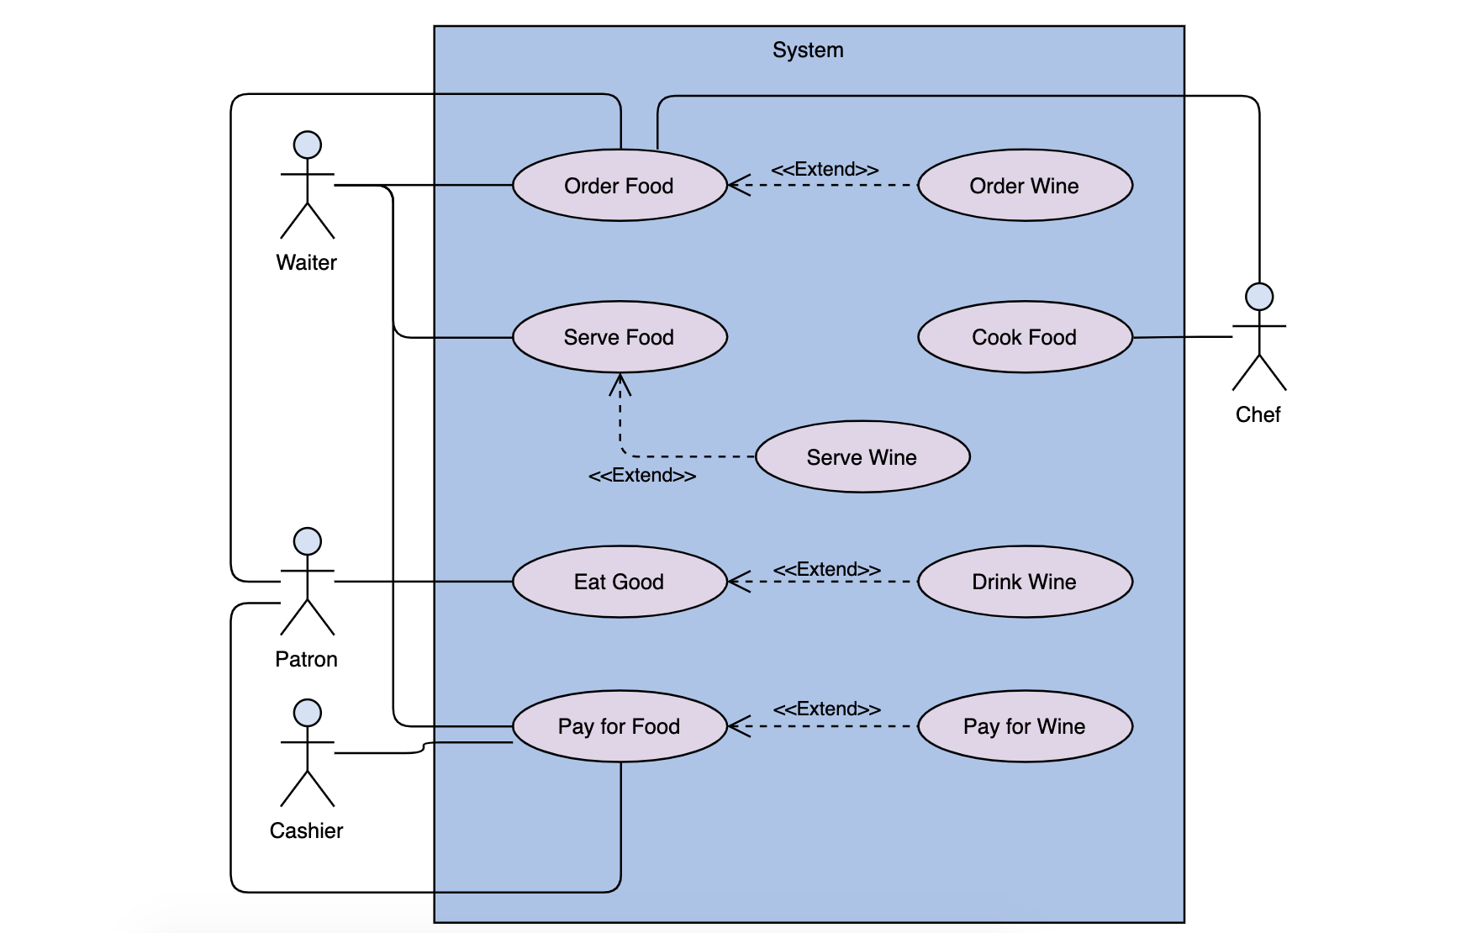
Use Cases
A Use Case Model Example?

Slide 22
Use Cases
Difference between Use Case Models and Diagrams?
A use case diagram is simply a type of use case model. A use case model diagram uses text and shapes to represent the relationship between a user and a system.
Primarily, use case model diagrams are used to:
Visualize the flow and behaviour of the system
Illustrate the functionality of the system
Represent key system-user interactions
Depending on the system, a use case model diagram can vary in complexity, showing basic associations or expanding to show multiple exceptions.
https://www.wrike.com/blog/what-is-a-use-case/

Slide 23
Use Cases – Learn more
Use Cases – Usability.gov
https://www.usability.gov/how-to-and-tools/methods/use-cases.html
How to Write a Use Case
https://www.bridging-the-gap.com/what-is-a-use-case/

Slide 24
OOP & UML

Slide 25
OOP & UML
What is OOP?
Object-oriented programming is an approach to software development in which the structure of the software is based on objects interacting with each other to accomplish a task.
This interaction takes the form of messages passing back and forth between the objects. In response to a message, an object can perform an action.

Slide 26
OOP & UML
A car object consists of other objects that interact with each other to accomplish the task of getting you to college.
You put the key object in the ignition object and turn it.
This in turn sends a message (through an electrical signal) to the starter object, which interacts with the engine object to start the car.
As a driver, you are isolated from the logic of how the objects of the system work together to start the car. You just initiate the sequence of events by executing the start method of the ignition object with the key.
You then wait for a response (message) of success or failure.

Slide 27
OOP & UML
Understanding the Unified Modelling Language
To successfully design object-oriented software, you need to follow a proven design methodology.
One proven design methodology used in OOP today is the Unified Modelling Language (UML).
UML was developed in the early 1980s as a response to the need for a standard, systematic way of modelling the design of object-oriented software.
This industry standard was created and is managed by the Object Management Group (OMG).
UML has evolved and matured along with the software industry and the current version 2.4.1 was formally released in 2011.

Slide 28
OOP & UML
There are many advantages to using UML during the design process.
When properly implemented, UML allows you to visualize the software system at various levels of detail.
You can verify requirements and scope of the project with the users.
It also can be used as the basis for testing the system.
UML lends itself well to an incremental development process.
UML modelling is also very beneficial for parallel development of large systems.
Using the model, each team is aware of how their pieces fit into the system and can convey changes that may affect other teams.

Slide 29
OOP & UML
UML consists of a series of textual and graphical models of the proposed solution.
These models define the system scope, components of the system, user interaction with the system, and how the system components interact with each other to implement the system functionality.

Slide 30
OOP & UML
Some common models used in UML are the following:
Software Requirement Specification (SRS): a textual description of the overall responsibilities and scope of the system.
Use Case: a textual/graphical description of how the system will behave from the user’s perspective. Users can be human or other systems.
Class Diagram: a visual blueprint of the objects that will be used to construct the system.
Sequence Diagram: a model of the sequence of object interaction as the program executes. Emphasis is placed on the order of the interactions and how they proceed over time.
Collaboration Diagram: a view of how objects are organized to work together as the program executes. Emphasis is placed on the communications that occur between the objects.
Activity Diagram: a visual representation of the flow of execution of a process or operation.

Slide 31
OOP - Developing an SRS 1
The purpose of the SRS is to do the following:
Define the functional requirements of the system.
Identify the boundaries of the system.
Identify the users of the system.
Describe the interactions between the system and the external users.
Establish a common language between the client and the program team for describing the system.
Provide the basis for modelling use cases.

Slide 32
OOP - Developing an SRS 2
To produce the SRS, you interview the business owners and the end users of the system.
The goals of these interviews are to document clearly the business processes involved and establish the system’s scope.
The outcome of this process is a formal document (the SRS) detailing the functional requirements of the system.
A formal document helps to ensure agreement between the customers and the software developers.
The SRS also provides a basis for resolving any disagreements over perceived system scope as development proceeds.
As an example, suppose that the owners of a small commuter airline want customers to be able to view flight information and reserve tickets for flights using a Web registration system.
After interviewing the business managers and the ticketing agents, the software designers draft an SRS document that lists the system’s functional requirements.

Slide 33
OOP - Developing an SRS 3
The following are some of these unrefined requirements:
Nonregistered web users can browse to the web site to view flight information, but they can’t book flights.
New customers who want to book flights must complete a registration form providing their name, address, company name, phone number, fax number, and e-mail address.
A customer is classified as either a corporate customer or a retail customer.
Customers can search for flights based on destination and departure times.
Customers can book flights indicating the flight number and the number of seats requested.
The system sends customers a confirmation via e-mail when the flight is booked.
Corporate customers receive frequent flier miles when their employees book flights.
Frequent-flier miles are used to discount future purchases.
Ticket reservations may be cancelled up to one week in advance for an 80 percent refund.
Ticketing agents can view and update flight information.

Slide 34
OOP - Developing an SRS 4
In this partial SRS document, you can see that several succinct statements define the system scope.
They describe the functionality of the system as viewed by the system’s users and identify the external entities that will use it.
It is important to note that the SRS does not contain references to the technical requirements of the system.
Once the SRS is developed, the functional requirements it contains are transformed into a series of use case diagrams.

Slide 35
OOP - Developing an SRS 5
Introducing Use Cases
Use cases describe how external entities will use a system.
These external entities can be human or other systems (called actors in UML terminology).
The description emphasizes the users’ view of the system and the interaction between the users and the system.
Use cases help to further define system scope and boundaries.
They are usually in the form of a diagram, along with a textual description of the interaction taking place.
This diagram consists of two actors represented by stick figures, the system represented by a rectangle, and use cases depicted by ovals inside the system boundaries.

Slide 36
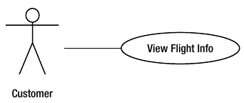
OOP - Developing an SRS 6
Use cases are developed from the SRS document.
The actor is any outside entity that interacts with the system.
An actor could be a human user (for instance, a rental agent), another software system (for instance, a software billing system), or an interface device (for instance, a temperature probe).
Each interaction that occurs between an actor and the system is modelled as a use case.
The sample use case shown here was developed for the flight-booking application discussed earlier.
It shows the use case diagram for the requirement “Customers can search for flights based on destination and departure times.”

Slide 37
OOP - Developing an SRS 7
Along with the graphical depiction of the use case, many designers and software developers find it helpful to provide a textual description of the use case.
The textual description should be succinct and focused on what is happening, not on how it is occurring.
Sometimes any preconditions or postconditions associated with the use case are also identified.

Slide 38
OOP - Developing an SRS 8
The following text further describes the use case diagram shown.
Description: A customer views the flight information page. The customer enters flight search information. After submitting the search request, the customer views a list of flights matching the search criteria.
Preconditions: None.
Postconditions: The customer has the opportunity to log in and proceed to the flight-booking page.

Slide 39
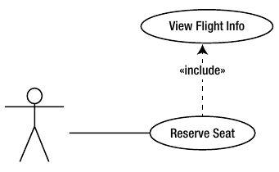
OOP - Developing an SRS 9
As another example, take a look at the Reserve Seat use case
Description: The customer enters the flight number and indicates the seats being requested. After the customer submits the request, some confirmation information is displayed.
Preconditions: The customer has looked up the flight information. The customer has logged in and is viewing the flight-booking screen.
Postconditions: The customer is sent a confirmation e-mail outlining the flight details and the cancellation policy.

Slide 40
OOP - Developing an SRS 9
As you can hopefully see, certain relationships can exist between use cases.
The Reserve Seat use case includes the View Flight Info use case.
This relationship is useful because you can use the View Flight Info use case independently of the Reserve Flight use case.
This is called inclusion.
You cannot use the Reserve Seat use case independently of the View Flight Info use case, however.
This is important information that will affect how you model the solution.

Slide 41
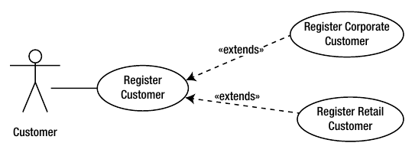
OOP - Developing an SRS 10
Another way that use cases relate to each other is through extension.
You might have a general use case that is the base for other use cases.
The base use case is extended by other use cases.
For example, you might have a Register Customer use case that describes the core process of registering customers.
You could then develop Register Corporate Customer and Register Retail Customer use cases that extend the base use case.
The difference between extension and inclusion is that, in extension, the base use case being extended is not used on its own.
This diagram demonstrates how you model this in a use case diagram.

Slide 42
OOP - Developing an SRS 11
Understanding Class Diagrams
The concepts of classes and objects are fundamental to OOP.
An object is a structure for incorporating data and the procedures for working with the data.
These objects implement the functionality of an object-oriented program.
Think of a class as a blueprint for an object and an object as an instance of a class.
A class defines the structure and the methods that objects based on the class type will contain.
Designers identify a potential list of classes that they will need to develop from the SRS and the use case diagrams.
One way you identify the classes is by looking at the noun phrases in the SRS document and the use case descriptions.
If you look at the documentation developed thus far for the airline booking application, you can begin to identify the classes that will make up the system.
For example, you can develop a Customer class to work with the customer data and a Flight class to work with the flight data.

Slide 43
OOP - Developing an SRS 12
A class is responsible for managing data.
When defining the class structure, you must decide what data the
class is responsible for maintaining.
The class attributes define this information.
For example, the Flight class will have attributes for identifying the flight number, departure time and date, flight duration, destination, capacity, and seats available.
The class structure must also define any operations that will be performed on the data.
An example of an operation the Flight class is responsible for is updating the seats available when a seat is reserved.

Slide 44
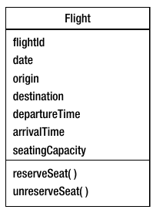
OOP - Developing an SRS 13
A class diagram can help you visualize the attributes and operations of a class. Here you can see an example of the class diagram for the Flight class used in the flight booking system example.
A rectangle divided into three sections represents the class.
The top section of the rectangle shows the name of the class, the middle section lists the attributes of the class, and the bottom section lists the operations performed by the class.

Slide 45
OOP - Developing an SRS 14
Modelling Object Relationships
In OOP, when the program executes, the various objects work together to accomplish the programming tasks.
For example, in the flight booking application, in order to reserve a seat on the flight, a Reservation object must interact with the Flight object.
A relationship exists between the two objects, and this relationship must be modelled in the class structure of the program.
The relationships among the classes that make up the program are modelled in the class diagram.
Analysing the verb phrases in the SRS often reveals these relationships.
The following slides examine some of the common relationships that can occur between classes and how the class diagram represents them.

Slide 46
OOP - Developing an SRS 15
Association
When one class refers to or uses another class, the classes form an association.
You draw a line between the two classes to represent the association and add a label to indicate the name of the association.
For example, a seat is associated with a flight in the flight-booking-application, as shown here

Slide 47
OOP - Developing an SRS 16
Association - continued
Sometimes a single instance of one class associates with multiple instances of another class.
This is indicated on the line connecting the two classes.
For example, when a customer makes a reservation, there is an association between the Customer class and the Reservation class.
A single instance of the Customer class may be associated with multiple instances of the Reservation class.
The n placed near the Reservation class indicates this multiplicity, as shown below

Slide 48
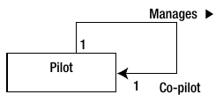
OOP - Developing an SRS 17
Association - continued
A situation may also exist where an instance of a class may be associated with multiple instances of the same class.
For example, an instance of the Pilot class represents the captain while another instance of the Pilot class represents the co-pilot.
The pilot manages the co-pilot.
This scenario is referred to as a self-association and is modelled by drawing the association line from the class back to itself:

Slide 49
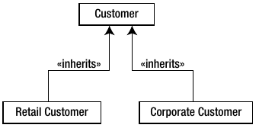
OOP - Developing an SRS 18
Inheritance
When multiple classes share some of the same operations and attributes, a base class can encapsulate the commonality.
The child class then inherits from the base class.
This is represented in the class diagram by a solid line with an open arrowhead pointing to the base class.
For example, a CorporateCustomer class and a RetailCustomer class could inherit common attributes and operations from a base Customer class, as you can see here:

Slide 50
OOP - Developing an SRS 19
Aggregation
When a class is formed by a composition of other classes, they are classified as an aggregation.
This is represented with a solid line connecting the classes in a hierarchical structure.
Placing a diamond on the line next to a class in the diagram indicates the top level of the hierarchy.
For example, an inventory application designed to track plane parts for the plane maintenance department could contain a Plane class that is a composite of various part classes as shown here

Slide 51
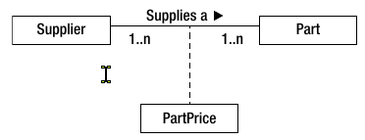
OOP - Developing an SRS 20
Association Classes
As the classes and the associations for a program are developed, there may be a situation where an attribute can’t be assigned to any one class, but is a result of an association between classes.
For example, the parts inventory application mentioned previously may have a Part class and a Supplier class.
Because a part can have more than one supplier and the supplier supplies more than one part, where should the price attribute be located?
It does not fit nicely as an attribute for either class, and it should not be duplicated in both classes.
The solution is to develop an association class that manages the data that is a product of the association. In this case, you would develop a PartPrice class.
The relationship is modelled with a dashed line drawn between the association and the association class, as shown

Slide 52
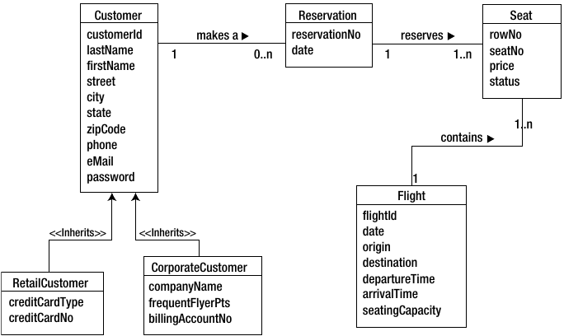
OOP - Developing an SRS 21
Here you can see the evolving class diagram for the flight booking application.
It includes the classes, attributes, and relationships that have been identified for the system.

Slide 53
OOP - Developing an SRS 22
So far, we have focused on modelling the static (organizational) aspects of an OOP solution.
We have introduced and discussed the methodologies of the UML and looked at the purpose and structure of use case diagrams and class diagrams.
Now, we will continue the discussion of UML modelling techniques and focuses on modelling the dynamic (behavioural) aspects of an OOP solution.
Let’s now focus on how the objects in the system interact with each other and what activities must occur to implement the solution. This is an important aspect of the modelling processes.

Slide 54
OOP - Developing an SRS 23
Understanding Scenarios
Scenarios help determine the dynamic interactions that will take place between the objects (class instances) of the system.
A scenario is a textual description of the internal processing needed to implement the functionality documented by a use case.
Remember that a use case describes the functionality of the system from the viewpoint of the system’s external users.
A scenario details the execution of the use case.
In other words, its purpose is to describe the steps that must be carried out internally by the objects making up the system.

Slide 55
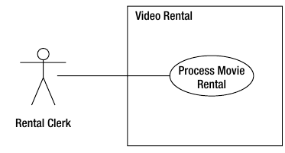
OOP - Developing an SRS 24
Here you can see a Process Movie Rental use case for a video rental application.
The following text describes the use case:
Preconditions: The customer makes a request to rent a movie from the rental clerk. The customer has a membership in the video club and supplies the rental clerk with her membership card and personal identification number (PIN). The customer’s membership is verified. The customer information is displayed, and the customer’s account is verified to be in good standing.
Description: The movie is confirmed to be in stock. Rental information is recorded, and the customer is informed of the due date.
Post conditions: None.

Slide 56
OOP - Developing an SRS 25
The following scenario describes the internal processing of the Process Movie Rental use case:
The movie is verified to be in stock.
The number of available copies in stock is decremented.
The due date is determined.
The rental information is recorded. This information includes the movie title, copy number, current date, and due date.
The customer is informed of the rental information.

Slide 57
OOP - Developing an SRS 26
This scenario describes the best possible execution of the use case.
Because exceptions can occur, a single use case can spawn multiple scenarios.
For example, another scenario created for the Process Movie Rental use case could describe what happens when a movie is not in stock.
After you map out the various scenarios for a use case, you can create interaction diagrams to determine which classes of objects will be involved in carrying out the functionality of the scenarios.
The interaction diagram also reveals what operations will be required of these classes of objects.
Interaction diagrams come in two flavours:
sequence diagrams
collaboration diagrams

Slide 58
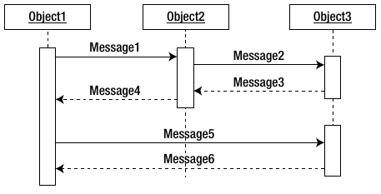
OOP - Developing an SRS 27
Introducing Sequence Diagrams
A sequence diagram models how the classes of objects interact with each other over time as the system runs.
The sequence diagram is a visual, two-dimensional model of the interaction taking place and is based on a scenario.
Here you can see a generic sequence diagram.

Slide 59
OOP - Developing an SRS 28
As Figure 3-2 demonstrates, the flow of messages from object to object is represented horizontally.
The time flow of the interactions taking place is depicted vertically, starting from the top and progressing downward.
Objects are placed next to each other from left to right according to the calling order.
A dashed line extends from each of them downward.
This dashed line represents the lifeline of the object.
Rectangles on the lifeline represent activations of the object.
The height of the rectangle represents the duration of the object’s activation.
In OOP, objects interact by passing messages to each other.
An arrow starting at the initiating object and ending at the receiving object depicts the interaction. A dashed arrow drawn back to the initiating object represents a return message.
The messages depicted in the sequence diagram will form the basis of the methods of the classes of the system.

Slide 60
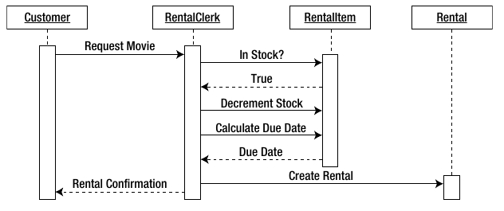
OOP - Developing an SRS 29
The diagram below shows a sample sequence diagram for the Process Movie Rental scenario discussed earlier.
At this point, the diagram only models the case where the movie is in stock.

Slide 61
OOP - Developing an SRS 30
As you analyse the sequence diagram, you gain an understanding of the classes of objects that will be involved in carrying out the program processing; you will also understand what methods you will need to create and attach to those classes.
You should also model the classes and methods depicted in the sequence diagram in the class diagram.
These design documents must be continually cross-referenced and revised as necessary.
The sequence diagram in on the previous slide reveals that there will be four objects involved in carrying out the Process Movie Rental scenario.
The Customer object is an instance of the Customer class and is responsible for encapsulating and maintaining the information pertaining to a customer.
The RentalClerk object is an instance of the RentalClerk class and is responsible for managing the processing involved in renting a movie.
The RentalItem object is an instance of the RentalItem class and is responsible for encapsulating and maintaining the information pertaining to a video available for rent.
The Rental object is an instance of the Rental class and is responsible for encapsulating and maintaining the information pertaining to a video currently being rented.

Slide 62
OOP - Developing an SRS 31
Message Types
By analysing the sequence diagram, you can determine what messages must be passed between the objects involved in the processing.
In OOP, messages are passed synchronously or asynchronously.
When messages are passed synchronously, the sending object suspends processing and waits for a response before continuing.
A line drawn with a closed arrowhead in the sequence diagram represents synchronous messaging.

Slide 63
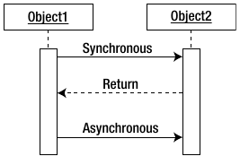
OOP - Developing an SRS 32
Message Types - continued
When an object sends an asynchronous message, the object continues processing and is not expecting an immediate response from the receiving object.
A line drawn with an open arrowhead in the sequence diagram represents asynchronous messaging.
A dashed arrow usually depicts a response message. These lines are shown here:

Slide 64
OOP - Developing an SRS 33
By studying the sequence diagram for the Process Movie Rental scenario shown on slide 56, you can see the types of messages that must be passed.
For example, the RentalClerk object initiates a synchronous message with the RentalItem object, requesting information as to whether a copy of the movie is in stock.
The RentalItem object then sends a response back to the RentalClerk object, indicating a copy is in stock.
This needs to be synchronous because the RentalClerk is waiting for the response to process the request.
An example of an asynchronous message would be if someone signs up for an e-mail alert when a movie is returned.
In this case, a message would be sent to fire off the e-mail but there is no need for a response.

Slide 65
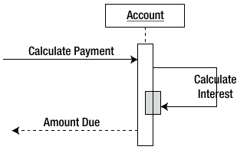
OOP - Developing an SRS 34
Recursive Messages
In OOP, it is not uncommon for an object to have an operation that invokes another object instance of itself. This is referred to as recursion.
A message arrow that loops back toward the calling object represents recursion in the sequence diagram.
The end of the arrow points to a smaller activation rectangle, representing a second object activation drawn on top of the original activation rectangle.
For example, an Account object calculates compound interest for overdue payments.
To calculate the interest over several compound periods, it needs to invoke itself several times.

Slide 66
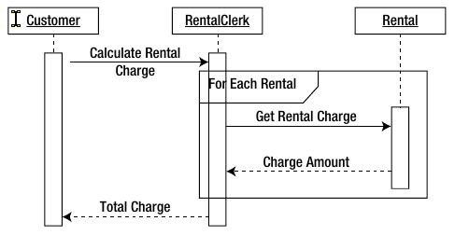
OOP - Developing an SRS 35
Message Iteration
Sometimes, a message call is repeated until a condition is met.
For example, when totalling rental charges, an Add method is called repeatedly until all rentals charged to the customer have been added to the total.
In programming terminology, this is iteration.
A rectangle drawn around the iterating messages represents an iteration in a sequence diagram.
The binding condition of the iteration is depicted in the upper-left corner of the rectangle.
This diagram shows an example of an iteration depicted in a sequence diagram.

Slide 67
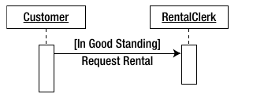
OOP - Developing an SRS 36
Message Constraints
Message calls between objects may have a conditional constraint attached to them.
For example, customers must be in good standing in order to be allowed to rent a movie.
You place the condition of the constraint within brackets ([]) in the sequence.
The message will be sent only if the condition evaluates to true

Slide 68
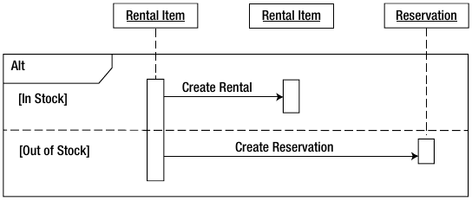
OOP - Developing an SRS 37
Message Branching
When conditional constraints are tied to message calling, you often run into a branching situation where, depending on the condition, different messages may be invoked.
This diagram represents a conditional constraint when requesting a movie rental.
If the status of the rental item is “in stock,” a message is sent to the Rental object to create a rental.
If the status of the rental item is “out of stock,” a message is sent to the Reservation object to create a reservation.
A rectangle (labelled as alt) drawn around the messages shows the alternate paths that can occur depending on the condition.

Slide 69
OOP - Developing an SRS 38
Understanding Activity Diagrams
An activity diagram illustrates the flow of activities that need to occur during an operation or process. You can construct the activity diagram to view the workflow at various levels of focus.
A high, system-level focus represents each use case as an activity and diagrams the workflow among the different use cases.
A mid-level focus diagrams the workflow occurring within a particular use case.
A low-level focus diagrams the workflow that occurs within a particular operation of one of the classes of the system.

Slide 70
OOP - Developing an SRS 39
Understanding Activity Diagrams - continued
The activity diagram consists of the starting point of the process represented by a solid circle and transition arrows representing the flow or transition from one activity to the next.
Rounded rectangles represent the activities, and a bull’s eye circle represents the ending point of the process.
For example, here we can see a generic activity diagram that represents a process that starts with activity A, proceeds to activity B, and concludes.

Slide 71
OOP - Developing an SRS 40
Decision Points and Guard Conditions
Often, one activity will conditionally follow another. For example, in order to rent a video, a PIN verifies membership.
An activity diagram represents conditionality by a decision point (represented by a diamond) with the guard condition (the condition that must be met to proceed) in brackets next to the flow line:

Slide 72
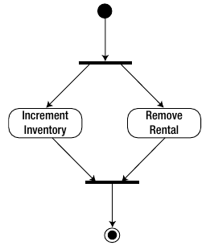
OOP - Developing an SRS 41
Parallel Processing
In some cases, two or more activities can run in parallel instead of sequentially.
A solid, bold line drawn perpendicularly to the transition arrow represents the splitting of the paths.
After the split, a second solid, bold line represents the merge. This image shows an activity diagram for the processing of a movie return.
The order in which the Increment Inventory and the Remove Rental activities occur does not matter.
The parallel paths in the diagram represent this parallel processing.

Slide 73
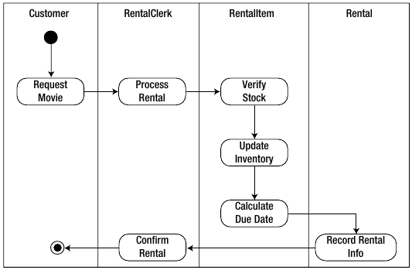
OOP - Developing an SRS 42
Activity Ownership
The activity diagram’s purpose is to model the control flow from activity to activity as the program processes.
The diagrams shown thus far do not indicate which objects have responsibility for these activities.
To signify object ownership of the activities, you segment the activity diagram into a series of vertical partitions (also called swim lanes).
The object role at the top of the partition is responsible for the activities in that partition.
This image shows an activity diagram for processing a movie rental, with swim lanes included.

Slide 74
OOP – UML- Further Reading
FreeCodeCamp Course on UML:
UML Diagram Course – How to Design Databases and Systems (freecodecam
p.org)

Slide 75
Algorithms

Slide 76
What is an algorithm?
An Algorithm is a set of instructions for accomplishing a task.
Every piece of code you write could therefore be called an algorithm.
In fact, the joke runs that developers use the word ‘algorithm’ when they don’t want to explain what they’ve done.
You can think of an algorithm as like a recipe on how to bake a cake.
Computer algorithms work via input and output. They take the input and apply each step of the algorithm to that information to generate an output.
For example, a search engine is an algorithm that takes a search query as an input and searches its database for items relevant to the words in the query. It then outputs the results.
You can easily visualise algorithms as a flowchart. The input leads to steps and questions that need handling in order. When each section of the flowchart is completed, the generated result is the output.

Slide 77
Visualising an algorithm?
As we know, an algorithm is simply a set of steps to accomplish a task.
As part of our design process for an app, it may be helpful to try to visualise the process of how an app, or a web app, functions.
Here is a great example of how a real-world developer uses flowcharts to visualise the algorithmic processing behind his apps.
How I Design An App Flowchart – YouTube

Slide 78
Visualising Algorithms – Learn more
Flowchart Tutorial (with Symbols, Guide and Examples)
https://www.visual-paradigm.com/tutorials/flowchart-tutorial/
Introduction to Creating Flowcharts
https://www.youtube.com/watch?v=SWRDqTx8d4k
Wikipedia entry on Flowcharts
https://en.wikipedia.org/wiki/Flowchart

Slide 79
Pseudocode

Slide 80
Pseudocode
Pseudocode is a term which is often used in programming and algorithm based fields.
It is a methodology that allows the programmer to represent the implementation of an algorithm.
Simply, we can say that it’s the cooked up representation of an algorithm.
Often at times, algorithms are represented with the help of pseudo codes as they can be interpreted by programmers no matter what their programming background or knowledge is.
Pseudocode, as the name suggests, is a false code or a representation of code which can be understood by even a layman with some school level programming knowledge.
Algorithm: It’s an organized logical sequence of the actions or the approach towards a particular problem. A programmer implements an algorithm to solve a problem. Algorithms are expressed using natural verbal but somewhat technical annotations.

Slide 81
Pseudocode
Pseudocode is simply an implementation of an algorithm written in plain English.
It has no syntax and thus can’t be compiled or interpreted by the computer.
Its use is to help us understand what is going on in a program.

Slide 82
Pseudocode
Why use pseudocode at all?
Better readability. Often, programmers work alongside people from other domains, such as mathematicians, business partners, managers, and so on. Using pseudocode to explain the mechanics of the code will make the communication between the different backgrounds easier and more efficient.
Ease up code construction. When the programmer goes through the process of developing and generating pseudocode, the process of converting that into real code written in any programming language will become much easier and faster as well.
A good middle point between flowchart and code. Moving directly from the idea to the flowchart to the code is not always a smooth ride. That’s where pseudocode presents a way to make the transition between the different stages somewhat smoother.
Act as a start point for documentation. Documentation is an essential aspect of building a good project. Often, starting documentation is the most difficult part. However, pseudocode can represent a good starting point for what the documentation should include. Sometimes, programmers include the pseudocode as a docstring at the beginning of the code file.
Easier bug detection and fixing. Since pseudocode is written in a human-readable format, it is easier to edit and discover bugs before actually writing a single line of code. Editing pseudocode can be done more efficiently than testing, debugging, and fixing actual code.
https://towardsdatascience.com/pseudocode-101-an-introduction-to-writing-good-pseudocode-1331cb855be7

Slide 83
Pseudocode
The main constructs of pseudocode
The core of pseudocode is the ability to represent 6 programming constructs (always written in uppercase): SEQUENCE, CASE, WHILE, REPEAT-UNTIL, FOR, and IF-THEN-ELSE.
These constructs — also called keywords —are used to describe the control flow of the algorithm.
SEQUENCE represents linear tasks sequentially performed one after the other.
WHILE a loop with a condition at its beginning.
REPEAT-UNTIL a loop with a condition at the bottom.
FOR another way of looping.
IF-THEN-ELSE a conditional statement changing the flow of the algorithm.
CASE the generalization form of IF-THEN-ELSE.
https://towardsdatascience.com/pseudocode-101-an-introduction-to-writing-good-pseudocode-1331cb855be7

Slide 84
Pseudocode
https://towardsdatascience.com/pseudocode-101-an-introduction-to-writing-good-pseudocode-1331cb855be7

Slide 85
Pseudocode
Although these 6 constructs are the most often used ones, you can theoretically use them to implement any algorithm. You might find yourself needing some more based on your specific application. Perhaps the two most needed commands are:
Invoking classes or calling functions (using the CALL keyword).
Handling exceptions (using EXCEPTION, WHEN keywords).
https://towardsdatascience.com/pseudocode-101-an-introduction-to-writing-good-pseudocode-1331cb855be7

Slide 86
Pseudocode
https://towardsdatascience.com/pseudocode-101-an-introduction-to-writing-good-pseudocode-1331cb855be7

Slide 87
Pseudocode
Of course, based on the field you’re working in, you might add more constructs (keywords) to your pseudocode glossary as long as you never use these keywords as variable names and that they are well known within your field or company.
https://towardsdatascience.com/pseudocode-101-an-introduction-to-writing-good-pseudocode-1331cb855be7

Slide 88
Pseudocode
Rules of writing pseudocode
When writing pseudocode, everyone often has their own style of presenting things out since it’s read by humans and not by a computer; its rules are less rigorous than that of a programming language. However, there are some simple rules that help make pseudocode more universally understood.
Always capitalize the initial word (often one of the main 6 constructs).
Have only one statement per line.
Indent to show hierarchy, improve readability, and show nested constructs.
Always end multiline sections using any of the END keywords (ENDIF, ENDWHILE, etc.).
Keep your statements programming language independent.
Use the naming domain of the problem, not that of the implementation. E.g., “Append the last name to the first name” instead of “name = first+ last.”
Keep it simple, concise, and readable.
https://towardsdatascience.com/pseudocode-101-an-introduction-to-writing-good-pseudocode-1331cb855be7

Slide 89
Pseudocode
Rules of writing pseudocode
Following these rules help you generate readable pseudocode and be able to recognize a not well-written one.
https://towardsdatascience.com/pseudocode-101-an-introduction-to-writing-good-pseudocode-1331cb855be7

Slide 90
Entity Relationships

Slide 91
What is an Entity Relationship?
ERD stands for Entity Relationship Diagram (AKA ER Model)
An Entity–relationship model (ER model) describes the structure of a database with the help of a diagram, which is known as Entity Relationship Diagram (ER Diagram).
An ER model is a design or blueprint of a database that can later be implemented as a database. The main components of E-R model are: entity set and relationship set.
https://beginnersbook.com/2015/04/e-r-model-in-dbms/

Slide 92
Entity Modelling
The ER model defines the conceptual view of a database.
It works around real-world entities and the associations among them.
At view level, the ER model is considered a good option for designing databases.

Slide 93
Entity Modelling
Entity
An entity can be a real-world object, either animate or inanimate, that can be easily identifiable. For example, in a school database, students, teachers, classes, and courses offered can be considered as entities. All these entities have some attributes or properties that give them their identity.
An entity set is a collection of similar types of entities. An entity set may contain entities with attribute sharing similar values. For example, a Students set may contain all the students of a school; likewise a Teachers set may contain all the teachers of a school from all faculties. Entity sets need not be disjoint.

Slide 94
Entity Modelling
Attributes
Entities are represented by means of their properties, called attributes. All attributes have values. For example, a student entity may have name, class, and age as attributes.
There exists a domain or range of values that can be assigned to attributes. For example, a student's name cannot be a numeric value. It has to be alphabetic. A student's age cannot be negative, etc.

Slide 95
Entity Modelling
Attributes
Types of Attributes
Simple attribute − Simple attributes are atomic values, which cannot be divided further. For example, a student's phone number is an atomic value of 10 digits.
Composite attribute − Composite attributes are made of more than one simple attribute. For example, a student's complete name may have first_name and last_name.
Derived attribute − Derived attributes are the attributes that do not exist in the physical database, but their values are derived from other attributes present in the database. For example, average_salary in a department should not be saved directly in the database, instead it can be derived. For another example, age can be derived from data_of_birth.
Single-value attribute − Single-value attributes contain single value. For example − Social_Security_Number.
Multi-value attribute − Multi-value attributes may contain more than one values. For example, a person can have more than one phone number, email_address, etc.

Slide 96
Entity Modelling
Attributes
These attribute types can come together in a way like −
simple single-valued attributes
simple multi-valued attributes
composite single-valued attributes
composite multi-valued attributes

Slide 97
Entity Modelling
Attributes
Entity-Set and Keys
Key is an attribute or collection of attributes that uniquely identifies an entity among entity set.
For example, the roll_number of a student makes him/her identifiable among students.
Super Key − A set of attributes (one or more) that collectively identifies an entity in an entity set.
Candidate Key − A minimal super key is called a candidate key. An entity set may have more than one candidate key.
Primary Key − A primary key is one of the candidate keys chosen by the database designer to uniquely identify the entity set.

Slide 98
Entity Modelling
Relationship
The association among entities is called a relationship. For example, an employee works_at a department, a student enrolls in a course. Here, Works_at and Enrolls are called relationships.
Relationship Set
A set of relationships of similar type is called a relationship set. Like entities, a relationship too can have attributes. These attributes are called descriptive attributes.
Degree of Relationship
The number of participating entities in a relationship defines the degree of the relationship.
Binary = degree 2
Ternary = degree 3
n-ary = degree

Slide 99
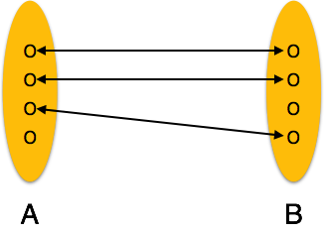
Entity Modelling
Relationship
Mapping Cardinalities
Cardinality defines the number of entities in one entity set, which can be associated with the number of entities of other set via relationship set.
One-to-one − One entity from entity set A can be associated with at most one entity of entity set B and vice versa.

Slide 100
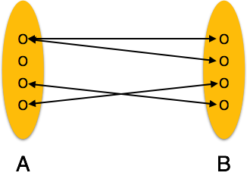
Entity Modelling
Relationship
Mapping Cardinalities
Cardinality defines the number of entities in one entity set, which can be associated with the number of entities of other set via relationship set.
One-to-many − One entity from entity set A can be associated with more than one entities of entity set B however an entity from entity set B, can be associated with at most one entity.

Slide 101
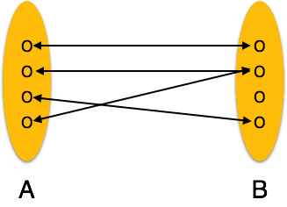
Entity Modelling
Relationship
Mapping Cardinalities
Cardinality defines the number of entities in one entity set, which can be associated with the number of entities of other set via relationship set.
Many-to-one − More than one entities from entity set A can be associated with at most one entity of entity set B, however an entity from entity set B can be associated with more than one entity from entity set A.

Slide 102
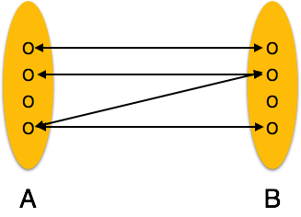
Entity Modelling
Relationship
Mapping Cardinalities
Cardinality defines the number of entities in one entity set, which can be associated with the number of entities of other set via relationship set.
Many-to-many − One entity from A can be associated with more than one entity from B and vice versa.
https://www.tutorialspoint.com/dbms/er_model_basic_concepts.htm

Slide 103
Entity Modelling
ER Diagram Representation
Let us now learn how the ER Model is represented by means of an ER diagram. Any object, for example, entities, attributes of an entity, relationship sets, and attributes of relationship sets, can be represented with the help of an ER diagram.

Slide 104
Entity Modelling
Entity
Entities are represented by means of rectangles. Rectangles are named with the entity set they represent.

Slide 105
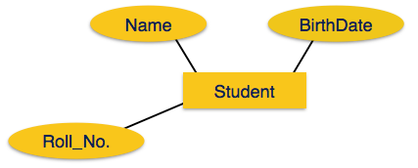
Entity Modelling
Attributes
Attributes are the properties of entities. Attributes are represented by means of ellipses. Every ellipse represents one attribute and is directly connected to its entity (rectangle).

Slide 106
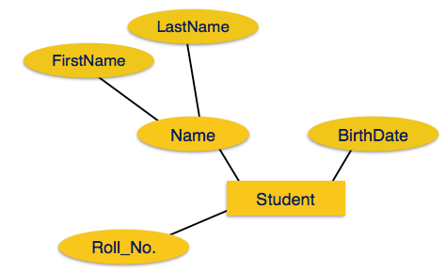
Entity Modelling
Attributes
If the attributes are composite, they are further divided in a tree like structure. Every node is then connected to its attribute. That is, composite attributes are represented by ellipses that are connected with an ellipse.

Slide 107
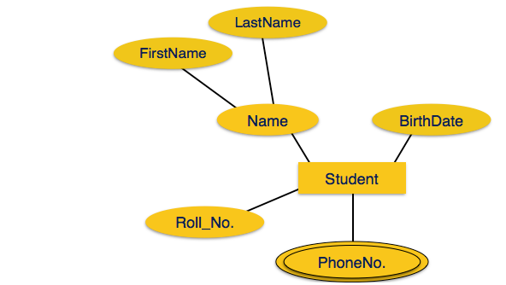
Entity Modelling
Attributes
Multivalued attributes are depicted by double ellipse

Slide 108
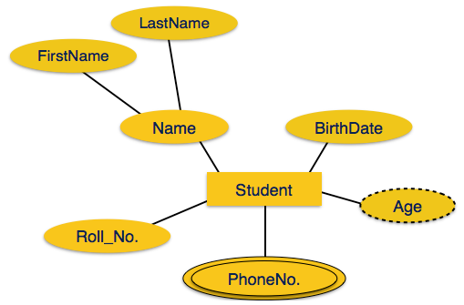
Entity Modelling
Attributes
Derived attributes are depicted by dashed ellipse

Slide 109
Entity Modelling
Relationship
Relationships are represented by diamond-shaped box. Name of the relationship is written inside the diamond-box. All the entities (rectangles) participating in a relationship, are connected to it by a line.
Binary Relationship and Cardinality
A relationship where two entities are participating is called a binary relationship. Cardinality is the number of instance of an entity from a relation that can be associated with the relation.
One-to-one − When only one instance of an entity is associated with the relationship, it is marked as '1:1'. The following image reflects that only one instance of each entity should be associated with the relationship. It depicts one-to-one relationship.

Slide 110
Entity Modelling
Relationship
Many-to-one − When more than one instance of entity is associated with the relationship, it is marked as 'N:1'. The following image reflects that more than one instance of an entity on the left and only one instance of an entity on the right can be associated with the relationship. It depicts many-to-one relationship.

Slide 111
Entity Modelling
Relationship
Many-to-many − The following image reflects that more than one instance of an entity on the left and more than one instance of an entity on the right can be associated with the relationship. It depicts many-to-many relationship.

Slide 112
Entity Modelling
Participation Constraints
Total Participation − Each entity is involved in the relationship. Total participation is represented by double lines.
Partial participation − Not all entities are involved in the relationship. Partial participation is represented by single lines.
https://www.tutorialspoint.com/dbms/er_diagram_representation.htm

Slide 113
Entity Modelling – Learn More
ER Diagram: Entity Relationship Diagram Model | DBMS Example
https://www.guru99.com/er-diagram-tutorial-dbms.html
ER Model - Basic Concepts
https://www.tutorialspoint.com/dbms/er_model_basic_concepts.htm
ER Diagram Representation
https://www.tutorialspoint.com/dbms/er_diagram_representation.htm
Generalization Aggregation
https://www.tutorialspoint.com/dbms/dbms_generalization_aggregation.htm

Slide 114
Good Practises

Slide 115
Good Practices
Comments
Code formatting and Naming conventions

Slide 116
Good Practices - Comments
Best practices for writing code comments
https://stackoverflow.blog/2021/07/05/best-practices-for-writing-code-comments/
While there are many resources to help programmers write better code—such as books and static analyzers—there are few for writing better comments.
While it's easy to measure the quantity of comments in a program, it's hard to measure the quality, and the two are not necessarily correlated.
A bad comment is worse than no comment at all. Here are some rules to help you achieve a happy medium.

Slide 117
Good Practices - Comments
Best practices for writing code comments
https://stackoverflow.blog/2021/07/05/best-practices-for-writing-code-comments/
Rule 1: Comments should not duplicate the code.
Rule 2: Good comments do not excuse unclear code.
Rule 3: If you can’t write a clear comment, there may be a problem with the code.
Rule 4: Comments should dispel confusion, not cause it.
Rule 5: Explain unidiomatic code in comments.
Rule 6: Provide links to the original source of copied code.
Rule 7: Include links to external references where they will be most helpful.
Rule 8: Add comments when fixing bugs.
Rule 9: Use comments to mark incomplete implementations.

Slide 118
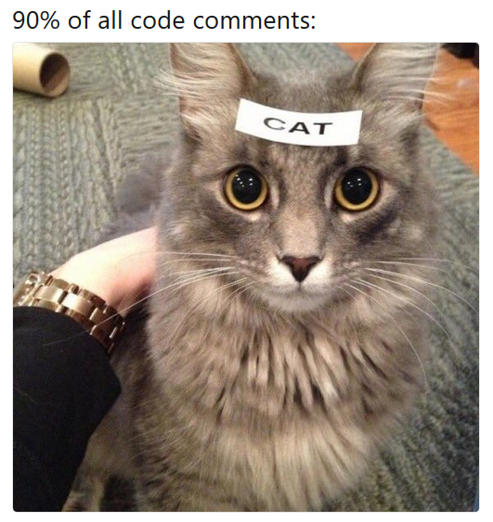
Good Practices - Comments
Best practices for writing code comments
https://stackoverflow.blog/2021/07/05/best-practices-for-writing-code-comments/

Slide 119
Good Practices – Code Formatting & Naming
Use the correct code formatting conventions for your language
Which to use?
camelCase?
PascalCase?
What’s the difference?
https://www.theserverside.com/answer/Pascal-case-vs-camel-case-Whats-the-difference
Here’s what Microsoft have to say about c# coding standards:
https://docs.microsoft.com/en-us/dotnet/csharp/fundamentals/coding-style/coding-conventions

Slide 120
Good Practices – Code Formatting & Naming
Use the correct code formatting conventions for your language
Here’s what Microsoft have to say about c# coding standards:
https://docs.microsoft.com/en-us/dotnet/csharp/fundamentals/coding-style/coding-conventions
Coding conventions serve the following purposes:
They create a consistent look to the code, so that readers can focus on content, not layout.
They enable readers to understand the code more quickly by making assumptions based on previous experience.
They facilitate copying, changing, and maintaining the code.
They demonstrate C# best practices.

