Slide 1
Assignments
^{<Assignments>}

Slide 2
^{<Assignment rules>}
Submission
Word count
Referencing
Marking criteria
Notes:
Suggest you tick them off if they are correct and X them if not!

Slide 3
^{<submission>}
Work must be submitted on time (by 14:00 on the deadline day)
Work submitted up to 24 hours late will be capped at 40%*
Work submitted more than 24 hours later will be treated as a non-submission (unless there is a serious, documented reason, in which case a 5-day extension may be permitted) * * These regulations are suspended under UWE Covid force majeure. Students may claim a 5-day extension without documentation. Work missing the 24-hour deadline will be a non-submission.

Slide 4
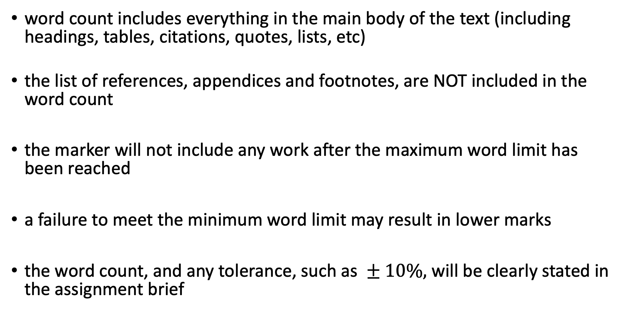
^{<word count>}
word count includes everything in the main body of the text (including headings, tables, citations, quotes, lists, etc)
the list of references, appendices and footnotes, are NOT included in the word count
the marker will not include any work after the maximum word limit has been reached
a failure to meet the minimum word limit may result in lower marks
the word count, and any tolerance, such as $± 10\%,$ will be clearly stated in the assignment brief

Slide 5
^{<referencing>}
See www.uwe.ac.uk/referencing/uweharvard
You are expected to acknowledge
the books
journal articles
other sources of information
that you use when preparing and completing your university work
This is done by briefly referring to (citing) the sources of information in the text of your work
And producing a corresponding, alphabetical list of references (or a bibliography) at the end of your work.

Slide 6
^{<referencing>}
Referencing demonstrates that you have done the following:
acknowledged your sources of information
read around the subject
taken on board related research
explored others' opinions
checked your facts
substantiated your arguments
come to your own conclusions
References also enable the reader to find your sources of information for themselves.
Referencing will become very important in year three and for the project in particular, so start now.

Slide 7
^{<referencing>}
When to and how to reference
Each time you use someone else's ideas, words or facts, it is essential that you acknowledge this in your work.
Not acknowledging other people's work is intellectually dishonest and can be illegal.
It is known as plagiarism. You do not need to reference common knowledge, but you should reference things that you have personally read, seen or heard.

Slide 8
^{<referencing>}
Examples at:
https://www.uwe.ac.uk/study/study-support/study-skills/referencing/uwe-bristol-harvard#a0bb62b71-8553-4539-80f1-e51683b0aa4c
Citing a source of information in your own text
The need for care and guidance (Pearson et al., 2007) is evident...
As Pearson et al. states (2007, p.72), "The basis of evidence-based practice is, of course, evidence."
The corresponding reference
Pearson, A., Field, J., Ford, D. and Jordan, Z. (2007) Evidence-Based Clinical Practice in Nursing and Health Care: Assimilating Research, Experience and Expertise. 2nd ed. Oxford: Blackwell Publishing.

Slide 9
^{<referencing>}
Electronic books: how to format your reference
Author surname, initials. (Year of publication) Title [online]. Edition (if not first edition). Place of publication: Publisher. [Accessed DD Month YYYY].
Example:
Tulloch M et al, J. (2010) Understanding Microsoft Virtualization Solutions [online]. Washington : Microsoft Press. [Accessed 2 October 2020].

Slide 10
^{<referencing>}
Webpages: How to format your reference
Author surname, initials. / Organisation (Year of publication or last update) Title of Webpage. Available from: URL [Accessed DD Month YYYY].
Example:
Durairaj. M, Kannan.P (2014) A Study On Virtualization Techniques And Challenges In Cloud Computing. Available from: https://www.researchgate.net [Accessed 2 October 2020].
Example of (citing) a work within your text:
A hypervisor is a layer of software (Durairaj. M et al, 2014).

Slide 11
^{<referencing>}
Images or diagrams taken from webpages: how to format your reference
Author surname, initials. / Organisation (Year of publication or last update) Title of Image/Diagram. Available from: URL [Accessed DD Month YYYY].
Example:
Terendo (2010) Hyper-V Architecture. Available from: https://commons.wikimedia.org/wiki/File:Hyper-V.png [Accessed 2 October 2020].

Slide 12
^{<referencing>}
For comprehensive instructions on how to reference all sorts of sources, use the guides on the UWE pages given earlier
Note:
Wikipedia articles themselves are NOT sources you should use
However, their reference section may lead you to sources you can cite

Slide 13
^{<marking criteria>}
Each assignment will contain a marking grid
This shows how marks will be allocated to sections of the assignment and any weighting that applies
This example shows that a pass can be achieved with a reasonable test plan, but that higher marks can only be obtained with the evaluation
 | 0-29 | 30-39 | 40-49 | 50-59 | 60-69 | 70-84 | 85-100
Test and evaluation (20%) | No test plan or evaluation | Poor test coverage and documentation | Basic functionality tested | Good coverage but the evaluation is superficial | Well documented test plan and results with good evaluation | Convincing evaluation backed by evidence. An excellent test plan. | Convincing evaluation with additional recommendations. An excellent test plan.

