Slide 1
Networks

Slide 2
No Connection
Single user
No connection
Very secure

Slide 3
Connection
Two users
Crossover cable
Full duplex
Transmit and receive at the same time
OSI layer 1 – Physical
Transmission of bits
100010100101010

Slide 4
Hub
Two or more users
A single network segment
Straight cables
OSI layer 1 – Physical
Transmission of bits
Hub
Amplifies signal
Broadcasts input on all outputs
Clients reject inputs not for them
Half duplex – transmit or receive
Poor performance
101001
101001
101001
101001

Slide 5
MAC (Media Access Control) Addressing
Uniquely identifies a network interface controller (NIC)
MAC addresses are used as a network address for Ethernet and Wi-Fi
Addresses are assigned by the manufacturer and stored in the NIC’s read-only memory or firmware
It is a 48-bit address for 281,474,976,710,656 possible MAC addresses (normally shown as 6 octets) ether 4a:00:02:00:ca:e0 (from ifconfig)
ipconfig or ifconfig commands show the MAC address

Slide 6
Packets and frames
A MAC address allows data to be directed to a specific device
The data segment is called a frame
Preamble | Start of frame delimiter | Destination | Source | Length | Data | CRC
Timing |  | MAC Addressing |  | Amount of data | Payload | Checksum
7 bytes | 1 byte | 6 bytes | 6 bytes | 2 bytes | 46-1500 bytes | 4 bytes
FRAME

Slide 7
Switch
Two or more users
A single network segment
Straight cables
OSI layer 2 – Data Link
Transmission of packets
Switch
Amplifies signal
Directs inputs to correct outputs
Full duplex
Best performance
Error checking
101001
111011
101001
111011

Slide 8
Switch operation
Works on the Layer 2 Header
Uses the source and destination MAC addresses to make its forwarding decisions.
MAC Address Table
maps the switch’s ports to MAC addresses
the source address and the port a frame was received on are entered in the MAC Address Table.
as each connected device sends a frame the table gets fully populated
the table is then used to forward frames to their intended destination

Slide 9
Local Area Network
When the area covered is small, such as an office, this is known as a Local Area Network (LAN)
Devices connected to the switches are called Hosts
The hosts are typically clients, servers or LAN attached peripherals, such as printers
A LAN can be wired or wireless
Switches can be cascaded to increase the number of hosts

Slide 10
Increasing the number of hosts
Adding switches is inefficient (inactive hosts are flushed from the MAC address table after 300s)
Adding hosts increases traffic congestion on the LAN (more collisions and failed transmissions)
Adding hosts means increased processing loads
The solution is to create additional physical networks

Slide 11
IP addresses
A MAC address is physical, it allows packets to be delivered from one NIC to another (hop to hop)
IP addresses are logical and allow delivery of packets across networks (from end to end)
IP addresses work at OSI layer 3 – Network
An address is a 32 bit binary number represented as 4 octets
E.g. 192.168.1.123 (IP v4)
Destination and source IP addresses are added to the data payload of the ethernet packet

Slide 12
Packets with IP addresses
Preamble | Start of frame delimiter | Destination | Source | Length | Data | CRC
Timing |  | MAC Addressing |  | Amount of data | Payload | Checksum
7 bytes | 1 byte | 6 bytes | 6 bytes | 2 bytes | 46-1500 bytes | 4 bytes
PACKET
Source IP address | Destination IP address
4 bytes | 4 bytes

Slide 13
Two networks
192.168.1.9
X
R1 NIC
R2 NIC
A
Router
B
192.168.1.12
192.168.2.7
Source MAC | Destination MAC | Source IP | Destination IP
Host A | Router R1 | 192.168.1.12 | 192.168.2.7
Source MAC | Destination MAC | Source IP | Destination IP
Router R2 | Host B | 192.168.1.12 | 192.168.2.7

Slide 14
ARP Address Resolution Protocol
Used to find the MAC address for a given IP
Host A (192.168.1.12) needs to send to Host B (192.168.2.7)
It knows 192.168.2.7 is in a different network
It has a default gateway of 192.168.1.1 (the router)
It sends a broadcast ARP message (MAC ff:ff:ff:ff:ff:ff) for 192.168.1.1 (this goes to all hosts on the network)
Only the router replies with its Mac and IP addresses
Host A updates its ARP table
Sends packet to 192.168.2.7 with router MAC address

Slide 15
ARP table

Slide 16
Router Table In Host A (192.168.1.12)
Contains a 0.0.0.0 entry which points to the default gateway 192.168.1.1
Contains other IP addresses on its own network and the address of its own NIC
If sending to Host X it will look in the table and send directly
If sending to Host B (192.168.2.7) will find 0.0.0.0 as the closest match in the table and send to the gateway
Network Destination | Gateway | Interface | Notes
0.0.0.0 | 192.168.1.1 | 192.168.1.12
127.0.0.1 | On-Link | 127.0.0.1 | Loopback
192.168.1.9 | On-Link | 192.168.1.12 | Host X

Slide 17
Router’s Table
Contains a list of IP addresses and interfaces
If sending to 192.168.1.n will forward via R1 NIC
If sending to 192.168.2.n will forward via R2 NIC /24 refers indirectly to the number of hosts on the network and is covered in subnetting (not in the BCS Cloud syllabus)
IP address | Interface
192.168.1.0/24 | R1 NIC
192.168.2.0/24 | R2 NIC

Slide 18
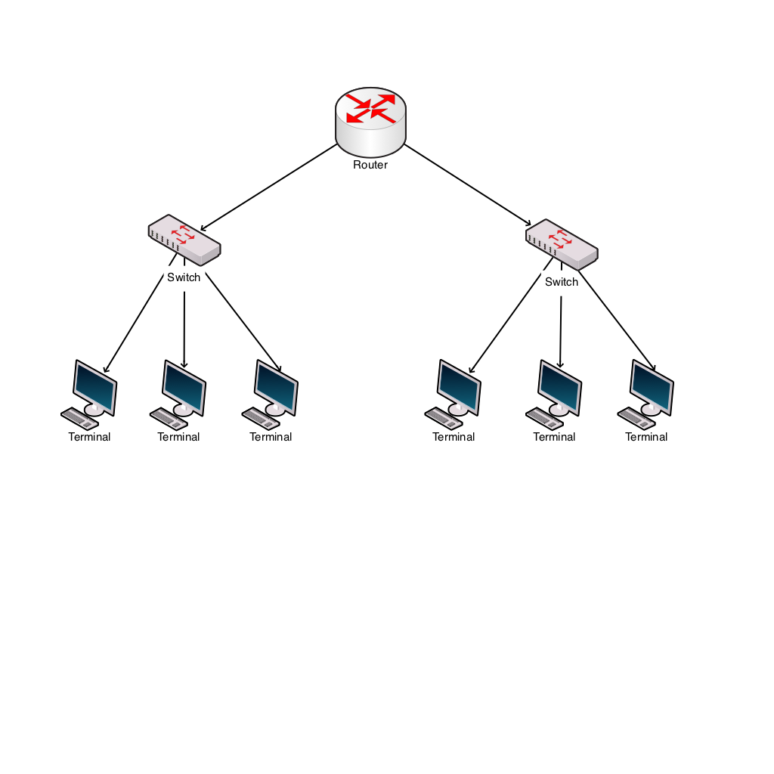
Windows Network Utilities
Ping
Tests connectivity
ping 192.168.2.7
ARP
Shows MAC addresses for IP addresses

Slide 19
IP addresses
IP address classes
Class D is used for multicast (224-239)
Class E is experimental (240-255)
One class A address is worth 16M hosts
Therefore a way is needed to allocate significantly more hosts than are available
Address class | First octet range | Number of hosts
A | 1-126 | 16M
B | 128-191 | 64k
C | 192-223 | 254

Slide 20
Private IP addresses
Address ranges allocated as private, therefore not permissible onto the general internet.
So, an organisation can have one outward facing IP address and up to 16M hosts inside
This is done using network address translation (explained later)
Address range | Number of hosts
10.0.0.0 – 10.255.255.255 | 16M
172.16.0.0 – 172.31.255.255 | 1M
192.168.0.0 – 192.168.255.255 | 64K

Slide 21
Setting IP addresses
Assume a small system with 192.168.1.n addresses
Static addresses are set on the device
Dynamic addresses are leased by a DHCP server
IP address | Host | Type
192.168.1.1 | Router | Static
192.168.1.10 | Server | Static
192.168.1.20 | Printer | Static
192.168.1.100 - 200 | Desktops | Dynamic

Slide 22
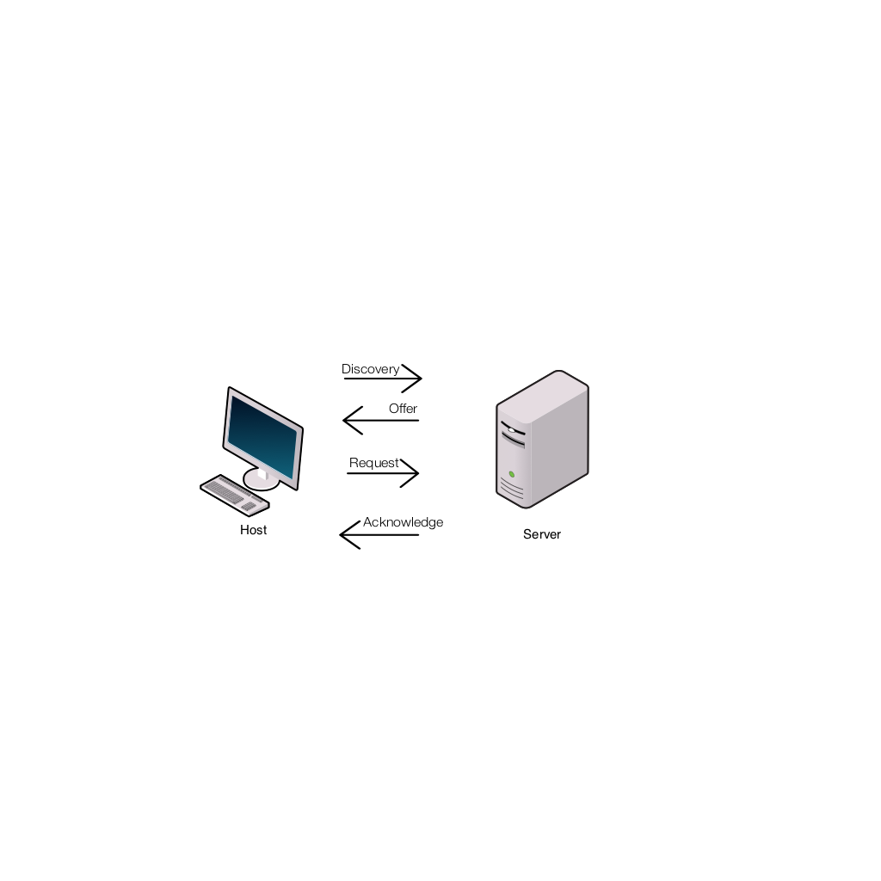
DHCP Dynamic Host Configuration Protocol
Host sends a discovery request (255.255.255.255) for a DHCP server
Server responds with a lease offer of an IP address, gateway address, duration and DNS server address (see later for DNS)
Host responds with a request to accept the offered lease
Server acknowledges the request
Host configures its network interface with the agreed parameters

Slide 23
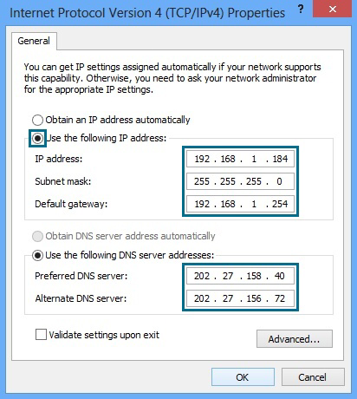
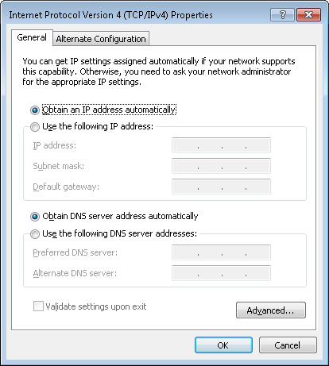
DHCP Windows Configuration
Static Dynamic

Slide 24
Recap
Hosts have MAC and IP addresses
They can communicate in the same network using switches and MAC addressing
To communicate between networks they use routers and IP addresses
Private IP addresses allow duplicate usage in different organisations, but are not allowed on the internet
IP addresses can be manually configured or obtained by DHCP

Slide 25
Internet connection
Connection to the ISP
ADSL
Cable
Satellite
Cellular
Leased line
ISP supplies:
IP address via DHCP
DNS address

Slide 26
ISP IP addresses
An ISP will allocate an IP address from a range it owns
These IP addresses are unique on the internet
Gloucester College IP address is 212.219.57.69
All internet traffic to and from Gloucester College is via the IP address 212.219.57.69
Internal IP addresses at the college will be from the private IP addresses ranges
How does traffic for a private IP address get to the right host?

Slide 27
Network and port address translation (NAT and PAT)
Implemented in the router
Allows many hosts on the internal network to connect via one public IP address
Allows many applications on one host to communicate with many services in the cloud
Uses IP and port numbers

Slide 28
Ports
An IP address and a port address make up a socket
Eg 212.219.57.69:80 (Gloucester college HTTP port)
An application, service or process uses the socket to send and receive data via the network – OSI Layer 4 Transport
The operating system
transmits the data from all application ports on to the network
directs received packets to the matching IP address and port number

Slide 29
Port allocation
Well known ports 0-1023
Examples
21 FTP
25 SMTP
80 HTTP
110 POP3
443 HTTPS
Registered ports 1024-49151
Dynamic ports 49152-65535

Slide 30
Packets with IP addresses and port numbers
Preamble | Start of frame delimiter | Destination | Source | Length | Data | CRC
Timing |  | MAC Addressing |  | Amount of data | Payload | Checksum
7 bytes | 1 byte | 6 bytes | 6 bytes | 2 bytes | 46-1500 bytes | 4 bytes
PACKET
Source IP address | Destination IP address | Source port number | Destination port number
4 bytes | 4 bytes | 2 bytes | 2 bytes

Slide 31
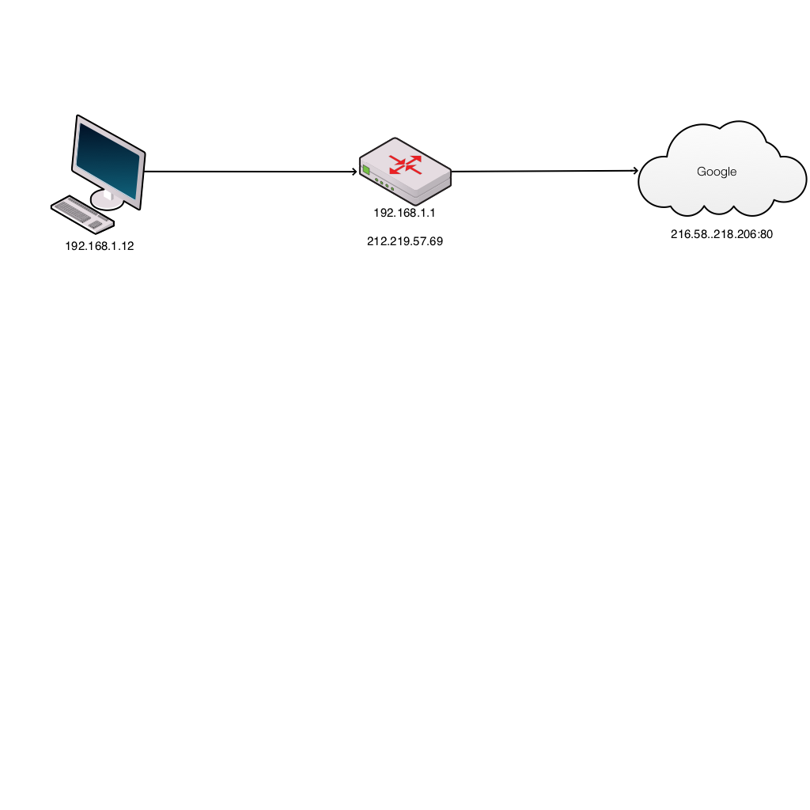
Browser request
Host | Router client side | Router ISP side | Cloud service
S 192.168.1.12:3333 D 216.58.218.206:80 | 192.168.1.12:3333 | 212.219.57.69:7777 | S 212.219.57.69:7777 D 216.58.218.206:80
Host inserts random source port number
Router translates internal network IP address to the external network address and port
Router updates translate table and records port numbers

Slide 32
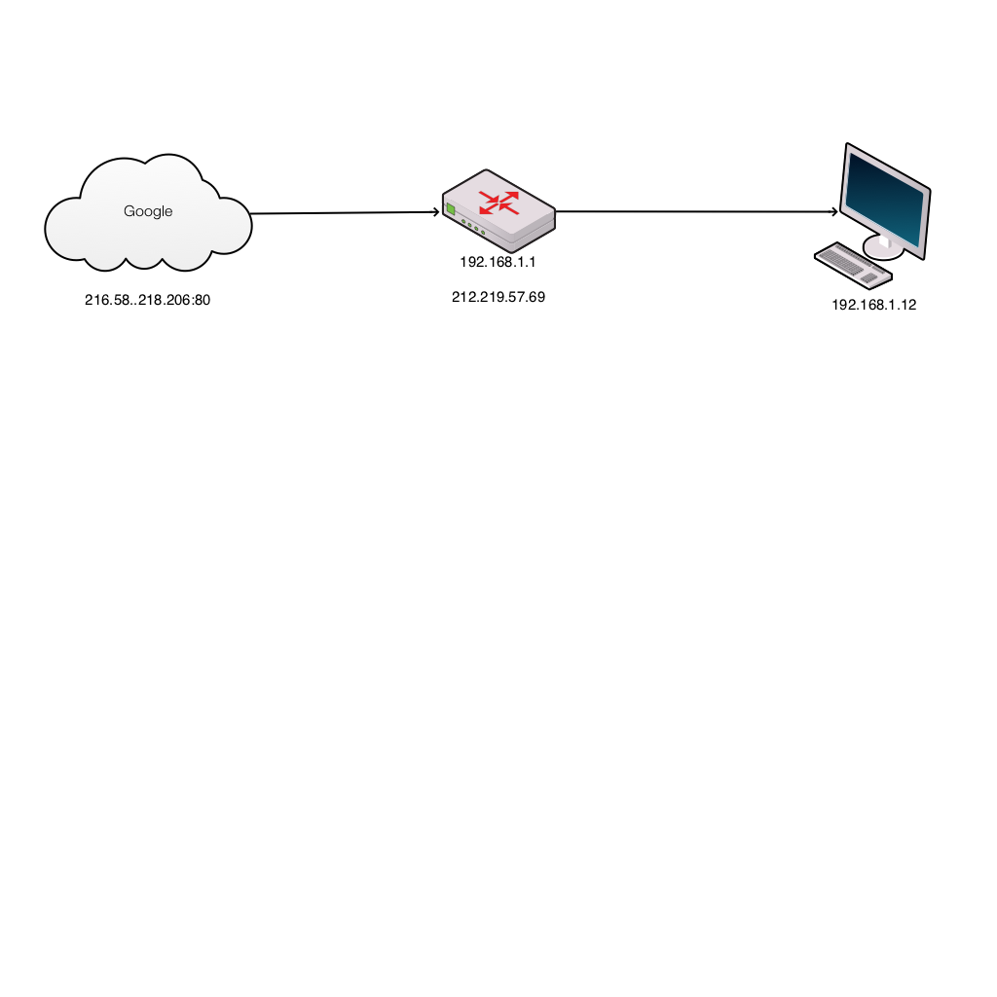
Server response
Cloud service | Router ISP side | Router client side | Host
S 216.58.218.206:80 D 212.219.57.69:7777 | 212.219.57.69:7777 | 192.168.1.12:3333 | S 216.58.218.206:80 D 192.168.1.12:3333
Server puts source address from received packet into destination address of outbound packet
Router translates external network IP address to the internal network address and port
Host receives packet and OS directs to correct application

Slide 33
Domain Name System
Translates domain names to IP addresses
A host will query a domain name server (address from DHCP) with the domain name (eg www.techrepublic.com)
DNS server returns the IP address
Windows command: nslookup

Slide 34
Recap
Internal networks connect to the internet via ISP
The ISP allocates an IP address
Network address translation (NAT) allows private IP addressing
Port address translation (PAT) allows multiple applications to connect to cloud services
DNS allows memorable names to be used for cloud resources

Slide 35
Infrastructure

Slide 36
Server hardware formats
Tower
Built in an upright cabinet that stands alone
Advantages
Cost effective
Easier cooling, lower component density
Scalable - can easily upgrade or add more
Disadvantages
Bulkier and heavier than rack or blade
Cabling for a set of tower servers is complicated
Several towers together can be noisy
Usage
Smaller environments
Limited number of clients to support

Slide 37
Server hardware formats
Rack Mount
Designed to be positioned in a bay
Servers vertically stacked
Racks can also have storage, cooling, SANs, network kit, UPS
Advantages
Cost effective – substantial power
Failure containment – easy to remove and replace
Easy cable management
Disadvantages
Power usage – additional cooling
Cost of racks, ancillary equipment
Usage
When 4 to 25 servers are required

Slide 38
Server hardware formats
Blade
Servers are placed inside blade enclosures, forming a blade system
Smallest type of server
Can be hot plugged
Advantages
Load balancing and failover
Centralised management
Minimal cabling
Minimum physical space
Disadvantages
Expensive
Stringent heating, ventilation and air con requirements
Usage
When at least 16 servers are required
Data centres

Slide 39
Switches – layer 2
Transports data on the data link layer
Operates on MAC addresses
Creates a LAN
Removes the collision domain
All ports are in a broadcast domain

Slide 40
Switches – layer 3
Inspect the incoming/outgoing network traffic – IP addressing (network layer 3)
Support of all major routing protocols and most of the routing of data/traffic to the next hop/router
Include switching abilities, and can forward data according to a device's physical address (layer 2)
Uses hardware routing, whereas typical routers use software routing
Use of hardware leads to higher performance
Very useful for VLANs

Slide 41
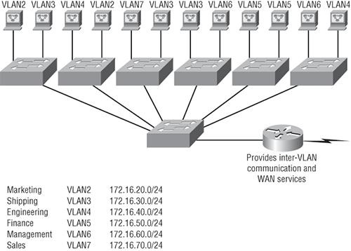
VLANs
Create smaller broadcast domains at layer 2
Broadcasts from one VLAN do not go to another VLAN
Adding VLANs reduces bandwidth requirements
Adding a user means allocating their port to a VLAN
Need a router to communicate between VLANs
Layer 3 switch combines the switching and routing required for VLANs (but not WAN)

Slide 42
Configure VLANs on Cisco S1 switch
S1#config t
S1(config)#vlan ?
WORD ISL VLAN IDs 1-4094
internal internal VLAN
S1(config)#vlan 2
S1(config-vlan)#name Sales
S1(config-vlan)#vlan 3
S1(config-vlan)#name Marketing
S1(config-vlan)#vlan 4
S1(config-vlan)#name Accounting
S1(config-vlan)#^Z
S1#

Slide 43
Three layer model (access, distribution, core)
Access
End-stations and servers connect to the enterprise at the access layer.
incorporates layer 2 switches and access points
Distribution
Routing and filtering are managed at the distribution layer.
Distribution layer devices also often manage individual branch-office WAN connections.
determines how packets can access the core.
consists of layer 3 routers and multilayer switches.
Core
consists of high speed devices, like high end routers and switches with redundant links
moves packets between distribution-layer devices in different regions of the network

Slide 44
Router
Forwards data packets between computer networks
Connected to two or more data lines (Ethernet, WAN etc) from different networks
Reads the network (IP) address information in the packet to determine the ultimate destination
Uses information in its routing table or routing policy to direct the packet to the next network on its journey
Is a layer 3 (network) device

Slide 45
Router
Incoming packet read into memory
Interrupt processor reads destination IP address
Checks in router cache to look for matching entry
If there is then builds new layer 2 header and alerts outbound processor
If not, then finds next hop address and layer 2 address in routing table, then builds new layer 2 header and alerts outbound processor

Slide 46
Hops
A hop occurs each time packets are passed to the next network device
The hop count is the number of intermediate devices the packet has to pass through from source to destination
The hop count can be used as a metric by routing protocols to determine the optimum path for a packet

Slide 47
Routing table
Contains the destination subnet
The metric (indicates best path)
Next hop or gateway
In the example (for a home router)
0.0.0.0 is for an address not found in the table
127.0.0.0 is localhost
Default gateway is 192.168.0.1 and reached through the local network card 192.168.0.100
Network Destination | Netmask | Gateway | Interface | Metric
0.0.0.0 | 0.0.0.0 | 192.168.0.1 | 192.168.0.100 | 10
127.0.0.0 | 255.0.0.0 | 127.0.0.1 | 127.0.0.1 | 1
192.168.0.0 | 255.255.255.0 | 192.168.0.100 | 192.168.0.100 | 10
192.168.0.100 | 255.255.255.255 | 127.0.0.1 | 127.0.0.1 | 10
192.168.0.1 | 255.255.255.255 | 192.168.0.100 | 192.168.0.100 | 10

Slide 48
Routing protocols
Used by routers to exchange information about routes between network nodes
Routing algorithms determine the choice of routes directly attached to router
This information is then shared, such that routers gain knowledge of the network topology
The results are stored as a metric in the routing table
Routing Information Protocol (RIP) counts hop (maximum 15)
Open Shortest Path First (OSPF) measures the cost – bandwidth, delay and load

Slide 49
Static routing
The network administrator adds entries in the routing table
Used:
For a default node when no other nodes are available
In a small network with only one or two routes
As a backup if dynamic routing is not available
Good for:
Full control over the network
Very little CPU load and no traffic to other routers
Problems:
Human error
Not fault tolerant if a route becomes unavailable

Slide 50
Dynamic routing
The entries in the routing table are made by the routing protocols
Entries are updated according to the conditions of the network
Failing nodes can be routed around
The paths can be adjusted based on traffic load, delays
Traffic can be switched to idle paths

Slide 51
Subnet access
Routers are used to connect subnets
If there were 400 clients to connect
Then split into two subnets of 200 each
192.168.1.n and 192.168.0.n
The router can use static routing to connect the two subnets together

Slide 52
WAN access
Requires a router with:
Connections to an ISP modem/connection
Typical specification of small business router
Dual 10/100 Mbps Fast Ethernet WAN ports to provide load balancing and/or business continuity
Built-in 8-port Fast Ethernet switch
Proven stateful packet inspection (SPI) firewall, hardware encryption
High-capacity, high-performance IPsec VPN capabilities
WAN connections
ADSL
Fibre
Receives IP address, DNS address from ISP
Not very modern by today’s standards

Slide 53
Segmentation and broadcast traffic reduction
Broadcasting is transmitting a packet that will be received by every device on the network
A MAC address of FF:FF:FF:FF:FF:FF or an IP address of x.x.x.255 is acted upon by every device
Excessive broadcast traffic can sometimes create a broadcast storm.
messages are broadcast on a network and each message prompts a receiving node to respond by broadcasting its own messages on the network.
This, in turn, prompts further responses that create a snowball effect.
The LAN is suddenly flooded with packets, creating unnecessary traffic that leads to poor network performance or even a complete loss of network service.
Subnetting reduces the number of devices on one network
Cisco recommend no more then 512 devices on a VLAN
250 is reasonable for a subnet
Some switches and routers have broadcast suppression

Slide 54
Wireless
Uses radio to connect network nodes
Avoids costly cabling
Works at the physical layer (1)
Bluetooth, NFC, Wi-Fi or Cellular (GSM)
Bluetooth
Low power, short range
Mice, keyboards, smartphone, headsets
Built into OS
NFC (Near field communication)
4cm range
Contactless payment (smartphone)
Data sharing(smartphone)

Slide 55
Wi-Fi
 | 802.11 | 802.11a | 802.11b | 802.11g | 802.11n | 802.11n IEEE Specification | 802.11ac Wave 1 | 802.11ac Wave 2 | 802.11ac IEEE Specification | 802.11ax
Band | 2.4GHz | 5.8GHz | 2.4GHz | 2.4GHz | 2.4GHz and 5GHz | 2.4GHz and 5GHz | 5GHz | 5GHz | 5GHz | 2.4GHz and 5GHz
Max Speed | 1.2Mbps | 54Mbps | 11Mbps | 54Mbps | 450Mbps | 600Mbps | 1.3Gbps | 2.34GHz – 3.47GHz | 6.9GHz | 10Gbps
MIMO | Single User | Single User | Single User | Single User | Single User | Single User | Single User | Multi User | Multi User | Multi User

Slide 56
Wi-Fi
Built into smartphones, laptops
Adapters for desktops
Used for wireless internet access in organisations
Hot spots, public Wi-Fi
Buses, trains, planes
Security
WEP - wired equivalent privacy(cracked)
WPA - Wi-Fi protected access (better)
WPA2 (best – but still vulnerable)
WPS – wireless protected set up (required on both devices, uses push button or PIN to connect)

Slide 57
Wireless access points
A device that connects wireless directly to a wired LAN
Wi-Fi on one side, Ethernet port on the other
Can be built into a router or standalone
Allows multiple wireless connections (maximum 15-25 recommended)

Slide 58
Wireless routers
Mainly domestic, small business use
Acts as a:
WAN modem/NIC
Router
Ethernet switch
Wireless access point
Lightweight web server for management
DHCP server
Security
Disable SSID broadcast.
Restrict access by MAC address.
Wireless security (WEP, WPA, WPA2).
Wireless Protected Setup (WPS).

Slide 59
Key network security devices
active devices
firewalls, antivirus scanning devices, content filtering devices, which block the surplus traffic
passive devices, such as intrusion detection appliances, which identify and report on unwanted traffic
preventative devices
penetration testing devices and vulnerability assessment appliances, which scan the networks and identify potential security problems;
Unified Threat Management (UTM) devices
such as firewalls, content filtering, web caching, which serve as all-in-one security devices.

Slide 60
Key network security devices

Slide 61
Firewalls - stateful, stateless and deep packet inspection
Stateful – monitors incoming and outgoing packets and the connection (Transport layer 4)
Was this connection made legitimately?
Significantly better at detecting and identifying unauthorized or forged connections
More useful to corporations more likely subject to cyber attack
Looks at connection data (TCP/UDP_ as well as packet headers
Stateless Firewalls contain rules about which traffic to allow or block depending on (Network layer 3)
Source IP,
Destination IP,
Port numbers,
Network Protocols
Have no knowledge of whether the connection was initiated by the client
Faster than stateful as only looks at the packet header

Slide 62
Firewalls - stateful, stateless and deep packet inspection
Stateful
# Generic rule to allow clients to connect to any
# webserver on the internet
Allow traffic going out to port 80
Allow traffic related to connections initiated by any internal client back to the same client
Deny any other traffic coming into the client.
Stateless
Allow traffic going out to port 80 on www.example.com
Allow traffic coming from host www.example.com and port 80
Deny any other traffic coming into the client

Slide 63
Firewalls - stateful, stateless and deep packet inspection
Deep packet inspection (DPI)
Firewalls cannot distinguish between permissible and forbidden data traffic between legitimate application
DPI looks at the the packet for:
virus signatures
worms
payload pattern matching
payload size
port numbers
IP matching
Can block, reroute or log infractions

Slide 64
Intrusion detection systems (IDS)
A device or software to monitor a network for malicious activity or policy violations
Events can be reported to administrators or collected in an event management system
Differs from a firewall as it monitors internal events
Works by inspecting network traffic and looking for:
known patterns (signature based)
deviations from regular activity (anomaly based)

Slide 65
Intrusion prevention systems (IPS)
Incorporates an IDS, but as an inline device so that it can attempt to block or stop malicious activity
An IPS can:
sending an alarm,
drop detected malicious packets
reset a connection
block traffic from an offending IP address
correct cyclic redundancy check (CRC) errors
defragment packet streams
mitigate TCP sequencing issues

Slide 66
Honeypot
A computer used to detect, deflect or counteract unauthorised use
Replicates legitimate parts of an IT system to attract and fool attackers
Production honeypots used by corporations as security devices
Research honeypots used to gather information and develop countermeasures
Spam honeypot
Catches open relay test messages from spammers
Returns the email to the spammer, but blocks all subsequent emails from the spammer
Notifies spammer’s ISP

Slide 67
BCS Level 4 Certificate in Network Security
QAN 603/0546/0
Network Engineer

Slide 68
Network Security
We Have 2 topics to cover
Types of security threat
Mitigating security threats

Slide 69
Security Threats
We have 10 different Security threats in the BCS syllabus.
These are all threats to a Network.
Lets see if we know them.
Notes:
Ask the students to list as many as they can.
Virus
Malware
DDoS attacks
Trojan
Worm
Spyware
Social engineering
Phishing attacks
Man-in-the-middle
DNS poisoning

Slide 70
Security Threats
Virus
Malware
DDoS attacks
Trojan
Worm
Spyware
Social engineering
Phishing attacks
Man-in-the-middle
DNS poisoning

Slide 71
All of our threats
Notes:
This is our network data centre/ business. And surrounding it is all of the treats that we may have. A threat is an event or object that may defeat our security measure in place and result in a loss of either services or data/money
Not all of these will be successful depending on if we have a vulnerability or not
A vulnerability is a weakness or exposure in a technology, protocol or design of an IT system. Can be Hardware or software
We have all these different threats trying to take our data!
From DNS Poisoning clockwise we have:
Trojan
Worm
Man in the middle
Social Engineering
Spyware
Malware
Virus
DDOS
Phishing

Slide 72
All of our threats
Notes:
Ask What is the best way to defend against all of these threats?

Slide 73
All of our threats
Before we can start to defend and mitigate these threats we need to understand what they are and how they work.
Notes:
Before we can start to defend and mitigate these threats we need to understand what they are and how they work.
We will look at the virus to begin with

Slide 74
Virus
A piece of code/software which is capable of copying itself and typically has a detrimental effect, such as
Corrupting the system
Destroying data
Stealing passwords
Taking over a machine
Designed to spread from host to host and has the ability to replicate itself
Will attempt to infect any system on a network
All viruses are malware

Slide 75
Malware
Malware is a term used to describe malicious software, including spyware, ransomware, viruses, and worms
Notes:
Malware is a portmanteau (a play on words) for Malicious software.
That’s why we have: Spyware, Randsomeware etc.
A Virus and a worm are also under the Malware umbrella

Slide 76
Malware
Malware breaches a network through a vulnerability, typically when a user clicks a dangerous link or email attachment that then installs risky software
Once inside the system, malware can do the following:
Blocks access to key components of the network (ransomware)
Installs malware or additional harmful software
Covertly obtains information by transmitting data from the hard drive (spyware)
Disrupts certain components and renders the system inoperable

Slide 77
DDoS Attacks
Floods systems, servers, or networks with traffic to exhaust resources and bandwidth
The system is unable to fulfill legitimate requests
Attackers can also use multiple compromised devices to launch this attack
This is known as a distributed-denial-of-service (DDoS) attack

Slide 78
Denial-of-Service (DoS and DDoS)
A denial-of-service attack (DoS attack) is a cyber-attack in which the perpetrator seeks to make a machine or network resource unavailable to its intended users by temporarily or indefinitely disrupting services of a host connected to the Internet
A distributed denial-of-service (DDoS) attack occurs when multiple systems flood the bandwidth or resources of a targeted system, usually one or more web servers
Such an attack is often the result of multiple compromised systems (for example, a botnet) flooding the targeted system with traffic

Slide 79
DoS vs DDoS

Slide 80
An Attack

Slide 81
DDoS Attacks
Jenkins is the current most common DDoS threat in Q1 2021.
Jenkins is an open source server used to automate tasks
Had a vulnerability with UDP
The vulnerability allows attackers to abuse Jenkins servers by reflecting UDP requests off port UDP/33848
Jenkins/Hudson responds to any traffic on UDP port 33848
send a UDP broadcast packet locally to 255.255.255.255:33848 or they could send a UDP multicast packet to JENKINS_REFLECTOR:33848. When a packet is received, regardless of the payload, Jenkins/Hudson will send an XML response of Jenkins metadata
Notes:
Ask what UDP is? User Datagram Protocol – Doesn’t need acknowledgement
Jenkins, by default, supports two network discovery services: UDP multicast/broadcast and DNS multicast. The vulnerability allows attackers to abuse Jenkins servers by reflecting UDP requests off port UDP/33848, resulting in an amplified DDoS attack containing Jenkins metadata. This is possible because Jenkins/Hudson servers do not properly monitor network traffic and are left open to discover other Jenkins/Hudson instances. Jenkins/Hudson responds to any traffic on UDP port 33848. An attacker can either send a UDP broadcast packet locally to 255.255.255.255:33848 or they could send a UDP multicast packet to JENKINS_REFLECTOR:33848. When a packet is received, regardless of the payload, Jenkins/Hudson will send an XML response of Jenkins metadata in a datagram to the requesting client, giving attackers the ability to abuse its UDP multicast/broadcast service to carry out DDoS attacks.

Slide 82
Social Engineering
Social engineering is the art of manipulating people so they give up confidential information
The types of information these criminals are seeking can vary, but when individuals are targeted the criminals are usually trying to trick you into giving them your passwords or bank information, or access your computer to secretly install malicious software
This will give them access to your passwords and bank information as well as giving them control over your computer
Notes:
This leads nicely into Tailgating. Once someone is in a building that should be secure people tend to have less of a guard up.
Be careful and check every person who enters the building.
Deepfakes are becoming a very big problem at the moment with this.

Slide 83
How it is done
Preparing the ground for attack:
Identifying the victim(s)
Gathering background information
Selecting attack method(s)
Closing the interaction, ideally without arousing suspicion:
Bringing the charade to a natural end
Removing all traces of malware
Covering tracks
Deceiving the victim(s) to gain a foothold:
Spinning a story
Taking control of the interaction
Obtaining the information over a period of time:
Expanding foothold
Executing the attack
Notes:
The person trying to get sensitive information will often act as if there is a crisis.
They could be you Manager asking for a password to get onto a network for a new critical business client leaving you little time to think and getting you to act on impulse.

Slide 84
Social Engineering
Social engineering can come in different forms.
Scareware attacks
Baiting
Hunting
Pretexting
Contact Spamming
Pharming
Spear Phisihing
Phishing – We will look into this
Notes:
Get the students to look at how Baiting to Pharming works and what is different about them.

Slide 85
Phishing Attacks
Phishing is the practice of sending fraudulent communications that appear to come from a reputable source, usually through email
The goal is to steal sensitive data like credit card and login information or to install malware on the victim’s machine
Notes:
Your friend has £100,000 in an account in a foreign country please help them!

Slide 86
Phishing Attacks
The act of sending an e-mail to a user falsely claiming to be an established legitimate enterprise in an attempt to scam the user into surrendering private information that will be used for identity theft.

Slide 87
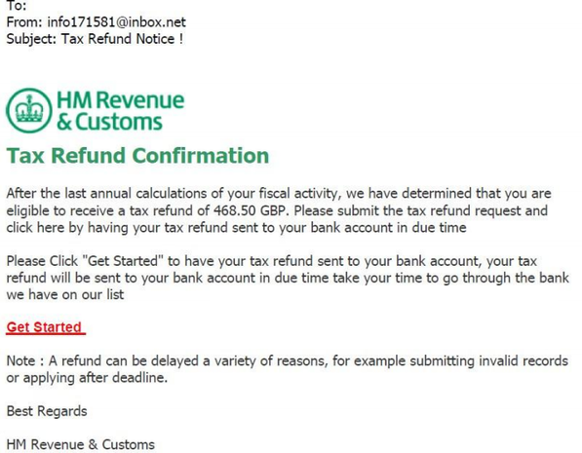
Look at the email header.
Where did it originate?
Why no Pound (£) symbol?
No name
Look for spelling and grammatical errors
This link will take you to a fake website

Slide 88
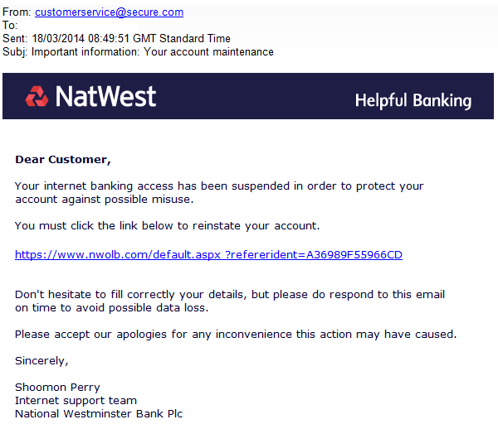

Slide 89
Man-in-the-Middle
Also known as eavesdropping attacks, occur when attackers insert themselves into a two-party transaction
Once the attackers interrupt the traffic, they can filter and steal data
Two common points of entry for MitM attacks:
On unsecure public Wi-Fi, attackers can insert themselves between a visitor’s device and the network. Without knowing, the visitor passes all information through the attacker
Once malware has breached a device, an attacker can install software to process all of the victim’s information

Slide 90
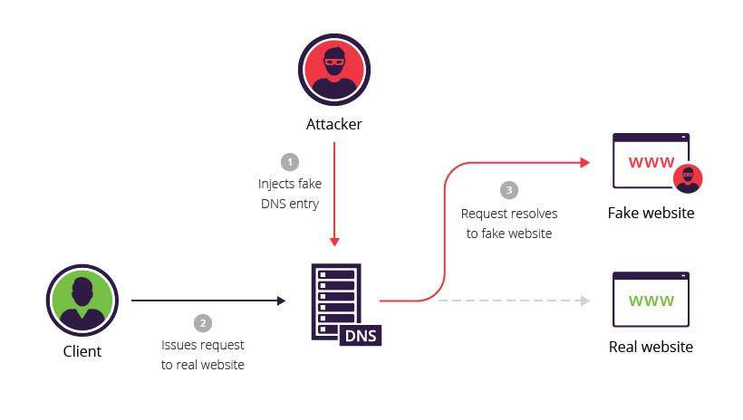
DNS Poisoning
DNS spoofing, also referred to as DNS cache poisoning
A form of computer security hacking in which corrupt Domain Name System data is introduced into the DNS resolver's cache
Causes the name server to return an incorrect result record, e.g. an IP address

Slide 91
Ransomware
Ransomware is a type of malicious software from cryptovirology that threatens to publish the victim's data or perpetually block access to it unless a ransom is paid
Most ransomware variants encrypt the files on the affected computer, making them inaccessible
The most dangerous ransomware attacks are caused by WannaCry, Petya, Cerber, Locky and CryptoLocker ransomware

Slide 92
Ransomware
Three choices in how to proceed:
Reinstall the operating system
Run an antivirus program from an external drive or bootable disc
Do a System Restore and take Windows back to a time before the ransomware was loaded

Slide 94
Vulnerabilities
Ports
Services
Code

Slide 96
Ports
The Internet Assigned Numbers Authority (IANA) has developed several port categories:
1 to 1023 are known as Well Known Ports
1024 to 49151 are known as Registered Ports
49152 to 65535 are known as Dynamic Ports
Well Known Ports usually make some type of network connection, and are typically assigned to a particular network protocol

Slide 97
Ports
Common IP Protocols
Protocol | Name
1 | ICMP (ping)
6 | TCP
17 | UDP
47 | GRE (PPTP)
50 | ESP (IPSec)
51 | AH (IPSec)

Slide 98
Ports
Common TCP and UDP Ports
Protocol | Port | Name
TCP | 20 | FTP data
TCP | 21 | FTP control
TCP | 22 | SSH
TCP | 23 | Telnet
TCP | 25 | SMTP (E-mail)
TCP/UDP | 53 | DNS query
UDP | 67/68 | DHCP (Dynamic IP address configuration)
TCP | 80 | HTTP (Web)
TCP | 110 | POP3 (E-mail)
TCP | 119 | NNTP (Newsgroups)
TCP | 143 | IMAP4 (E-mail)
TCP | 389 | LDAP (Directory service)
TCP | 443 | HTTPS (Web SSL)
UDP | 1701 | L2TP (Virtual Private Networks)
TCP | 1723 | PPTP (Virtual Private Networks)

Slide 99
IP Ranges
Class A Public Address
IP Range: 1.0.0.0 to 126.0.0.0
First Octet value range from 1 to 127
Subnet Mask: 255.0.0.0
Number of Networks: 126
Number of hosts per networks: 16,777,214
A

Slide 100
IP Ranges
Class B Public Address
IP Range: 128.0.0.0 to 191.255.0.0
First Octet value range from 128 to 191
Subnet Mask: 255.255.0.0
Number of Networks: 16,382
Number of hosts per networks: 65,534
B

Slide 101
IP Ranges
Class C Public Address
IP Range: 192.0.0.0 to 223.255.255.0
First Octet value range from 192 to 223
Subnet Mask: 255.255.255.0
Number of Networks: 2,097,150
Number of hosts per networks: 254
C

Slide 102
IP Ranges
Class D Address Range
IP Range: 224.0.0.0 to 239.255.255.255
First Octet value range from 224 to 239
Number of Networks: N/A
Number of hosts per networks: Multicasting
D
Notes:
Class D is only used for Multi Casting

Slide 103
IP Ranges
Class E Address Range
IP Range: 240.0.0.0 to 255.255.255.255
First Octet value range from 240 to 255
Number of Networks: N/A
Number of hosts per networks: Research/Reserved/Experimental
E
Notes:
Class E is only used for Research and development or reserved for future purposes and experiments

Slide 104
IP Ranges
Private Addresses
Class A: Private Range: 10.0.0.0 to 10.255.255.255
Class B: Private APIPA Range:169.254.0.0 to 169.254.255.255
Class B: Private Range: 172.16.0.0 to 172.31.255.255
Class C: Private Range: 192.168.0.0 to 192.168.255.255
A
Special Address Range
127.0.0.1 to 127.255.255.255
E
B
D
C
Notes:
A Private range is a non internet facing address range and are non routable.
Used inside you own home or business network.
What is the Class B private Range? It is an APIPA Address, Automatic private IP Address and this set automatically if NO DHCP server can be contacted
Special Address range is Loopback and is used to test networks. You can use Ping on a loopback or your “home (127.0.0.1)” to test if your internal NIC is capable of sending and receiving packets.

Slide 105
Services
Vulnerabilities within network services may result in data loss, denial of services, or allow attackers to facilitate attacks against other devices
Checking for insecure or non-essential services is critical to reducing risk on the network
The vast majority of network attacks are focused around easily identified vulnerabilities which can be exploited

Slide 106
Services
Email
DNS
Printers
Network shares
VOIP
IM (Instant messaging)

Slide 107
Email Clients
Encryption protocols
PGP
S/MIME (Secure/Multipurpose Internet Mail Extensions)
Notes:
PGP – Pretty good Privacy – Public and Private keys for encrypted emails Public key is used to lock and the private key is used to unlock
S/MIME has a few key elements. It can check authenticity of the sender via digital certificates. It can also check confidentiality by using encryption and message integrity to make sure nothing has changed since being sent to you receiving it

Slide 108
Email
Phishing
Ancestor of all modern phish, beloved of ‘Nigerian royalty’, lonely hearts and helpful “pharmacists.”
Its distinctive behaviours of poor spelling and awkward language make it easy to spot and avoid, but if it hooks its prey, the results can be deadly
Whaling
Takes only the biggest and juiciest catches
Usually targeting CEO’s and other C people like CIO’s, CTO’s, and CFO’s
Spearphishing
Picks its targets carefully based on the access they have to information it craves
May spend months lurking and researching its prey before it attacks with one targeted email strike
Clones
Impersonates legitimate contacts
Sends cloned messages with malicious links in place of genuine ones

Slide 109
DNS
A DNS attack is an exploit in which an attacker takes advantage of vulnerabilities in the domain name system
DNS is a protocol that translates a user-friendly domain name, like WhatIs.com, into the computer-friendly IP address such as 206.19.49.154
Notes:
Translates names to IP

Slide 110
DNS

Slide 111
Types of DNS Attack
Zero day attack
The attacker exploits a previously unknown vulnerability in the DNS protocol stack or DNS server software
Cache poisoning
Corrupts a DSN server by replacing a legitimate IP address in the server’s cache with that of another, rogue address
Aim is to redirect traffic to a malicious website, collect information or initiate another attack
Cache poisoning may also be referred to as DNS poisoning
Denial of Service
An attack in which a malicious bot sends send more traffic to a targeted IP address than the programmers who planned its data buffers anticipated someone might send
The target becomes unable to resolve legitimate requests
Distributed Denial of Service
The attacker uses a botnet to generate massive amounts of resolution requests to a targeted IP address
Example: Mirai
DNS amplification
Takes advantage of a DNS server that permits recursive lookups and uses recursion to spread his attack to other DNS servers.
Fast-flux DNS
The attacker swaps DNS records in and out with extreme frequency in order redirect DNS requests and avoid detection
https://searchsecurity.techtarget.com/definition/DNS-attack

Slide 112
Printers
Older printers
Multifunction printers
Secure printers from:
Unauthorized access
Print configuration alterations
Eavesdropping
Device compromise
Use RFC1918 private IP address space to restrict access to printers to hosts only, making printers unreachable from the Internet
Configure the printer's access control list (ACL) to restrict access by subnet or device
Remove the default gateway in the IP configuration to disable Internet routing, making printing only available on your local network segment

Slide 113
Network Shares
Vulnerabilities in SMB Shares Enumeration is a Medium risk vulnerability
Most frequently found on networks around the world
This issue has been around since at least 1990
Proven to be either difficult to detect, difficult to resolve or prone to being overlooked entirely

Slide 114
VOIP
VOIP – Voice Over IP
VoIP is vulnerable to similar types of attacks that Web connection and emails are prone to

Slide 115
VOIP Vulnerabilities
Remote eavesdropping
Network Attacks
Default security settings
VOIP over WiFi

Slide 116
VOIP Exploits
VOIP spam
VOIP phishing
Notes:
VOIP SPAM is exactly like spam phone calls saying you have been in an accident but over IP

Slide 117
VOIP Attacks
Invite of Death
A type of attack on a VoIP-system that involves sending a malformed or otherwise malicious SIP INVITE request to a telephony server
Results in a crash of that server
Causes a denial of service
Notes:
SIP INVITE Session initiation protocol the standard VOIP initiation method

Slide 118
Instant Messaging
Viruses and worms over IM
Identity theft/authentication spoofing
Firewall tunnelling
Data security leaks
SPIM

Slide 119
Viruses and Worms over IM
Most viruses are sent through file transfers
Bypasses traditional gateway and anti-virus security
Public IM clients also have publicized vulnerabilities
Flaws such as buffer overflows and boundary condition errors have been exploited to spread viruses, worms or denial-of-service attacks

Slide 120
Identity Theft/Authentication Spoofing
Public IM systems let individuals create anonymous identities
These do not map to e-mail addresses
IDs can be created even if the IDs and domains are not owned by that individual i.e. "billgates" or "johnchambers,“
Spoofing creates risk, as these IDs can be used maliciously, outside the control of the IT security department

Slide 121
Firewall Tunnelling
IM clients find ways to tunnel through firewalls
Most IM services come through well-publicized ports (5190 for AOL Instant Messenger, 1863 for MSN and 5050 for Yahoo)
IM clients also can exploit any open port on the firewall, including those used by other applications (such as Port 80 for Web and HTTP traffic)
Some clients also can connect via peer-to-peer connections or establish connections on randomly negotiated ports

Slide 122
Data Security Leaks
Unmonitored content leaving the corporation without the knowledge of the information security department introduces legal and competitive risk
Such as a CFO sending a confidential spreadsheet via IM without an audit trail
File transfer over IM is a powerful way to send information beyond the tracing capabilities of the IT department
The lack of content filtering and archiving makes it difficult for IT to discover potential breaches of policy or to hold individuals accountable

Slide 123
SPIM
Instant messaging spam
Can be more disruptive than e-mail spam
More intrusive (the pop-up SPIM interrupts the user) and generally of a more sexually offensive nature
Leads to human resources and legal risk

Slide 124
Code
The most common computer vulnerabilities include:
Bugs
Weak passwords
Software that is already infected with virus
Missing data encryption
OS command injection
SQL injection
Buffer overflow
Missing authorization
Use of broken algorithms
URL redirection to untrusted sites
Path traversal
Missing authentication for critical function
Unrestricted upload of dangerous file types
Dependence on untrusted inputs in a security decision
Cross-site scripting and forgery
Download of codes without integrity checks

Slide 125
Section 2

Slide 126
Securing the Perimeter
A network perimeter is the boundary between the private and locally managed-and-owned side of a network and the public and usually provider-managed side of a network

Slide 127
Securing the Perimeter
Three questions that have to be answered:
What is it that we are trying to protect?
We will have to determine what are the workstations, servers, databases and other devices that have to be protected.
What are the threats?
Next, we determine what are the different type of threats
Internet facing systems are always under the possibility of an attack
Other threats can also be from former employees who have access to vital resources.
And finally the business requirements of the organization.
The security design must meet the business goals of an organization
An eCommerce site with more online transactions will need a more robust security design than a site which just needs an online presence

Slide 130
Physical Security
Physical security is the protection of personnel, hardware, software, networks and data from physical actions and events that could cause serious loss or damage to an enterprise, agency or institution
This includes protection from fire, flood, natural disasters, burglary, theft, vandalism and terrorism

Slide 132
Securing the Network
Run a network security audit
Conduct cybersecurity awareness training
Limit user access privileges to the minimum necessary for work
Patch your software ASAP
Review your cybersecurity tools

Slide 133
Run a network security audit
A network security audit is a process by which a company can investigate their network security policies and the various assets they have on their network
Aim is to identify any potential deficiencies that might lead to a security compromise/breach

Slide 134
Security Audit
A comprehensive audit covers multiple review processes, such as:
Firewall Architectures/Configurations. What kind of firewall solutions are in place and where do they rest on your network (at the perimeter, in between individual servers/assets)? Also, are firewall configurations up to date and free of conflicts that could be exploited by an attacker?
Asset Identification. What kind of assets are on the network, and what kinds of software and operating system (OS) does each one run? Knowing what’s on your network is crucial for identifying potential weaknesses so they can be fixed—such as software that isn’t up to date with its latest security patch.
Security Policies/Procedures. What standards does each of the people in your organization understand/follow when it comes to keeping your business’ data secure? Do you have a BYOD (bring-your-own-device) policy for using personal devices at work? How are security policies enforced? A review of all your security policies and procedures is crucial for keeping your data secure.
Risk Assessment. After identifying all of the assets on your network and reviewing your security policies/procedures, what are the most significant threats that you need to take care of ASAP? Risk assessments help you prioritize your cybersecurity efforts to close your biggest gaps first.

Slide 135
Conduct cybersecurity awareness training
Training should be given to network/security administrator and supporting staff as well as users to ensure that they follow the security best practice and follow security policies
Weakest link in any organization’s cybersecurity architecture is, usually, the organization’s employees

Slide 136
Limit user access privileges
Limit user access privileges to the minimum necessary for work
Manage accounts and access privileges: e.g. access rights should be granted on an as-needed basis and should be reviewed regularly

Slide 137
Patch your software ASAP
Companies are constantly finding and fixing security flaws in their software and systems
These flaws give hackers a way past otherwise solid defences
While many panic over the “zero-day” exploit—that vulnerability which the original software developer doesn’t know about that hackers can use with impunity—the truth of the matter is that the most-frequently used exploits involve older, known security issues that already have fixes available

Slide 138
Review your cybersecurity tools
Use cybersecurity tools to protect your business’ network infrastructure
Cover the basics needed for mitigating risks and covering the regulatory obligations specific to your industry
Tools include:
Firewalls
IDS/IPS
Antivirus
remote backups
Use tools that you can use to respond to your biggest threats

Slide 139
Securing Devices
Devices should be secured in locked wiring closets
Important to secure administrative access to the network devices such as:
Routers
Firewalls
Switches
Servers

Slide 140
Securing Applications
When it comes to securing applications on a network, limiting privileges is the golden rule
Vulnerabilities that expose web applications start with the database and work outwards towards the application code itself
Users or application functions should be given only as much access to the database as necessary
Create firewall settings
Set user authentication based on least priviledge

Slide 141
Application Security
Application security encompasses measures taken to improve the security of an application often by finding, fixing and preventing security vulnerabilities
Different techniques are used to surface such security vulnerabilities at different stages of an applications lifecycle such as design, development, deployment, upgrade, maintenance
An always evolving but largely consistent set of common security flaws are seen across different applications

Slide 142
According to the patterns & practices Improving Web Application Security book, the following are classes of common application security threats / attacks:
Category | Threats / Attacks
Input Validation | Buffer overflow; cross-site scripting; SQL injection; canonicalization
Software Tampering | Attacker modifies an existing application's runtime behavior to perform unauthorized actions; exploited via binary patching, code substitution, or code extension
Authentication | Network eavesdropping; Brute force attack; dictionary attacks; cookie replay; credential theft
Authorization | Elevation of privilege; disclosure of confidential data; data tampering; luring attacks
Configuration management | Unauthorized access to administration interfaces; unauthorized access to configuration stores; retrieval of clear text configuration data; lack of individual accountability; over-privileged process and service accounts
Sensitive information | Access sensitive code or data in storage; network eavesdropping; code/data tampering
Session management | Session hijacking; session replay; man in the middle
Cryptography | Poor key generation or key management; weak or custom encryption
Parameter manipulation | Query string manipulation; form field manipulation; cookie manipulation; HTTP header manipulation
Exception management | Information disclosure; denial of service
Auditing and logging | User denies performing an operation; attacker exploits an application without trace; attacker covers his or her tracks

Slide 143
The OWASP community publishes a list of the top 10 vulnerabilities for web applications and outlines best security practices for organizations and while aiming to create open standards for the industry. As of 2017, the organization lists the top application security threats as:
Category | Threats / Attacks
Injection | SQL injection; NoSQL; OS Command; Object-relational mapping; LDAP injection
Broken authentication | Credential stuffing; brute force attacks; weak passwords
Sensitive data exposure | Weak cryptography; un-enforced encryption
XML external entities | XML external entity attack
Broken access control | CORS misconfiguration; force browsing; elevation of privilege
Security misconfiguration | Unpatched flaws; failure to set security values in settings; out of date or vulnerable software
Cross-site scripting (XSS) | Reflected XSS; Stored XSS; DOM XSS
Insecure deserialization | Object and data structure is modified; data tampering
Using components with known vulnerabilities | Out of date software; failure to scan for vulnerabilities; failure to fix underlying platform frameworks; failure to updated or upgraded library compatibility
Insufficient logging & monitoring | Failure to log auditable events; failure to generate clear log messages: inappropriate alerts; failure to detect or alert for active attacks in or near real-time

Slide 144
O/S Updates
An operating system (e.g. Windows XP, Mac OS X, Linux, FreeBSD, Solaris) is the core set of programs that run a computer and upon which all other programs rely in order to operate
Operating system updates are corrections for program incompatibilities, discovered errors, and security vulnerabilities

Slide 145
The Risks
Not keeping your operating system up to date can result in serious issues, affecting both your device and your own personal security
These include:
Viruses, spyware and other malware
Cybercrime attacks
Crashing, freezing and generally poor performance

Slide 146
2.2 Describe Common Ways to Protect Data
File and folder permissions
Encryption
Group policy

Slide 147
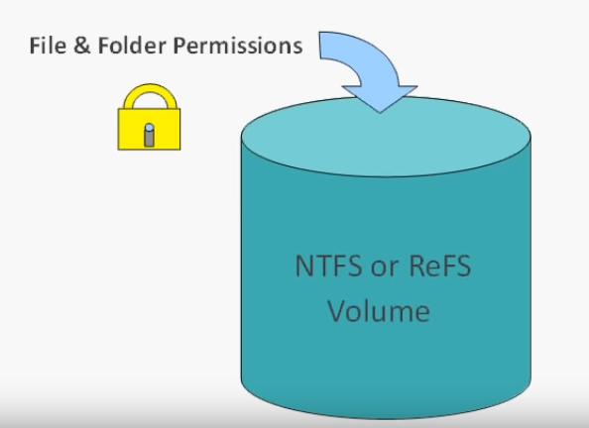
File and Folder Permissions
Implement access controls
Mainly for Windows
NTFS Permissions

Slide 148
Folders
Access Controls
10 Sniffing Analysis Wireshark 11 CLI Network Sniffers 12 Vulnerability Research 13 Denial of Service 14 Check & Crack Passwords 15 Hiding Files 16 Malware 17 Netcat
18 Web Attacks 19 SQL Injection 20 Social Engineering 21 Intrusion Detection & Firewalls
00 Contact Info 00 IT Governance Evaluation 01 The Information Battle Space 02 Hacking Methodology 03 Company Reconnaissance 04 People Reconnaissance 05 Systems Reconnaissance 06 General Recon 07 Cryptography 08 Recon Obfuscation 09 Scanning - Nmap
Users
Files

Slide 149
Create & Modify
Folders
10 Sniffing Analysis Wireshark 11 CLI Network Sniffers 12 Vulnerability Research 13 Denial of Service 14 Check & Crack Passwords 15 Hiding Files 16 Malware 17 Netcat
18 Web Attacks 19 SQL Injection 20 Social Engineering 21 Intrusion Detection & Firewalls
Technical Users
00 Contact Info 00 IT Governance Evaluation 01 The Information Battle Space 02 Hacking Methodology 03 Company Reconnaissance 04 People Reconnaissance 05 Systems Reconnaissance 06 General Recon 07 Cryptography 08 Recon Obfuscation 09 Scanning - Nmap
Read
Files
Production Users

Slide 150
Standard Permissions
Full control
Modify
Read & execute
List folder contents
Read
Write

Slide 151
Special Permissions
Traverse Folder/Execute File
Traverse Folder:
Allows or denies moving through a restricted folder to reach files and folders beneath the restricted folder in the folder hierarchy
Traverse folder takes effect only when the group or user is not granted the "Bypass traverse checking user" right in the Group Policy snap-in
This permission does not automatically allow running program files
Execute File:
Allows or denies running program (executable) files
List Folder/Read Data
List Folder:
Allows or denies viewing file names and subfolder names within the folder
List Folder only affects the contents of that folder and does not affect whether the folder you are setting the permission on will be listed
Read Data:
Allows or denies viewing data in files
Read Attributes
Allows or denies viewing the attributes of a file or folder, for example, "read-only" and "hidden".

Slide 152
Special Permissions
Write Extended Attributes
Allows or denies changing the extended attributes of a file or folder.
Extended attributes are defined by programs and may vary by program
The Write Extended Attributes permission does not imply creating or deleting files or folders, it only includes the permission to make changes to the extended attributes of an existing file or folder
Delete Subfolders and Files
Allows or denies deleting subfolders and files, even if the Delete permission has not been granted on the subfolder or file
Delete
Allows or denies deleting the file or folder
If you don't have Delete permission on a file or folder, you can still delete it if you have been granted Delete Subfolders and Files on the parent folder

Slide 153
Special Permissions
Read Permissions
Allows or denies reading permissions of a file or folder
Change Permissions
Allows or denies changing permissions of the file or folder
Take Ownership
Allows or denies taking ownership of the file or folder
The owner of a file or folder can always change permissions on it, regardless of any existing permissions that protect the file or folder
Synchronize
Allows or denies different threads to wait on the handle for the file or folder and synchronize with another thread that may signal it
This permission applies only to multithreaded, multiprocessing programs

Slide 154
Encryption
Read Extended Attributes
Allows or denies viewing the extended attributes of a file or folder. Extended attributes are defined by programs and may vary by program
Create Files/Write Data
Create Files:
Allows or denies creating files within the folder
Write Data:
Allows or denies making changes to a file and overwriting existing content
Create Folders/Append Data
Create Folders:
Allows or denies creating subfolders within the folder
Append Data:
Allows or denies making changes to the end of the file but not changing, deleting, or overwriting existing data
Write Attributes
Allows or denies changing the attributes of a file or folder, for example, "read-only" or "hidden"
The Write Attributes permission does not imply creating or deleting files or folders, it only includes the permission to make changes to the attributes of an existing file or folder

Slide 155
Group Policy
Group Policy is a feature of the Microsoft Windows NT family of operating systems that controls the working environment of user accounts and computer accounts
Group Policy provides centralized management and configuration of operating systems, applications, and users' settings in an Active Directory environment
Is a hierarchical infrastructure that allows a network administrator in charge of Microsoft's Active Directory to implement specific configurations for users and computers
Group Policy can also be used to define user, security and networking policies at the machine level

Slide 156
2.3 Describe Protection Against Malicious Software
Anti-virus
Anti-malware

Slide 157
Anti-virus
Antivirus software, or anti-virus software (abbreviated to AV software), also known as anti-malware, is a computer program used to prevent, detect, and remove malware
Antivirus software was originally developed to detect and remove computer viruses

Slide 158
Anti-malware
Antimalware (anti-malware) is a type of software program designed to prevent, detect and remove malicious software (malware) on IT systems, as well as individual computing devices

Slide 159
2.4 Describe Types of Firewalls
Packet filter
Stateful
Application level
Intrusion detection systems
Intrusion prevention systems

Slide 160
Packet Filter
Packet filtering is a firewall technique used to control network access by monitoring outgoing and incoming packets and allowing them to pass or halt based on the source and destination Internet Protocol (IP) addresses, protocols and ports
3 Ways to configure:
Filter passes only safe packets
Accept all but filter drops unsafe packets
The packet can be quarantined if the filter encounters a packet for which its rules do not provide instructions

Slide 161
Stateful
A stateful firewall is a network firewall that tracks the operating state and characteristics of network connections traversing it
The firewall is configured to distinguish legitimate packets for different types of connections
Tightens rules for TCP traffic by creating a directory of TCP connections
Reviews packet information but also records information about TCP connections
There is an entry for each currently established connection
Packet filter will allow incoming traffic to high-numbered ports only for those packets that fit the profile of one of the entries in this directory
Keeps track of TCP sequence numbers to prevent attacks that depend on the sequence number
Inspects data for protocols like FTP, IM and SIPS commands

Slide 162
Application Level
An application firewall is a form of firewall that controls input, output, and/or access from, to, or by an application or service
It operates by monitoring and potentially blocking the input, output, or system service calls that do not meet the configured policy of the firewall
The application firewall is typically built to control all network traffic on any OSI layer up to the application layer
It is able to control applications or services specifically, unlike a stateful network firewall, which is - without additional software - unable to control network traffic regarding a specific application
There are two primary categories of application firewalls, network-based application firewalls and host-based application firewalls.

Slide 163
Network-Based
A network-based application layer firewall is a computer networking firewall operating at the application layer of a protocol stack,and is also known as a proxy-based or reverse-proxy firewall
Application firewalls specific to a particular kind of network traffic may be titled with the service name, such as a web application firewall
They may be implemented through software running on a host or a stand-alone piece of network hardware
Often, it is a host using various forms of proxy servers to proxy traffic before passing it on to the client or server
Because it acts on the application layer, it may inspect the contents of traffic, blocking specified content, such as certain websites, viruses, or attempts to exploit known logical flaws in client software

Slide 164
Host-Based
A host-based application firewall can monitor any application input, output, and/or system service calls made from, to, or by an application
Done by examining information passed through system calls instead of or in addition to a network stack
Can only provide protection to the applications running on the same host

Slide 165
Intrusion Detection Systems
An intrusion detection system (IDS) is a device or software application that monitors a network or systems for malicious activity or policy violations
Is a passive system that scans traffic and reports back on threats
Any malicious activity or violation is typically reported either to an administrator or collected centrally using a security information and event management (SIEM) system
A SIEM system combines outputs from multiple sources, and uses alarm filtering techniques to distinguish malicious activity from false alarms

Slide 166
Intrusion Prevention Systems
An Intrusion Prevention System (IPS) is a network security/threat prevention technology that examines network traffic flows to detect and prevent vulnerability exploits
Vulnerability exploits usually come in the form of malicious inputs to a target application or service that attackers use to interrupt and gain control of an application or machine

Slide 167
Intrusion Prevention Systems
The IPS often sits directly behind the firewall and provides a complementary layer of analysis that negatively selects for dangerous content
Unlike its predecessor the Intrusion Detection System (IDS) the IPS is placed inline (in the direct communication path between source and destination), actively analyzing and taking automated actions on all traffic flows that enter the network
Specifically, these actions include:
Sending an alarm to the administrator (as would be seen in an IDS)
Dropping the malicious packets
Blocking traffic from the source address
Resetting the connection

Slide 168
Tasks
Group Policy
Setting file permissions
Setting users and computers

Slide 169
Other Useful Things

Slide 170
Wireless Protocols
Bluetooth
2G (GSM)
3G & 4G
LTE Cat 0, 1, & 3
LTE-M1
5G
NFC
RFID

Slide 171
Bluetooth
Bluetooth is a global 2.4 GHz personal area network for short-range wireless communication
Uses short-wavelength UHF radio waves in the industrial, scientific and medical radio bands
Frequencies from 2.400 to 2.485 GHz
Used to build personal area networks (PANs)
Device-to-device file transfers
Wireless speakers
Wireless headsets
Range is typically less than 10 m (33 ft)

Slide 172
2G (GSM)
2G is the “old-school” TDMA (usually) cellular protocol
ATMs and old alarm systems used this
In most parts of the world it is phased out or in the process of being phased out

Slide 173
3G & 4G
3G was the first “high speed” cellular network
It is a name that refers to a number of technologies that meet IMT-2000 standards
4G is the generation of cellular standards that followed 3G, and is what most people use today for mobile cellular data
You can use 3G and 4G for IoT devices, but the application needs a constant power source or must be able to be recharged regularly

Slide 174
LTE Cat 0, 1, & 3
With LTE classes, the lower the speed, the lower the amount of power they use
LTE Cat 1 and 0 are typically more suitable for IoT devices

Slide 175
LTE-M1
This is the first cellular wireless protocol that was build from the ground up for IoT devices. That being said, it isn’t available yet, so how it performs remains to be seen.
With LTE, it’s worth understanding that carriers typically don’t have to modify hardware for their basestations; upgrades can be done entirely through software.

Slide 176
5G
Though it likely won’t be released for another five years, 5G is set to be the next generation of cellular network protocol. It’s designed for high throughput, and it will probably face the same issues as 3G and 4G in regards to IoT.

Slide 177
NFC
Near field communication is precisely as it sounds
IoT network protocols used for very close communication
When you wave your phone over a card reader to pay for groceries, you’re likely using NFC

Slide 178
RFID
There are two types of radio frequency identification:
Active
Commonly used for real-time location tracking
Passive
Does not contain a battery
Power is supplied by the reader
This protocol was designed specifically so devices without batteries could send a signal
In most systems, one side of an RFID system is powered, creating a magnetic field, which induces an electric current in the chip
This creates a system with enough power to send data wirelessly over and over again
Because of this, RFID tags are used for shipping and tracking purposes

Slide 179
WIFI
IEEE 802.11 is a set of standards for implementing wireless local area networks
802.11a
802.11b
802.11c
802.11g
802.11n
802.11i

Slide 180
The 802.11 Protocols
The 802.11abgn specifications are collectively and individually referred to as Wi-Fi

Slide 181
802.11a
802.11a operates in the 5 GHz frequency band and utilizes OFDM (Orthogonal Frequency Division Multiplexing)
Modulation for up to 54 Mbps data rate.

Slide 182
802.11b
802.11b operates in the 2.4 GHz frequency band and utilizes DSSS (Direct Sequence Spread Spectrum)
Modulation for up to 11 Mbps data rate
Supported range of 150 feet (doesn't include occluding objects)
Devices that can cause interference include:
Microwave ovens
Bluetooth devices
Baby monitors
Cordless telephones
Amateur radio equipment

Slide 183
802.11c
This works in the 2.4 GHz band (like 802.11b), but uses the same OFDM based transmission scheme as 802.11a
Operates at a maximum physical layer bit rate of 54 Mbit/s exclusive of forward error correction codes, or about 22 Mbit/s average throughput
Fully backward compatible with 802.11b hardware
Experience interference from other products operating in the 2.4 GHz band

Slide 184
802.11g
802.11g operates in the 2.4 GHz frequency band and utilizes OFDM and DSSS modulation for up to 54 Mbps data rate
Can suffer from the same interference issues as 802.11b
802.11g hardware is fully backward compatible with 802.11b hardware

Slide 185
802.11i
Used for WPA2
Used to facilitate secure end-to-end communication for wireless local area networks (WLAN)

Slide 186
802.11n
IEE 802.11n sought to increase the achievable speeds of Wi-Fi networks beyond that achievable using 802.11g
802.11n is an amendment that improves upon the previous 802.11 standards by adding multiple-input multiple-output antennas (MIMO)
802.11n operates in both the 2.4 GHz and 5 GHz frequency bands
Utilizes OFDM modulation, and uses advanced technologies including MIMO (Multiple-Input Multiple-Output) spatial multiplexing to increase throughput and range

Slide 187
802.11n (Wi-Fi 4)
Supports a theoretical transfer rate of 300 Mbps, can achieve 450 Mbps when using 3 antennae
Uses MIMI (Multiple Input Multiple Output) allows for multiple transmitters/receivers to operate simultaneously
Support for 2.4 GHz and 5 GHz

Slide 188
802.11ac (Wi-Fi 5)
Speeds ranging from 433 Mbps up to several Gigabits per second
Only supports 5GHz
Uses MU-MIMO (Multi User MIMO) this doesn’t increase speeds but increase the data throughput

Slide 189
WiFi Security
WEP
WPA
WPA2
WPS

Slide 190
WEP
Wired Equivalent Privacy
When a client connects to a WEP-protected network, the WEP key is added to some data to create an “initialization vector,” or “IV” for short
When a client sends its request to the access point, the portion containing the IV is transmitted wirelessly in clear-text (not encrypted)
WEP is not the correct choice for securing your network

Slide 191
WPA
WiFi Protected Access (WPA
Ratified by the WiFi Alliance in 2003 as a response to the insecurities that were discovered in WEP
Uses a pre-shared key (PSK), referred to as WPA Personal, and the Temporal Key Integrity Protocol or TKIP
Included a new message integrity check nicknamed “Michael”
While Michael offered a great deal of improvement over the old way of securing networks, there was still some worry about some security issues with using a similar (though much stronger) implementation

Slide 192
WPA2
The concerns about Michael led to WPA2’s introduction in 2004
At the center of WPA2 is its use of a security protocol based on Advanced Encryption Standard (AES), the U.S. Government’s preferred choice of encryption
As it stands now, the only people who should still be using TKIP on a wireless network are those who are dealing with hardware that is rated for 802.11g only

Slide 193
WPS
WiFi Protected Setup
A user is able to add new devices to their network by simply pushing a button (within administration software or physically on the router) and then typing in an 8-digit PIN number on the client device

Slide 194
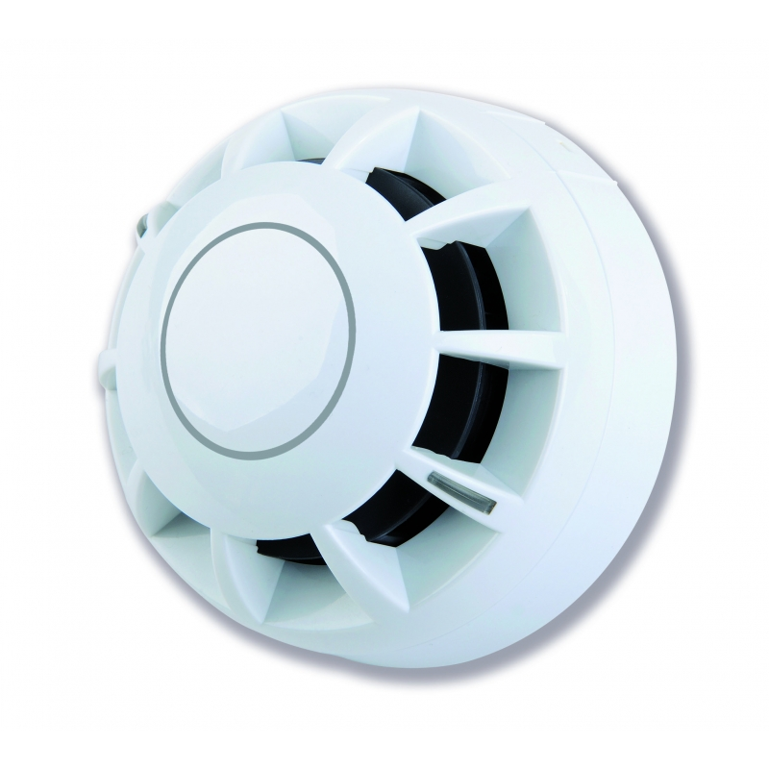
Fire Suppression
A typical data centre needs a Fire Suppression control panel
A Smoke detector
And Audible Alarms

Slide 195
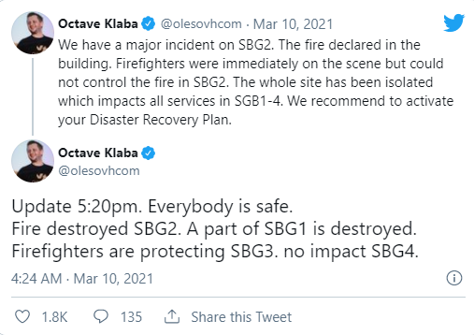
Fire Suppression
Inert Gas fire suppression systems for Data centres – Reduce Oxygen
LG541
LG55
Notes:
Reduces the amount of oxygen to down around 12 -14% this is good but doesn’t always work against certain data centre hardware. UPS batteries don’t need the Oxygen –
OVH data centre fire

Slide 196
Fire Suppression
Chemical/synthetic fire suppression based on cooling
FM200 (HFC227ea)
Novec 1230 (FK-5-1-12)
Sapphire (FK-5-1-12)

