Slide 1
BCS Level 4 Certificate in Network Systems and Architecture Network Infrastructure Components
Network Engineer

Slide 2
Exam
Syllabus Area | Target number of questions
1 Load balancing failures | 1
2 Storage protocol failures | 7
3 Hardware failures | 3
4 Configuration errors | 3
5 Environmental problems | 3
6 Errors in security | 4
7 Errors resulting from lack of capacity | 5
8 Network Infrastructure Components | 6
9 Features of Client-Server Operating Systems and Applications | 4
10 Components and functions of virtualised systems | 3
11 Features of Middleware | 1
Total | 40 questions

Slide 3
8 Network Infrastructure Components (15%)
8.1 Explain the purpose of types of network switches.
Layer 2;
Layer 3;
Three layered model (access, distribution, core);
VLANs.
8.2 Describe the functions of routers.
static routing;
dynamic routing;
subnet access;
WAN access;
segmentation and broadcast traffic reduction

Slide 4
8 Network Infrastructure Components (15%)
8.3 Describe the function of wireless systems.
wireless access points (WAP);
wireless routers.
8.4 Describe the functions of key network security devices.
firewalls - stateful, stateless and deep packet inspection;
intrusion prevention systems (IPS);
intrusion detection systems (IDS);
honeypot.
8.5 Explain the differences between server hardware formats.
tower;
rack mount;
blade.

Slide 5
Infrastructure

Slide 6
Server hardware formats
Tower
Built in an upright cabinet that stands alone
Advantages
Cost effective
Easier cooling, lower component density
Scalable - can easily upgrade or add more
Disadvantages
Bulkier and heavier than rack or blade
Cabling for a set of tower servers is complicated
Several towers together can be noisy
Usage
Smaller environments
Limited number of clients to support

Slide 7
Server hardware formats
Rack Mount
Designed to be positioned in a bay
Servers vertically stacked
Racks can also have storage, cooling, SANs, network kit, UPS
Advantages
Cost effective – substantial power
Failure containment – easy to remove and replace
Easy cable management
Disadvantages
Power usage – additional cooling
Cost of racks, ancillary equipment
Usage
When 4 to 25 servers are required

Slide 8
Server hardware formats
Blade
Servers are placed inside blade enclosures, forming a blade system
Smallest type of server
Can be hot plugged
Advantages
Load balancing and failover
Centralised management
Minimal cabling
Minimum physical space
Disadvantages
Expensive
Stringent heating, ventilation and air con requirements
Usage
When at least 16 servers are required
Data centres

Slide 9
Switches – layer 2
Transports data on the data link layer
Operates on MAC addresses
Creates a LAN
Removes the collision domain
All ports are in a broadcast domain

Slide 10
Switches – layer 3
Inspect the incoming/outgoing network traffic – IP addressing (network layer 3)
Support of all major routing protocols and most of the routing of data/traffic to the next hop/router
Include switching abilities, and can forward data according to a device's physical address (layer 2)
Uses hardware routing, whereas typical routers use software routing
Use of hardware leads to higher performance
Very useful for VLANs

Slide 11
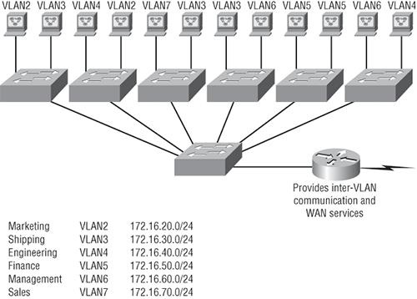
VLANs
Create smaller broadcast domains at layer 2
Broadcasts from one VLAN do not go to another VLAN
Adding VLANs reduces bandwidth requirements
Adding a user means allocating their port to a VLAN
Need a router to communicate between VLANs
Layer 3 switch combines the switching and routing required for VLANs (but not WAN)

Slide 12
Configure VLANs on Cisco S1 switch
S1#config t
S1(config)#vlan ?
WORD ISL VLAN IDs 1-4094
internal internal VLAN
S1(config)#vlan 2
S1(config-vlan)#name Sales
S1(config-vlan)#vlan 3
S1(config-vlan)#name Marketing
S1(config-vlan)#vlan 4
S1(config-vlan)#name Accounting
S1(config-vlan)#^Z
S1#

Slide 13
Three layer model (access, distribution, core)
Access
End-stations and servers connect to the enterprise at the access layer.
incorporates layer 2 switches and access points
Distribution
Routing and filtering are managed at the distribution layer.
Distribution layer devices also often manage individual branch-office WAN connections.
determines how packets can access the core.
consists of layer 3 routers and multilayer switches.
Core
consists of high speed devices, like high end routers and switches with redundant links
moves packets between distribution-layer devices in different regions of the network

Slide 14
Router
Forwards data packets between computer networks
Connected to two or more data lines (Ethernet, WAN etc) from different networks
Reads the network (IP) address information in the packet to determine the ultimate destination
Uses information in its routing table or routing policy to direct the packet to the next network on its journey
Is a layer 3 (network) device

Slide 15
Router
Incoming packet read into memory
Interrupt processor reads destination IP address
Checks in router cache to look for matching entry
If there is then builds new layer 2 header and alerts outbound processor
If not, then finds next hop address and layer 2 address in routing table, then builds new layer 2 header and alerts outbound processor

Slide 16
Hops
A hop occurs each time packets are passed to the next network device
The hop count is the number of intermediate devices the packet has to pass through from source to destination
The hop count can be used as a metric by routing protocols to determine the optimum path for a packet

Slide 17
Routing table
Contains the destination subnet
The metric (indicates best path)
Next hop or gateway
In the example (for a home router)
0.0.0.0 is for an address not found in the table
127.0.0.0 is localhost
Default gateway is 192.168.0.1 and reached through the local network card 192.168.0.100
Network Destination | Netmask | Gateway | Interface | Metric
0.0.0.0 | 0.0.0.0 | 192.168.0.1 | 192.168.0.100 | 10
127.0.0.0 | 255.0.0.0 | 127.0.0.1 | 127.0.0.1 | 1
192.168.0.0 | 255.255.255.0 | 192.168.0.100 | 192.168.0.100 | 10
192.168.0.100 | 255.255.255.255 | 127.0.0.1 | 127.0.0.1 | 10
192.168.0.1 | 255.255.255.255 | 192.168.0.100 | 192.168.0.100 | 10

Slide 18
Routing protocols
Used by routers to exchange information about routes between network nodes
Routing algorithms determine the choice of routes directly attached to router
This information is then shared, such that routers gain knowledge of the network topology
The results are stored as a metric in the routing table
Routing Information Protocol (RIP) counts hop (maximum 15)
Open Shortest Path First (OSPF) measures the cost – bandwidth, delay and load

Slide 19
Static routing
The network administrator adds entries in the routing table
Used:
For a default node when no other nodes are available
In a small network with only one or two routes
As a backup if dynamic routing is not available
Good for:
Full control over the network
Very little CPU load and no traffic to other routers
Problems:
Human error
Not fault tolerant if a route becomes unavailable

Slide 20
Dynamic routing
The entries in the routing table are made by the routing protocols
Entries are updated according to the conditions of the network
Failing nodes can be routed around
The paths can be adjusted based on traffic load, delays
Traffic can be switched to idle paths

Slide 21
Subnet access
Routers are used to connect subnets
If there were 400 clients to connect
Then split into two subnets of 200 each
192.168.1.n and 192.168.0.n
The router can use static routing to connect the two subnets together

Slide 22
WAN access
Requires a router with:
Connections to an ISP modem/connection
Typical specification of small business router
Dual 10/100 Mbps Fast Ethernet WAN ports to provide load balancing and/or business continuity
Built-in 8-port Fast Ethernet switch
Proven stateful packet inspection (SPI) firewall, hardware encryption
High-capacity, high-performance IPsec VPN capabilities
WAN connections
ADSL
Fibre
Receives IP address, DNS address from ISP

Slide 23
Segmentation and broadcast traffic reduction
Broadcasting is transmitting a packet that will be received by every device on the network
A MAC address of FF:FF:FF:FF:FF:FF or an IP address of x.x.x.255 is acted upon by every device
Excessive broadcast traffic can sometimes create a broadcast storm.
messages are broadcast on a network and each message prompts a receiving node to respond by broadcasting its own messages on the network.
This, in turn, prompts further responses that create a snowball effect.
The LAN is suddenly flooded with packets, creating unnecessary traffic that leads to poor network performance or even a complete loss of network service.
Subnetting reduces the number of devices on one network
Cisco recommend no more then 512 devices on a VLAN
250 is reasonable for a subnet
Some switches and routers have broadcast suppression

Slide 24
Wireless
Uses radio to connect network nodes
Avoids costly cabling
Works at the physical layer (1)
Bluetooth, NFC, Wi-Fi or Cellular (GSM)
Bluetooth
Low power, short range
Mice, keyboards, smartphone, headsets
Built into OS
NFC (Near field communication)
4cm range
Contactless payment (smartphone)
Data sharing(smartphone)

Slide 25
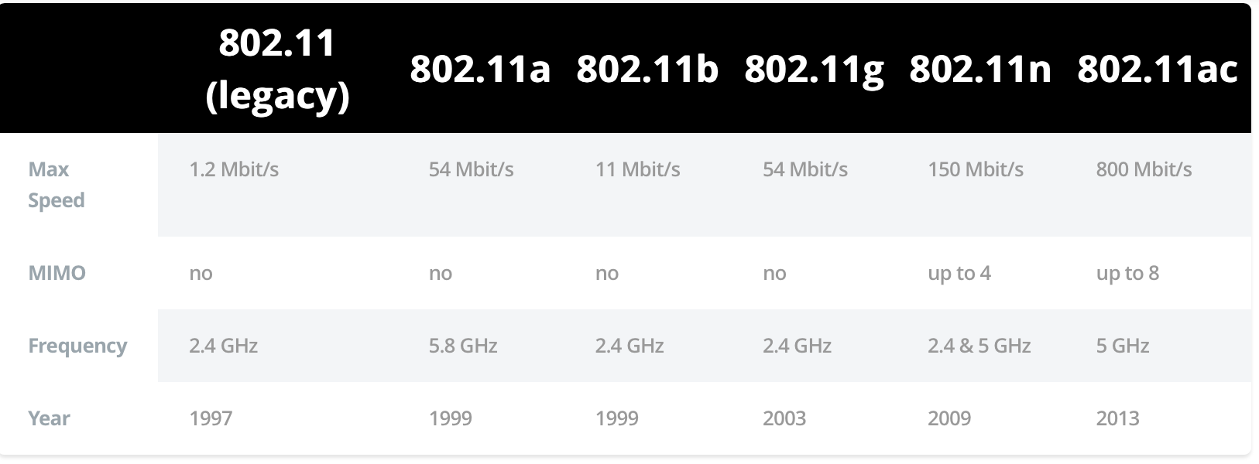
Wi-Fi
MIMO – multiple antennas

Slide 26
Wi-Fi
Built into smartphones, laptops
Adapters for desktops
Used for wireless internet access in organisations
Hot spots, public Wi-Fi
Buses, trains, planes
Security
WEP - wired equivalent privacy(cracked)
WPA - Wi-Fi protected access (better)
WPA2 (best – but still vulnerable)
WPS – wireless protected set up (required on both devices, uses push button or PIN to connect)

Slide 27
Wireless access points
A device that connects wireless directly to a wired LAN
Wi-Fi on one side, Ethernet port on the other
Can be built into a router or standalone
Allows multiple wireless connections (maximum 15-25 recommended)

Slide 28
Wireless routers
Mainly domestic, small business use
Acts as a:
WAN modem/NIC
Router
Ethernet switch
Wireless access point
Lightweight web server for management
DHCP server
Security
Disable SSID broadcast.
Restrict access by MAC address.
Wireless security (WEP, WPA, WPA2).
Wireless Protected Setup (WPS).

Slide 29
Key network security devices
active devices
firewalls, antivirus scanning devices, content filtering devices, which block the surplus traffic
passive devices, such as intrusion detection appliances, which identify and report on unwanted traffic
preventative devices
penetration testing devices and vulnerability assessment appliances, which scan the networks and identify potential security problems;
Unified Threat Management (UTM) devices
such as firewalls, content filtering, web caching, which serve as all-in-one security devices.

Slide 30
Key network security devices

Slide 31
Firewalls - stateful, stateless and deep packet inspection
Stateful – monitors incoming and outgoing packets and the connection (Transport layer 4)
Was this connection made legitimately?
Significantly better at detecting and identifying unauthorized or forged connections
More useful to corporations more likely subject to cyber attack
Looks at connection data (TCP/UDP_ as well as packet headers
Stateless Firewalls contain rules about which traffic to allow or block depending on (Network layer 3)
Source IP,
Destination IP,
Port numbers,
Network Protocols
Have no knowledge of whether the connection was initiated by the client
Faster than stateful as only looks at the packet header

Slide 32
Firewalls - stateful, stateless and deep packet inspection
Stateful
# Generic rule to allow clients to connect to any
# webserver on the internet
Allow traffic going out to port 80
Allow traffic related to connections initiated by any internal client back to the same client
Deny any other traffic coming in to the client.
Stateless
Allow traffic going out to port 80 on www.example.com
Allow traffic coming from host www.example.com and port 80
Deny any other traffic coming in to the client

Slide 33
Firewalls - stateful, stateless and deep packet inspection
Deep packet inspection (DPI)
Firewalls cannot distinguish between permissible and forbidden data traffic between legitimate application
DPI looks at the the packet for:
virus signatures
worms
payload pattern matching
payload size
port numbers
IP matching
Can block, reroute or log infractions

Slide 34
Intrusion detection systems (IDS)
A device or software to monitor a network for malicious activity or policy violations
Events can be reported to administrators or collected in an event management system
Differs from a firewall as it monitors internal events
Works by inspecting network traffic and looking for:
known patterns (signature based)
deviations from regular activity (anomaly based)

Slide 35
Intrusion prevention systems (IPS)
Incorporates an IDS, but as an inline device so that it can attempt to block or stop malicious activity
An IPS can:
sending an alarm,
drop detected malicious packets
reset a connection
block traffic from an offending IP address
correct cyclic redundancy check (CRC) errors
defragment packet streams
mitigate TCP sequencing issues

Slide 36
Honeypot
A computer used to detect, deflect or counteract unauthorised use
Replicates legitimate parts of an IT system to attract and fool attackers
Production honeypots used by corporations as security devices
Research honeypots used to gather information and develop countermeasures
Spam honeypot
Catches open relay test messages from spammers
Returns the email to the spammer, but blocks all subsequent emails from the spammer
Notifies spammer’s ISP

