Slide 1
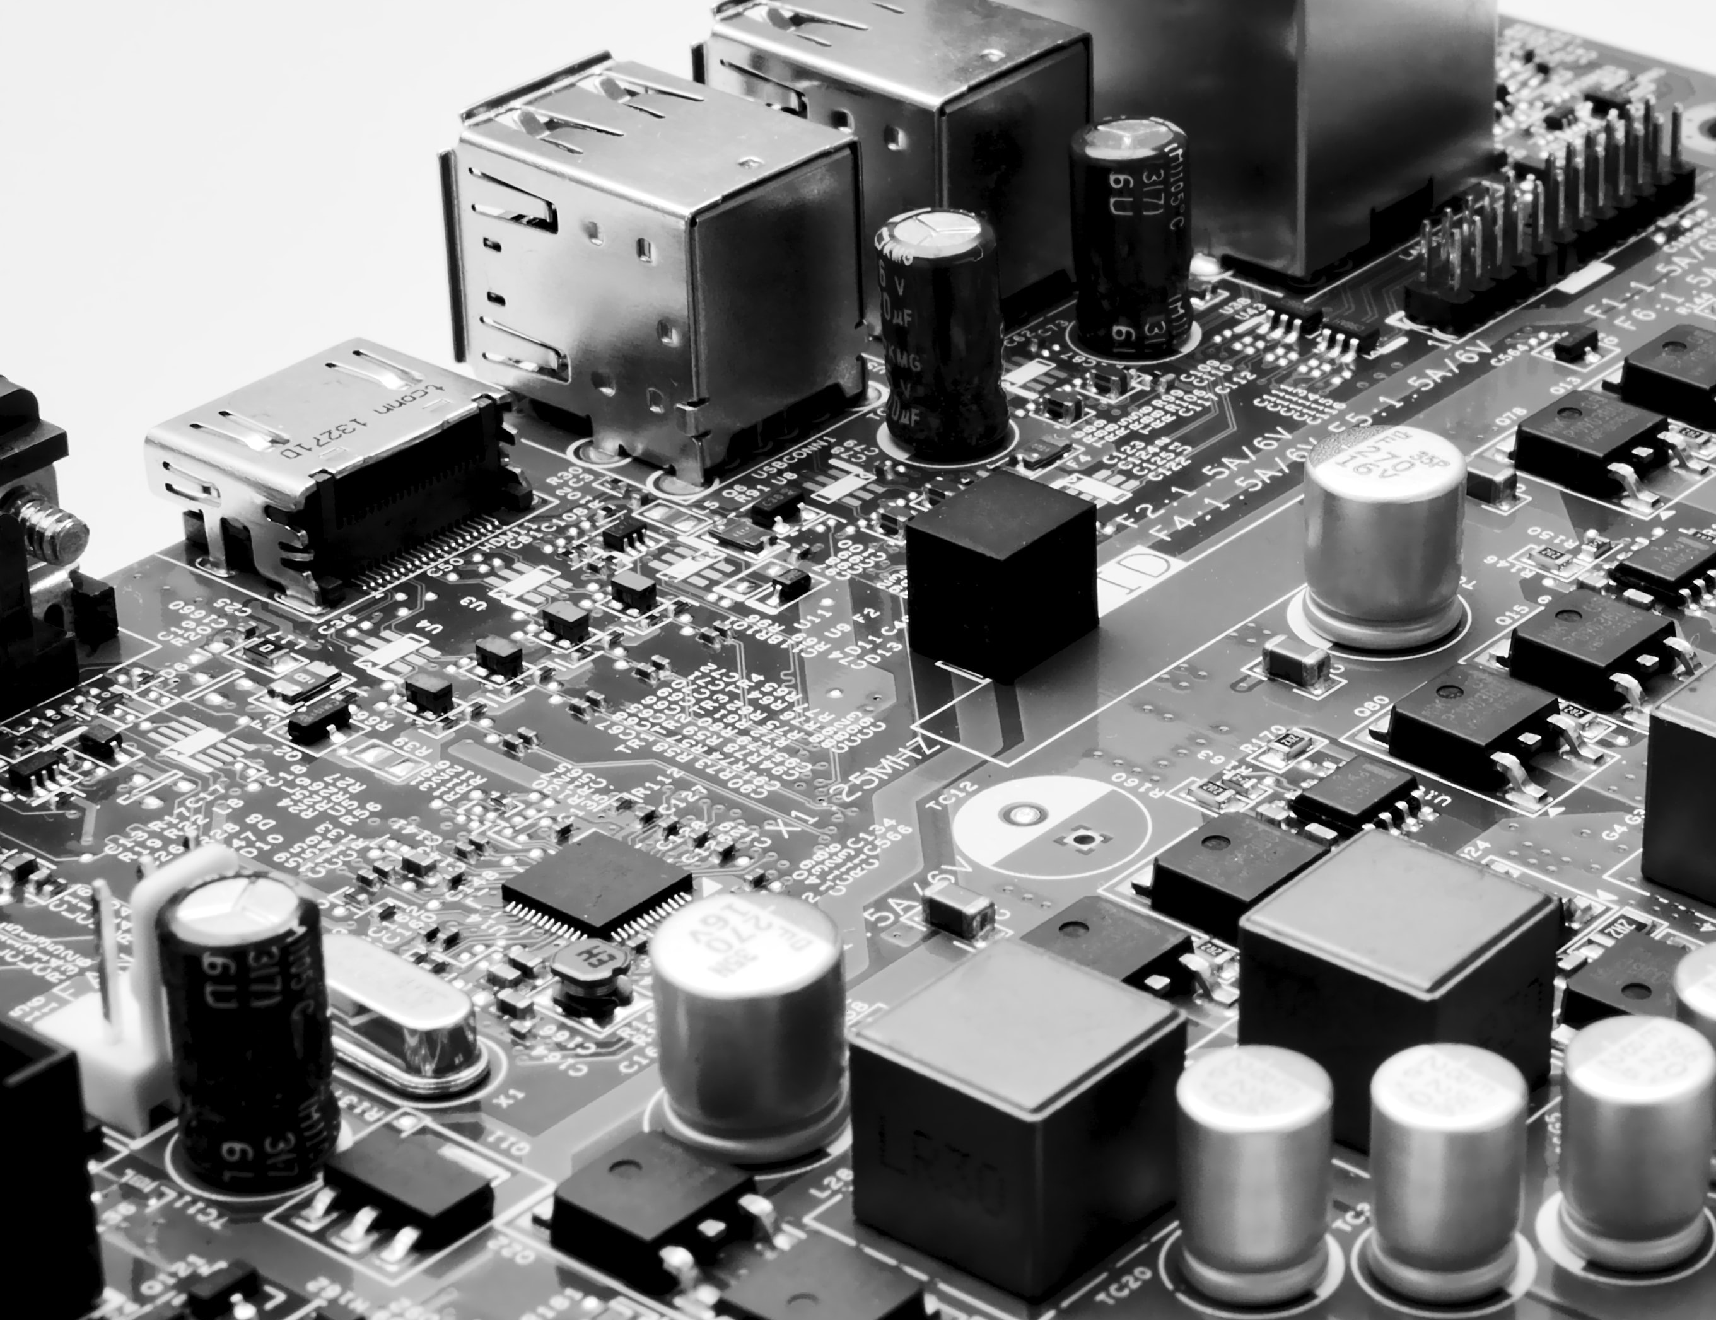
CY102 - Networking
Virtualisation

Slide 2
Hypervisor
App
Operating
System
App
App
Operating
System
Operating
System
App
Operating
System
Hardware
Hardware
App
Operating
System
App
Operating
System
Hardware
Before
Hardware
After
Notes:
Before: Three different servers for three different operating systems and services
After: Only one server required for three different servers and operating systems

Slide 3
Hypervisor
Two types of hypervisor
Type 1
Type 2

Slide 4
Type 1 Hypervisor
Hypervisors run directly on the system hardware – A “bare metal” embedded hypervisor
Operating
System
Operating
System
Operating
System
Application
Application
Application
Hypervisor
Host Hardware

Slide 5
Type 1 Hypervisors
VMware ESX and ESXi
Microsoft Hyper-V
Citrix XenServer
Oracle VM

Slide 6
Type 2 Hypervisor
Hypervisors run on a host operating system that provides virtualisation services, such as I/O device support and memory management
Operating
System
Operating
System
Operating
System
Application
Application
Application
Hypervisor
Operating System
Host Hardware

Slide 7
Type 2 Hypervisors
VMware Workstation/Fusion/Player
Microsoft Virtual PC – Windows 7 only
Oracle VM VirtualBox
Red Hat Enterprise Virtualization
KVM - virtualization infrastructure for the Linux kernel

Slide 8
Purposes of virtualisation and network storage technologies
Virtual networking components
Virtual switch
Virtual firewall
Virtual NIC
Virtual router, Hypervisor
Network storage types
NAS
SAN
Connection Types
FCoE
Fibre Channel
iSCSI
Infiniband
Jumbo frames

Slide 9
About Virtualisation
There are many virtualisation technologies applying to different technology fields, but the underlying concept is the same:
changing the way users or software see and use a hardware platform by applying abstraction layers between the two

Slide 10
Virtual machines
Host
Virtual Machine (VM)
Hypervisor

Slide 11
Virtual Networking Components
Virtual switch
Virtual firewall
Virtual NIC
Virtual router
Hypervisor

Slide 12
Virtual Switch
A software program that allows one virtual machine (VM) to communicate with another
The virtual switch allows the VM to use the hardware of the host OS (the NIC) to connect to the Internet

Slide 13
Virtual Firewall
A virtual firewall (VF) is either a network firewall service or an appliance running entirely within the virtualized environment
Regardless of which implementation, a VF serves the same purpose as a physical one: packet filtering and monitoring
The firewall can also run in a guest OS VM
One key to a VF is to not overlook the contribution from Network Address Translation (NAT)
This allows an organization to present a single address (or set of addresses) to the Internet for all computer connections—it acts as a proxy between the local-area network (which can be using private IP addresses) and the Internet

Slide 14
Virtual NIC
On an isolated internal network: the VNIC is assigned an internal IP address, and can communicate only with the hypervisor and/or other VMs on the same host.
On an internal subnet: the VNIC is assigned an internal IP address, but the hypervisor performs NAT so the VM can connect to the outside network.
As a bridged adapter: the VNIC is assigned an external IP address and joined directly to the outside network. To outside observers, the VM and host will appear to be different network addresses even though they share a physical NIC.
At its most basic, the VNIC on a VM can be configured a few ways.

Slide 15
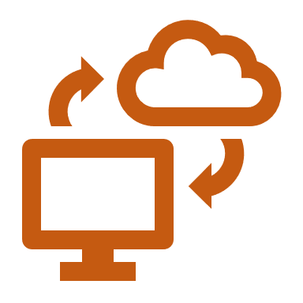
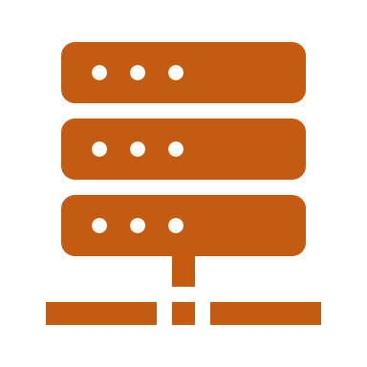
Virtual Router
A Virtual Router, or vRouter, is a software function that replicates in software the functionality of a hardware-based Layer 3 Internet Protocol (IP) routing, which has traditionally used a dedicated hardware device
vRouter is often used as a generic term for virtual routing, but it is also included in the name of several brand-name commercial products
Virtual routing is a form of network functions virtualization (NFV), in which the functions of traditional hardware-based network appliances are converted to software that can be run on standard commercial off-the-shelf (COTS) hardware

