Slide 1
BCS Level 4 Certificate in Network Systems and Architecture
NSaA-QAN_60305472
3 – Hardware Failures
4 – Configuration Errors

Slide 2
3 Hardware Failures (7.5%)
3.1 Explain the causes and impact of computer system failures and summarise the appropriate response for each
3.2 Express the causes and impact of network failures and summarise the appropriate response for each

Slide 3
Computer System Failures
Memory component failure
Individual node crash
SSD/HDD failure
System crash and possible loss of data
CPU failure
Intermittent system crash or failure to boot on a single node
Power supply
Intermittent system crash or failure to boot on a single node
Cooling
Intermittent crash or possibly permanent damage to components

Slide 4
Network Failures
NIC failure
Loss of access from/to one network node
Switch failure
Loss of access to LAN or reduction in throughput depending on redundant configuration
Router failure
Loss of access to WAN or reduction in throughput depending on redundant configuration
Firewall
Loss of access to some/all network nodes / protocols
Web proxy
Loss of access to web traffic
Cabling
Incorrect cable type (straight through / cross over)
Cabling
Exceeding recommended lengths and / or EMI
Wireless
Exceeding maximum distance and / or EMI or RFI

Slide 5
4 Configuration Errors (7.5%)
4.1 Describe the causes and impact of incorrectly applied / faulty patches and summarise the appropriate response for each.
4.2 Explain causes and impact of IP Addressing configuration errors and summarise the appropriate response for each; with a focus on Invalid IP address, netmask, gateway and DNS Server.
4.3 Describe the causes and impact of VLAN configuration errors and summarise the appropriate response for each.

Slide 6
4 Configuration Errors (7.5%)
4.1 Describe the causes and impact of incorrectly applied / faulty patches and summarise the appropriate response for each.
4.2 Explain causes and impact of IP Addressing configuration errors and summarise the appropriate response for each; with a focus on Invalid IP address, netmask, gateway and DNS Server.
loss of access to some / all LAN / WAN / nodes.
4.3 Describe the causes and impact of VLAN configuration errors and summarise the appropriate response for each.
invalid VLAN tagging - loss of access to nodes / lack of necessary network isolation.

Slide 7
Incorrectly Applied / Faulty Patches
intermittent problems / complete loss of function;
failure to boot OS

Slide 8
IP Addressing Configuration Errors
Will not be able to access the internet or the local network
Using wrong IP addressing
Example: 192.168.xxx.xxx instead of 192.165.xxx.xxx
Might be notified of IP address conflict
Usually static setting in a DHCP environment
Router gateway configuration in OS
DNS configuration in OS
Incorrect netmask chosen

Slide 9
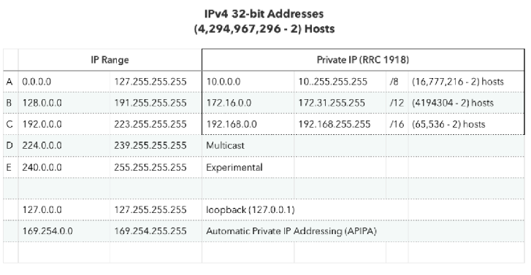

Slide 10
VLAN Configuration Errors
Virtual LANs within a switched local area network provide segmentation and effective network management as well as security
Network Engineers have the flexibility of segmenting their network into separate VLANs according to work groups, department differentiation or even application usage without worrying about the physical location of the hosts
Virtual Local Area Networks (VLANs) allow a single physical Ethernet network to appear to be multiple logical networks
There are a couple of reasons to use VLANs, including:
Enhance network security by preventing wireless devices from accessing LAN resources
Increase performance by limiting broadcast domains
invalid VLAN tagging - loss of access to nodes / lack of necessary network isolation

Slide 11
IP Addressing Issues (VLAN)
Each VLAN must correspond to a unique IP subnet
If two devices in the same VLAN have different subnet addresses, they cannot communicate
This is a common problem, and it is easy to solve by identifying the incorrect configuration and changing the subnet address to the correct one

Slide 12
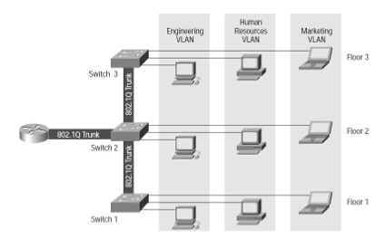
VLAN Tagging
VLAN Tagging, also known as Frame Tagging, is a method developed by Cisco to help identify packets travelling through trunk links
When an Ethernet frame traverses a trunk link, a special VLAN tag is added to the frame and sent across the trunk link
VLAN tagging typically requires a non-trivial amount of LAN configuration on the upstream switches, routers, and firewalls
A typical VLAN configuration might break up a physical LAN by department

Slide 13
VLAN Tagging
VLAN enabled ports are generally categorized in one of two ways:
Tagged
Untagged
These may also be referred to as "trunk" or "access" respectively
The purpose of a tagged or "trunked" port is to pass traffic for multiple VLAN's
Untagged or "access" port accepts traffic for only a single VLAN
Generally speaking, trunk ports will link switches, and access ports will link to end devices

Slide 14
Missing VLANs
If a VLAN is ‘missing’, it is usually an indication that the VLAN or group of VLANs has not been tagged
Cisco switches are configured to be VTP (VLAN Trunking Protocol ) servers by default
May need to set them to VTP transparent

Slide 15
Task
Sign up for a Cisco account here: https://www.netacad.com/courses/packet-tracer/introduction-packet-tracer. It is free.
Using Packet Tracer (setup file on the Wiki), set up a network and configure VLANs by watching the video at https://www.youtube.com/watch?v=9IaDFx0nDfA
Watch this video as well: https://www.youtube.com/watch?v=aBOzFa6ioLw
There are more videos by danscourses in the series if you want to know more

