Slide 1
Operating Systems and Architecture
^{<Operating System Principles>}
(UFCFCU-30-1)

Slide 2
^{<outcomes>}
After completing this section of the module you will be able to:
Describe and explain the purposes and implementation of operating systems
This section will cover the principles, multiprogramming and processes

Slide 3
^{<purpose>}
What do you think the purposes of an operating system are?
Take 5 minutes and then write them on the board
Then they can be discussed as we go through this session
Notes:
Suggest you tick them off if they are correct and X them if not!

Slide 4
^{<objectives>}
These are the prime objectives of an operating system
Make the computer convenient to use
Use the computer system resources efficiently
Allow the effective development of new services

Slide 5
^{<purposes>}
And here are the main purposes
Schedule program execution
Provide access to I/O devices (day 11)
Control access to files (day 12)
Control access to the system and specific resources
Detect and respond to errors
Log statistics and events

Slide 6
^{<modes>}
Before discussing the functions we look at modes of operation
CPUs provide privilege or protection rings of operation
 | Ring 3
 | Ring 2
 | Ring 1
 | Ring 0
 | PL 0
 | PL 1
 | PL 2
x86
ARM
Notes:
ARM is perverse in having privilege level 2 as the most secure

Slide 7
^{<modes>}
Only programs in ring 0 can directly access the hardware resources of the computer. They can do anything with the system.
A program may access only data that reside on the same ring or a less privileged ring
A program may call services residing on the same or a more privileged ring
 |  | X86 | ARM
 | Ring 3, PL 0 | User mode | Application | No hardware access
 | Ring 2
 | Ring 1, PL 1 |  | Operating system | Hardware access
 | Ring 0, PL 2 | Supervisor mode | Hypervisor | Hardware access
Notes:
Where would malware like to run?
ARM Hypervisor is separate – Supervisor mode is across both in X86

Slide 8
^{<modes>}
System processes or threads will have a supervisor mode bit set to instruct the CPU to run in that mode
Processes or threads in user space will not have the bit set
What should happen if a program in user mode fails?
What will happen if a program in supervisor mode fails?
Linux, OSX, Windows and Android use these 2 modes
Notes:
User mode: Graceful termination of program and error logging, reporting. Supervisor mode: System hang, BSOD, dump of memory, registers etc.

Slide 9
^{<kernel>}
Operating systems put the code responsible for accessing the hardware in supervisor mode into a structure – the kernel
The kernel is the first software loaded by the bootloader
It is resident in memory
APPLICATIONS
KERNEL
CPU | MEMORY | DEVICES

Slide 10
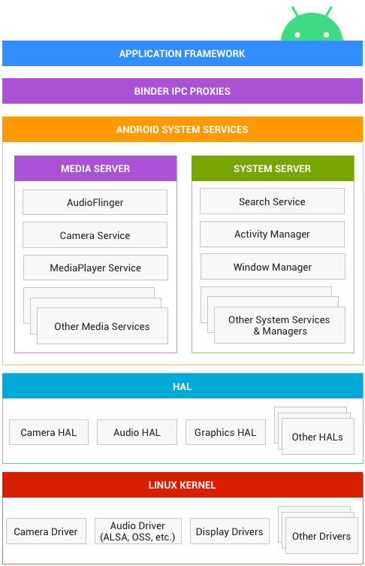
^{<kernel>}
It isn’t as simple as the previous diagram
This is the Android OS diagram
Above the kernel is HAL (hardware abstraction layer)
What is the purpose of the HAL?
Is it, or should it be part of the kernel in any OS?
Notes:
API – Everything above can talk in normal language
Kernel wrote in C but a 10gb Network adapter will be in assembler – No overheads.

Slide 11
^{<kernel>}
The Android apps are part of the Android framework
A camera app would request access to the camera via the Binder Inter Process Communication layer
This would be received by the camera service
That then uses an interface to the hardware abstraction layer (HAL) to finally get the kernel to address the camera hardware via the specific device driver for that hardware
How many defined interfaces are there in this model and which ones vary with hardware, Android version and application?

Slide 12
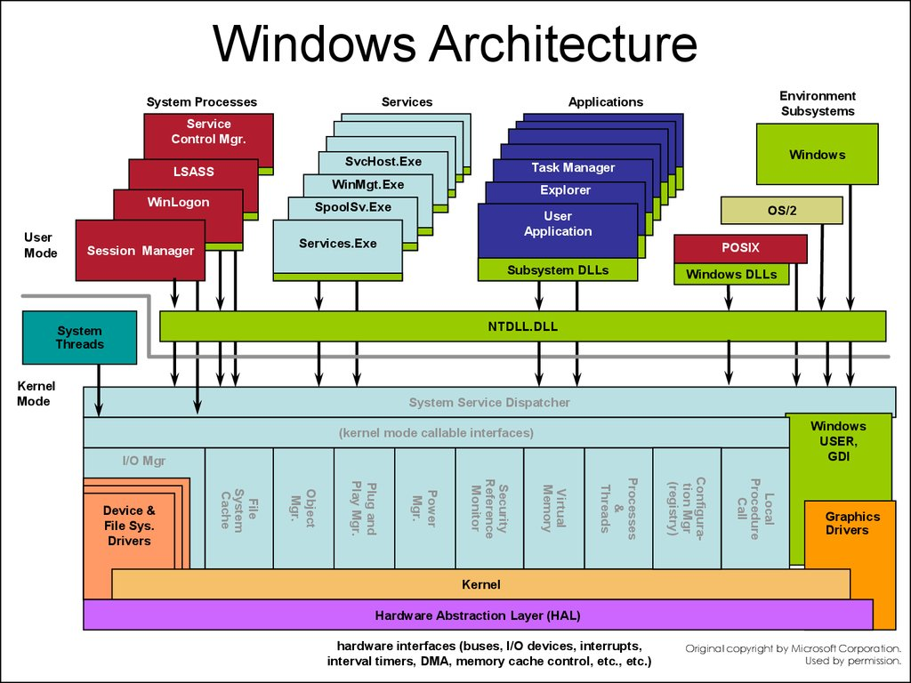
^{<kernel>}
Windows is more complex
What is a DLL?
How much of Windows runs in user mode?
What does NTDLL do?
Why is the UI in Kernel mode? Is it in Linux, and if not, why?

Slide 13
^{<objective review>}
One of the objectives was:
Allow the effective development of new services
How has this been achieved?
Discuss the advantages of OS abstraction layers to:
An application developer
An adapter manufacturer
A Linux distribution developer
A Chinese smartphone manufacturer
Notes:
Should lead to Android Open Source Project, apps written once for many different hardware, adapters + driver can be used on many systems, choice of GUI for Linux

Slide 14
^{<process>}
When a program starts the OS creates a process for that program
The process owns:
The executable machine code of the program
Memory containing
The executable code
I/O data
A stack for sub routines
A heap
File descriptors (Linux) or handles (Windows)
Security attributes such as owner, permissions
Processor state – registers, memory addresses
This information is held in a process control block
What are file handles/descriptors and the heap?
Notes:
Reference to a resource, such as a file or network socket. The heap is a pool of memory.

Slide 15
^{<process control block>}
Process number (PID) | Unique ID for each process
Related PIDs | Child IDs or related IDs
Program counter | Pointer to next instruction
Registers | Register set in use
Memory tables | Allocation of memory
I/O tables | Device availability, status, location of buffers
File tables | File descriptors/handles of files in use
Process state | New, ready, running, waiting, exit
Priority | Low, normal high etc
Interprocess information | Flags, messages, signals for communication with other processes
Process privileges | Allowed/disallowed access to system resources
CPU scheduling | Information scheduling CPU time
Accounting information | Amount of CPU used etc
This is a generic PCB

Slide 16
^{<threads>}
A thread is a small unit of code for processing that can be scheduled
They are components of a process
Process | Thread
PCB | TCB
Independent | Subset of process
Significant state information | Multiple threads within a process share memory and resources
Separate address space | Shared address space
Thread number (TID) | Unique ID for each thread
Program counter | Pointer to next instruction
Registers | Register set in use
Stack pointer | Pointer to thread’s stack in the process
Thread state | Start, ready, running, waiting, done
Pointer to PCB | Pointer to process control block the thread is living on

Slide 17
^{<process>}
With process and thread control blocks the OS can manage multitasking, multiprogramming and multi user
Processes and threads can be:
Time shared – to give the impression of concurrent program execution
Interrupt driven – to use the resources efficiently
On Windows view all the current processes and threads that are running
What information is available?
Did it come from the control blocks?
Start programs and see what happens
Notes:
Good discussion possibilities. What is hogging CPU/memory. Start some apps to see changes. Learn task manager.

Slide 18
^{<summary>}
The operating system manages the execution of applications so that:
Resources are made available to multiple applications
The physical processor is switched among multiple applications so that all will appear to be progressing
The processor and the I/O devices can be used efficiently

Slide 19
^{<process states>}
The OS must:
Interleave the execution of multiple processes and threads
Allocate resources in accordance with policy (eg priority) while avoiding deadlocks
What is a deadlock?
Notes:
Should come up with examples of this, eg process A locks resource B but needs resource A to release, Process B locks resource A but needs resource B to release. Let’s play the dining philosopher’s game, see next slide

Slide 20
^{<dining philosophers>}
5 philosophers can:
Only eat spaghetti
Must use 2 forks
When dining they:
All go to the table
Sit
Take 2 forks and eat
Devise solutions to avoid the death of one or more philosophers due to starvation
Notes:
Queue the philosophers, queue the forks, buy more forks or bowls (increase hardware resources), time slice the philosophers,
Teach them to eat with one fork. Very slow resources though
Attendent that only allows 4 in at a time so at least one philosopher can eat and rotate around.

Slide 21
^{<process states>}
The process states are:
New
Ready
Running
Blocked/waiting
Exit
Transitions are:
New to ready
Ready to running
Running to ready
Running to blocked/waiting
Blocked/waiting to ready
Running to exit
Draw a state diagram showing these transitions
Notes:
Solution on next page

Slide 22
^{<process state model>}
Dispatch
New
Admit
Ready
Running
Release
Exit
Time-out
Event occurs
Event wait
Blocked/
waiting

Slide 23
^{<process state transitions>}
New to ready
OS does this when it is ready to add an additional process
Contingent on being below a limit on existing processes and memory availability
Ready to running
OS scheduler program picks the process
Running to exit
Terminated by the process or reasons given on next slide

Slide 24
^{<process termination>}
Normal completion | Process says it is done
Time limit exceeded | Ran longer than a specified limit
Memory unavailable | Needs more than the system has
Bounds violation | Tries to access a prohibited memory location
Protection error | Tries to use a prohibited resource
Arithmetic error | Divide by zero, number too large etc
Time overrun | Waited longer than specified for an event
I/O failure | Invalid operation, file not found, read/write failure
Invalid instruction | Attempt to execute data (by branching into the data area by error)
Privileged instruction | Attempt to use an OS reserved instruction
Data misuse | Incorrect data type or not initialised
User or OS intervention | User quit or OS resolving a deadlock (force quit)
Parent termination | OS terminates all child processes
Parent request | Parent requests termination of child process

Slide 25
^{<process state transitions>}
Running to ready
OS does this when the allocated time for uninterrupted execution has run out
Also when a higher priority process is ready
A process may voluntarily do this, eg an intermittent background task
Running to blocked
OS puts it in this state if it requests something it must wait for, via a system service call
The process may be waiting for am I/O operation
The process may be waiting for a communication from another process
Blocked to ready
Happens when the event it was waiting for occurs

Slide 26
^{<process queues>}
Where are the processes when they are not running?
In queues
Are the queues LIFO or FIFO?
Are two queues enough?
CPU
Release
Ready queue
Admit
Dispatch
Time out
Blocked queue
Event wait
Event occurs
Notes:
FIFO. No, need a queue for each event so that OS doesn't have to scan blocked Q for the appropriate event. Also queue for each priority. Coffee shop: 1 Q for coffee only and food + coffee waiting for one of 2 servers. 2 Q’s more efficient. You may prefer a McDonald’s analogy. A new process queue?

Slide 27
^{<process queues>}
CPU
Release
Admit
Ready queue
Dispatch
Time out
Blocked queue 1
Event 1 wait
Event 1 occurs
Blocked queue 2
Event 2 wait
Event 2 occurs
Blocked queue n
Event n wait
Event n occurs

Slide 28
^{<process state swapping>}
So far the OS has mechanisms for making sure the CPU is busy and that processes are handled fairly
But what if all the running processes are waiting for an event?
The CPU is then idle
Swapping is a technique for moving waiting processes out of memory to secondary storage in a suspend queue
Then a new process can be brought in from the new queue or one back from the suspend queue
Amend the state diagram you drew (slide 22) to add the suspend state

Slide 29
^{<process state model>}
Dispatch
New
Admit
Ready
Running
Release
Exit
Time-out
Activate
Event occurs
Event wait
Suspend
Suspend
Blocked/
waiting
But there is a problem with this. What is it?
Notes:
The suspended processes were blocked when they were suspended, so they can’t go back to running when activated

Slide 30
^{<process state swapping>}
There are two more states required:
Blocked/suspend
Ready/suspend
And new transitions
Blocked to blocked/suspend (to free up memory for another process)
Blocked/suspend to ready /suspend (the waiting event has occurred)
Ready/suspend to ready (when there is no ready process)
Ready to ready/suspend (might be needed to free large block of memory)
Update the state diagram again

Slide 31
^{<process state model>}
New
Admit
Admit
Activate
Dispatch
Ready - suspend
Ready
Running
Release
Exit
Suspend
Time-out
Event occurs
Event occurs
Event wait
Blocked - suspend
Activate
Blocked/
waiting
Suspend
Notes:
New to ready dotted as new most likely to be created in ready/suspend and wait for memory availability

Slide 32
^{<process switching>}
The OS can only take actions when it gets control
Events that trigger a switch to OS control when a process is running
A clock interrupt – if a time slice is exceeded the process is switched to a ready state
An I/O interrupt – if it is for blocked processes, then these are moved to the ready state, or if is for blocked/suspend processes, these are moved to the ready/suspend state
A memory fault – the processor finds a virtual address outside the main memory range (more on this on day 10) and blocks the process while the I/O request brings in the required memory block
A trap –an error or exception is detected and handled accordingly
A supervisor call - a user process requests an action, such an I/O write, that it does not have the privilege to run itself

Slide 33
^{<threads>}
Modern OSs use multiple processes each of which can support multiple threads
All threads of a process share the process data and file handles etc
If a process is suspended, so are all its threads
Benefits of threads:
Less time to create, switch and terminate threads than processes
Communication between threads does not require the kernel
Multiple threads for the same process can be executing on different processors
The OS can assign the next ready thread to the next available processor (virtual or real)

Slide 34
^{<conclusion>}
An objective of the OS was to:
Use the computer system resources efficiently
Discuss how well and by what means the OS achieves this for a 4 core, hyperthreaded processor
List the techniques that you covered in this section from day 1 up to day 8 that the OS takes advantage of
Notes:
Main ones are interrupts and stack

