Slide 1
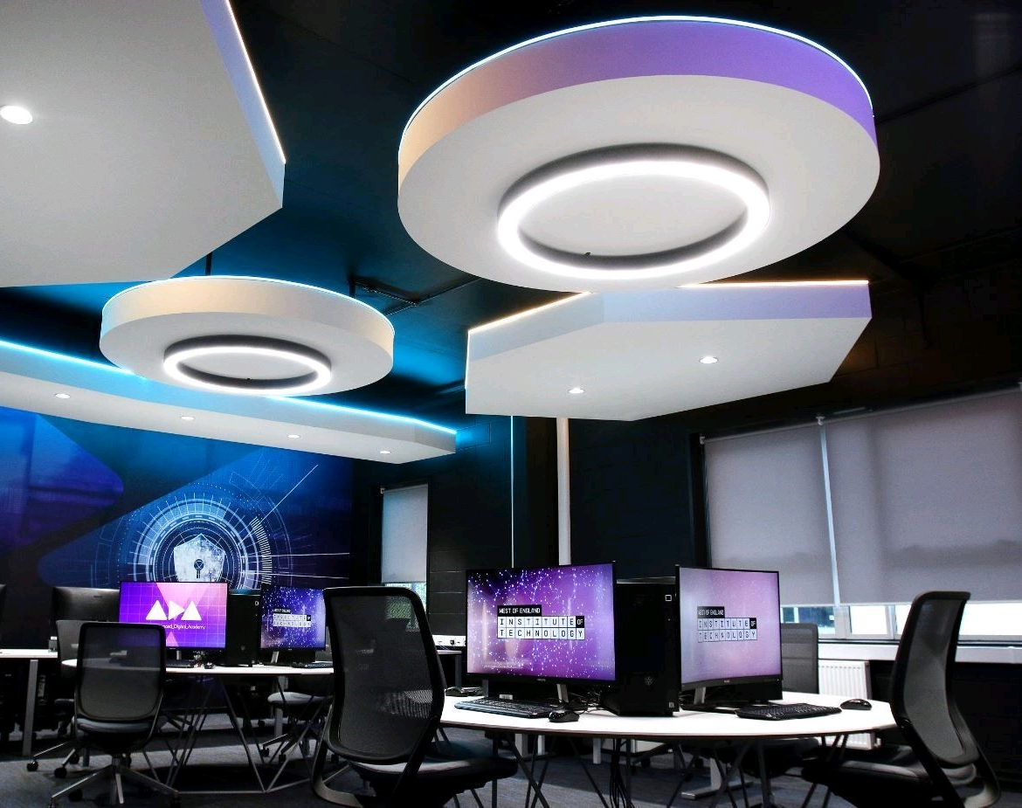
Induction Day
BCS - SDT Apprenticeship

Slide 2
Announcements
Fire and emergencies
Mobile phones
Toilets
Breaks and lunch

Slide 3
Agenda
Enrolment – Photos & Badges
Introductions
College and computing sign on Office 365
Smart Assessor Software = online digital portfolio
Off the Job Hours - Template
Super Glos Wiki
The program – Dates on wiki
Handbook and skills checklist
Projects
Monthly Visits / Some might be remote
Safeguarding Video
Covid Secure

Slide 4
Enrolment
Get enrolled at student services, photo taken and ID Badge
Reset college password for Email & office 365 ( need to visit helpdesk)
Smart Assessor Login details will be emailed to you

Slide 5
Introductions
Lecturers
Emma Littlefair - Lead Sofware Dev & Tester
Mark Higgins – Software Dev & Dev Ops

Slide 6
College & Computer sign on – 3 different logins
Office 365 & email
In the classroom
Smart Assessor

Slide 7
What is Smart Assessor
https://www.smartassessor.co.uk/Account
You will upload your evidence of your competence to the E Portfolio
OTJ hours uploaded
Plans and feedback from your Assessors
Wellbeing resources
E mail handout

Slide 8
Off the job hours
Off the job training is learning which is undertaken outside a person’s usual day to day working environment, and contributes towards the achievement of an apprenticeship. This can include training that is delivered at the apprentice’s workplace, but must not be delivered as part of their usual working duties.
What is included in off the job training?
The off the job training must be directly relevant to the apprenticeship, and could include:
The teaching of theory (for example lectures, roles play, online learning, manufacturer training)
Practical training: shadowing, mentoring, industry visits and attendance at competitions
Learning support
Time spent writing assessments/assignments
What isn’t included in off the job training?
English and maths functional skills (up to level 2) which is funded separately
Progress reviews or on programme assessments that are part of the apprenticeship
Training which takes place outside of the apprentice’s paid working hours

Slide 9
Digital Apprenticeship Website
The wiki website will provide apprentices on the Apprenticeship Standards information relevant to their chosen apprenticeship.
https://gloscolapprenticeships.co.uk/appWiki/doku.php?id=start

Slide 10
Dates for your diary

Slide 11
The program – 18 months
Handbook on Smart Assessor
Key Steps
Block release weeks – Knowledge & Skills
Smart Assessor – Building your online portfolio & uploading competencies in the workplace
Project– In the workplace
Interview from BCS

Slide 12
Apprentice Journey
18 month apprenticeship
Block release sessions
Build E Portfolio
Visits from assessors in the workplace/might be remote
Work based project
Interview with BCS (British Computer Society)
End Point Assessment (EPA) – 3 months

Slide 13
What it looks like
Examples of Standard
https://www.instituteforapprenticeships.org/apprenticeship-standards/software-development-technician-v1-1
Example of Learner Journey

Slide 14
Safeguarding
https://gloscolac-my.sharepoint.com/:v:/g/personal/coyneg_gloscol_ac_uk/EQYN5AQumNZDthQccaQ34vEBV_ymPdXJNblWpNB2s7G5hA

