Slide 1
Introduction
Cyber Security Technician
Level 3

Slide 2
Intro to Cyber
Week 1
Intro
Monday
01
02
Wednesday
03
04
Tuesday
05
06
Thursday
Friday

Slide 3
Course Pre-requisites
GC Badges? - Student Services
GC User ID’s? - Student Services
ADA Computer Logins
ADA Wifi Logins
Notes:
Notes & Resources:
http://www.gloscolapprenticeships.co.uk/appWiki/doku.php

Slide 4
Course Pre-requisites
Apprentice pre-module preparation
Access to Smart Assessor? - login and complete "Skills Scan"
- Smart Assessor
Access to the Apprenticeship Wiki?
- Apprenticeship Wiki
Notes:
Notes & Resources:
http://www.gloscolapprenticeships.co.uk/appWiki/doku.php

Slide 5
Cyber Security Technician
This occupation is found in all sectors where information is held digitally and where that information is an asset that needs to be protected including but not limited to:
Finance, Retail, Telecoms,
Health, Media, Manufacturing,
and local authorities
Notes:
Notes & Resources:
https://www.instituteforapprenticeships.org/apprenticeship-standards/cyber-security-technician-v1-0

Slide 6
Cyber Security Technician
The broad purpose of the occupation is to provide first line cyber security support.
This requires individuals to monitor and detect potential security threats and escalate as necessary and to support secure and uninterrupted business operations of an organisation through the implementation of cyber security mechanisms and the application of cyber security procedures and controls.
Notes:
Notes & Resources:
https://www.instituteforapprenticeships.org/apprenticeship-standards/cyber-security-technician-v1-0

Slide 7
Cyber Security Technician
To contribute to the delivery of a security culture across an organisation, understanding vulnerabilities and threats and supporting the development of an organisation's cyber security maturity.
To apply procedures and controls to maintain security and control of an organisation, and process security requests ensuring confidentiality, integrity and availability of information stored digitally.
Notes:
Notes & Resources:
https://www.instituteforapprenticeships.org/apprenticeship-standards/cyber-security-technician-v1-0

Slide 8
Cyber Security Technician - Overview
The Cyber Security Technician apprenticeship is delivered at: Level 3
Course Duration: 18 Months
Content Delivery Duration: 12 Months
Preparation to Gateway: 3 Months
End Point Assessment: 3 Months
Notes:
Notes & Resources:
https://www.instituteforapprenticeships.org/apprenticeship-standards/cyber-security-technician-v1-0

Slide 9
Cyber Security Technician
Throughout the course you’ll need to build evidence to meet specific competency requirements, which include:
K’s – Knowledge – Gained in GC, and in the Workplace
S’s – Skills – Gained in the Workplace
B’s – Behaviours – Gained in the Workplace
Notes:
Notes & Resources:
https://www.instituteforapprenticeships.org/apprenticeship-standards/cyber-security-technician-v1-0

Slide 10
Cyber Security Technician - EPA
End Point Assessment (EPA) duration is typically 3 Months
EPA consists of 3 Formal Assessments:
Assessment method 1: Scenario Demonstrations (with questioning)
Assessment method 2: Professional Discussion (underpinned by Portfolio)
Assessment method 3: Knowledge Test
English & Maths Level 2 to be achieved prior to EPA
Performance in the EPA will determine the overall apprenticeship standard grade
Notes:
Notes & Resources:
https://www.instituteforapprenticeships.org/media/5023/st0865_cyber_security_technician_l3_ap-for-publication_20210315.pdf

Slide 11
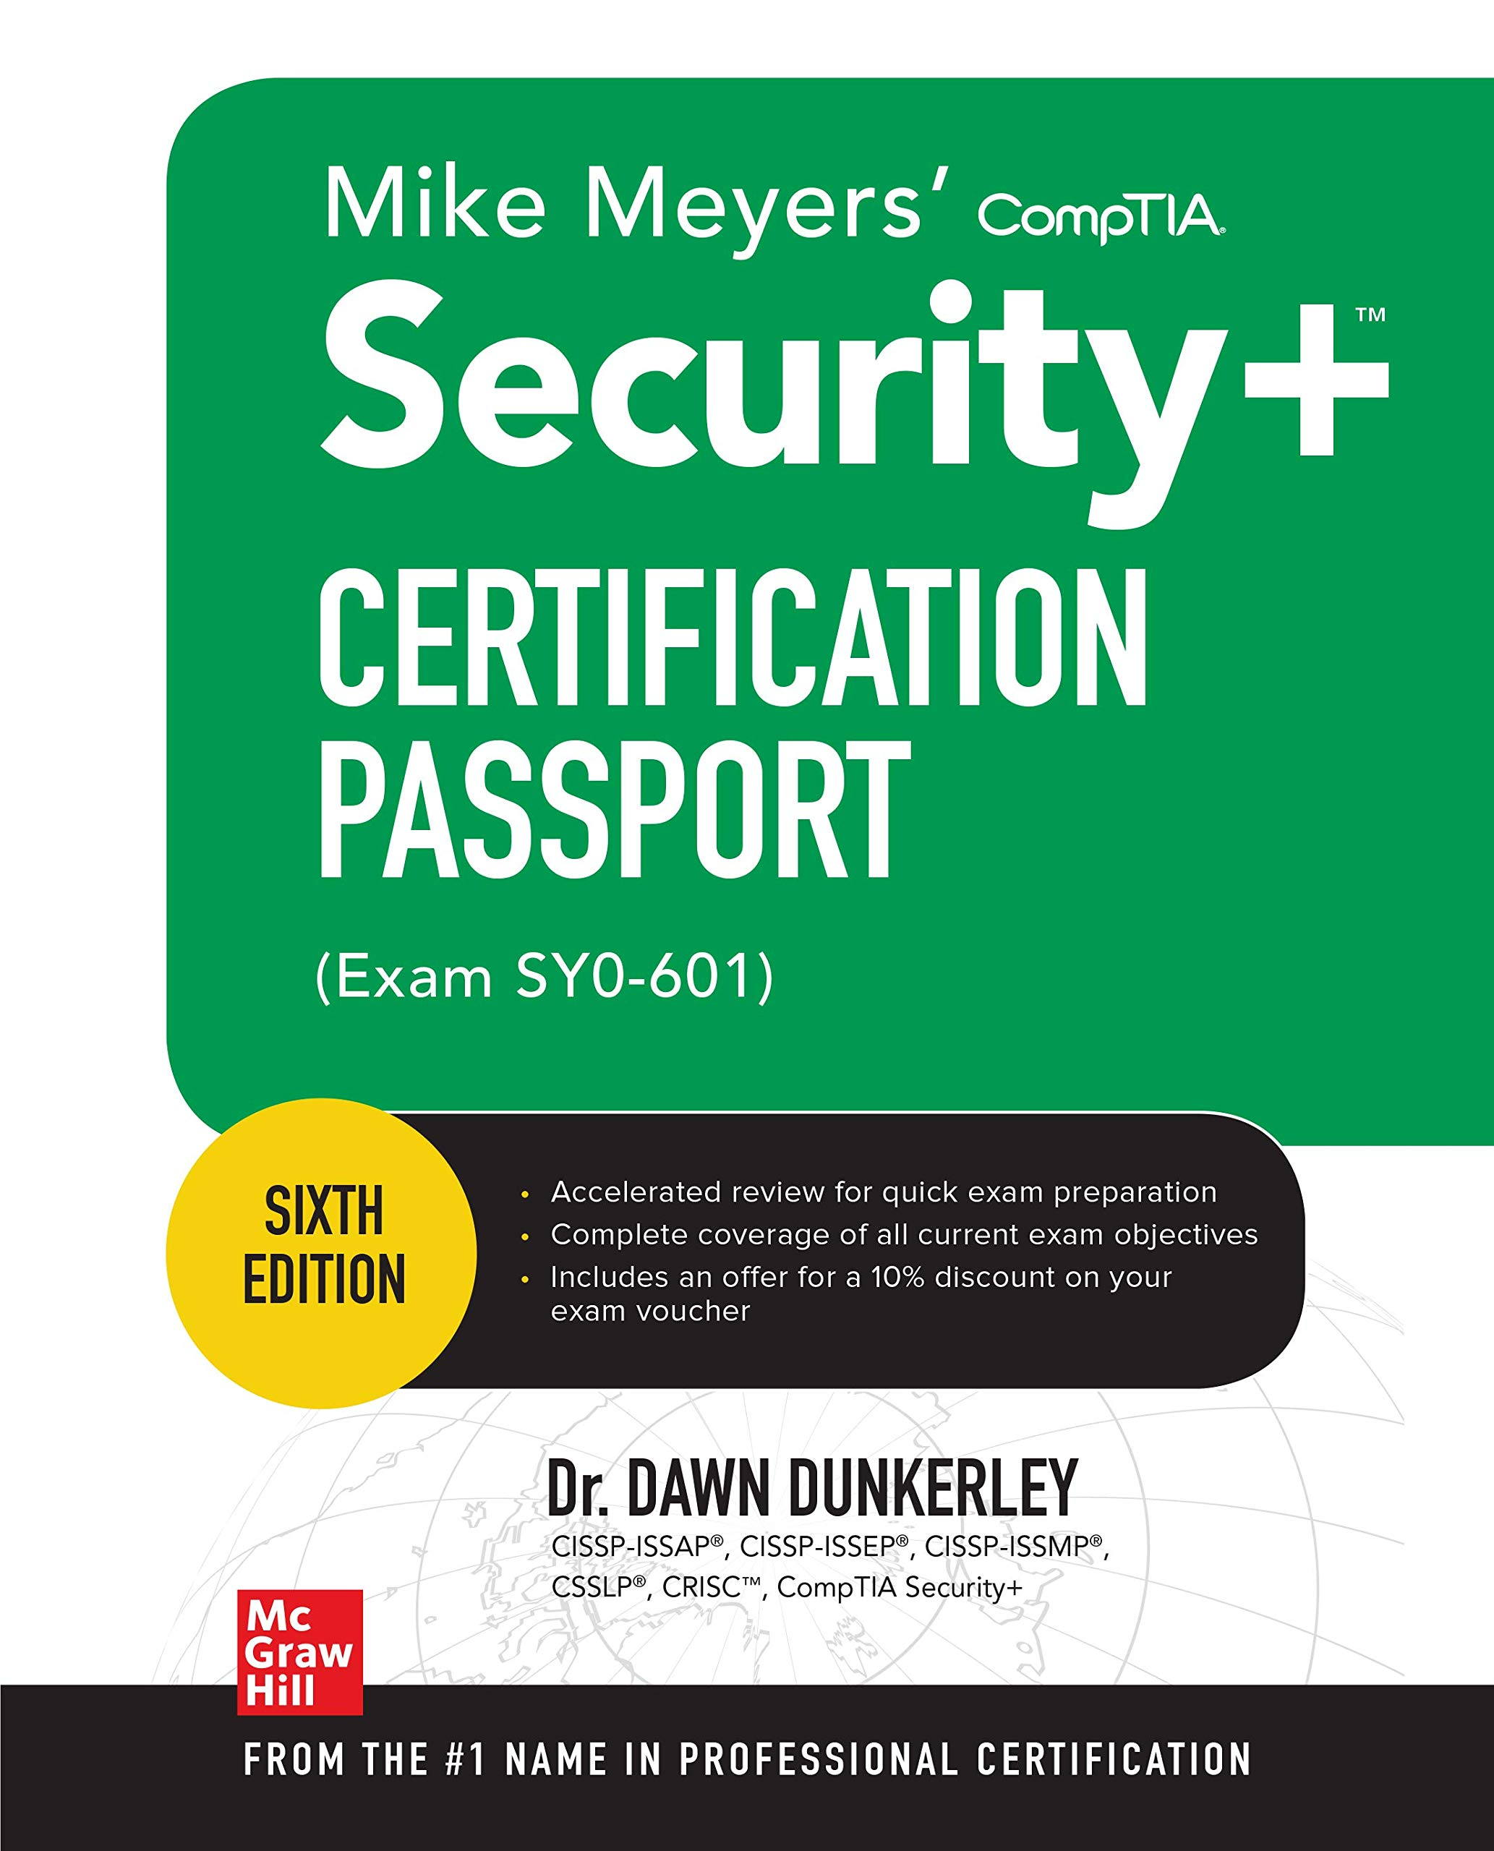
Useful Reading / Reference
Mike Meyers’ Security+
CISSP Study Guide

Slide 12
Essential Information Sources
Trusted Information Sources
Respected Printed / Digital Publications
NCSC
NIST
OWASP
CYBOK
CISA
SANS Internet Storm Centre
The Register
Security Weekly
Infosecurity Magazine
CSO Online

Slide 13
Evidence Considerations
When completing written Assessments consider the following prior to submitting:
Show -
Are your responses clear? Consider using screenshots and / or supporting documents where appropriate
Describe -
Have you provided clear and concise descriptions to explain each element or aspect of your response? For example, if computing / security terms are used, have you expanded on the terms to ensure there can be no doubt in their meaning?
Don’t take the approach that the assessor or reviewer will “fill in the blanks” and / or "understand what you mean”!
Justify -
Are there several potential options open to you in your response, if so, consider providing additional context and reasoning to support your choice

Slide 14
Evidence Considerations
When completing written Assessments consider the following prior to submitting:
Output -
Are the results of any calculations clearly marked and obvious to the assessor / reviewer? Don’t assume that the assessor or reviewer will hunt through your document to try to find what appears to be the correct answer!
Sources -
Have you clearly referenced, included and / or provided links to external sources i.e. documents, websites, articles etc.? if so, consider whether it’s clear to the assessor or reviewer how and where you are using the information being referred to

Slide 15
Evidence – In Summary
Show
Describe
Justify
Output
Sources

Slide 16
Apprenticeship IT Training Environments
Please note:
IT training environments are shared by different apprenticeships
You do not have a dedicated PC during the apprenticeship
PC’s can be re-installed without prior notice
You are responsible for backing up your own work
(Use of personally owned USB sticks are permitted for backups)

Slide 17
Main Section

Slide 18
Sub-Section

Slide 19
If you see a slide with this background…
Exercises & Labs =

Slide 20
If you see a slide with this background…
Important Information =

Slide 21
If you see a slide with this background…
Recap Session

Slide 22
Please Keep Your Phone On Mute!

Slide 23
“Chatham House” Rule
Throughout this module and the entire apprenticeship there will no-doubt be times when we discuss real-world commercial examples in order to provide additional context to a given topic or challenge.
Please note that anything discussed by either the Apprentices or Trainer relating to real-world examples will respect the “Chatham House Rule”
Chatham House Rule:
“When a meeting, or part thereof, is held under the Chatham House Rule, participants are free to use the information received, but neither the identity nor the affiliation of the speaker(s), nor that of any other participant, may be revealed”
Source: https://www.chathamhouse.org/

Slide 24
Introduction & Goals – Martin Webley
Career covering the majority of specialist areas in IT, over the last 35+ years
20+ years Security / IT Security / Information Security / Cyber Security
Built, matured, delivered security solutions in:
Private,
Public
3rd Sector Organisations
Career successes includes: Head of Cyber Security for NHS Wales
(Leading national security at Operational, Tactical and Strategic levels, working with NHS Bodies, Welsh Government and the National Cyber Security Centre)

Slide 25
Introduction & Goals – Martin Webley
Certifications include:
CISSP, CEH, CHFI, Lead Auditor, Prince 2 Practitioner
Goals:
Provide you with necessary information to gain a robust understanding of the topic, successfully pass this module and provide value added commercial context and background
Make GC Apprenticeships and ADA the best in the UK!

Slide 26
Introduction & Goals – Sulaiman Janjua
Certifications include:
Degree in Computer Networking & Security
Goals:
Supporting you to become passionate about Cyber Security
Helping you pick the right “Hat” for Hacking!

Slide 27
Introductions & Aspirations - Apprentices
Name
Apprenticeship company placement
Module Goals, Including any workplace challenges / questions
Career aspirations
How will you consider this module a success

Slide 28
WEST OF ENGLAND
INSTITUTE OF TECHNOLOGY
SKILLS FOR OUR DIGITAL FUTURE

Slide 29
WHAT IS THE WEST OF ENGLAND INSTITUTE OF TECHNOLOGY (WEIoT)?
Industry, education and research collaborating to design and deliver flexible, higher-level technical learning
The WEIoT has been designed to support businesses across the region to thrive and embrace the opportunities of the digitalisation of the economy.
One of only 12 national Institutes of Technology licenced by the Department for Education.
Working as a partnership across the region developing the future talent of tomorrow, by training and developing the workforce today.
Supporting local employers develop higher level skills and train employees for the jobs of tomorrow.

Slide 30
WEIoT PARTNERS
EMPLOYER PARTNERS
EDUCATION PARTNERS

Slide 31
SECTORS

Slide 32
YOU ARE AN WEIOT STUDENT.... WHAT DOES THIS MEAN FOR YOU?
AS WELL AS BEING REGISTERED WITH GLOUCESTERSHIRE COLLEGE YOU ARE ALSO AN ASSOCIATE LEARNER OF WEIOT.
THIS ENTITLES YOU TO A NUMBER OF BENEFITS WHICH ARE UNIQUE TO A WEIOT STUDENT:
SHARED UNDERSTANDING WITHIN A SUPPORTIVE NETWORK
POSSIBILITIES OF FUTURE POTENTIAL COLLABORATION WITH OTHER WEIOT STUDENTS ACROSS THE WEIOT REGION

Slide 33
ACCESS TO STATE OF
THE ART FACILITIES
LINKS TO LOCAL
EMPLOYERS WITHIN THE RELEVANT INDUSTRY
State of the art Cyber and Engineering labs,
including attack and defence room
Brand NEW IT suites
Work experience
World-class cyber, IT and engineering provision
Access to employers’ premises to access cutting
edge technology and develop new skills
Guest lectures
A dedicated workspace for IoT
learners to work in
Other support being planned

Slide 34
WHAT NEXT?
ENJOY YOUR COURSE
INVITE TO A ‘WELCOME EVENT’ FOR ALL COURSES AND STARTS ACROSS PARTNERSHIP
NOVEMBER 2021 (TBC)
YOU ARE AN ‘ASSOCIATE LEARNER’ FOR THE IoT
ANY QUESTIONS?
EMAIL: INFO@WEIOT.AC.UK
ADD your organisation details

Slide 35
Intro to Cyber
Week 1
Intro
Monday
01
02
Wednesday
03
04
Tuesday
05
06
Thursday
Friday

