Slide 1
Operating Systems and Architecture
^{<computer architecture>}
(UFCFCU-30-1)

Slide 2
^{<outcomes>}
After completing this section of the module you will be able to:
Describe and explain the purposes and implementation of operating systems.
Virtualised architectures

Slide 3
^{<Architectures>}
Virtual memory has already been covered (day 10)
We will cover
Full virtualisation: Virtual Machines
OS level virtualisation - Containers
Virtual machines and Containers are two ways of deploying multiple, isolated services on a single platform

Slide 4
^{<Purpose>}
Under nearly all conditions, the demands of a workload do not exactly match the CPU, memory or storage capacity of a physical server
Consequently hardware is often over specified and under utilised
Virtualisation allows multiple workloads to run on a single machine, securely and without interfering with each other
In full virtualisation the complete OS kernel, services and application stack runs in a virtual machine
A container runs in user mode. Only the application, required APIs and services are present. The OS and kernel are in the host machine.

Slide 5
^{<comparison>}
VM
VM
Apps
Services
Apps
Services
Kernel
Kernel
Hypervisor
Hardware
Container
Container
Apps
Services
Apps
Services
Orchestration
Host OS
Apps
Services
Kernel
Hardware
Notes:
Hypervisors and orchestration are explained later

Slide 6
^{<virtual machine>}
A virtual machine is a set of files holding:
the state of the VM’s BIOS
the virtual disk – the storage used by the OS and applications
the VM’s paging file
any snapshots – the state of the VM at the time the snapshot was taken
the suspended state of the VM – taken when it was suspended
the VM’s configuration
virtual devices – USB, network, keyboard, mouse, storage
the guest OS and applications
As they are files, the VM can be cloned, moved or copied to other systems

Slide 7
^{<virtual machine>}
Advantages of a virtual machine:
Resource utilisation – multiple VMs on single servers
Scale - easy to deploy multiple copies of the same VM in cloud computing
Portable – VMs can be moved to machines with spare capacity or into the cloud
Flexible – a VM can be created with an OS, then cloned to provide multiple VMs for different applications
Secure
VMs can be scanned by external software for malware
Snapshot for reversion to clean copies
Easy to delete a compromised VM, then recreate a clean version

Slide 8
^{<virtual machine>}
Additional uses of virtual machines:
Run incompatible software
Secure browsing – rollback to a snapshot after each session
Testing new applications or OS versions
Supporting software development
Investigating malware

Slide 9
^{<hypervisors>}
A hypervisor is the small software layer that allows multiple operating systems to run alongside each other on the same hardware
time slices the CPU, memory and storage resources
logically separates the VMs
runs directly on the hardware of the host system in ring 0
handles tasks such CPU and memory resource allocation for the virtual machines
provide interfaces for higher level administration and monitoring tools
The guest OS will issue privilege operations in ring 0, but that is where the hypervisor runs
The guest OS’s privileged operations that will only run in ring 0 have to be replaced with calls to the hypervisor (known as hypercalls).

Slide 10
^{<hypervisors>}
Intel VT-x and AMD-V respectively, provide extensions necessary to run unmodified guest virtual machines
These processors provide an additional privilege mode (referred to as ring -1) above ring 0
The hypervisor can operate in ring -1
ring 0 is then available for unmodified guest operating systems

Slide 11
^{<hypervisors>}
Type 1 hypervisor is bare metal
Runs directly on the hardware
Replaces the host operating system
Very efficient
Suited to servers
More secure (no host OS vulnerabilities)
VDI virtual desktop integration
Multiple desktops
Example is ESXi, Hyper-V
Guest OS
Guest OS
Hypervisor
Hardware

Slide 12
^{<hypervisors>}
Type 2 hypervisor is an application on the host OS
More suitable for desktops
Easy to have an alternative OS
Windows on macOS or Linux
Example is VirtualBox
Latency issues
Security risk if host OS compromised
Guest OS
Guest OS
Hypervisor
Host OS
Hardware
Notes:
Latency due to extra layer

Slide 13
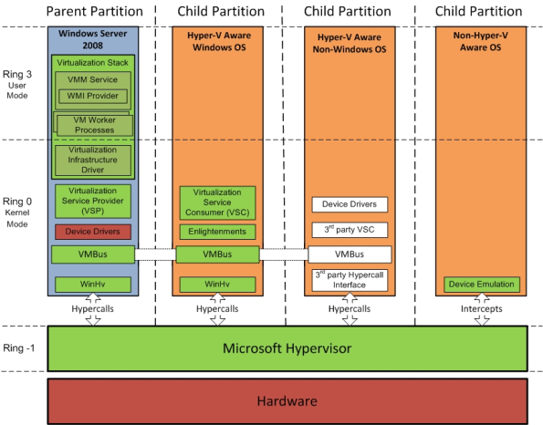
^{<hyper-V>}
The partition is a unit of isolation
It is allocated physical memory address space and virtual processors
The parent owns the hardware and controls operations
Guests run in child partitions
Notes:
WMI is Windows Management Instrumentation an extension to the Windows Driver Model and subset of PowerShell giving access to system monitoring tools and remote administration

Slide 14
^{<hyper-V>}
Component | Description
Virtual Machine Management Service (VMM Service) | Manages the state of virtual machines running in the child partitions
Virtual Machine Worker Process | The Virtual Machine Worker Process manages creating, configuring, running, pausing, resuming, saving, restoring and snapshotting the associated virtual machine.
Virtual Devices | Virtual Devices are managed by the Virtual Motherboard (VMB). Virtual Motherboards are contained within the Virtual Machine Worker Processes,
Virtual Infrastructure Driver | Operates in kernel mode (i.e. in the privileged CPU ring) and provides partition, memory and processor management for the virtual machines running in the child partitions.
Windows Hypervisor Interface Library | Allows the operating system’s drivers to access the hypervisor using standard Windows API calls instead of hypercalls.
VMBus | Part of Hyper-V Integration Services, the VMBus facilitates highly optimized communication between child partitions and the parent partition.
Virtualization Service Providers | Resides in the parent partition and provides synthetic device support via the VMBus to Virtual Service Clients (VSCs) running in child partitions.
Virtualization Service Clients | Virtualization Service Clients fulfil the child partition’s device access requests.

Slide 15
^{<hyper-V>}
The parent partition:
Creates and manages child partitions
Provides an interface for remote management
Manages and assigns devices (except CPU and physical memory)
Shares hardware resources it owns with the child partitions
Handles power management, plug and play and event logging
Supported guest OS
https://docs.microsoft.com/en-us/virtualization/hyper-v-on-windows/about/supported-guest-os

Slide 16
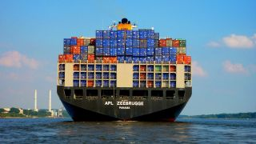
^{<containers>}
OS level virtualisation
Containers provide a way to virtualise an OS so that multiple workloads can run on a single OS instance
Each container shares the host OS kernel and, usually, the binaries and libraries, too. Shared components are read-only.
Containers have to run the same OS as the host

Slide 17
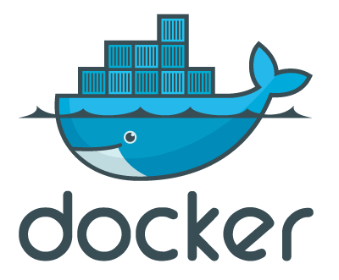
^{<containers>}
Docker is an open platform for developing, shipping, and running applications
Docker packages and runs an application in a loosely isolated environment called a container
Isolation and security allow many containers to run simultaneously on a given host
Containers are lightweight because they don’t need the extra load of a hypervisor (VM image 10-20GB, container 10-20 MB)
Containers can run in VMs
Containers are suited to high load, cloud applications

Slide 18
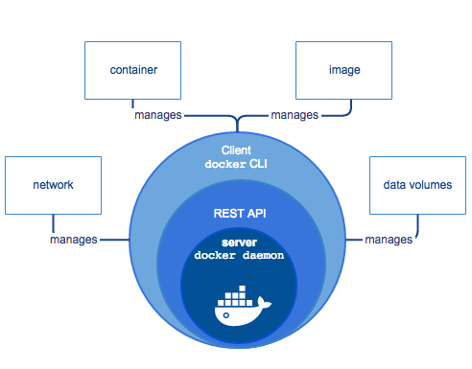
^{<containers>}
An image is a read-only template with instructions for creating a Docker container
A container is a runnable instance of an image
Containers can be created, started, stopped, moved, or deleted using the Docker API or CLI
The REST API is for web services
The daemon carries out the operations

Slide 19
^{<containers>}
Images are held in a registry
A base image, e.g. Ubuntu, can be the starting point for developing the required image
A run command with an image in Docker will:
Create a new container
Allocate a read/write file system to the container
Create a network interface to the default host network and allocate an IP address to the container
Start the container and any specified application in the run command
Start up can be in seconds due to the lightweight container
Notes:
Docker Hub is an opensource registry for holding individual and shared images.

Slide 20
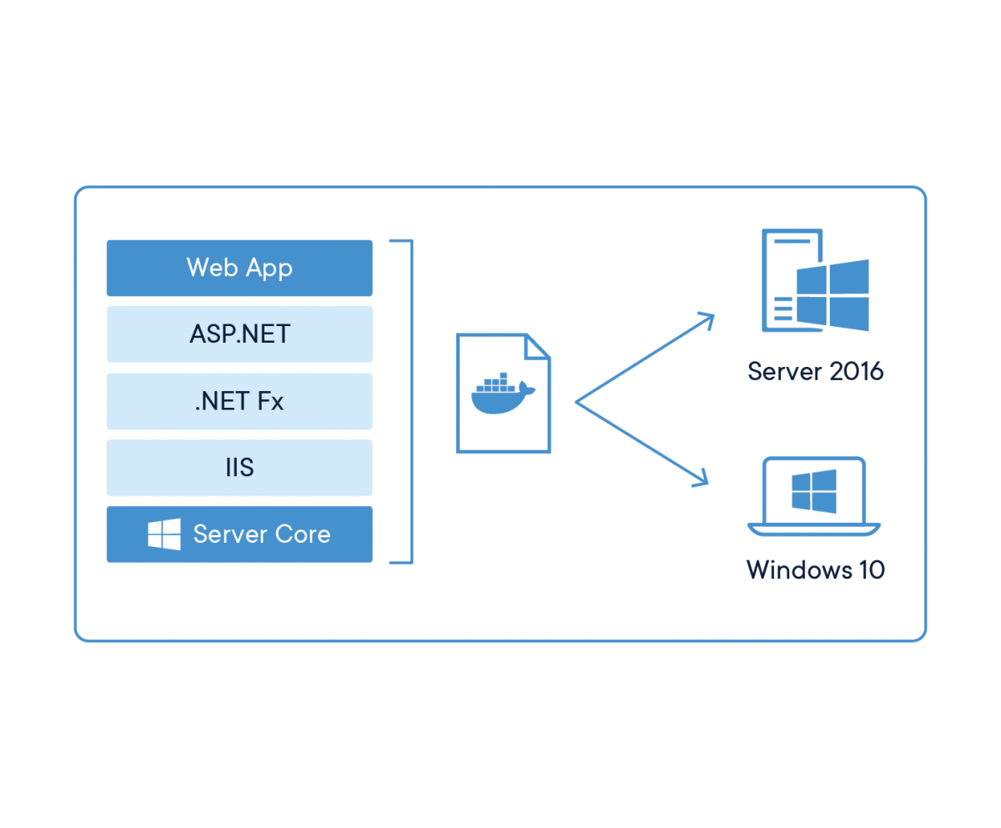
^{<containers>}
Docker and Windows
Windows Server 2016 (and later) comes with Docker Engine – Enterprise
Docker Desktop runs on Windows 10
Uses the same commands and UI in Windows as on Linux environments
Different versions of IIS/.NET can coexist on a single system with container isolation
Complementary with Hyper-V virtualization
Takes advantage of new smaller base images in Windows Server 1709, 1803 and Windows Server 2019:
Windows Server Core
Nano Server

Slide 21
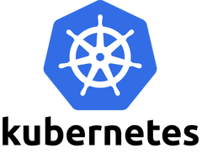
^{<containers>}
Orchestration
In a production environment, the containers that run the applications need to be managed to ensure that there is no downtime
Kubernetes
provides a framework to run distributed systems resiliently. It takes care of scaling and failover for the application
can expose a container using the DNS name or IP address. It is able to load balance and distribute the network traffic so that the deployment is stable.
can automatically create new containers for a deployment, remove existing containers and adopt all their resources to the new container
can automatically fit containers onto hardware nodes to make the best use of resources.
can restart containers that fail, replace containers and kill containers that don't respond to a user-defined health check

Slide 22
^{<comparison>}
Feature | VM | Container
Isolation | Complete | Lightweight
OS | Complete OS | Tailored services
Guests | Any | Same as host
Size | Large | Light
Start up time | Minutes | Seconds
Memory | Uses a lot | Much less than VM
Security | Good | Less secure than VM

Slide 23
^{<summary>}
Two virtualisation architectures
Virtual Machines
Type 1 hypervisor
Type 2 hypervisor
Containers
How they work and what they are suited to

