Slide 1
Teamwork (2.6)

Slide 2
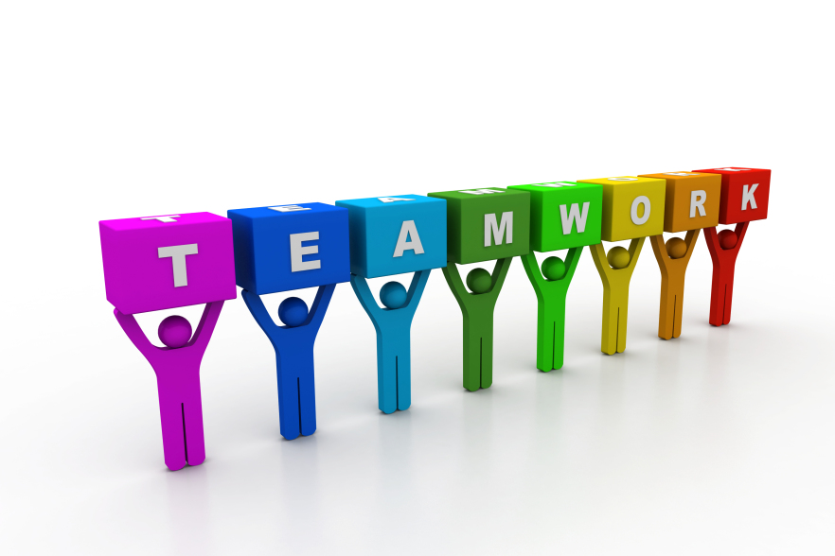
Understand how effective team-working contributes to the effective delivery of software projects
decision making
conflict resolution
collaboration
communication
peer review and retrospectives

Slide 3
Teamwork
The collaborative effort of a team to achieve a common goal or to complete a task in the most effective and efficient way
Open communication to avoid conflicts
Effective coordination to avoid confusion and the overstepping of boundaries
Efficient cooperation to perform the tasks in a timely manner and produce the required results, especially in the form of workload sharing
High levels of interdependence to maintain high levels of trust, risk-taking, and performance

Slide 4
Decision making
Combine points of view, expertise, history
Avoid biased personal idiosyncrasies
Own the decisions
Accountable
Understand risks
Team communication allows members to make concrete decisions

Slide 5
Conflict resolution
Strong, productive teams understand that conflicts can pave the way for innovation
Team members must face conflicts head on in order to resolve and improve
Sharing problems
Honest communication
Trust

Slide 6
Collaboration
Buddy system
Pair of developers
Different experience
Informally review each others work
Between business development, designers, testers and customers
Collaboration tools
Slack – communication
Asana – project management
Agreedo – scrum management

Slide 7
Communication
Clear communication with one another about their
needs
the overall demands of the project
specific work processes
allows team members to be more productive
When team members feel comfortable expressing themselves among their fellow developers, they can be more confident in their introduction of new ideas, concepts and processes

Slide 8
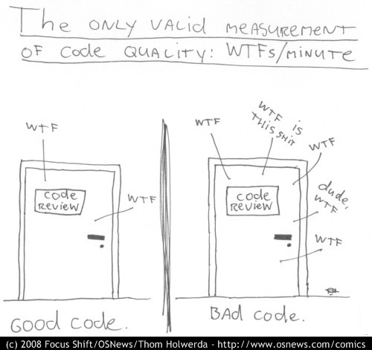
Peer review
“In my Bill Gates review meeting, the whole reporting hierarchy was there, along with their cousins, sisters, and aunts, and a person who came along from my team whose whole job during the meeting was to keep an accurate count of how many times Bill said the F word. The lower the f***-count, the better”
Joel Spolsky, Excel program manager

Slide 9
Peer review
Code and/or documents, examined by its author and one or more colleagues, in order to evaluate its technical content and quality
Light touch – buddy review
More formal – walkthroughs, inspections
Enforced by Apple, Google – but not Microsoft

Slide 10
Retrospective – Agile process
A retrospective meeting is held at the end of every iteration
What should we start doing?
What should we stop doing?
What should we continue to do?
Retrospective meetings are useful to identify the ways of continuous improvement of an Agile team
metrics and velocity of the team
tracking tools
defect density
team dynamics
self-organization
any potential impediments that surfaced during the iteration
Managers and senior management may be barred from entering a retro meeting; the team may not speak up due to inherent fear of management

