Slide 1
3.1 Given a scenario, use appropriate documentation and diagrams to manage the network
Diagram symbols
Standard operating procedures/ work instructions
Logical vs. physical diagrams
Rack diagrams
Change management documentation
Wiring and port locations
IDF/MDF documentation
Labeling
Network configuration and performance baselines
Inventory management

Slide 2
Documentation
What do you have?
Who has it?
What is in it?
Procedures for downtime?
SLA?
What SLA times?
Down periods?

Slide 3
Change Management
What needs to be changed?
Who can authorise the change?
Is it an emergency?
What documentation do you need?
What notice do you give customers?

Slide 4
Network symbols

Slide 5
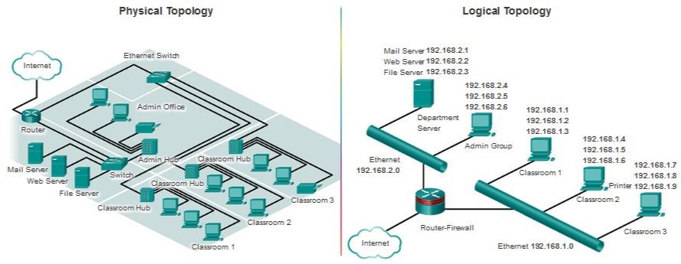
Logical and physical network diagrams

Slide 6
Create a network diagram
You have come in to work on our network and you have no documentation. Why is this bad?
Fix it!
Take our network
Create a physical and logical network diagram of what we have
You have access to the rooms
We can provide insight on what we have in the server/comms rooms
What do you need to know?

Slide 7
3.2 Compare and contrast business continuity and disaster recovery concepts
Availability concepts
Fault tolerance
High availability
Load balancing
NIC teaming
Port aggregation
Clustering
Power management
Battery backups/UPS
Power generators
Dual power supplies
Redundant circuits
Recovery
Cold sites
Warm sites
Hot sites
Backups
Full
Differential
Incremental
Snapshots
MTTR
MTBF
SLA requirements

Slide 8
Availability concepts
Fault Tolerance
What happens if a problem occurs?
What is the cost of a problem?
What is the cost of fault tolerance?
Cold or Hot site
Notes:
Cost of a problem could be less but the bigger impact on image and reputation might be more!
Are there different network paths for data to take?
Might have RAID
Might have 2 servers one main and one redundant
Could be a cold/hot site

Slide 9
Fault Tolerance

Slide 10
Fault Tolerance
Notes:
What happens if the firewall breaks?
We can put in a new one but the cost of being down is never good
What if this breaches your SLA?

Slide 11
High availability network
Notes:
What else could we improve to minimise that down time?
Extra servers?
Extra ISP?
Add a load balancer to maintain throughput
NIC teaming? Help increase throughput and redudnacy

Slide 12
Load Balancers
Network servers are the workhorses of the network
They are relied on to hold and distribute data, maintain backups, secure network communications, and more
The load of servers is often a lot for a single server to maintain. This is where load balancing comes into play
Load balancing is a technique in which the workload is distributed among several servers
This feature can take networks to the next level; it increases network performance, reliability, and availability
Notes:
You may have multiple servers and a load balancer will help distribute that load in case one fails or one is being hit more than the others

Slide 13
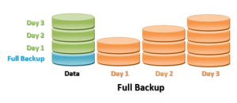
Full backup
All files and folders backed up
Advantages
Fast and easy recovery as complete data is readily available
Files and folders are backed up to one backup set
Easy version control
Disadvantages
More storage space is needed
Additional bandwidth required
Time-consuming if full backup is run all the time

Slide 14
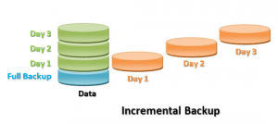
Incremental backup
Backs up all of the files that have changed since the last full or incremental backup was made
Advantages
Fast elapsed time, as there is less data compared to full backups
Less storage space (disk, tape, or network drive) needed
Allows retention of several versions of same files
Disadvantages
Slower recovery, as all increments must be restored
Initial full backup is needed before incremental backups start
A full backup and all incremental backups are needed for recovery
Takes longer to restore a specific file, as you need to search more than one backup set
If one of the backups fails (either the full or incremental), then recovery will be incomplete

Slide 15
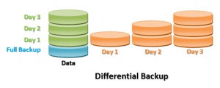
Differential backup
Backs up all of the files that have changed since the last full backup was made
Advantages
Less storage space (disk, tape, or network drive) needed as compared to incremental
Only full backup and the last differential backup needed for restore
Allows retention of several versions of same files
Disadvantages
Slower backups than incremental backups
Initial full backup is needed before differential backups start
A full backup and all differential backups are needed for recovery
If one of the backups fails (either the full or differential), then recovery will be incomplete
Takes longer to restore a specific file, as you need to locate the file on differential or full backup sets

Slide 16
3.3 Explain common scanning, monitoring and patching processes and summarize their expected outputs
Processes
Log reviewing
Port scanning
Vulnerability scanning
Patch management
Rollback
Reviewing baselines
Packet/traffic analysis
Event management
Notifications
Alerts
SIEM
SNMP monitors
MIB
Metrics
Error rate
Utilization
Packet drops
Bandwidth/ throughput

Slide 17
Performance Monitoring
Assess user demand when network infrastructure is installed
Performance monitoring allows the network administrator to determine that resources are being stretched before that point is reached or performance is impacted
Need to set a baseline
When an upgrade or new equipment is implemented, a new baseline is required
Notes:
Assess user demand when network infrastructure is installed
Performance monitoring allows the network administrator to determine that resources are being stretched before that point is reached or performance is impacted
Need to set a baseline
When an upgrade or new equipment is implemented, a new baseline is required

Slide 18
Network Monitoring Utilities
Solarwinds Network Performance monitor
Datadog
Atera
Paessler PRTG network monitor
Nagios Core
Zabbix
Notes:
Solarwinds Network Performance monitor - Far more than just a simple scanner. Most network security issues arise when configurations are changed and SolarWinds NPM identifies these and can automatically resolve many
Datadog – A cloud-based monitoring system for onsite, remote, cloud, or hybrid network resource
Atera - Cloud-based RMM system includes a large range of monitors – server, network device, and application
Paessler PRTG network monitor - Free network monitoring software that uses SNMP, packet sniffing and WMI to monitor your network
Nagios Core - One of the top open-source network monitoring tools. Includes a dashboard view, alerts system, community plugins, and more
Zabbix - Open source network monitoring software with SNMP and IPMP monitoring. Includes an alerts system and community plugins

Slide 19
Monitoring tools
Network analyzer
Interface monitor
Top talkers/listeners
Packet flow monitor
Wireless analyzers
SNMP management software
Logs
Syslog
SIEM
Physical monitoring tools

Slide 20
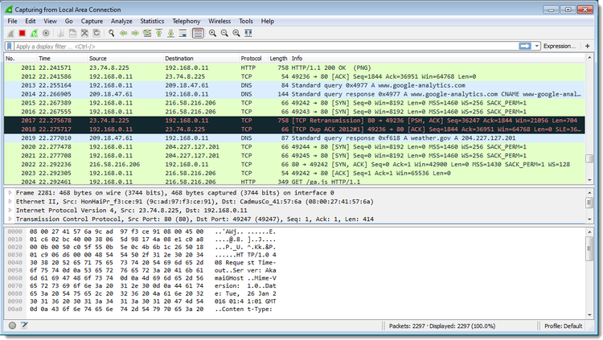
Network analyzers
Network analyzers, by whatever name you use, are one of the most powerful and versatile tools for network monitoring and troubleshooting.

Slide 21
SNMP
Simple Network Management Protocol
Notes:
Generally an SNMP agent and manager will utilize an array of relatively simple commands to communicate with one another, most of which are quite self explanatory – Get, GetNext, Set, GetBulk, Response, Trap, and Inform.
The majority of those are easy to discern the functionality of just at a glance – Get is sent to request a value, and Response provides it.
GetNext does the same but for the next sequential object after the previous Get, rather than having to continually call Get after Get by proper identification number.
The only less obvious ones include Trap, which provide an unsolicited Response, generally to serve as an alert or heads up of an event or threshold, and Inform, which is essentially a response but specific to Traps to assure agents that it has been received, as they will continue sending Traps otherwise.
Traps can be used to essentially trigger polling from the manager to the agent and create a much more smooth SNMP interface setup.

Slide 22
SNMP (Cont.)
SNMP consists of:
Agent
Manager
Object identifier (OID)
Management Information Base (MIB)
There are several types of PDU (Protocol Data Unit), which vary somewhat depending on the protocol version
Get
Set
Inform
Response
Trap
Notes:
Simple Network Management Protocol (SNMP) is an application–layer protocol defined by the Internet Architecture Board (IAB) in RFC1157 for exchanging management information between network devices. It is a part of Transmission Control Protocol ⁄ Internet Protocol (TCP⁄IP) protocol suite.
SNMP is one of the widely accepted protocols to manage and monitor network elements. Most of the professional–grade network elements come with bundled SNMP agent. These agents have to be enabled and configured to communicate with the network monitoring tools or network management system (NMS).
Management Information Base (MIB) is a collection of Information for managing network element. The MIBs comprises of managed objects identified by the name Object Identifier (Object ID or OID).
Each Identifier is unique and denotes specific characteristics of a managed device. When queried for, the return value of each identifier could be different e.g. Text, Number, Counter, etc.
A PDU is a specific block of information transferred over a network. It is often used in reference to the OSI model

Slide 23
SNMP versions
SNMPv1
SNMPv2c
SNMPv3

Slide 24
Syslog
Header
Contains unique identification for the entry, such as a timestamp along with the generating device's hostname or IP address.
Facility
Describes the type of program that generated the message. Syslog servers can be configured to process messages from different facilities differently.
Severity level
Describes the severity of a logged event on a numerical scale so that logs can be filtered by importance.
Message
Contains the name of the application or service which generated the message, as well as the message details themselves.

Slide 25
System logs

Slide 26
System logs (Cont.)
Windows logs
Application
Security
Setup
System
Forwarded Events
Applications and Services logs
Admin
Operational
Analytic
Debug

Slide 27
SIEM
Security Information and Event Management
Aggregation and analyses activity from many different resources across the entire IT infrastructure
Correlation
Alerts
Log retention
Analysis tools
Notes:
Security Information and Event Management (SIEM) is a software solution that aggregates and analyses activity from many different resources across your entire IT infrastructure. SIEM collects security data from network devices, servers, domain controllers, and more
SIEM event correlation is an essential part of any SIEM solution. It aggregates and analyses log data from across your network applications, systems, and devices, making it possible to discover security threats and malicious patterns of behaviours that otherwise go unnoticed and can lead to compromise or data loss.

Slide 28
SIEM Capabilities
Main features
Threat detection
Investigation
Time to respond
Additional features
Basic security monitoring
Advanced threat detection
Forensics & incident response
Log collection
Normalization
Notifications and alerts
Security incident detection
Threat response workflow

Slide 29
SIEM Tools
Splunk
IBM Qradar
LogRhythm

Slide 30
Metrics
Network performance can be affected by a number of different factors
Using a network performance monitoring (NPM) solution, your enterprise can search for these factors
Allows you to understand how they’re affecting your network’s performance
The data the network monitoring solution collects allows the IT team to gain insights into performance metrics as well
Notes:
Network performance can be affected by a number of different factors. Using a network performance monitoring (NPM) solution, your enterprise can search for these factors and understand how they’re hurting your network’s performance. The data your network monitoring solution collects allows your IT team to gain insights into performance metrics as well.

Slide 31
About metrics
Resource use of a host or network device
Interface statistics
Bandwidth used by a specific service, physical link, or wireless channel
Users logged onto a network or service

Slide 32
Performance tracking
Establish a baseline: a measurement of your network's usage patterns under normal operation, which you can then use to plan for later expansion or unusual network demands.
The main goal of performance monitoring is to find and correct the bottlenecks that limit network performance as utilization increases.

Slide 33
Analysing Performance Metrics
Bandwidth usage
Bandwidth is the maximum data transmission rate possible on a network
Throughput
Throughput measures your network’s actual data transmission rate, which can vary wildly through different areas of your network
Latency
Latency is the delay that happens between a node or device requesting data and when that data is finished being delivered
Packet loss
Packet loss examines how many data packets are dropped during data transmissions on your network
Retransmission
When packets are lost, the network needs to retransmit it to complete a data request
Availability
Network availability, also know as uptime, simply measures whether or not the network is currently operational
Connectivity
Connectivity refers to whether or not the connections between the nodes on your network are working properly.
Notes:
Bandwidth usage
Bandwidth is the maximum data transmission rate possible on a network.
Throughput
Throughput measures your network’s actual data transmission rate, which can vary wildly through different areas of your network
Latency
Latency is the delay that happens between a node or device requesting data and when that data is finished being delivered. This delay can happen for a variety of reasons, but whatever the cause, your NPM solution can track any delays and log them
Packet loss
Packet loss examines how many data packets are dropped during data transmissions on your network. The more data packets that are lost, the longer it takes for a data request to be fulfilled
Retransmission
When packets are lost, the network needs to retransmit it to complete a data request. This retransmission rate lets your enterprise know how often packets are being dropped, which is an indication of congestion on your network
Availability
Network availability, also know as uptime, simply measures whether or not the network is currently operational. You can never guarantee 100% availability
Connectivity
Connectivity refers to whether or not the connections between the nodes on your network are working properly. If there is an improper or malfunctioning connection on your network, it can be a major hurdle for your company

Slide 34
Patch Management
The process of managing a network of computers by regularly performing patch deployment to keep computers up to date
Patch management is one of the most important IT tasks in any organization as leaving software and operating systems unpatched puts your organization at risk of serious security breaches
Cybercriminals are looking to exploit any unpatched systems
Manually monitoring and applying security updates is not only difficult but dangerous
Notes:
Patch management is the process that helps acquire, test and install multiple patches (code changes) on existing applications and software tools on a computer, enabling systems to stay updated on existing patches and determining which patches are the appropriate ones. Managing patches thus becomes easy and simple.
Patch management is one of the most important IT tasks in any organization as leaving software and operating systems unpatched puts your organization at risk of serious security breaches. Soon after a security update is released, cybercriminals are already on the move, looking to exploit any unpatched systems. This is why security updates should be deployed in your systems as soon as possible. Manually monitoring and applying these security updates is not only difficult but dangerous; even a slight delay in installing security updates could put your systems in a vulnerable position. Do you feel confident enough to bet on yourself in a race against today's cybercriminal?

Slide 35
Patch Management
Patch management is an area of systems management that involves acquiring, testing, and installing multiple patches (code changes) to an administered computer system
Patch management tasks include maintaining current knowledge of available patches, deciding what patches are appropriate for particular systems, ensuring that patches are installed properly, testing systems after installation, and documenting all associated procedures, such as specific configurations required.
Notes:
Some important points to remember
A patch is an important component of software update and it usually fixes some known bugs. If you need to apply it on a server, where the downtime is critical, it is recommended practice to install the patch on a lab server first. Install it on the production server once you find it satisfactory.

Slide 36
Vulnerability Scanning
Vulnerability scanners are tools that allow us to check and audit devices on our network to see if there are any known weaknesses
Two vulnerability scanners are Nessus and Nmap
Nessus scans for known vulnerabilities and provides account and auditing. It is run on a scheduled scan cycle
Nmap conducts scanning to look for open ports and protocols, services running on ports and OS fingerprinting.
Notes:
Vulnerability scanning is an inspection of the potential points of exploit on a computer or network to identify security holes. A vulnerability scan detects and classifies system weaknesses in computers, networks and communications equipment and predicts the effectiveness of countermeasures.
Vulnerability scans can provide you with a wealth of information about your network security and can give you the information you need to make your network resilient to attacks.

Slide 37
3.4 Given a scenario, use remote access methods
VPN
IPSec
SSL/TLS/DTLS
Site-to-site
Client-to-site
RDP
SSH
VNC
Telnet
HTTPS/management URL
Remote file access
FTP/FTPS
SFTP
TFTP
Out-of-band management
Modem
Console router

Slide 38
3.5 Identify policies and best practices
Privileged user agreement
Password policy
On-boarding/off-boarding procedures
Licensing restrictions
International export controls
Data loss prevention
Remote access policies
Incident response policies
BYOD
AUP
NDA
System life cycle
Asset disposal
Safety procedures and policies

