Slide 1
How code integrates into the wider project (10%, K2)
Understand how code integrates into the wider project.

Slide 2
Software Development (2.1 & 2.2)
Describe the activities undertaken in the following stages of software development:
Feasibility study
Requirements analysis
Design
Code development
Testing
Deployment / implementation

Slide 3
Development lifecycle - waterfall
Feasibility study
Customer (User) requirements
Requirements analysis
Negotiated statement of requirements document
Specification
System specification document
Verification and validation
Design
Design document
Implementation
Programs
Maintenance
Modified programs

Slide 4
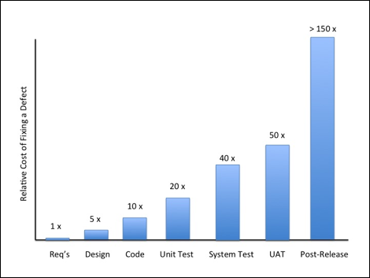
Cost of fixing errors

Slide 5
Feasibility study
Technical Feasibility
evaluation of the hardware, software, and other technology requirements of the proposed system
Economic Feasibility
a cost/ benefits analysis of the project
determines the positive economic benefits of the proposed project
Legal Feasibility
investigates conflicts with legal requirements like data protection acts, or social media laws
Operational Feasibility
can the organisation’s needs can be met by completing the project
Scheduling Feasibility
estimates how much time the project will take to complete

Slide 6
Requirements analysis
Find out where the problem is in an attempt to fix the system
Break down the system into different pieces and draw diagrams to analyse the situation
Analyse project goals
Break down functions that need to be created
Attempt to engage users so that definite requirements can be written

Slide 7
Specification
The set of documentation that describes the requested behaviour of a system
Focuses on what various outside agents (people using the program, computer peripherals, or other computers, for example) might "observe" when interacting with the system.

Slide 8
Design
Functions and operations are described in detail, including:
screen layouts
business rules
process diagrams
documentation
The output of this stage will describe the new system as a collection of modules or subsystems

Slide 9
Implementation
Modular and subsystem programming code written
Individual modules integrated into the main project.
Goals set, targets defined, schedules established, budgets estimated
The software is put into production and is used by the actual business.

Slide 10
Validation and verification
The code is tested at various levels:
Data set testing
Unit testing
System Testing
Integration testing
User acceptance

Slide 11
Deployment
The product or application is:
Released
Moved into production
Transferred to maintenance

Slide 12
Maintenance
The life of the system which includes:
new changes
system updates
decommissioning or sunset of the system

Slide 13
Waterfall problems
People do not know exactly what they want
During implementation things are learnt that invalidate the design
External changes may invalidate previous design decisions
Errors will be made
Burdened by preconceived design ideas
Using software that was developed for some other project

Slide 14
Alternative models
Agile software development
Chaos model
Iterative and incremental development
Rapid application development
Spiral model
System Development Methodology,
V-model

Slide 15
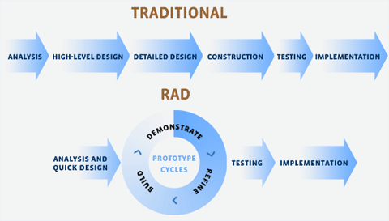
Rapid Application Development - RAD

Slide 16
RAD – requirements planning
Developers, clients (software users), and team members communicate to determine the goals and expectations for the project
They consider current and potential issues that would need to be addressed during the build
Approval obtained from each key stakeholder and developer,
Avoids miscommunications and costly changes later on

Slide 17
RAD – User design
Clients work hand in hand with developers
Users test each prototype of the product, at each stage, to ensure it meets their expectations.
Bugs and flaws are worked out in an iterative process.
The developer designs a prototype,
the client (user) tests it
they communicate on what worked and what didn’t.
Developers tweak the model as they go until they reach a satisfactory design.
Both the software developers and the clients learn from the experience to make sure there is no potential for something to slip through the cracks

Slide 18
RAD – Rapid construction
Take the prototypes and beta systems from the design phase and converts them into the working model
Several small steps:
Preparation for rapid construction
Program and application development
Coding
Unit, integration, and system testing
The software development team of programmers, coders, testers, and developers work together
Ensures the end result satisfies the client’s expectations and objectives (client checks this throughout)

Slide 19
RAD - Cutover
Implementation phase
Data conversion (if applicable)
Testing
Acceptance
Release or phase into production
User training
Any final changes are made while the coders and clients continue to look for bugs in the system

Slide 20
Scrum
Teams of three to nine developers
Work broken into actions called sprints (30 days or less, most commonly two weeks)
Track progress and re-plan in 15-minute stand-up meetings, called daily scrums
Works on the product backlog
List of product requirements
Features, bug fixes, non functional requirements
Ordered in delivery sequence

Slide 21
Scrum roles
Product owner
Represents the customer
Owns the backlog
Communicates status to stakeholders
demonstrates solutions
defines and announces releases;
organizes milestone reviews;
negotiates priorities, scope, funding, and schedule
Developers
analysis, design, development, testing, technical writing

Slide 22
Scrum roles
Scrum master
Ensures the work is well understood so the team can continually make forward progress
Defines “completion” with input from key stakeholders
Coaching the team
Promoting self-organization within the team
Helping the scrum team to avoid or remove impediments to its progress, whether internal or external to the team
Facilitating team events to ensure regular progress

Slide 23
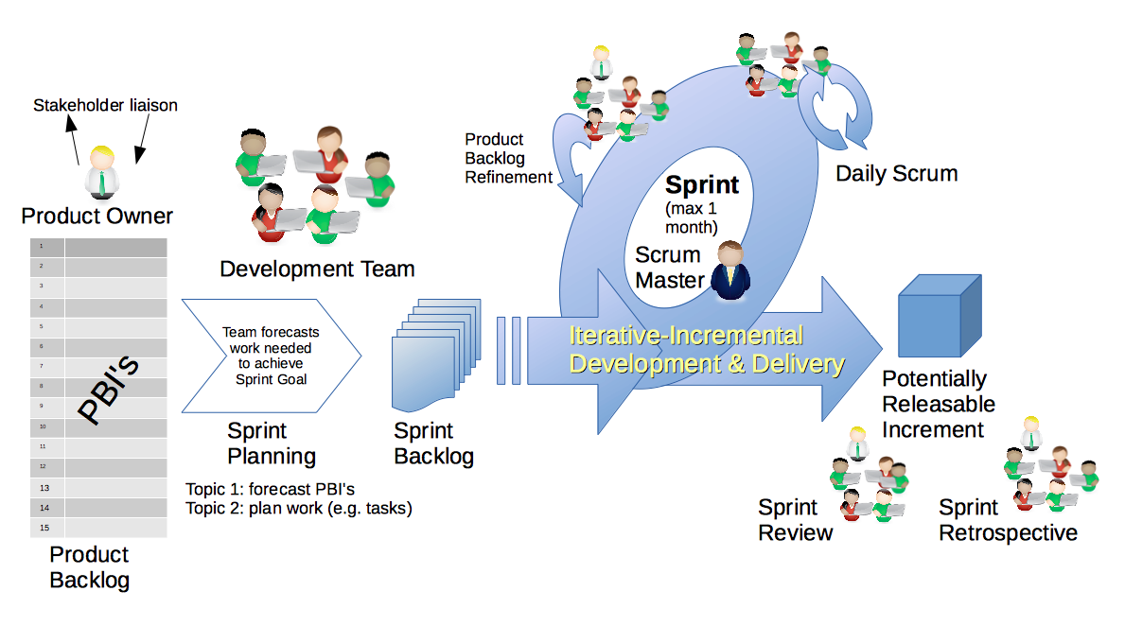
Scrum - workflow

Slide 24
Sprint planning
Mutually discuss and agree on the scope of work that is intended to be done during that sprint
The whole scrum team (development team, scrum master, and product owner) selects the product backlog items they believe could be completed in that sprint
The development team identifies the detailed work (tasks) required to complete those product backlog items
Choose (usually by voting) which tasks will be delivered within the sprint

Slide 25
Daily scrum
Starts precisely on time even if some development team members are missing
should happen at the same time and place every day
is limited to fifteen minutes
Each team member says
What was completed yesterday that contributed to the team meeting its sprint goal?
What is planned to complete today
Are there any impediment that could prevent them or the team from meeting the sprint goal?
Any impediment (e.g., stumbling block, risk, issue, delayed dependency, assumption proved unfounded
Is documented by the scrum master
Is allocated to to an agreed member to working provide a resolution outside of the daily scrum

Slide 26
Sprint review
At the sprint review, the team:
Reviews the work that was completed and the planned work that was not completed
Presents the completed work to the stakeholders (a.k.a. the demo)
The team and the stakeholders collaborate on what to work on next

Slide 27
Coding
Writing the program in one or more programming languages
Finding a sequence of instructions that will automate the performance of a task for solving a given problem
Requires expertise in:
application domains
specialized algorithms
formal logic
Related tasks include testing and debugging

Slide 28
Testing
Unit Testing
Integration Testing
Functional Testing
System Testing
Stress Testing
Performance Testing
Usability Testing
Acceptance Testing
Regression Testing
Beta Testing

Slide 29
Unit testing
Unit testing is the testing of an individual unit or group of related units.
White box testing (knowledge of internals)
Done by the programmer
Tests that the unit is producing expected output against given input

Slide 30
Integration testing
A group of components are combined to produce output
Interaction between software and hardware is tested
It may fall under both white box testing and black box (no knowledge of internal) testing

Slide 31
Functional testing
Ensures that the specified functionality required in the system requirements works
It falls under the class of black box testing

Slide 32
System testing
Ensures that by putting the software in different environments (e.g., Operating Systems) it still works
Done with full system implementation and environment
It falls under the class of black box testing

Slide 33
Stress testing
Evaluates how the system behaves under unfavourable conditions
Testing is conducted at and beyond limits of the specifications
It falls under the class of black box testing.

Slide 34
Performance testing
Assesses the speed and effectiveness of the system
Makes sure it is generating results within a specified time (as in performance requirements)
It falls under the class of black box testing.

Slide 35
Usability testing
Evaluates
how the GUI is user-friendly
how easily can the client learn?
how proficiently can the client perform?
how pleasing is it to use its design?
It falls under the class of black box testing.

Slide 36
Acceptance testing
Done by the customer to ensure that the delivered product
meets the requirements
works as the customer expected
It falls under the class of black box testing.

Slide 37
Regression testing
Regression testing is the testing after modification of a system, component, or a group of related units
Ensures that
the modification is working correctly
is not damaging or imposing other modules to produce unexpected results.
It falls under the class of black box testing.

Slide 38
Beta testing
Beta testing is the testing which is done by
end users
a team outside development
or publicly releasing full pre-version of the product which is known as beta version
The aim of beta testing is to cover unexpected errors
It falls under the class of black box testing.

Slide 39
Test coverage
Test coverage by feature - a test for every feature in the specification
Test coverage by GUI icon. – test for every screen, button, pull-down, tab, menu, etc
Test coverage by instrumentation – run a tool to run pre-prepared tests
Test coverage by structure - exercise parts of the code, eg statements, loops etc
Test coverage by scenario – exercise user work flows
Test coverage by transition – exercise the paths a user may take to achieve a goal

Slide 40
Deployment
Release
Installation and activation
Deactivation
Uninstallation
Update and version tracking
Adaptation

Slide 41
Deployment - release
All the operations to prepare a system for assembly and transfer to the computer system(s) on which it will be run in production
Involves determining the resources required for the system to operate with tolerable performance

Slide 42
Deployment - installation
Simple installer or complex options
Configuration
Test system or production system
Different, simultaneous, versions for cloud services
Different, simultaneous versions for A/B testing

Slide 43
Deployment – deactivation, uninstallation
Graceful shutdown
Decommissioning
Removal of software and dependencies

Slide 44
Deployment – update and version tracking
Replacing all or parts of the system
Update managers
Software catalogues
Application stores

Slide 45
Deployment – adaptation
Modifying the product for a specific customer

Slide 46
Recap
Described the activities undertaken in the following stages of software development:
Feasibility study
Requirements analysis
Design
Code development
Testing
Deployment / implementation

