Slide 1
Coding and Logic - Linux
Infrastructure Technician

Slide 2
Command line
Everything we do with Linux in this module will be in the command line
This is so that you can:
administer non-GUI servers
automate tasks
Start a Linux Distro4 (or install it first) in a VM
Press Ctrl-Alt-F1 to start a console and login
It is a part of the OS that defines how the terminal will behave and look
The shell in use is bash
It can be used for running scripts as well as entering commands
IMPORTANT: Linux is case sensitive!

Slide 3
Directories
Login to the console
You are in your home directory
Type ls
This lists the directories and files in your home directory
Type ls –a
This lists all files, including hidden ones, which start with a . (dot)

Slide 4
Navigation
Type cd Documents
Type pwd (print working directory)
This shows you where you are
/ is the root directory
home is where all users store their personal files
bob is the directory for the user bob’s files
Documents is where all bob’s documents are

Slide 5
Paths
Type ls –a
The . refers to your current directory
The .. refers to the parent directory
Type ls ../../../
This goes back through each parent directory in the path until ls lists the contents of the root directory

Slide 6
Path shortcut
Type cd ../../../
You are now in the root directory
Type cd ~
You are now in your home directory
~ is a short cut for the home directory
Note how the prompt has changed from / for root to ~ for home

Slide 7
Tab completion
Type cd /h TAB KEY
Autocomplete fills in the rest

Slide 8
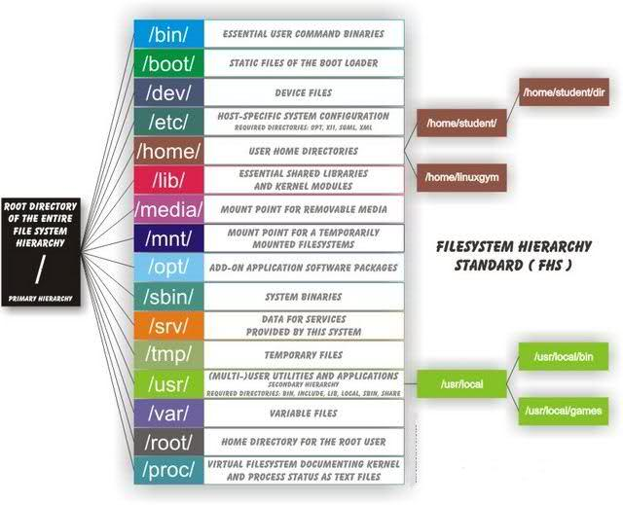
File structure
Go the root directory and list the contents
Linux has a fixed file structure

Slide 9
man pages
Type man ls
You get help pages for the command
Type q to quit
Type clear any time you want to clear the screen

Slide 10
ls options
Type ls –l /
You get a full listing of the root directory
Type ls –alh
Use the man pages to find out what the option h did
Type ls *
You get a full listing of everything (* is a wildcard)
Change directories to boot
Type ls and then ls m*

Slide 11
ls sorting
CD to bin
Type ls –lSh – long list, sorted by size, human readable sizes
Type ls –lSh | more – one page at a time, space bar to advance
Type ls –lShr – reverse order of size
Type ls –lth – long list, sorted by time, human readable sizes
- file
d directory
l link
Permissions – owner, group, world
r read, w write, x execute
file and group owner
file size in bytes
date of last modification
file name
human readable

Slide 12
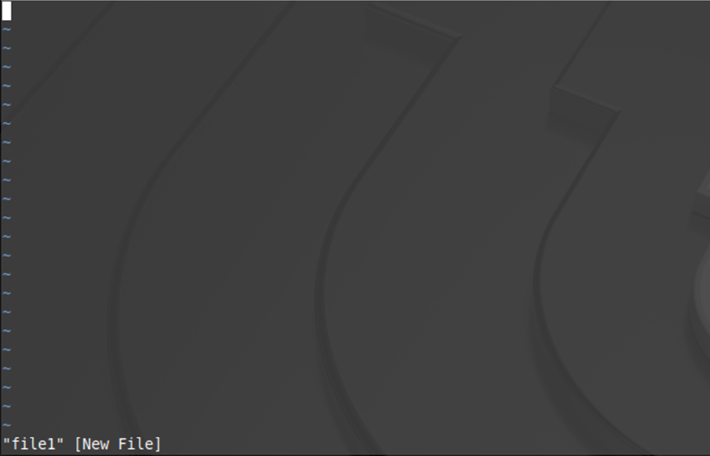
Editing
Change to the Documents directory
Type vi file1
The vim text editor opens in command mode
Try typing – nothing happens
Type i – change to insert mode
Type some lines of text
Press Esc – return to command mode
Type :wq – command to save and exit
Check the file exists ls –al

Slide 13
vi commands
Type vi file1 and experiment with these commands
$ move to end of line
0 move to start of line
A move to end of line and start appending text
ESC key exit insert mode
o insert a line below the current one
O insert a line above the current one
dd delete the current line
x delete a character

Slide 14
File and directory manipulation
In the Documents directory
Type mkdir Examples
cd mkdir Examples
Type touch File2 (creates the file)
Edit File2 and add 22 lines of text
Type head File2 (how many lines are shown)
Type tail File2 (how many lines are shown)
Type cat File2 (how many lines are shown)
Type mv File2 File3 (rename)
Type cp File3 ~/Documents/File4 (copy and rename)
Check that File3 is in Examples, file1 and File4 are in Documents
Type rm File4 (no confirmation required !)
Type rm Examples (Fails)
Type rm –r Examples (deletes directory, subdirectories and all files !)
Caution – there is no Undo, Recycle Bin or Recovery

Slide 15
Create a sample file
In the Documents directory create a Sample file with the following contents:
Fred apples 20
Susy oranges 5
Mark watermelons 12
Robert pears 4
Terry oranges 9
Lisa peaches 7
Susy oranges 12
Mark grapes 39
Anne mangoes 7
Greg pineapples 3
Oliver melons 2
Betty limes 14

Slide 16
Searching a file
Type grep ‘melon’ Sample – search for a string
Type grep –n ‘melon’ Sample – add line numbers
Type grep –c ‘melon’ Sample – count the lines
grep is useful for searching log files
Press Ctrl-Alt-F7
Lock your Linux session
Sign in with a bad password
Sign back in
Press Ctrl-Alt-F1
Type cat /var/log/auth.log
Type grep ‘password check’ /var/log/auth.log

Slide 17
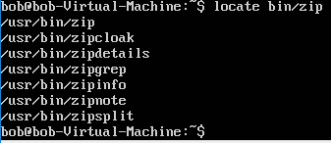
Searching for a file
Type locate bin/zip – find files with zip in their names
Type locate zip – finds all files with zip in their names
Type locate zip | grep bin takes the output of locate zip and pipes it as an input file to grep which then searches and outputs the lines with bin

Slide 18
nano and your first script
A better editor
Type nano
Type #!/bin/bash (a script)
Type echo ‘Hello world!’
Press Ctrl-o
Enter hello_world
Press Ctrl-x
Type ls to verify file saved
Type hello_world
“Command not found”
Type ls –l hello_world
Can you see the problem?

Slide 19
chmod
The file is not executable
chmod (change mode) changes access permissions
We need to make hello_world executable
Type chmod 700 hello_world Type hello_world
“Command not found” !!
Symbolic | Numeric | Meaning
--------- | 000 | No permissions
Rwx------ | 700 | Owner can read, write and execute
Rwxrwx--- | 770 | Owner and group can read, write and execute
Rwxrwxrwx | 777 | All can read, write and execute
R--r—r-- | 444 | All can read
Rw-rw-rw- | 666 | All can read and write

Slide 20
Path
hello-world is not in the search path for executable files
The path need to be explicit
Type ./hello_world
Success

Slide 21
ifconfig and ping (1)
ifconfig details of all network interfaces in operation
ifconfig –a details of all network interfaces
ifconfig eth0 – details of a specific network interface
ping 127.0.0.1 (ctrl-c to halt)
sudo ifconfig lo down – disable local interface (requires superuser)
ping 127.0.0.1 (prove it is down)
sudo ifconfig lo up – enable local interface
ping 127.0.0.1 (prove it is up)

Slide 22
ifconfig and ping (2)
sudo ifconfig lo 192.168.100.1 – change IP address
ping 127.0.0.1 (prove it has gone)
ping 192.168.100.1 (prove it has changed)
sudo ifconfig lo 127.0.0.1
ping 127.0.0.1 (prove it is back)
ping 192.168.100.1 (prove it has gone)

Slide 23
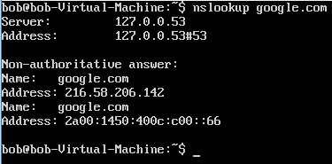
nslookup
Queries internet name servers for information
nslookup google.com
nslookup 134.170.188.200

Slide 24
traceroute
Used to identify the path used by a packet to reach the destination
traceroute google.com
Sends 3 packets to a maximum of 30 hops
* indicates no response from the next node
(probably blocked by a firewall)

Slide 25
Bash script with comparisons and constructs
#!/bin/bash
# test-integer: evaluate the value of an integer.
echo -n "Please enter an integer -> "
read int
if [ -z "$INT" ]; then
echo "INT is empty." >&2
exit 1
fi
if [ "$INT" -eq 0 ]; then
echo "INT is zero."
else
if [ "$INT" -lt 0 ]; then
echo "INT is negative."
else
echo "INT is positive."
fi
if [ $((INT % 2)) -eq 0 ]; then
echo "INT is even."
else
echo "INT is odd."
fi
fi
Comparisons
-z true if length of string is zero
-eq true if value 1 = value 2
-lt true if value 1 less than value 2
Construct
if (a test is true)
then do something
else
do something else
fi (end the construct)

Slide 26
Exercise
Research what if [ $((INT % 2)) -eq 0 ]; is doing Rewrite the script to use –gt and –ne without changing the result

