Slide 1
Unit 51 – Software Design Fundamentals
Unit Overview

Slide 2
After Successfully Completing This Unit You Will:
Understand the principles of software design
Apply the techniques of software designs.

Slide 3
Software Development Life Cycle
Analysis Stage
Design Stage
Implementation Stage
Testing Stage
Maintenance Stage

Slide 4
SDLC
Development of a program forms part of a natural lifecycle. New solutions are designed due to:
A system failing
Users needs change over time

Slide 5
Analysis Stage
Analyse the existing system
Determine the scope of the problem
What are the boundaries of the problem? (Scope). It is important to note what is and also what is not covered by the program, and who is affected by it
Understanding all of these elements combined help understand the nature of the program
Gather requirements
What is wanted from the program off your stakeholders, so that it can specify what the program is going to do (looking at the functional requirements)
A high number of commercial solutions fail because not enough research is done in this stage
They are often collected describing individually how each task is going to be achieved

Slide 6
Analysis Stage
Writing the specification
Make a list of all the elements which cover:
Inputs and outputs
Processing
Storage
User interface
Constraints

Slide 7
Design Stage
Solution is built using suitable design tools (it shows a set of procedures)
pseudocode and
flow diagrams
Can be paper or electronic
Without correct planning and design a lot of time is wasted from mistakes made!
No language has been decided here

Slide 8
Implementation Stage
This is where the coding is done
A language and paradigm is chosen
OOP
Procedural
Event Driven
Can be done in small bite size chunks given to different team members

Slide 9
Testing Stage
All testing is carried out
Two types of testing:
White box
Standard and extreme testing
Black box

Slide 10
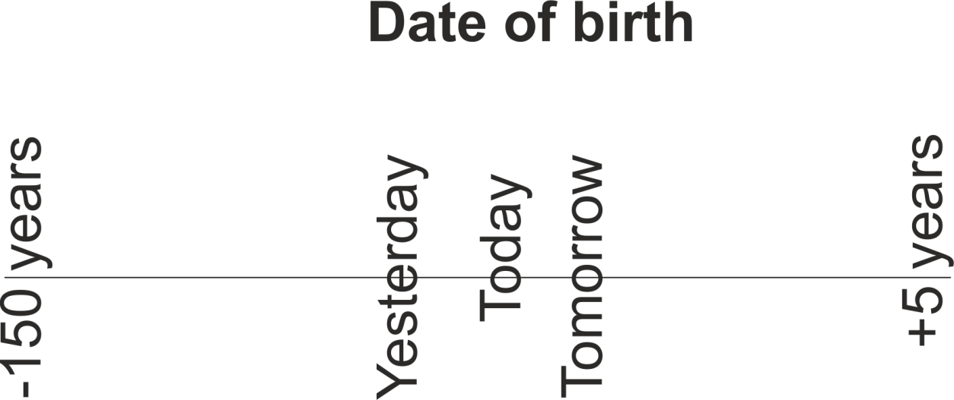
White Box
Every eventuality is tested

Slide 11
Black Box
Don’t care how it works as long as we get the desired result
Similar to microwave oven

Slide 12
Testing (Continued)
Black Box testing
Does it meet the list of its functional requirements?
Does it do what it is supposed to do?
e.g. Area = height * width
White Box Testing
Examines the performance of the code AFTER the functionality is working
Is there a better way to do the task?
Does it allow for flexibility?
Is it robust?
Is the use of language clear for the end user?
Is the solution displayed in a logical order?
ALL Boundaries should be tested thoroughly….

Slide 13
Maintenance Stage
Includes Documentation
There are three types of documentation
Internal documentation
Technical documentation
User documentation
Review and maintain
Reviewing is reflective by comparing this to the original stakeholder requirements – does it do what you want it to do, how well does it work?
Maintenance is ongoing, fixing minor errors as they occur and making small adjustments as you feel they are necessary, adding extra features and extra functionality

Slide 14
Methodologies
Waterfall
Spiral
Agile
RAD
CASE tools

Slide 15
Waterfall
Requirements
Design
Implementation
Testing
Maintenance

Slide 16
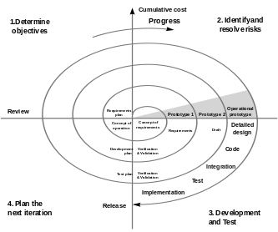
Spiral
Used for large projects

Slide 17
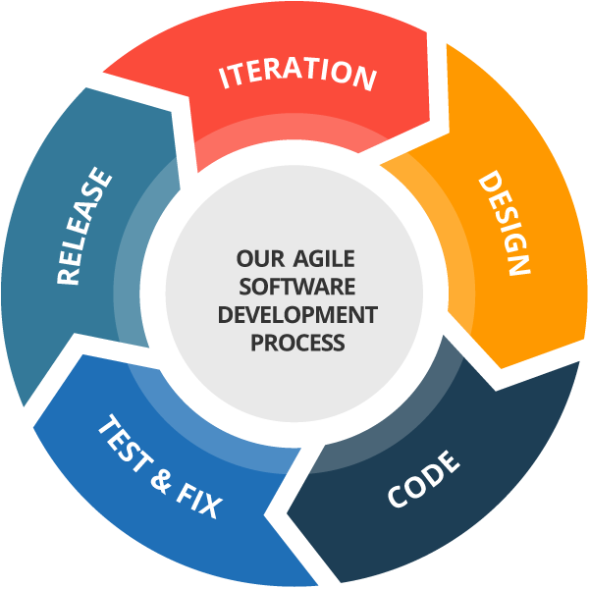
Agile

Slide 18
RAD
Design
Develop
Evaluate
Specify
Implement

Slide 19
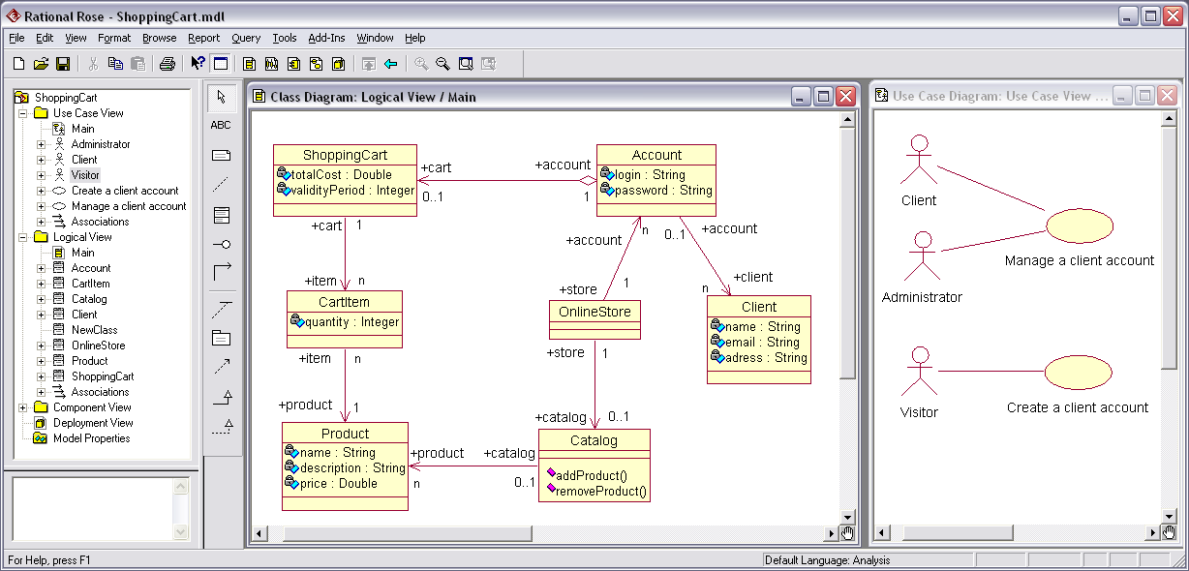
CASE Tools
Computer Aided Software Engineering
CASE tools are used for developing high-quality, defect-free, and maintainable software
Rational Rose

