Slide 1
SQL Basics
BCS Programming

Slide 2
SQL Database Tables
This tutorial uses a MySql database which you need to create in your hosting area.
To do this we need to use phpMyAdmin.
PHPMyAdmin is accessed using a browser on the client by using the url given to you.
Demo PHPMyAdmin

Slide 3
PHPMyAdmin
This program is a user friendly interface to an SQL database
It allows you to create, populate and test databases
The SQL database resides on the server
PHPMyAdmin (the client) is accessed using a browser on the local machine

Slide 4
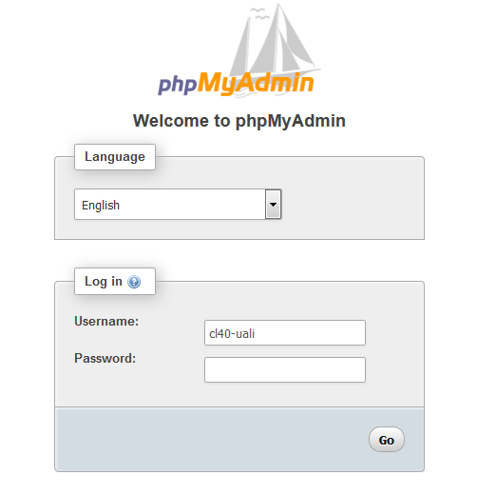
PHPMyAdmin login
The user name and password were given to you

Slide 5
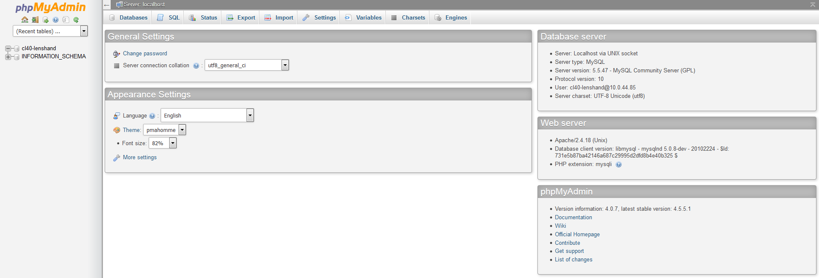
PHPMyAdmin home screen
Database list

Slide 6
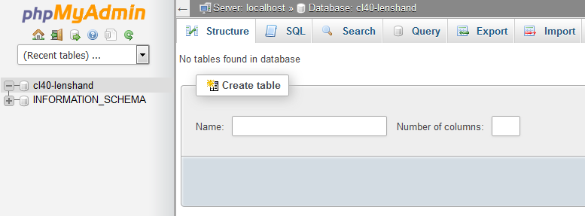
SQL Database Tables
Your database exists but with no tables..

Slide 7
SQL Database Tables
Now you will need to create some tables.
For this we are going to use the file that contains SQL for both table creation and sample data.
It contains 3 tables called books, borrower and loans.
You need to download this file from the wiki
It is called library_sql.doc
Open it in Notepad
Copy the SQL into the SQL window in PHPMyAdmin

Slide 8
SQL Query
Click the SQL tab to get the entry screen
Type SQL here
Press Go to run the query

Slide 9
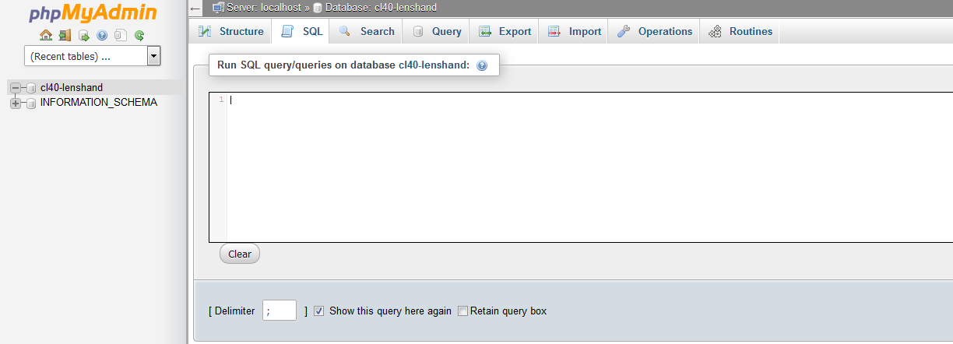
SQL Database Tables
Still in phpMyAdmin choose the SQL tab.

Slide 10
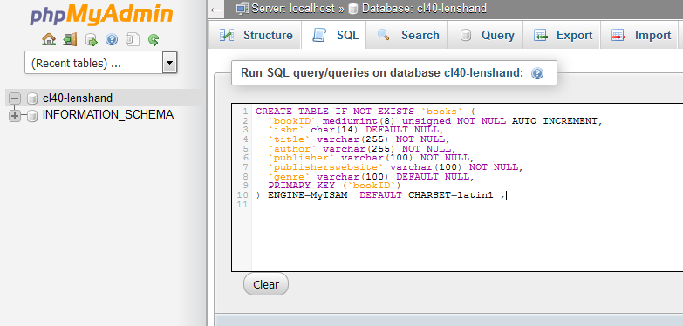
SQL Database Tables
This should be what you get.
Click on Go

Slide 11
Creating Tables and Populating the Tables
Continue to add all the sections

Slide 12
Database screen
Click on your database
Tables
Browse
Structure

Slide 13
Structure
Click on the structure button

Slide 14
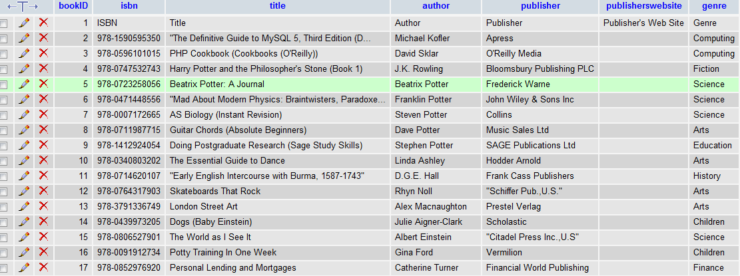
Content
Click on the browse button

Slide 15
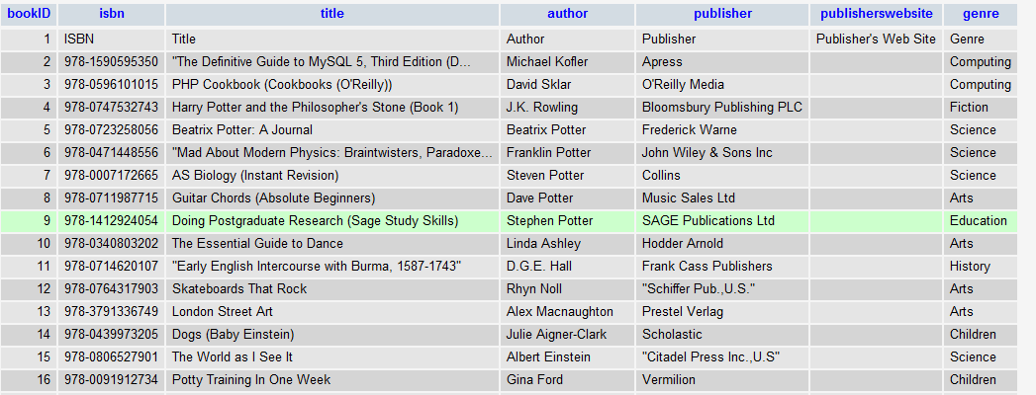
SQL Queries
With SQL, we can query a database and have a result set returned.
SELECT * FROM books

Slide 16
Edit a query
To edit a query press Edit
This opens a separate window

Slide 17
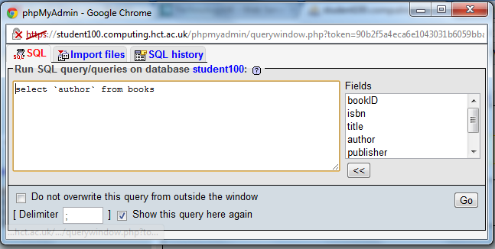
Query window

Slide 18
The SQL SELECT Statement
The SELECT statement is used to select data from a table. The tabular result is stored in a result table (called the result-set).
Syntax
SELECT column_name(s) FROM table_name
Note: SQL statements are not case sensitive. SELECT is the same as select.

Slide 19
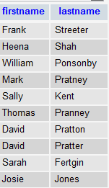
SQL SELECT Example
To select the content of columns named “lastname" and “firstname", from the database table called “borrower", use a SELECT statement like this:
SELECT lastname, firstname FROM borrower

Slide 20
The SELECT DISTINCT Statement
The DISTINCT keyword is used to return only distinct (different) values.
The SELECT statement returns information from table columns. But what if we only want to select distinct elements?
With SQL, all we need to do is to add a DISTINCT keyword to the SELECT statement:
Syntax
SELECT DISTINCT column_name(s) FROM table_name

Slide 21
Using the DISTINCT keyword
To select ALL values from the column named “address2" we use a SELECT statement
SELECT address2 FROM borrower
Note that “Molden and “Highcliffe" are listed more than once.
To select only DIFFERENT values from the column named “address2" we use a SELECT DISTINCT statement SELECT DISTINCT address2 FROM borrower

Slide 22
The WHERE Clause
To conditionally select data from a table, a WHERE clause can be added to the SELECT statement.
Syntax
SELECT column FROM table WHERE column operator value

Slide 23
Using the WHERE Clause
To select only the persons living in the city “Perth", we add a WHERE clause to the SELECT statement:
SELECT lastname FROM borrower WHERE address2 = "Perth"

Slide 24
Using Quotes
Note that we have used single quotes around the conditional values in the examples.
SQL uses single quotes around text values (most database systems will also accept double quotes). Numeric values should not be enclosed in quotes.
For text values:
This is correct: SELECT lastname FROM borrower WHERE firstname=‘Frank‘
This is wrong: SELECT lastname FROM borrower WHERE firstname=Frank

Slide 25
The LIKE Condition
The LIKE condition is used to specify a search for a pattern in a column.
Syntax
SELECT column FROM table WHERE column LIKE pattern
A "%" sign can be used to define wildcards (missing letters in the pattern) both before and after the pattern.

Slide 26
Using LIKE
SELECT firstname, postcode FROM borrower WHERE firstname LIKE "f%“
SELECT lastname, postcode FROM borrower WHERE lastname LIKE "%r
SELECT lastname, postcode FROM borrower WHERE lastname LIKE "%v%"

Slide 27
The INSERT INTO Statement
The INSERT INTO statement is used to insert new rows into a table.
Syntax
INSERT INTO table_name VALUES (value1, value2,....)
You can also specify the columns for which you want to insert data:
INSERT INTO table_name (column1, column2,...) VALUES (value1, value2,....)

Slide 28
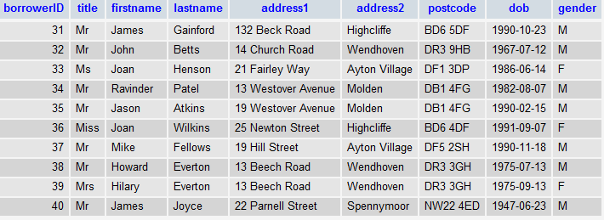
Insert a New Row
INSERT INTO borrower VALUES (40, "Mr", "James", "Joyce", "22 Parnell Street", "Spennymoor", "NW22 4ED", "1947-06-23", "M")

Slide 29
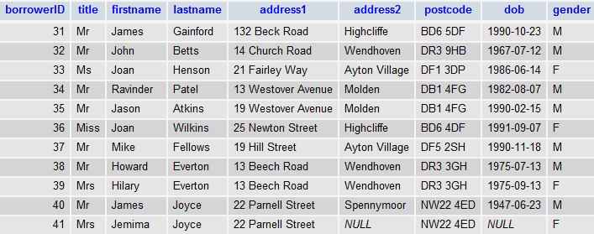
Insert Data in Specified Columns
INSERT INTO borrower (borrowerid, title, firstname, lastname, address1, postcode, gender) VALUES(41, "Mrs", "Jemima", "Joyce", "22 Parnell Street", "NW22 4ED", "F")
Note that where a value was not entered, the returned value is NULL

Slide 30
The Update Statement
The UPDATE statement is used to modify the data in a table.
Syntax
UPDATE table_name SET column_name = new_value WHERE column_name = some_value

Slide 31
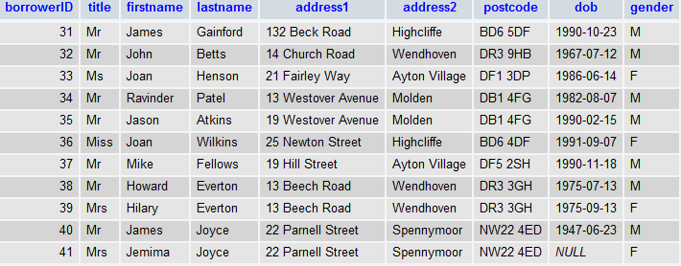
Update one row
UPDATE borrower SET address2 = "Spennymoor" WHERE borrowerid = 41

Slide 32
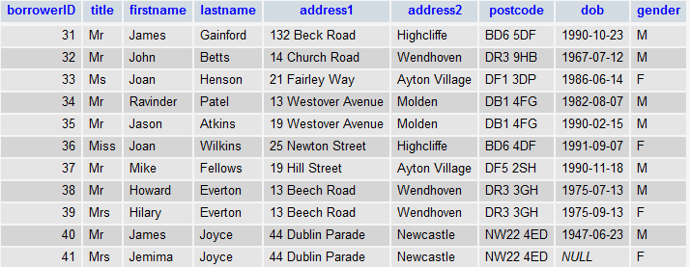
Update several Columns in a Row
UPDATE borrower SET address1 = "44 Dublin Parade", address2 = "Newcastle" WHERE postcode = "NW22 4ED"

Slide 33
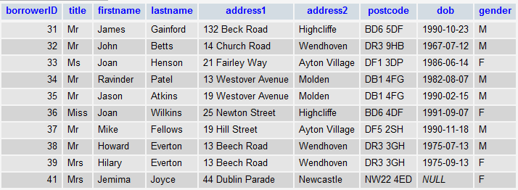
The DELETE Statement
The DELETE statement is used to delete rows in a table.
DELETE FROM borrower WHERE borrowerID = 40
Delete All Rows
It is possible to delete all rows in a table without deleting the table. This means that the table structure, attributes, and indexes will be intact:
DELETE FROM table_name Please take care here! Do not run this one!!!
Or DELETE * FROM table_name

Slide 34
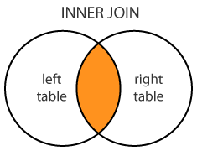
SQL JOIN
An SQL JOIN combines records from two tables
INNER JOIN: Select records that have matching values in both tables
SELECT column-names
FROM table-name1 INNER JOIN table-name2
ON column-name1 = column-name2
WHERE condition

Slide 35
Exercise
Recreate the Access database in MySQL
Demonstrate an SQL statement that lists the owners, their dogs and their breed (using all three tables)

