Slide 1
Cyber Technician
Level 3

Slide 2
Networks

Slide 3
Network security
The ubiquity of the Internet allows us to connect all sorts of devices to the network and gain unprecedented access to a whole range of applications and services anytime, anywhere.
However, our heavy reliance on networking technology also makes it an attractive target for malicious users who are willing to compromise the security of our communications and/or cause disruption to services that are critical for our day-to-day survival in a connected world.
An understanding of basic networking protocol stack and TCP/IP suite is assumed.
Cybok 1.0

Slide 4
Network threats
Eavesdropping
Man in the middle
Denial of service
IP spoofing
DNS spoofing
Router hijacking
Switch poisoning
MAC spoofing
ARP spoofing
VLAN hopping

Slide 5
No Connection
Single user
No connection
Very secure

Slide 6
Connection
Two users
Network interface cards (NICs)
Crossover cable, fibre or wireless
Full duplex
Transmit and receive at the same time
OSI layer 1 – Physical
Transmission of bits
100010100101010

Slide 7
OSI model
Open Systems Interconnection Reference Model
Mnemonic
Please Do Not Throw Sausage Pizza Away
Please Do Not Touch Steve’s Pet Alligator
Layer 7
Application
Layer 6
Presentation
Layer 5
Session
Layer 4
Transport
Layer 3
Network
Layer 2
Data Link
Layer 1
Physical
Signalling, cabling, connectors
(Cable, NIC, Repeaters)
Notes:
We will come back to this.

Slide 8
MAC (Media Access Control) Addressing
Uniquely identifies a network interface controller (NIC)
MAC addresses are used as a network address for Ethernet and Wi-Fi
Addresses are assigned by the manufacturer and stored in the NIC’s read-only memory or firmware
It is a 48-bit address for 281,474,976,710,656 possible MAC addresses (normally shown as 6 octets) ether 4a:00:02:00:ca:e0 (from ifconfig)
ipconfig or ifconfig commands show the MAC address

Slide 9
MAC (Media Access Control) Addressing
ipconfig (Windows command line)
ifconfig (OSX Terminal) command
On Chromebook press CTRL + ALT + T in the browser to open a terminal tab. You may need sudo ifconfig

Slide 10
Packets and frames
A MAC address allows data to be directed to a specific device
The data segment is called a frame
Preamble | Start of frame delimiter | Destination | Source | Length | Data | CRC
Timing |  | MAC Addressing |  | Amount of data | Payload | Checksum
7 bytes | 1 byte | 6 bytes | 6 bytes | 2 bytes | 46-1500 bytes | 4 bytes
FRAME

Slide 11
Switch
Two or more users
A single network segment
Straight cables
OSI layer 2 – Data Link
Transmission of packets
Switch
Amplifies signal
Directs inputs to correct outputs
Full duplex
Best performance
Error checking
101001
111011
101001
111011

Slide 12
OSI model
Layer 7
Application
Layer 6
Presentation
Layer 5
Session
Layer 4
Transport
Layer 3
Network
The switching layer
(Frame, MAC address, EUI-48, EUI-64, Switch)
Layer 2
Data Link
Layer 1
Physical
Notes:
We will come back to this.

Slide 13
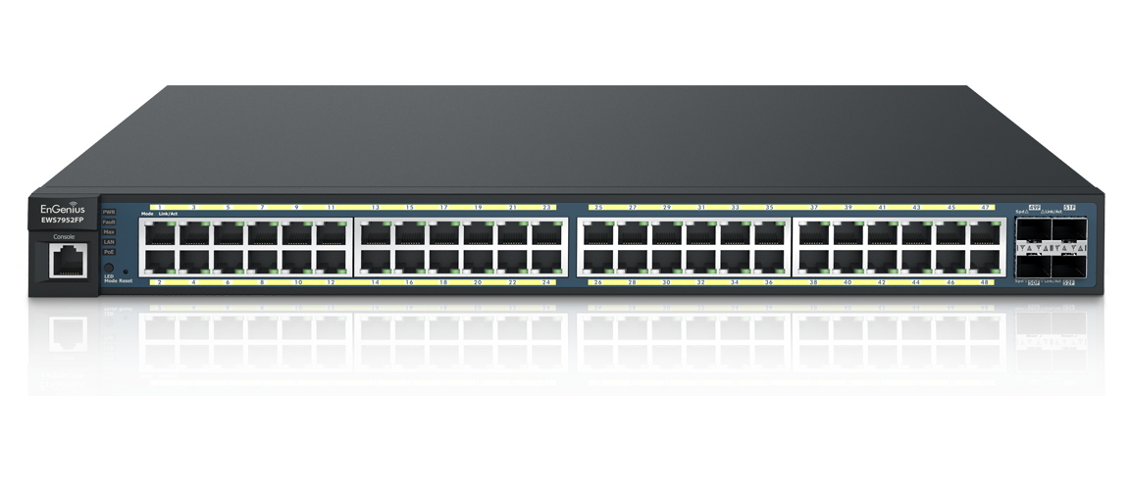
Switch operation
Works on the Layer 2 Header
Uses the source and destination MAC addresses to make its forwarding decisions.
MAC Address Table
maps the switch’s ports to MAC addresses
the source address and the port a frame was received on are entered in the MAC Address Table.
as each connected device sends a frame the table gets fully populated
the table is then used to forward frames to their intended destination

Slide 14
Local Area Network
When the area covered is small, such as an office, this is known as a Local Area Network (LAN)
Devices connected to the switches are called Hosts
The hosts are typically clients, servers or LAN attached peripherals, such as printers
A LAN can be wired or wireless
Switches can be cascaded to increase the number of hosts

Slide 15
Increasing the number of hosts
Adding switches is inefficient (inactive hosts are flushed from the MAC address table after 300s)
Adding hosts makes larger broadcast domains
Adding hosts means increased processing loads
The solution is to create additional physical networks

Slide 16
IP addresses
A MAC address is physical, it allows packets to be delivered from one NIC to another (hop to hop)
IP addresses are logical and allow delivery of packets across networks (from end to end)
IP addresses work at OSI layer 3 – Network
An address is a 32 bit binary number represented as 4 octets
E.g. 192.168.1.123 (IP v4)
Destination and source IP addresses are added to the data payload of the ethernet packet

Slide 17
OSI model
Layer 7
Application
Layer 6
Presentation
Layer 5
Session
Layer 4
Transport
Layer 3
Network
The routing layer
(IP address, router, packet)
Layer 2
Data Link
Layer 1
Physical
Notes:
We will come back to this.

Slide 18
Packets with IP addresses
Preamble | Start of frame delimiter | Destination | Source | Length | Data | CRC
Timing |  | MAC Addressing |  | Amount of data | Payload | Checksum
7 bytes | 1 byte | 6 bytes | 6 bytes | 2 bytes | 46-1500 bytes | 4 bytes
PACKET
Source IP address | Destination IP address
4 bytes | 4 bytes

Slide 19
Two networks
192.168.1.9
X
R1 NIC
R2 NIC
A
Router
B
192.168.1.12
192.168.2.7
Source MAC | Destination MAC | Source IP | Destination IP
Host A | Router R1 | 192.168.1.12 | 192.168.2.7
Source MAC | Destination MAC | Source IP | Destination IP
Router R2 | Host B | 192.168.1.12 | 192.168.2.7

Slide 20
ARP Address Resolution Protocol
Used to find the MAC address for a given IP
Host A (192.168.1.12) needs to send to Host B (192.168.2.7)
It knows 192.168.2.7 is in a different network
It has a default gateway of 192.168.1.1 (the router)
It sends a broadcast ARP message (MAC ff:ff:ff:ff:ff:ff) for 192.168.1.1 (this goes to all hosts on the network)
Only the router replies with its Mac and IP addresses
Host A updates its ARP table
Sends packet to 192.168.2.7 with router MAC address

Slide 21
ARP table

Slide 22
Router Table In Host A (192.168.1.12)
Contains a 0.0.0.0 entry which points to the default gateway 192.168.1.1
Contains other IP addresses on its own network and the address of its own NIC
If sending to Host X it will look in the table and send directly
If sending to Host B (192.168.2.7) will find 0.0.0.0 as the closest match in the table and send to the gateway
Network Destination | Gateway | Interface | Notes
0.0.0.0 | 192.168.1.1 | 192.168.1.12
127.0.0.1 | On-Link | 127.0.0.1 | Loopback
192.168.1.9 | On-Link | 192.168.1.12 | Host X

Slide 23
Router’s Table
Contains a list of IP addresses and interfaces
If sending to 192.168.1.n will forward via R1 NIC
If sending to 192.168.2.n will forward via R2 NIC /24 refers indirectly to the number of hosts on the network and is covered in subnetting
IP address | Interface
192.168.1.0/24 | R1 NIC
192.168.2.0/24 | R2 NIC

Slide 24
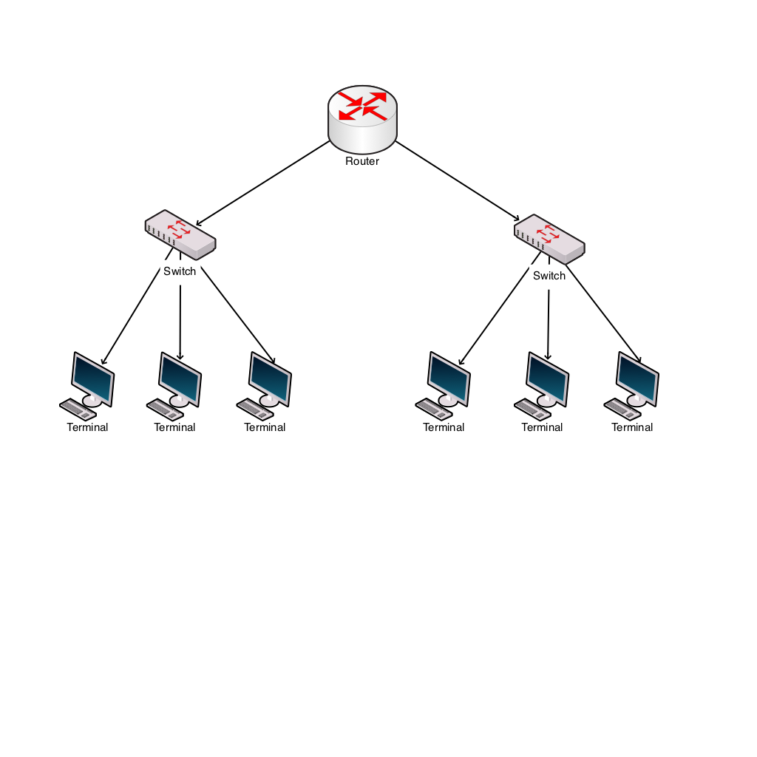
Windows Network Utilities
Ping
Tests connectivity
ping 192.168.2.7
ARP
Shows MAC addresses for IP addresses

Slide 25
IP addresses
IP address classes
Class D is used for multicast (224-239)
Class E is experimental (240-255)
One class A address is worth 16M hosts
Therefore a way is needed to allocate significantly more hosts than are available
Address class | First octet range | Number of hosts
A | 1-126 | 16M
B | 128-191 | 64k
C | 192-223 | 254

Slide 26
Private IP addresses
Address ranges allocated as private, therefore not permissible onto the general internet.
So, an organisation can have one outward facing IP address and up to 16M hosts inside
This is done using network address translation (explained later)
Address range | Number of hosts
10.0.0.0 – 10.255.255.255 | 16M
172.16.0.0 – 172.31.255.255 | 1M
192.168.0.0 – 192.168.255.255 | 64K

Slide 27
Setting IP addresses
Assume a small system with 192.168.1.n addresses
Static addresses are set on the device
Dynamic addresses are leased by a DHCP server
IP address | Host | Type
192.168.1.1 | Router | Static
192.168.1.10 | Server | Static
192.168.1.20 | Printer | Static
192.168.1.100 - 200 | Desktops | Dynamic

Slide 28
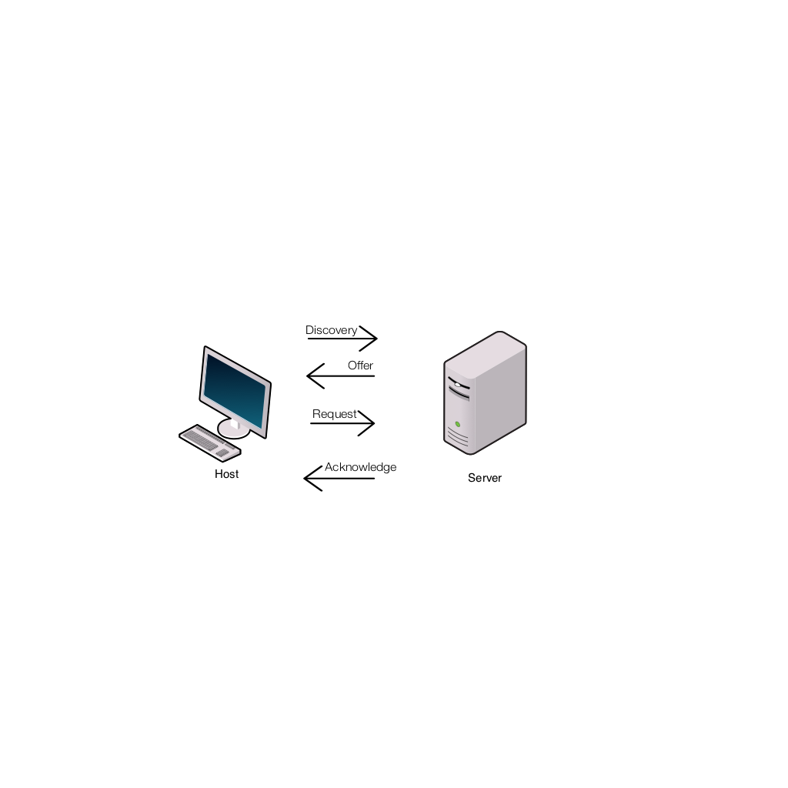
DHCP Dynamic Host Configuration Protocol
Host sends a discovery request (255.255.255.255) for a DHCP server
Server responds with a lease offer of an IP address, gateway address, duration and DNS server address (see later for DNS)
Host responds with a request to accept the offered lease
Server acknowledges the request
Host configures its network interface with the agreed parameters

Slide 29
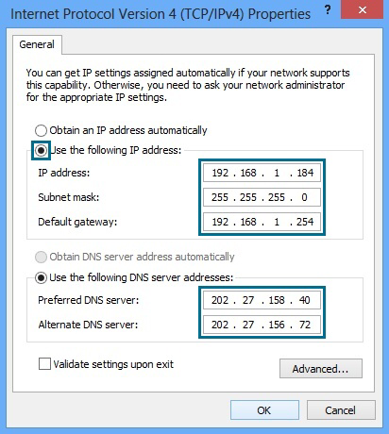
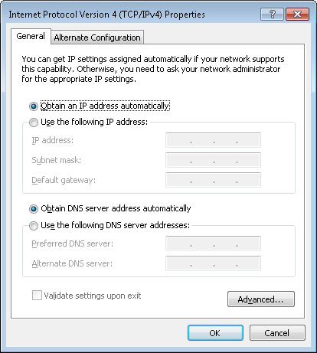
DHCP Windows Configuration
Static Dynamic

Slide 30
Recap
Hosts have MAC and IP addresses
They can communicate in the same network using switches and MAC addressing
To communicate between networks they use routers and IP addresses
Private IP addresses allow duplicate usage in different organisations, but are not allowed on the internet
IP addresses can be manually configured or obtained by DHCP

Slide 31
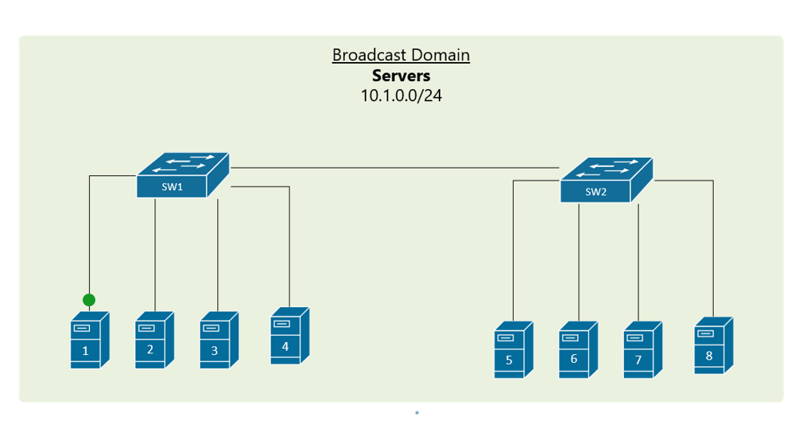
Broadcast domains
If two switches are connected, they form 1 broadcast domain
As you add switches the domain gets larger and inefficient

Slide 32
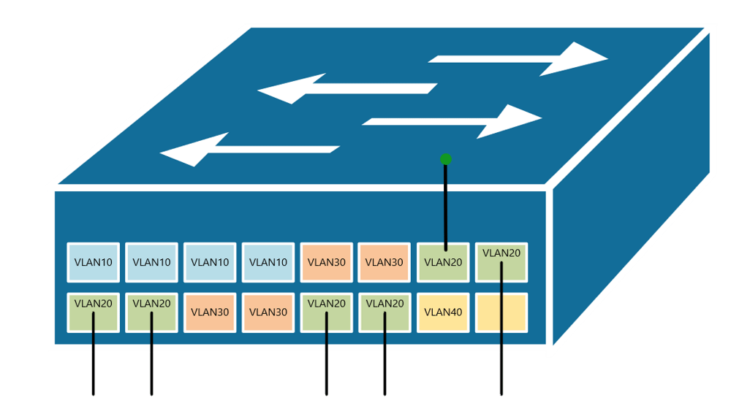
VLAN
A single switch can act as 2 logical switches
Done on a port-by-port basis

Slide 33
Advantages of VLANs
It improves the security by reducing the number of end-stations that receive copies of BUM (broadcast, unicast, multicast) traffic
It creates smaller fault domains by isolating different groups of devices in separate broadcast domains
It reduces the CPU overhead on each device in the LAN by limiting the number of broadcast frames received
It improves network performance and speed of failure recovery
It allows separation of organisation’s departments
It allows logical reconfiguration when users move workstations

Slide 34
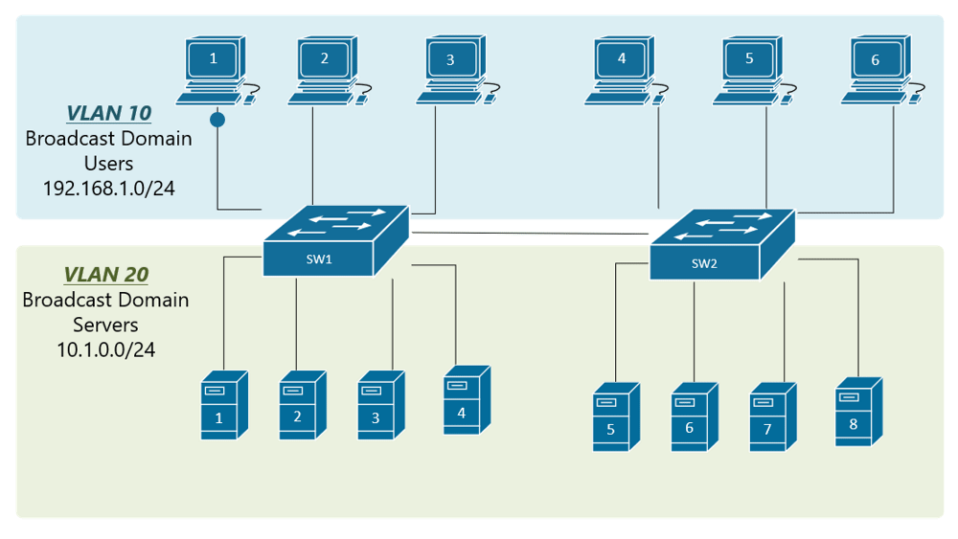
VLAN trunking
Allows 1 connection between switches for several VLANs

Slide 35
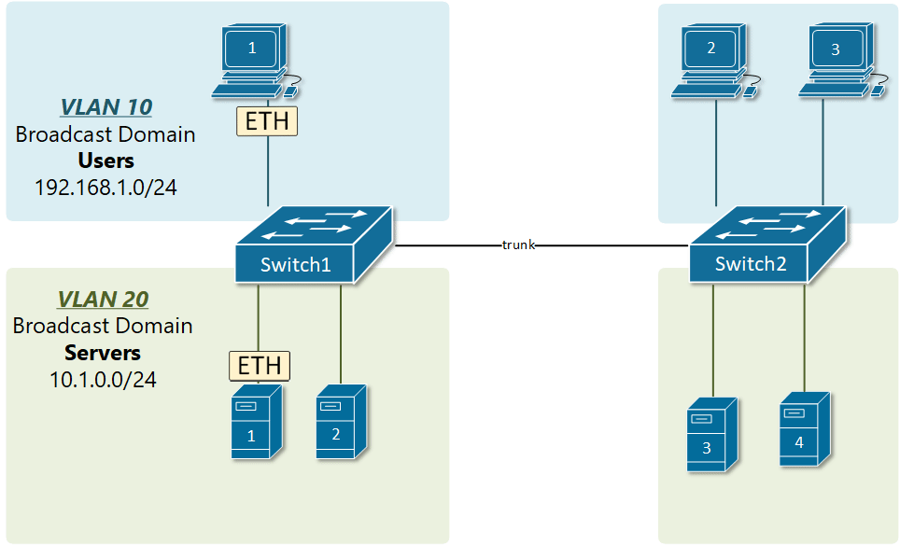
VLAN tagging
Adds a VLAN ID to an ethernet frame so that a receiving switch knows which VLAN the frame is intended for

Slide 36
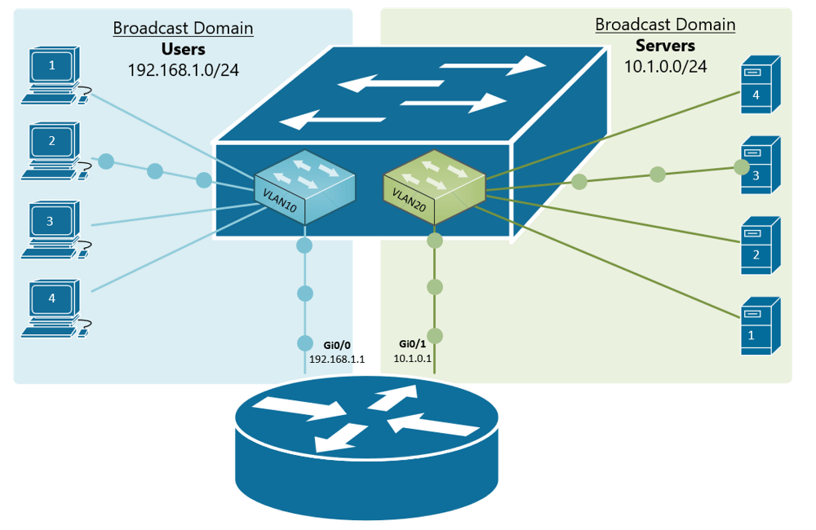
VLAN inter communication
How does 1 VLAN communicate with another?
You could use a router, but what is the issue with this?

Slide 37
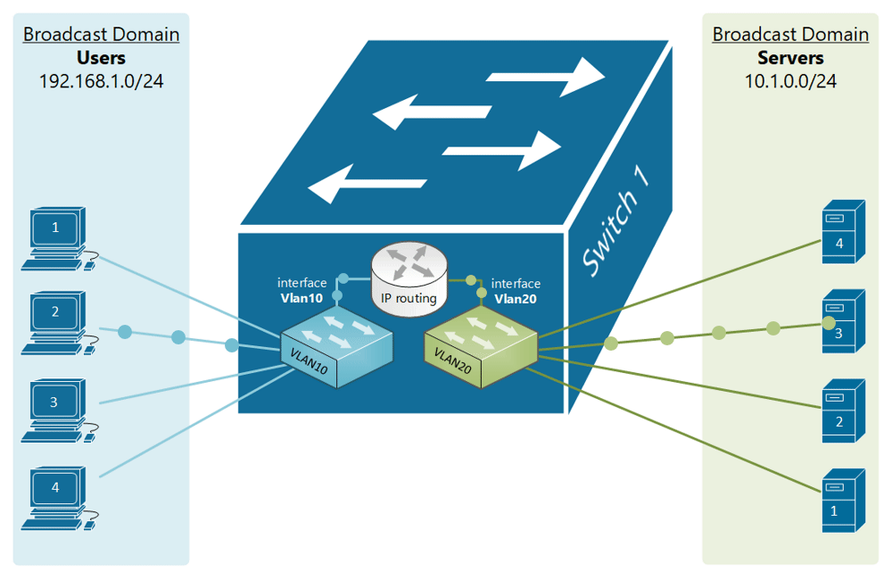
VLAN inter communication
The switch is a layer 2 device, working on MAC addresses
A multilayer switch (L2/3) can be used to perform switching and routing

Slide 38
Internet connection
Connection to the ISP
ADSL
Cable
Satellite
Cellular
Leased line
ISP supplies:
IP address via DHCP
DNS address

Slide 39
ISP IP addresses
An ISP will allocate an IP address from a range it owns
These IP addresses are unique on the internet
Gloucestershire College IP address is 212.219.57.69
All internet traffic to and from Gloucestershire College is via the IP address 212.219.57.69
Internal IP addresses at the college will be from the private IP address ranges
How does traffic for a private IP address get to the right host?

Slide 40
Network and port address translation (NAT and PAT)
Implemented in the router
Allows many hosts on the internal network to connect via one public IP address
Allows many applications on one host to communicate with many services in the cloud
Uses IP and port numbers (not the same as a port on a switch)

Slide 41
Ports
An IP address and a port address make up a socket
Eg 212.219.57.69:80 (Gloucestershire college HTTP port)
An application, service or process uses the socket to send and receive data via the network – OSI Layer 4 Transport (TCP)
The operating system
transmits the data from all application ports on to the network
directs received packets to the matching IP address and port number

Slide 42
OSI model
Layer 7
Application
Layer 6
Presentation
Layer 5
Session
The “post office” layer
(TCP segment, UDP datagram)
Layer 4
Transport
Layer 3
Network
Layer 2
Data Link
Layer 1
Physical
Notes:
We will come back to this.

Slide 43
Port allocation
Well known ports 0-1023
Examples
21 FTP
22 SFTP secure port - encrypted
25 SMTP
80 HTTP
110 POP3
443 HTTPS – secure port - encrypted
Registered ports 1024-49151
Dynamic ports 49152-65535

Slide 44
Packets with IP addresses and port numbers
Preamble | Start of frame delimiter | Destination | Source | Length | Data | CRC
Timing |  | MAC Addressing |  | Amount of data | Payload | Checksum
7 bytes | 1 byte | 6 bytes | 6 bytes | 2 bytes | 46-1500 bytes | 4 bytes
PACKET
Source IP address | Destination IP address | Source port number | Destination port number
4 bytes | 4 bytes | 2 bytes | 2 bytes

Slide 45
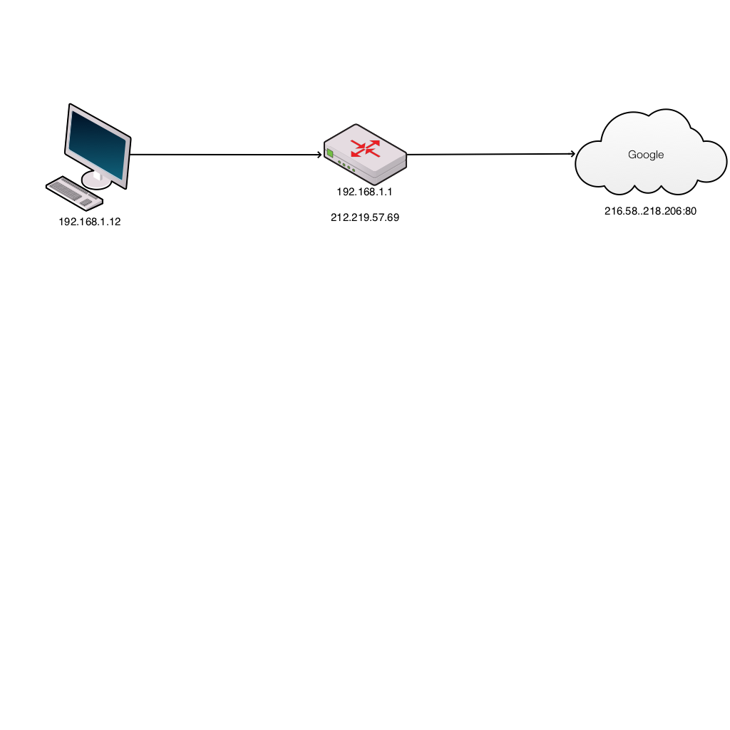
Browser request
Host | Router client side | Router ISP side | Cloud service
S 192.168.1.12:3333 D 216.58.218.206:80 | 192.168.1.12:3333 | 212.219.57.69:7777 | S 212.219.57.69:7777 D 216.58.218.206:80
Host inserts random source port number
Router translates internal network IP address to the external network address and port
Router updates translate table and records port numbers

Slide 46
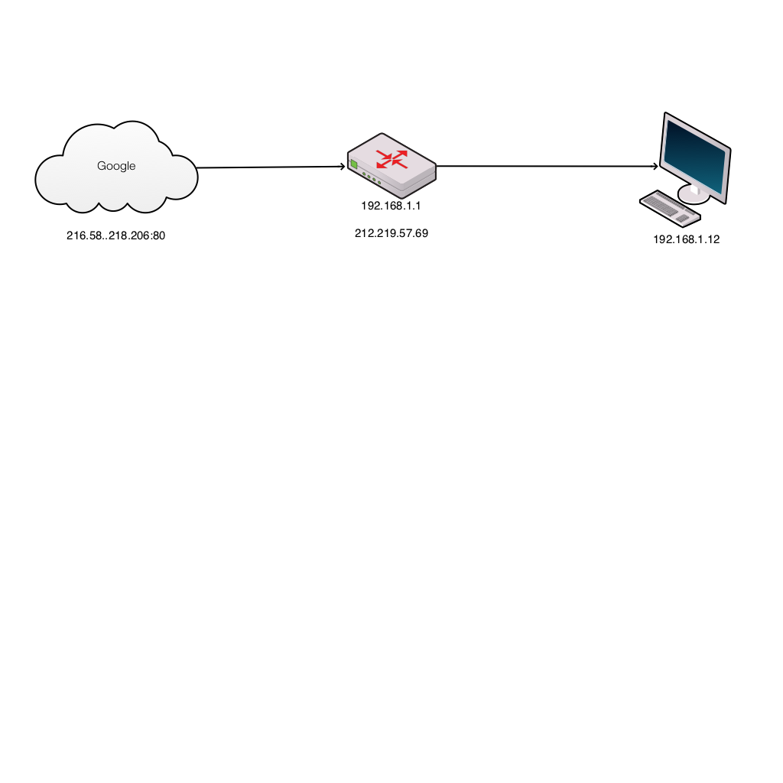
Server response
Cloud service | Router ISP side | Router client side | Host
S 216.58.218.206:80 D 212.219.57.69:7777 | 212.219.57.69:7777 | 192.168.1.12:3333 | S 216.58.218.206:80 D 192.168.1.12:3333
Server puts source address from received packet into destination address of outbound packet
Router translates external network IP address to the internal network address and port
Host receives packet and OS directs to correct application

Slide 47
Domain Name System
Translates domain names to IP addresses
A host will query a domain name server (address from DHCP) with the domain name (eg www.techrepublic.com)
DNS server returns the IP address
Windows command: nslookup

Slide 48
TCP – transmission control protocol
Establishes host to host communication at the transport layer
Layer 7
Application
Layer 6
Presentation
Layer 5
Session
The “post office” layer
(TCP segment, UDP datagram)
Layer 4
Transport
Layer 3
Network
Layer 2
Data Link
Layer 1
Physical

Slide 49
TCP – connection oriented
Data arrives in order to the application
Errors are corrected
Lost or discarded packets are resent
Duplicate data is discarded
Needed because IP is a “best effort delivery” protocol
Uses port numbers for addresses
Uses positive acknowledgment with retransmission

Slide 50
UDP – user datagram protocol
Best effort, unreliable
Message stream oriented
No acknowledgment or retransmission
Not ordered
Typical usage:
Media streaming
VOIP
DNS
Broadcasts – can address all hosts on a subnet
Multicasts - can be routed without duplication to a group of subscribers

Slide 51
Recap
Internal networks connect to the internet via ISP
The ISP allocates an IP address
Network address translation (NAT) allows private IP addressing
Port address translation (PAT) allows multiple applications to connect to cloud services
DNS allows memorable names to be used for cloud resources
TCP uses connections, UDP streams

Slide 52
IPSec and VPN
IPSec Internet Protocol Security
Encrypts IP packets
VPNs use IPSec to establish and run encrypted connections
Adds headers and trailers to the packet data payload (50-60 bytes), may require MTU (maximum transmission unit) adjustments
Authenticates each packet
Uses UDP to get through firewalls
In tunnel mode the original IP addresses are encrypted and new IP headers added. The tunnel exists between the source and destination routers
In transport mode the original IP headers are in the clear
IPSec uses port 500

Slide 53
Hops
A hop occurs each time packets are passed to the next network device
The hop count is the number of intermediate devices the packet has to pass through from source to destination
The hop count can be used as a metric by routing protocols to determine the optimum path for a packet

Slide 54
Routing table
Contains the destination subnet
The metric (indicates best path)
Next hop or gateway
In the example (for a home router)
0.0.0.0 is for an address not found in the table
127.0.0.0 is localhost
Default gateway is 192.168.0.1 and reached through the local network card 192.168.0.100
Network Destination | Netmask | Gateway | Interface | Metric
0.0.0.0 | 0.0.0.0 | 192.168.0.1 | 192.168.0.100 | 10
127.0.0.0 | 255.0.0.0 | 127.0.0.1 | 127.0.0.1 | 1
192.168.0.100 | 255.255.255.255 | 127.0.0.1 | 127.0.0.1 | 10
192.168.0.1 | 255.255.255.255 | 192.168.0.100 | 192.168.0.100 | 10

Slide 55
Routing protocols
Used by routers to exchange information about routes between network nodes
Routing algorithms determine the choice of routes directly attached to router
This information is then shared, such that routers gain knowledge of the network topology
The results are stored as a metric in the routing table

Slide 56
Routing protocols
BGP: The Border Gateway Protocol (BGP) routing protocol is used to announce which networks control which IP addresses, and which networks connect to each other. BGP is a dynamic routing protocol.
OSPF: The Open Shortest Path First (OSPF) protocol is commonly used by network routers to dynamically identify the fastest and shortest available routes for sending packets to their destination.
RIP: The Routing Information Protocol (RIP) uses "hop count" to find the shortest path from one network to another, where "hop count" means number of routers a packet must pass through on the way.

Slide 57
Static routing
The network administrator adds entries in the routing table
Used:
For a default node when no other nodes are available
In a small network with only one or two routes
As a backup if dynamic routing is not available
Good for:
Full control over the network
Very little CPU load and no traffic to other routers
Problems:
Human error
Not fault tolerant if a route becomes unavailable

Slide 58
Dynamic routing
The entries in the routing table are made by the routing protocols
Entries are updated according to the conditions of the network
Failing nodes can be routed around
The paths can be adjusted based on traffic load, delays
Traffic can be switched to idle paths

Slide 59
Network defence tools
Protect your perimeter
Firewalls
Proxies
Intrusion detection systems (IDS)
Intrusion protection systems (IPS)
Demilitarised zones (DMZs)

Slide 60
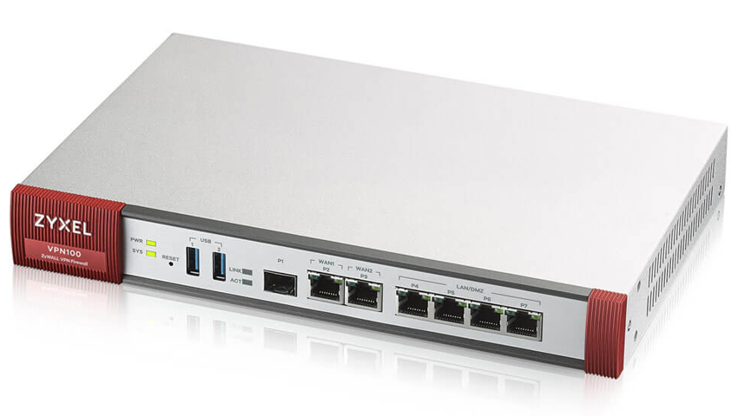
Firewalls
A network security system that monitors and controls incoming and outgoing network traffic based on predetermined security rules
A firewall typically establishes a barrier between a trusted internal network and untrusted external network, such as the Internet

Slide 61
Stateful Firewalls
Stateful – monitors incoming and outgoing packets and the connection
Was this connection made legitimately?
Significantly better at detecting and identifying unauthorized or forged connections
More useful to corporations more likely subject to cyber attack
Looks at connection data (TCP/UDP as well as packet headers)

Slide 62
Stateless Firewalls
Stateless Firewalls contain rules about which traffic to allow or block depending on (Network layer 3)
Source IP,
Destination IP,
Port numbers,
Network Protocols
Have no knowledge of whether the connection was initiated by the client
Faster than stateful as only looks at the packet header

Slide 63
Firewalls - stateful, stateless
Stateful
# Generic rule to allow clients to connect to any webserver on the internet
Allow traffic going out to port 80
Allow traffic related to connections initiated by any internal client back to the same client
Deny any other traffic coming into the client.
Stateless
Allow traffic going out to port 80 on www.example.com
Allow traffic coming from host www.example.com and port 80
Deny any other traffic coming into the client

Slide 64
Simple example of rules
Is this stateless or stateful?

Slide 65
Firewalls - deep packet inspection
Deep packet inspection (DPI)
Firewalls cannot distinguish between permissible and forbidden data traffic between legitimate applications
DPI looks at the the packet for:
virus signatures
worms
payload pattern matching
payload size
port numbers
IP matching
Can block, reroute or log infractions

Slide 66
Application proxies
Provide one of the most secure types of access you can have in a security gateway
An application proxy sits between the protected network and the network you want to be protected from
Every time an application makes a request, the application proxy intercepts the request to the destination system
The application proxy initiates its own request, as opposed to actually passing the client's initial request
When the destination server responds back to the application proxy, the proxy responds back to the client as if it was the destination server

Slide 67
Functions of a Proxy
Obscure client IP
Block malicious traffic
Block sites
Log activity
Improve performance

Slide 68
HTTP/80
Client 1
HTTP/80
HTTP/80
Proxy
Server
Client 2
HTTP/80
HTTP, SSL, FTP, and SOCKS proxies.
Client 3

Slide 69
Types of Proxy
Forward
Reverse

Slide 70
Forward Proxy Servers
Forward proxies send the requests of a client onward to a web server
Surf directly to a web proxy address or by configuring their Internet settings
Allow circumvention of firewalls and increase the privacy and security for a user
May sometimes be used to download illegal materials such as copyrighted materials or child pornography

Slide 71
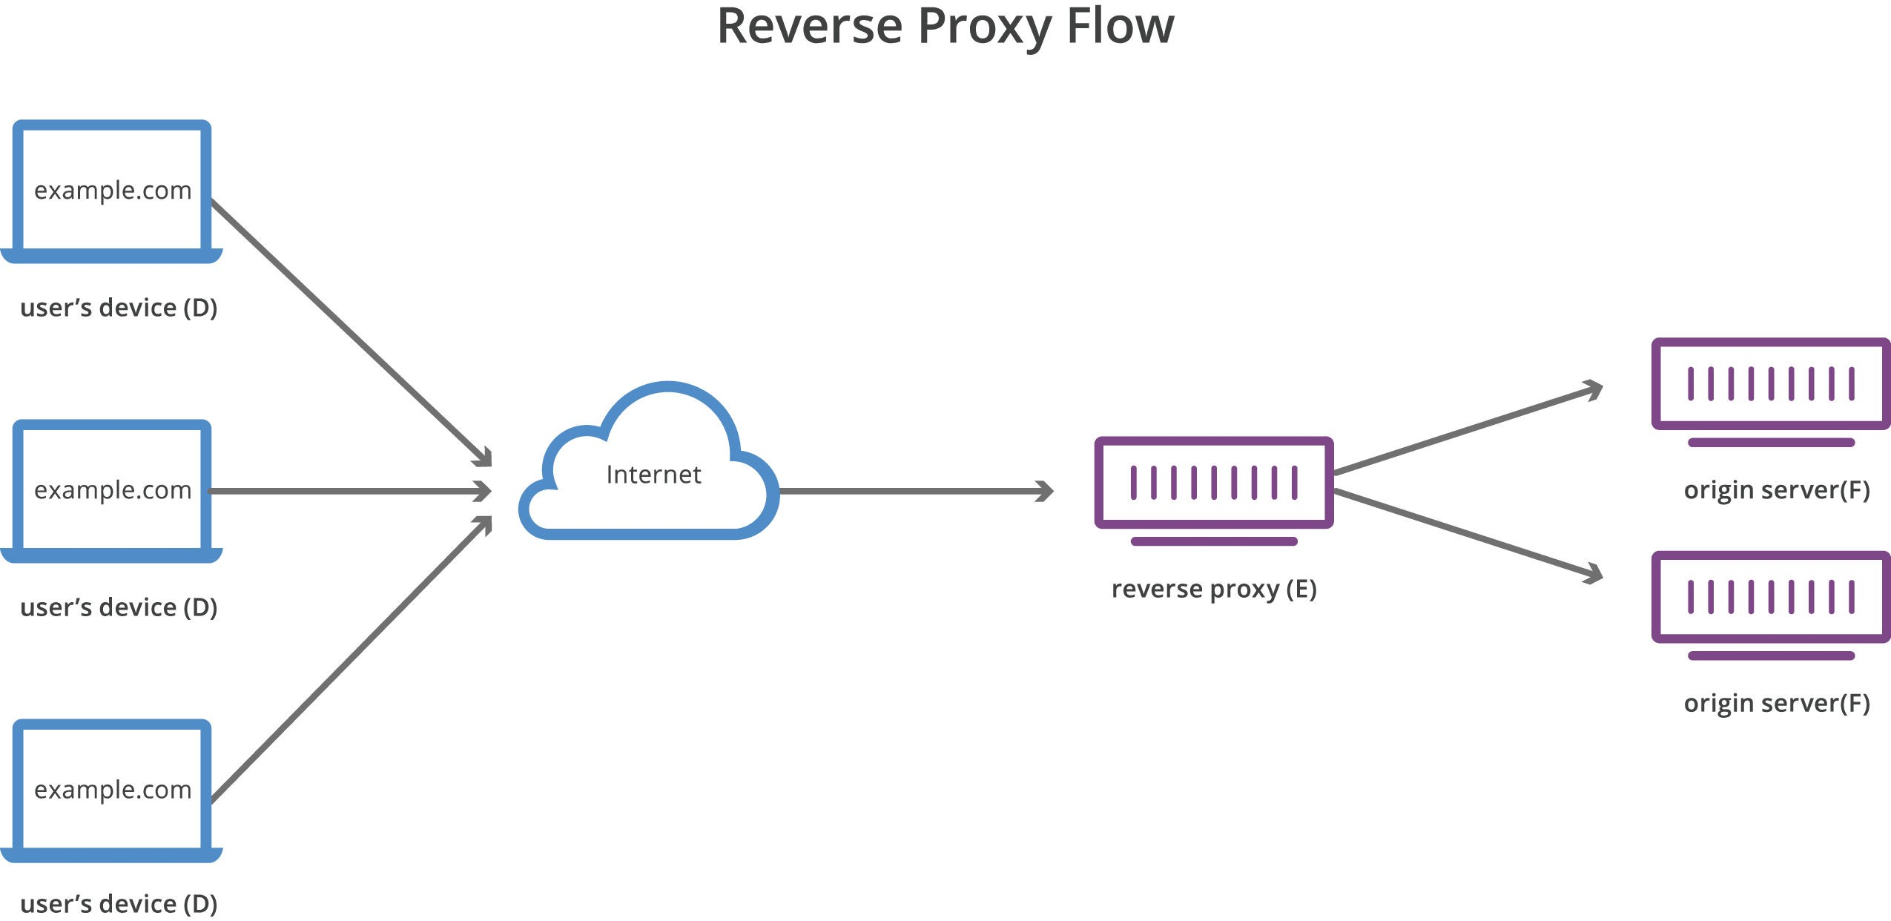
Reverse proxy

Slide 72
Reverse Proxy Server
Reverse proxies transparently handle all requests for resources on destination servers without requiring any action on the part of the requester
Reverse proxies are used to:
enable indirect access when a website disallows direct connections as a security measure
allow for load balancing between servers
stream internal content to Internet users
disable access to a site, for example when an ISP or government wishes to block a website
Notes:
Reverse proxies transparently handle all requests for resources on destination servers without requiring any action on the part of the requester.
Reverse proxies are used:
To enable indirect access when a website disallows direct connections as a security measure
To allow for load balancing between severs
To stream internal content to Internet users
To disable access to a site, for example when an ISP or government wishes to block a website

Slide 73
Anonymous proxies
Accesses the internet on behalf of the user while hiding their identity and computer information
A high anonymity proxy erases user information before making the connection to the target site
A distorting proxy changes its IP address to an incorrect one, providing misleading location information
Proxies do not encrypt, use VPNs for encryption

Slide 74
Intrusion detection systems (IDS)
A device or software to monitor a network for malicious activity or policy violations
Events can be reported to administrators or collected in an event management system
Differs from a firewall as it monitors internal events
Works by inspecting network traffic and looking for:
known patterns (signature based)
deviations from regular activity (anomaly based)

Slide 75
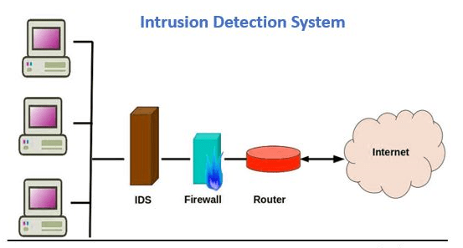
Intrusion detection system

Slide 76
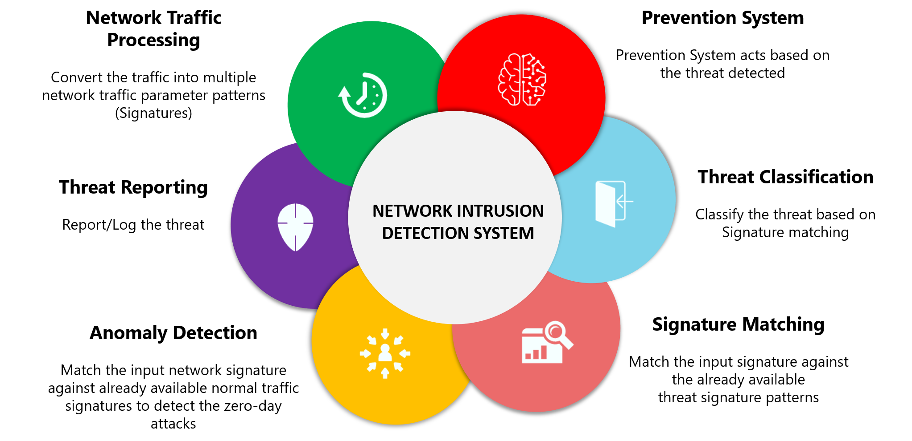
Intrusion detection system

Slide 77
Intrusion prevention systems (IPS)
Incorporates an IDS, but as an inline device so that it can attempt to block or stop malicious activity
An IPS can:
send an alarm,
drop detected malicious packets
reset a connection
block traffic from an offending IP address
correct cyclic redundancy check (CRC) errors
defragment packet streams
mitigate TCP sequencing issues

Slide 78
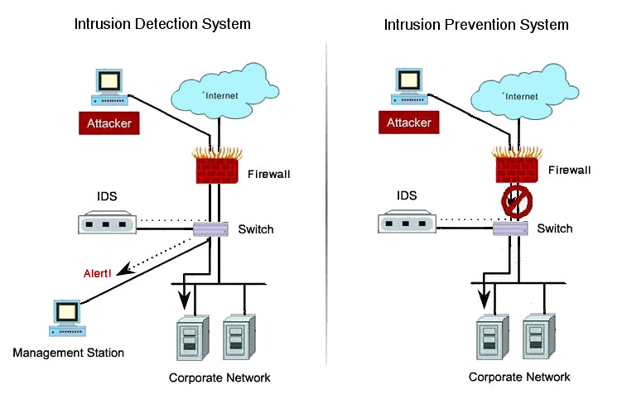
Comparison

Slide 79
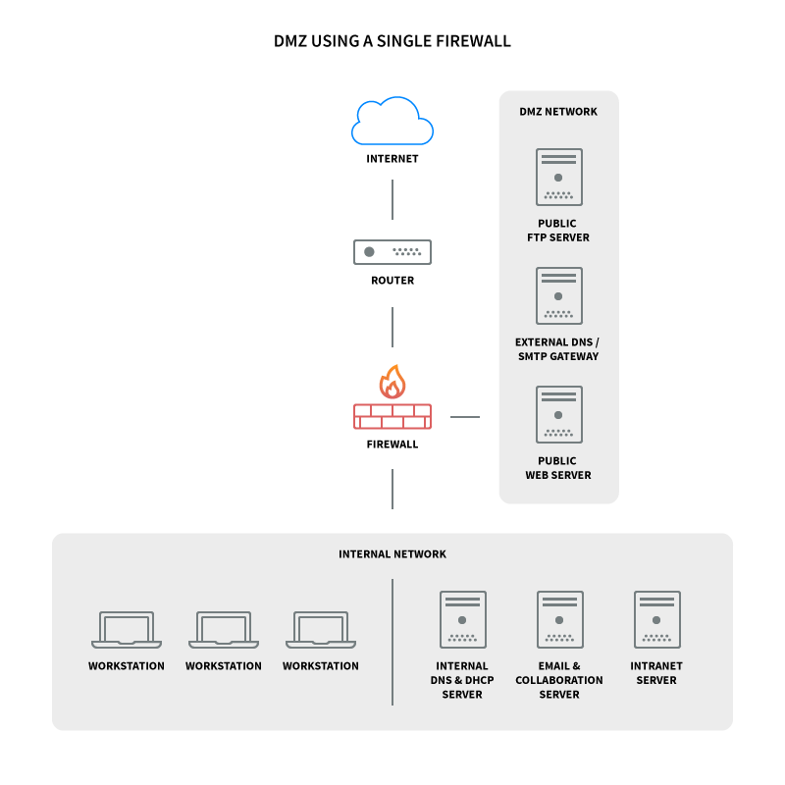
Single firewall DMZ

Slide 80
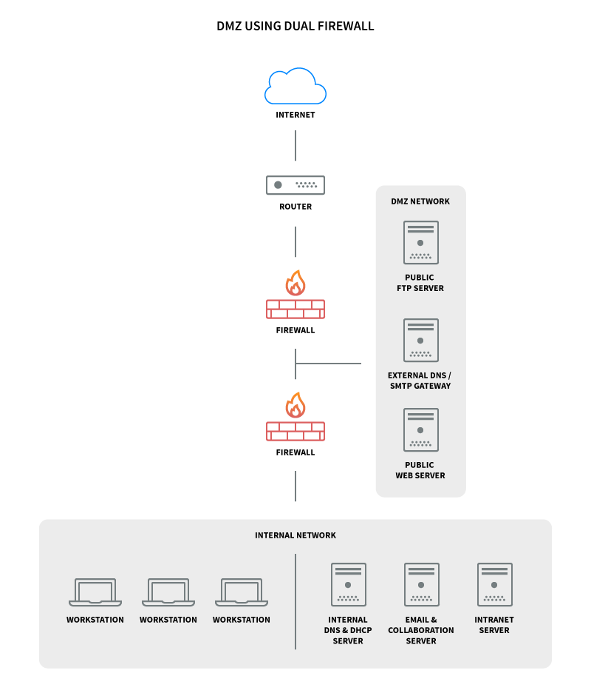
Dual firewall DMZ

Slide 81
Knowledge criteria covered
K1: Principles of organisational information security governance and the components of an organisation's cyber security technical infrastructure including hardware, operating systems, networks, software and cloud

