Slide 1
Introduction
Operating System Security & Defensive Programming
UFCFHU-30-2
Level 5
30 Credits

Slide 2
OS Security &
Defensive
Programming
Week 2
Intro
Monday
01
02
Wednesday
03
04
Tuesday
05
06
Thursday
Friday

Slide 3
Example App
An ASP.NET Core MVC app using several design patterns

Slide 4
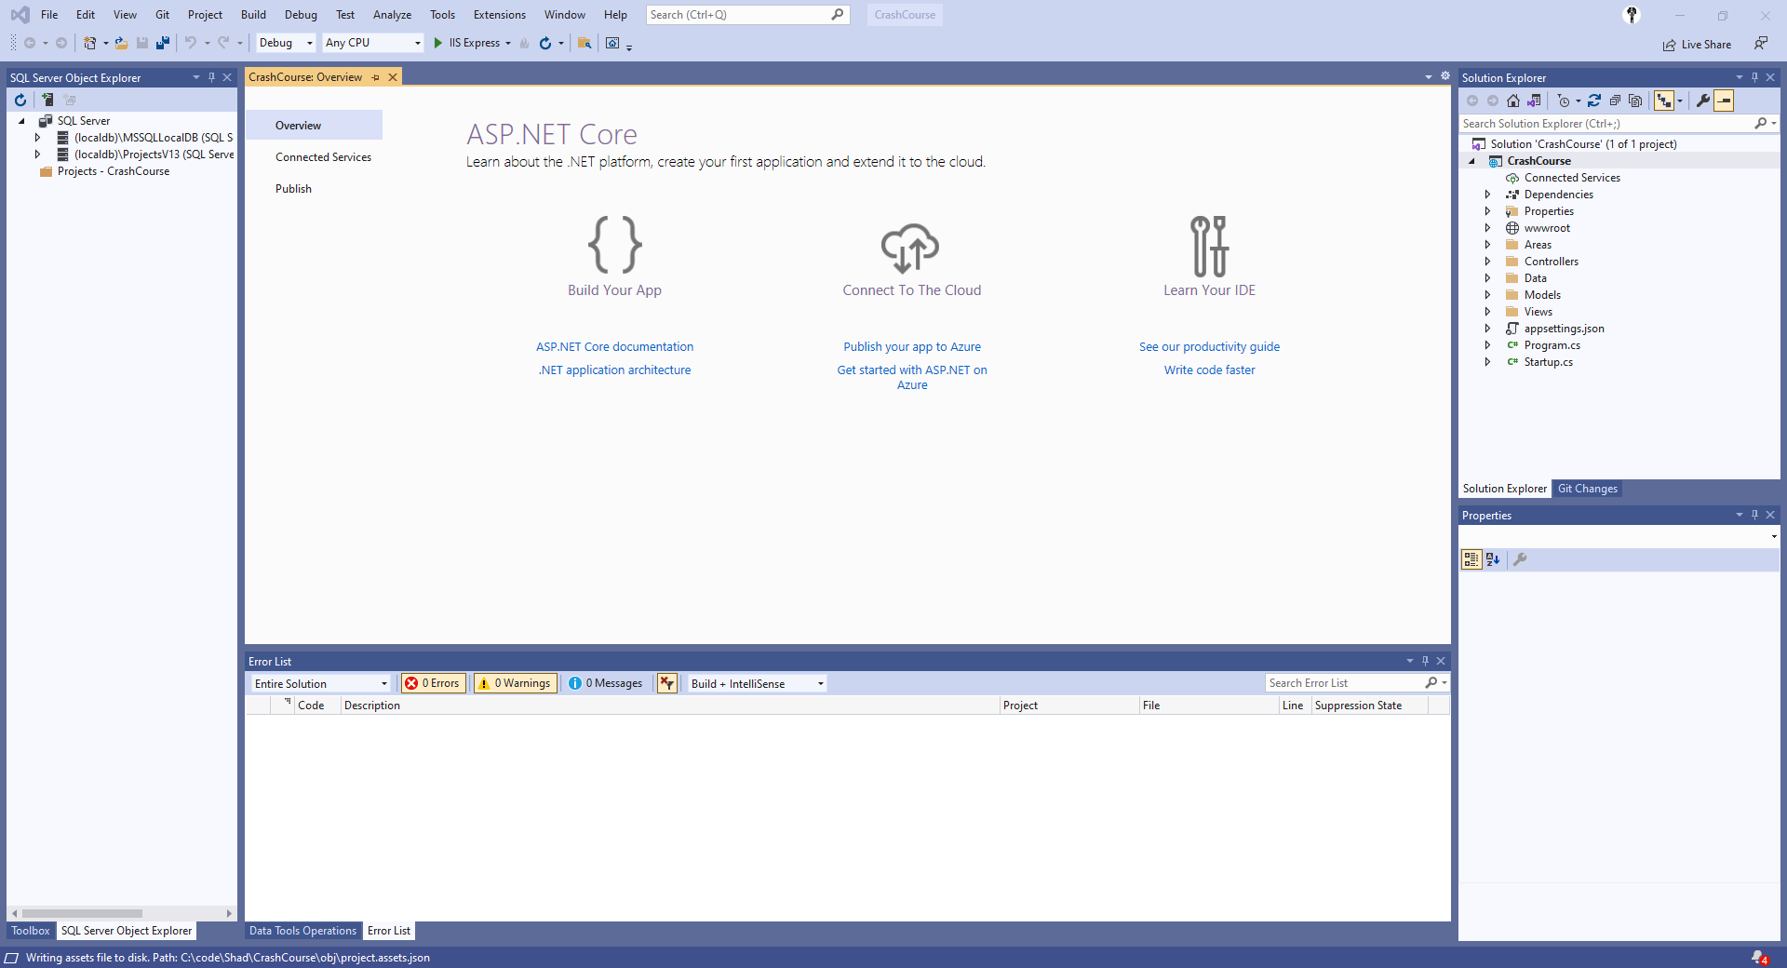
Our sample app
Today we’re going to configure an asp.net core mvc web app

Slide 5
Our first home page

Slide 6
What have we got?
We have controllers and View folder
A View is a web page
In our sample, we have Home and Shared
Look inside Home and you will see index.cshtml and privacy.cshtml
You can edit these pages.
Try it now.

Slide 7
What is MVC?
Models are classes (objects)
Views are pages (using Razor HTML)
Controller’s connect models, business logic and web pages
The MVC Design Pattern helps enforce the separation of concerns to help you avoid mixing presentation logic, business logic and data access together.
Why is separation of concerns a good thing?

Slide 8
What is MVC?
Models manage the behaviour and data
Views manage the display of data
Controllers handle page events and navigation between pages
Try it – create a diagram describing the workflow of the ASP.NET MVC design pattern and add annotations explaining how it operates

Slide 9
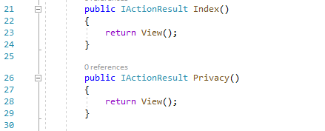
What does MVC look like in an ASP.NET Project?
Click on HomeController.cs in the Controllers folder in your project and look for the following section
This code handles the routing of requests to your web pages.
If someone clicks the Privacy link in your header menu, they will be routed to your Privacy page (return the privacy view), and if someone click Home then they will be routed to your home page (return your default Index view)
What does the code dealing with Error() beginning on line 32 do?

Slide 10
Views
Views are files used to generate web pages
View files contain a mixture of HTML and C# code – this mix is called Razor code.
Views usually get their data from a Controller.
Views dynamically combine data with HTML in a template

Slide 11
Models
Models are data related
Models consist of classes (objects) with properties
Models use SQL statements
Models return lists of objects to the Controller

Slide 12
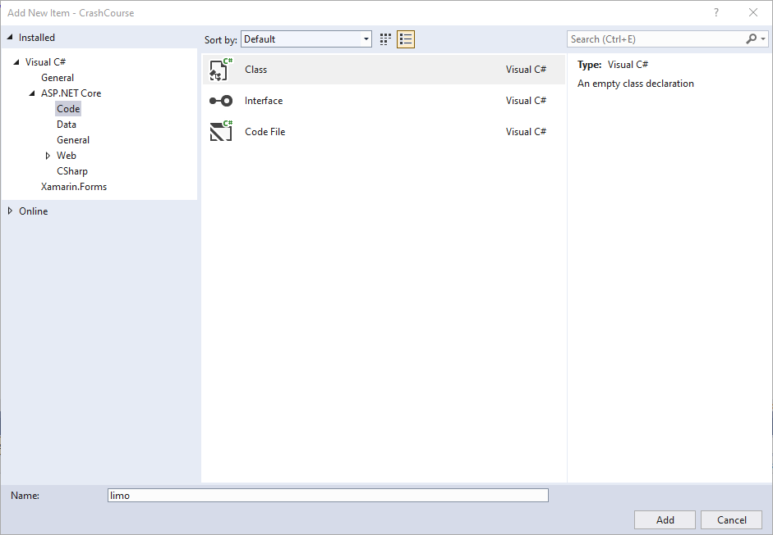
Creating a Model
Right click Models folder and choose Add > Class, you’re presented with this window. Give your new class a suitable name

Slide 13
Creating a Model
You will see the limo.cs file has been created and is open

Slide 14
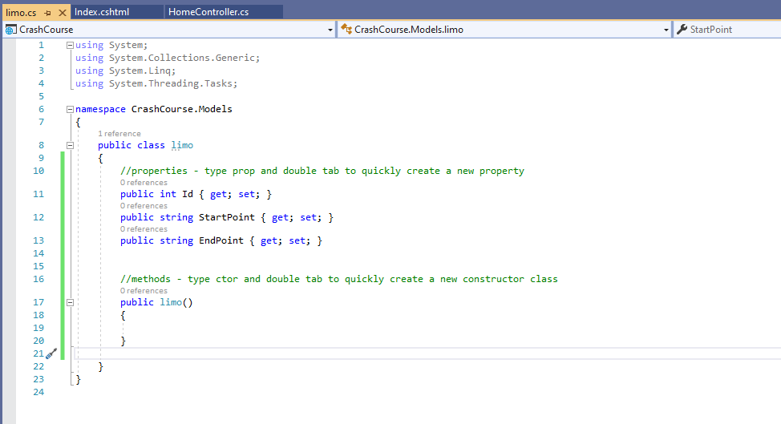
Creating a Model
Let’s give our class some properties

Slide 15
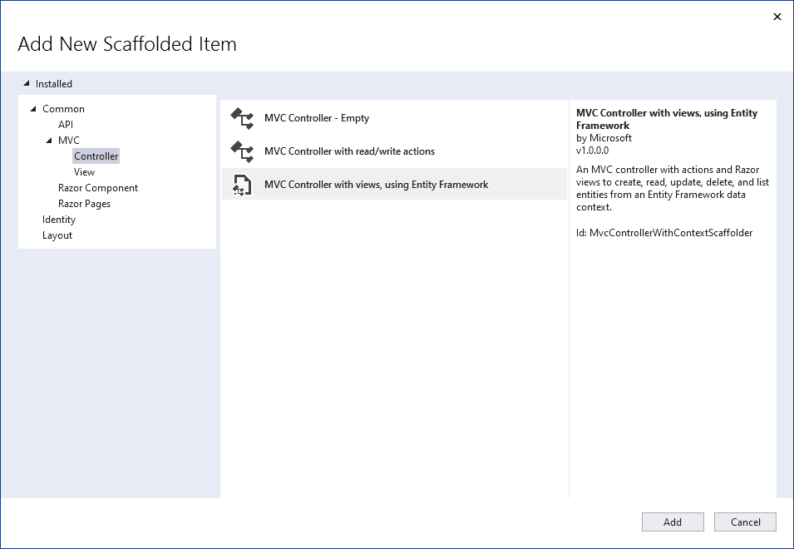
Create our controller
Right click our Controllers folder and select Add
Select MVC Controller with Views, using Entity Framework

Slide 16
Create our controller
Right click our Controllers folder and select Add
Select MVC Controller with Views, using Entity Framework

Slide 17
Create our controller
Right click our Controllers folder and select Add
Select MVC Controller with Views, using Entity Framework

Slide 18
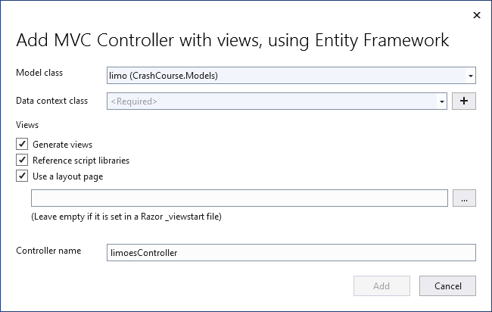
Create our controller
You should see something similar to this.
Click the large + sign next to the Data Context Class entry field

Slide 19
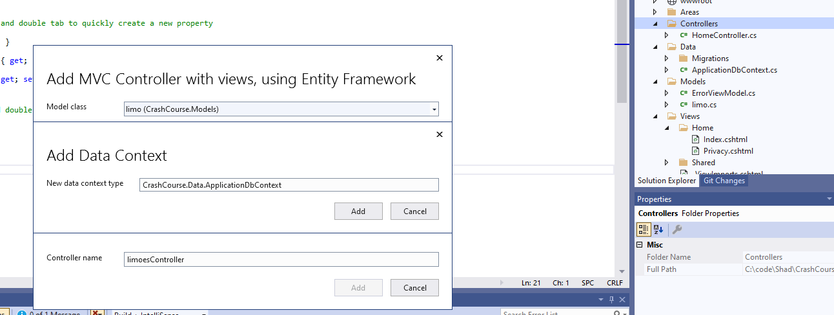
Create our controller
In the popup, modify the entry as follows:
Change the New Data Context Type to
CrashCourse.Data.ApplicationDbContext
Press Add

Slide 20
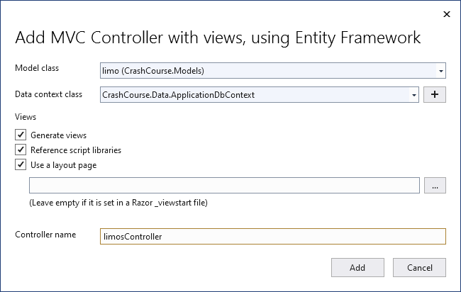
Create our controller
Your window should now look like this:
Note – I have updated the Controller Name field to remove an ‘e’
Press Add

Slide 21
Create our controller
Visual studio will now construct your new controller:

Slide 22
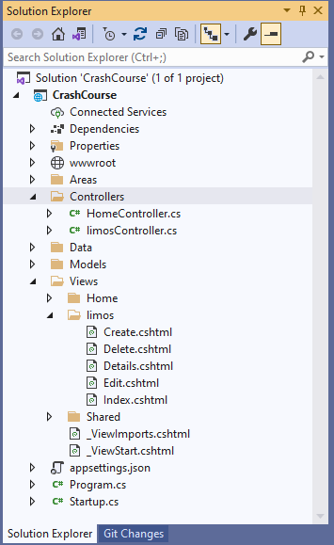
Create our controller and views
Visual studio will now construct your new controller and Views
Try running the application using Visual Studio…

Slide 23
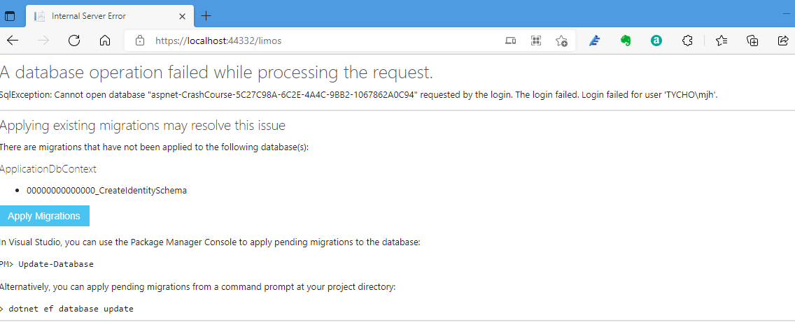
Create our controller and views
In your browser window you should be able to see the default homepage
Try adding /limos after the port number in the URL and you will see a window like this:
Don’t worry – all this means is we have not yet connected a database

Slide 24
Models
Models are data related
Models consist of classes (objects) with properties
Models use SQL statements
Models return lists of objects to the Controller
Database Migrations

Slide 25
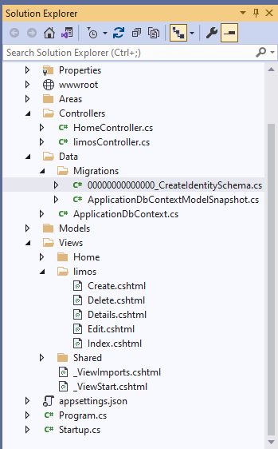
Database Migrations
Database Migrations let us set up our database using the structure built in our code.
Click on this Migrations file in the Migrations folder, under your Data folder

Slide 26
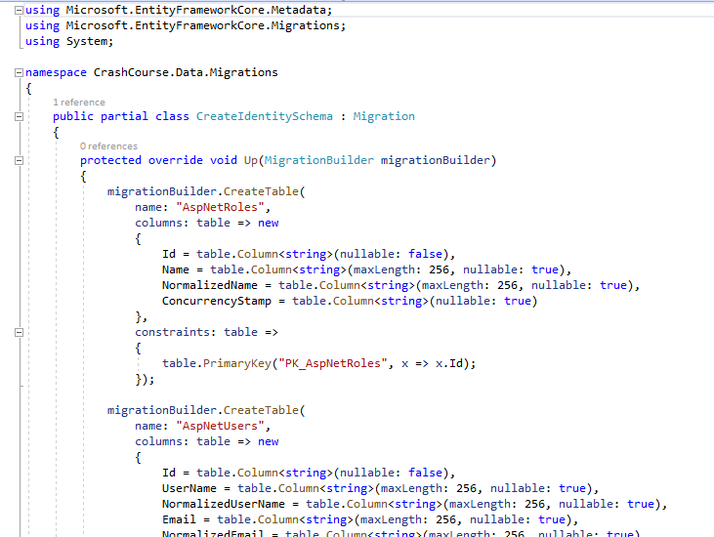
Database Migrations
In the Create Identity Schema file, you should see something like the following:
ASP.Net will construct several tables for us in the Microsoft SQL Server, here you can see AspNetRoles and AspNetUsers

Slide 27
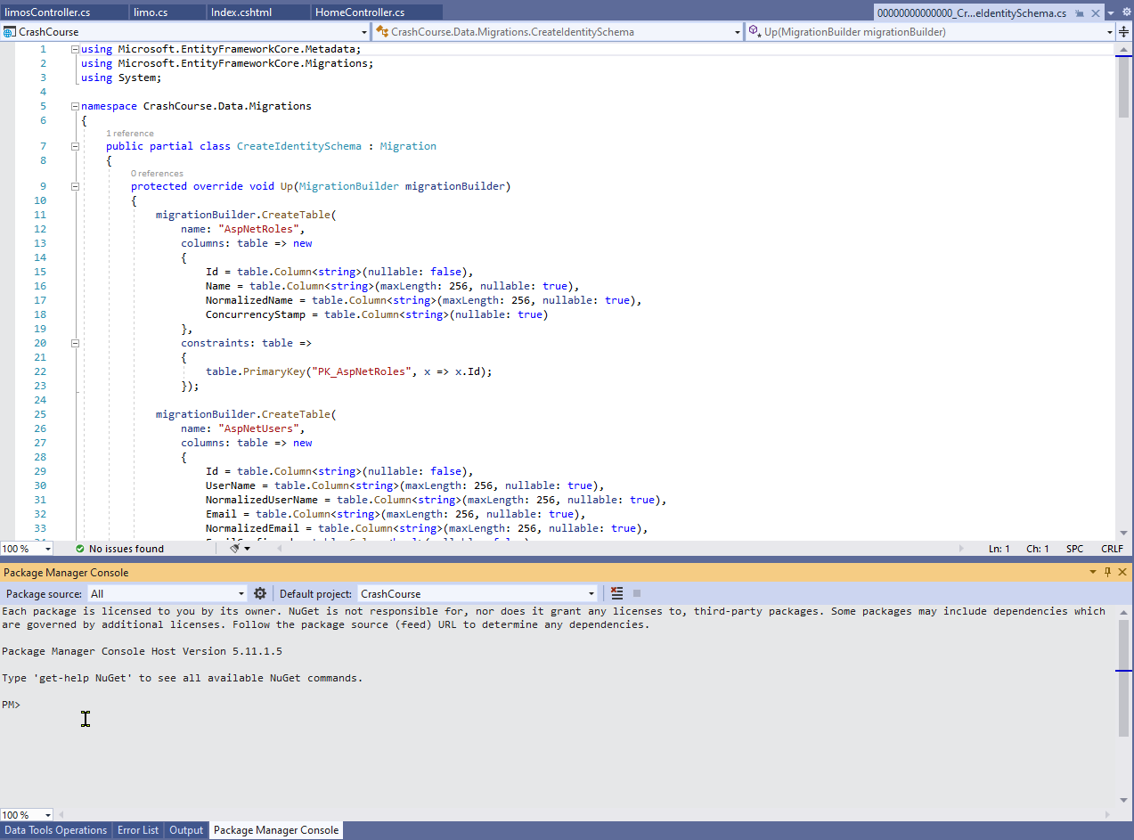
Database Migrations
However, we do not see any reference to Limos tables.
Open the Package Manager Console in the
View >
Other Windows >
Package Manager Console Window

Slide 28
Database Migrations
We are going to use the Package Manager Console for some DB Management activities
A database migration sets up the tables in the database for us, so lets do that.
In the package manager console window type
Add-Migration “initialsetup” and press enter

Slide 29
Database Migrations
The Migration command runs…

Slide 30
Database Migrations
The Migration command runs… and completes

Slide 31
Database Migrations
In the Migrations folder we see a new file called initialsetup

Slide 32
Database Migration
The initialsetup file contains the following code to create a table names limo on line 10 and columns for our startpoints and endpoints on lines 15 and 16, as you can see here:
This is called an ORM – and Object Relational Mapper
Using ORMs is considered a good practise as it abstracts the database interaction

Slide 33
Setting up the database
ORMs are automated so they are quick, but don’t provide much fine grained control over the database configuration.
Alternatively, we can use DAOs – Data Access Objects – these are more traditional in that we hand craft the database, and consequently are slower.
ORMs are preferred by developers, but DAOs are preferred by DBAs
The Microsoft ORM in ASP.NET is called Entity Framework, and it does a lot of the heavy lifting for you.

Slide 34
Setting up the Database with Migrations
The files contained within the Migrations folder are used to configure the database.
To trigger an update, we type update-database in the Package Manager Console

Slide 35
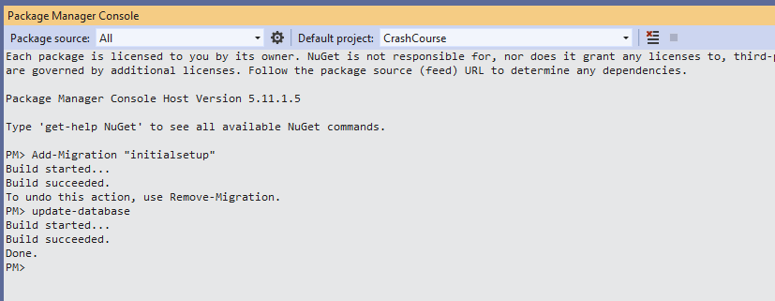
Setting up the Database with Migrations
The reconfiguration completes…

Slide 36
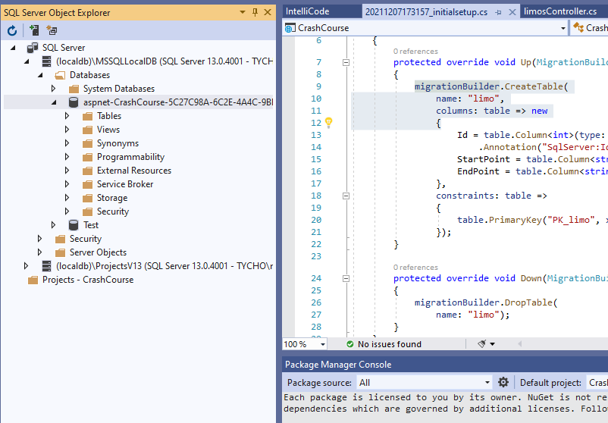
Setting up the Database with Migrations
If you open SQL Server Object Explorer, you can see the our CrashCourse database has been created

Slide 37
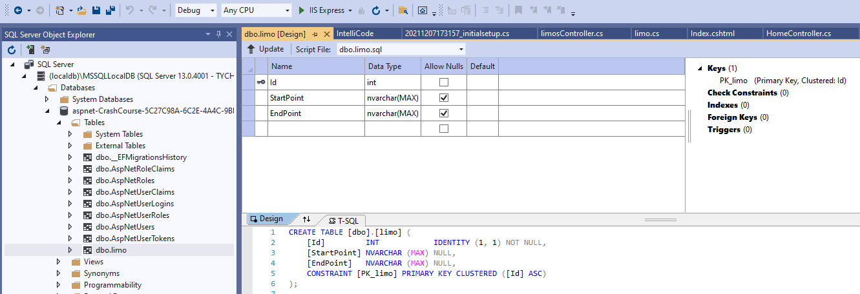
Setting up the Database with Migrations
Open the Tables folder and you can see many tables, including Tables for AspNetUsers and our limo application, double click the limo table
Press the Green Arrow next to IISExpress on the menu bar to run our application

Slide 38
Voila – we have our Limo index page!
Click Create New

Slide 39
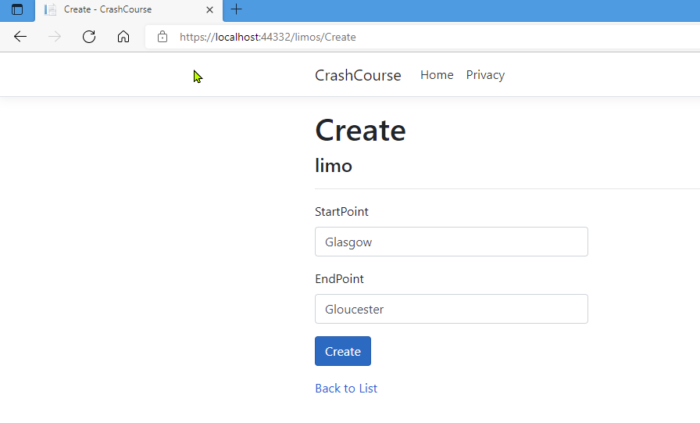
Create a new limo trip
Try entering a new limo trip
Click Create New

Slide 40
Create a new limo trip – progress!

Slide 41
Congratulations – you’ve just made a simple CRUD web app!

Slide 42
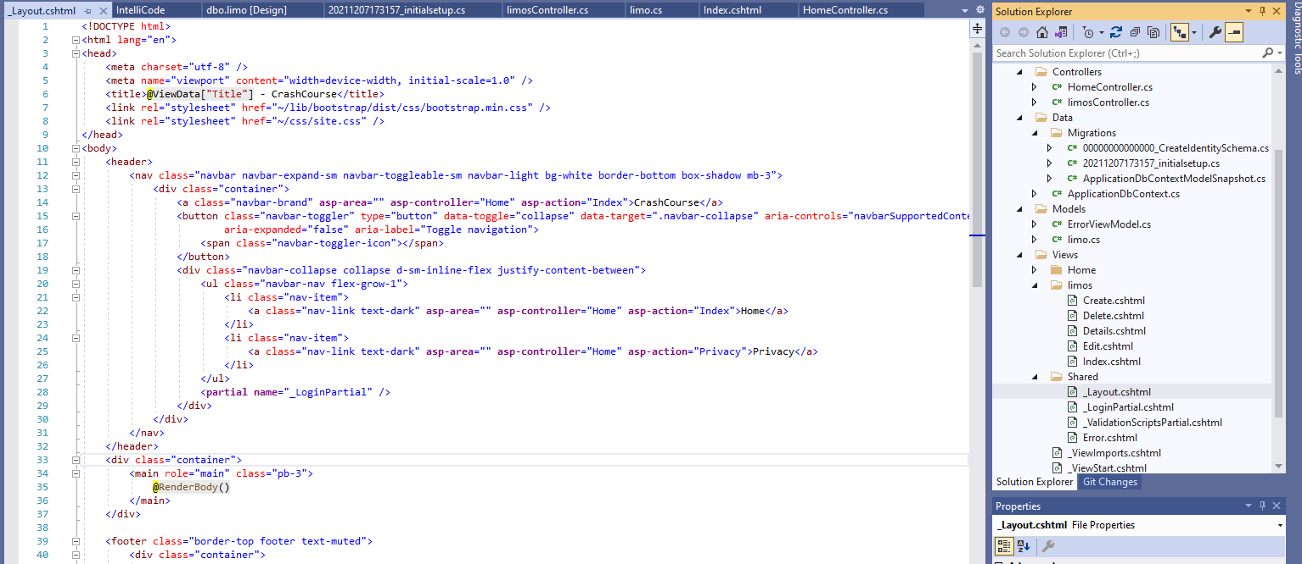
Add items to menu bar
Open the _Layout.cshtml file located in
Views\shared

Slide 43
Add items to menu bar
Look for the menu entry item for Home link around line 21
Copy the menu item entry for Privacy and paste it underneath the Privacy entry.
Change the asp-controller entry to point to our limos controller and the asp-action entry to point to our Index file in our limos Views folder and finally, update the displayed link text to say Limos, as you can see here:

Slide 44
Add items to menu bar
Change the asp-controller entry to point to our limos controller and the asp-action entry to point to our Index file in our limos Views folder and finally, update the displayed link text to say Limos, as you can see here, and then try running your website:

Slide 45
Add items to menu bar
You can see our page’s Menu bar has a new entry for our limousines
Try clicking the new Menu entry item

Slide 46
Add items to menu bar
You can see our page’s Menu bar has a new entry for our limousines
Try clicking the new Menu entry item

Slide 47
Add items to menu bar
You can see our page’s Menu bar has a new entry for our limousines
Try clicking the new Menu entry item

Slide 48
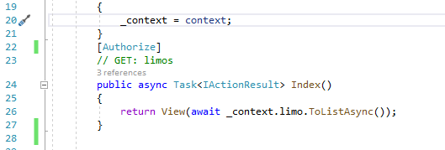
Authorized Access
Let’s add some very basic authentication to our website
Open the Limos Controller
Add the line [Authorize] immediately above // GET: limos
This will prompt the user to log in before they can view any info about the limos
Start your app and try it out
Now update your limos controller to require authorization to create, edit, update and delete a limo journey

Slide 49
Authorized Access
Try to register an account using a weak password – what do you get?

Slide 50
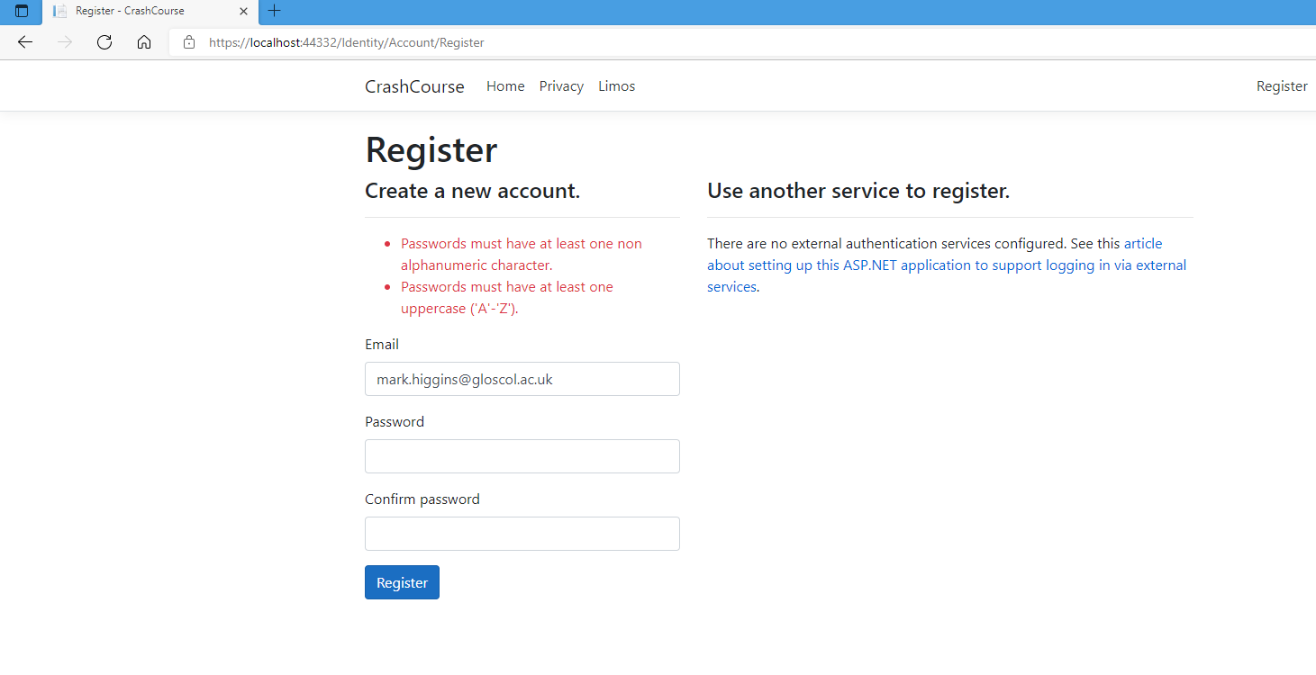
Authorized Access
Try to register an account using a weak password – what do you get?

Slide 51
Conclusion 1/3
This has been a very simple example of an MVC ASP.Net Core web app.
Hopefully you can see there is nothing to be afraid of.
Next, try adding logging functionality using Shad’s tutorial on implementing a log system using Nlog and a singleton design pattern
https://youtu.be/eOU42e8vrFo

Slide 52
Conclusion 2/3
I customised Shad’s crash course tutorial, you may find it helpful to watch his unabridged version here: https://youtu.be/BfEjDD8mWYg
Shad has much more in his tutorial that I covered, including adding a search facility and custom CSS
Shad has an excellent tutorial series on ASP.Net, but it’s not as end-to-end and integrated as the Gavin Lon series.
If you wish to try Shad’s tutorial series, then here’s the link to the playlist:
https://youtube.com/playlist?list=PLhPyEFL5u-i2ShGqmuP3uDdSy06hzBzdo

Slide 53
Conclusion 3/3
Things to think about
How would you implement role based access controls for Admin, Super-User and User roles?
How to add ASP.NET MVC Admin Roles: https://youtu.be/IfNt-OW1sCs
How would you add unit testing to your asp.net core MVC app?
How to Add Unit Tests to C# ASP.Net Core Web App in Visual Studio + Complete Examples of Clean Tests: https://youtu.be/2grpPdVzMzA
How would you perform server and client side input validations and sanitization?
What secure coding practises are you going to employ in your app?

Slide 54
Now Try
Adding an Nlog using a singleton pattern
Adding role based access controls
Adding some good security practises such as client and server side input validation

