Slide 1
BCS Level 4 Certificate in Network Systems and Architecture
NSaA-QAN_60305472

Slide 2
5 Environmental Problems (7.5%)
5.1 Explain causes and impact of excessive heat and summarise the appropriate response
5.2 Describe causes and impact of a lack of power and summarise the appropriate response.
5.3 Describe causes and impact of EMI / RFI and summarise the appropriate response

Slide 3
Environmental Problems - Heat
Excessive heat
Causes
Poor location
Poor ventilation
Dust build-up
Heat emitting components
Malfunction
Insufficient cooling

Slide 4
Environmental Problems - Power
Lack of power
Blackout
Complete interruption of power in a given service area
Brownout
Partial, temporary reduction in system voltage or total system capacity
Intermittent problems
System reboots
Complete loss of systems
Data loss
Solution to most of the above:
UPS or generator

Slide 5
Environmental Problems – EMI/RFI
EMI (Electromagnetic Interference) is also called RFI (Radio Frequency Interference
EMI and RFI are often used interchangeably
EMI is actually any frequency of electrical noise
RFI is a specific subset of electrical noise on the EMI spectrum
Solved by earthing, shielding or filtering

Slide 6
6 Errors in Security – Backup Failures
Backup failure
Misconfigured backup or restore
loss of some or all data
Corrupted missing or backup medium
Loss of some or all data;
Fault backup or restore device
Loss of some or all data.

Slide 7
6 Errors in Security – Malware
Malware infection
Lack of user training
Loss of some or all data and or reduction in work efficiency
Insufficient anti-malware tools
Loss of some or all data and / or reduction in work efficiency
Poorly configured firewall
Loss of some or all data and / or reduction in work efficiency

Slide 8
6 Errors in Security – Wireless Security
Weak encryption
Weak Algorithm Strength
Weak Implementation
Weak Unique/Secret Key used
Key shared among many people
Known plain-text cipher-text pair
Known plain-text and key
Known key and cipher
Poor selection of passphrase
Loss of some or all data and / or reduction in work efficiency.

Slide 9
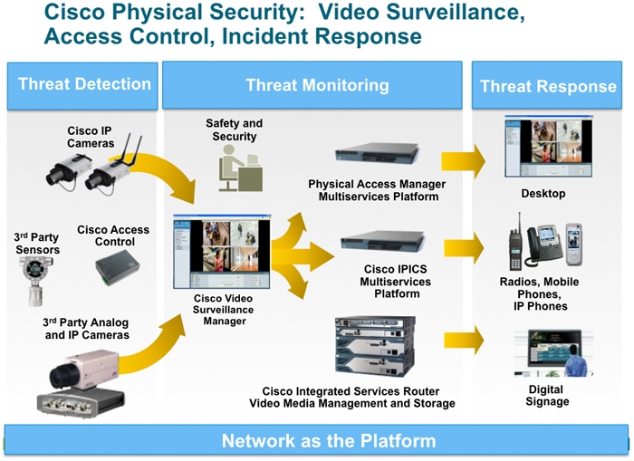
6 Errors in Security – Physical Security
Protection of personnel, hardware, software, networks and data from physical actions and events that could cause serious loss or damage to an enterprise, agency or institution
Often overlooked
Importance underestimated
Unauthorised access
Loss of data
Reduction in work efficiency.

Slide 10
7 Errors Resulting from a Lack of Capacity - Latency
Network latency
Latency is a measure of delay
Latency measures the time it takes for some data to get to its destination across the network
Measured as a round trip delay
The time taken for information to get to its destination and back again
The round trip delay is an important measure because a computer that uses a TCP/IP network sends a limited amount of data to its destination and then waits for an acknowledgement to come back before sending any more
The round trip delay has a key impact on the performance of the network
Latency is usually measured in milliseconds (ms)
In video or sound latency will cause jitter on time critical services
Poor quality VOIP or video conferencing

Slide 11
7 Errors Resulting from a Lack of Capacity – Lack of Bandwidth
Bandwidth is like lanes on a highway
It allows for more traffic to go through at once, while still retaining high speeds
More traffic than network designed to accommodate
Misconfigured network device(s)
Common activities causing bandwidth problems are:
Watching videos from Internet (YouTube, Netflix)
Large file transfers between computers (greater than 100 megabytes in size)
Constant stream of data (surveillance footage from security cameras)
Downloading files from internet

Slide 12
7 Errors Resulting from a Lack of Capacity - Storage
Hard drive is the data bottleneck
Faster hard drives takes less time to send data to the processor
Larger hard drives can support a larger page file
Lack of maintenance - storage filled resulting in system slowdown / crash;
Neglecting to plan for future storage needs
Storage filled therefore resulting in system slowdown or even a crash
System failure producing large files

Slide 13
7 Errors Resulting from a Lack of Capacity - Lack of Memory
Lack of memory
Files or applications take a long time to open or load
Unable to run multiple programs at once
Many users accessing a server will not find files quickly
Unexpected demand
System slow and / or crashes
Application memory leaks
System slow and / or crashes;
Failure to plan

Slide 14
7 Errors Resulting from a Lack of Capacity – Lack of Compute Capacity
CPU is the component that physically performs the calculations that make up "computing.“
64-bit v 32-bit
Unexpected demand will cause CPU to hit 100% for extended periods of time
Failure to plan will cause bottlenecks, crashes
Solution
Replace CPU with improved models
Add extra CPU in server (if available)
Could be expensive

