Slide 1
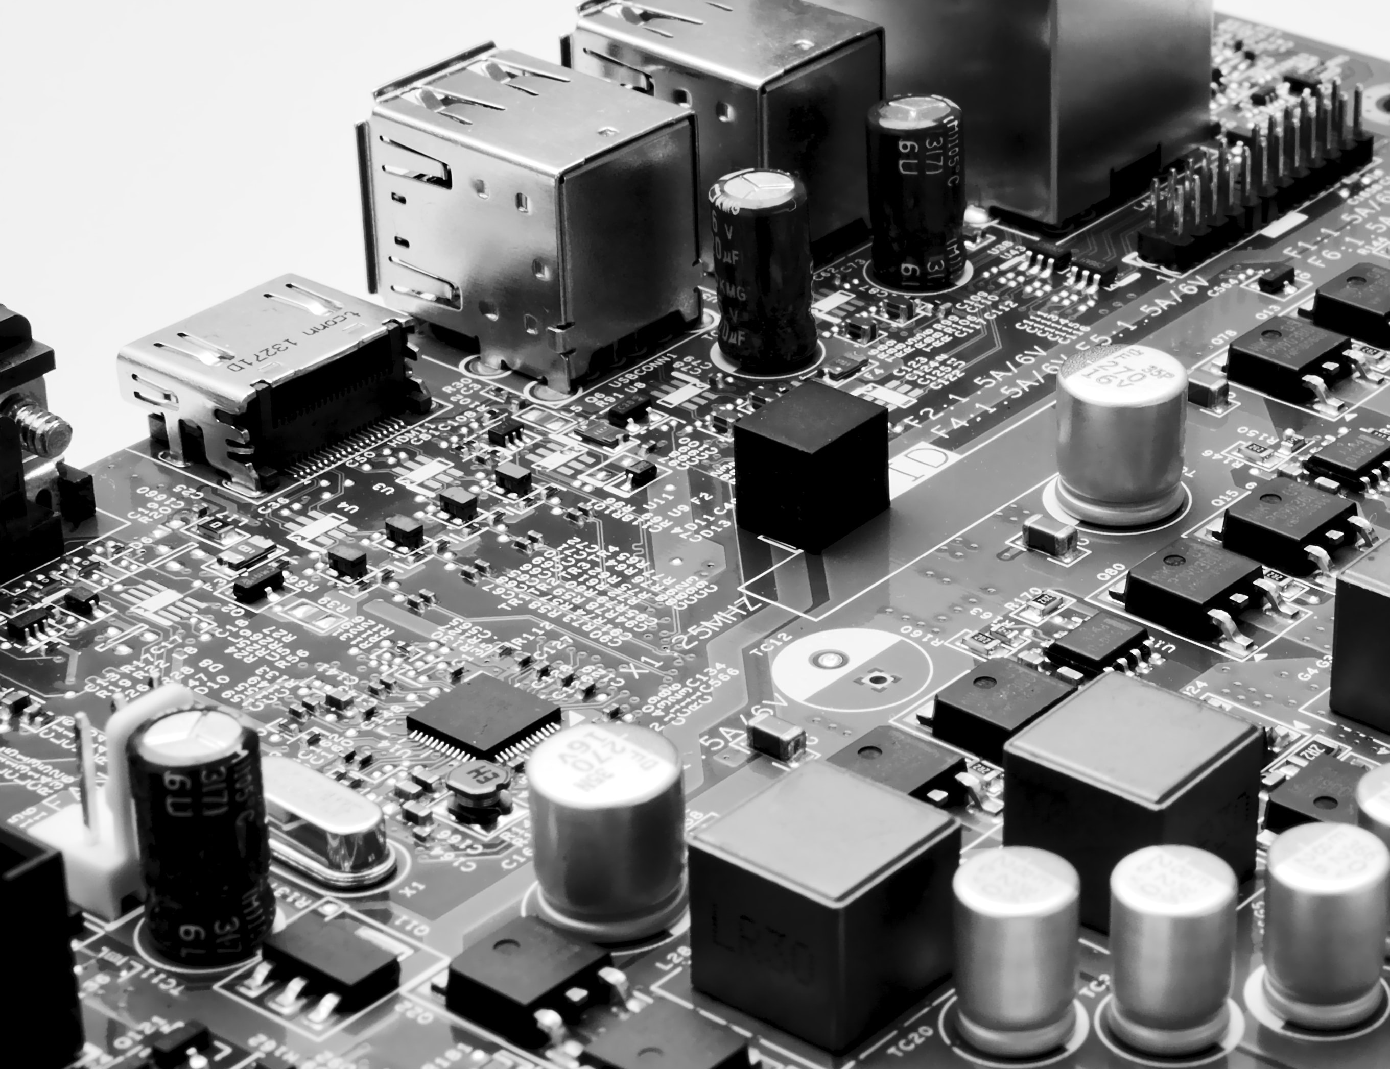
CY102 - Networking
Security Hardware & Software

Slide 2
Security Hardware and Software
Firewalls
Encryption for data at rest
Encryption for communication
Intrusion detection systems (IDS)
Intrusion protection systems (IPS)
Identity and access management (IDAM) tools
Anti-virus
Web proxy
Application firewalls
Cross domain components
Hardware security module (HSM)
Trusted platform module (TPM)
Unified threat module (UTM)

Slide 3
Firewalls

Slide 4
About firewalls

Slide 5
Stateful filtering
A stateful firewall inspects source and destination headers, and possibly other TCP or UDP data, in order to determine whether the current packet represents a new communication session, or a continuation of an existing one.
Sometimes called dynamic packet filtering, since the firewall can modify rules based on what it knows about the ongoing conversation.

Slide 6
Stateful filtering (Cont.)

Slide 7
Application layer firewalls
Application layer firewalls, also known as Layer 7 firewalls.
While they can require a lot more processing power, application layer firewalls can use deep packet inspection (DPI) to find irregularities SPI can miss.
Layer 7 firewalls are often separate devices used alongside conventional firewalls, and are devoted to particular applications and services on the network.

Slide 8
Encryption For Data At Rest

Slide 9
Encryption For Communication

Slide 10
Intrusion Detection Systems (IDS

Slide 11
Intrusion detection systems (IDS)
A device or software to monitor a network for malicious activity or policy violations
Events can be reported to administrators or collected in an event management system
Differs from a firewall as it monitors internal events
Works by inspecting network traffic and looking for:
known patterns (signature based)
deviations from regular activity (anomaly based)

Slide 12
Intrusion detection and prevention
Signature-based
Stateful protocol analysis
Anomaly-based (or heuristic)

Slide 13
Intrusion Protection Systems (IPS)

Slide 14
Intrusion prevention systems (IPS)
Incorporates an IDS, but as an inline device so that it can attempt to block or stop malicious activity
An IPS can:
sending an alarm,
drop detected malicious packets
reset a connection
block traffic from an offending IP address
correct cyclic redundancy check (CRC) errors
defragment packet streams
mitigate TCP sequencing issues

Slide 15
Intrusion detection and prevention (Cont.)
Whenever the IDS (or IPS) evaluates a potential intrusion and makes a decision, there are four possible results.
True positive
An attack occurred, and the IDS recognized it. This is a good result: even if the attack itself is bad, it was recognized and can be addressed.
True negative
The event was benign, and triggered no alerts. This is a good result, since everything is quietly working properly.
False positive
The event was benign, but the IDS mistook it for an attack. This is bad: frequent false alarms can disrupt network function, cost administrators time, or just make people less alert when a real attack happens.
False negative
An attack occurred, and the IDS mistook it for benign behavior. This is potentially disastrous, since the network could be compromised without anyone knowing.

Slide 16
IDS vs IPS
Intrusion detection systems are fundamentally passive monitoring systems designed to keep administrators aware of malicious activity: they can record detected intrusions in a database, and send alert notifications, but they rely on humans to actually take action.
Intrusion protection systems are active protection systems. While they still might keep logs and trigger alerts, they're defined by how they can actively block traffic, disconnect users, lock accounts, or whatever else they're given permission to do when an attack is detected.

Slide 17
IDS vs IPS (Cont.)

Slide 18
Identity and Access Management (IDAM) Tools

Slide 19
Anti-virus

Slide 20
Web Proxy

Slide 21
Application Firewalls

Slide 22
Cross Domain Components

Slide 23
Hardware Security Module (HSM)

Slide 24
Trusted Platform Module (TPM)

Slide 25
Unified Threat Module (UTM)

