Slide 1
Software Design Fundamentals BTEC Unit 51
12 February 2017
Python

Slide 2
Pseudocode
Pseudocode enables:
a programmer to concentrate and test the algorithms without worrying about the programming language
You can write pseudocode without even knowing what programming language will be used

Slide 3
Variables
A variable is a value that can change during the execution of a program
Variables are assigned using the = operator
x=3
name=“Bob”

Slide 4
Data types
A variable is declared the first time a value is assigned. It assumes the data type of the value it is given.
A string is a sequence of characters
An integer is a whole number
A float is a decimal number
A boolean is true or false

Slide 5
Output
print(string)
Example
print(“hello”)

Slide 6
Input
variable=input(prompt to user)
Example name=input(“Please enter your name”)
print and input are procedures
a procedure is a type of subroutine – a self-contained section of code that performs a specific task and is referenced by name
a procedure is passed a parameter when it is called from the main program
the parameter is in brackets ()

Slide 7
Exercise
Write pseudocode to obtain a number from the user and then print it out

Slide 8
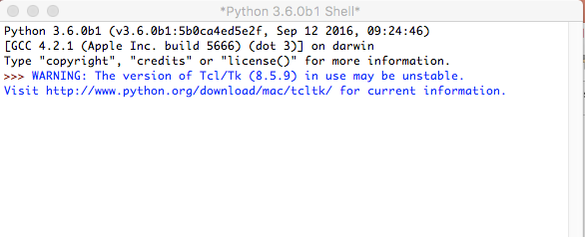
Python
Start IDLE

Slide 9
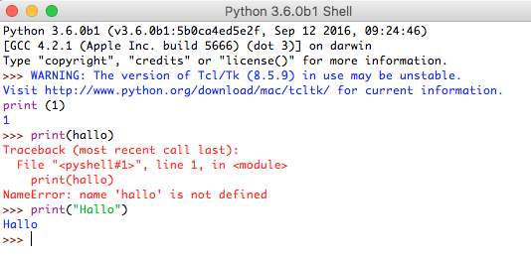
Interpretative
Python will compute each line when entered

Slide 10
Saving programs
Open a new file
Type print(1+2)
Save the file
Run the module
Should get the result 3

Slide 11
Write a program
Write a Python program to obtain a number from the user and then print it out
variable = input (‘Prompt')

Slide 12
Operators
== | Equal to
!= | Not equal to
< | Less than
<= | Less than or equal to
> | Greater than
>= | Greater than or equal to
Arithmetic Operators
+ | Addition e.g. x=6+5 gives 11
- | Subtraction e.g. x=6-5 gives 1
* | Multiplication e.g. x=12*2 gives 24
/ | Division e.g. x=12/2 gives 6
MOD | Modulus e.g. 12MOD5 gives 2
DIV | Quotient e.g. 17DIV5 gives 3
^ | Exponentiation e.g. 3^4 gives 81

Slide 13
Logical Operators
AND
OR
NOT
while x<=5 AND flag==false

Slide 14
Exercises
Write pseudocode to obtain a number from the user and then print out the square and the cube
Write pseudocode to obtain two numbers from the user and then print out their sum
Write pseudocode to obtain a radius of a circle from the user and then print out the area
Write Python programs for each one

Slide 15
Iteration
Iteration – Count Controlled
for i=0 to 7
print(“Hello”)
next i
Will print hello 8 times (0–7 inclusive)

Slide 16
Iteration
Iteration – Condition Controlled
while answer!=“computer”
answer=input(“What is the password?”)
endwhile
do
answer=input(“What is the password?”)
until answer==”computer”

Slide 17
Exercises
Write pseudocode to prompt the user to enter a radius of a circle and then print out the area, unless the radius is zero, in which case the program ends
Write pseudocode to print out Fibonacci numbers up to a number entered by the user (The Fibonacci sequence is a series of numbers where a number is found by adding up the two numbers before it. 0 1 1 2 3 5 etc)
Write Python programs for each
HINT – use while

Slide 18
Selection
if/else
if entry==“a” then
print(“You selected A”)
elseif entry==“b” then
print(“You selected B”)
else
print(“Unrecognised selection”)
endif

Slide 19
Selection
switch/case
switch entry:
case “A”:
print(“You selected A”)
case “B”:
print(“You selected B”)
switch/case
switch entry:
case “A”:
print(“You selected A”)
case “B”:
print(“You selected B”)
default:
print(“Unrecognised selection”)
endswitch
default:
print(“Unrecognised selection”)
endswitch

Slide 20
Exercises
Write pseudocode to prompt the user to enter a radius of a circle and then print out either the area or the circumference according to user input, unless the radius is zero, in which case the program ends
Write pseudocode for a program that prompts for two numbers and then either adds, subtracts, multiplies or divides them according to user input.
Write Python programs for each
HINT – initialise variables, declare constants

Slide 21
You have learnt:
The three fundamentals of programming
Sequence
Iteration
Selection

