Slide 1
Operating Systems and Architecture
^{<number systems>}
(UFCFCU-30-1)

Slide 2
Module introduction
Number systems
Digital logic
Representation of data
Computer architecture
Memory systems and storage architecture
I/O systems

Slide 3
^{<outcomes>}
After completing this section of the module you will be able to:
Describe and explain computer architecture, digital logic and machine level representation of data (number systems)
Binary
Hexadecimal
Binary addition and subtraction
2’s complement
Floating point
Logical operators

Slide 4
^{<computers don’t do decimal>}
All computers do is manipulate numbers
A computer required to work in decimal would not be impossible, but it would be impractical
Early computers did work in decimal using BCD (binary coded decimal) but even then the basic operation is in binary - a two state numbering system
Why?
Because there are 3 economical physical representations of two states
Electricity
Magnetism
Electromagnetic (light, radio)

Slide 5
^{<electricity>}
Electricity can be used to represent two states
Presence of a voltage or absence of a voltage

Slide 6
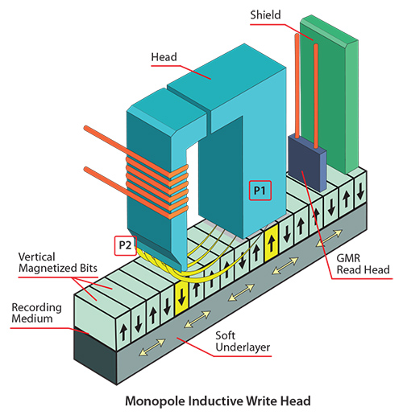
^{<magnetism>}
The orientation of the magnetic particles on a disc or tape (North-South or South-North) represents a 0 or a 1

Slide 7
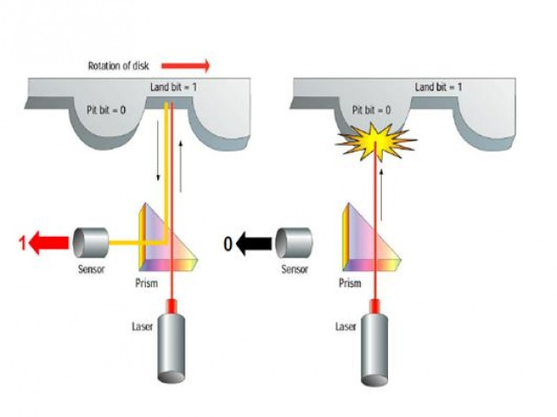
^{<light>}
The surface of an optical disc has pits burnt into it by a laser.
When laser light is shone on the disc a pit will scatter light and the regular surface (land) reflects the light.
In the diagram a reflection is given the value 1, scattering has the value 0

Slide 8
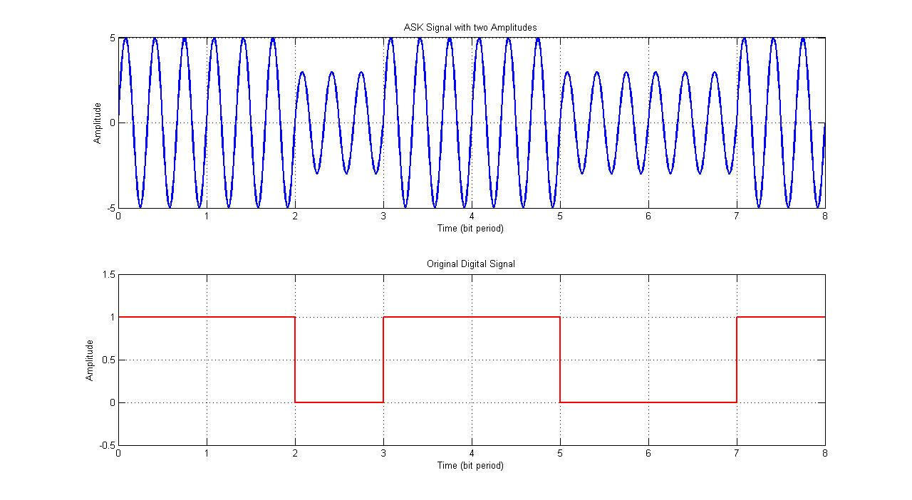
^{<wireless>}
A radio wave is amplitude modulated by binary data (amplitude shift keying)
A binary value of 1 has a greater amplitude than a binary value of 0

Slide 9
^{<base 10>}
256
In the first column from the right we multiply by 0 times 10
In the second column we multiply by 1 times 10
In the third column we multiply by 2 times 10
So the value 256 is really (2x10x10) + (5x10) + 6
Another way of saying this is that:
the first column is 10 to the power 0 = 1
the second column is 10 to the power 1 = 10
the third column is 10 to the power 2 = 100
So 256 = (2x10²)+(5x10¹)+(6x10⁰)
This is known as a base 10 numeral system, or decimal

Slide 10
^{<base 2>}
Decimal (or base 10) had 10 values
Binary (or base 2) has 2 values: 0 and 1
The binary digit is known as a bit
In computing the value 0 = false and the value 1 = true
Compared to base 10 each column is a power of 2
the first column is 2 to the power 0 = 1
the second column is 2 to the power 1 = 2
the third column is 2 to the power 2 = 4
the fourth column is 2 to the power 3 = 8

Slide 11
^{<values>}
The same value can be represented in base 10 or base 2
Range of 5 columns of binary = 0 - 31
Possible values of 5 columns of binary = 32
Value | 1 x 10¹ | 1 x 10⁰ |  | 1 x 2⁴ | 1 x 2³ | 1 x 2² | 1 x 2¹ | 1 x 2⁰
0 | 0 | 0 |  | 0 | 0 | 0 | 0 | 0
7 | 0 | 7 |  | 0 | 0 | 1 | 1 | 1
15 | 1 | 5 |  | 0 | 1 | 1 | 1 | 1
17 | 1 | 7 |  | 1 | 0 | 0 | 0 | 1

Slide 12
^{<bytes>}
In computing we use 8 columns – a byte
Range of 8 columns of binary = 0 - 255
Possible values of 8 columns of binary = 256
Value | 1 x 2⁷ | 1 x 2⁶ | 1 x 2⁵ | 1 x 2⁴ | 1 x 2³ | 1 x 2² | 1 x 2¹ | 1 x 2⁰
0 | 0 | 0 | 0 | 0 | 0 | 0 | 0 | 0
1 | 0 | 0 | 0 | 0 | 0 | 0 | 0 | 1
2 | 0 | 0 | 0 | 0 | 0 | 0 | 1 | 0
4 | 0 | 0 | 0 | 0 | 0 | 1 | 0 | 0
8 | 0 | 0 | 0 | 0 | 1 | 0 | 0 | 0
16 | 0 | 0 | 0 | 1 | 0 | 0 | 0 | 0
32 | 0 | 0 | 1 | 0 | 0 | 0 | 0 | 0
64 | 0 | 1 | 0 | 0 | 0 | 0 | 0 | 0
128 | 1 | 0 | 0 | 0 | 0 | 0 | 0 | 0

Slide 13
^{<hexadecimal>}
This is a 32 binary number (4 bytes)
10010010 11100110 01111010 10110101
It is painfully long to read or write
For convenience we read and write in hexadecimal
16 values: 0 – F
0 1 2 3 4 5 6 7 8 9 A B C D E F
These represent all the values of 4 bits
Two hexadecimal digits represent a byte

Slide 14
^{<hexadecimal>}
Converting our 32 bit binary number (4 bytes)
10010010 11100110 01111010 10110101
Split into groups of four
1001 0010 1110 0110 0111 1010 1011 0101
Covert to decimal
9 2 14 6 7 10 11 5
Convert to hexadecimal
9 2 E 6 7 A B 5
Return to bytes
92 E6 7A B5

Slide 15
^{<hexadecimal>}
92 E6 7A B5 is easy to read and write
Remember: the computer only works in binary
Is 92 decimal or hexadecimal?
Write hex as:
0x92

Slide 16
^{<operations>}
In manipulating numbers the two types of operations are:
Mathematical
Addition
Subtraction (done by addition using 2’s complement)
Multiplication (done by repeated addition)
Division (done by repeated subtraction)
Addition is the most efficient in hardware
Logical
Not
Or
And
Exclusive OR

Slide 17
^{<binary addition>}
Rule
0+0 = 0
1+0 = 1
1 +1 = 0 and carry 1
Examples
 | Binary |  |  |  | Decimal |  | Binary |  |  |  | Decimal
 | 0 | 1 | 0 | 1 | 5 |  | 0 | 1 | 1 | 1 | 7
 | 1 | 0 | 1 | 0 | 10 |  | 0 | 1 | 0 | 1 | 5
Sum | 1 | 1 | 1 | 1 |  |  | 0 | 0 | 1 | 0
Carried | 0 | 0 | 0 | 0 |  |  | 1 | 1 | 1
Result | 1 | 1 | 1 | 1 | 15 |  | 1 | 1 | 1 | 0 | 14

Slide 18
^{<negative binary >}
So far all integers have been unsigned
To represent signed integers there are 2 methods
1: Signed-magnitude
Use the most significant (leftmost) bit to indicate the sign
0 = positive
1 = negative
0001 1011 is +27
1001 1011 is -27
Range is -128 to +128
Problem: 2 values for zero (0000 0000 and 1000 0000)
Problem: Does not follow rules for addition or subtraction

Slide 19
^{<negative binary >}
2: Two’s complement
Use the most significant (leftmost) bit to indicate the sign
0 = positive
1 = negative
0001 1011 is +27 (the same as for signed-magnitude)
Negative numbers are a pattern that when added to the positive pattern results in zero
The two’s complement is obtained by flipping the bits and adding 1
Range is -128 to +127 (zero is treated as an integer)
Follows rules for addition or subtraction
3 |  | 0000 0011
 | Flip the bits | 1111 1100
-3 | Add 1 | 1111 1101
0 | Add 3 and -3 | 0000 0000

Slide 20
^{<binary subtraction>}
Examples
Note: ignore the carry beyond the MSB
7 | 0111
5 | 0101
-5 | 1011
7-5 = 2 | 0010
5 | 0101
7 | 0111
-7 | 1001
5-7 = -2 | 1110

Slide 21
^{<real numbers>}
Real numbers
+ 3.142
+ 1,000,205
- 0.000475
Floating point (scientific), set by the value of the exponent
+ 3.142 x 10⁺⁰
+ 1.000205 x 10⁺⁶
- 4.75 x 10⁻⁴
Labels - 4.75 x 10⁻ ⁴
Sign
Mantissa
Exponent’s sign
Exponent

Slide 22
^{<floating point>}
Use the same scheme for binary floating point
IEEE 754 Floating point standard (32 bit)
The most-significant bit, bit 31, is the sign of the number: 0 is positive, -1 is negative
The exponent field holds an 8-bit unsigned value from which we subtract 127 to get the actual power of two. This allows for positive and negative values without needing a sign bit
This is called biased notation, where the exponent has a bias (in this case, 127) subtracted to get the real power of two.
The mantissa (or fraction) is 23 bits long, which is about 8 decimal places long.
Each bit in the mantissa is a power of two which comes after the "decimal" place, i.e. the "decimal" place is implicitly to the left of bit 22.
31 | 30 | 29 | 28 | 27 | 26 | 25 | 24 | 23 | 22 | 21 | 20 | 19 | 18 | 17 | 16 | 15 | 14 | 13 | 12 | 11 | 10 | 9 | 8 | 7 | 6 | 5 | 4 | 3 | 2 | 1 | 0
S | 8 bit exponent |  |  |  |  |  |  |  | 23 bit mantissa

Slide 23
^{<floating point>}
Examples
The sign bit is 0, so it is a positive number
The exponent is 127, so 127-127 = 0
The mantissa is 11 with an implied 1 = 1.11
(the leading mantissa bit is always 1, so it is implied rather than stored)
1.11 = 1. 0.1₂ + 0.1₄ which is 1.5 + 0.25 = 1.75
The result is 1.75 x 2⁰ = 1.75
0 | 0 | 1 | 1 | 1 | 1 | 1 | 1 | 1 | 1 | 1 | 0 | 0 | 0 | 0 | 0 | 0 | 0 | 0 | 0 | 0 | 0 | 0 | 0 | 0 | 0 | 0 | 0 | 0 | 0 | 0 | 0
S | 8 bit exponent |  |  |  |  |  |  |  | 23 bit mantissa

Slide 24
^{<floating point>}
Difficulties with floating point
32 bit corresponds to 8 decimal places
Rounding errors
Implementation
Requires special hardware (FPU) or done in software

Slide 25
^{<logic>}
Logic functions
OR
A | B | Output
0 | 0 | 0
1 | 0 | 1
0 | 1 | 1
1 | 1 | 1
AND
A | B | Output
0 | 0 | 0
1 | 0 | 0
0 | 1 | 0
1 | 1 | 1
NOT
A | Output
0 | 1
1 | 0
XOR
A | B | Output
0 | 0 | 1
1 | 0 | 0
0 | 1 | 0
1 | 1 | 1

Slide 26
Module introduction
Number systems
Digital logic
Representation of data
Computer architecture
Memory systems and storage architecture
I/O systems

