Slide 1
1.3 Explain the following features of the Trustworthy Software Initiative (TSI):
Safety
Reliability
Availability
Resilience
Security

Slide 2
TSI Security Design Principles
Trustworthiness is based on five characteristics—safety, security, privacy, reliability and resilience, which directly and in combination provide protection against hazards and threats related to environmental disturbances, human errors, system faults and attacks.
Trustworthiness concerns must be addressed through architecture, design and proper software implementation procedures.

Slide 3
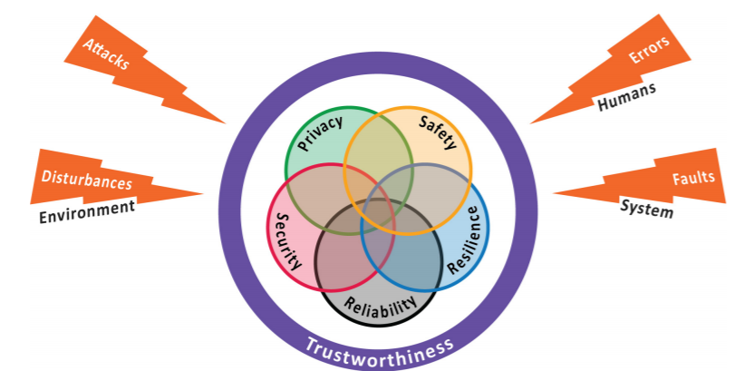
TSI Security Design Principles

Slide 4
TSI Security Design Principles
The root cause of many cybersecurity problems is untrustworthy software, caused by vulnerabilities related to safety, reliability, availability, resilience and security.
The Trustworthy Software Initiative (TSI) raises awareness of the dangers of untrustworthy software and provides the tools, techniques and information on software engineering good practice in order to deliver software that addresses these issues.

Slide 5
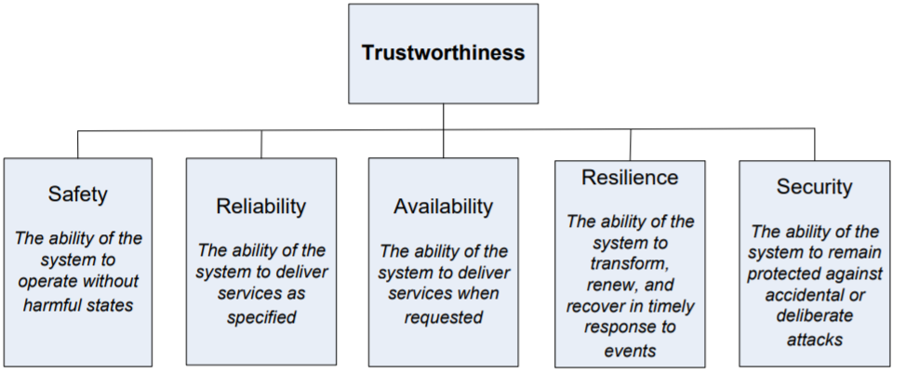
TSI Security Design Principles

Slide 6
TSI Security Design Principles
The UK Governments National Cyber Security Programme (NCSP) is sponsoring the TSI to provide tools, techniques and guidance in training both the future and current workforce in the production, supply and procurement of Trustworthy Software with the objective of ‘Making Software Better’.
Guidance for this initiative is provided by the Department for Business Innovation and Skills (BIS), the Centre for the Protection of the National Infrastructure (CPNI) and private sector organisations via a Stakeholder Advisory Group (SAG).
The TSI has captured and collated a body of existing guidance, relevant standards and best practices as its Trustworthy Software Framework (TSF) and is working with professional bodies, particularly the Institution of Engineering and Technology (IET), the British Computer Society (BCS) and the Institution of Analysts and Programmers (IAP) to provide education and training collateral to enable trustworthy systems to flourish.

Slide 7
TSI Security Design Principles
The TSF has been built as a layered repository with increasing levels of detail.
At the top level it introduces concepts, the next level addresses principles, the third level encompasses techniques and the fourth level is a repository for methods, citations and data sharing.

Slide 8
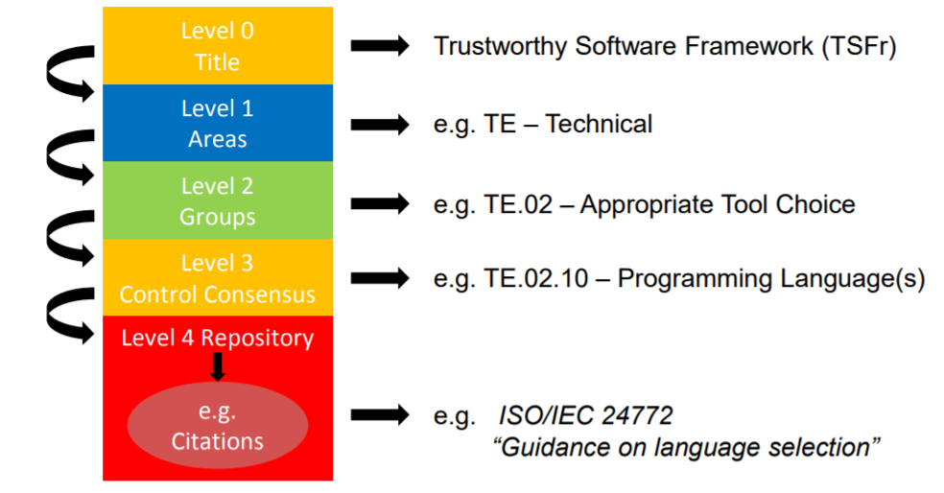
TSI Security Design Principles

Slide 9
TSI Security Design Principles

Slide 10
TSI Security Design Principles
Safety
“Safety is a property of a system that it will not endanger human life or the environment. “
[Storey 1996]
“We will define safety as a judgement of the acceptability of risk, and risk, in turn, as a measure of the probability and severity of harm to human health. A thing is safe if its attendant risks are judged to be acceptable.”
[Lowrance 1976]
“Safety of a system is the absence of catastrophic consequences on the user(s) and the environment.”
[Avižienis et al. 2004])

Slide 11
TSI Security Design Principles
Security
“the protection of information systems against unauthorized access to or modification of information, whether in storage, processing or transit, and against the denial of service to authorized users or the provision of service to unauthorized users, including those measure necessary to detect, document, and counter such threats .”
- National Information Systems Security Glossary
Notes:
With reference to Information Security

Slide 12
TSI Security Design Principles
Security
“There are no quick fixes for digital security. And with the number of security vulnerabilities, breaches, and digital disasters increasing over time, it's vital that you learn how to manage the vulnerabilities and protect your data in this networked world. You need to understand who the attackers are, what they want, and how to deal with the threats they represent.”
-Bruce Schneier

Slide 13
TSI Security Design Principles
Security
Information Security deals with several different trust aspects of data.
Information security applies to all aspects or safeguarding data in whatever form and is not confined to just computer systems or information in electronic form.
Three widely accepted elements of Information Security are confidentiality, integrity, and availability also known as the mnemonic “CIA”

Slide 14
TSI Security Design Principles
Security
Hackers, crackers, white hats, black hats, script kiddies to the elite attackers agree security or lack of security is their topic of choice.
While there are tools which has been proclaimed legitimate for “white hats” or security administrators by computer underground group Cult of the Dead Cow, can easy become a tool used for cyber terrorism acts by script kiddies or “black hats”.

Slide 15
TSI Security Design Principles
Security
Viruses, Trojans and worms are used and relied on heavily in attacks. Companies such as Symantec and McAfee defend and protect against such malware, but yet the possibly biggest threat is still at large and can not be stopped by software.
Social Engineering is the art of exploiting weaknesses in people, rather than software, tricking someone into giving out information like passwords that will compromise a systems security.
Kevin Mitnick one of the worlds proclaimed hacking legends gives the reason for his status to the art of social engineering.
Kevin’s book The Art of Deception shows the weakness in organizations and the government by disposing the weakest security link, the end user.

Slide 16
TSI Security Design Principles
Availability
Data availability means that information is accessible to authorized users. It provides an assurance that your system and data can be accessed by authenticated users whenever they’re needed.
Availability is typically associated with reliability and system uptime, which can be impacted by non-malicious issues like hardware failures, unscheduled software downtime, and human error, or malicious issues like cyberattacks and insider threats.

Slide 17
TSI Security Design Principles
Availability
Information security policies and security controls address availability concerns by putting various backups and redundancies in place to ensure continuous uptime and business continuity.
Your information is more vulnerable to data availability threats than the other two components in the CIA model.
Making regular off-site backups can limit the damage caused to hard drives by natural disasters or server failure. Information only has value if the right people can access it at the right time.

Slide 18
TSI Security Design Principles
Availability
It guarantees that systems, applications and data are available to users when they need them. The most common attack that impacts availability is denial-of-service in which the attacker interrupts access to information, system, devices or other network resources.

Slide 19
TSI Security Design Principles
Resilience
Resilience in software describes its ability to withstand stress and other challenging factors to continue performing its core functions and avoid loss of data.
“Software solution resiliency refers to the ability of a solution to absorb the impact of a problem in one or more parts of a system, while continuing to provide an acceptable service level to the business.”
--IBM

Slide 20
TSI Security Design Principles
Resilience
Resilience is an essential quality attribute of most systems because they provide critical capabilities and services that must continue despite the inevitable adversities.
System resilience is the degree to which a system rapidly and effectively protects its critical capabilities from harm caused by adverse events and conditions.

Slide 21
TSI Security Design Principles
Resilience
System resilience testing is not about verifying whether the system operates properly under normal circumstances. Instead, this type of test is primarily performed to verify whether the system is actually resilient when faced with the adversities.
Adversities are created to determine how the system reacts to check system Resilience..
System resilience testing primarily falls into three categories:
Black Box
White Box
Grey Box

Slide 22
TSI Security Design Principles
Reliability
“the extent to which an experiment, test, or measuring procedure yields the same results on repeated trials”
- Merriam-Webster

Slide 23
TSI Security Design Principles
Reliability
The concern for reliability is not anything newly introduced.
Today, Microsoft is taking new strives to define reliability by defining it in one of their four core areas of Trustworthy Computing

Slide 24
TSI Security Design Principles
Reliability
Relaibiltiy in the content of Trustworthy Computing is presented by Microsoft as more then just reliable software and provding support.
Microsoft believes it means being a reliable business partner, maintaining an open dialogue with our customers and industry partners, and seeking feedback about how we can improve our software and services

Slide 25
TSI Security Design Principles
Reliability
In engineering and telecommunication, the mean time between failures (MTBF) is the average time a system will operate without a failure.
A primary way to determine the level of reliability provided is to measure the amount of MTBF.
MTBF is an indicator of expected system reliability calculated on a statistical basis from the known failure rates of various components of the system usually expressed in hours .

Slide 26
TSI Security Design Principles
Reliability
It should also be noted that currently:
· There is no standard measure of MTBF
· Its often calculated and inferred rather than tested
· The MTBF applies only statistically (and cannot be taken as an expected lifetime)

Slide 27
TSI Security Design Principles
Reliability
In 1984 Charles Perrow wrote a book called Normal Accidents: Living with High Risk Technologies. In it Charles observed that system accidents can be the result of one big failure, but most often are caused by the unexpected interactions between failures of multiple components. The observations by Charles Perrow and others lead to NASA’s Normal Accident Theory in which suggests that in complex tightly coupled systems, accidents are inevitable, thus creating MTBF .
Normal Accident defined by World Spy is an accident that is the nearly inevitable result of technological interactions so complex that they cannot fully predicted or controlled.

Slide 28
TSI Security Design Principles
Availability
Data availability means that information is accessible to authorized users. It provides an assurance that your system and data can be accessed by authenticated users whenever they’re needed.
Availability is typically associated with reliability and system uptime, which can be impacted by non-malicious issues like hardware failures, unscheduled software downtime, and human error, or malicious issues like cyberattacks and insider threats.

Slide 29
TSI Security Design Principles
Availability
Information security policies and security controls address availability concerns by putting various backups and redundancies in place to ensure continuous uptime and business continuity.
Your information is more vulnerable to data availability threats than the other two components in the CIA model.
Making regular off-site backups can limit the damage caused to hard drives by natural disasters or server failure. Information only has value if the right people can access it at the right time.

Slide 30
TSI Security Design Principles
Availability
It guarantees that systems, applications and data are available to users when they need them. The most common attack that impacts availability is denial-of-service in which the attacker interrupts access to information, system, devices or other network resources.

Slide 31
TSI Security Design Principles
Resilience
Resilience in software describes its ability to withstand stress and other challenging factors to continue performing its core functions and avoid loss of data.
“Software solution resiliency refers to the ability of a solution to absorb the impact of a problem in one or more parts of a system, while continuing to provide an acceptable service level to the business.”
--IBM

Slide 32
TSI Security Design Principles
Resilience
Resilience is an essential quality attribute of most systems because they provide critical capabilities and services that must continue despite the inevitable adversities.
System resilience is the degree to which a system rapidly and effectively protects its critical capabilities from harm caused by adverse events and conditions.

Slide 33
TSI Security Design Principles
Resilience
System resilience testing is not about verifying whether the system operates properly under normal circumstances. Instead, this type of test is primarily performed to verify whether the system is actually resilient when faced with the adversities.
Adversities are created to determine how the system reacts to check system Resilience..
System resilience testing primarily falls into three categories:
Black Box
White Box
Grey Box

Slide 34
TSI Security Design Principles
“Trustworthy Software is software that is appropriately free from defects that cause it to fail.
It performs as it should, when it should and how it should.”
------------TSI WORKING DEFINITION…

Slide 35
TSI Security Design Principles

Slide 36
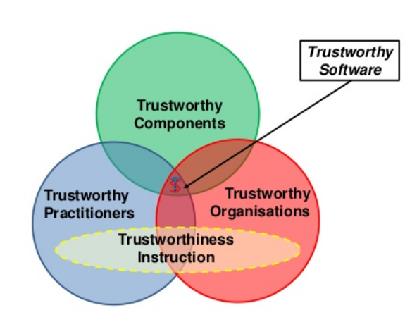
TSI Security Design Principles

Slide 37
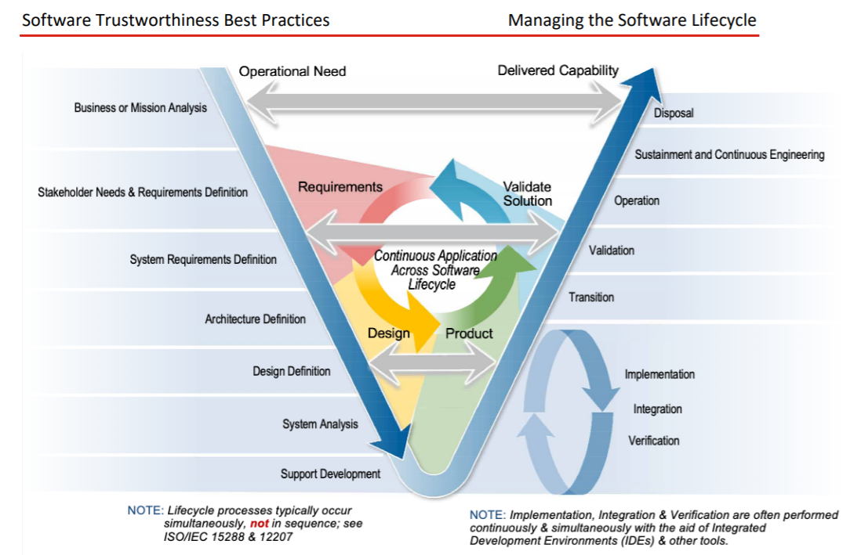
TSI Security Design Principles
.

Slide 38
TSI Security Design Principles
.
Notes:
The figure illustrates the lifecycle phases and the activities, focusing on iterative cycles of whatever duration. Particular attention is given to show how operation needs initiate an iterative cycle of requirements, design, product and solution validation as well as the underlying iterative cycles with the software production itself showing the flexibility of addressing them using either the waterfall or agile methods or a hybrid approach.

Slide 39
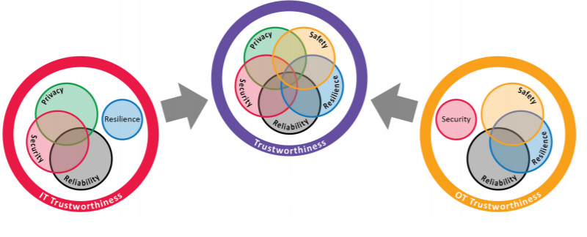
TSI Security Design Principles
Differing concerns of IT and OT and how they must be considered together in an overall system.

Slide 40
CIA Triad
Confidentiality
Secure
Integrity
Availability

Slide 41
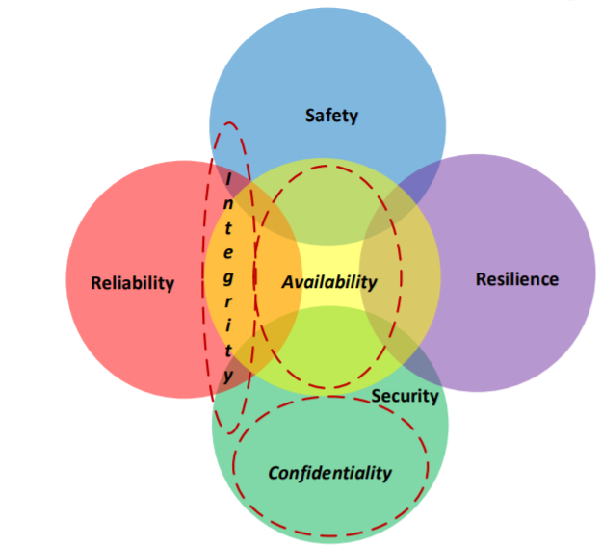
Trustworthiness and Security Mapping
On their own, each component has a methodology
The challenge is combining it all together.

Slide 42
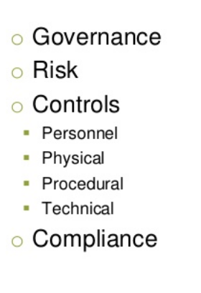
TSI Security Design Principles

Slide 43
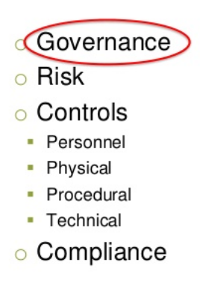
TSI Security Design Principles

Slide 44
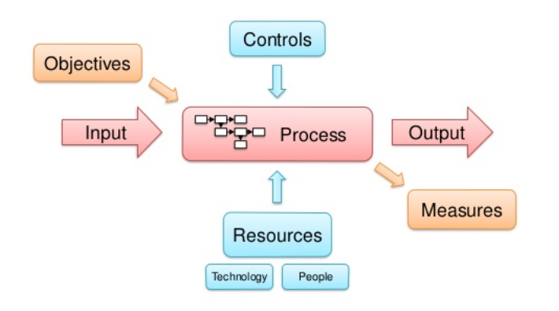
TSI Security Design Principles

Slide 45
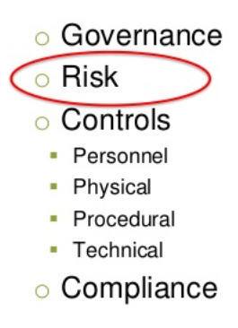
TSI Security Design Principles

Slide 46
TSI Security Design Principles
.

Slide 47
TSI Security Design Principles
.

Slide 48
TSI Security Design Principles
.

Slide 49
TSI Security Design Principles
.

Slide 50
TSI Security Design Principles

Slide 51
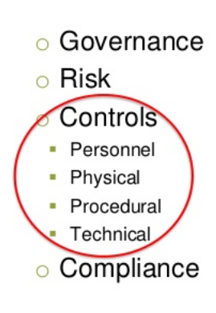
TSI Security Design Principles

Slide 52
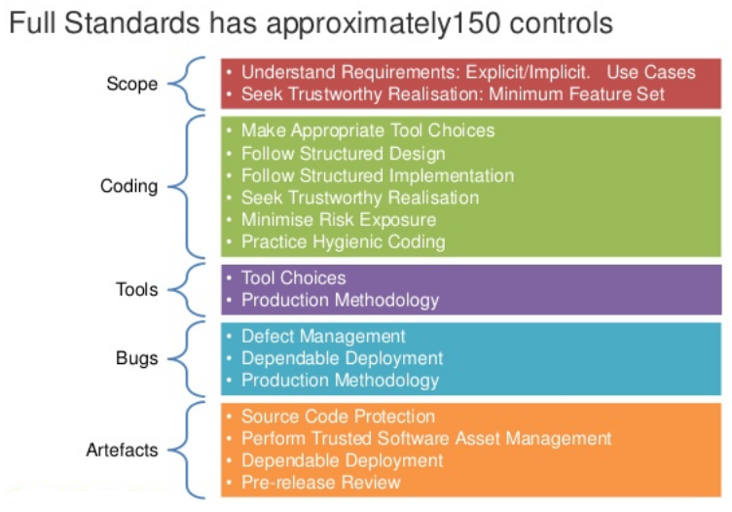
TSI Security Design Principles

Slide 53
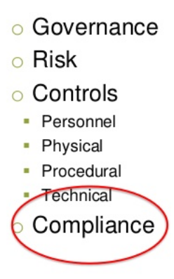
TSI Security Design Principles

Slide 54
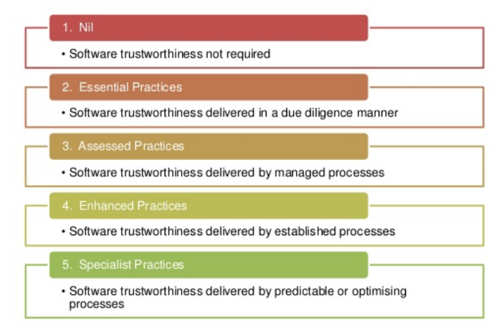
TSI Security Design Principles

Slide 55
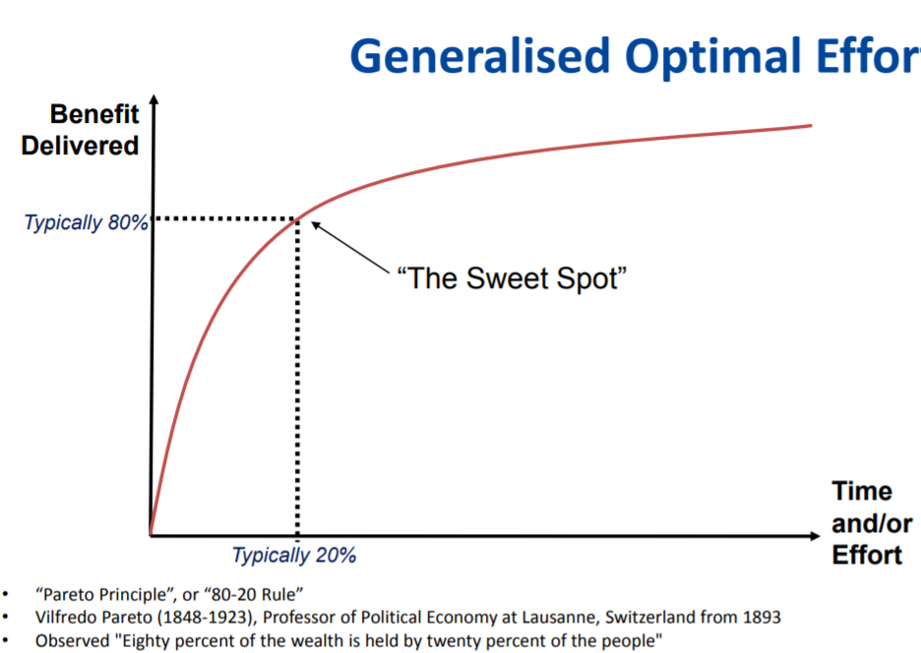
TSI Security Design Principles
.

Slide 56
TSI Security Design Principles

Slide 57
TSI Security Design Principles

Slide 58
TSI Security Design Principles

Slide 59
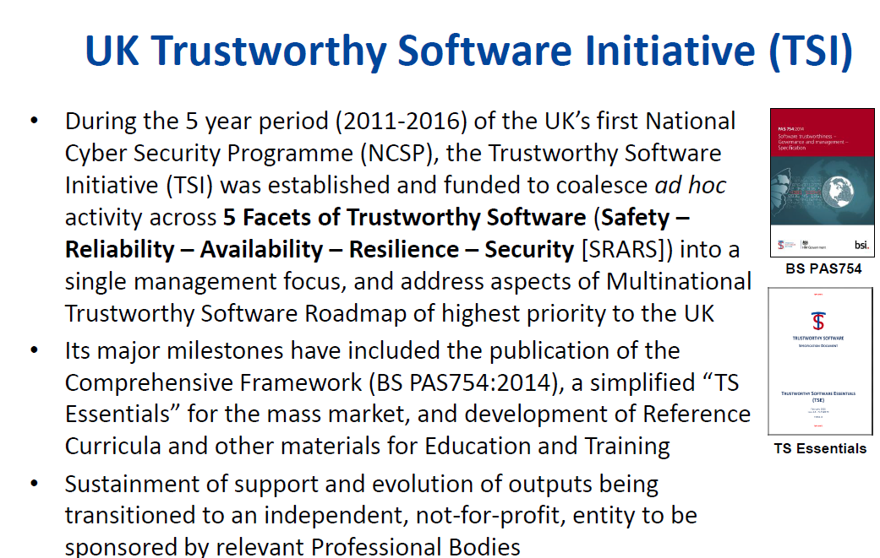
TSI Security Design Principles
.
Notes:
The figure illustrates the lifecycle phases and the activities, focusing on iterative cycles of whatever duration. Particular attention is given to show how operation needs initiate an iterative cycle of requirements, design, product and solution validation as well as the underlying iterative cycles with the software production itself showing the flexibility of addressing them using either the waterfall or agile methods or a hybrid approach.

Slide 60
TSI Security Design Principles
.

Slide 61
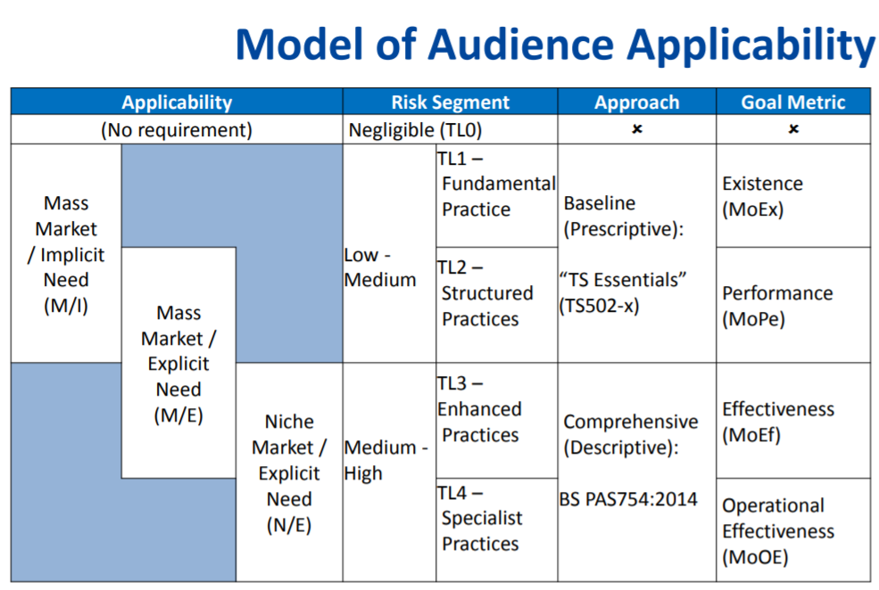
TSI Security Design Principles

