Slide 1
Week 2 – Day 4
Cyber Threats
UFCFFU-30-1

Slide 2
Cyber Threats
Week 2
Monday
01
02
Ways to defend against cyber attack
Tuesday
04
03
Thursday
Wednesday
05
Friday

Slide 3
Week 2 - Thursday
Ways to defend against cyber attack

Slide 4
Ways to defend against cyber attack
Reducing the impact helps organisations understand what a common cyber attack looks like and explains why all organisations should establish basic security controls and processes, to protect themselves from such attacks
Regardless of whether an attack is targeted or un-targeted, or the attacker is using commodity or bespoke tools, cyber attacks have a number of stages in common. Some of these will meet their goal whilst others may be blocked

Slide 5
Stages of an Attack
Breach
Exploiting the vulnerability/vulnerabilities to gain some form of unauthorised access
Affect
Carrying out activities within a system that achieve
the attacker’s goal
Survey
Investigating and analysing available information about the target in order to identify potential vulnerabilities
Delivery
Getting to the point in a system where a
vulnerability can be exploited

Slide 6
Change your security focus
Most computer security defenders focus on the wrong things
They focus on specific threats and what they did after hackers broke in, not how they broke in
About a dozen different ways that they initially exploited an environment, including:
Unpatched software
Social engineering
Misconfigurations
Password attacks
Physical attacks
Eavesdropping
User errors
Denial of service

Slide 7
Unpatched Software
Most enterprise vulnerabilities remain unpatched a month after discovery
Security vulnerabilities in Microsoft software have become an even more popular means of attack by cyber criminals
Adobe Flash vulnerability still ranks as the second most used exploit by hacking groups

Slide 8
Problems With Unused Software
Unused software doesn’t get added to the inventory, positioning the business to be compromised
It’s expensive and companies are losing valuable dollars
Noncompliance is a nightmare
Security breaches will run rampant on you
Productivity diminishes

Slide 9
Issues with Unpatched Software
Bad Reputation
High penetration rates, especially on Windows 7 or 8
Open door to malware, just like unused software is
No or little integration with new software
If the outdated software includes the use, storage or application of data, that data becomes at risk
Out-of-date software becomes less and less likely to work on new hardware and remain compatible with newer operating systems
Don’t let your software go off — keep it updated, secure and healthy
Notes:
Bad Reputation
High penetration rates, especially on Windows 7 or 8
Open door to malware, just like unused software is
No or little integration with new software
If the outdated software includes the use, storage or application of data, that data becomes at risk
Out-of-date software becomes less and less likely to work on new hardware and remain compatible with newer operating systems
You wouldn’t leave rotten food in the fridge, because you risk the fresh food spoiling too.
Software is the same. So, don’t let your software go off — keep it updated, secure and healthy

Slide 10
Social Engineering
The act of tricking someone into divulging information or taking action, usually through technology
The idea behind social engineering is to take advantage of a potential victim’s natural tendencies and emotional reactions

Slide 11
Five most common forms of digital social engineering assaults
Baiting attacks
Use a false promise to pique a victim’s greed or curiosity
The most reviled form of baiting uses physical media to disperse malware.
Baiting scams don’t necessarily have to be carried out in the physical world
Scareware attacks
Scareware involves victims being bombarded with false alarms and fictitious threats
Scareware is also referred to as deception software, rogue scanner software and fraudware.
Scareware is also distributed via spam email that doles out bogus warnings, or makes offers for users to buy worthless/harmful services.
Pretexting
Obtains information through a series of cleverly crafted lies
Phishing
One of the most popular social engineering attack types
Spear phishing
A more targeted version of the phishing scam whereby an attacker chooses specific individuals or enterprises

Slide 12
Misconfigurations
82% of vulnerabilities analysed were due to misconfiguration in areas like firewalls and passwords; categorized as CWE-16
CWE-16 weaknesses can be introduced due to weak/default passwords, deprecated protocols, open public database instance or if the file system is exposed and not encrypted
Security misconfigurations are security controls that are inaccurately configured or left insecure, putting your systems and data at risk
Basically, any poorly documented configuration changes, default settings, or a technical issue across any component in your endpoints could lead to a misconfiguration
Notes:
CWE – Common Weakness Enumeration

Slide 13
Password attacks
Password reuse at 60%
One of the most common forms of corporate and personal data breach
A password attack is simply when a hacker tries to steal your password
In 2020, 81% of data breaches were due to compromised credentials

Slide 14
Password Attack Vectors
Phishing
Man-in-the-middle attack
Brute force
Dictionary attack
Credential stuffing
Keyloggers

Slide 15
Physical attacks
Covered physical security yesterday
An attacker gains physical access to a physical asset in the infrastructure system in order to damage it, disable it, steal it, or use it in an undesirable way

Slide 16
Eavesdropping
Eavesdropping is the act of secretly or stealthily listening to the private conversation or communications of others without their consent in order to gather information
An eavesdropping attack, also known as a sniffing or snooping attack, is a theft of information as it is transmitted over a network by a computer, smartphone, or another connected device
The attack takes advantage of unsecured network communications to access data as it is being sent or received by its user

Slide 17
User errors
Self explanatory

Slide 18
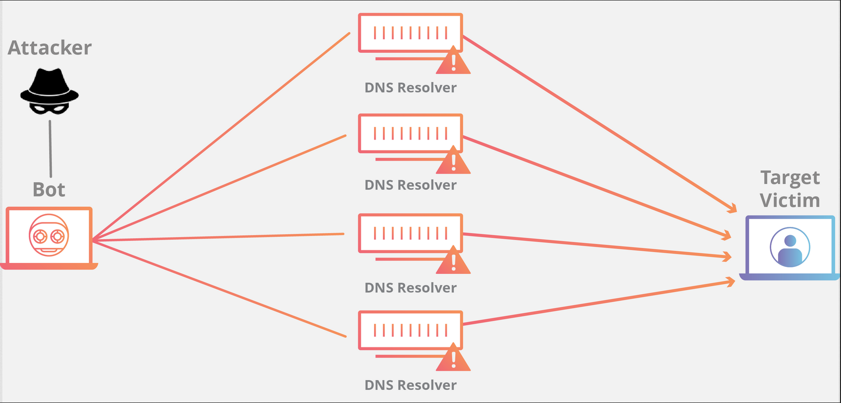
Denial of service
A Denial-of-Service (DoS) attack is an attack meant to shut down a machine or network, making it inaccessible to its intended users
DoS attacks accomplish this by flooding the target with traffic, or sending it information that triggers a crash

Slide 19
Reducing Exposure to Cyber Attack
Breaking the attack pattern
Reducing your exposure using essential security controls
Mitigating the stages of an attack

Slide 21
10 Steps to Cyber Security
The 10 steps to cyber security was originally published in 2012 and is now used by a majority of the FTSE350
Risk Management Regime
Secure Configuration
Home and Mobile Working
Incident Management
Malware Prevention
Managing User Privileges
Monitoring
Network Security
Removable Media Controls
User Education and Awareness
See document on the Wiki

Slide 22
10 Ways to Prevent Cyber Attacks
Train employees in cyber security principles
Install, use and regularly update antivirus and antispyware software on every computer used in your business
Use a firewall for your Internet connection
Download and install software updates for your operating systems and applications as they become available
Make backup copies of important business data and information
Control physical access to your computers and network components.
Secure your Wi-Fi networks. If you have a Wi-Fi network for your workplace make sure it is secure and hidden
Require individual user accounts for each employee
Limit employee access to data and information and limit authority to install software
Regularly change passwords

Slide 23
Mitre Att&ck
Globally-accessible knowledge base of adversary tactics and techniques based on real-world observations
The ATT&CK knowledge base is used as a foundation for the development of specific threat models and methodologies in the private sector, in government, and in the cybersecurity product and service community

Slide 24
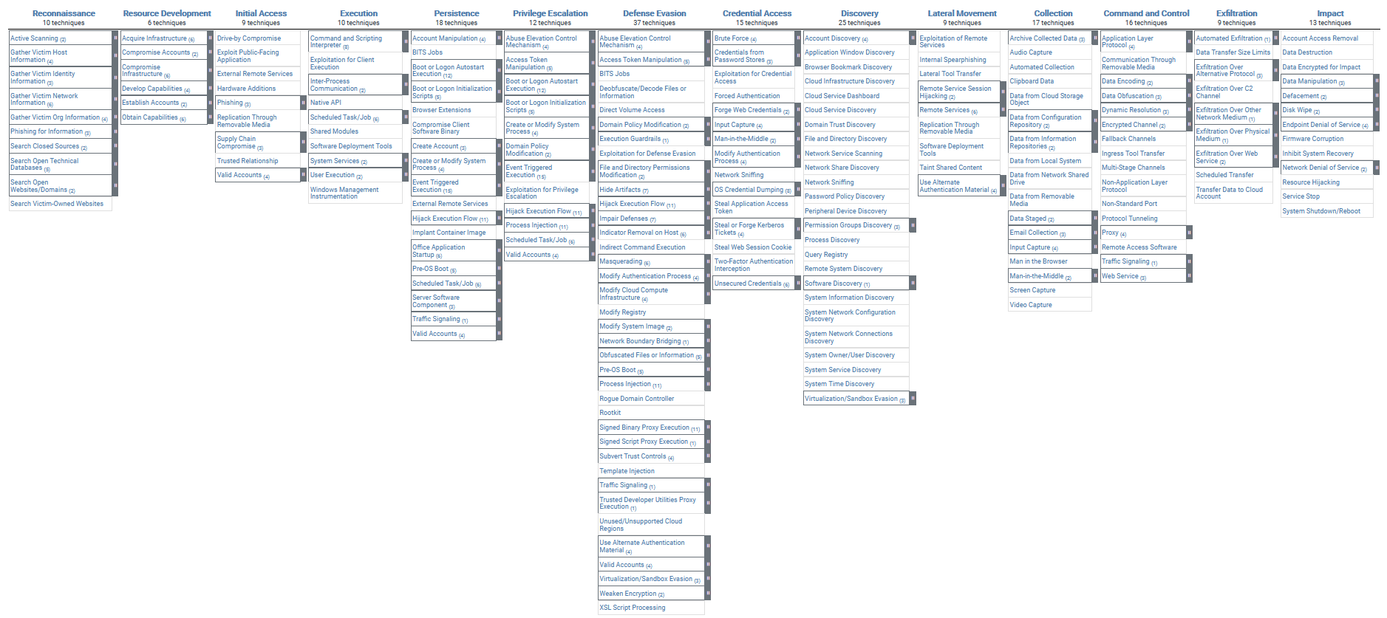
Mitre Att&ck

Slide 25
Mitre Att&ck
Each item in the knowledgebase has a unique code which is searchable
Each item in the knowledgebase has a hyperlink which will give you more information on that particular technique

Slide 26
Cyber Threats
Week 1
Monday
01
Tuesday
02
03
Wednesday
04
Thursday
05
Friday

