Slide 1
Network Engineer L4 COMPTIA NETWORK+
N10-007 Day 1

Slide 2
Why Network+
Shows interest in the field of networking at large
Show competency in crucial networking configuration duties
The Network+ certification is a product of choice for many companies
Comptia is not product-specific
Preparation of Network+ will improve your chances for future IT certifications

Slide 3
Introduction
Week 1
Week 2
Modules 1 – Local Area Networks
Module 2 – IP Addressing
Module 3 - Internetworking
Module 4 – Applications and Security
Module 5 – Operations and Infrastructure

Slide 4
Network+ Exam Facts
Number of questions: | Maximum of 90 questions
Type of questions: | Multiple choice and performance-based
Length of test: | 90 minutes
Passing score: | 720 (scale of 100-900)
Exam codes: | N10-007 released Mar 2018 N10-006 retired Aug 31, 2018
Cert timeframe: | Valid for three years from date exam is passed.

Slide 5
Domains and Weighting
COMPTIA Network+ Certification Domain Areas | Weighting
1.0 - Networking Concepts | 23%
2.0 - Infrastructure | 18%
3.0 – Network Operations | 17%
4.0 – Network Security | 20%
5.0 – Network Troubleshooting and Tools | 22%

Slide 6
Introduction – Module 1: Local Area Networks
Topologies and OSI model
Ethernet
Hubs, bridges and switches
Infrastructure and design
Policies and best practice

Slide 7
Introduction – Module 2: IP Addressing
Internet Protocol
IPv4 Addressing
IPv6 Addressing
DHCP and APIPA

Slide 8
Introduction – Module 3: Internetworking
Routing
TCP and UDP
Name resolution and IPAM
Monitoring and Scanning
Network troubleshooting

Slide 9
Introduction – Module 4: Applications and Security
Applications and Security
Virtualisation, SAN and Cloud Services
Network Security Design
Network Security Appliances
Authentication and Endpoint Security

Slide 10
Introduction – Module 5: Operations and Infrastructure
Network Site Management
Installed Cable Networks
Installing Wireless Networks
Installing WAN Links
Configuring Remote Access

Slide 11
Network Engineer L4 COMPTIA NETWORK+
N10-007
Module 1

Slide 12
Module 1 - Local Area Networks
Topologies and OSI model
Ethernet
Hubs, bridges and switches
Infrastructure and design
Policies and best practice

Slide 13
Topologies
Bus
Star
Ring
Mesh
Ad Hoc
Infrastructure
Wireless Mesh

Slide 14
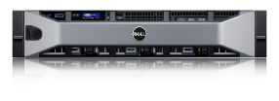
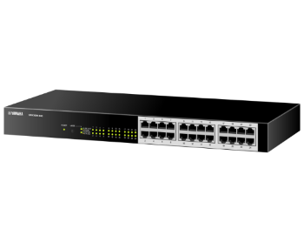
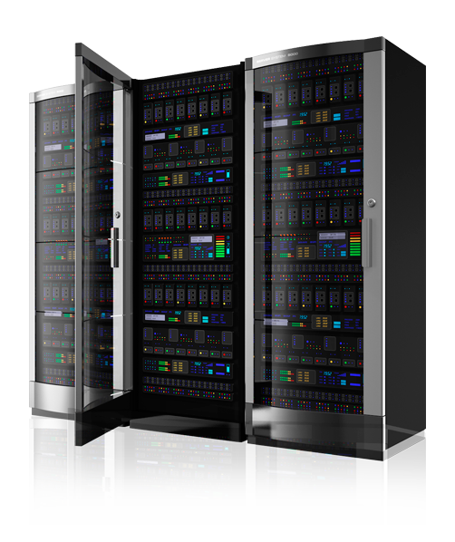
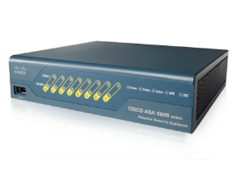
Before We Dive in …
Building 2
Subnet
192.168.3.0/24
Email
192.168.10.5
DB
192.168.10.7
Building 2 Switch
192.168.3.1
Core Switch
192.168.10.100
Core Router
10.1.10.1
Internet
Internet Router
10.1.1.1
Internet
Firewall
Building 1
Subnet
192.168.2.0/24
Building 1 Switch
192.168.2.1

Slide 15
Topologies
A term used in the description of the schematic depiction of the arrangement of a network
It is used to describe the various ways in which nodes are connected

Slide 16
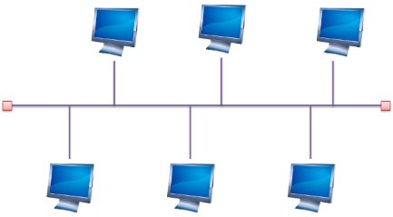
Topologies: Bus
A bus network is an arrangement in a local area network (LAN) in which each node (workstation or other device) is connected to a main cable or link called the bus
Simple and reliable
Transmission of data in only one direction
If one node fails to operate, all the rest can still communicate with each other
For a major disruption to take place, the bus itself must be broken somewhere
Bus networks are easy to expand
Additional nodes can be added anywhere along the bus

Slide 17
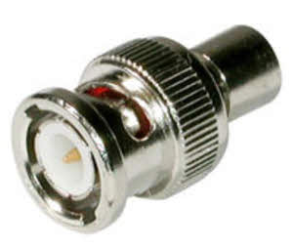
Topologies - Bus
There are several limitations to the bus network topology
The length of the bus is limited by cable loss
A bus network may not work well if the nodes are located at scattered points that do not lie near a common line
In situations like this, a ring network, mesh network, or star network may prove more flexible and more cost effective
Requires terminators
Limited to 10Mbps

Slide 18
Topologies - Bus
Advantages of the Bus Topology
The bus topology as we know it is very cost-effective
This topology system makes use of the least amount of cable, unlike the others
This is sufficient for small networks
A layperson can easily understand this system
You can also quickly expand on this network

Slide 19
Topologies - Bus
Disadvantages of the Bus Topology
Once there is a problem in one part of the cable, the whole network is down
At the advent of traffic on the network, the entire network will have a slowed-down performance
Collisions occur in the network resulting in packet loss
There is a limit to the strength of the cable
This topology is not as speed effective as the ring topology
It is difficult to isolate faults in the network

Slide 20
Topology - Bus
https://www.bbc.co.uk/bitesize/guides/z7mxh39/revision/6

Slide 21
Topologies: Star
Star topology (or ‘star network’) is the most widely used network for LANs
First popularized by ARCnet, before being adopted by Ethernet
Each node (such as a computer or printer) within the company or team is connected to one central network device (which could be a hub, a switch, or a computer) via a cable
When the nodes (or computers) want to communicate with each other, they pass the message on to the central server hub, which then forwards that message back on to the different nodes

Slide 22
Topologies: Star
Advantages of a Star topology
If one node or connection breaks, the rest of the network remains unaffected
Other computers and their connections can continue working with zero downtime
It’s highly scalable: new computers/machines can be added or removed without disturbing the whole network
Star networks can accommodate lots of different machines, which means it’s possible to create a large network
Star networks are safer in the event of a cyber attack
Notes:
Star networks are safer in the event of a cyber attack. Let’s say you run a bank with several branches. If one branch or office comes under attack, the server will be notified and prevent a second. One branch goes down, but the others continue running in complete safety

Slide 23
Topologies: Star
Disadvantages of a Star topology
Each cable is individually connected to the central node, which means you’re going to need A LOT of cables
The hub (central node) is a single point of failure, which means that if it stops, it brings the whole lot down
In reality, there are only so many machines you can connect to a central server before you start running out of cable length and ports
Notes:
Each cable is individually connected to the central node, which means you’re going to need A LOT of cables
And that doesn’t come cheap. Although it’s worth noting that the upfront cost of cables is a fraction of the cost of downtime in the event of a total system failure. Most network designers think this benefit far outweighs the cable cost.
The hub is a single point of failure, which means that if it stops, it brings the whole lot down.
In reality, there are only so many machines you can connect to a central server before you start running out of cable length and ports. One way to get around this is to extend the star topology into multiple stars with a new central server in the middle. In this situation, messages from each system are transferred to its star, which then transfers it to the core server, then back out to the star and then to the destination system.

Slide 24
Topologies: Ring
Computers are connected to each other in a circular format
Every device in the network will have two neighbours and no more or no less
Ring topologies were commonly used in the past but you would be hard pressed to find an enterprise still using them today
The first node is connected to the last node to link the loop together
As a consequence of being laid out in this format packets need to travel through all nodes on the way to their destination
Within this topology, one node is chosen to configure the network and monitor other devices
Ring topologies are half-duplex but can also be made full-duplex
To make ring topologies full-duplex you would need to have two connections between network nodes to form a Dual Ring Topology

Slide 25
Topologies: Ring
Disadvantages of a ring topology:
If any of the nodes fail, the ring is broken and data cannot be transmitted
It is difficult to troubleshoot a ring network topology
Because all nodes are wired together, the network must be temporarily stopped to add additional nodes

Slide 26
Topologies: Ring
Advantages of a ring topology:
Data passes around the network in one direction, there are no network collisions
Adding additional nodes has very little impact on bandwidth

Slide 27
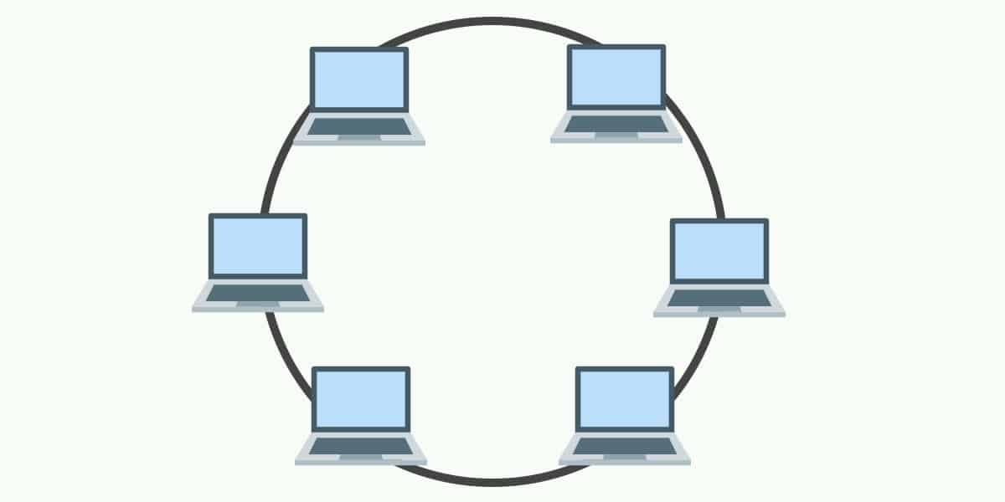
Topologies: Ring
Single – half-duplex
Dual – full-duplex

Slide 28
Topologies - Ring

Slide 29
Topologies: Mesh
Each computer and network device is interconnected with one another, allowing for most transmissions to be distributed even if one of the connections go down
It is a topology commonly used for wireless networks
Each node has a dedicated point-to-point link to every other node
A fully connected mesh network having ‘n’ number of nodes has a total of n(n-1)/2 number of links
Example: 6 nodes = (6(6-1))/2 = 15 links

Slide 30
Topologies - Mesh
Full Mesh
Every node has a circuit connecting it to every other node in the network
Yields greatest redundancy, so if one node fails, network traffic can be redirected to any of the other nodes
Usually reserved for backbone networks since it is very expensive

Slide 31
Mesh

Slide 32
Topologies - Mesh
Partial Mesh
Some nodes are organized in a full mesh scheme but others are only connected to 1 or 2 in the network
Common in peripheral networks connected to a full meshed backbone
Less expensive to implement
Yields less redundancy

Slide 33
Partial Mesh
Notes:
Nodes 1 and 2 are connected to every other node

Slide 34
Topologies: Ad Hoc or Hybrid
No pre-existing infrastructure
Devices communication amongst themselves
Can be a mixture of topologies
Multiple physical topologies are combined to form one large network
Each topology has its own strengths and weakness
Objective: total strength improves the network performance

Slide 35
Topologies: Infrastructure
All devices communicate through an access point
The most common wireless communication mode

Slide 36
Topologies: Wireless Mesh
Ad hoc devices work together to form a mesh “cloud”
Self form and self heal

Slide 37
Topologies: Wireless Mesh
Advantages
Scalability
Robustness
Redundancy
Notes:
. Scalability
One of the advantages of a mesh topology is that (in theory) you don’t need to add routers to the network, as each node can act as a router. If you’re working on a mesh network for the lighting in your office building, and you want to add a light in a particular room, you should be able to add the light and have it automatically connect to the network. There isn’t a lot of extra management that needs to happen, which makes the network scalable.
2. Robustness
Another benefit of a mesh network topology is that if one of the nodes goes down, it doesn’t necessarily bring the entire network down. The network can heal itself around a bad node if other nodes can complete the mesh. Additionally, if you need to get more range out of a mesh system, you can add another node and the messages can hop through the mesh back to the gateway—which is why some believe mesh networks are more robust.
Because all nodes in a mesh are receiving and translating information, there is some redundancy in a mesh topology; however, you can also gain speed with the excess bandwidth. If one route happens to be slow, a mesh network could potentially find a better route and optimize itself.

Slide 38
Topologies: Wireless Mesh
Disadvantages
Complexity
Network Planning
Latency
Power Consumption
Notes:
Disadvantages Of A Mesh Topology
1. Complexity
Each node needs to both send messages as well as act as a router, which causes the complexity of each node to go up pretty significantly. Let’s say you’re making a small, low-power device—like a room occupancy sensor—and you are looking to get better range out of your system. The nodes have to now keep track of messages from five or 10 of their ‘neighbors,” which exponentially increases the amount of data that node has to deal with in order to pass along a message. Thus, if you add additional sensors to the mesh just to benefit the range, you’re naturally making the system more complex.
2. Network Planning
As we mentioned previously, mesh networks are often considered highly scalable, and adding a node to the network typically isn’t very involved. But planning the network as a whole is a different story. Let’s say you have poor latency in one area of your building (which we’ll discuss below), and you need a particular light to turn on faster than it currently turns on. With a mesh network, you’d need to add a dedicated node that only forwards messages. But this complicates your network planning, because you now have to deploy a piece of equipment just to get your messages properly routed in a reasonable amount of time.
3. Latency
As mentioned, latency—the time it takes a message to get from a node to the gateway—can impact your mesh network planning. Interestingly, you may improve some latency by using a mesh network with a larger scale system with more bandwidth, memory, and power. But latency becomes an issue in smaller low power, wide-area networks (LPWANs) because it doesn’t have the processing capability to handle the messaging. Thus, if you have a WiFi mesh, messages will likely be translated much quicker than a ZigBee mesh. This is something to consider based on the protocol you’ll be using and the latency your application requires.
4. Power Consumption
Because each node in a mesh has to act as an endpoint and a router, it has to draw more power to operate. Thus, if you have battery-powered, low-power nodes, a mesh may be difficult to deploy without a lot of network planning.
Let’s say you have battery-powered nodes in windows and doors for your smart security system. The customer keeps the control panel in the basement, but all of the sensors are on the first and second floor. So while a second-floor window may be low power, because it only transmits messages, the sensors on the first floor will have to handle messages from the second floor windows and doors. In other words, you’re compounding the amount of data each node has to handle in a mesh, and so batteries on some nodes are likely to die faster.

Slide 39
Physical and Logical Topology
Physical topology defines how the systems are physically connected
Logical Topology - How devices are connected to the network through the actual cables that transmit data
The logical topology defines how the systems communicate across the physical topologies

Slide 40
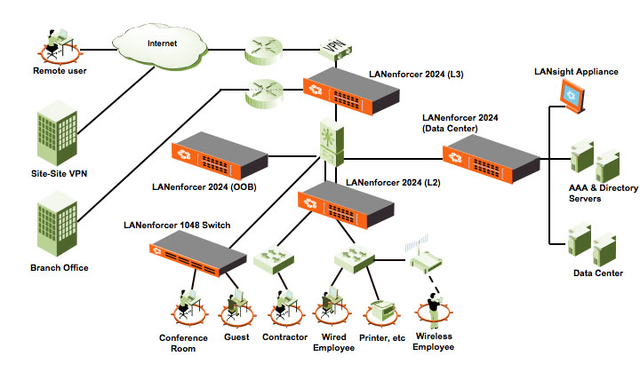
NETWORK TOPOLOGY (LOGICAL TOPOLOGY)

Slide 41
Physical – Logical Topology
Inside, the ports of the hub are wired in a circle. Data packets travels in a ring – not as a star!
Each computer connects
to the central hub

Slide 42
OSI Model

Slide 43
OSI model
Layer 7
Application
Open Systems Interconnection Reference Model
It’s a guide (thus the term “model”)
Don’t get wrapped up in the details
This is not the OSI protocol suite
Most of the OSI protocols didn’t catch on
There are unique protocols at every layer
You’ll refer to this model for the rest of your career
Layer 6
Presentation
Layer 5
Session
Layer 4
Transport
Layer 3
Network
Layer 2
Data Link
Layer 1
Physical
Notes:
All People Seem To Need Data Processing

Slide 44
OSI model
Layer 7
Application
Open Systems Interconnection Reference Model
Mnemonic
Please Do Not Throw Sausage Pizza Away
Layer 6
Presentation
Layer 5
Session
Layer 4
Transport
Layer 3
Network
Layer 2
Data Link
Layer 1
Physical

Slide 45
The OSI Layers
Application
The layer we see – Google Mail, Twitter, Facebook
Encoding and encryption
(SSL/TLS)
Presentation
Session
Communication between devices (Control protocols, tunnelling protocols)
The “post office” layer
(TCP segment, UDP datagram)
Transport
Network
The routing layer
(IP address, router, packet)
The switching layer
(Frame, MAC address, EUI-48, EUI-64, Switch)
Data Link
Signalling, cabling, connectors
(Cable, NIC, Hub)
Physical

Slide 46
OSI model

Slide 47
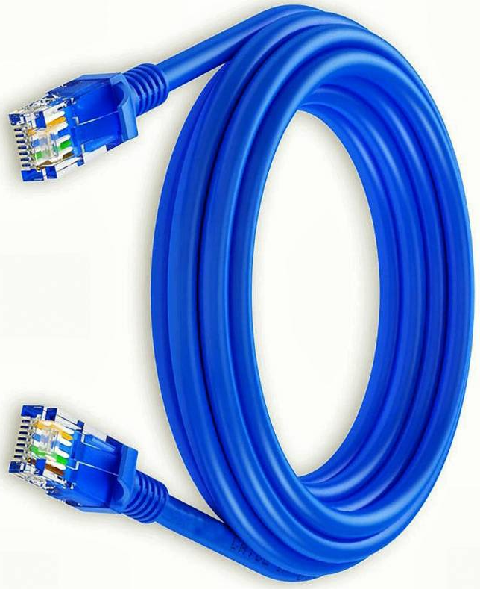
OSI Model – Layer 1: The Physical Layer
The physics of the network
Signalling, cabling, connectors
This layer isn’t about protocols
You have a physical layer problem
Fix your cabling, punch-downs, etc.
Run loopback tests, test/replace cables, swap adapter cards

Slide 48
OSI Model – Layer 1: The Physical Layer
From Data Link Layer
To Data Link Layer
110
1010101100001101
Physical Layer
110
1010101100001101
Transmission Medium
The physical layer is responsible for movements of individual bits from one hop (node) to the next

Slide 49
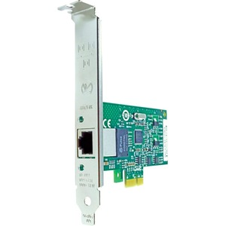
OSI Model – Layer 2: Data Link Layer
The basic network “language”
The foundation of communication at the data link layer
Data Link Control (DLC) protocols
MAC (Media Access Control) address on Ethernet
The “switching” layer
0
1
1
1
0
1
0
9C-35-58-5F-4C-D7
0C-9D-92-87-47-1E
Notes:
The Data Link Layer is referencing the MAC addresses that are communicating on the network.

Slide 50
OSI Model – Layer 2: The Data Link Layer
From Network Layer
To Network Layer
H2
Data
T2
H2
Data
T2
Data Link Layer
Data Link Layer
To Physical Layer
From Physical Layer
The data link layer is responsible for moving frames from one hop (node) to the next.
Notes:
H2 is the Header
Data is the packet from the network layer
The trailer includes error detection and the ending transmission data

Slide 51
Hop-to-Hop delivery

Slide 52
OSI Model - Layer 3: Network Layer
The “routing” layer
Internet Protocol (IP)
Fragments frames to traverse different networks

Slide 53
OSI Model - Layer 3: Network Layer
What is IP Fragmentation?
Fragments are always in multiples of 8 because of the number of fragmentation offset bits in the IP header

Slide 54
OSI Model – Layer 3: The Network Layer
From Transport Layer
To Transport Layer
H3
Data
H3
Data
Network Layer
Network Layer
To Data Link Layer
From Data Link Layer
The network layer is responsible for the delivery of individual packets from the source host to the destination host.
Notes:
H3 is the Header
Data is the packet from the transport layer

Slide 55
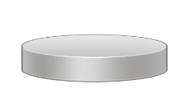
Source to Destination Delivery
Intermediate
system
Link
X
Link
Intermediate
system
C
D
Link
X
B
Intermediate
system
A
Link
X
Link
E
F
Hop-to-hop delivery
Hop-to-hop delivery
Hop-to-hop delivery
Data Link Layer
Source-to-destination delivery
A
B
E
F
Network
Network
Network
Data Link
Data Link
Data Link
Physical
Physical
Physical

Slide 56
OSI Model – Layer 4: Transport Layer
The “post office” layer
Parcels and letters
TCP (Transmission Control Protocol) and UDP (User Datagram Protocol)

Slide 57
Transport Layer
From Session Layer
To Session Layer
H4
Data
H4
Data
H4
Data
H4
Data
H4
Data
H4
Data
Transport Layer
Transport Layer
To Network Layer
From Network Layer
The transport layer is responsible for the delivery of a message from one process to another.

Slide 58
OSI Model – Layer 5: Session
Communication management between devices
Start, stop, restart
Half-duplex, full-duplex
Control protocols, tunnelling protocols

Slide 59
Session Layer
From Presentation Layer
To Presentation Layer
H5
H5
SYN
SYN
SYN
SYN
SYN
SYN
Session Layer
Session Layer
To Transport Layer
From Transport Layer
The session layer is responsible for dialog control and synchronization.

Slide 60
Session Layer
The session layer is responsible for dialog control and synchronization.

Slide 61
OSI Model – Layer 5: Presentation
Character encoding
Application encryption
Often combined with the Application Layer

Slide 62
OSI Model – Layer 5: Presentation
From Application Layer
To Application Layer
H6
Data
H6
Data
Presentation Layer
Presentation Layer
To Session Layer
From Session Layer
The presentation layer is responsible for translation, compression, and encryption.

Slide 63
OSI Model – Layer 5: Application
The layer we see - HTTP, FTP, DNS, POP3

Slide 64
OSI Model – Layer 5: Application
User:
Human or Program
User:
Human or Program
…
…
X.500
FTAM
X.400
X.500
FTAM
X.400
H7
Data
Message
H7
Data
Message
Application Layer
Application Layer
To Presentation Layer
From Presentation Layer
The application layer is responsible for providing services to the user.

Slide 65
Summary of Layers
Application
To allow access to network resources
To translate, encrypt and compress data
Presentation
Session
To establish, manage and terminate sessions
To provide reliable process-to-process message delivery and error recovery
Transport
Network
To move packets from source to destination; to provide internetworking
To organise bits into frames; to provide hop-to-hop delivery
Data Link
To transmit bits over a medium; to provide mechanical and electrical specifications
Physical

Slide 66
Next…
Physical Networks and Ethernet

Slide 67
Physical Networks
Transmission Media
Media Access Control
Broadcast Domains
Ethernet Frames
Ethernet Deployment Standards
MAC Addressing
Address Resolution Protocol
Packet Sniffers

Slide 68
Ethernet - History
Developed in 1973 by Xerox
Was based on a bus technology
Could transfer data at a rate of up to three million bits per second (Mbps)
In conjunction with DEC and Intel Xerox published the DIX standards in 1979
Screamed along at 10Mbps!!!
Notes:
DEC – Digital Equipment Corporation
Ethernet is entirely ubiquitous. It's not just the standard used for almost all modern wired LANs, but it's increasingly being used for telecommunications and storage networks, and even being increasingly adopted as a WAN technology. Even other common standards, such as Wi-Fi, incorporate technologies and standards originally developed as part of Ethernet.

Slide 69
Ethernet - History
They gave away the control of the Ethernet standard to the IEEE
They created the 802.3 (Ethernet) committee
Thus Ethernet became an open standard
Notes:
IEEE - Institute of Electrical and Electronics Engineers

Slide 70
Transmission Media
The physical channel through which signals travel to allow nodes to communicate
All use electromagnetic radiation of type or the other
Electrical
Light
Radio signals
Transmission media can be classified as:
Cabled
wireless

Slide 71
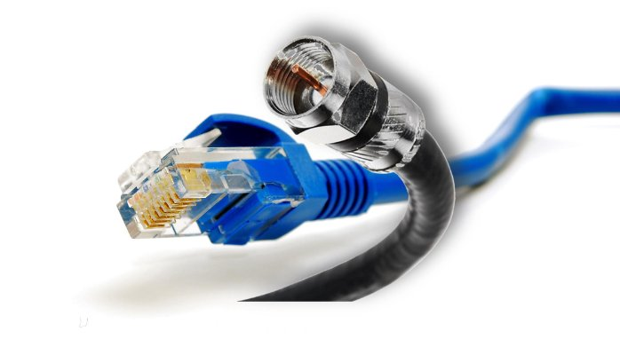
Transmission Media - Cabled
A physical signal conductor between two nodes
Cable types such as:
Copper
Fibre optic
Cabled media can also be described as bounded media

Slide 72
Transmission Media - Wireless
Uses free space between nodes
Types such as:
Microwave radio
Wireless media can also be described as unbounded media

Slide 73
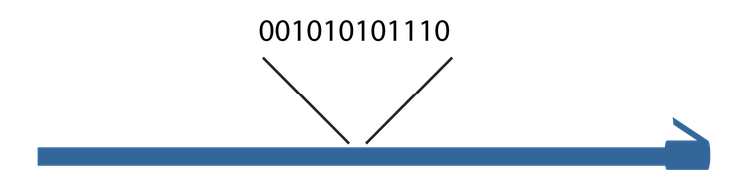
Signaling and modulation
Every kind of physical network needs to turn data into a signal that can be sent across the media.
The simplest way is by encoding it into a single binary signal and transmitting it along a wire or fiber optic cable
This is called digital baseband, or line coding, and is the method used by Ethernet cables among others
Notes:
Every kind of physical network needs to turn data into a signal that can be sent across the media. The simplest way is by encoding it into a single binary signal and transmitting it along a wire or fiber optic cable. This is called digital baseband, or line coding, and is the method used by Ethernet cables among others.
As you know, a cable, on which bits in the form of signals are transmitted, is busy with signals containing zeros and ones, and to distinguish between what bits are the actual travelled data and what bits are non-wanted noise is very difficult ; so a method to tell the difference is required. For that reason, control information is utilized. This information is in the form of zeros and ones that indicate where a frame start and where the frame ends.

Slide 74
Signaling and modulation (Cont.)
In other communication types, especially those used over long distances, data is combined with a signal called a carrier wave

Slide 75
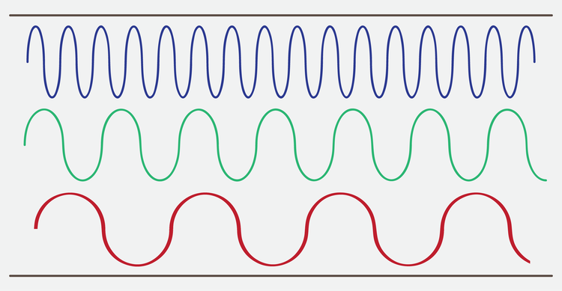
Signaling and modulation (Cont.)
Three channels in a broadband transmission

Slide 76
Signal Methods
Notes:
Three possible variations which are amplitude, frequency, and phase.

Slide 77
Bit rate and bandwidth
Bit rate, the number of bits carried per second
For example, the earliest popular Ethernet standards had a bit rate of ten megabits per second, abbreviated as 10 Mbps
Gross bit rate
Net bit rate or throughput
goodput
Notes:
Bandwidth means the amount of data that can be carried in a given amount of time; or, in other words, the capacity of a medium to carry data in a specific period of time. As stated previously, data transfer is measured using bits per second (bps). Thanks to the technological development, bandwidth is now commonly referred to in kilobits per second and megabits per second, and in case using highly sophisticated media, bandwidth can reach gigabits per second and terabits per second. These speeds can be achieved relying on the physical characteristics of media and the signalling method being applied. Thus if one is to calculate the bandwidth of a given medium, the physical properties as well as the signalling method must be taken into consideration.
Throughput can be defined as the real or actual data transfer rate in a given amount of time. We said that bandwidth is the capacity of a medium for data transmission, however, this capacity is hardly attained in real data transfer because of a variety of factors such as interference, noise, and errors in data transmission. For this reason, when we talk about bandwidth, we are actually taking about a theoretical rate of speed which is not same when data frames are really transmitted, whereas when we refer to the speed rate of a given medium using a throughput value, we are actually utilizing the real value at which data frames are carried. This means that throughput is bandwidth minus interference and errors, and therefore bandwidth is theoretical and throughput is practical.
Goodput denotes the transfer rate of the actual usable data bits; or, to put it another way, goodput measures the final data that the user benefits from or use, for data such as a picture, text, or video does not travel on media alone, but rather there is another control information, which is generally considered as data, or what is referred to as overhead. Its purpose is to make sure that data is safe, undamaged, unrepeated, and to guide data up to the destination. By and large, it can be said that goodput is throughput minus overhead traffic

Slide 78
Bit rate and bandwidth (Cont.)
A transmission using two-bit symbols

Slide 79
Multiplexing
Space-division multiplexing (SDM)
Frequency-division multiplexing (FDM)
Time-division multiplexing (TDM)
Notes:
Space-division multiplexing, also known as Space-division multiple access is the use of separate point-to-point electrical conductors for each transmitted channel. Examples include an analogue stereo audio cable, with one pair of wires for the left channel and another for the right channel, and a multi-pair telephone cable, a switched star network such as a telephone access network, a switched Ethernet network, and a mesh network.
Frequency-division multiplexing (FDM) is inherently an analogue technology. FDM achieves the combining of several signals into one medium by sending signals in several distinct frequency ranges over a single medium. In FDM the signals are electrical signals.
Time-division multiplexing (TDM) is a digital (or in rare cases, analogue) technology which uses time, instead of space or frequency, to separate the different data streams. TDM involves sequencing groups of a few bits or bytes from each individual input stream, one after the other, and in such a way that they can be associated with the appropriate receiver. If done sufficiently quickly, the receiving devices will not detect that some of the circuit time was used to serve another logical communication path.
Multiple low data rate signals are multiplexed over a single high data rate link, then demultiplexed at the other end

Slide 80
Media Access Control
Ethernet Media Access Control address
The “physical” address of a network adapter
The MAC address
Unique to a device
48 bits / 6 bytes long
Displayed in hexadecimal
00:0a:83
:
00:0a:83
Organisationally Unique Identifier (OUI)
Network Interface Controller-Specific
The manufacturer
The serial number
Notes:
A physical address corresponding to a particular network interface.
Ethernet's physical address format is a 48-bit number called a MAC address, MAC-48, or EUI-48.
MAC addresses are usually written as 12 hexadecimal digits. For readability, they're usually grouped into pairs, separated by dashes or colons; for example, 10:0D:7F:F3:CE:8F.
Sometimes you'll also see three groups of four separated by periods or full stops, such as 100D.7FF3.CE8F.

Slide 81
MAC addresses (Cont.)
MAC Address
0001101
00010000
01111111
00010010
11001110
00001101
0D
10
7F
12
CE
0D
0001101
00010000
01111111
11111111
11111110
00010010
11001110
00001101
0D
10
7F
FF
FE
12
CE
0D
EUI-64 Address

Slide 82
Unicast, broadcast, and multicast
An address corresponding to a specific recipient is called a unicast address.
A broadcast address is intended to be read by any node that receives it.

Slide 83
Unicast, broadcast, and multicast (Cont.)
Multicast addresses are intended to go to multiple nodes but not everywhere on the network
0001101
00010000
01111111
00010010
11001110
00001101
0D
10
7F
12
CE
0D

Slide 84
Media Access Control - Duplex
Half-duplex
Full-duplex
A device cannot send and receive simultaneously
All LAN hubs are half-duplex devices
Switch interfaces can be configured as half-duplex, but usually only when connecting to another half-duplex device
Data can be sent and received at the same time
A properly configured switch interface will be set to full-duplex

Slide 85
Broadcast Domains

Slide 86
Ethernet Frames
There have been four different Ethernet frame types defined over the years
Only the Ethernet II frame type is used today
Every version of 802.3 Ethernet uses the same Ethernet II frame
Using frames addresses two networking issues
Frames prevent any single machine from monopolizing the shared bus cable
The process of retransmitting lost data is more efficient
Notes:
An Ethernet frame is a data link layer protocol data unit and uses the underlying Ethernet physical layer transport mechanisms

Slide 87
Ethernet Frame
Ethernet Type II Frame
(64 to 1518 bytes)
A8 A1 59 1D 79 8F
A8 A1 52 1D 21 98
08 00
IP, ARP, etc.
01 20 13 3A
Destination MAC Address
Source MAC Address
EtherType
Payload
CRC Checksum
MAC Header
(14 bytes)
Data
(46 - 1500 bytes)
4 bytes
EtherType values:
0x0800 signals that the frame contains an IPv4 datagram 0x0806 indicates an ARP frame
0x86DD indicates an IPv6 frame
0x8100 indicates the presence of an IEEE 802.1 Q tag
Notes:
The MAC header has 14 bytes and the payload can have from 46 to 1500 bytes. The checksum is 4 bytes which means that the Type II frame can therefore have from 64 to 1518 bytes

Slide 88
Ethernet Deployment Standards

Slide 89
802.3 Standards
The 802.3 committee defines wired network standards that share the same basic frame type and network access method
Here’s a small selection of 802.3 standards:
802.3i 10 Mbps Ethernet using twisted pair cabling (1990)
802.3ab Gigabit Ethernet over twisted pair (1999)
802.3by 25 Gigabit Ethernet over fibre (2016)

Slide 90
Address Resolution Protocol
A protocol used by the Internet Protocol (IP) [RFC826], specifically IPv4, to map IP network addresses to the hardware addresses used by a data link protocol
The protocol operates below the network layer as a part of the interface between the OSI network and OSI link layer
It is used when IPv4 is used over Ethernet
For ARP, we are talking about layer 2
Notes:
ARP stands for Address Resolution Protocol. When you try to ping an IP address on your local network, say 192.168.1.1, your system has to turn the IP address 192.168.1.1 into a MAC address. This involves using ARP to resolve the address, hence its name.

Slide 91
Address Resolution Protocol
There are four types of ARP messages that may be sent by the ARP protocol
These are identified by four values in the "operation" field of an ARP message
The types of message are:
ARP-Request (Broadcast, source IP address of the requester)
ARP-Reply (Unicast to requester, the target)

Slide 92
Address Resolution Protocol
The format of an ARP message is shown below:
Hardware type
Protocol type
HW LEN
Protocol LEN
Operation
Sender Hardware Address (octets 0-3)
Sender Hardware Address (octets 4-5)
Sender IP Address (octets 0-1)
Sender IP Address (octets 2-3)
Target Hardware Address (octets 0-1)
Target Hardware Address (octets 2-5)
Target IP Address (octets 0-3)
Notes:
Hardware (HW) Type: 1 is for Ethernet
Protocol Type: 0800₁₆ = IP address
Hardware Length and Protocol length allows arbitrary networks to be used
Operation: 1 = ARP request, 2 = ARP response, 3 = RARP request, 4 = RARP response
ARP messages are sent directly to MAC layer
ARP message is 28 octets long

Slide 93
Packet Sniffers
A packet analyser (also known as a packet sniffer) is a computer program or piece of computer hardware
Can intercept and log traffic that passes over a digital network or part of a network
A "Packet Sniffer" is a utility that sniffs without modifying the network's packets in any way
Packet sniffers merely watch, display, and log this traffic
Notes:
A packet analyser (also known as a packet sniffer) is a computer program or piece of computer hardware (such as a packet capture appliance) that can intercept and log traffic that passes over a digital network or part of a network
A "Packet Sniffer" is a utility that sniffs without modifying the network's packets in any way
Packet sniffers merely watch, display, and log this traffic
By comparison, a firewall sees all of a computer's packet traffic as well, but it has the ability to block and drop any packets that its programming dictates

Slide 94
Computer A
Computer B
Computer C
Computer C
is the recipient
of the data packet
Hub
Hub broadcasts data packet to all network computers
Data packet sent to computer C
Broadcast
Computer
Passive sniffing
Notes:
Passive sniffing is intercepting packages transmitted over a network that uses a hub. It is called passive sniffing because it is difficult to detect. It is also easy to perform as the hub sends broadcast messages to all the computers on the network.

Slide 95
Computer A
Computer B
Computer C
Computer C
is the recipient
of the data packet
Switch
Switch maps IP/MAC addresses to physical ports
Data packet sent to computer C
Broadcast
Computer
Active sniffing
Notes:
Active sniffing is intercepting packages transmitted over a network that uses a switch. There are two main methods used to sniff switch linked networks, ARP Poisoning, and MAC flooding.

