Slide 1
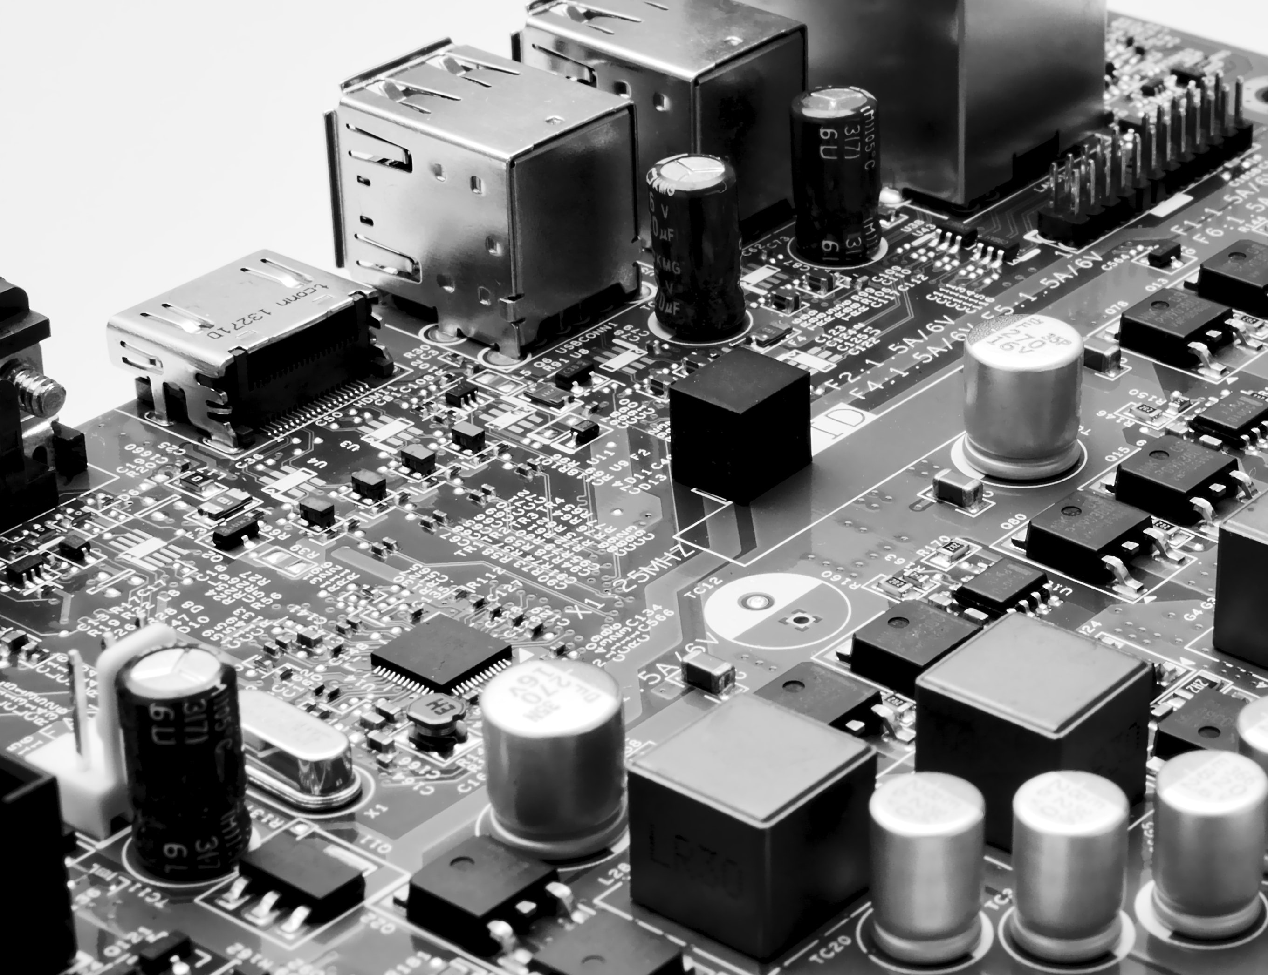
CY102 - Networking
Network Performance

Slide 2
Many reasons behind faulty network performance
Network problems can arise from faulty hardware such as routers, switches, and firewalls
They can also arise from unexpected usage patterns such as in the case of network bandwidth spikes that exceed their allocated bandwidth for users, or due to security breaches or changes in device configuration

Slide 3
Bandwidth
How much information can you handle
A 10 Mbps line doesn’t have the same Bandwidth as a 100Mbps

Slide 4
Number of Users
The number of users can affect the speed and quality of your network.
More users accessing the same bandwidth will start to reduce the network performance
We can reduce the amount of users allowed.
Or we can reduce the amount of bandwidth each user can access to allow more users

Slide 5
Nature and architecture
What is the network doing?
How is it connected?
We can also account for fibre links or wireless links to different WANs
Is the network wireless?
Does it use 802.11…
Does it use 2.4 or 5ghz?

Slide 6
Nature
What traffic is going through the network
General
Load balance
Voip (qos)
Data comms
Data centers
Malicious traffic
Bursty data Small but many
and leaky data fixed data but low bandwidth

Slide 7
Contention
More than one device trying to access a file at the same time
This is more noticeable when you think about your Broadband at home.
We can prioritize traffic to try and stop this but it will always cause some network performance issues

Slide 8
Improving Network Performance
Notes:
Highlight the security and cyber aspects in this section as well.
In the management part, look at standard management procedures, and then look at some SIEM stuff

Slide 9
Traffic shaping
CoDel
Controlled delay designed to overcome bufferbloat
Bufferbloat – flow of traffic changes from a fast and slow network.
Buffers allow a fast network to store the packets
PIE
Aims to attain high link utilization
Works based on queue latency not length
If latency can be controlled it frees up buffers for sporadic use
Happens at network layer

Slide 10
Network Policies
Restrict the types of traffic
Internet user permissions – Why do they need access to certain parts of the web?

Slide 11
Bottlenecks and Streaming
Congestion and bottle necks are more of a risk now. Even with increased bandwidth
Most downloads come from HTTP – Hard to identify what is needed and what's not
Traffic shaping and user education can help with these

Slide 12
Performance Monitoring
Assess user demand when network infrastructure is installed
Performance monitoring allows the network administrator to determine that resources are being stretched before that point is reached or performance is impacted
Need to set a baseline
When an upgrade or new equipment is implemented, a new baseline is required
Notes:
Assess user demand when network infrastructure is installed
Performance monitoring allows the network administrator to determine that resources are being stretched before that point is reached or performance is impacted
Need to set a baseline
When an upgrade or new equipment is implemented, a new baseline is required

Slide 13
Network Monitoring Utilities
Solarwinds Network Performance monitor
Datadog
Atera
Paessler PRTG network monitor
Nagios Core
Zabbix
Notes:
Solarwinds Network Performance monitor - Far more than just a simple scanner. Most network security issues arise when configurations are changed and SolarWinds NPM identifies these and can automatically resolve many
Datadog – A cloud-based monitoring system for onsite, remote, cloud, or hybrid network resource
Atera - Cloud-based RMM system includes a large range of monitors – server, network device, and application
Paessler PRTG network monitor - Free network monitoring software that uses SNMP, packet sniffing and WMI to monitor your network
Nagios Core - One of the top open-source network monitoring tools. Includes a dashboard view, alerts system, community plugins, and more
Zabbix - Open source network monitoring software with SNMP and IPMP monitoring. Includes an alerts system and community plugins

Slide 14
Monitoring tools
Network analyzer
Interface monitor
Top talkers/listeners
Packet flow monitor
Wireless analyzers
SNMP management software
Logs
Syslog
SIEM
Physical monitoring tools

Slide 15
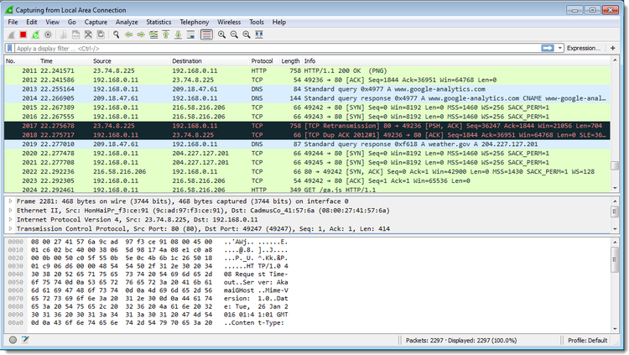
Network analyzers
Network analyzers, by whatever name you use, are one of the most powerful and versatile tools for network monitoring and troubleshooting.

Slide 16
Metrics
Network performance can be affected by a number of different factors
Using a network performance monitoring (NPM) solution, your enterprise can search for these factors
Allows you to understand how they’re affecting your network’s performance
The data the network monitoring solution collects allows the IT team to gain insights into performance metrics as well
Notes:
Network performance can be affected by a number of different factors. Using a network performance monitoring (NPM) solution, your enterprise can search for these factors and understand how they’re hurting your network’s performance. The data your network monitoring solution collects allows your IT team to gain insights into performance metrics as well.

Slide 17
About metrics
Resource use of a host or network device
Interface statistics
Bandwidth used by a specific service, physical link, or wireless channel
Users logged onto a network or service

Slide 18
Performance tracking
Establish a baseline: a measurement of your network's usage patterns under normal operation, which you can then use to plan for later expansion or unusual network demands.
The main goal of performance monitoring is to find and correct the bottlenecks that limit network performance as utilization increases.

Slide 19
Analysing Performance Metrics
Bandwidth usage
Bandwidth is the maximum data transmission rate possible on a network
Throughput
Throughput measures your network’s actual data transmission rate, which can vary wildly through different areas of your network
Latency
Latency is the delay that happens between a node or device requesting data and when that data is finished being delivered
Packet loss
Packet loss examines how many data packets are dropped during data transmissions on your network
Retransmission
When packets are lost, the network needs to retransmit it to complete a data request
Availability
Network availability, also know as uptime, simply measures whether or not the network is currently operational
Connectivity
Connectivity refers to whether or not the connections between the nodes on your network are working properly.
Notes:
Bandwidth usage
Bandwidth is the maximum data transmission rate possible on a network.
Throughput
Throughput measures your network’s actual data transmission rate, which can vary wildly through different areas of your network
Latency
Latency is the delay that happens between a node or device requesting data and when that data is finished being delivered. This delay can happen for a variety of reasons, but whatever the cause, your NPM solution can track any delays and log them
Packet loss
Packet loss examines how many data packets are dropped during data transmissions on your network. The more data packets that are lost, the longer it takes for a data request to be fulfilled
Retransmission
When packets are lost, the network needs to retransmit it to complete a data request. This retransmission rate lets your enterprise know how often packets are being dropped, which is an indication of congestion on your network
Availability
Network availability, also know as uptime, simply measures whether or not the network is currently operational. You can never guarantee 100% availability
Connectivity
Connectivity refers to whether or not the connections between the nodes on your network are working properly. If there is an improper or malfunctioning connection on your network, it can be a major hurdle for your company

Slide 20
Patch Management
The process of managing a network of computers by regularly performing patch deployment to keep computers up to date
Patch management is one of the most important IT tasks in any organization as leaving software and operating systems unpatched puts your organization at risk of serious security breaches
Cybercriminals are looking to exploit any unpatched systems
Manually monitoring and applying security updates is not only difficult but dangerous
Notes:
Patch management is the process that helps acquire, test and install multiple patches (code changes) on existing applications and software tools on a computer, enabling systems to stay updated on existing patches and determining which patches are the appropriate ones. Managing patches thus becomes easy and simple.
Patch management is one of the most important IT tasks in any organization as leaving software and operating systems unpatched puts your organization at risk of serious security breaches. Soon after a security update is released, cybercriminals are already on the move, looking to exploit any unpatched systems. This is why security updates should be deployed in your systems as soon as possible. Manually monitoring and applying these security updates is not only difficult but dangerous; even a slight delay in installing security updates could put your systems in a vulnerable position. Do you feel confident enough to bet on yourself in a race against today's cybercriminal?

Slide 21
Patch Management
Patch management is an area of systems management that involves acquiring, testing, and installing multiple patches (code changes) to an administered computer system
Patch management tasks include maintaining current knowledge of available patches, deciding what patches are appropriate for particular systems, ensuring that patches are installed properly, testing systems after installation, and documenting all associated procedures, such as specific configurations required.
Notes:
Some important points to remember
A patch is an important component of software update and it usually fixes some known bugs. If you need to apply it on a server, where the downtime is critical, it is recommended practice to install the patch on a lab server first. Install it on the production server once you find it satisfactory.

