Slide 1
Introduction
Information management and security
UFCFHU-30-2
Level 5
30 Credits

Slide 2
Information management and security Week 3
Intro
Monday
01
02
Wednesday
03
04
Tuesday
05
06
Thursday
Friday

Slide 3
Today
Graph Theory
Analysing Big Data using Power BI and Excel
Statistical analysis techniques
Performing a statistical analysis using…
Excel
Power BI

Slide 4
Graph Theory

Slide 5
Graph Theory
What is a graph?
A graph can be defined as a network that helps define and visualise relationships between different components
Graph theory is the study of these networks and how they can be used to solve problems

Slide 6
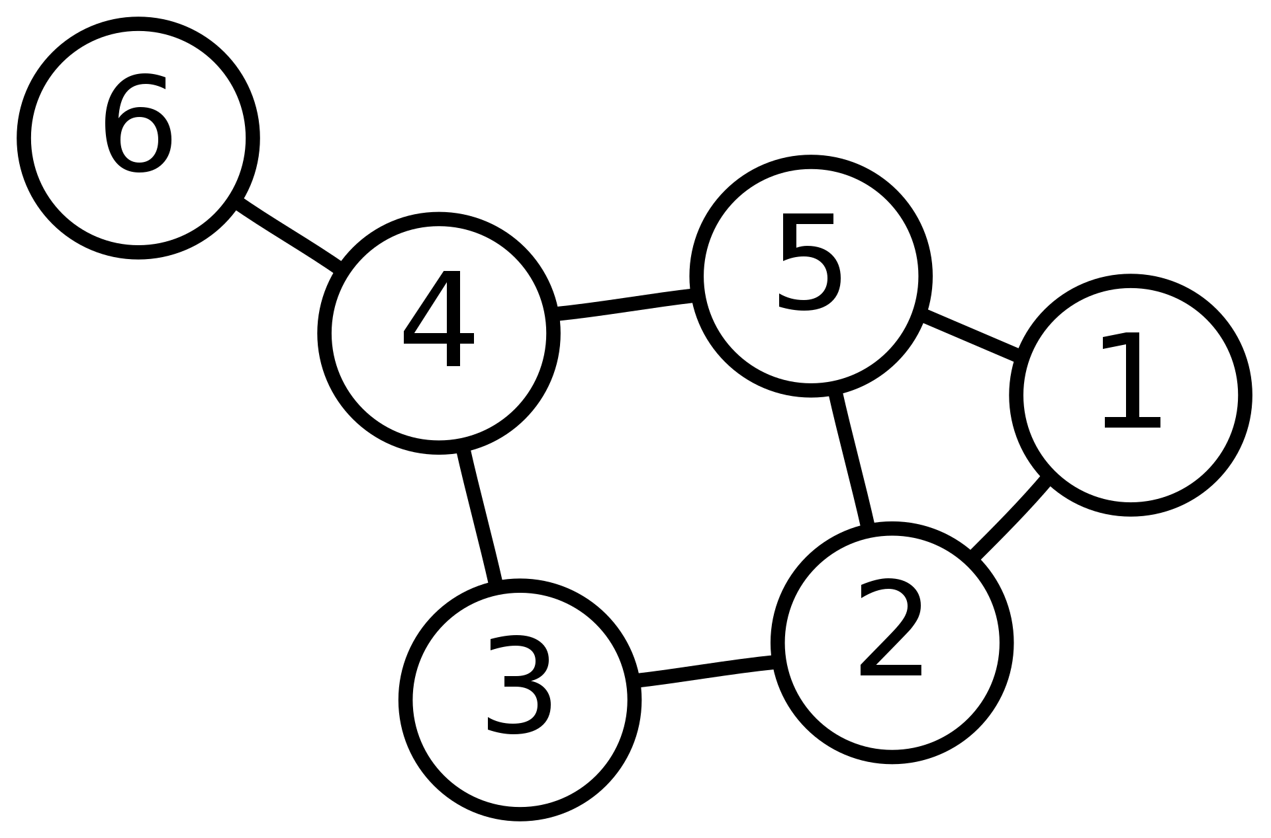
Intro to Graph Theory
What is a graph?
X
Component
(known as
Vertex/Vertices
or Nodes)
Indicates
relationship
between
components
(known as
Edges)

Slide 7
Graph Theory
Why do we study graphs?
Graphs show up everywhere – e.g.: Google Maps
In Google maps, road junctions can be thought of as Nodes and the roads between junctions as Edges

Slide 8
Graph Theory
In this example, if we give each junction (Node) and ID number and record the road connections as edges, we can then begin to calculate the shortest/quickest/longest/most or least efficient routes from A to B.

Slide 9
Graph Theory
Another example would be social networking.
When Facebook, Linkedin or Google is building up your profile and makes suggestions for who you may know, Graph Theory is clearly a simple way to model relationships between individuals or groups.
Graph algorithms can help with sudoku too

Slide 10
Graph Theory
A graph is a set of vertices V and edges E where each edge is a connection between vertices.
This graph can be written using Set notation as follows:
V = {0,1,2,3,4}
E = {(0,1),(0,2),(0,3),(1,3),(2,3),(3,4)}
1
0
3
4
2

Slide 11
Graph Theory
Terminology
Neighbours – vertices 0 and 1 are neighbours because an edge {0,1} connects them
1
0
3
4
2

Slide 12
Graph Theory
Terminology
Degree – the number of edges connected to a vertex
Degree (0) = 3
Degree (4) = 1
1
0
3
4
2

Slide 13
Graph Theory
Terminology
Path Length – the number of edges in a path.
e.g.: 0 → 1 → 3 → 4
Path length is 3
1
0
3
4
2

Slide 14
Graph Theory
Terminology
Cycle – a path that starts and ends at the same vertex.
Note: All cycles are paths, but not all paths are cycles
e.g.: 0 → 1 → 3 → 2 → 0
1
0
3
4
2

Slide 15
Graph Theory
Terminology
Connectivity – a path that starts and ends at the same vertex.
Note: All cycles are paths, but not all paths are cycles
e.g.: 0 → 1 → 3 → 2 → 0
1
0
3
4
2

Slide 16
Graph Theory – Types of Graph
An Undirected Graph
A Directed Graph
1
1
0
3
4
0
3
4
2
2

Slide 17
Graph Theory
Representing Graphs
1
 | 0 | 1 | 2 | 3 | 4
0 | 0 | 1 | 1 | 1 | 0
1 | 1 | 0 | 0 | 1 | 0
2 | 1 | 0 | 0 | 1 | 0
3 | 1 | 1 | 1 | 0 | 1
4 | 0 | 0 | 0 | 1 | 0
0
3
4
2
The relationships between vertices can
be illustrated as a multidimensional array
as an adjacency matrix.

Slide 18
Graph Theory - Task
Think of 5 applications of Graph theory
Can you think of any alternatives to using Graphs in these problems?
5

Slide 19
Graph Theory – Further study
Areas for further study
Directed and Undirected cyclic graphs
Degrees of Graph connectivity
Weighted Graphs (useful for mapping applications)
Graphs and Trees
Completed Graphs

Slide 20
Analysing Big Data using Excel & other tools

Slide 21
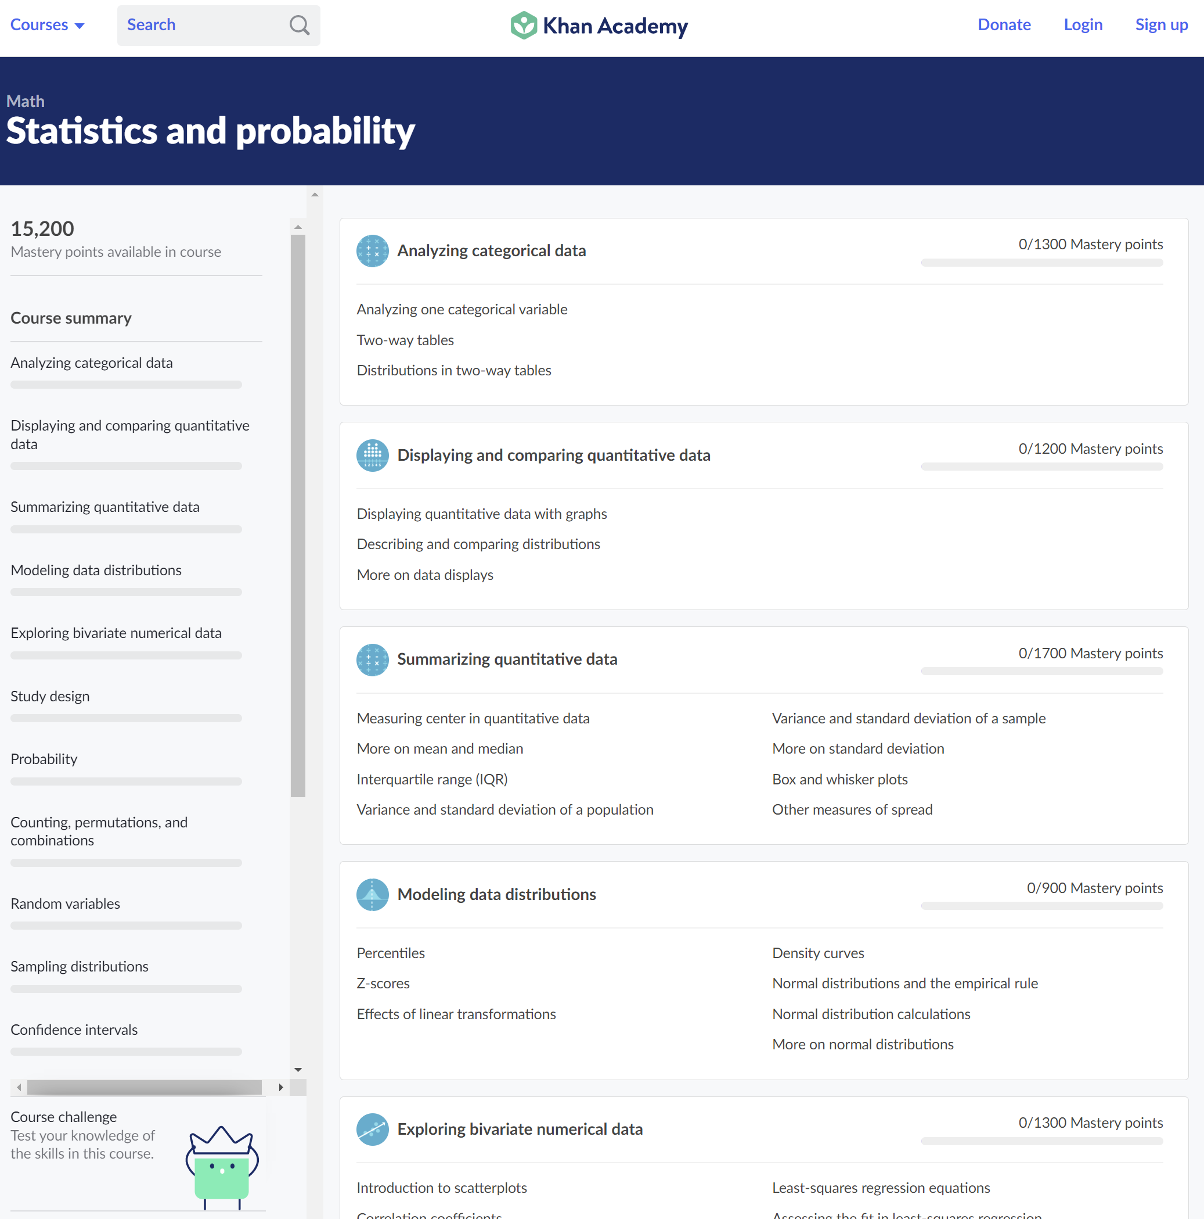
Statistics – Learn more
One of the best resources to learn maths is Khan Academy.

Slide 22
Statistical Analysis
What is statistical analysis?
Statistics is the branch of science that renders various tools and analytical techniques in order to deal with the huge extent of data.
Simply put, it is the science of assembling, classifying, analysing and interpreting & manifesting the numeric form of data for making inferences about the population, from the picked out sample data that can be used by business experts to solve their problems.

Slide 23
Statistical Analysis Techniques
Some types of statistical analysis to consider
time series analysis,
probability,
standard deviation,
normal distribution.

Slide 24
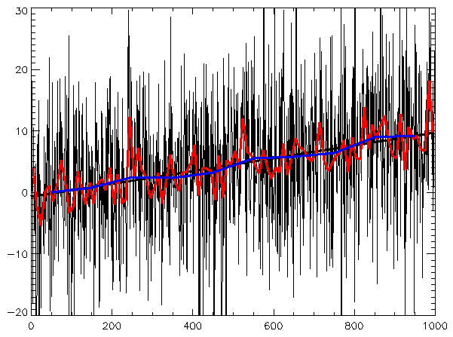
Introduction to… Time Series Analysis
In mathematics, a time series is a series of data points indexed (or listed or graphed) in time order.
Most commonly, a time series is a sequence taken at successive equally spaced points in time.
Thus it is a sequence of discrete-time data.

Slide 25
Introduction to… Time Series Analysis
Examples of time series are heights of ocean tides, counts of sunspots, and the daily closing value of the Dow Jones Industrial Average.
A Time series is very frequently plotted via a run chart (which is a temporal line chart).

Slide 26
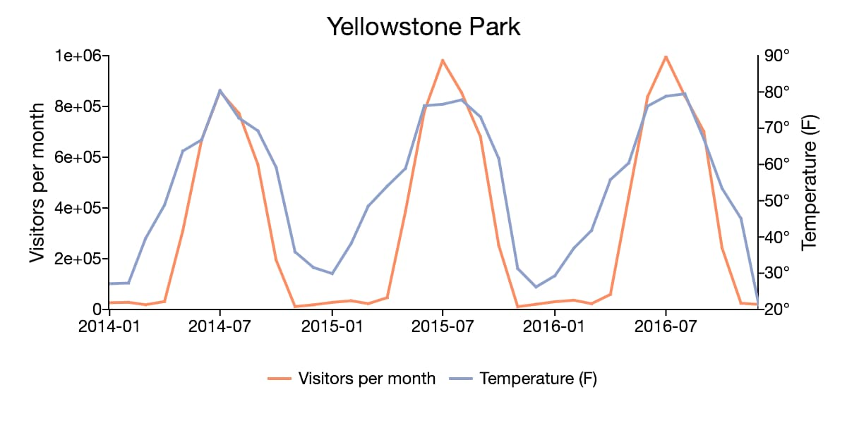
Introduction to… Time Series Analysis
Time series are used in statistics, signal processing, pattern recognition, econometrics, mathematical finance, weather forecasting, earthquake prediction, electroencephalography, control engineering, astronomy, communications engineering, and largely in any domain of applied science and engineering which involves temporal measurements.

Slide 27
Introduction to… Probability
Probability is the branch of mathematics concerning numerical descriptions of how likely an event is to occur, or how likely it is that a proposition is true.
The probability of an event is a number between 0 and 1, where, roughly speaking, 0 indicates impossibility of the event and 1 indicates certainty.

Slide 28
Introduction to… Probability
The higher the probability of an event, the more likely it is that the event will occur.
A simple example is the tossing of a fair (unbiased) coin.

Slide 29
Introduction to… Probability
Since the coin is fair, the two outcomes ("heads" and "tails") are both equally probable; the probability of "heads" equals the probability of "tails"; and since no other outcomes are possible, the probability of either "heads" or "tails" is 1/2 (which could also be written as 0.5 or 50%).

Slide 30
Introduction to… Probability
Monte Carlo simulations are used to model the probability of different outcomes in a process that cannot easily be predicted due to the intervention of random variables.
It is a technique used to understand the impact of risk and uncertainty in prediction and forecasting models.
A Monte Carlo simulation can be used to tackle a range of problems in virtually every field such as finance, engineering, supply chain, and science.
It is also referred to as a multiple probability simulation.

Slide 31
Introduction to… Standard Deviation
Standard deviation is a number used to tell how measurements for a group are spread out from the average (mean or expected value). A low standard deviation means that most of the numbers are close to the average, while a high standard deviation means that the numbers are more spread out.
The reported margin of error is usually twice the standard deviation.
Scientists commonly report the standard deviation of numbers from the average number in experiments.
They often decide that only differences bigger than two or three times the standard deviation are important.
Standard deviation is also useful in money, where the standard deviation on interest earned shows how different one person’s interest earned might be from the average.
https://simple.wikipedia.org/wiki/Standard_deviation

Slide 32
Introduction to… Standard Deviation
Standard deviation is a statistic that measures the dispersion of a dataset, relative to its mean. It’s calculated as the square root of the variance (the spread of numbers in a dataset). Determining the variation between each data point relative to the mean is valuable for comparing sets of data that may have the same mean but a different range.
https://www.jotform.com/blog/how-to-calculate-standard-deviation/

Slide 33
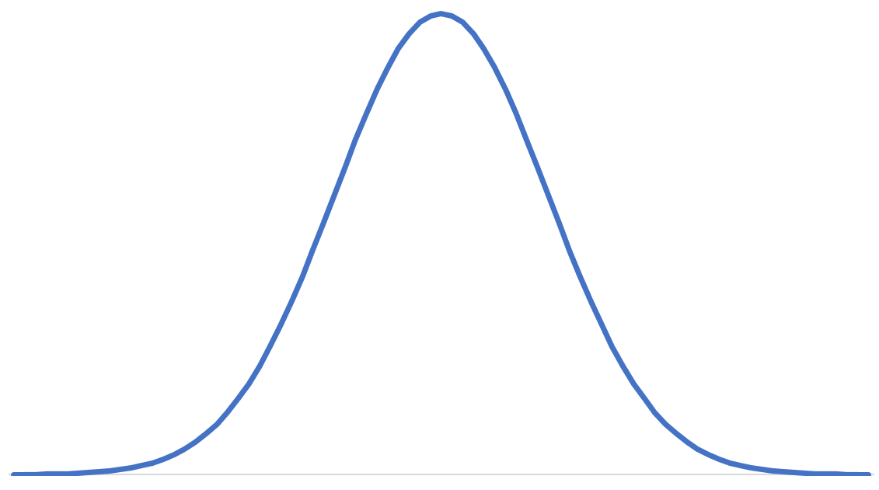
Introduction to… Normal Distribution
Normal distribution is sometimes referred to as a Gaussian distribution.
Also known as the Bell curve for obvious reasons

Slide 34
Introduction to… Normal distribution
The y axis represents the probability of observing someone who is short, tall, or average height.
It is relatively rare to see someone who is really tall or really short.
It is more common to see people who are average height.
Normal distributions are always centered around the average value.
The width of the bell curve is defined by the standard deviation!
More likely
y axis
Less likely
Short
Average height
Tall
x axis

Slide 35
Task
Research the terms Standard Deviation and Normal Distribution, and in your own words, describe what they are and how they are calculated.

Slide 36
Statistical Analysis using Excel

Slide 37
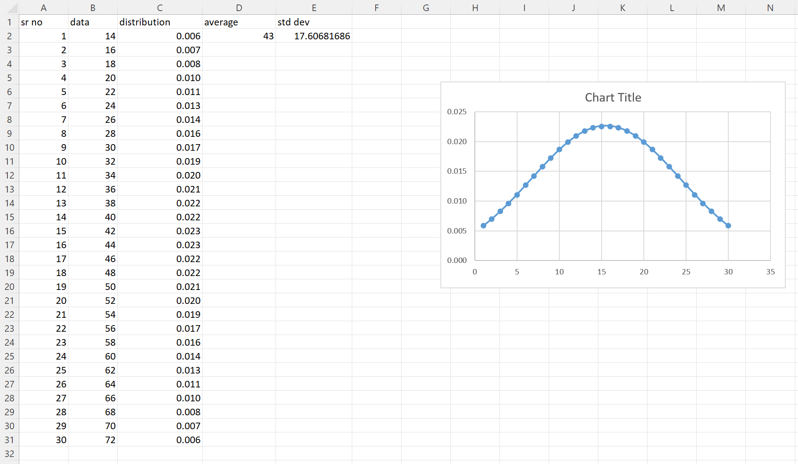
Normal Distribution in Excel
This is what we are going produce

Slide 38
Normal Distribution in Excel
We will use Column A for our serial number or index
We will use Column B for our data values
Column C will be a calculated field for the distribution.
Column D will record a single value – the average.
Column E will be another calculated single field, this time for the Standard Deviation

Slide 39
Normal Distribution in Excel
Complete columns A (index) and B (data), or just B if you are in a hurry but you will need to adjust the formulas accordingly.
In cell D2, enter =AVERAGE(B2:B31)
In cell E2 enter =STDEV.S(B2:B31)
In cell C2, enter =NORM.DIST(B2,$D$2,$E$2,FALSE) and fill down.
Research what each of these formula do, and record them in your notes. You may need them later.

Slide 40
Normal Distribution in Excel
When you have completed your spreadsheet, click on the insert tab and select a chart to create. I chose a scatter chart.

Slide 41
Normal Distribution in Excel The Movie
How to Create Bell Curve in Excel
https://www.youtube.com/watch?v=Ot6kOHBB8Vw

Slide 42
Statistical Analysis using

Slide 43
Microsoft Learn
Follow this Microsoft Learn tutorial series on Power BI Desktop to be productive with visualising data with Power BI Desktop.
Get data with Power BI Desktop
https://docs.microsoft.com/en-us/learn/modules/get-data-power-bi/
Use visuals in Power BI Desktop
https://docs.microsoft.com/en-us/learn/modules/visuals-in-power-bi/

Slide 44
Task
Using Microsoft Power BI and the Microsoft Learn tutorial, find a data source on the web and practice producing a data visualization of your choice.

