Slide 1
BCS Level 4 Certificate in Network Security
QAN 603/0546/0
Network Engineer

Slide 2
Syllabus
Types of security threat (35%, K2)
Mitigating security threats (65%, K2)

Slide 3
1 Types of security threat (35%, K2)
In this topic, the apprentice will understand the types of security threats
Describe security threats
Describe vulnerabilities

Slide 4
Security Threats
Virus
Malware
DDoS attacks
Trojan
Worm
Spyware
Social engineering
Phishing attacks
Man-in-the-middle
DNS poisoning

Slide 5
Threat
An event or object that may defeat the security measures in place and result in a loss

Slide 6
Vulnerability
A weakness or exposure in a technology, protocol or design of an information technology system such as hardware, firmware and software

Slide 7
Virus
A piece of code which is capable of copying itself and typically has a detrimental effect, such as corrupting the system or destroying data
Designed to spread from host to host and has the ability to replicate itself
Will attempt to infect any new system on a network
All viruses are malware

Slide 8
Malware
Malware is a term used to describe malicious software, including spyware, ransomware, viruses, and worms
Malware breaches a network through a vulnerability, typically when a user clicks a dangerous link or email attachment that then installs risky software
Once inside the system, malware can do the following:
Blocks access to key components of the network (ransomware)
Installs malware or additional harmful software
Covertly obtains information by transmitting data from the hard drive (spyware)
Disrupts certain components and renders the system inoperable

Slide 9
DDoS Attacks
Floods systems, servers, or networks with traffic to exhaust resources and bandwidth
The system is unable to fulfill legitimate requests
Attackers can also use multiple compromised devices to launch this attack
This is known as a distributed-denial-of-service (DDoS) attack

Slide 10
Denial-of-Service (DoS and DDoS)
A denial-of-service attack (DoS attack) is a cyber-attack in which the perpetrator seeks to make a machine or network resource unavailable to its intended users by temporarily or indefinitely disrupting services of a host connected to the Internet
A distributed denial-of-service (DDoS) attack occurs when multiple systems flood the bandwidth or resources of a targeted system, usually one or more web servers
Such an attack is often the result of multiple compromised systems (for example, a botnet) flooding the targeted system with traffic

Slide 11
DoS vs DDoS

Slide 12
An Attack

Slide 13
Trojan
A Trojan horse, or Trojan, is any malicious computer program which misleads users of its true intent
Often disguised as legitimate software. Trojans can be employed by cyber-thieves and hackers trying to gain access to users' systems
Users are typically tricked by some form of social engineering into loading and executing Trojans on their systems

Slide 14
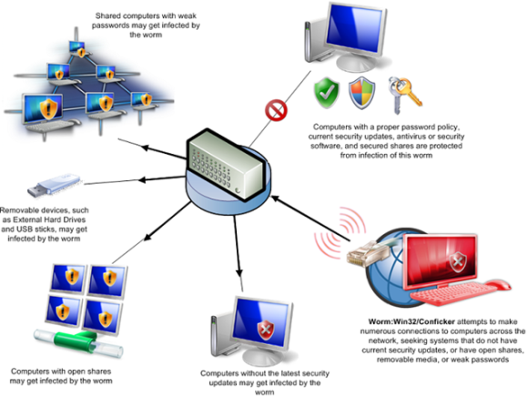
Worm
A computer worm is a type of malware that spreads copies of itself from computer to computer
A worm can replicate itself without any human interaction, and it does not need to attach itself to a software program in order to cause damage

Slide 15
Spyware
Spyware is software that aims to gather information about a person or organization, sometimes without their knowledge
May send such information to another entity without the consumer's consent
A lot of spyware harvests information related to your computer and how you use it
For example, it may monitor your Web browsing patterns

Slide 16
Social Engineering
Social engineering is the art of manipulating people so they give up confidential information
The types of information these criminals are seeking can vary, but when individuals are targeted the criminals are usually trying to trick you into giving them your passwords or bank information, or access your computer to secretly install malicious software
This will give them access to your passwords and bank information as well as giving them control over your computer

Slide 17
How it is done
Preparing the ground for attack:
Identifying the victim(s)
Gathering background information
Selecting attack method(s)
Closing the interaction, ideally without arousing suspicion:
Bringing the charade to a natural end
Removing all traces of malware
Covering tracks
Deceiving the victim(s) to gain a foothold:
Spinning a story
Taking control of the interaction
Obtaining the information over a period of time:
Expanding foothold
Executing the attack

Slide 18
Five most common forms of digital social engineering assaults
Baiting attacks
Use a false promise to pique a victim’s greed or curiosity
The most reviled form of baiting uses physical media to disperse malware.
Baiting scams don’t necessarily have to be carried out in the physical world
Scareware attacks
Scareware involves victims being bombarded with false alarms and fictitious threats
Scareware is also referred to as deception software, rogue scanner software and fraudware.
Scareware is also distributed via spam email that doles out bogus warnings, or makes offers for users to buy worthless/harmful services.
Pretexting
Obtains information through a series of cleverly crafted lies
Phishing
One of the most popular social engineering attack types
Spear phishing
A more targeted version of the phishing scam whereby an attacker chooses specific individuals or enterprises

Slide 19
Phishing Attacks
Phishing is the practice of sending fraudulent communications that appear to come from a reputable source, usually through email
The goal is to steal sensitive data like credit card and login information or to install malware on the victim’s machine

Slide 20
Phishing
The act of sending an e-mail to a user falsely claiming to be an established legitimate enterprise in an attempt to scam the user into surrendering private information that will be used for identity theft

Slide 21
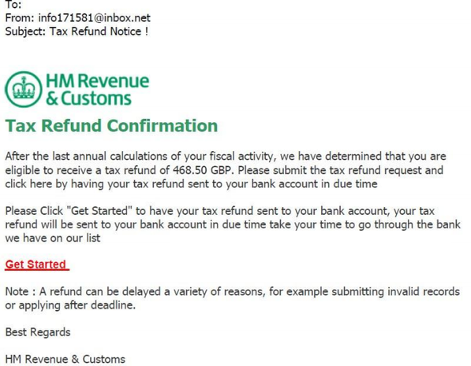
Look at the email header.
Where did it originate?
Why no Pound (£) symbol?
No name
Look for spelling and grammatical errors
This link will take you to a fake website

Slide 22
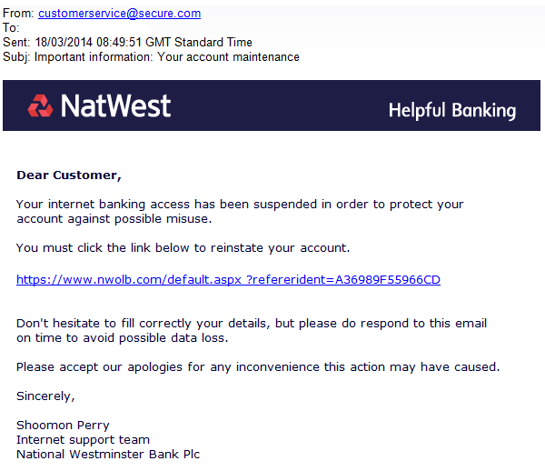

Slide 23
Man-in-the-Middle
Also known as eavesdropping attacks, occur when attackers insert themselves into a two-party transaction
Once the attackers interrupt the traffic, they can filter and steal data
Two common points of entry for MitM attacks:
On unsecure public Wi-Fi, attackers can insert themselves between a visitor’s device and the network. Without knowing, the visitor passes all information through the attacker
Once malware has breached a device, an attacker can install software to process all of the victim’s information

Slide 24
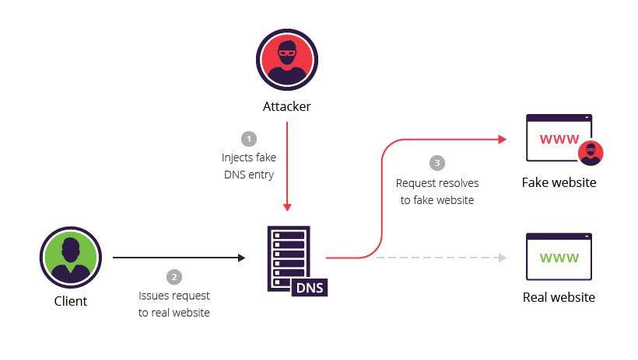
DNS Poisoning
DNS spoofing, also referred to as DNS cache poisoning
A form of computer security hacking in which corrupt Domain Name System data is introduced into the DNS resolver's cache
Causes the name server to return an incorrect result record, e.g. an IP address

Slide 25
Ransomware
Ransomware is a type of malicious software from cryptovirology that threatens to publish the victim's data or perpetually block access to it unless a ransom is paid
Most ransomware variants encrypt the files on the affected computer, making them inaccessible
The most dangerous ransomware attacks are caused by WannaCry, Petya, Cerber, Locky and CryptoLocker ransomware

Slide 26
Ransomware
Three choices in how to proceed:
Reinstall the operating system
Run an antivirus program from an external drive or bootable disc
Do a System Restore and take Windows back to a time before the ransomware was loaded

Slide 27
Vulnerabilities
Ports
Services
Code

Slide 29
Ports
The Internet Assigned Numbers Authority (IANA) has developed several port categories:
1 to 1023 are known as Well Known Ports
1024 to 49151 are known as Registered Ports
49152 to 65535 are known as Dynamic Ports
Well Known Ports usually make some type of network connection, and are typically assigned to a particular network protocol
Use CVSS to identify vulnerabilities by ports
Notes:
Common Vulnerability Scoring System (CVSS)

Slide 30
Common IP Protocols
Protocol | Name
1 | ICMP (ping)
6 | TCP
17 | UDP
47 | GRE (PPTP)
50 | ESP (IPSec)
51 | AH (IPSec)

Slide 31
Common TCP and UDP Ports
Protocol | Port | Name
TCP | 20 | FTP data
TCP | 21 | FTP control
TCP | 22 | SSH
TCP | 23 | Telnet
TCP | 25 | SMTP (E-mail)
TCP/UDP | 53 | DNS query
UDP | 67/68 | DHCP (Dynamic IP address configuration)
TCP | 80 | HTTP (Web)
TCP | 110 | POP3 (E-mail)
TCP | 119 | NNTP (Newsgroups)
TCP | 143 | IMAP4 (E-mail)
TCP | 389 | LDAP (Directory service)
TCP | 443 | HTTPS (Web SSL)
UDP | 1701 | L2TP (Virtual Private Networks)
TCP | 1723 | PPTP (Virtual Private Networks)

Slide 32
Private and Automatic IP Address Ranges
A | 10.0.0.0 to 10.255.255.255 (10.0.0.0/8)
B | 172.16.0.0 to 172.31.255.255 (172.16.0.0/12)
C | 192.168.0.0 to 192.168.255.255 (192.168.0.0/16)
APIPA | 169.254.0.0 to 169.254.255.255 (169.254.0.0/16)

Slide 33
Services
Vulnerabilities within network services may result in data loss, denial of services, or allow attackers to facilitate attacks against other devices
Checking for insecure or non-essential services is critical to reducing risk on the network
The vast majority of network attacks are focused around easily identified vulnerabilities which can be exploited

Slide 34
Services
Email
DNS
Printers
Network shares
VOIP
IM

Slide 35
Email Clients
Encryption protocols
PGP
S/MIME (Secure/Multipurpose Internet Mail Extensions)

Slide 36
Email
Phishing
Ancestor of all modern phish, beloved of ‘Nigerian royalty’, lonely hearts and helpful “pharmacists.”
Its distinctive behaviours of poor spelling and awkward language make it easy to spot and avoid, but if it hooks its prey, the results can be deadly
Whaling
Takes only the biggest and juiciest catches
Usually targeting CEO’s and other C people like CIO’s, CTO’s, and CFO’s
Spearphishing
Picks its targets carefully based on the access they have to information it craves
May spend months lurking and researching its prey before it attacks with one targeted email strike
Clones
Impersonates legitimate contacts
Sends cloned messages with malicious links in place of genuine ones

Slide 37
DNS
A DNS attack is an exploit in which an attacker takes advantage of vulnerabilities in the domain name system
DNS is a protocol that translates a user-friendly domain name, like WhatIs.com, into the computer-friendly IP address such as 206.19.49.154

Slide 39
Types of DNS Attack
Zero day attack
The attacker exploits a previously unknown vulnerability in the DNS protocol stack or DNS server software
Cache poisoning
Corrupts a DSN server by replacing a legitimate IP address in the server’s cache with that of another, rogue address
Aim is to redirect traffic to a malicious website, collect information or initiate another attack
Cache poisoning may also be referred to as DNS poisoning
Denial of Service
An attack in which a malicious bot sends send more traffic to a targeted IP address than the programmers who planned its data buffers anticipated someone might send
The target becomes unable to resolve legitimate requests
Distributed Denial of Service
The attacker uses a botnet to generate massive amounts of resolution requests to a targeted IP address
Example: Mirai
DNS amplification
Takes advantage of a DNS server that permits recursive lookups and uses recursion to spread his attack to other DNS servers.
Fast-flux DNS
The attacker swaps DNS records in and out with extreme frequency in order redirect DNS requests and avoid detection
https://searchsecurity.techtarget.com/definition/DNS-attack

Slide 40
Printers
Older printers
Multifunction printers
Secure printers from:
Unauthorized access
Print configuration alterations
Eavesdropping
Device compromise
Use RFC1918 private IP address space to restrict access to printers to hosts only, making printers unreachable from the Internet
Configure the printer's access control list (ACL) to restrict access by subnet or device
Remove the default gateway in the IP configuration to disable Internet routing, making printing only available on your local network segment

Slide 41
Network Shares
Vulnerabilities in SMB Shares Enumeration is a Medium risk vulnerability
Most frequently found on networks around the world
This issue has been around since at least 1990
Proven to be either difficult to detect, difficult to resolve or prone to being overlooked entirely

Slide 42
VOIP
VOIP – Voice Over IP
VoIP is vulnerable to similar types of attacks that Web connection and emails are prone to

Slide 43
VOIP Vulnerabilities
Remote eavesdropping
Network Attacks
Default security settings
VOIP over WiFi

Slide 44
VOIP Exploits
VOIP spam
VOIP phishing

Slide 45
VOIP Attacks
Invite of Death
A type of attack on a VoIP-system that involves sending a malformed or otherwise malicious SIP INVITE request to a telephony server
Results in a crash of that server
Causes a denial of service

Slide 46
Instant Messaging
Viruses and worms over IM
Identity theft/authentication spoofing
Firewall tunnelling
Data security leaks
SPIM

Slide 47
Viruses and Worms over IM
Most viruses are sent through file transfers
Bypasses traditional gateway and anti-virus security
Public IM clients also have publicized vulnerabilities
Flaws such as buffer overflows and boundary condition errors have been exploited to spread viruses, worms or denial-of-service attacks

Slide 48
Identity Theft/Authentication Spoofing
Public IM systems let individuals create anonymous identities
These do not map to e-mail addresses
IDs can be created even if the IDs and domains are not owned by that individual i.e. "billgates" or "johnchambers,“
Spoofing creates risk, as these IDs can be used maliciously, outside the control of the IT security department

Slide 49
Firewall Tunnelling
IM clients find ways to tunnel through firewalls
Most IM services come through well-publicized ports (5190 for AOL Instant Messenger, 1863 for MSN and 5050 for Yahoo)
IM clients also can exploit any open port on the firewall, including those used by other applications (such as Port 80 for Web and HTTP traffic)
Some clients also can connect via peer-to-peer connections or establish connections on randomly negotiated ports

Slide 50
Data Security Leaks
Unmonitored content leaving the corporation without the knowledge of the information security department introduces legal and competitive risk
Such as a CFO sending a confidential spreadsheet via IM without an audit trail
File transfer over IM is a powerful way to send information beyond the tracing capabilities of the IT department
The lack of content filtering and archiving makes it difficult for IT to discover potential breaches of policy or to hold individuals accountable

Slide 51
SPIM
Instant messaging spam
Can be more disruptive than e-mail spam
More intrusive (the pop-up SPIM interrupts the user) and generally of a more sexually offensive nature
Leads to human resources and legal risk

Slide 52
Code
The most common computer vulnerabilities include:
Bugs
Weak passwords
Software that is already infected with virus
Missing data encryption
OS command injection
SQL injection
Buffer overflow
Missing authorization
Use of broken algorithms
URL redirection to untrusted sites
Path traversal
Missing authentication for critical function
Unrestricted upload of dangerous file types
Dependence on untrusted inputs in a security decision
Cross-site scripting and forgery
Download of codes without integrity checks

Slide 53
2 Mitigating Security Threats (65%, K2)
In this topic area, the apprentice will learn how to mitigate known security threats
2.1 Describe security procedures
2.2 Describe common ways to protect data
2.3 Describe protection against malicious software
2.4 Describe types of firewalls

Slide 54
2.1 Describe Security Procedures
Security policy
Securing the perimeter
Physical security
Securing the network
Securing devices
Securing applications
O/S updates

Slide 55
Security Policy
A security policy is a definition of what it means to be secure for a system, organization or other entity
For an organization, it addresses the constraints on behaviour of its members as well as constraints imposed on adversaries by mechanisms such as doors, locks, keys and walls
A document that states in writing how a company plans to protect the company's physical and information technology (IT) assets

Slide 56
Security Policy
WHAT
you want to protect
HOW
you want to protect
Security Groups
Security Policies
APPLY TO

Slide 57
Securing the Perimeter
A network perimeter is the boundary between the private and locally managed-and-owned side of a network and the public and usually provider-managed side of a network

Slide 58
Securing the Perimeter
Three questions that have to be answered:
What is it that we are trying to protect?
We will have to determine what are the workstations, servers, databases and other devices that have to be protected.
What are the threats?
Next, we determine what are the different type of threats
Internet facing systems are always under the possibility of an attack
Other threats can also be from former employees who have access to vital resources.
And finally the business requirements of the organization.
The security design must meet the business goals of an organization
An eCommerce site with more online transactions will need a more robust security design than a site which just needs an online presence

Slide 60
Physical Security
Physical security is the protection of personnel, hardware, software, networks and data from physical actions and events that could cause serious loss or damage to an enterprise, agency or institution
This includes protection from fire, flood, natural disasters, burglary, theft, vandalism and terrorism

Slide 62
Securing the Network
Run a network security audit
Conduct cybersecurity awareness training
Limit user access privileges to the minimum necessary for work
Patch your software ASAP
Review your cybersecurity tools

Slide 63
Run a network security audit
A network security audit is a process by which a company can investigate their network security policies and the various assets they have on their network
Aim is to identify any potential deficiencies that might lead to a security compromise/breach

Slide 64
Security Audit
A comprehensive audit covers multiple review processes, such as:
Firewall Architectures/Configurations. What kind of firewall solutions are in place and where do they rest on your network (at the perimeter, in between individual servers/assets)? Also, are firewall configurations up to date and free of conflicts that could be exploited by an attacker?
Asset Identification. What kind of assets are on the network, and what kinds of software and operating system (OS) does each one run? Knowing what’s on your network is crucial for identifying potential weaknesses so they can be fixed—such as software that isn’t up to date with its latest security patch.
Security Policies/Procedures. What standards does each of the people in your organization understand/follow when it comes to keeping your business’ data secure? Do you have a BYOD (bring-your-own-device) policy for using personal devices at work? How are security policies enforced? A review of all your security policies and procedures is crucial for keeping your data secure.
Risk Assessment. After identifying all of the assets on your network and reviewing your security policies/procedures, what are the most significant threats that you need to take care of ASAP? Risk assessments help you prioritize your cybersecurity efforts to close your biggest gaps first.

Slide 65
Conduct cybersecurity awareness training
Training should be given to network/security administrator and supporting staff as well as users to ensure that they follow the security best practice and follow security policies
Weakest link in any organization’s cybersecurity architecture is, usually, the organization’s employees

Slide 66
Limit user access privileges
Limit user access privileges to the minimum necessary for work
Manage accounts and access privileges: e.g. access rights should be granted on an as-needed basis and should be reviewed regularly

Slide 67
Patch your software ASAP
Companies are constantly finding and fixing security flaws in their software and systems
These flaws give hackers a way past otherwise solid defences
While many panic over the “zero-day” exploit—that vulnerability which the original software developer doesn’t know about that hackers can use with impunity—the truth of the matter is that the most-frequently used exploits involve older, known security issues that already have fixes available

Slide 68
Review your cybersecurity tools
Use cybersecurity tools to protect your business’ network infrastructure
Cover the basics needed for mitigating risks and covering the regulatory obligations specific to your industry
Tools include:
Firewalls
IDS/IPS
Antivirus
remote backups
Use tools that you can use to respond to your biggest threats

Slide 69
Securing Devices
Devices should be secured in locked wiring closets
Important to secure administrative access to the network devices such as:
Routers
Firewalls
Switches
Servers

Slide 70
Securing Applications
When it comes to securing applications on a network, limiting privileges is the golden rule
Vulnerabilities that expose web applications start with the database and work outwards towards the application code itself
Users or application functions should be given only as much access to the database as necessary
Create firewall settings
Set user authentication based on least priviledge

Slide 71
Application Security
Application security encompasses measures taken to improve the security of an application often by finding, fixing and preventing security vulnerabilities
Different techniques are used to surface such security vulnerabilities at different stages of an applications lifecycle such as design, development, deployment, upgrade, maintenance
An always evolving but largely consistent set of common security flaws are seen across different applications

Slide 72
According to the patterns & practices Improving Web Application Security book, the following are classes of common application security threats / attacks:
Category | Threats / Attacks
Input Validation | Buffer overflow; cross-site scripting; SQL injection; canonicalization
Software Tampering | Attacker modifies an existing application's runtime behavior to perform unauthorized actions; exploited via binary patching, code substitution, or code extension
Authentication | Network eavesdropping; Brute force attack; dictionary attacks; cookie replay; credential theft
Authorization | Elevation of privilege; disclosure of confidential data; data tampering; luring attacks
Configuration management | Unauthorized access to administration interfaces; unauthorized access to configuration stores; retrieval of clear text configuration data; lack of individual accountability; over-privileged process and service accounts
Sensitive information | Access sensitive code or data in storage; network eavesdropping; code/data tampering
Session management | Session hijacking; session replay; man in the middle
Cryptography | Poor key generation or key management; weak or custom encryption
Parameter manipulation | Query string manipulation; form field manipulation; cookie manipulation; HTTP header manipulation
Exception management | Information disclosure; denial of service
Auditing and logging | User denies performing an operation; attacker exploits an application without trace; attacker covers his or her tracks

Slide 73
The OWASP community publishes a list of the top 10 vulnerabilities for web applications and outlines best security practices for organizations and while aiming to create open standards for the industry. As of 2017, the organization lists the top application security threats as:
Category | Threats / Attacks
Injection | SQL injection; NoSQL; OS Command; Object-relational mapping; LDAP injection
Broken authentication | Credential stuffing; brute force attacks; weak passwords
Sensitive data exposure | Weak cryptography; un-enforced encryption
XML external entities | XML external entity attack
Broken access control | CORS misconfiguration; force browsing; elevation of privilege
Security misconfiguration | Unpatched flaws; failure to set security values in settings; out of date or vulnerable software
Cross-site scripting (XSS) | Reflected XSS; Stored XSS; DOM XSS
Insecure deserialization | Object and data structure is modified; data tampering
Using components with known vulnerabilities | Out of date software; failure to scan for vulnerabilities; failure to fix underlying platform frameworks; failure to updated or upgraded library compatibility
Insufficient logging & monitoring | Failure to log auditable events; failure to generate clear log messages: inappropriate alerts; failure to detect or alert for active attacks in or near real-time

Slide 74
O/S Updates
An operating system (e.g. Windows XP, Mac OS X, Linux, FreeBSD, Solaris) is the core set of programs that run a computer and upon which all other programs rely in order to operate
Operating system updates are corrections for program incompatibilities, discovered errors, and security vulnerabilities

Slide 75
The Risks
Not keeping your operating system up to date can result in serious issues, affecting both your device and your own personal security
These include:
Viruses, spyware and other malware
Cybercrime attacks
Crashing, freezing and generally poor performance

Slide 76
2.2 Describe Common Ways to Protect Data
File and folder permissions
Encryption
Group policy
Software

Slide 77
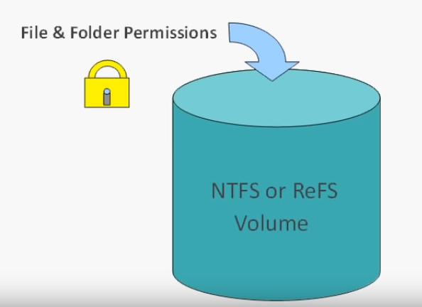
File and Folder Permissions
Implement access controls
Mainly for Windows
NTFS Permissions

Slide 78
Folders
Access Controls
10 Sniffing Analysis Wireshark 11 CLI Network Sniffers 12 Vulnerability Research 13 Denial of Service 14 Check & Crack Passwords 15 Hiding Files 16 Malware 17 Netcat
18 Web Attacks 19 SQL Injection 20 Social Engineering 21 Intrusion Detection & Firewalls
00 Contact Info 00 IT Governance Evaluation 01 The Information Battle Space 02 Hacking Methodology 03 Company Reconnaissance 04 People Reconnaissance 05 Systems Reconnaissance 06 General Recon 07 Cryptography 08 Recon Obfuscation 09 Scanning - Nmap
Users
Files

Slide 79
Create & Modify
Folders
10 Sniffing Analysis Wireshark 11 CLI Network Sniffers 12 Vulnerability Research 13 Denial of Service 14 Check & Crack Passwords 15 Hiding Files 16 Malware 17 Netcat
18 Web Attacks 19 SQL Injection 20 Social Engineering 21 Intrusion Detection & Firewalls
Technical Users
00 Contact Info 00 IT Governance Evaluation 01 The Information Battle Space 02 Hacking Methodology 03 Company Reconnaissance 04 People Reconnaissance 05 Systems Reconnaissance 06 General Recon 07 Cryptography 08 Recon Obfuscation 09 Scanning - Nmap
Read
Files
Production Users

Slide 80
Standard Permissions
Full control
Modify
Read & execute
List folder contents
Read
Write

Slide 81
Special Permissions
Traverse Folder/Execute File
Traverse Folder:
Allows or denies moving through a restricted folder to reach files and folders beneath the restricted folder in the folder hierarchy
Traverse folder takes effect only when the group or user is not granted the "Bypass traverse checking user" right in the Group Policy snap-in
This permission does not automatically allow running program files
Execute File:
Allows or denies running program (executable) files
List Folder/Read Data
List Folder:
Allows or denies viewing file names and subfolder names within the folder
List Folder only affects the contents of that folder and does not affect whether the folder you are setting the permission on will be listed
Read Data:
Allows or denies viewing data in files
Read Attributes
Allows or denies viewing the attributes of a file or folder, for example, "read-only" and "hidden".

Slide 82
Special Permissions
Write Extended Attributes
Allows or denies changing the extended attributes of a file or folder.
Extended attributes are defined by programs and may vary by program
The Write Extended Attributes permission does not imply creating or deleting files or folders, it only includes the permission to make changes to the extended attributes of an existing file or folder
Delete Subfolders and Files
Allows or denies deleting subfolders and files, even if the Delete permission has not been granted on the subfolder or file
Delete
Allows or denies deleting the file or folder
If you don't have Delete permission on a file or folder, you can still delete it if you have been granted Delete Subfolders and Files on the parent folder

Slide 83
Special Permissions
Read Permissions
Allows or denies reading permissions of a file or folder
Change Permissions
Allows or denies changing permissions of the file or folder
Take Ownership
Allows or denies taking ownership of the file or folder
The owner of a file or folder can always change permissions on it, regardless of any existing permissions that protect the file or folder
Synchronize
Allows or denies different threads to wait on the handle for the file or folder and synchronize with another thread that may signal it
This permission applies only to multithreaded, multiprocessing programs

Slide 84
Encryption
Read Extended Attributes
Allows or denies viewing the extended attributes of a file or folder. Extended attributes are defined by programs and may vary by program
Create Files/Write Data
Create Files:
Allows or denies creating files within the folder
Write Data:
Allows or denies making changes to a file and overwriting existing content
Create Folders/Append Data
Create Folders:
Allows or denies creating subfolders within the folder
Append Data:
Allows or denies making changes to the end of the file but not changing, deleting, or overwriting existing data
Write Attributes
Allows or denies changing the attributes of a file or folder, for example, "read-only" or "hidden"
The Write Attributes permission does not imply creating or deleting files or folders, it only includes the permission to make changes to the attributes of an existing file or folder

Slide 85
Group Policy
Group Policy is a feature of the Microsoft Windows NT family of operating systems that controls the working environment of user accounts and computer accounts
Group Policy provides centralized management and configuration of operating systems, applications, and users' settings in an Active Directory environment
Is a hierarchical infrastructure that allows a network administrator in charge of Microsoft's Active Directory to implement specific configurations for users and computers
Group Policy can also be used to define user, security and networking policies at the machine level

Slide 86
Linux Systems
Ownership of Linux files
Every file and directory on your Unix/Linux system is assigned 3 types of owner, given below
User
A user is the owner of the file
By default, the person who created a file becomes its owner
Hence, a user is also sometimes called an owner
Group
A user- group can contain multiple users
All users belonging to a group will have the same access permissions to the file
Suppose you have a project where a number of people require access to a file instead of manually assigning permissions to each user, you could add all users to a group, and assign group permission to file such that only this group members and no one else can read or modify the files
Other
Any other user who has access to a file
This person has neither created the file, nor he belongs to a usergroup who could own the file Practically, it means everybody else
Hence, when you set the permission for others, it is also referred as set permissions for the world

Slide 87
Question
How does Linux distinguish between these three user types so that a user 'A' cannot affect a file which contains some other user 'B's' vital information/data??
It is like you do not want your colleague, who works on your Linux computer, to view your images
This is where Permissions set in, and they define user behaviour

Slide 88
Permissions
Every file and directory in your UNIX/Linux system has following 3 permissions defined for all the 3 owners discussed above.
Read
Write
Execute

Slide 89
Read
This permission give you the authority to open and read a file
Read permission on a directory gives you the ability to lists its content

Slide 90
Write
The write permission gives you the authority to modify the contents of a file
The write permission on a directory gives you the authority to add, remove and rename files stored in the directory
Consider a scenario where you have to write permission on file but do not have write permission on the directory where the file is stored
You will be able to modify the file contents
But you will not be able to rename, move or remove the file from the directory

Slide 91
Execute
In Windows, an executable program usually has an extension ".exe" and which you can easily run
In Unix/Linux, you cannot run a program unless the execute permission is set
If the execute permission is not set, you might still be able to see/modify the program code(provided read & write permissions are set), but not run it

Slide 92
Linux - Basic File Permissions
Permission Groups
Each file and directory has three user based permission groups:
owner - The Owner permissions apply only the owner of the file or directory, they will not impact the actions of other users
group - The Group permissions apply only to the group that has been assigned to the file or directory, they will not effect the actions of other users.
all users - The All Users permissions apply to all other users on the system, this is the permission group that you want to watch the most

Slide 93
Permission Types
Each file or directory has three basic permission types:
read - The Read permission refers to a user's capability to read the contents of the file
write - The Write permissions refer to a user's capability to write or modify a file or directory
execute - The Execute permission affects a user's capability to execute a file or view the contents of a directory

Slide 94
Permission Types
The Permission Types that are used are:
r - Read
w - Write
x - Execute
So for an example, lets say I have a file named file1 that currently has the permissions set to _rw_rw_rw, which means that the owner, group and all users have read and write permission

Slide 95
Adding and Removing Permissions
To remove a permission you would invoke the command: chmod a-rw file1
To add the permissions above you would invoke the command: chmod a+rw file1

Slide 96
Let’s Add Some Confusion
Linux files have permissions like so….
777
Linux has the following permissions:
0 – no permission 1 – execute 2 – write 3 – write and execute 4 – read 5 – read and execute 6 – read and write 7 – read, write, and execute

Slide 97
So, -rw-rw-rw is 666

Slide 98
Common Permissions
755:
This set of permissions is commonly used in web server
The owner has all the permissions to read, write and execute
Everyone else can only read and execute, but cannot make changes to the file.
777:
Everyone can read write and execute
In a web server, it is not advisable to set ‘777’ permission for your files and folders as it allows anyone to add malicious code to your server
However, in some cases, you will need to set the 777 permissions before you can upload any file to the server (For example, uploading images in WordPress)
644:
Only the owner can read and write
Everyone else can only read
No one can execute the file
655
Only the owner can read and write, but not execute the file
Everyone else can read and execute, but cannot modify the file

Slide 99
Protection
Hardware Passkey
Licence Key
Dongle
RSA-DSA

Slide 100
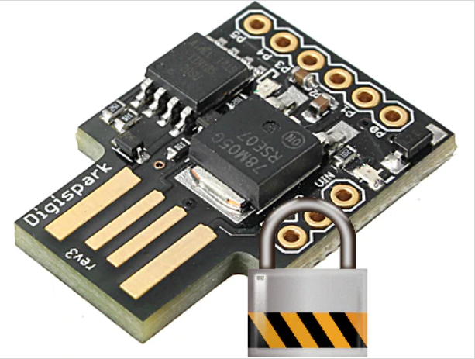
Passkey
Also referred to as a security key
Generates and stores ultra secure passwords
Security keys can be used with 2-Step Verification to help you keep hackers out of your accounts

Slide 101
Licence Key
A key to register software
Allows you to confirm that your software is legitimate and obtain patches and updates

Slide 102
Dongle
A dongle is a small piece of computer hardware that connects to a port on another device to provide it with additional functionality, or enable a pass-through to such a device that adds functionality
Initially synonymous with software protection dongles—a form of hardware digital rights management where a piece of software will only operate if a specified dongle—which typically contains a license key or some other cryptographic protection mechanism—is plugged into the computer while it is running
Term has since been applied to other forms of devices with a similar form factor, such as adapters that convert ports to handle different types of connectors

Slide 103
Encryption
In cryptography, encryption is the process of encoding a message or information in such a way that only authorized parties can access it and those who are not authorized cannot. Encryption does not itself prevent interference but denies the intelligible content to a would-be interceptor

Slide 104
RSA v DSA
DSA is faster at decrypting and signing, while RSA is faster at encrypting and verifying
DSA was originally intended for signing but used for encryption and decryption
RSA used for signing and encryption
DSA is faster than RSA at key generation
DSA is faster than RSA at creating digital signatures
RSA faster at encryption
RSA is faster than DSA at verifying a digital signature

Slide 105
2.3 Describe Protection Against Malicious Software
Anti-virus
Anti-malware

Slide 106
Anti-virus
Antivirus software, or anti-virus software (abbreviated to AV software), also known as anti-malware, is a computer program used to prevent, detect, and remove malware
Antivirus software was originally developed to detect and remove computer viruses

Slide 107
Anti-malware
Antimalware (anti-malware) is a type of software program designed to prevent, detect and remove malicious software (malware) on IT systems, as well as individual computing devices

Slide 108
2.4 Describe Types of Firewalls
Packet filter
Stateful
Application level
Intrusion detection systems
Intrusion prevention systems

Slide 109
Packet Filter
Packet filtering is a firewall technique used to control network access by monitoring outgoing and incoming packets and allowing them to pass or halt based on the source and destination Internet Protocol (IP) addresses, protocols and ports
3 Ways to configure:
Filter passes only safe packets
Accept all but filter drops unsafe packets
The packet can be quarantined if the filter encounters a packet for which its rules do not provide instructions

Slide 110
Stateful
A stateful firewall is a network firewall that tracks the operating state and characteristics of network connections traversing it
The firewall is configured to distinguish legitimate packets for different types of connections
Tightens rules for TCP traffic by creating a directory of TCP connections
Reviews packet information but also records information about TCP connections
There is an entry for each currently established connection
Packet filter will allow incoming traffic to high-numbered ports only for those packets that fit the profile of one of the entries in this directory
Keeps track of TCP sequence numbers to prevent attacks that depend on the sequence number
Inspects data for protocols like FTP, IM and SIPS commands

Slide 111
Application Level
An application firewall is a form of firewall that controls input, output, and/or access from, to, or by an application or service
It operates by monitoring and potentially blocking the input, output, or system service calls that do not meet the configured policy of the firewall
The application firewall is typically built to control all network traffic on any OSI layer up to the application layer
It is able to control applications or services specifically, unlike a stateful network firewall, which is - without additional software - unable to control network traffic regarding a specific application
There are two primary categories of application firewalls, network-based application firewalls and host-based application firewalls.

Slide 112
Network-Based
A network-based application layer firewall is a computer networking firewall operating at the application layer of a protocol stack,and is also known as a proxy-based or reverse-proxy firewall
Application firewalls specific to a particular kind of network traffic may be titled with the service name, such as a web application firewall
They may be implemented through software running on a host or a stand-alone piece of network hardware
Often, it is a host using various forms of proxy servers to proxy traffic before passing it on to the client or server
Because it acts on the application layer, it may inspect the contents of traffic, blocking specified content, such as certain websites, viruses, or attempts to exploit known logical flaws in client software

Slide 113
Host-Based
A host-based application firewall can monitor any application input, output, and/or system service calls made from, to, or by an application
Done by examining information passed through system calls instead of or in addition to a network stack
Can only provide protection to the applications running on the same host

Slide 114
Intrusion Detection Systems
An intrusion detection system (IDS) is a device or software application that monitors a network or systems for malicious activity or policy violations
Is a passive system that scans traffic and reports back on threats
Any malicious activity or violation is typically reported either to an administrator or collected centrally using a security information and event management (SIEM) system
A SIEM system combines outputs from multiple sources, and uses alarm filtering techniques to distinguish malicious activity from false alarms

Slide 115
Intrusion Prevention Systems
An Intrusion Prevention System (IPS) is a network security/threat prevention technology that examines network traffic flows to detect and prevent vulnerability exploits
Vulnerability exploits usually come in the form of malicious inputs to a target application or service that attackers use to interrupt and gain control of an application or machine

Slide 116
Intrusion Prevention Systems
The IPS often sits directly behind the firewall and provides a complementary layer of analysis that negatively selects for dangerous content
Unlike its predecessor the Intrusion Detection System (IDS) the IPS is placed inline (in the direct communication path between source and destination), actively analyzing and taking automated actions on all traffic flows that enter the network
Specifically, these actions include:
Sending an alarm to the administrator (as would be seen in an IDS)
Dropping the malicious packets
Blocking traffic from the source address
Resetting the connection

Slide 117
Tasks
Setup a server 2012 server in VMWare
Create two folders on C:
AdminUsers
Staff
Group Policy
Setting users and computers
Create two users
AdminUser
Peter Pan
Setting file permissions
Admin users have access to both folders
Peter Pan only has access to Staff folder

Slide 118
Tasks
Group Policy
Create a group policy so that users have local admin rights but not admin rights on active directory. Also stops the local admin users to RDP to the server.
Create a desktop background of an image of your choice for the local machine
A different image must be displayed when the AdminUser logs in to the local machine
Push the policy to the local machine

Slide 119
Other Useful Things

Slide 120
Wireless Protocols
Bluetooth
2G (GSM)
3G & 4G
LTE Cat 0, 1, & 3
LTE-M1
5G
NFC
RFID

Slide 121
Bluetooth
Bluetooth is a global 2.4 GHz personal area network for short-range wireless communication
Uses short-wavelength UHF radio waves in the industrial, scientific and medical radio bands
Frequencies from 2.400 to 2.485 GHz
Used to build personal area networks (PANs)
Device-to-device file transfers
Wireless speakers
Wireless headsets
Range is typically less than 10 m (33 ft)

Slide 122
2G (GSM)
2G is the “old-school” TDMA (usually) cellular protocol
ATMs and old alarm systems used this
In most parts of the world it is phased out or in the process of being phased out

Slide 123
3G & 4G
3G was the first “high speed” cellular network
It is a name that refers to a number of technologies that meet IMT-2000 standards
4G is the generation of cellular standards that followed 3G, and is what most people use today for mobile cellular data
You can use 3G and 4G for IoT devices, but the application needs a constant power source or must be able to be recharged regularly

Slide 124
LTE Cat 0, 1, & 3
With LTE classes, the lower the speed, the lower the amount of power they use
LTE Cat 1 and 0 are typically more suitable for IoT devices

Slide 125
LTE-M1
This is the first cellular wireless protocol that was build from the ground up for IoT devices. That being said, it isn’t available yet, so how it performs remains to be seen.
With LTE, it’s worth understanding that carriers typically don’t have to modify hardware for their basestations; upgrades can be done entirely through software.

Slide 126
5G
Though it likely won’t be released for another five years, 5G is set to be the next generation of cellular network protocol. It’s designed for high throughput, and it will probably face the same issues as 3G and 4G in regards to IoT.

Slide 127
NFC
Near field communication is precisely as it sounds
IoT network protocols used for very close communication
When you wave your phone over a card reader to pay for groceries, you’re likely using NFC

Slide 128
RFID
There are two types of radio frequency identification:
Active
Commonly used for real-time location tracking
Passive
Does not contain a battery
Power is supplied by the reader
This protocol was designed specifically so devices without batteries could send a signal
In most systems, one side of an RFID system is powered, creating a magnetic field, which induces an electric current in the chip
This creates a system with enough power to send data wirelessly over and over again
Because of this, RFID tags are used for shipping and tracking purposes

Slide 129
WIFI
IEEE 802.11 is a set of standards for implementing wireless local area networks
802.11a
802.11b
802.11c
802.11g
802.11n
802.11i

Slide 130
The 802.11 Protocols
The 802.11abgn specifications are collectively and individually referred to as Wi-Fi

Slide 131
802.11a
802.11a operates in the 5 GHz frequency band and utilizes OFDM (Orthogonal Frequency Division Multiplexing)
Modulation for up to 54 Mbps data rate.

Slide 132
802.11b
802.11b operates in the 2.4 GHz frequency band and utilizes DSSS (Direct Sequence Spread Spectrum)
Modulation for up to 11 Mbps data rate
Devices include:
Microwave ovens
Bluetooth devices
Baby monitors
Cordless telephones
Amateur radio equipment

Slide 133
802.11c
This works in the 2.4 GHz band (like 802.11b), but uses the same OFDM based transmission scheme as 802.11a
Operates at a maximum physical layer bit rate of 54 Mbit/s exclusive of forward error correction codes, or about 22 Mbit/s average throughput
Fully backward compatible with 802.11b hardware
Experience interference from other products operating in the 2.4 GHz band

Slide 134
802.11g
802.11g operates in the 2.4 GHz frequency band and utilizes OFDM and DSSS modulation for up to 54 Mbps data rate
802.11g hardware is fully backward compatible with 802.11b hardware

Slide 135
802.11i
Used for WPA2

Slide 136
802.11n
IEE 802.11n sought to increase the achievable speeds of Wi-Fi networks beyond that achievable using 802.11g
802.11n is an amendment that improves upon the previous 802.11 standards by adding multiple-input multiple-output antennas (MIMO)
802.11n operates in both the 2.4 GHz and 5 GHz frequency bands
Utilizes OFDM modulation, and uses advanced technologies including MIMO (Multiple-Input Multiple-Output) spatial multiplexing to increase throughput and range

Slide 137
802.11n
Data rate ranges from 54 Mbit/s to 600 Mbit/s
Support for 5 GHz bands is optional

Slide 138
WiFi Security
WEP
WPA
WPA2
WPS

Slide 139
WEP
Wired Equivalent Privacy
When a client connects to a WEP-protected network, the WEP key is added to some data to create an “initialization vector,” or “IV” for short
When a client sends its request to the access point, the portion containing the IV is transmitted wirelessly in clear-text (not encrypted)
WEP is not the correct choice for securing your network

Slide 140
WPA
WiFi Protected Access (WPA
Ratified by the WiFi Alliance in 2003 as a response to the insecurities that were discovered in WEP
Uses a pre-shared key (PSK), referred to as WPA Personal, and the Temporal Key Integrity Protocol or TKIP
Included a new message integrity check nicknamed “Michael”
While Michael offered a great deal of improvement over the old way of securing networks, there was still some worry about some security issues with using a similar (though much stronger) implementation

Slide 141
WPA2
The concerns about Michael led to WPA2’s introduction in 2004
At the center of WPA2 is its use of a security protocol based on Advanced Encryption Standard (AES), the U.S. Government’s preferred choice of encryption
As it stands now, the only people who should still be using TKIP on a wireless network are those who are dealing with hardware that is rated for 802.11g only

Slide 142
WPS
WiFi Protected Setup
A user is able to add new devices to their network by simply pushing a button (within administration software or physically on the router) and then typing in an 8-digit PIN number on the client device

Slide 143
Honeypot
A computer used to detect, deflect or counteract unauthorised use
Replicates legitimate parts of an IT system to attract and fool attackers
Production honeypots used by corporations as security devices
Research honeypots used to gather information and develop countermeasures
Spam honeypot
Catches open relay test messages from spammers
Returns the email to the spammer, but blocks all subsequent emails from the spammer
Notifies spammer’s ISP

Slide 144
Steganography
Steganography is the practice of concealing a file, message, image, or video within another file, message, image, or video
The word steganography comes from New Latin steganographia, which combines the Greek words steganós, meaning "covered or concealed", and -graphia meaning "writing“
Steganography works by replacing bits of useless or unused data in regular computer files (such as graphics, sound, text, HTML, or even floppy disks ) with bits of different, invisible information
The hidden file is encoded in the least significant bits of the values encoding the colour of each pixel of the image

Slide 145
Glossary
Stateful Inspection (SI) - a firewall technology that monitors the state of active connections and uses this information to determine which network packets to allow through the firewall. Stateful inspection has largely replaced an older technology, static packet filtering
Network Address Translation (NAT) - a method of remapping one IP address space into another by modifying network address information in the IP header of packets while they are in transit across a traffic routing device
Demilitarised Zone (DMZ) - a DMZ or demilitarized zone (sometimes referred to as a perimeter network or screened subnet) is a physical or logical subnetwork that contains and exposes an organization's external-facing services to an untrusted, usually larger, network such as the Internet
Orange Zone (OZ) – a DMZ (we have red [internet], green [LAN] and orange [DMZ]
Port scanner - an application designed to probe a server or host for open ports
Virus scanner – an anti-virus application
Ethernet sniffer – packet analyser or packet sniffer - a computer program or piece of computer hardware (such as a packet capture appliance) that can intercept and log traffic that passes over a digital network or part of a network

Slide 146
Glossary
SSH - Secure Shell (SSH) is a cryptographic network protocol for operating network services securely over an unsecured network
FTPS - an extension to the commonly used File Transfer Protocol (FTP) that adds support for the Transport Layer Security (TLS) and, formerly, the Secure Sockets Layer
HTTP - Hypertext Transfer Protocol (HTTP) is an application protocol for distributed, collaborative, hypermedia information systems
RPC - a remote procedure call (RPC) is when a computer program causes a procedure (subroutine) to execute in a different address space (commonly on another computer on a shared network), which is coded as if it were a normal (local) procedure call, without the programmer explicitly coding the details for the remote interaction
ARP - Address Resolution Protocol (ARP) is a communication protocol used for discovering the link layer address, such as a MAC address, associated with a given internet layer address, typically an IPv4 address
DHCP - Dynamic Host Configuration Protocol (DHCP) is a network management protocol used on Internet Protocol networks whereby a DHCP server dynamically assigns an IP address and other network configuration parameters to each device on a network so they can communicate with other IP networks
DNS - Domain Name System (DNS) is a hierarchical and decentralized naming system for computers, services, or other resources connected to the Internet or a private network. It associates various information with domain names assigned to each of the participating entities

Slide 147
Glossary
RTO - Recovery Time Objective (RTO)[8][9] is the targeted duration of time and a service level within which a business process must be restored after a disaster (or disruption) in order to avoid unacceptable consequences associated with a break in business continuity
RPO - Recovery Point Objective (RPO) is defined by business continuity planning. It is the maximum targeted period in which data (transactions) might be lost from an IT service due to a major incident
MTTR - Mean time to repair (MTTR) is a basic measure of the maintainability of repairable items
MTPOD - The duration after which an organisation's viability will be irrevocably threatened if product and service delivery cannot be resumed
SWOT - Strengths, Weaknesses, Opportunities, Threats

