Slide 1
Week 1 – Day 3
Cyber Threats
UFCFFU-30-1

Slide 2
Cyber Threats
Week 1
Introduction
Monday
01
02
Wednesday
03
Tuesday
04
Vulnerabilities in computer networks, applications and systems (e.g., Insecure coding and unprotected networks) and how they can be exploited
Network-based attacks e.g.: Eavesdropping/sniffing, man-in-the-middle, spoofing, session hijacking, denial of service, traffic redirection, routing attacks, traffic analysis
05
06
Thursday
Friday

Slide 3
Syllabus – Week 1
Foundations of cyber security, its significance, concepts, threats, vulnerabilities and assurance
Application of cyber security concepts to IT infrastructure
Fundamental building blocks and typical architectures of IT infrastructure
Common vulnerabilities in networks and systems
Vulnerabilities in computer networks, applications and systems (e.g., Insecure coding and unprotected networks) and how they can be exploited
Network-based attacks e.g.: Eavesdropping/sniffing, man-in-the-middle, spoofing, session hijacking, denial of service, traffic redirection, routing attacks, traffic analysis
Impact of vulnerabilities in an organisational context
Human dimension of cyber security and adversarial thinking applied to system development
How an employee may enable a successful attack chain without realising it

Slide 4
Vulnerabilities in computer networks, applications and systems
Insecure coding
Unprotected networks
How they can be exploited

Slide 5
Non Secure Coding
Vulnerabilities are a subset of weaknesses.
Almost all software analysis tools find weaknesses not vulnerabilities
Attack surface
the set of points in the program’s interface that can be controlled by the user

Slide 6
Attack Surfaces
Network input buffer
Field in a form
Line in an input file
Environment variable
Program option
Entry in a database

Slide 7
According to OWASP
Input Validation
Output Encoding
Authentication and Password Management (includes secure handling of credentials by external services/scripts)
Session Management
Access Control
Cryptographic Practices
Error Handling and Logging
Data Protection
Communication Security
System Configuration
Database Security
File Management
Memory Management
General Coding Practices

Slide 8
Common Application Vulnerability Exploits
Cross Site Scripting
SQL Injection
LDAP Injection
Cross Site Request Forgery
Insecure Cryptographic Storage

Slide 9
Task
Build a mini website in PHP that has an input form. The input form must take an email and a password.
When submitting the form, make use of POST.
When submitting the form, see what happens in the URL window.
Now, go back and change the POST to GET and see what happens in the URL window

Slide 10
Cross Site Scripting
Cross-Site Scripting (also known as XSS) is one of the most common application-layer web attacks
XSS vulnerabilities target scripts embedded in a page that are executed on the client-side (in the user’s web browser) rather than on the server-side
XSS in itself is a threat that is brought about by the internet security weaknesses of client-side scripting languages, such as HTML and JavaScript
The concept of XSS is to manipulate client-side scripts of a web application to execute in the manner desired by the malicious user
Such a manipulation can embed a script in a page that can be executed every time the page is loaded, or whenever an associated event is performed
XSS is the most common security vulnerability in software today
XSS vulnerabilities can have consequences such as tampering and sensitive data theft.

Slide 11
XSS
By exploiting XSS vulnerabilities, an attacker can perform malicious actions, such as:
Hijack an account.
Spread web worms.
Access browser history and clipboard contents.
Control the browser remotely.
Scan and exploit intranet appliances and application

Slide 12
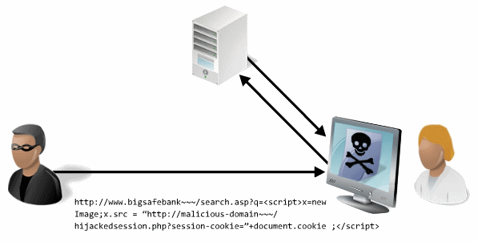
Example

Slide 13
SQL Injection
An application security weakness that allows attackers to control an application’s database
Lets them access or delete data, change an application’s data-driven behaviour, and do other undesirable things
Done by tricking the application into sending unexpected SQL commands.
SQL injection weaknesses occur when an application uses untrusted data, such as data entered into web form fields, as part of a database query
When an application fails to properly sanitize this untrusted data before adding it to a SQL query, an attacker can include their own SQL commands which the database will execute
Easy to prevent

Slide 14
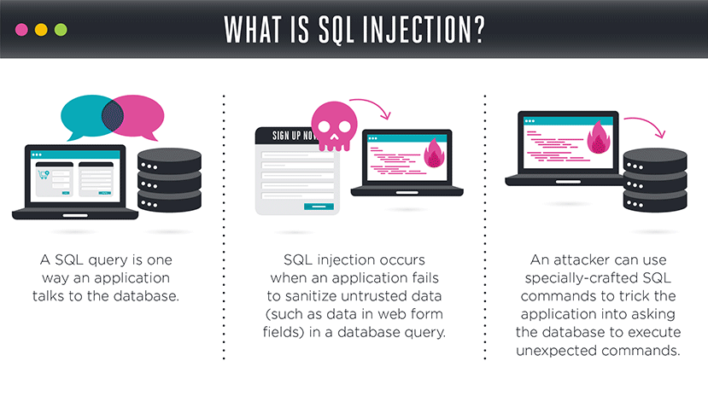
Example

Slide 15
LDAP Injection
A type of attack on a web application where hackers place code in a user input field in an attempt to gain unauthorized access or information
Like Java SQL injection or .NET SQL injection, an LDAP injection can lead to information theft, browser or session hijacking, defacement of website and worse
Uses client-supplied data in LDAP (Lightweight Directory Access Protocol) statements without removing potentially harmful code from the request

Slide 16
Cross Site Request Forgery
An attack outlined in the OWASP Top 10 whereby a malicious website will send a request to a web application that a user is already authenticated against from a different website
This way an attacker can access functionality in a target web application via the victim's already authenticated browser
Targets include web applications like social media, in-browser email clients, online banking and web interfaces for network devices

Slide 17
Insecure Cryptographic Storage
A common vulnerability that occurs when sensitive data is not stored securely
Insecure Cryptographic Storage isn’t a single vulnerability, but a collection of vulnerabilities
The vulnerabilities in the collection all have to do with making sure your most important data is encrypted when it needs to be
This includes:
Making sure you are encrypting the correct data
Making sure you have proper key storage and management
Making sure that you are not using known bad algorithms
Making sure you are not implementing your own cryptography, which may or may not be secure

Slide 18
Unprotected Networks
Usually applicable to WiFi
Using weak encryption (WEP or WPA instead of WPA2)

Slide 19
Task
Find out more about the differences between WPA2 and WEP.
Specifically look at the cryptography behind this.

Slide 20
Cyber Threats
Week 1
Introduction
Monday
01
02
Tuesday
03
Wednesday
04
05
06
Thursday
Friday

