Slide 1
Unit 51 – Software Design Fundamentals
Programming concepts and practice

Slide 2
Sequence
When a program runs it executes each line of code in turn
The order of statements in a program is really important

Slide 3
What would this code do?
#initial values
lastmonth = "June"
thismonth = "July”
#roll over to a new month
thismonth = "August"
lastmonth = thismonth
#print outcome
print("Previous month ", lastmonth)
print("Current month ", thismonth)

Slide 4
Precedence Rules
Expressions contained within parenthesis will be performed first
Multiplication will be performed before addition and subtraction
If more than one multiplication, it goes left to right
Division and multiplication take equal precedence

Slide 5
Examples
2
4+3-5 =
4+3*5 =
(4+3) *5 =
4 * (3+3) * 3 =
5-2*2+3 =
19
35
72
4

Slide 6
Naming conventions
Many parts of a program, including variables need to be named. In programming these names are called identifiers.
They cannot start with a digit and only can start with letters and the underscore
They cannot contain a space

Slide 7
Visual Basic Conventions
Control | Prefix | Example
Checkbox | chk | chkUndercoat
Combo/dropdown box | cbo | cboPaintType
Command button | cmd | cmdPrint
Form | frm | frmInvoice
Label | lbl | lblFirstName
Option button | opt | optLuxury
Text box | txt | txtLength

Slide 8
Conditions
A condition must result in a value which is either true or false. This is often used to compare one value to another.
> Greater than >=Greater than or equal to < less than
<less than or equal to
== equal to
!= not equal to

Slide 9
Selection using If…
Conditional expressions can used in selection and repetition
#event welcome
adult_Age = 18
age = int(input(“What is your age? ”))
if age <adult_age:
print(“you get a youth discount”)
print(“Welcome to this event”)
Notes:
Students to do (exercise 6) – challenge A
Challenge B for extension/homework

Slide 10
Selection using if else…..
#Blood donor eligibility
Age = float(input(“Age:”))
Weight = float(input(Weight in kgs:”))
donor_age_limit = 16
donor weight limit = 10
if age>donor_age_limit and weight>donor_weight_limit:
print(“eligible to donate blood”)
else:
print(“not eligible to donate blood”)
Notes:
Students to do Exercise 7 challenge A, Challenge B = Extension/homework
Who was George Boole and what was his legacy?

Slide 11
Iteration
Every time a program cycles through a sequence (loop) it is called an iteration
These are used when lines of code are executed many times
How many times depends on either various conditions being met or it has to run a set number of times
Notes:
Chapter 6 repetition….. (exercise 8)

Slide 12
For loop structures….
To run a fixed number of times, use a For….. Loop
def workWeek(): #returns the weekly income after tax
return 2000
def totalBills(): #returns the total owed this week on bills
return 600
weeks = 26 #this is the main routine
bank Balance = 0.0
for week in range (0, weeks): #this is the for loop header
spareIncome = workWeek () - totalBills()
bankBalance = bankBalance + spareIncome
print (week)
print (“Bank Balance after” , weeks, “weeks is £”, “{0:.2f}”.format(bankBalance))
Notes:
The variable, test condition and update are all in the loop header – students to do exercise 8 challenge A

Slide 13
While loop structures…
The construction of a while loop specifies a condition and a body or statement.
While some condition is true:
Perform a statement or block of statements (body) – this is the what you want the program to do.
To stop it repeating forever, at some point it must reach a false value in order for it to end…
Notes:
Students to do exercise 8 – challenge B

Slide 14
While loop structures (contd.)
choice = 0
while choice < 1 or choice > 5:
choice = int(input("Choose a number between 1 and 5 "))
if choice < 1 or choice > 5:
print(" not a valid choice – try again ")
print(“You managed to do that!”)

Slide 15
So far:
Explained:
Sequence
Selection
Iteration

Slide 16
Code Abstraction
An abstraction is the collecting together of several lines of code and giving them a new name
For instance this code:
#Blood donor eligibility
Age = float(input(“Age:”))
Weight = float(input(Weight in kgs:”))
donor_age_limit = 16
donor weight limit = 10
if age>donor_age_limit and weight>donor_weight_limit:
print(“eligible to donate blood”)
else:
print(“not eligible to donate blood”)
Could be collected in a function called CheckEligibility
A call to CheckEligibility with the parameters Age and Weight could return True or False

Slide 17
Data abstraction
This abstraction hides details of how items are constructed
In VB you can drag a control, such as a button, onto a form
The data abstraction of the button control hides the data elements of the button, such as the outline, the colour and the individual vectors required to draw the button

Slide 18
Data and code abstraction
Advantages
Reduced complexity for the programmer
More efficient programming, less repeated code
Efficient maintenance, code is simpler to understand
Distances the programmer from the actual hardware, no need to understand instruction sets, assembler language
More abstraction implemented as language generations increase

Slide 19
Use of abstraction
Functions in VB
Controls in VB

Slide 20
Procedural programming
Step by step programs
Divided into procedures (blocks of code) or functions (blocks of code)
Functions can be re-used
Division into manageable sizes of code
The examples in Python and VB are procedural

Slide 21
Object oriented
Take all the data and all the methods (what can be done) into one entity called a class
Then the class can be considered to be a “black box”
A programmer does not need to know what goes on in a class, just how to use it
Because the class only knows about its own data, it cannot corrupt other data, so classes are more secure

Slide 22
Example
We could define a class called Paint
It could have the methods GetCost, GetTins
Within the class there would be data for the coverage (litres/m²), litres/tin, tin sizes, cost/tin
This class is an abstract class – paint does not exist
In the program we can create subclasses of paint which do exist
Luxury, Standard, Economy, Undercoat, Exterior etc
We don’t need to write code for each as they will inherit the methods from the paint class
We can reuse the class in other programs

Slide 23
Why use OOP?
Suppose a game has monsters of different type
They could have attributes of health, hunger, inventory
In procedural programming you would have these defined for each type of monster (goblin, dragon etc)
There would be significant duplication
In OOP you could have a class called living_thing
It would have the same attributes
Then any subclass monster (goblin etc) would inherit the same attributes
If you wanted to add an attribute, you only do it to the living_thing and not all the individual monsters, as they will inherit it
No duplication and simplicity of change
But OOP complex to learn, so not useful for simple projects

Slide 24
Event driven programming
These programs respond to input from users, such as clicking a button, choosing an option from a list, entering text.
They generally have a visual user interface (GUI) as opposed to a text based command line interface (CLI)
In VB the graphical control button has a Click event handler which calls the associated VB code to run when the button is clicked. This is event driven.

Slide 25
Batch programming
Batch Scripts are stored in simple text files
They contain lines with commands that get executed in sequence
They are used to automate command sequences
Setting up servers for different purposes.
Automating housekeeping activities such as deleting unwanted files or log files.
Automating the deployment of applications from one environment to another.
Installing programs on various machines at once.

Slide 26
Batch program
@echo off
Rem This is for listing down all the files in the directory Program files
dir "C:\Program Files" > C:\lists.txt
echo "The program has completed”
This batch file will save all the names of the files in C:\Program Files in a new file called C:\lists.txt
Batch files have an extension of .bat and will run when clicked, or from a command window or Run box

Slide 27
Integrated Development Environments (IDEs)
These are aids to programming
A text editor program such as Notepad++ will allow:
Hiding blocks of code
Context highlighting
Useful for any scripting or procedural language
IDEs such as IDLE (Python), Visual Studio (VB, C#), Eclipse (Android) have GUI tools and comprehensive debuggers
Suitable for event driven and OOP languages

Slide 28
Quality of Code
These are the attributes of good quality code:
Portability
Efficiency
Accuracy
Robustness
Reliability
Usability
Maintainability

Slide 29
Portability
Code can be recompiled for different hardware and software platforms with a minimum of changes
For example
Android phone Apps recompiled into iOS
Unix code recompiled for Linux or MacOS (both are Unix based)
Java code can be run on any device with a Java Virtual Machine
JavaScript running in any browser

Slide 30
Efficiency
The code calculates results and performs operations as quickly as possible
Code is written with fewer lines and uses the least amount of memory to work
Some programs are known to produce inefficient (Dreamweaver)
The most efficient is to use a low level language (assembler)
Event Driven Programs can take up a lot of computer resources because of the graphics requirement
Procedural programs are good for data processing tasks such as stock control, payroll processing

Slide 31
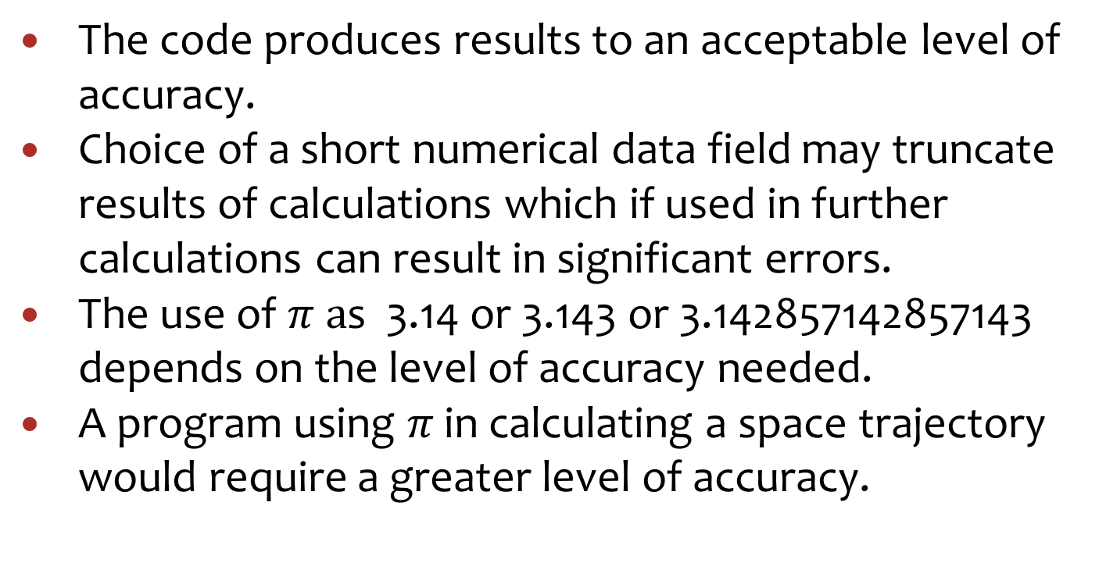
Accuracy
The code produces results to an acceptable level of accuracy.
Choice of a short numerical data field may truncate results of calculations which if used in further calculations can result in significant errors.
The use of $π a$s 3.14 or 3.143 or 3.142857142857143 depends on the level of accuracy needed.
A program using $π$ in calculating a space trajectory would require a greater level of accuracy.

Slide 32
Robustness
The program does not crash when given bad data
Validate your inputs (check for range: wall height 2.4 – 3m) ¹
Strip out invalid characters from inputs
Protect databases from SQL injection and cross site scripting
¹ You can demonstrate range checks in your program

Slide 33
Reliability
The code works the same way every time it is used and there are no unexpected surprises
Handle errors gracefully
Do not violate memory space (cause a BSOD)
Same actions results in same path through code

Slide 34
Usability
The program is intuitive and easy to learn.
Use tool tips
Contextual help
Visually helpful (clear buttons and labels) ¹
¹ You can demonstrate these in your program

Slide 35
Maintainability
The code is easy to modify and improve
good commenting throughout¹
indentation used for data structures such as selection (if) and iteration (loops) ¹
variable names and other names follow naming conventions¹
¹You can demonstrate these in your program

