Slide 1
Day2
BCS Level 4 Certificate in Security Technology Building Blocks Enhanced Syllabus
QAN 603/0884/9

Slide 2
2.1 Describe the hardware components available for network protection and their purpose and identify the appropriate system for a given task.
A candidate should be able to:
Understand network protocols and their use in the enforcement of security policies
Describe the use of network layers (OSI model) in the implementation of security functions
Demonstrate the use of network packet filtering in firewall settings
Use different types of firewalls in different settings
Explain the use of penetration testing in identifying security weaknesses
Identify the most appropriate Intrusion Detection and Prevention Systems
Snort
CounterACT
AirMagnet
Firewalls and DPI
Application proxies
IDS vs. Ips
Radius
Diameter
AAA

Slide 3
OSI model
Layer 7
Application
Open Systems Interconnection Reference Model
It’s a guide (thus the term “model”)
Don’t get wrapped up in the details
This is not the OSI protocol suite
Most of the OSI protocols didn’t catch on
There are unique protocols at every layer
You’ll refer to this model for the rest of your career
Layer 6
Presentation
Layer 5
Session
Layer 4
Transport
Layer 3
Network
Layer 2
Data Link
Layer 1
Physical
Notes:
All People Seem To Need Data Processing

Slide 4
OSI model
Layer 7
Application
Open Systems Interconnection Reference Model
Mnemonic
Please Do Not Throw Sausage Pizza Away
Layer 6
Presentation
Layer 5
Session
Layer 4
Transport
Layer 3
Network
Layer 2
Data Link
Layer 1
Physical

Slide 5
The OSI Layers
Application
The layer we see – Google Mail, Twitter, Facebook
Encoding and encryption
(SSL/TLS)
Presentation
Session
Communication between devices (Control protocols, tunnelling protocols)
The “post office” layer
(TCP segment, UDP datagram)
Transport
Network
The routing layer
(IP address, router, packet)
The switching layer
(Frame, MAC address, EUI-48, EUI-64, Switch)
Data Link
Signalling, cabling, connectors
(Cable, NIC, Hub)
Physical

Slide 6
OSI model

Slide 7
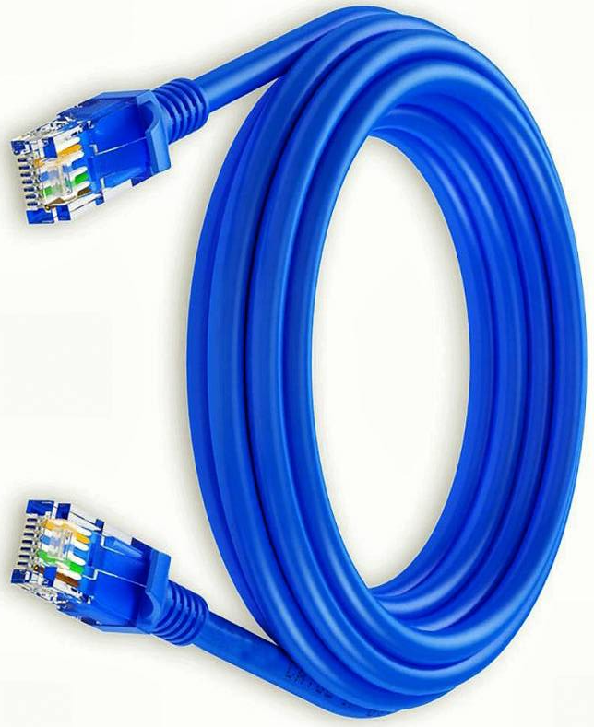
OSI Model – Layer 1: The Physical Layer
The physics of the network
Signalling, cabling, connectors
This layer isn’t about protocols
You have a physical layer problem
Fix your cabling, punch-downs, etc.
Run loopback tests, test/replace cables, swap adapter cards

Slide 8
OSI Model – Layer 1: The Physical Layer
From Data Link Layer
To Data Link Layer
110
1010101100001101
Physical Layer
110
1010101100001101
Transmission Medium
The physical layer is responsible for movements of individual bits from one hop (node) to the next

Slide 9
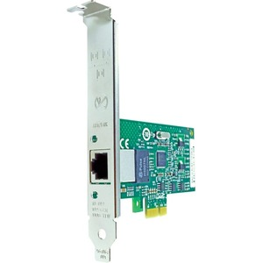
OSI Model – Layer 2: Data Link Layer
The basic network “language”
The foundation of communication at the data link layer
Data Link Control (DLC) protocols
MAC (Media Access Control) address on Ethernet
The “switching” layer
0
1
1
1
0
1
0
9C:35:58:5F:4C:D7
00:1b:48:63:b2:56
Notes:
The Data Link Layer is referencing the MAC addresses that are communicating on the network.

Slide 10
OSI Model – Layer 2: The Data Link Layer
From Network Layer
To Network Layer
H2
Data
T2
H2
Data
T2
Data Link Layer
Data Link Layer
To Physical Layer
From Physical Layer
The data link layer is responsible for moving frames from one hop (node) to the next.
Notes:
H2 is the Header
Data is the packet from the network layer
The trailer includes error detection and the ending transmission data

Slide 11
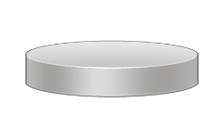
Hop-to-Hop delivery
Intermediate
system
End
system
Link
X
Link
End
system
Intermediate
system
C
D
Link
X
B
Intermediate
system
A
End
system
Link
X
Link
E
F
Hop-to-hop delivery
Hop-to-hop delivery
Hop-to-hop delivery
A
B
E
F
Network
Network
Network
Data Link
Data Link
Data Link
Physical
Physical
Physical
Hop-to-hop delivery
Hop-to-hop delivery
Hop-to-hop delivery

Slide 12
OSI Model - Layer 3: Network Layer
The “routing” layer
Internet Protocol (IP)
Fragments frames to traverse different networks

Slide 13
OSI Model - Layer 3: Network Layer
What is IP Fragmentation?
Fragments are always in multiples of 8 because of the number of fragmentation offset bits in the IP header

Slide 14
OSI Model – Layer 3: The Network Layer
From Transport Layer
To Transport Layer
H3
Data
H3
Data
Network Layer
Network Layer
To Data Link Layer
From Data Link Layer
The network layer is responsible for the delivery of individual packets from the source host to the destination host.
Notes:
H2 is the Header
Data is the packet from the network layer
The trailer includes error detection and the ending transmission data

Slide 15
Source to Destination Delivery
Intermediate
system
Link
X
Link
Intermediate
system
C
D
Link
X
B
Intermediate
system
A
Link
X
Link
E
F
Hop-to-hop delivery
Hop-to-hop delivery
Hop-to-hop delivery
Data Link Layer
Source-to-destination delivery
A
B
E
F
Network
Network
Network
Data Link
Data Link
Data Link
Physical
Physical
Physical

Slide 16
OSI Model – Layer 4: Transport Layer
The “post office” layer
Parcels and letters
TCP (Transmission Control Protocol) and UDP (User Datagram Protocol)

Slide 17
Transport Layer
From Session Layer
To Session Layer
H4
Data
H4
Data
H4
Data
H4
Data
H4
Data
H4
Data
Transport Layer
Transport Layer
To Network Layer
From Network Layer
The transport layer is responsible for the delivery of a message from one process to another.

Slide 18
OSI Model – Layer 5: Session
Communication management between devices
Start, stop, restart
Half-duplex, full-duplex
Control protocols, tunnelling protocols

Slide 19
Session Layer
From Presentation Layer
To Presentation Layer
H5
H5
SYN
SYN
SYN
SYN
SYN
SYN
Session Layer
Session Layer
To Transport Layer
From Transport Layer
The session layer is responsible for dialog control and synchronization.

Slide 20
OSI Model – Layer 6: Presentation
Character encoding
Application encryption
Often combined with the Application Layer

Slide 21
OSI Model – Layer 6: Presentation
From Application Layer
To Application Layer
H6
Data
H6
Data
Presentation Layer
Presentation Layer
To Session Layer
From Session Layer
The presentation layer is responsible for translation, compression, and encryption.

Slide 22
OSI Model – Layer 7: Application
The layer we see - HTTP, FTP, DNS, POP3

Slide 23
OSI Model – Layer 7: Application
User:
Human or Program
User:
Human or Program
…
…
X.500
FTAM
X.400
X.500
FTAM
X.400
H7
Data
Message
H7
Data
Message
Application Layer
Application Layer
To Presentation Layer
From Presentation Layer
The application layer is responsible for providing services to the user.

Slide 24
Summary of Layers
Application
To allow access to network resources
To translate, encrypt and compress data
Presentation
Session
To establish, manage and terminate sessions
To provide reliable process-to-process message delivery and error recovery
Transport
Network
To move packets from source to destination; to provide internetworking
To organise bits into frames; to provide hop-to-hop delivery
Data Link
To transmit bits over a medium; to provide mechanical and electrical specifications
Physical

Slide 25
Cryptography and the OSI model
Early network protocols used (plaintext) password authentication or data checksums, cryptographic security
Cryptographic security isn't tied to any particular layer of the OSI model
Networks more commonly apply cryptographic protections where attack is most likely
to authentication processes
to particular types of traffic
certain segments of the physical network
Notes:
Early network protocols used (plaintext) password authentication or data checksums, cryptographic security.
Cryptographic security isn't tied to any particular layer of the OSI model; in theory you could apply it to any layer to protect data on that level.
In practice, networks more commonly apply cryptographic protections where attack is most likely: to authentication processes, to particular types of traffic, or on certain segments of the physical network.

Slide 26
Secure shell
SSH was first used to apply security to common protocols.
SSH can also be used as a tunneling protocol to carry a wide variety of application data.
SSH uses TCP port 22.
SSH uses public key cryptography to authenticate connections.

Slide 27
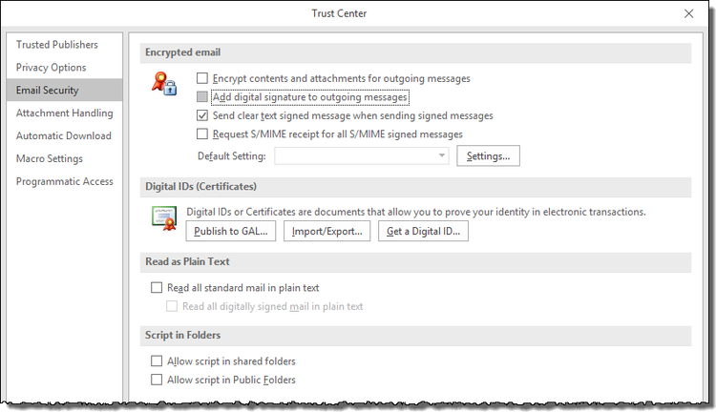
Secure email
Encryption and certificate settings in Microsoft Outlook

Slide 28
Firewalls and DPI
Firewalls are a common first defence against malicious actors
Can be a physical device or virtualised machine
Used to create a trusted portion of the network and then to separate that trusted portion from the untrusted portion
We initially set the firewall up to ‘Just say NO!’
We can then allow certain types of traffic through the firewall

Slide 29
Trusted
Branch Office
Computer 3
Printer
Public Facing
Servers
Access
Point
Untrusted
Computer 1
Switch 2
Switch 1
Service
Provider
Service
Provider
Router 1
Computer 2
Internal
Server
Router 2
Internet
Firewall
Notes:
Here we have a typical enterprise network setup.
We have a firewall which is setup to monitor traffic and then to either allow traffic through or to deny traffic.
On the one side we have the trusted network.
On the other we have the outward facing, public, untrusted network.

Slide 30
Types of Firewalls
Packet-filtering firewalls
Circuit-level gateways
Stateful inspection firewalls
Application-level gateways (a.k.a. proxy firewalls)
Next-gen firewalls
Software firewalls
Hardware firewalls
Cloud firewalls

Slide 31
Types of Firewalls
Packet-filtering firewalls
Circuit-level gateways
Stateful inspection firewalls
Application-level gateways (a.k.a. proxy firewalls)
Next-gen firewalls
Software firewalls
Hardware firewalls
Cloud firewalls
Deliver firewall functionality, rather than being types of firewall architectures

Slide 32
Packet-Filtering Firewalls
As the most “basic” and oldest type of firewall architecture
Create a checkpoint at a traffic router or switch
Performs a simple check of the data packets coming through the router
inspecting information such as the destination and origination IP address, packet type, port number, and other surface-level information without opening up the packet to inspect its contents
If the information packet doesn’t pass the inspection, it is dropped
Notes:
As the most “basic” and oldest type of firewall architecture, packet-filtering firewalls basically create a checkpoint at a traffic router or switch. The firewall performs a simple check of the data packets coming through the router—inspecting information such as the destination and origination IP address, packet type, port number, and other surface-level information without opening up the packet to inspect its contents.
If the information packet doesn’t pass the inspection, it is dropped.

Slide 33
Circuit-Level Gateways
Another simplistic firewall type that is meant to quickly and easily approve or deny traffic without consuming significant computing resources
Circuit-level gateways work by verifying the transmission control protocol (TCP) handshake
This TCP handshake check is designed to make sure that the session the packet is from is legitimate
While extremely resource-efficient, these firewalls do not check the packet itself
If a packet held malware, but had the right TCP handshake, it would pass right through
Circuit-level gateways are not enough to protect your business by themselves
Notes:
Another simplistic firewall type that is meant to quickly and easily approve or deny traffic without consuming significant computing resources, circuit-level gateways work by verifying the transmission control protocol (TCP) handshake.
This TCP handshake check is designed to make sure that the session the packet is from is legitimate.
While extremely resource-efficient, these firewalls do not check the packet itself.
So, if a packet held malware, but had the right TCP handshake, it would pass right through.
This is why circuit-level gateways are not enough to protect your business by themselves.

Slide 34
Stateful Inspection Firewalls
Combine both packet inspection technology and TCP handshake verification
Creates a level of protection greater than either of the previous two architectures could provide alone
Do put more of a strain on computing resources
This may slow down the transfer of legitimate packets compared to the other solutions
Notes:
Combine both packet inspection technology and TCP handshake verification to create a level of protection greater than either of the previous two architectures could provide alone.
However, these firewalls do put more of a strain on computing resources as well. This may slow down the transfer of legitimate packets compared to the other solutions.

Slide 35
Application-Level Gateways (a.k.a. proxy firewalls)
Operate at the application layer to filter incoming traffic between your network and the traffic source
Hence, the name “application-level gateway”
These firewalls are delivered via a cloud-based solution or another proxy device
Rather than letting traffic connect directly, the proxy firewall first establishes a connection to the source of the traffic and inspects the incoming data packet.
This check is similar to the stateful inspection firewall in that it looks at both the packet and at the TCP handshake protocol
However, proxy firewalls may also perform deep-layer packet inspections, checking the actual contents of the information packet to verify that it contains no malware
Can create significant slowdown because of the extra steps in the data packet transferal process
Notes:
Operate at the application layer to filter incoming traffic between your network and the traffic source—hence, the name “application-level gateway.”
These firewalls are delivered via a cloud-based solution or another proxy device. Rather than letting traffic connect directly, the proxy firewall first establishes a connection to the source of the traffic and inspects the incoming data packet.
Can create significant slowdown because of the extra steps in the data packet transferal process

Slide 36
There is not as much consensus on what makes a firewall truly next-gen
Some common features of next-generation firewall architectures include:
Deep-packet inspection (checking the actual contents of the data packet)
TCP handshake checks
Surface-level packet inspection
Next-generation firewalls may include other technologies as well, such as intrusion prevention systems (IPSs) that work to automatically stop attacks against your network
Next-Gen Firewalls
The issue is that there is no one definition of a next-generation firewall, so it’s important to verify what specific capabilities such firewalls have before investing in one.
Notes:
There is not as much consensus on what makes a firewall truly next-gen.
Some common features of next-generation firewall architectures include deep-packet inspection (checking the actual contents of the data packet), TCP handshake checks, and surface-level packet inspection. Next-generation firewalls may include other technologies as well, such as intrusion prevention systems (IPSs) that work to automatically stop attacks against your network.
The issue is that there is no one definition of a next-generation firewall, so it’s important to verify what specific capabilities such firewalls have before investing in one.

Slide 37
Application proxies
Provide one of the most secure types of access you can have in a security gateway
An application proxy sits between the protected network and the network you want to be protected from
Every time an application makes a request, the application intercepts the request to the destination system
The application proxy initiates its own request, as opposed to actually passing the client's initial request
When the destination server responds back to the application proxy, the proxy responds back to the client as if it was the destination server
Notes:
Provide one of the most secure types of access you can have in a security gateway. An application proxy sits between the protected network and the network you want to be protected from. Every time an application makes a request, the application intercepts the request to the destination system. The application proxy initiates its own request, as opposed to actually passing the client's initial request. When the destination server responds back to the application proxy, the proxy responds back to the client as if it was the destination server.
This way the client and the destination server never actually interact directly. This is the most secure type of firewall because the entire packet, including its application portion, can be completely inspected.

