Slide 1
BCS Level 4 Certificate in Security Case Development and Design Good Practice
QAN 603/0904/0

Slide 2
1.3 Explain the following features of the Trustworthy Software Foundation (TSFdn):
• Safety
• Reliability
• Availability
• Resilience
• Security
A candidate should be able to:
• Explain what the TSFdn is.
• Describe and explain the features of the TSFdn (as above).

Slide 5
1.4 Compare TSI and IT Security Design Principles and explain their commonalities
1.4 Understand TSFdn and IT Security Design Principles and explain their commonalities.
A candidate should be able to:
• Explain how the TSFdn features (Safety, Reliability, Availability, Resilience, Security) relate to IT Security Design Principles (Least privilege, Economy of mechanism, Defence in depth (complete mediation), Human factors - psychological acceptability, Fail-safe defaults, Open design, Separation of privileges, Least common mechanism).
• Describe the commonalities between TSFdn and IT Security Design Principles.

Slide 6
TSI and IS comparison
System trustworthiness is a measure of how worthy a system might be to trusted to satisfy whatever critical requirements are desired, often relating to safety, security, reliability, guarantees of real-time performance(resilience) and resource availability, survivability, and more – all in spite of a wide range of adversities (known and some unknown and unknowable).

Slide 7
TSI and IS comparison
Trustworthiness depends on hardware,
software,
communications media,
power supplies,
physical environments,
and ultimately people in many capacities –
requirements specifiers,
designers,
implementers,
users,
operators,
maintenance personnel,
administrators, and (unfortunately)
the abilities of attackers to exploit weaknesses or limitations in all of the above.

Slide 8
TSI and IS comparison
A fundamental point in this analysis is that achieving assurably trustworthy systems requires much greater observance of certain underlying principles than is normally present.
However, it is important to explore various potential conflicts within and among these principles, and emphasize that those conflicts must be thoroughly understood and respected.

Slide 9
TSI and IS comparison
The challenges in developing trustworthy systems development are intrinsically complicated, especially when attempting to meet life-critical or other stringent requirements.
For example, it is important to find ways to manage that complexity, rather than mistakenly believing that intrinsic complexity is avoidable by pretending to practice “simplicity”.

Slide 10
TSI and IS comparison
The ten basic security principles formulated by Saltzer and Schroeder
Economy of mechanism
Fail-safe defaults
Complete mediation
Open design
Separation of privileges
Least privilege
Least common mechanism
Psychological acceptability

Slide 11
TSI and IS comparison
With regard to these IS security policies , appropriate trustworthiness should be situated where it is most needed – suitable to overall system requirements, rather than required uniformly across widely distributed components (with potentially many weak links) or totally centralized (with creation of a single weak link and forgetting other vulnerabilities).
Trustworthiness is expensive to implement and to ensure;
As a consequence, significant benefits can result from architecturally minimizing the extent to which higher-layer mechanisms have to trustworthy, especially if they can depend on (and rely on) the trustworthiness of lower layers.

Slide 12
TSI and IS comparison
Remember that these are principles, not hard-and-fast rules.
By no means should they be interpreted as ironclad, especially in light of some of their potential mutual contradictions that require development trade offs.
Some of these principles have taken on almost mythic proportions among the security elite, and to some extent buzzword cult status among many fringe parties

Slide 13
TSI and IS comparison
There are two fundamental caveats regarding these principles.
First, each principle by itself may be useful in some cases and not in others.
The second is that when taken in combinations, groups of principles are not necessarily all reinforcing;
indeed, they may actually be mutually in conflict. Consequently, any sensible development must consider appropriate use of each principle in the context of the overall effort.

Slide 14
TSI and IS comparison
In particular, complete mediation, separation of privileges, and allocation of least privilege are enormously helpful to composability and trustworthiness.
Open design, there is considerable debate about the importance of open design with respect to trustworthiness, with some people still clinging tenaciously to the notion that security by obscurity is sensible – despite risks of many flaws being so obvious as to be easily detected externally.

Slide 15
TSI and IS comparison
Indeed, the recent emergence of very good decompilers for C and Java, along with the likelihood of similar reverse engineering tools for other languages, both suggest that such attacks are becoming steadily more practical.
Overall, the assumption of design secrecy and the supposed unavailability of source code is often not a deterrent, especially with ever-increasing skills among black-box system analysts.
However, there are of course cases in which security by obscurity is unavoidable – as in the hiding of private and secret cryptographic keys, even where the cryptographic algorithms and implementations are public.

Slide 16
TSI and IS comparison
Fundamental to trustworthiness is the extent to which systems and networks can avoid being compromised by malicious or accidental human behavior and by events such as hardware malfunctions and so-called acts of God.

Slide 17
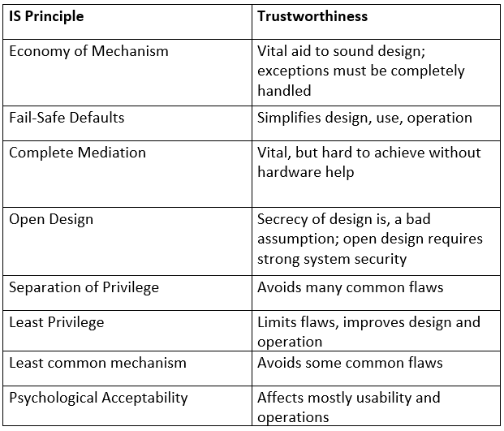

Slide 18
TSI and IS comparison
From outside, compromise from within, and compromise from below, with fairly intuitive meanings.
For example, outsiders may penetrate a system, or create denials of service; insiders may be able to masquerade as other users or misuse existing privileges; operating systems may be compromised from below by utilizing hardware quirks, and applications may be compromised by manipulating operating systems. There are cases in theory where weak links can be avoided (e.g., end-to-end encryption for integrity, and zero-knowledge protocols that can establish a shared key without any part of the protocol requiring secrecy), although in practice they may also be undermined by compromises from below.

Slide 19
TSI and IS comparison
The principles referred to here may be in conflict with one another if each is applied independently;
In certain cases, the principles are not composable .
In general, each principle must be applied in the context of the overall development.
Ideally, greater effort might be useful to reformulate the principles to make them more readily composable, or at least to make their potential trade offs or incompatibilities more explicit.
However, this is probably counterproductive, because judicious use of principles is not a cookbook exercise.

Slide 20
TSI and IS comparison- Nutshell
The Saltzer-Schroeder principle of design simplicity is one of the most popular and commonly cited.
However, it can be extremely misleading when espoused (as it commonly is) in reference to systems with critical requirements for security, reliability, survivability, real-time performance(availability , resilience), and high assurance – especially when all of these requirements are necessary within the same system environment.

Slide 21
TSI and IS comparison- Nutshell
Simplicity is a very important concept in principle (in the small), but complexity is often unavoidable in practice (in the large).
For example, serious attempts to achieve fault-tolerant behavior often result in roughly doubling the size of the overall subsystem or even the entire system.
As a result, the principle of simplicity should really be one of managing complexity rather than trying to eliminate it, particularly where complexity is in fact inherent in the combination of requirements.
Keeping things simple is indeed a conceptually wonderful principle, but often not achievable in reality.
Nevertheless, unnecessary complexity should of course be avoided.

Slide 22
TSI and IS comparison
An extremely effective approach to dealing with intrinsic complexity is through a combination of the IS security principles
By keeping the components and their interconnections conceptually simple, it is possible to achieve conceptual simplicity of the overall system or networks of systems despite inherent complexity.
Furthermore, simplicity can sometimes be achieved through design generality, recognizing that several seemingly different problems can be solved symmetrically at the same time, rather than creating different (and perhaps incompatible) solutions

Slide 23
TSI and IS comparison
In theory, there is no difference between theory and practice. In practice, there is an enormous difference.
What would be extremely desirable in our quest for trustworthy systems and networks is theory that is practical and practice that is sufficiently theoretical.
Thoughtful and judiciously applied adherence to sensible principles appropriate for a particular development can greatly enhance the security, reliability, and overall survivability of the resulting systems and networks.

Slide 24
2. Common Security Architectures (30%, K3)
You will be able to describe and illustrate common security architectures that incorporate hardware and software components.
2.1 Demonstrate the difference between enterprise architecture and security architecture
2.2 Compare features of common security architectures
2.3 Relate how national bodies such as CESG, FIPS, NIST and GCHQ provide guidance and information to public and private sector organisations

Slide 25
2.1 Demonstrate the difference between enterprise architecture and security architecture
Enterprise Architecture
Security Architecture
Explain where their physical and logical boundaries may exist

Slide 26
Enterprise Architecture
“My opinion is, we are on the verge of seeing Enterprise Architecture “come into its own,”
and in the 21st Century, it will be the determining factor,
the factor that separates the winners from the losers,
the successful and the failures, the acquiring from the acquired, the survivors from the others.”
[Zachman, 1997].

Slide 27
Enterprise Architecture
The discipline of enterprise architecture (EA) has evolved enormously since John Zachman ignited its flame in 1987 [Zachman, 1987].
Approaches to enterprise architecture (including, e.g., methods, artifacts, models) have sprung up in different forms since then, driven both by practitioners and academics.
In particular, First and foremost, “The Open Group Architecture Framework” (TOGAF) [The Open Group, 2009] has garnered the most attention for its contributions within the EA arena .
Nevertheless, enterprise architecture still seems to be developing on its journey to a common understanding and greater methodological consistency.

Slide 28
Enterprise Architecture
An enterprise architecture (EA) is a conceptual blueprint that defines the structure and operation of an organization.
The intent of an enterprise architecture is to determine how an organization can most effectively achieve its current and future objectives.
• “Enterprise architecture consists of the vision, principles and standards that guide the purchase and deployment of technology within an enterprise”
-- Forrester, Gene Leganza, 2001
• “Enterprise architecture (EA) is the process of translating business vision and strategy into effective enterprise change by creating, communicating, and improving the key principles and models that describe the enterprise’s future state and enable its evolution.”
-- Gartner Group

Slide 29
Enterprise Architecture

Slide 30
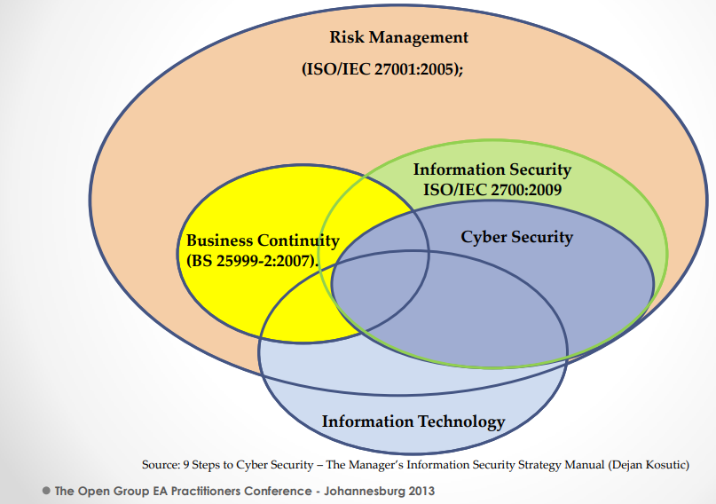
No clear line
of separation
Notes:
No clear line of separation lies

Slide 31
Enterprise Architecture
Enterprise Architecture (EA) as a holistic approach tries to address main concerns of enterprises; therefore, the frameworks and methods of EA have considered security issues.
However, EA frameworks follow different strategies to address security concerns, but most of the EA frameworks and methods have accepted the Security Architecture (SA) term as a holistic approach to security concern.

Slide 32
Enterprise Architecture
• Enterprise Architecture is the Governance and overall Plan to effectively structure, manage, integrate, secure and evolve the information system landscape of the company, aligning to business and IT strategy Architecture Scope is twofold!

Slide 33
Why Enterprise Architecture?
The purpose of Enterprise Architecture (and city planning" for information systems) is to define the main principles in the implementation and construction of computer applications, to ensure consistency throughout while decreasing the costs of building and integrating new applications.
This should improve the company’s ability to respond to a constantly changing environment.
The city planning for the information system explains what the applications do, documenting redundancies so they can be reduced.
The application architecture defines or documents (maps) the structure of applications and their services, showing the cooperation between them.

Slide 34
Why Enterprise Architecture?
Manage IS complexity
The introduction of new non-standard technology
imposes a voluntary tax of 5 to 12% on the development budget, and an increase of 21 to 33% on project duration.
Studies have shown that, over time, Enterprise Architectural efforts can result in a reduction of annual IT spending by as much as 20%.
More projects can be completed within a given project budget when Enterprise Architecture Methods/Tools are followed than when they are not.
Repair Cost are greatly reduced through EA by reducing errors in IT solution designs early.

Slide 35
Why Enterprise Architecture?
Manage IS complexity
Alignment
Ensuring the reality of the implemented enterprise is aligned with management's intent
Change
Facilitating and managing change to any aspect of the enterprise
Resilience
Reducing systems development, applications modernization
Convergence
Striving toward a standard IT product portfolio (service and asset reuse)
Integration
Realizing that the business rules are consistent across the organization, that the data and its use are immutable, interfaces and information flow are standardized or controlled and the connectivity and interoperability are managed across the enterprise

Slide 36
Why Enterprise Architecture?

Slide 37
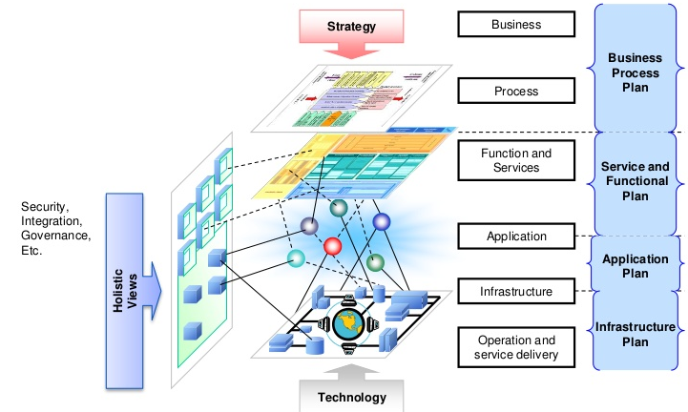
Why Enterprise Architecture?

Slide 38
Why Enterprise Architecture?
Enterprise Architecture is justified for businesses:
• which have significant application assets.
• which have a long history in information technology.
• where information technology is strategic.
• It may also be justified in:
• Mergers/Acquisitions
• Enterprises dependent on software packages
• Apart from these cases, city planning projects are rarely flagship projects.
• They must be low key, with no negative impact on other projects.

Slide 39
How To do Enterprise Architecture??
EA processes
• Understand
• My Information System (patrimonial)
• Its organization, its structure
• its components et its interactions
• Manage
• Analysis et KPI
• Projects Specifications
• Govern
• Bring under control Cost Risk, and IS risks
• Bring under control IS Performance
• Bring under control IS evolution Also referred to City Planning or Urbanization

Slide 40
How To do Enterprise Architecture??
From As-Is to To-Be
• EA planning entails the definition of a current state (called AS-IS) or as-is architecture in four categories:
• business processes
• application programs
• information/data
• and infrastructure technology.
• Then the business plans are reviewed and an appropriate future state (called TO-BE) is created for each category.
• The future state is compared to the current state in a gap analysis, and a sequencing plan is developed to progress from the current state to the future state.

Slide 41
How to do Enterprise Architecture

Slide 42
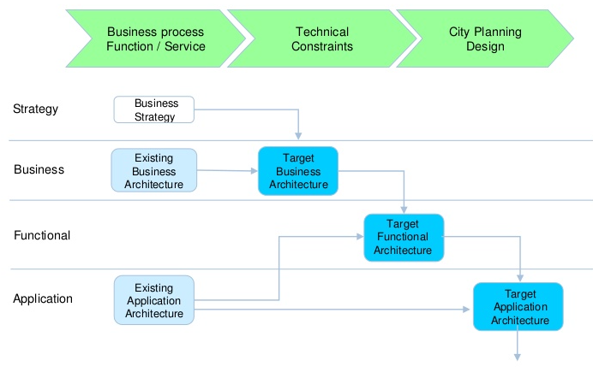
How To do Enterprise Architecture??
From As-Is to To-Be in Top-Down Approach

Slide 43
How To do Enterprise Architecture??
From As-Is to To-Be in Top-Down Approach

Slide 44
Enterprise Architecture Approaches

Slide 45
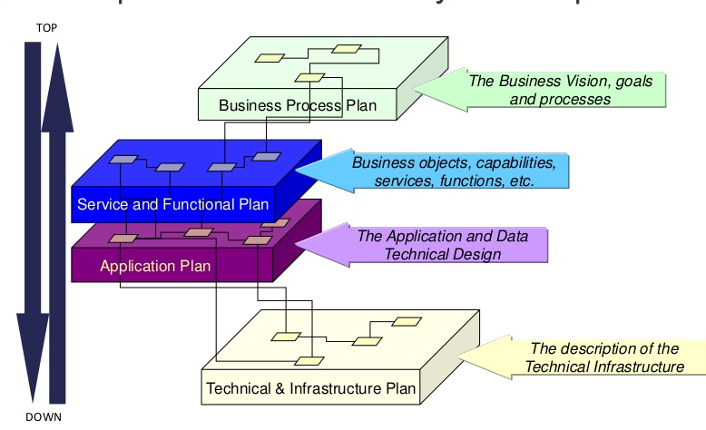
Enterprise Architecture Layers Deep dive

Slide 46
Enterprise Architecture Layers Deep dive
Why need an Enterprise Architecture Framework?
• In a large modern enterprise, a defined framework is necessary to be able to capture a vision of the “entire organization” in all its dimensions and complexity.
• Enterprise Architecture is a program supported by frameworks, which is able to coordinate the many facets that make up the fundamental essence of an enterprise at a holistic way.
• That’s why architecture frameworks have become critical for enterprise architects.
• Just like the old saying, “if you don’t know where you want to go, any road will take you there”

Slide 47
Enterprise Architecture Layers Deep dive
Enterprise Architecture Framework Objectives
• Establish terms and concepts for architectural thinking and provide a uniform way to talk about Enterprise Architecture
• Gain a 360-degree view across IT and development projects and propose real-time visibility to make rapid, well-informed decisions
• Operationalize best practices and automate portfolio processes
• Increase collaboration between Development and Service Delivery teams
• Codify current best practices and insights of both the systems and software engineering communities
• Promote (micro)Service or Resource Oriented Architecture

Slide 48
EA Frameworks
Frameworks
Zachman, TOGAF, DoDaf, MODAF, NATO, Gartner EA, SAP EA, SOA
The value of EA is the value of the Enterprise
When it came to acquisitions, do you know that the value of the enterprise is much higher if it has an EA office?

Slide 49
EA Frameworks
What an Enterprise Architecture Framework is not?
An architecture framework does not include a methodology or process for enterprise architecture.
It also does not ensure that individual programs and projects fit into a global EA vision.
It does not explicitly recognize the importance of other enterprise IT dimensions and how they’re tied together
For example, the importance of architectural governances or the different ways of transitioning an enterprise.
It does not depend on particular tools

Slide 50
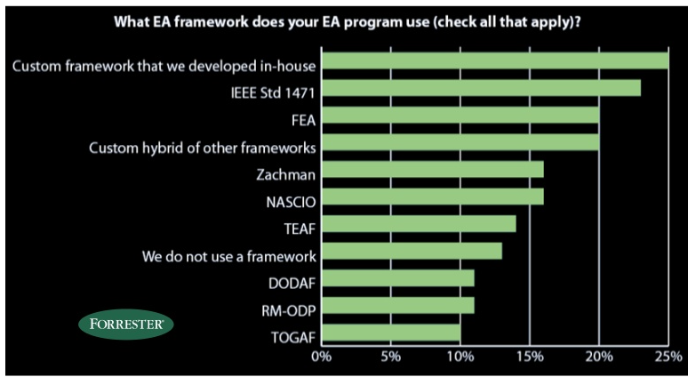
Most Commonly used EA Frameworks

Slide 51
Zachman
The Zachman Framework, invented by John Zachman in the 1980s at IBM,
• This ontology provides a formal and structured way of viewing and defining an enterprise using a two dimensional classification schema that reflects the intersection between two historical classifications.
• The first are primitive interrogatives: What, How, When, Who, Where, and Why.
• The second is derived from the philosophical concept of retification, the transformation of an abstract idea into an instantiation.
• The Zachman Framework retification transformations are: Identification, Definition, Representation, Specification, Configuration and Instantiation.
• The Zachman Framework is not a methodology in that it does not imply any specific method or process for collecting, managing, or using the information that it describes.

Slide 52
Zachman
The Zachman Framework is influenced by principles of classical architecture that establish a common vocabulary and set of perspectives for describing complex enterprise systems.
This influence is reflected in the set of rules that govern an ordered set of relationships that are balanced and orthogonal.
By designing a system according to these rules, the architect can be assured of a design that is clean, easy to understand, balanced, and complete in itself.
Zachman's Framework provides the blueprint, or architecture, for an organization's information infrastructure.

Slide 53
Zachman
Scope:
The Zachman Framework describes a holistic model of an enterprise's information infrastructure from six perspectives planner, owner, designer, builder, subcontractor, and the working system.
There is no guidance on sequence, process, or implementation of the framework. The focus is on ensuring that all aspects of an enterprise are well-organized and exhibit clear relationships that will ensure a complete system regardless of the order in which they are established.

Slide 54
Zachman
Why Zachman:
responding to changes becomes more natural for organisations
It is a proactive business tool to model an organization's existing functions, elements and processes
The framework draws on Zachman's experience of how change is managed in complex products such as airplanes and buildings.
Notes:
In today's complex business environments, many large organizations have great difficulty responding to changes. Part of this difficulty is due to a lack of internal understanding of the complex structure and components in different areas of the organization, where legacy information about the business is locked away in the minds of specific employees or business units, without being made explicit.
The Zachman framework provides a means of classifying an organization's architecture. It is a proactive business tool, which can be used to model an organization's existing functions, elements and processes - and help manage business change. The framework draws on Zachman's experience of how change is managed in complex products such as airplanes and buildings.

Slide 55
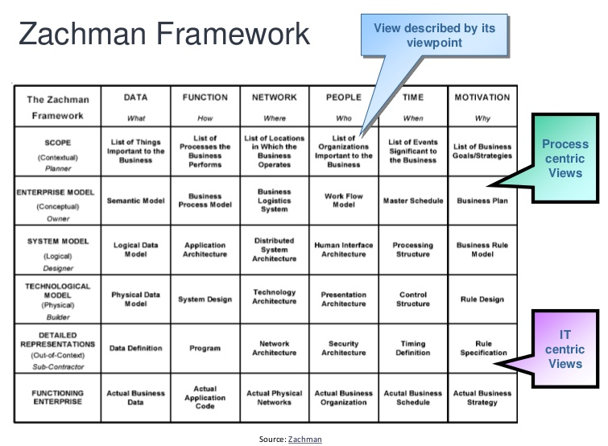

Slide 56
Zachman
Structure
The Zachman Framework is a simple concept with powerful implications. By understanding any particular aspect of a system at any point in its development, system designers construct a tool that can be very useful in making decisions about changes or extensions. The framework contains 6 rows and 6 columns yielding 36 unique cells or aspects. This can be seen in the framework diagram.

Slide 57
Zachman
Rows
Scope. Corresponds to an executive summary for a planner who wants an estimate of the size, cost, and functionality of the system.
Business model. Shows all the business entities and processes and how they interact.
System model. Used by a systems analyst who must determine the data elements and software functions that represent the business model.
Technology model. Considers the constraints of tools, technology, and materials.
Components. Represent individual, independent modules that can be allocated to contractors for implementation.
Working system. Depicts the operational system.

Slide 58
Zachman
Columns
Who. Represents the people relationships within the enterprise. The design of the enterprise organization has to do with the allocation of work and the structure of authority and responsibility. The vertical dimension represents delegation of authority, and the horizontal represents the assignment of responsibility.
When. Represents time, or the event relationships that establish performance criteria and quantitative levels for enterprise resources. This is useful for designing the master schedule, the processing architecture, control architecture, and timing devices.
Why. Describes the motivations of the enterprise. This reveals the enterprise goals and objectives, business plan, knowledge architecture, and knowledge design.
What. Describes the entities involved in each perspective of the enterprise. Examples include business objects, system data, relational tables, or field definitions.
How. Shows the functions within each perspective. Examples include business processes, software application function, computer hardware function, and language control loop.
Where. Shows locations and interconnections within the enterprise. This includes major business geographical locations, separate sections within a logistics network, allocation of system nodes, or even memory addresses within the system.

Slide 59
Zachman
Rules of Zachman Framework
The framework offers a set of descriptive representations or models relevant for describing an enterprise.
Each cell in the Zachman Framework must be aligned with the cells immediately above and below it.
All the cells in each row also must be aligned with each other.
Each cell is unique.
Combining the cells in one row forms a complete description of the enterprise from that view.

Slide 60
TOGAF9
TOGAF was created and is maintained by The Open Group, an independent industry association.
• It builds on an earlier framework known as TAFIM, or Technical Architecture Framework for Information Management, originally devised by the U.S. Defense Dept. In early 2009, The Open Group released TOGAF version 9.
• The basic TOGAF 9 document contains descriptions of an architecture development method and related techniques, an architecture content framework, an enterprise continuum, TOGAF reference models and a capability framework.
• Version 9 creates a model for extensibility, among other enhancements.

Slide 63
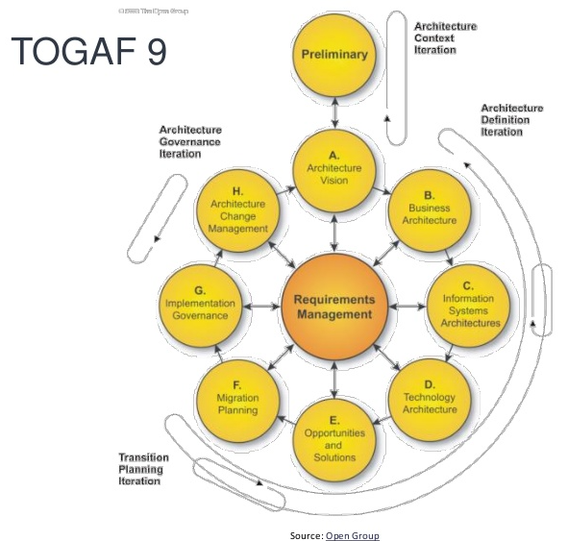
TOGAF9

Slide 64
TOGAF9

Slide 65
TOGAF9

Slide 66
TOGAF9

Slide 67
TOGAF9

Slide 70
Basic Principles

Slide 73
TOGAF9
Conclusion:
• Each Framework has its own advantages and drawbacks
• No framework tells you how and where to start and this is a big question
• No framework tells you how to progress or to do it iteratively (methodology and/or EA Governance)
• Some sources define a framework by describing what it contains (Togaf), and some define it describing what it does (Zachman).
• Recommendations
• Chose the one that is the easiest framework to evangelize to your project architects, CIO, developers, project managers.
• Taylor it to your requirements and know what you are not yet covering.
• Enhance it iteratively but do not change it each year (if possible)

