Slide 1
BCS Level 3 Certificate in Programming
QAN 603/1192/7

Slide 2
Learning outcomes
7 Following good coding practices (12.5%, K2)
Understand why there is a need to follow good coding practices.
7.1 Explain the importance of good coding practice
7.2 Explain the purpose of good software coding principles and practices
7.3 Understand that there are a range of open and organisational coding standards and where to source them

Slide 3
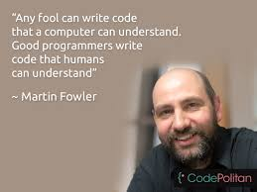
Quality Of Coding Development
"Any fool can write code that a computer can understand. Good programmers write code that humans can understand."- Martin Fowler
To this end code should be readable more so than optimised code
It is easier and quicker to make readable code than optimised code
Do you know who Martin Fowler is ?

Slide 4
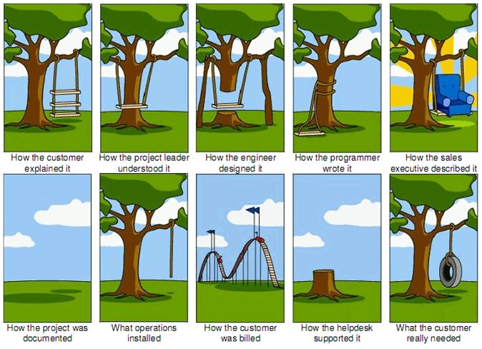
IT project joke – How the project requirements are documented

Slide 5
Design Documentation
Documentation is an important part of software engineering
Documentation includes:
Requirement's documentation
Technical documentation
User documentation
Marketing documentation
Requirements are produced and consumed by everyone involved in the production of software: end users, customers, product managers, project managers, sales, marketing, software architects, usability engineers, interaction designers, developers, and testers, to name a few

Slide 6
Requirements Documentation
Requirements documentation is the description of what a particular software does or shall do
It is used throughout development to communicate how the software functions or how it is intended to operate

Slide 7
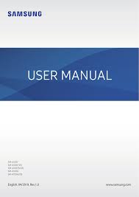
User Documentation
User documents simply describe how a program is used
Describes each feature of the program
Should be able to be used for troubleshooting
Tutorials are also classed as user documentation

Slide 8
Marketing Documentation
Purely for promotional materials to encourage observers to spend more
This form of documentation has three purposes:-
To excite the potential user about the product and instill in them a desire for becoming more involved with it
To inform them about what exactly the product does, so that their expectations are in line with what they will be receiving
To explain the position of this product with respect to other alternatives

Slide 9
Technical Documentation
Code documents associated with the source code (which may include README files and API documentation)
This documentation may be used by developers, testers, and also the end-users using the software application
Comments in code should be descriptive enough that they can be extracted by certain IDEs to help compile a technical document

Slide 10
7.1 Explain the importance of good coding practice

Slide 11
Task – Make a list of top 10 best practices for coding effectively
Looking within your industry , prepare a list of good coding principles and practices
You can use the internet for research

Slide 12
Break

Slide 13
Structure of Code
Programs should have a logical structure
Comments should be used to highlight any code that may need an explanation at a later date
Keep indentation consistent
Keep modules contained
A good article for coding standards:
https://www.perforce.com/blog/qac/9-coding-standards-best-practices

Slide 14
Consistent Design and Structure
The design of your program is different to the design of the interface
Your program requires:
a consistent naming convention
consistent indentation
consistent commenting

Slide 15
Secure Code
Top Secure Coding Practices
Validate input.
Validate input from all untrusted data sources. Proper input validation can eliminate the vast majority of software vulnerabilities. Heed compiler warnings.
Compile code using the highest warning level available for your compiler and eliminate warnings by modifying the code [C MSC00-A, C++ MSC00-A].
Create a software architecture and design your software to implement and enforce security policies. For example, if your system requires different privileges at different times, consider dividing the system into distinct intercommunicating subsystems, each with an appropriate privilege set.
Keep it simple.
Keep the design as simple and small as possible . Complex designs increase the likelihood that errors will be made in their implementation, configuration, and use. Additionally, the effort required to achieve an appropriate level of assurance increases dramatically as security mechanisms become more complex.
Default deny.
Base access decisions on permission rather than exclusion. This means that, by default, access is denied and the protection scheme identifies conditions under which access is permitted [Saltzer 74, Saltzer 75].

Slide 16
Secure Code
Top 10 Secure Coding Practices (cont.)
Adhere to the principle of least privilege.
Every process should execute with the least set of privileges necessary to complete the job. Any elevated permission should only be accessed for the least amount of time required to complete the privileged task. This approach reduces the opportunities an attacker has to execute arbitrary code with elevated privileges [Saltzer 74, Saltzer 75].
Sanitize data sent to other systems.
Sanitize all data passed to complex subsystems [C STR02-A] such as command shells(user interface for access to an operating system's services), relational databases, and commercial off-the-shelf (COTS) components. Attackers may be able to invoke unused functionality in these components through the use of SQL, command, or other injection attacks.
Practice defence in depth.
Manage risk with multiple defensive strategies, so that if one layer of defense turns out to be inadequate, another layer of defence can prevent a security flaw from becoming an exploitable vulnerability and/or limit the consequences of a successful exploit. For example, combining secure programming techniques with secure runtime environments ( by monitoring its inputs, and blocking those that could allow attacks)should reduce the likelihood that vulnerabilities remaining in the code at deployment time can be exploited in the operational environment [Seacord 05].
Use effective quality assurance techniques.
Good quality assurance techniques can be effective in identifying and eliminating vulnerabilities. Fuzz testing (inputting massive amounts of random data), penetration testing, and source code audits should all be incorporated as part of an effective quality assurance program. Independent security reviews can lead to more secure systems. External reviewers bring an independent perspective; for example, in identifying and correcting invalid assumptions [Seacord 05].
Adopt a secure coding standard.
Develop and/or apply a secure coding standard for your target development language and platform.

Slide 17
Purpose Of Good Software Coding Principles And Practices
Here we are going to look at the following:
the basic common principles
DRY (don’t repeat yourself)
defensive programming
commenting
refactoring
patterns / anti-patterns

Slide 18
Basic Common Principles
Don’t Repeat Yourself (DRY) is a software development principle, the main aim of which is to reduce repetition of code.
Write Everything Twice (WET) is a cheeky abbreviation to mean the opposite i.e. code that doesn’t adhere to DRY principle.
It is quite obvious which one of the two should all developers be aiming for.

Slide 19
DRY
//get the current Subject
Subject currentUser = context.getSubject();
if (isPermitted(currentUser)) {
//allow execution of deletePage
} else {
//block execution
}

Slide 20
Advantages of DRY
Maintainability
Readability
Reuse
Cost
Testing

Slide 21
Caution
•With all the advantages of using DRY, there are some pitfalls though.
•Not all code needs to be merged into one piece. Some times 2 pieces of code can look similar but with subtle differences. When to merge these prices of code into one and when to leave them separated needs to be thought over carefully.
•If the code is “over dried”, it becomes difficult to read and understand. I have also seen developers trying to apply DRY principles even when there is only one instance of a block of code. While I appreciate their thinking and foresight into making the code better and reusable, I wouldn’t bother to make the code follow DRY principle until the situation to re-use it is needed.
•Often missed, DRY is not to be limited to just the code. It is to be applied in equal measure to database design, documentation, testing code etc.

Slide 22
Defensive Programming
Defensive programming is a form of defensive design intended to ensure the continuing function of a piece of software under unforeseen circumstances. Defensive programming practices are often used where high availability, safety or security is needed — Wikipedia

Slide 23
Defensive Code
Never trust user input
Assume always you’re going to receive something you don’t expect. This should be your approach as a defensive programmer, against user input, or in general things coming into your system.
Use database abstraction
The first of OWASP Top 10 Security Vulnerabilities is Injection. That means someone (a lot of people out there) is yet not using secure tools to query their databases. Please use Database Abstraction packages and libraries. In PHP you can use PDO to ensure basic injection protection
Don’t re-invent the wheel

Slide 24
Commenting
Comments should be useful
Don’t comment every line!!!!
Comments are meant to be helpful

Slide 25
Refactoring
Code refactoring is the process of restructuring existing computer code—changing the factoring — without changing its external behaviour
The basic purpose of code refactoring is to make the code more efficient and maintainable. This is key in reducing technical cost since it’s much better to clean up the code now than pay for costly errors later. Code refactoring, which improves readability, makes the QA and debugging process go much more smoothly.
Refactoring can also improve non-functional attributes of the software

Slide 26
Patterns/Anti-patterns
Patterns can speed up the development process by providing tested, proven development paradigms
An AntiPattern is a literary form that describes a commonly occurring solution to a problem that generates decidedly negative consequences
Definition
Anti-patterns are certain patterns in software development that are considered bad programming practices. As opposed to design patterns which are common approaches to common problems which have been formalized and are generally considered a good development practice, anti-patterns are the opposite and are undesirable

Slide 27
Standards
There are a range of open and organisational coding standards
Organisational coding standards
Open coding standards
Provides a standard way of working

Slide 28
Coding Standards give the program a common look and feel
Coding standards typically address
Use of comments
Variable names
Function names
Maximum length of a routine (lines of code)
Maximum number of routines within a class
Degree of complexity allowed (nested loops, etc)
Naming convention of source code files
Source code directory structure for developer machines, build machines and source code control tools
Source code file contents (i.e. one C++ class per file)
Ways to indicate incomplete code in source.

Slide 29
Organisational Coding Standards
These are designed, created, maintained and controlled by a licence agreement which is owned by an organisation or individual, ie privately owned. Proprietary standards may be free to use, but the file specification is often closed rather than being open.
Some popular proprietary standards include:
DOC files (Microsoft Word Document file format). This has become a de facto standard used for most word-processing software.
MP3. MPEG Audio is a de jure standard patented by the Fraunhofer Society (now free).
De facto means a state of affairs that is true in fact, but that is not officially sanctioned. In contrast, de jure means a state of affairs that is in accordance with law (i.e. that is officially sanctioned).

Slide 30
Open Coding Standards
Open standards are usually controlled by a Creative Commons licence or they are unlicensed
They can be used by anyone and are not owned by a commercial organisation or individual
Normally, they will have been developed by experts collaborating online
The source code behind files and programs created using open standards will normally be open source which means the code should be freely available. Anyone could look at the code and make improvements

Slide 31
Task
Write a definition for patterns and refactoring including examples

Slide 32
Module 7 Good Coding Practices Extra reading/research

Slide 33
Where to Find Standards
Vendor Websites
W3C -
GNU coding Standards
C++ coding Standards
Python coding standards – check len

Slide 34
Can you find any others
Assembly Language
AIS
Fortran-77
GNU
Linux
Java
C
Perl
ASP
GUI

Slide 35
Reading/Research
OWASP Top 10 Security Vulnerabilities
What is OWASP and the OWASP Top 10?

