Slide 1
Embedded Systems
^{<introduction to the module>}
(UFCFCU-)

Slide 2
<Embedded systems Learning outcomes>
Describe and explain the characteristics and complexity of secure, embedded systems.
Analyse and evaluate security threats and vulnerabilities with regards to embedded systems and identify how these can be mitigated.
Analyse malware & identify its mechanisms.

Slide 3
^{< What is an Embedded system?>}
An embedded system is an electronic product that contains a microprocessor (one or more) and software to perform some constituent function within a larger entity.
They can consist of a:
Microprocessor
Microcontroller
SoC – (Apple have made this confusing)
FPGA (Field Programmable Gate Array)
Notes:
Constituent – component
FPGA – Can be programmed after the creation to use a test to make sure the embedded system can work before being “fused” separates the HW and SW layers

Slide 4
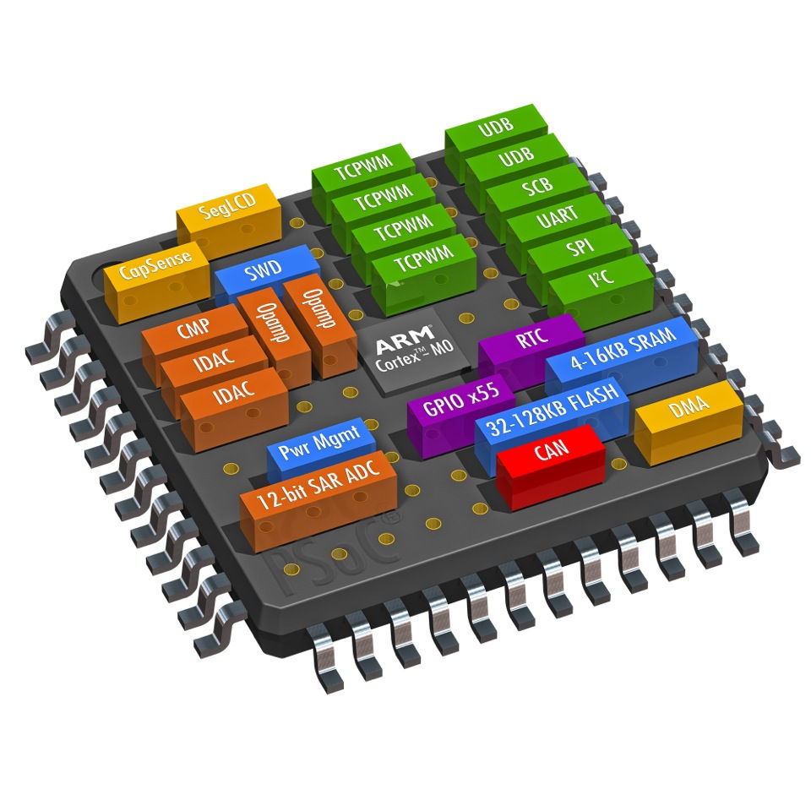
^{< What is an Embedded system?>}
forms part of a larger system, device or machine. Its purpose is to control the device and to allow a user to interact with it if needed. Embedded systems tend to have one, or a limited number of tasks that they can perform.
Notes:
Dishwasher, Heating systems,

Slide 5
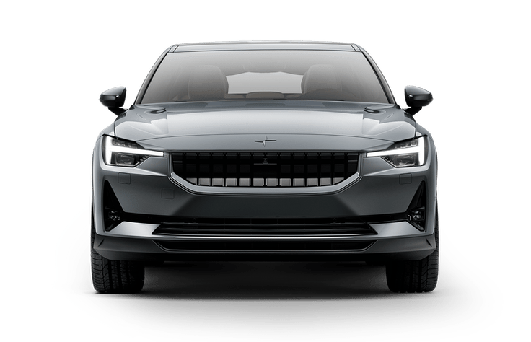
^{< What is an Embedded system?>}
The most common examples today are a Plane or a Car
Also known as distributed Embedded Systems
One of the first embedded systems in a car was for the cars trip computer (1978 Cadillac Seville)
What Embedded systems do we have on a car?
Notes:
Ask group to think of all the systems we have in a car that need a separate system to function to give a driving experience?
Radar control, Cruise control, ABS, Traction Control, Infotainment clusters, Smart lights, etc. Each component needs a separate system that works together as a whole to create a good or bad car.
Why do they need separate controllers for each section? Safety etc
1978 Cadillac Seville’s trip computer, run by a Motorola 6802 microprocessor with 128 bytes of RAM and two kilobytes of ROM. The printed source code could not have occupied more than a handful of pages.

Slide 6
< Distributed Embedded Systems >
System-centered (designed as a whole)
- Confined in space (despite possibly large)
- Normally fixed set of components
- Preference for wired networks w/ fixed topology
• Most common non-functional requirements
- Real-time
- - Jitter constraints on periodic activities
- Dependability
- Ultra high reliability and safety, high availability
- Maintainability
Notes:
Is a smartphone an embedded system? Sort of. A lot of them have some microcontroller or processor for certain separate tasks. Wifi etc.
Is an IOT device?

Slide 7
< Distributed Embedded Systems >

Slide 8
< Distributed Embedded Systems >
An Aircraft is not an embedded system
The flight control system
Traffic collision avoidance system (TCAS)
In flight entertainment systems
These are all embedded systems but are part of the plane

Slide 9
< What Embedded Systems are not >
The antithesis of an embedded system is the Desktop PC
A desktop PC has multiple uses and can have multiple pieces of software to perform varying tasks.
You can also use a desktop to produce outputs that are far beyond an embedded system, such as creating a new program for an embedded system
A server is the same situation
Notes:
Antithesis – Direct opposite

Slide 10
^{< What Embedded Systems are >}
UI
Embedded System.
Analog/Digital Input
Hardware and software built In
Output
Notes:
An embedded system will always have an input and an output. They don’t always require a UI though.
They will always have some form of software and hardware to control the input and output.

Slide 11
^{< Embedded Systems >}
Practically every major multinational corporation—firms such as Lockheed Martin, Exxon, General Motors, Hewlett Packard, and Johnson & Johnson—builds and depends on embedded systems within its most important products.
Roughly 90% of the worlds computers are embedded systems.

Slide 12
^{< Embedded Systems Task >}
Take a moment and think about what Embedded systems you might use at home or personally everyday.
Write down as many as you can
Then write down the embedded systems you can think of in your workplace.
Do you have any security policies around any embedded systems?

Slide 13
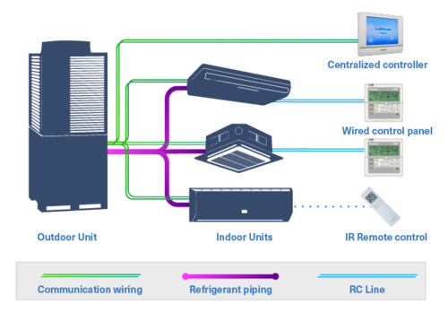
^{< Networked Embedded Systems >}
Interconnected stand-alone equipment or systems for extra functionality
(communication-centered)
- Fuzzy notion of global system
- Variable set of components
- A combination of wireless/wired networks
- Structured / Ad-hoc connections
- Varying topology
- Multi-hop communication
Smart Meters
Network relays
Energy Company

Slide 14
^{< Embedded Systems complexity>}
The average consumer depends on embedded systems.
We rely on medical equipment to keep us healthy
Cars to keep us safe
Embedded systems in power stations.
Alexa to tell you the weather
Many of the problems relating to loss in quality, safety, and/or security in electronic products can be attributed to the growth of complexity that cannot be effectively managed.
Notes:
What examples can we think of where growth has exceeded the safety requirement. A Company might buy a lot of microprocessors for a device. And use the same chip in the next line of products and the ones after that. The actual microprocessor is already at this stage old and potentially have a security issue. Amazon Alexa has the same processor for the last 3 years almost in every device. If one device is compromised essentially all can be.

Slide 15
^{< Embedded Systems OS>}
What is the most common OS that embedded systems use?
What is the most secure part of the OS?
What is the issue with this?
Notes:
Linux
Kernel – Since the Operating System has control over the system so, the Kernel also has control over everything in the system. It is the most important part of an Operating System.
Any Kernel vulnerability can be used against most devices using the OS

Slide 16
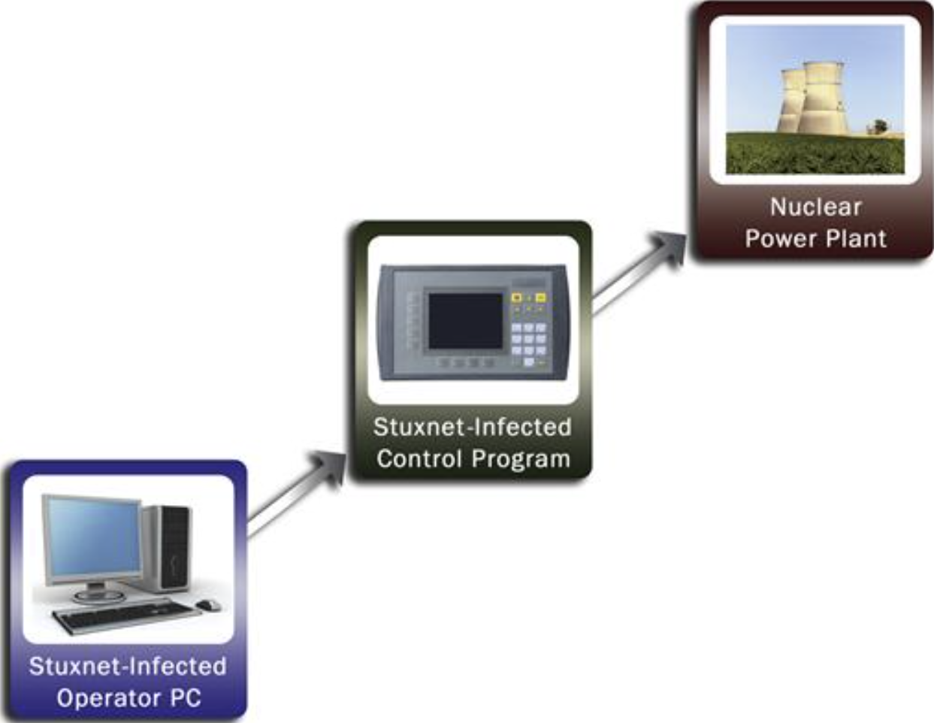
^{< Embedded Systems Threats>}
The Stuxnet worm is likely the first malware to directly target embedded process control systems and demonstrates the incredible sophistication potential in modern embedded security attacks.

Slide 17
^{< Embedded Systems Threats>}
Stuxnet was the reason a lot of government agencies created separate isolated network for critical infrastructure.
Processor consolidation – History repeats itself. As more and more devices relied on embedded systems the demand grew for greater complexity and more embedded systems to achieve a better overall product.
This led to Processor consolidation where you would combine certain functions into one embedded system.
What is wrong with this?
Notes:
We have the same issues happening now with the Chip shortage. Cars are leaving the manufacturing line without certain functions due to the shortage.

Slide 18
^{< Processor consolidation >}
Using a review camera on a car for example. This used to be a separate systems for the camera.
Now it looks a bit like this.
Head Unit/Infotainment
Rear View Camera
Graphics Multiplexor
Microprocessor
Notes:
And its becoming more consolidated.

Slide 19
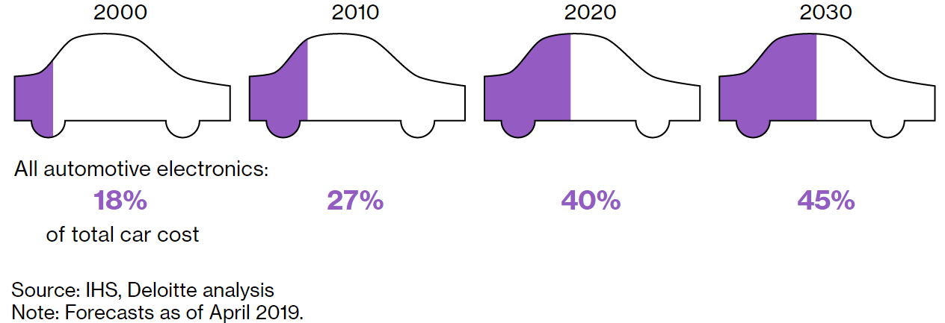
^{< Processor consolidation >}
Nissan is leaving navigation systems out of thousands of vehicles that typically would have them because of the shortages. Dodge Ram no longer offers its 1500 pickups with a standard “intelligent” rearview mirror that monitors for blind spots. Renault has stopped offering an oversized digital screen behind the steering wheel on its Arkana SUV -- also to save on chips.

Slide 20
^{< Processor consolidation >}
Instead, carmakers will use fewer processors running software to control the vehicles’ various functions. “They will collapse today’s 150 boxes into a handful of boxes that are easily software updatable,” he said. “We’ll see a massive shift of how these vehicles are designed, and 2024 is where it starts to pick up.”
One example of the consolidation of these chips is the infotainment system introduced in the latest Ford models, according to Carlson. “Ford announced they are using this tech for all new vehicles, including the F-150 and Mach-E,” he said. The technology is a single-chip evolution of a previous system that used a pair of NXP processors. “There are multiple generations of the technology,” he said. “We initially had a two-chip solution and that converged into a one-chip solution.”

Slide 21
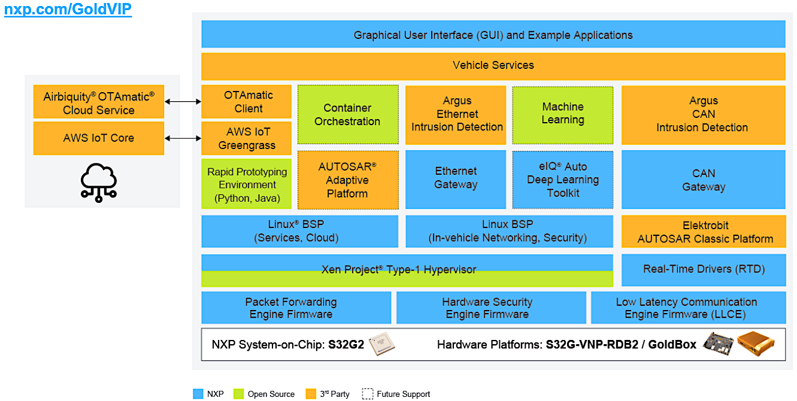
^{< Processor consolidation >}

Slide 22
^{< Embedded Systems Task >}
Find a device/product that has multiple embedded systems.
Create a 5 to 10-minute presentation
Explain a few key components of the device/product and how the embedded systems work, taking key focus to:
Inputs – What is going in?
What might it process and why?
The output – Why is the output needed? What does it do or change?
Is there any UI for the user to engage with?

Slide 23
^{< Embedded Systems Security >}
So far, we have talked about some security aspects of an embedded system.
We will investigate a bit more of this and expand through the week
All the embedded systems need security and a security policy around them.
CVE-2022-27254 Detail
The remote keyless system on Honda Civic 2018 vehicles sends the same RF signal for each door-open request, which allows for a replay attack, a related issue to CVE-2019-20626.
Notes:
The best security is a Brick.

Slide 24
^{< Embedded Systems Security >}
Microkernel embedded operating systems can be small enough to mathematically prove that the security is “perfect”
What are some of the issues around this?
Notes:
The embedded system OS that can be proven to be secure is only for a small system. We can have it running a big multi-input/output device.
The security of these OSs has to be tested a lot to prove they are secure, this can lead to a lot of time and money.

Slide 25
^{< CIA >}

Slide 26
^{< CIA >}
What would the C, I, and A be for the CVE of a remote-control car key we looked at earlier.
CVE-2022-27254 Detail
The remote keyless system on Honda Civic 2018 vehicles sends the same RF signal for each door-open request, which allows for a replay attack, a related issue to CVE-2019-20626.
Notes:
CIA
A – That the system is working when needed and has not been tampered. Unlock to lock etc.
I – Integrity of the RF key they send
C – Making sure the system doesn’t leave it open to other information about the car or system it uses to allow greater access or entry into multiple areas

Slide 27
^{< Information flow control >}
New threads or IO control need to have some protection and access control from the kernel and OS and applications
Flow control helps with protection against certain components talking to each other.
This can allow certain systems to be more “protected”
Car infotainment being linked to the reversing camera etc.

Slide 28
< Physical Security of Embedded systems >
Do some research and find 1 example of invasive and non invasive attacks on an embedded system.
TEMPEST

Slide 29
^{< Embedded systems Threats >}
As there are thousands of embedded systems spanning from daily devises we use to critical infrastructure.
Let's discuss how we determine what needs software and physical security against these threats?
Notes:
What level of protection does a Fitbit tracker need?
What about auto pilot on a plane?

