Slide 1
BCS Level 4 Certificate in Network and Digital Communications Theory
QAN 603/0703/1

Slide 2
Networking Basics

Slide 3
No Connection
Single user
No connection
Very secure

Slide 4
Connection
Two users
Crossover cable
Full duplex
Transmit and receive at the same time
OSI layer 1 – Physical
Transmission of bits
100010100101010

Slide 5
Hub
Two or more users
A single network segment
Straight cables
OSI layer 1 – Physical
Transmission of bits
Hub
Amplifies signal
Broadcasts input on all outputs
Clients reject inputs not for them
Half duplex – transmit or receive
Poor performance
101001
101001
101001
101001

Slide 6
MAC (Media Access Control) Addressing
Uniquely identifies a network interface controller (NIC)
MAC addresses are used as a network address for Ethernet and Wi-Fi
Addresses are assigned by the manufacturer and stored in the NIC’s read-only memory or firmware
It is a 48-bit address for 281,474,976,710,656 possible MAC addresses (normally shown as 6 octets) ether 4a:00:02:00:ca:e0 (from ifconfig)
ipconfig or ifconfig commands show the MAC address

Slide 7
Packets and frames
A MAC address allows data to be directed to a specific device
The data segment is called a frame
Preamble | Start of frame delimiter | Destination | Source | Length | Data | CRC
Timing |  | MAC Addressing |  | Amount of data | Payload | Checksum
7 bytes | 1 byte | 6 bytes | 6 bytes | 2 bytes | 46-1500 bytes | 4 bytes
FRAME

Slide 8
Switch
Two or more users
A single network segment
Straight cables
OSI layer 2 – Data Link
Transmission of packets
Switch
Amplifies signal
Directs inputs to correct outputs
Full duplex
Best performance
Error checking
101001
111011
101001
111011

Slide 9
Switch operation
Works on the Layer 2 Header
Uses the source and destination MAC addresses to make its forwarding decisions.
MAC Address Table
maps the switch’s ports to MAC addresses
the source address and the port a frame was received on are entered in the MAC Address Table.
as each connected device sends a frame the table gets fully populated
the table is then used to forward frames to their intended destination

Slide 10
Local Area Network
When the area covered is small, such as an office, this is known as a Local Area Network (LAN)
Devices connected to the switches are called Hosts
The hosts are typically clients, servers or LAN attached peripherals, such as printers
A LAN can be wired or wireless
Switches can be cascaded to increase the number of hosts

Slide 11
Increasing the number of hosts
Adding switches is inefficient (inactive hosts are flushed from the MAC address table after 300s)
Adding hosts increases traffic congestion on the LAN (more collisions and failed transmissions)
Adding hosts means increased processing loads
The solution is to create additional physical networks

Slide 12
IP addresses
A MAC address is physical, it allows packets to be delivered from one NIC to another (hop to hop)
IP addresses are logical and allow delivery of packets across networks (from end to end)
IP addresses work at OSI layer 3 – Network
An address is a 32 bit binary number represented as 4 octets
E.g. 192.168.1.123 (IP v4)
Destination and source IP addresses are added to the data payload of the ethernet packet

Slide 13
Packets with IP addresses
Preamble | Start of frame delimiter | Destination | Source | Length | Data | CRC
Timing |  | MAC Addressing |  | Amount of data | Payload | Checksum
7 bytes | 1 byte | 6 bytes | 6 bytes | 2 bytes | 46-1500 bytes | 4 bytes
PACKET
Source IP address | Destination IP address
4 bytes | 4 bytes

Slide 14
Two networks
192.168.1.9
X
R1 NIC
R2 NIC
A
Router
B
192.168.1.12
192.168.2.7
Source MAC | Destination MAC | Source IP | Destination IP
Host A | Router R1 | 192.168.1.12 | 192.168.2.7
Source MAC | Destination MAC | Source IP | Destination IP
Router R2 | Host B | 192.168.1.12 | 192.168.2.7
Notes:
14

Slide 15
ARP Address Resolution Protocol
Used to find the MAC address for a given IP
Host A (192.168.1.12) needs to send to Host B (192.168.2.7)
It knows 192.168.2.7 is in a different network
It has a default gateway of 192.168.1.1 (the router)
It sends a broadcast ARP message (MAC ff:ff:ff:ff:ff:ff) for 192.168.1.1 (this goes to all hosts on the network)
Only the router replies with its Mac and IP addresses
Host A updates its ARP table
Sends packet to 192.168.2.7 with router MAC address

Slide 16
ARP table

Slide 17
Router Table In Host A (192.168.1.12)
Contains a 0.0.0.0 entry which points to the default gateway 192.168.1.1
Contains other IP addresses on its own network and the address of its own NIC
If sending to Host X it will look in the table and send directly
If sending to Host B (192.168.2.7) will find 0.0.0.0 as the closest match in the table and send to the gateway
Network Destination | Gateway | Interface | Notes
0.0.0.0 | 192.168.1.1 | 192.168.1.12
127.0.0.1 | On-Link | 127.0.0.1 | Loopback
192.168.1.9 | On-Link | 192.168.1.12 | Host X

Slide 18
Router’s Table
Contains a list of IP addresses and interfaces
If sending to 192.168.1.n will forward via R1 NIC
If sending to 192.168.2.n will forward via R2 NIC /24 refers indirectly to the number of hosts on the network and is covered in subnetting (not in the BCS Cloud syllabus)
IP address | Interface
192.168.1.0/24 | R1 NIC
192.168.2.0/24 | R2 NIC

Slide 19
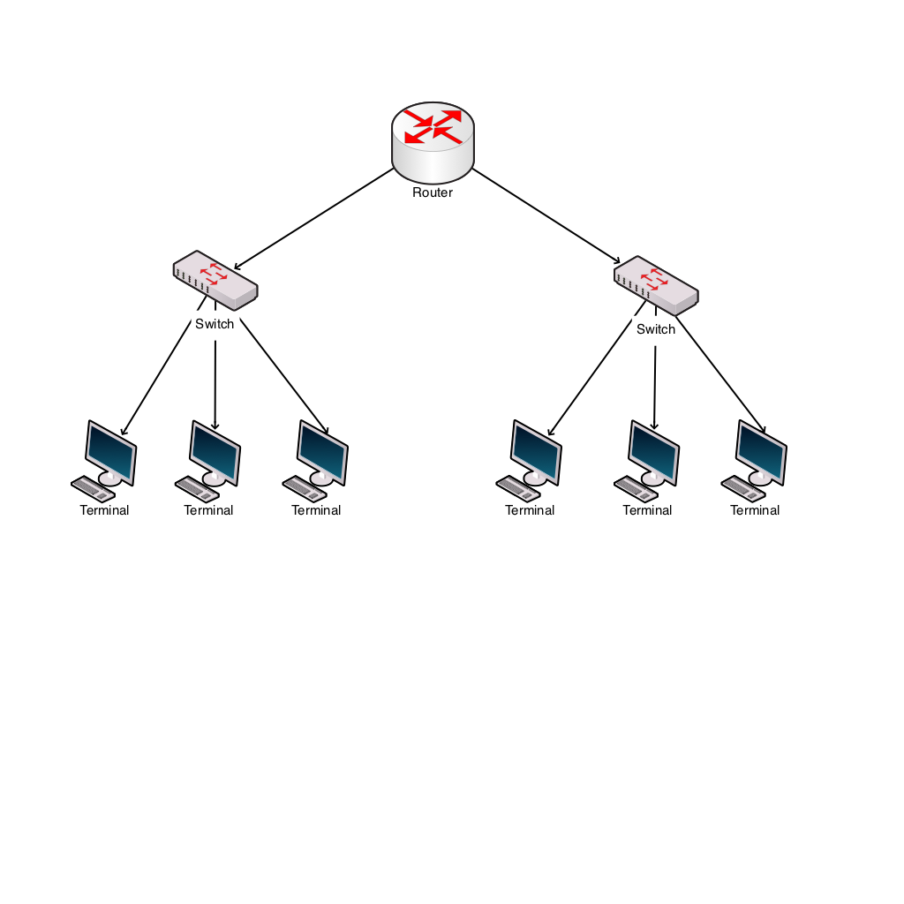
Windows Network Utilities
Ping
Tests connectivity
ping 192.168.2.7
ARP
Shows MAC addresses for IP addresses

Slide 20
IP addresses
IP address classes
Class D is used for multicast (224-239)
Class E is experimental (240-255)
One class A address is worth 16M hosts
Therefore a way is needed to allocate significantly more hosts than are available
Address class | First octet range | Number of hosts
A | 1-126 | 16M
B | 128-191 | 64k
C | 192-223 | 254

Slide 21
Private IP addresses
Address ranges allocated as private, therefore not permissible onto the general internet.
So, an organisation can have one outward facing IP address and up to 16M hosts inside
This is done using network address translation (explained later)
Address range | Number of hosts
10.0.0.0 – 10.255.255.255 | 16M
172.16.0.0 – 172.31.255.255 | 1M
192.168.0.0 – 192.168.255.255 | 64K

Slide 22
Setting IP addresses
Assume a small system with 192.168.1.n addresses
Static addresses are set on the device
Dynamic addresses are leased by a DHCP server
IP address | Host | Type
192.168.1.1 | Router | Static
192.168.1.10 | Server | Static
192.168.1.20 | Printer | Static
192.168.1.100 - 200 | Desktops | Dynamic

Slide 23
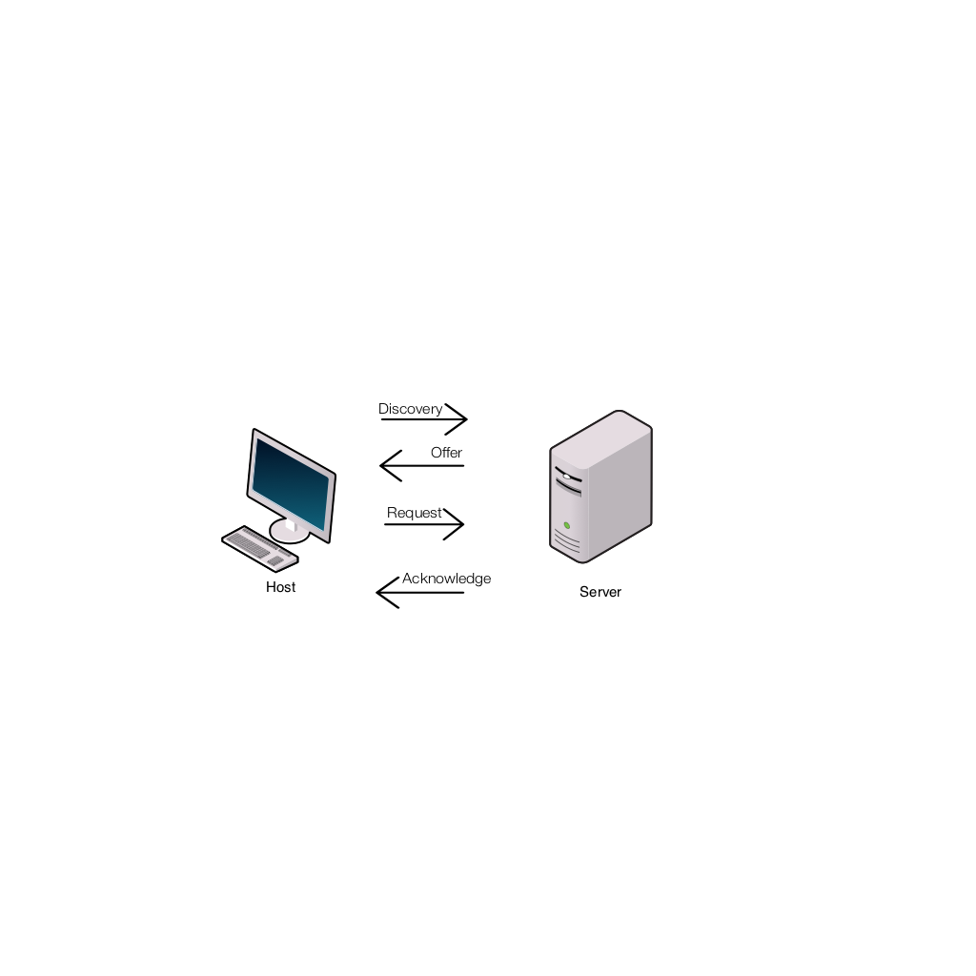
DHCP Dynamic Host Configuration Protocol
Host sends a discovery request (255.255.255.255) for a DHCP server
Server responds with a lease offer of an IP address, gateway address, duration and DNS server address (see later for DNS)
Host responds with a request to accept the offered lease
Server acknowledges the request
Host configures its network interface with the agreed parameters

Slide 24
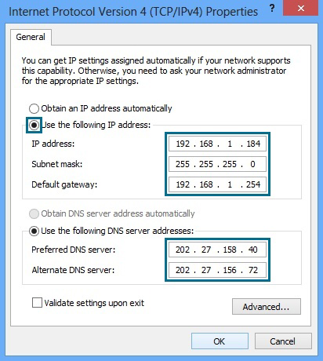
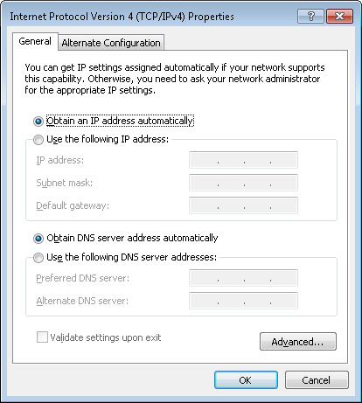
DHCP Windows Configuration
Static Dynamic

Slide 25
Recap
Hosts have MAC and IP addresses
They can communicate in the same network using switches and MAC addressing
To communicate between networks they use routers and IP addresses
Private IP addresses allow duplicate usage in different organisations, but are not allowed on the internet
IP addresses can be manually configured or obtained by DHCP

Slide 26
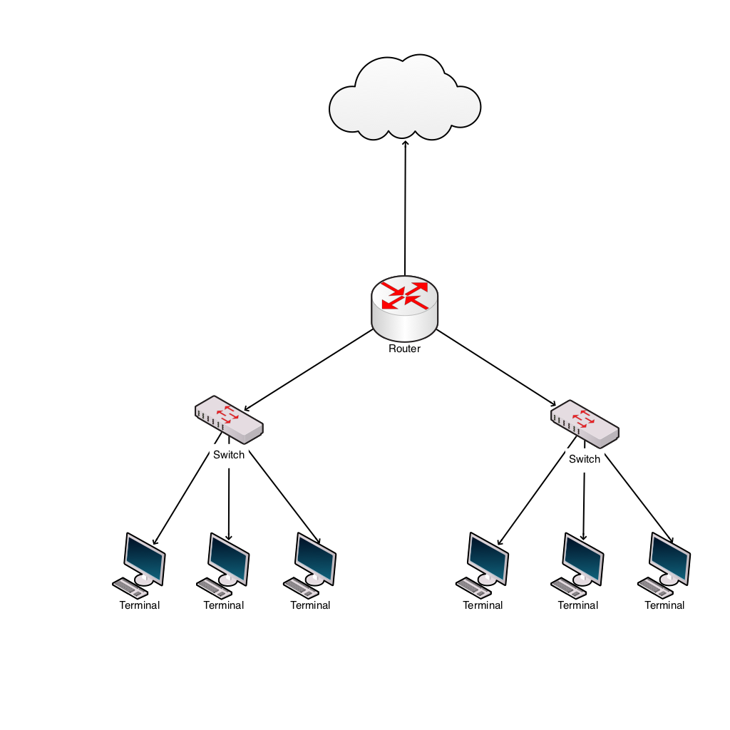
Internet connection
Connection to the ISP
ADSL
Cable
Satellite
Cellular
Leased line
ISP supplies:
IP address via DHCP
DNS address

Slide 27
ISP IP addresses
An ISP will allocate an IP address from a range it owns
These IP addresses are unique on the internet
Gloucester College IP address is 212.219.57.69
All internet traffic to and from Gloucester College is via the IP address 212.219.57.69
Internal IP addresses at the college will be from the private IP addresses ranges
How does traffic for a private IP address get to the right host?

Slide 28
Network and port address translation (NAT and PAT)
Implemented in the router
Allows many hosts on the internal network to connect via one public IP address
Allows many applications on one host to communicate with many services in the cloud
Uses IP and port numbers

Slide 29
Ports
An IP address and a port address make up a socket
Eg 212.219.57.69:80 (Gloucester college HTTP port)
An application, service or process uses the socket to send and receive data via the network – OSI Layer 4 Transport
The operating system
transmits the data from all application ports on to the network
directs received packets to the matching IP address and port number

Slide 30
Port allocation
Well known ports 0-1023
Examples
21 FTP
25 SMTP
80 HTTP
110 POP3
443 HTTPS
Registered ports 1024-49151
Dynamic ports 49152-65535

Slide 31
Packets with IP addresses and port numbers
Preamble | Start of frame delimiter | Destination | Source | Length | Data | CRC
Timing |  | MAC Addressing |  | Amount of data | Payload | Checksum
7 bytes | 1 byte | 6 bytes | 6 bytes | 2 bytes | 46-1500 bytes | 4 bytes
PACKET
Source IP address | Destination IP address | Source port number | Destination port number
4 bytes | 4 bytes | 2 bytes | 2 bytes

Slide 32
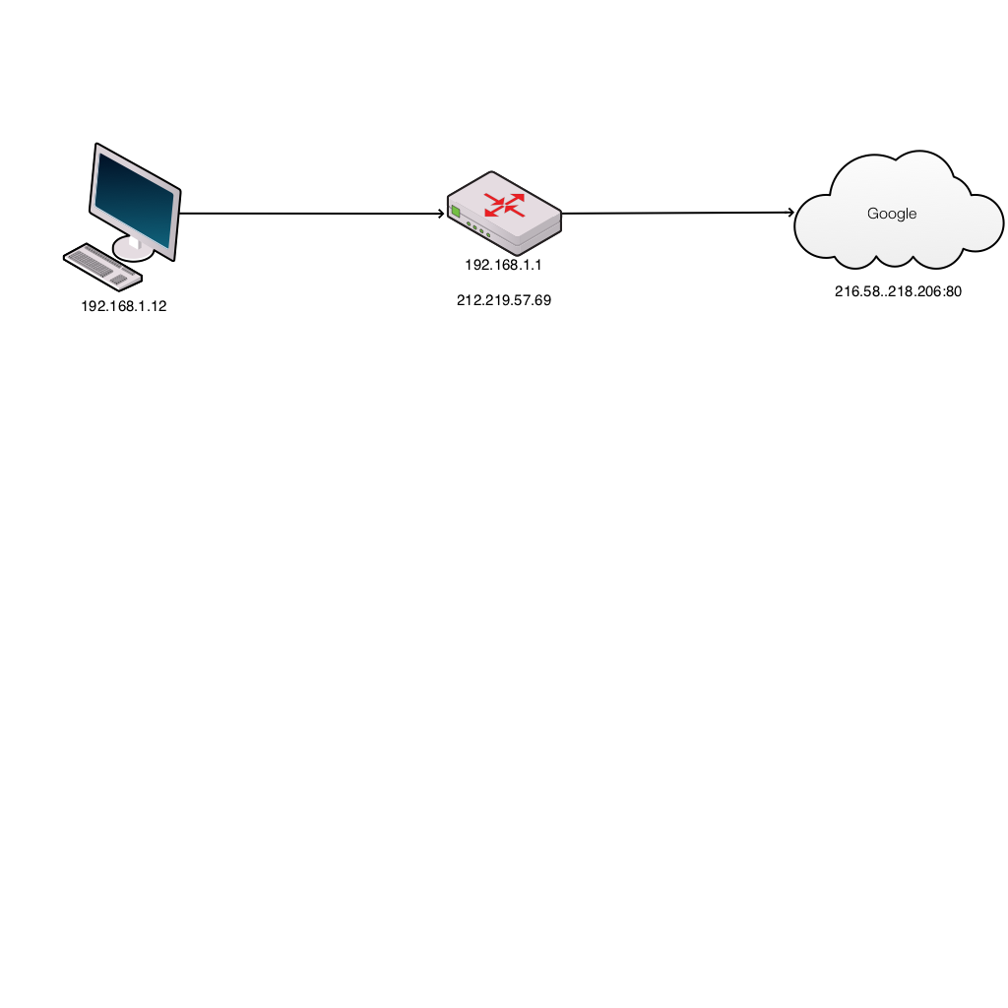
Browser request
Host | Router client side | Router ISP side | Cloud service
S 192.168.1.12:3333 D 216.58.218.206:80 | 192.168.1.12:3333 | 212.219.57.69:7777 | S 212.219.57.69:7777 D 216.58.218.206:80
Host inserts random source port number
Router translates internal network IP address to the external network address and port
Router updates translate table and records port numbers

Slide 33
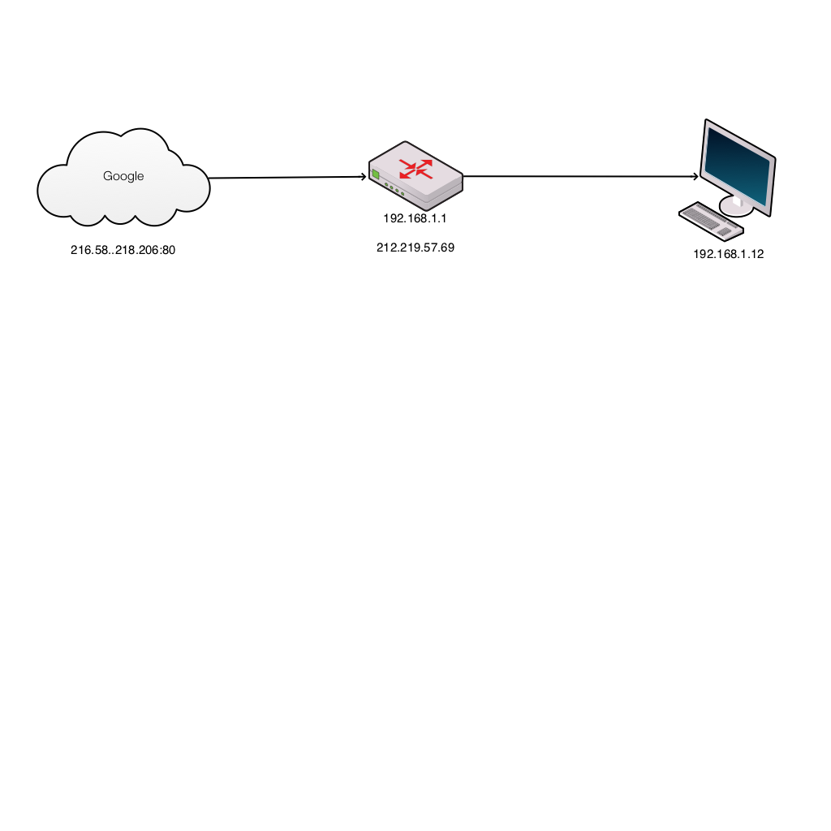
Server response
Cloud service | Router ISP side | Router client side | Host
S 216.58.218.206:80 D 212.219.57.69:7777 | 212.219.57.69:7777 | 192.168.1.12:3333 | S 216.58.218.206:80 D 192.168.1.12:3333
Server puts source address from received packet into destination address of outbound packet
Router translates external network IP address to the internal network address and port
Host receives packet and OS directs to correct application

Slide 34
Domain Name System
Translates domain names to IP addresses
A host will query a domain name server (address from DHCP) with the domain name (eg www.techrepublic.com)
DNS server returns the IP address
Windows command: nslookup

Slide 35
802.11 (Wireless LAN Standards)
Transfer rates
Frequency bands
Range and environment
Susceptibility to interference

Slide 36
Network Address Translation
Static / dynamic NAT
Maps IP address from private LAN to public IP address (or address pool)
Port Address Translation / NAT overloading
Allows multiple private addresses to map to a single public address

Slide 37
TCP versus UDP
Transmission Control Protocol (TCP)
Connection-oriented, reliable delivery
Connection establishment
Acknowledgements and negative acknowledgments
Segmentation and sequencing
User Datagram Protocol (UDP)
Connectionless, non-guaranteed delivery
Lightweight header

Slide 38
Hops
A hop occurs each time packets are passed to the next network device
The hop count is the number of intermediate devices the packet has to pass through from source to destination
The hop count can be used as a metric by routing protocols to determine the optimum path for a packet

Slide 39
Key network security devices
active devices
firewalls, antivirus scanning devices, content filtering devices, which block the surplus traffic
passive devices, such as intrusion detection appliances, which identify and report on unwanted traffic
preventative devices
penetration testing devices and vulnerability assessment appliances, which scan the networks and identify potential security problems;
Unified Threat Management (UTM) devices
such as firewalls, content filtering, web caching, which serve as all-in-one security devices.

Slide 40
Key network security devices

Slide 41
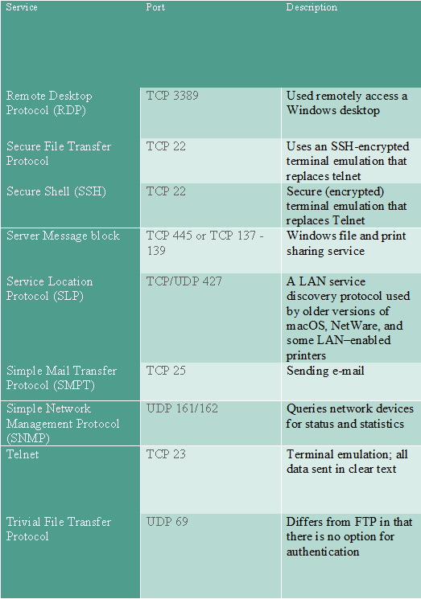

Slide 42
Recap
Internal networks connect to the internet via ISP
The ISP allocates an IP address
Network address translation (NAT) allows private IP addressing
Port address translation (PAT) allows multiple applications to connect to cloud services
DNS allows memorable names to be used for cloud resources

Slide 43
1. Network Data and Protocols (20%, K2)
In this key topic, the apprentice will describe and explain the common networks in use and their associated data formats, protocols and related performance issues. Outcomes should include an ability to:
1.1 Describe data formats and protocols in current use
1.2 Explain features of network protocols in widespread use on the Internet
1.3 Identify network failure modes and reasons why networks ‘hang’
1.4 Describe approaches to error control in a network

Slide 44
1.1 Describe data formats and protocols in current use
A candidate should be able to:
• Explain what is meant by data and protocol.
• Explain the relationship between data and protocol.
• Explain the technical specification of data formats and protocols.
• Describe the main features of data formats and protocols such as syntax, synchronisation, error recovery methods and error detection.
• Identify what data formats and protocols are in current use such as PPP, 802.3 and SLIP.
• Recognise protocol diagrams such as UML and Time-Sequence.

Slide 45
Data
Data is information that has been translated into a form that is efficient for movement or processing
Relative to today's computers and transmission media, data is information converted into binary digital form
It is acceptable for data to be used as a singular subject or a plural subject
Raw data is a term used to describe data in its most basic digital format
At its most rudimentary level, data is usually in the form of ones and zeros, known as binary data
As all computer data is in binary format, it can be created, processed, saved, and stored digitally
Allows data to be transferred from one computer to another using a network connection or various media devices
Does not deteriorate over time or lose quality after being used multiple times

Slide 46
Protocol
Network protocols are formal standards and policies comprised of rules, procedures and formats that define communication between two or more devices over a network
Network protocols govern the end-to-end processes of timely, secure and managed data or network communication
These rules include what type of data may be transmitted, what commands are used to send and receive data, and how data transfers are confirmed
Notes:
You can think of a protocol as a spoken language. Each language has its own rules and vocabulary. If two people share the same language, they can communicate effectively. Similarly, if two hardware devices support the same protocol, they can communicate with each other, regardless of the manufacturer or type of device. For example, an Apple iPhone can send an email to an Android device using a standard mail protocol.
46

Slide 47
Protocols
Protocols exist for several different applications
Examples include wired networking (e.g., Ethernet), wireless networking (e.g., 802.11ac), and Internet communication (e.g., IP)
The Internet protocol suite, which is used for transmitting data over the Internet, contains dozens of protocols
May be broken up into four categories:
Link layer - PPP, DSL, Wi-Fi, etc.
Internet layer - IPv4, IPv6, etc.
Transport layer - TCP, UDP, etc.
Application layer - HTTP, IMAP, FTP, etc

Slide 48
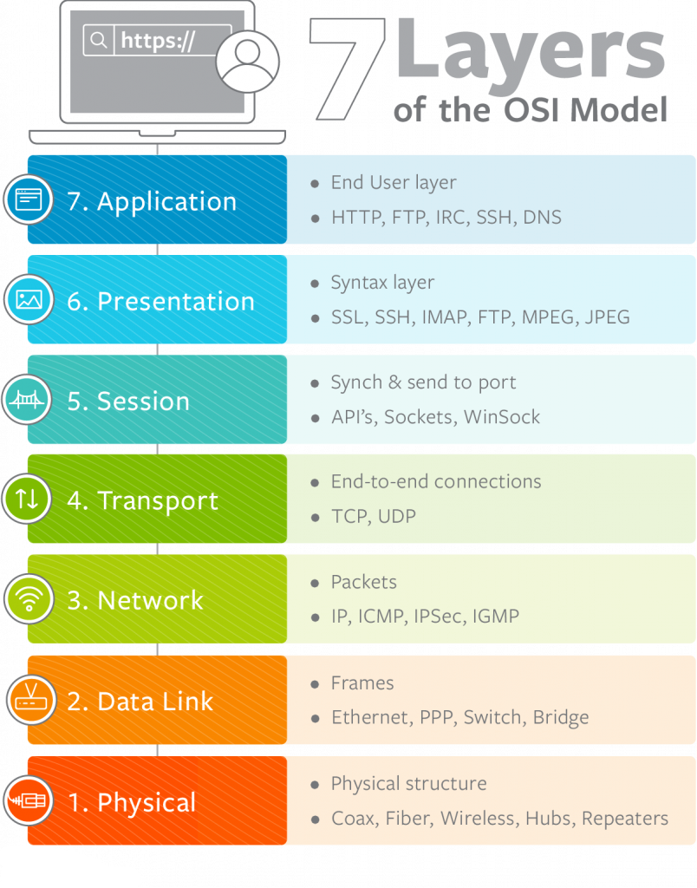
ISO Model
TCP/IP Model Layers
Application
(Host-to-host) Transport
Internet
Network Interface
(Hardware)
Notes:
The TCP/IP architectural model has four layers that approximately match six of the seven layers in the OSI Reference Model. The TCP/IP model does not address the physical layer, which is where hardware devices reside. The next three layers—network interface, internet and (host-to-host) transport—correspond to layers 2, 3 and 4 of the OSI model. The TCP/IP application layer conceptually “blurs” the top three OSI layers. It’s also worth noting that some people consider certain aspects of the OSI session layer to be arguably part of the TCP/IP host-to-host transport layer.
48

Slide 49
Link Layer Protocols
Establish communication between devices at a hardware level
In order to transmit data from one device to another, each device's hardware must support the same link layer protocol

Slide 50
Internet Layer Protocols
Used to initiate data transfers and route them over the Internet

Slide 51
Transport Layer Protocols
Define how packets are sent, received, and confirmed

Slide 52
Application Layer Protocols
Contain commands for specific applications
For example, a web browser uses HTTPS to securely download the contents of a webpage from a web server
An email client uses SMTP to send email messages through a mail server.

Slide 53
Data Formats
A data format or file format is the format in which the data is coded
The information is coded in such a way that a program or application can recognize, read and use the data
Data transmission occurs:
In the form of bits (1’s and 0’s)
Light
Radio
Microwave
Can be analogue or digital
Data can be compressed and decompressed

Slide 54
Data Formats - Microwave
Uses a beam of radio waves in the microwave frequency range (6GHz to 8.2GHz) to transmit information between two fixed locations on the earth
Beams are unidirectional
Have high loss due to high frequency
Max distance ~40km
Use line of sight

Slide 55
Data Formats - Light
Can be laser (Light Amplification by Stimulated Emission of Radiation) (ultraviolet) or normal white light
Ultraviolet waves have wavelengths of 400 to 700 nm
Can be transmitted along optic fibre

Slide 56
Loss of data
Data can become unusable in three different ways:
Loss of bits The carrier is damaged, is lost of its quality deteriorates in such a way that it effect the bits, popularly called 'bit rot‘
Loss of documentation It is unclear how one file is tied to another, for instance when different versions of a file or the metadata are no longer available, leaving the meaning of the data unclear
Loss of display possibilities The operating system, the hardware or the application are no longer present or cannot be used anymore. That can also be caused by external factors such as computer virus, fire or accidental deleting of files.

Slide 57
1.2 Explain features of network protocols in widespread use on the Internet.
Including, but not limited to:
HTTPS HTTP SMTP SNMP TCP UDP IP

Slide 58
HTTP
HTTP is a simple but powerful protocol:
HTTP is connectionless
HTTP is media independent
HTTP is stateless
HTTP is not secure as it is not encrypted
HTTP operates at the highest layer of the TCP/IP model, the Application layer

Slide 59
HTTPS
HTTPS is an extension of the Hypertext Transfer Protocol (HTTP)
It is used for secure communication over a computer network, and is widely used on the Internet
HTTPS is not a separate protocol, but refers to use of ordinary HTTP over an encrypted SSL/TLS connection
Operates at the Application layer, as does the TLS security protocol (operating as a lower sublayer of the same layer)
The TLS protocol performs the encryption
HTTPS connections uses a public key certificate for the web server
This certificate must be signed by a trusted certificate authority for the web browser to accept it without warning

Slide 60
SMTP
The primary job of the Simple Mail Transfer Protocol (SMTP) is to implement the TCP/IP electronic mail delivery system
SMTP includes a number of other features and capabilities
These allow SMTP to support special requirements and auxiliary needs of the mail system, and are described in detail in RFC 2821
Mail relaying
Mail forwarding
Mail Gatewaying
Address debugging
Mailing list expansion
Turning
Notes:
Mail Relaying: As discussed in the SMTP communication overview, the protocol was once widely used in a “relaying mode” where e-mail was routed from one SMTP server to another to reach its destination. Today, the normal method of e-mail transfer on the Internet today is directly from the sender's SMTP server to the recipient's, using DNS MX records to determine the recipient SMTP server address. SMTP still includes the ability to relay mail from one server to another, provided certain conditions are met. Note that in addition to the inefficiency of relaying, many servers won't relay mail because this feature has been abused for spamming and hacking.
Mail Forwarding: Under certain conditions, an SMTP server may agree to accept e-mail for a non-local mailbox and forward it to the appropriate destination. This sounds similar to relaying but is used in a different way. A common example is when a user changes his or her e-mail address. If I have worked at XYZ Industries for years and then retire, the company may no longer wish to let me receive e-mail at the company's SMTP server. As a courtesy, however, they may forward e-mail sent to me there so I still receive it at my new company.
Mail Gatewaying: Certain SMTP servers may be configured as e-mail gateways. These devices “translate” TCP/IP e-mail into a form suitable for another e-mail system, and vice-versa. Gatewaying is a complex topic because e-mail systems can be so different; one of the more important problems is the inconsistency of addressing methods of different e-mail systems.
Address Debugging: SMTP includes a VRFY (verify) command, which can be used to check the validity of an e-mail address without actually sending mail to it.
Mailing List Expansion: The SMTP command EXPN (expand) can be used to determine the individual e-mail addresses associated with a mailing list. (Note however that this has nothing directly to do with mailing list software like Majordomo.)
“Turning”: The original SMTP protocol included a command that allows the SMTP sender and SMTP receiver to change roles. This could be used to allow SMTP server A to send e-mail to server B, and then have B send e-mail it has queued for A in the same session. In practice, this capability was not widely used for a variety of reasons, including security considerations. It is now officially “not recommended”, but may still be implemented in some SMTP software.
60

Slide 61
SMTP
The SMTP class supports the following Proxy servers:
Proxy | Name
SOCKS4 | SOCKS4 proxy.
SOCKS4A | SOCKS4A proxy (capable of resolving domain names).
SOCKS5 | SOCKS5 proxy.
HTTP CONNECT | HTTP proxy using CONNECT method.

Slide 62
SNMP
Simple Network Management Protocol” is a communications protocol through which an admin, via manager systems and authorized agents, can monitor and even manipulate some aspects of a networks configuration and traffic
SNMP is an open internet standard for managing networked devices (systems)
three versions of SNMP that define approved standards:
SNMPv1
SNMPv2 (also known, and referred to in this document, as SNMPv2c)
SNMPv3

Slide 63
SMNP
Main features:
Managers and Agents
SNMP is a network protocol that allows devices to be managed remotely by a network management station (NMS), also commonly called a manager.
To be managed, a device must have an SNMP agent associated with it. The purpose of the agent is to:
Receive requests for data representing the state of the device from the manager, and provide an appropriate response
Accept data from the manager to enable control of the device state
Generate SNMP traps, which are unsolicited messages sent to one or more selected mangers to signal significant events relating to the device

Slide 64
SMNP
Main Features (cont):
Management Information Base
To manage and monitor a device, its characteristics must be represented using a format known to both the agent and the manager
These characteristics can represent physical properties such as fan speeds, or services such as routing tables
The data structure defining these characteristics is known as a management information base (MIB)
In response to a get operation, the agent provides data, either maintained locally or directly from the managed device
In response to a set operation, the agent typically performs some action affecting the state of either itself or the managed device

Slide 65
SMNP
Main Features (cont):
MIB Tables
Much of the data content defined by MIBs is in tabular form, and organized as entries consisting of a sequence of objects, each with its own OIDs. For example, a table of fan characteristics could consist of a number of rows, one per fan, with each row containing columns corresponding to the current speed, the expected speed, and the minimum acceptable speed
The addressing of the rows within the table can be as follows:
Simple, single-dimensional index (a row number within the table, for example `6')
More complex, multidimensional, instance specifier such as an IP address and port number (for instance, 127.0.0.1, 1234)

Slide 66
SMNP
Main Features (cont):
Access Control
All addressable objects defined in the MIB have associated maximum access rights, for instance, read-only or read-write
These determine the maximum access the agent can support, and can be used by the manager to restrict the operations it will permit the operator to attempt
The agent is able to apply lower access rights as required, that is, it is able to refuse writes to objects that are considered read-write
This refusal can be on the basis of:
How applicable the operation is to the object being addressed (for example, where an object defined by the MIB represents a state machine for which only certain transactions are legal)
Security restrictions that limit certain operations to restricted sets of managers

Slide 67
TCP
Transmission Control Protocol (TCP - RFC 793) is considered as a reliable protocol
Transmission Control Protocol (TCP) is responsible for breaking up the message (Data from application layer) into TCP Segments and reassembling them at the receiving side
It is not sure that the data reaching at the receiving device is in the same order as the sending side, because of the problems in network or different paths packets flow to the destination
TCP is responsible for keeping the unordered segments in the right order
TCP assures a reliable delivery by resending anything that gets lost while traveling the network

Slide 68
TCP - Characteristics
Stream Data transfer:
Applications working at the Application Layer transfers a contiguous stream of bytes to the bottom layers
It is the duty of TCP to pack this byte stream to packets, known as TCP segments, which are passed to the IP layer for transmission to the destination device
The application does not have to bother to chop the byte stream data packets

Slide 69
TCP - Characteristics
Reliability:
The most important feature of TCP is reliable data delivery. In order to provide reliability, TCP must recover from data that is damaged, lost, duplicated, or delivered out of order by the Network Layer
TCP assigns a sequence number to each byte transmitted, and expects a positive acknowledgment (ACK) from the receiving TCP layer
If the ACK is not received within a timeout interval, the data is retransmitted
The receiving TCP uses the sequence numbers to rearrange the TCP segments when they arrive out of order, and to eliminate duplicate TCP segments

Slide 70
TCP - Characteristics
Flow control:
Network devices operate at different data rates because of various factors like CPU and available bandwidth
It may happen a sending device to send data at a much faster rate than the receiver can handle
TCP uses a sliding window mechanism for implementing flow control
The number assigned to a segment is called the sequence number and this numbering is actually done at the byte level
The TCP at the receiving device, when sending an ACK back to the sender, also indicates to the TCP at the sending device, the number of bytes it can receive (beyond the last received TCP segment) without causing serious problems in its internal buffers

Slide 71
TCP - Characteristics
Multiplexing:
Multitasking achieved through the use of port numbers
Connections:
Before application processes can send data by using TCP, the devices must establish a connection
The connections are made between the port numbers of the sender and the receiver devices
A TCP connection identifies the end points involved in the connection
A socket number is a combination of IP address and port number, which can uniquely identify a connection
Full duplex:
TCP provides for concurrent data streams in both directions

Slide 72
IP
Internet Protocol
Principal communications protocol in the Internet protocol suite for relaying datagrams across network boundaries
Its routing function enables internetworking, and essentially establishes the Internet
Addressing
IP packet headers contain addresses that identify the sending computer and the receiving computer
Routers use this information to guide each packet across communication networks and connect the sending and receiving computers

Slide 73
IP
Reassembly
Internet Protocol keeps track of the way messages between computers are broken into packets
Since most messages are too big to fit in one packet, and since packets aren't sent in any organized order, they must be reassembled as they arrive at the recipient
IP dictates how packets are reassembled into usable messages

Slide 74
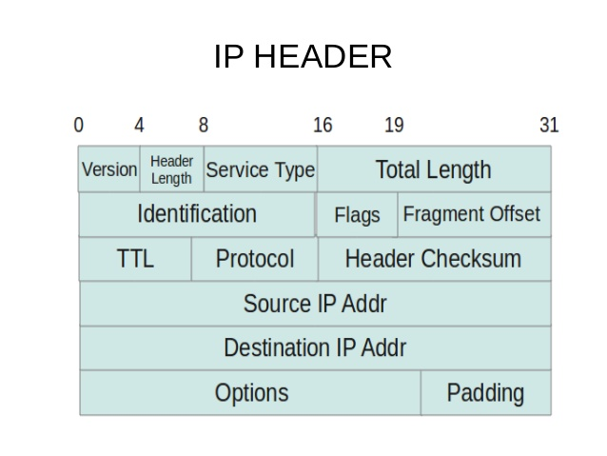
IP – Frame Format

Slide 75
TCP/IP
TCP/IP is a set of protocols (Protocol Suit) that enable communication between computers
It is a tested and proved protocol suit
Features:
Multi-vendor support
Iteroperability
Logical addressing
Routability
Name resolution
Error control and flow control
Multiplexing/de-multiplexing
Notes:
1) Multi-Vendor Support. TCP/IP is implemented by many hardware and software vendors. It is an industry standard and not limited to any specific vendor.
2) Interoperability. Today we can work in a heterogeneous network because of TCP/IP. A user who is sitting on a Windows box can download files from a Linux machine, because both Operating Systems support TCP/IP. TCP/IP eliminates the cross-platform boundaries.
3) Logical Addressing. Every network adapter has a globally unique and permanent physical address, which is known as MAC address (or hardware address). The physical address is burnt into the card while manufacturing. Low-lying hardware-conscious protocols on a LAN deliver data packets using the adapter's physical address. The network adapter of each computer listens to every transmission on the local network to determine whether a message is addressed to its own physical address.
For a small LAN, this will work well. But when your computer is connected to a big network like internet, it may need to listen to millions of transmissions per second. This may cause your network connection to stop functioning.
To avoid this, network administrators often segment (divide) big networks into smaller networks using devices such as routers to reduce network traffic, so that the unwanted data traffic from one network may not create problem in another network. A network can be again subdivided into smaller subnets so that a message can travel efficiently from its source to the destination. TCP/IP has a robust subnetting capability achieved using logical addressing. A logical address is an address configured through the network software. The logical addressing system used in TCP/IP protocol suit is known as IP address.
4) Routability. A router is a network infrastructure device which can read logical addressing information and direct data across the network to its destination.TCP/IP is a routable protocol, which means the TCP/IP data packets can be moved from one network segment to another.
5) Name Resolution. IP addresses are designed for the computers and it is difficult for humans to remember many IP addresses. TCP/IP allows us to use human-friendly names, which are very easy to remember (Ex. www.omnisecu.com). Name Resolutions servers (DNS Servers) are used to resolve a human readable name (also known as Fully Qualified Domain Names (FQDN)) to an IP address and vice versa.
6) Error Control and Flow Control.The TCP/IP protocol has features that ensure the reliable delivery of data from source computer to the destination computer. TCP (Transmisssion Control Protocol) defines many of these error-checking, flow-control, and acknowledgement functions.
7) Multiplexing/De-multiplexing. Multiplexing means accepting data from different applications and directing that data to different applications listening on different receiving computers. On the receiving side the data need to be directed to the correct application, for that data was meant for. This is called De-multiplexing. We can run many network applications on the same computer. By using logical channels called ports, TCP/IP provides means for delivering packets to the correct application. In TCP/IP, ports are identified by using TCP or UDP port numbers.
75

Slide 76
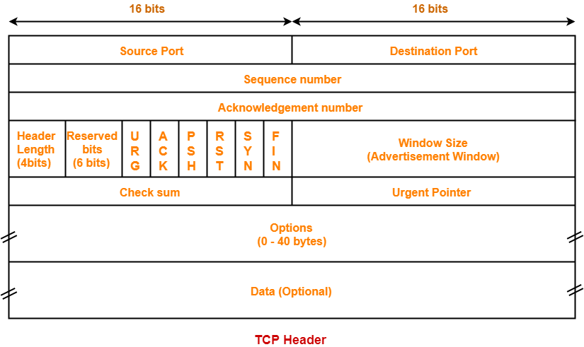
TCP – Frame Format

Slide 77
UDP
User Datagram Protocol
Provides connectionless, unreliable service
So UDP faster than TCP
Adds only checksum and process-to-process addressing to IP
Used for DNS and NFS
Used when socket is opened in datagram mode
It sends bulk quantity of packets
No acknowledgment
Good for video streaming: it is an unreliable protocol

Slide 78
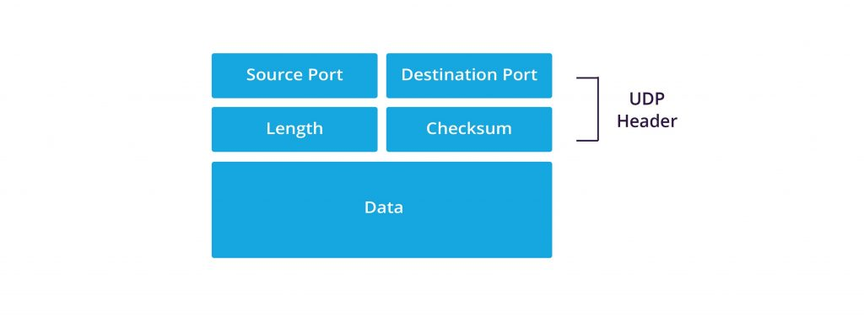
UDP – Frame Format

Slide 79
1.3 Identify network failure modes and reasons why networks ‘hang’
A candidate should be able to:
• Describe failure modes in protocols.
• Describe the effect on a protocol of data communication errors.
• Describe causes for network failures.
• Explain the causes for system 'hangs'.

Slide 80
The Effect On A Protocol Of Data Communication Errors
Error control is the technique of detecting and correcting blocks of data during communication
It checks the reliability of characters both at the bit level and packet level
If proper error control is in place, transmitted and received data is ensured to be identical, as in many cases communication channels can be highly unreliable
Data can be corrupted while in transmission
In order to retain reliable communication, errors must be detected and corrected
Forward error control and feedback error control are the two types of error-control mechanisms used in communications

Slide 81
Causes for Network Failures
Misconfiguration
Security breaches
Old equipment
Human error
Incompatible changes
Hardware failures
Power failures

Slide 82
Causes for System 'Hangs'
CPU
RAM
NIC failure
Overheating
Software errors
Electrical problems
Environment

Slide 83
1.4 Describe approaches to error control in a network
A candidate should be able to:
• Describe at least one approach to error control in a network such as; forward error control, feedback error control and block error control.
• Identify methods of error control, such as checksum, parity and redundancy.

Slide 84
Forward Error Control
In forward error control, additional redundant information is also transmitted along with the data
This helps the receiver to detect and determine the location of the error in the transmitted data
Forward error control is less commonly used due to the amount of additional redundant information which is transmitted.

Slide 85
Feedback Error Control
In backward or feedback error control, along with each character, a little additional information is provided for the detection of errors
The receiver in this technique performs no error correction
If the received data is found to contain errors, the entire data is retransmitted

Slide 86
Methods of Error Control
Checksum
Parity
Redundancy

Slide 87
Checksum
A checksum is an error-detection method in a the transmitter computes a numerical value according to the number of set or unset bits in a message and sends it along with each message frame
At the receiver end, the same checksum function (formula) is applied to the message frame to retrieve the numerical value
A checksum error means there was a problem with the serial communications
A checksum is created based on the data values in the data blocks to be transmitted using some algorithm and appended to the data
When the receiver gets this data, a new checksum is calculated and compared with the existing checksum
A non-match indicates an error

Slide 88
Parity
Historically the most commonly used data integrity method
Parity can detect - but not correct - single-bit errors
Error Correction Code (ECC) is a more comprehensive method of data integrity checking that can detect and correct single-bit errors

Slide 89
Redundancy
Cyclic Redundancy Check (CRC):
CRC is based on binary division.
A sequence of redundant bits called CRC or the CRC remainder is appended to the end of a data unit, so that the resulting data unit becomes exactly divisible by a second, predetermined binary number
At its destination, the incoming data unit is divided by the same number
If at this step there is no remainder, the data unit is assumed to be intact and therefore is accepted

Slide 90
End of Day 1

Slide 91
2. Layered Network Models (20%, K2)
In this key topic, the apprentice will be able to explain network layer models and then contrast their differences. Outcomes should include an ability to:
2.1 Explain features layered network models
2.2 Compare the differences between the following physical layer categories and datalink layer protocols

Slide 92
2.1 Explain features of the following layered network models:
TCP/IP Reference Model
OSI 7 Layer Model

Slide 93
OSI
Systems must be developed which are compatible to communicate with each other ISO has developed a standard
ISO stands for International organization of Standardization
This is called a model for Open System Interconnection (OSI) and is commonly known as OSI model
The ISO-OSI model is a seven layer architecture. It defines seven layers or levels in a complete communication system
They are:
Application Layer
Presentation Layer
Session Layer
Transport Layer
Network Layer
Datalink Layer
Physical Layer

Slide 94
Feature of OSI Model
Big picture of communication over network is understandable through this OSI model
We see how hardware and software work together
We can understand new technologies as they are developed
Troubleshooting is easier by separate networks
Can be used to compare basic functional relationships on different networks

Slide 95
Functions of Different Layers
Following are the functions performed by each layer of the OSI model
This is just an introduction, we will cover each layer in details in the coming tutorials

Slide 96
OSI Model Layer 1: The Physical Layer
Physical Layer is the lowest layer of the OSI Model.
It activates, maintains and deactivates the physical connection.
It is responsible for transmission and reception of the unstructured raw data over network.
Voltages and data rates needed for transmission is defined in the physical layer.
It converts the digital/analog bits into electrical signal or optical signals.
Data encoding is also done in this layer.

Slide 97
OSI Model Layer 2: Data Link Layer
Data link layer synchronizes the information which is to be transmitted over the physical layer
The main function of this layer is to make sure data transfer is error free from one node to another, over the physical layer
Transmitting and receiving data frames sequentially is managed by this layer.
This layer sends and expects acknowledgements for frames received and sent respectively
Resending of non-acknowledgement received frames is also handled by this layer
This layer establishes a logical layer between two nodes and also manages the Frame traffic control over the network
It signals the transmitting node to stop, when the frame buffers are full

Slide 98
OSI Model Layer 3: The Network Layer
Network Layer routes the signal through different channels from one node to other
It acts as a network controller
It manages the Subnet traffic
It decides by which route data should take
It divides the outgoing messages into packets and assembles the incoming packets into messages for higher levels

Slide 99
OSI Model Layer 4: Transport Layer
Transport Layer decides if data transmission should be on parallel path or single path
Functions such as Multiplexing, Segmenting or Splitting on the data are done by this layer
It receives messages from the Session layer above it, convert the message into smaller units and passes it on to the Network layer
Transport layer can be very complex, depending upon the network requirements
Transport layer breaks the message (data) into small units so that they are handled more efficiently by the network layer

Slide 100
OSI Model Layer 5: The Session Layer
Session Layer manages and synchronize the conversation between two different applications.
Transfer of data from source to destination session layer streams of data are marked and are resynchronized properly, so that the ends of the messages are not cut prematurely and data loss is avoided

Slide 101
OSI Model Layer 6: The Presentation Layer
Presentation Layer takes care that the data is sent in such a way that the receiver will understand the information (data) and will be able to use the data
While receiving the data, presentation layer transforms the data to be ready for the application layer
Languages(syntax) can be different of the two communicating systems
Under this condition presentation layer plays a role of translator
It performs Data compression, Data encryption, Data conversion etc.

Slide 102
OSI Model Layer 7: Application Layer
Application Layer is the topmost layer
Transferring of files disturbing the results to the user is also done in this layer
Mail services, directory services, network resource etc. are services provided by application layer
This layer mainly holds application programs to act upon the received and to be sent data

Slide 103
Merits of OSI reference model
OSI model distinguishes well between the services, interfaces and protocols
Protocols of OSI model are very well hidden
Protocols can be replaced by new protocols as technology changes
Supports connection oriented services as well as connectionless service

Slide 104
Demerits of OSI reference model
Model was devised before the invention of protocols
Fitting of protocols is tedious task
It is just used as a reference model

Slide 105
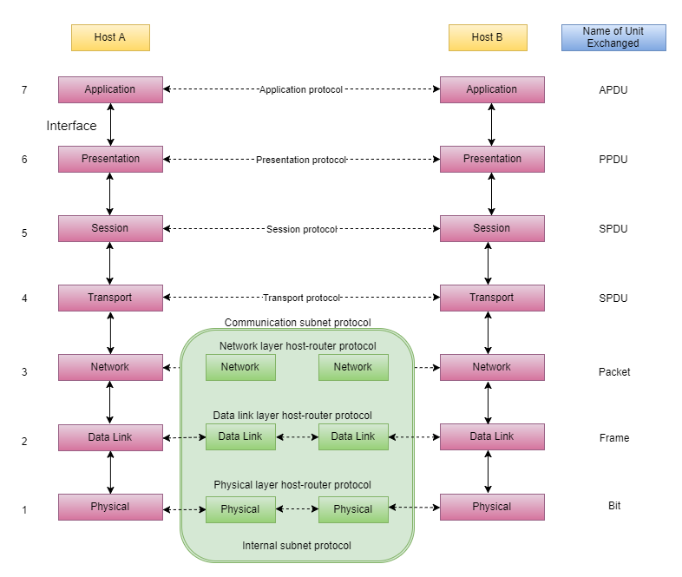

Slide 106
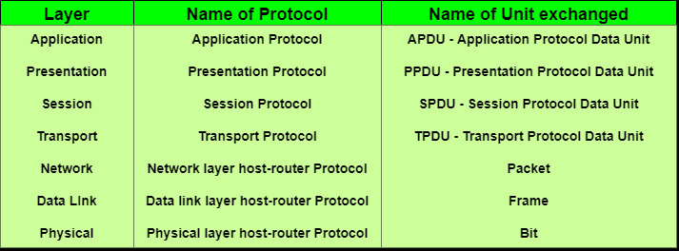

Slide 107
TCP/IP
The TCP/IP model was developed prior to the OSI model
The TCP/IP model is not exactly similar to the OSI model
The TCP/IP model consists of five layers:
the application layer
transport layer
network layer
data link layer
physical layer
The first four layers provide physical standards, network interface, internetworking, and transport functions that correspond to the first four layers of the OSI model and these four layers are represented in TCP/IP model by a single layer called the application layer
TCP/IP is a hierarchical protocol made up of interactive modules, and each of them provides specific functionality

Slide 108
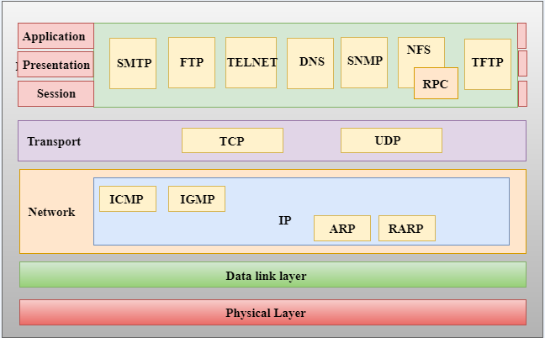
Functions of TCP/IP layers

Slide 109
Network Access Layer
A network layer is the lowest layer of the TCP/IP model
A network layer is the combination of the Physical layer and Data Link layer defined in the OSI reference model
It defines how the data should be sent physically through the network.
This layer is mainly responsible for the transmission of the data between two devices on the same network
The functions carried out by this layer are encapsulating the IP datagram into frames transmitted by the network and mapping of IP addresses into physical addresses
The protocols used by this layer are ethernet, token ring, FDDI, X.25, frame relay

Slide 110
Internet Layer
An internet layer is the second layer of the TCP/IP model
An internet layer is also known as the network layer
The main responsibility of the internet layer is to send the packets from any network, and they arrive at the destination irrespective of the route they take

Slide 111
Following are the protocols used in this layer
IP Protocol
ARP Protocol
ICMP Protocol

Slide 112
Responsibilities of the IP protocol
IP Addressing:
This protocol implements logical host addresses known as IP addresses. The IP addresses are used by the internet and higher layers to identify the device and to provide internetwork routing.
Host-to-host communication:
It determines the path through which the data is to be transmitted.
Data Encapsulation and Formatting:
An IP protocol accepts the data from the transport layer protocol. An IP protocol ensures that the data is sent and received securely, it encapsulates the data into message known as IP datagram.
Fragmentation and Reassembly:
The limit imposed on the size of the IP datagram by data link layer protocol is known as Maximum Transmission unit (MTU). If the size of IP datagram is greater than the MTU unit, then the IP protocol splits the datagram into smaller units so that they can travel over the local network. Fragmentation can be done by the sender or intermediate router. At the receiver side, all the fragments are reassembled to form an original message.
Routing:
When IP datagram is sent over the same local network such as LAN, MAN, WAN, it is known as direct delivery. When source and destination are on the distant network, then the IP datagram is sent indirectly. This can be accomplished by routing the IP datagram through various devices such as routers.

Slide 113
ARP Protocol
ARP stands for Address Resolution Protocol
ARP is a network layer protocol which is used to find the physical address from the IP address
The two terms are mainly associated with the ARP Protocol:
ARP request: When a sender wants to know the physical address of the device, it broadcasts the ARP request to the network
ARP reply: Every device attached to the network will accept the ARP request and process the request, but only recipient recognize the IP address and sends back its physical address in the form of ARP reply
The recipient adds the physical address both to its cache memory and to the datagram header

Slide 114
ICMP Protocol
ICMP stands for Internet Control Message Protocol
It is a mechanism used by the hosts or routers to send notifications regarding datagram problems back to the sender
A datagram travels from router-to-router until it reaches its destination. If a router is unable to route the data because of some unusual conditions such as disabled links, a device is on fire or network congestion, then the ICMP protocol is used to inform the sender that the datagram is undeliverable
An ICMP protocol mainly uses two terms:
ICMP Test: ICMP Test is used to test whether the destination is reachable or not
ICMP Reply: ICMP Reply is used to check whether the destination device is responding or not
The core responsibility of the ICMP protocol is to report the problems, not correct them
The responsibility of the correction lies with the sender
ICMP can send the messages only to the source, but not to the intermediate routers because the IP datagram carries the addresses of the source and destination but not of the router that it is passed to

Slide 115
Transport Layer
The transport layer is responsible for the reliability, flow control, and correction of data which is being sent over the network

Slide 116
Transport Layer
The two protocols used in the transport layer are User Datagram protocol and Transmission control protocol

Slide 117
User Datagram Protocol (UDP)
It provides connectionless service and end-to-end delivery of transmission
It is an unreliable protocol as it discovers the errors but not specify the error
User Datagram Protocol discovers the error, and ICMP protocol reports the error to the sender that user datagram has been damaged
UDP consists of the following fields: Source port address: The source port address is the address of the application program that has created the message Destination port address: The destination port address is the address of the application program that receives the message Total length: It defines the total number of bytes of the user datagram in bytes. Checksum: The checksum is a 16-bit field used in error detection
UDP does not specify which packet is lost. UDP contains only checksum; it does not contain any ID of a data segment

Slide 118
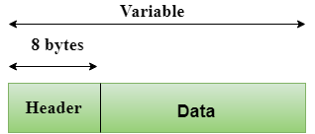
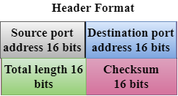
User Datagram Protocol (UDP)

Slide 119
Transmission Control Protocol (TCP)
It provides a full transport layer services to applications
It creates a virtual circuit between the sender and receiver, and it is active for the duration of the transmission
TCP is a reliable protocol as it detects the error and retransmits the damaged frames
Therefore, it ensures all the segments must be received and acknowledged before the transmission is considered to be completed and a virtual circuit is discarded
At the sending end, TCP divides the whole message into smaller units known as segment, and each segment contains a sequence number which is required for reordering the frames to form an original message
At the receiving end, TCP collects all the segments and reorders them based on sequence numbers

Slide 120
Application Layer
An application layer is the topmost layer in the TCP/IP model
It is responsible for handling high-level protocols, issues of representation
This layer allows the user to interact with the application
When one application layer protocol wants to communicate with another application layer, it forwards its data to the transport layer
There is an ambiguity that occurs in the application layer
Every application cannot be placed inside the application layer except those who interact with the communication system
For example: text editor cannot be considered in application layer while web browser using HTTP protocol to interact with the network where HTTP protocol is an application

Slide 121
Main Protocols Used in the Application Layer
HTTP: HTTP stands for Hypertext transfer protocol. This protocol allows us to access the data over the world wide web. It transfers the data in the form of plain text, audio, video. It is known as a Hypertext transfer protocol as it has the efficiency to use in a hypertext environment where there are rapid jumps from one document to another.
SNMP: SNMP stands for Simple Network Management Protocol. It is a framework used for managing the devices on the internet by using the TCP/IP protocol suite.
SMTP: SMTP stands for Simple mail transfer protocol. The TCP/IP protocol that supports the e-mail is known as a Simple mail transfer protocol. This protocol is used to send the data to another e-mail address.
DNS: DNS stands for Domain Name System. An IP address is used to identify the connection of a host to the internet uniquely. But, people prefer to use the names instead of addresses. Therefore, the system that maps the name to the address is known as Domain Name System.
TELNET: It is an abbreviation for Terminal Network. It establishes the connection between the local computer and remote computer in such a way that the local terminal appears to be a terminal at the remote system.
FTP: FTP stands for File Transfer Protocol. FTP is a standard internet protocol used for transmitting the files from one computer to another computer.

Slide 122
2.2 Compare the differences between the following physical layer categories and datalink layer protocols:
Physical Layers (including, but not limited to: Wireless, Fibre, Wired)
Data Link Layer (including, but not limited to: Ethernet [802.3], Wireless LAN [802.11], Bluetooth)

Slide 123
Done

Slide 124
Digital Transmission
DIGITAL-TO-DIGITAL CONVERSION
Digital-to-digital encoding is the representation of digital information by a digital signal
When binary 1s and 0s generated by the computer are translated into a sequence of voltage pulses that can be propagated over a wire, this process is known as digital-to-digital encoding

Slide 125
ANALOG-TO-DIGITAL CONVERSION
When an analog signal is digitalized, this is called an analog-to-digital conversion
Suppose human sends a voice in the form of an analog signal, we need to digitalize the analog signal which is less prone to noise
It requires a reduction in the number of values in an analog message so that they can be represented in the digital stream
In analog-to-digital conversion, the information contained in a continuous wave form is converted in digital pulses

Slide 126
Techniques for Analog-To-Digital Conversion
PAM
PAM stands for pulse amplitude modulation
PAM is a technique used in analog-to-digital conversion
PAM technique takes an analog signal, samples it, and generates a series of digital pulses based on the result of sampling where sampling means measuring the amplitude of a signal at equal intervals
PAM technique is not useful in data communication as it translates the original wave form into pulses, but these pulses are not digital
To make them digital, PAM technique is modified to PCM technique

Slide 127
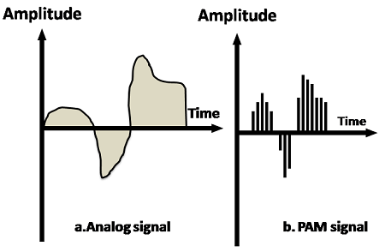

Slide 128
PCM
PCM stands for Pulse Code Modulation
PCM technique is used to modify the pulses created by PAM to form a digital signal. To achieve this, PCM quantizes PAM pulses
Quantization is a process of assigning integral values in a specific range to sampled instances
PCM is made of four separate processes: PAM, quantization, binary encoding, and digital-to-digital encoding.

Slide 129
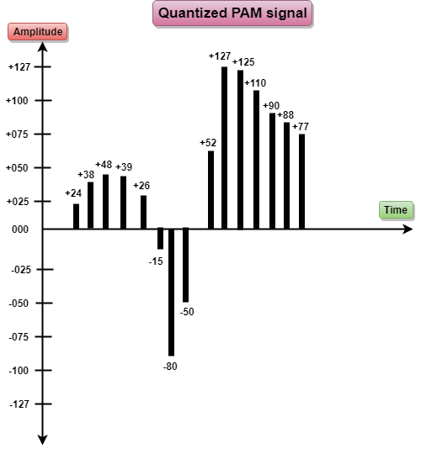

Slide 130
End of Day 2

Slide 131
3. Network Routing Protocols (30%, K3)
In this key topic, the apprentice will describe and explain network routing protocols. Outcomes should include an ability to:
3.1 Describe current network routing protocols in use
3.2 Compare the differences between static and dynamic routing

Slide 132
3.1 Describe current network routing protocols in use; including, but not limited to:
RIP/RIP2
RIP-NG
OSPF
OSPFv2
OSPFv3
A candidate should be able to:
• Explain the technical specification of network routing protocols.
• Describe the main features of network routing protocols.
• Explain the advantages and disadvantages of current network routing protocols, such as security, complexity / simplicity, resilience and scalability

Slide 133
This table lists the administrative distance default values of the protocols
Route Source | Default Distance Values
Connected interface | 0
Static route | 1
Enhanced Interior Gateway Routing Protocol (EIGRP) summary route | 5
External Border Gateway Protocol (BGP) | 20
Internal EIGRP | 90
IGRP | 100
OSPF | 110
Intermediate System-to-Intermediate System (IS-IS) | 115
Routing Information Protocol (RIP) | 120
Exterior Gateway Protocol (EGP) | 140
On Demand Routing (ODR) | 160
External EIGRP | 170
Internal BGP | 200
Unknown* | 255

Slide 134
Routing Information Protocol - RIP/RIP2
Routing Information Protocol (RIP) is a dynamic routing protocol which uses hop count as a routing metric to find the best path between the source and the destination network
It is a distance vector routing protocol which has an administrative distance (AD) value 120 and works on the application layer of OSI model
RIP uses port number 520
It is an Interior Gateway Protocol (IGP)

Slide 135
Hop Count
Hop count is the number of routers occurring in between the source and destination network
The path with the lowest hop count is considered as the best route to reach a network and therefore placed in the routing table
RIP prevents routing loops by limiting the number of hopes allowed in a path from source and destination
The maximum hop count allowed for RIP is 15 and hop count of 16 is considered as network unreachable

Slide 136
Features of RIP
Updates of the network are exchanged periodically
Updates (routing information) are always broadcast
Full routing tables are sent in updates
Routers always trust on routing information received from neighbor routers
This is also known as ‘Routing on rumours’
RIP requires routers to send the entire routing table to neighbours every 30 seconds

Slide 137
RIP versions
RIP v1 | RIP v2 | RIPng
Sends update as broadcast | Sends update as multicast | Sends update as multicast
Broadcast at 255.255.255.255 | Multicast at 224.0.0.9 | Multicast at FF02::9 (RIPng can only run on IPv6 networks)
Doesn’t support authentication of update messages | Supports authentication of RIPv2 update messages | –
Classful routing protocol | Classless protocol, supports classful | Classless updates are sent
RIP v1 is known as Classful Routing Protocol because it doesn’t send information of subnet mask in its routing update RIP v2 is known as Classless Routing Protocol because it sends information of subnet mask in its routing update

Slide 138
RIP-NG
RIP-ng is an extension of RIP developed for support of IPv6
Features:
just like RIP for IPv4, it uses hop count as the metric
sends updates every 30 seconds
RIPng messages use the UDP port 521 and the multicast address of FF02::9

Slide 139
OSPF
Routers connect networks using the Internet Protocol (IP), and OSPF (Open Shortest Path First) is a router protocol used to find the best path for packets as they pass through a set of connected networks
OSPF is an Interior Gateway Protocols (IGPs): that is, protocols aimed at traffic moving around within a larger autonomous system network like a single enterprise's network, which may in turn be made up of many separate local area networks linked through routers
The OSPF routing protocol has largely replaced the older Routing Information Protocol (RIP) in corporate networks

Slide 140
OSPF
Routers that use OSPF learns about changes to the network
It reads the routing table, learns of a change, and immediately broadcasts it to all other OSPF hosts in the network
OSPF sends only the part that has changed and only when a change has taken place
When routes change -- sometimes due to equipment failure -- the time it takes OSPF routers to find a new path between endpoints with no loops (which is called "open") and that minimizes the length of the path is called the convergence time

Slide 141
OSPF
Rather than simply counting the number of router hops between hosts on a network, as RIP does, OSPF bases its path choices on "link states"
This takes into account additional network information, including IT-assigned cost metrics that give some paths higher assigned costs
OSPF has RIP support built in both for router-to-host communication and for compatibility with older networks using RIP as their primary protocol

Slide 142
OSPF v2
A routing protocol which is described in RFC 2328
OSPFv2 is an IGP
See previous slides
(OSPF v1 (RFC1131) has never gone beyond the experimental stage)

Slide 143
OSPFv3
OSPFv3 is the Open Shortest Path First routing protocol for IPv6
It is similar to OSPFv2 in its concept of a link state database, intra- and inter-area, and AS external routes and virtual links
OSPFv3 still establishes neighbour adjacencies, has areas, different network types, the same metrics, runs SPF, etc.
There are however some differences
OSPFv2 runs on top of IPv4 and since OSPFv3 runs on IPv6, some changes had to be made

Slide 144
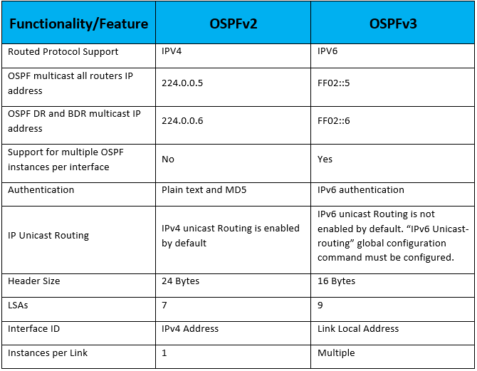
OSPF Differences

Slide 145
OSPF Differences
Advantage | Disadvantage
Changes are quick to propagate | Processor intensive
Hierarchical – area 0 is the top | Multiple copies of routing information
Link State algorithm | Not as easy to learn
Variable length subnet masks (VLSM)
Multicasting in areas (broadcast if not in an area)
Only sends what has changed
Logically segmented to reduce routing table size
Open standard

Slide 146
3.2 Compare the differences between static and dynamic routing
A candidate should be able to:
• Explain the static and dynamic routing.
• Compare static and dynamic routing.
• Explain the advantages and disadvantages of static and dynamic routing such as security, complexity / simplicity, resilience and scalability.

Slide 147
Static And Dynamic Routing
Routers are designed to communicate with each other and to share information about networks
Routers can be configured to work with static and dynamic routes

Slide 148
Static Routing
A Static route is a route that is manually entered by a network administrator
This is known as non-adaptive routing because the router will always use this static route when sending data
The data path is predetermined by the administrator
Static routes are useful for network security
A fault with any of the routes requires the system administrator to go to the affected routers and make the required changes to get the system working again
The overuse of static routing is not recommended because the main function of a router is to learn and devise new paths for data in the event of system failures

Slide 149
Dynamic Routing
Most routers are dynamic with the capability of being statically configured
Dynamic routing involves the regular communication of routers with other routers
Allows the routers to learn and adapt to a changing environment
This is the embodiment of packet switching with routers automatically adapting to network changes and even system failures

Slide 150
4. Network Performance (30%, K3)
In this key topic, the apprentice will describe and explain the factors that affect network performance. Outcomes should include an ability to:
4.1 Demonstrate the relationship between factors that affect network performance
4.2 Explain methods of improving network performance

Slide 151
4.1 Demonstrate the relationship between factors that affect network performance
Bandwidth
Number of users
Nature
Contention
A candidate should be able to:
• Describe the factors affecting network performance (such as Bandwidth, Number of users, Nature of traffic, traffic contention) and explain how they affect performance.
• Explain the interaction between the factors (e.g. how a change in one factor will affect other factors).

Slide 152
Bandwidth
How much information can you handle
A 10 Mbps line doesn’t have the same Bandwidth as a 100Mbps

Slide 153
Number of Users
The number of users can affect the speed and quality of your network.
More users accessing the same bandwidth will start to reduce the network performance
We can reduce the amount of users allowed.
Or we can reduce the amount of bandwidth each user can access to allow more users

Slide 154
Nature and architecture
What is the network doing?
How is it connected?
We can also account for fibre links or wireless links to different WANs
Is the network wireless?
Does it use 802.11…
Does it use 2.4 or 5ghz?

Slide 155
Nature
What traffic is going through the network
General
Load balance
Voip (qos)
Data comms
Data centers
Malicious traffic
Bursty data Small but many
and leaky data fixed data but low bandwidth

Slide 156
Contention
More than one device trying to access a file at the same time
This is more noticeable when you think about your Broadband at home.
We can prioritize traffic to try and stop this but it will always cause some network performance issues

Slide 157
4.2 Explain methods of improving network performance, such as traffic shaping, architecture and network policy
A candidate should be able to:
• Explain methods of network management such as traffic shaping, network architecture and network policies.
• Explain the effects of network management on users.
• Explain common causes of sub-optimal network performance such as bottlenecks and streaming.
Notes:
Highlight the security and cyber aspects in this section as well.
In the management part, look at standard management procedures, and then look at some SIEM stuff

Slide 158
Traffic shaping
CoDel
Controlled delay designed to overcome bufferbloat
Bufferbloat – flow of traffic changes from a fast and slow network.
Buffers allow a fast network to store the packets
PIE
Aims to attain high link utilization
Works based on queue latency not length
If latency can be controlled it frees up buffers for sporadic use
Happens at network layer

Slide 159
Network Policies
Restrict the types of traffic
Internet user permissions – Why do they need access to certain parts of the web?

Slide 160
Bottlenecks and Streaming
Congestion and bottle necks are more of a risk now. Even with increased bandwidth
Most downloads come from HTTP – Hard to identify what is needed and what's not
Traffic shaping and user education can help with these

