Slide 1
Demilitarized Zones

Slide 2
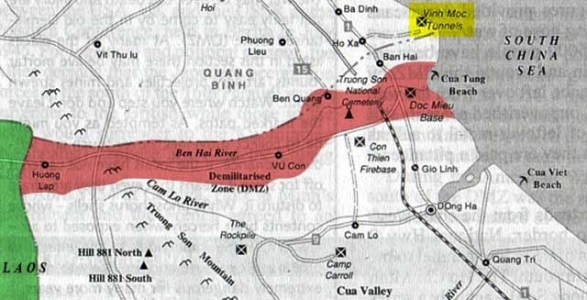
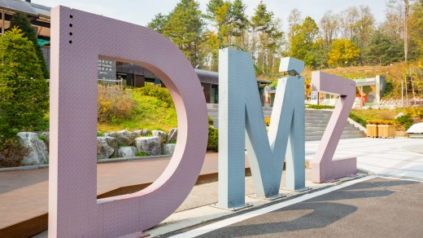
What is a DMZ?
A demilitarized zone, DMZ or DZ is an area in which treaties or agreements between nations, military powers or contending groups forbid military installations, activities or personnel

Slide 3
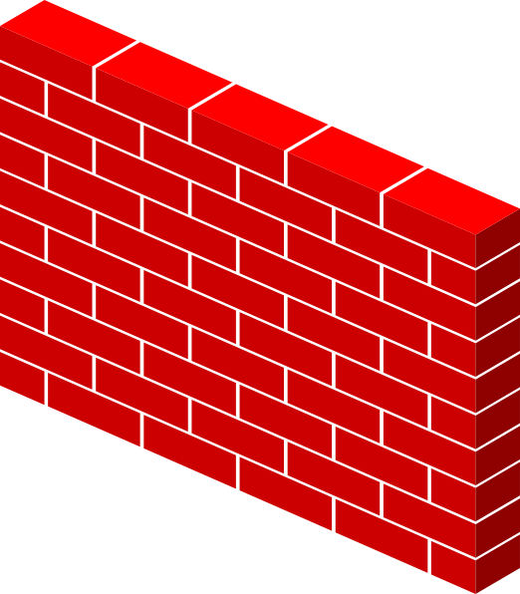
Apply to Networks
Internet

Slide 4
Apply to Networks - Business
Internet

Slide 5
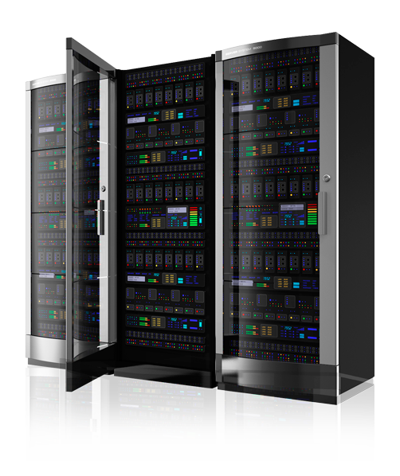
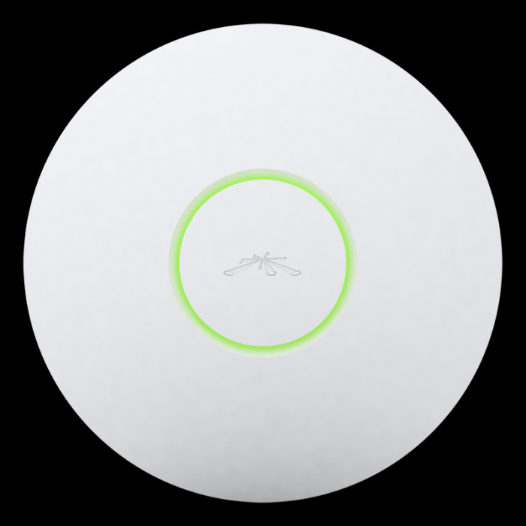
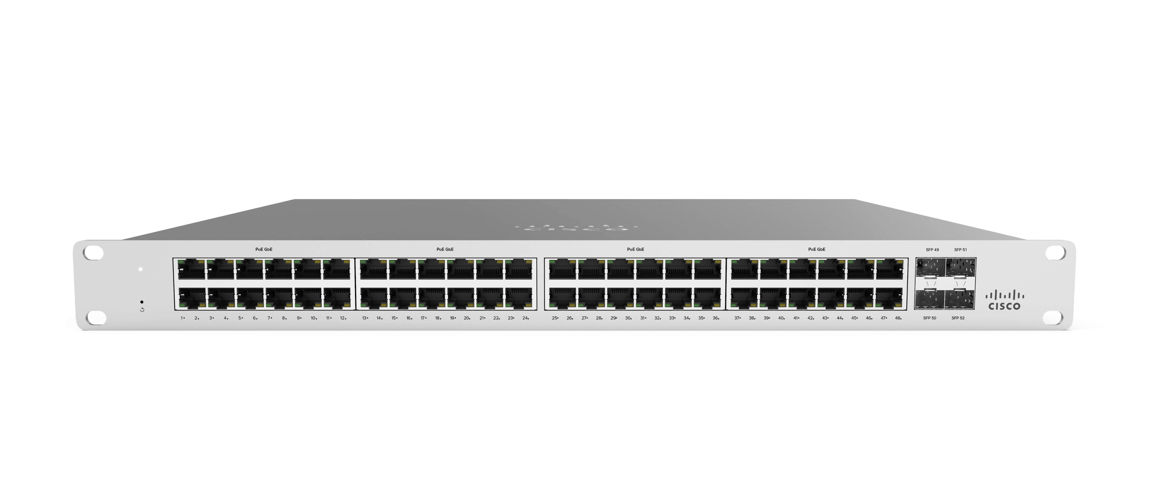
Apply to Networks - Business
Internet

Slide 6
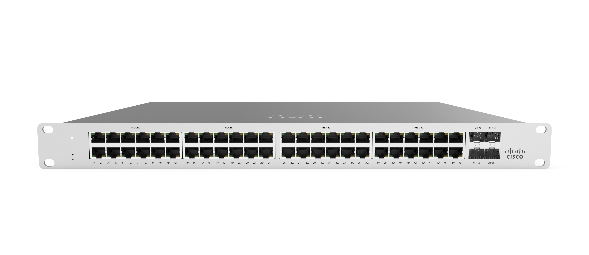
Apply to Networks - Business
Internet

Slide 7
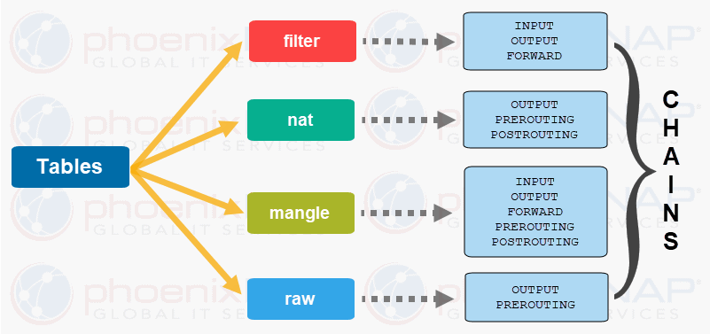
Firewall

Slide 8
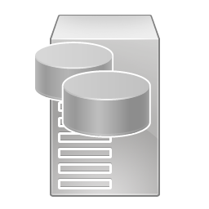

Slide 9
Web
Server
File
Server
AD
Server
DB
Server

Slide 10
Web
Server
Honeypot
DB
Server
File
Server
AD
Server

