Slide 1
Week 2 – Day 5
Cyber Threats
UFCFFU-30-1

Slide 2
Cyber Threats
Week 2
Monday
01
02
Tuesday
04
03
Thursday
Adversarial thinking in the context of system development, application development and analysis
CTI
Wednesday
05
Friday

Slide 3
Week 2 - Friday
Adversarial Thinking
Cyber Threat Intelligence

Slide 4
“If you know the enemy and know yourself, you need not fear the results of a hundred battles.”
Sun Tzu

Slide 5
Adversarial thinking
Adversarial thinking in the context of system development, application development and analysis
Think as an adversary, or, think like a hacker
Computer security is in continuous evolution due to its adversarial nature
Notes:
Let’s say that adversarial thinking is the ability to look at system rules and think about how to exploit and subvert them as well as to identify ways to alter the material, cyber, social, and physical operational space

Slide 6
Hackers
“What kind of a hacker?”
For example, the following hacker activities differ substantially:
email spear phishing
writing worms and viruses
circumventing digital rights management (DRM) protection
coding buffer overflow attacks
password cracking
Additionally, there are various different broad categories of hackers, ranging from script kiddies to highly trained professionals and from insider threats to hacktivists

Slide 7
How to Start
A security professional needs to study past attacks in order to understand the common patterns attackers follow during the compromise of a network or a piece of software
The Cuckoo's Egg describes several techniques that we see today in many sophisticated, state-sponsored attacks:
creation of backdoors
lateral movement
intelligence gathering

Slide 8
Where to Gather Information
Enormous amount of information about the tools and techniques used by cybercriminals
This information is collected and shared among organisations using several different tools and standards among them, MITRE's ATT&CK framework

Slide 9
Colours
The cybersecurity industry has built stark schisms between the types of people who can break systems, and those that build or defend them
The ‘red team’ versus the ‘blue team’
RED TEAM
BLUE TEAM
Talks about:
Squiblydoo
AS-REP roasting
Hot potato attacks
SPN enumeration
LocalAccountTokenFilterPolicy
Unquoted service paths
OLE embedded phishing
LLMNR poisoning
Bloodhound / user hunting
DLL side loading
GPP exploitation
Time-stomping
Talks about:
SQL injection
Password cracking
Phishing
Port-scanning
Patch management
Notes:
Squiblydoo is a specific usage of regsvr32. dll to load a COM scriptlet directly from the internet and execute it in a way that bypasses application whitelisting. It can be seen by looking for regsvr32.exe executions that load the scrobj.
AS-REP Roasting is an attack against Kerberos for user accounts that do not require preauthentication.

Slide 10
Adversarial Thinking - System Development & Application Development
Secure by design (SBD), in software engineering, means that software products have been designed from the foundation to be secure
Alternate security tactics and patterns are considered at the beginning of a software design, and the best are selected and enforced by the architecture
Malicious attacks on software should be assumed to occur, and care should be taken to minimise impact
Ensure everything works with the fewest privileges possible

Slide 11
Adversarial thinking - Analysis
A cyber analysis method is a threat-oriented approach for combating cyberattacks that shows a change from reactive security to proactive security
Knowledge of how internal and external information vulnerabilities pertinent to a particular organization could be matched against real-world cyber attacks
Apply threat modelling
A threat model should be systematic and structured

Slide 12
Four Questions
What are we working on?
What are the things that can go wrong?
How do we go about problems that occur?
Did we do a good job?

Slide 13
Components of the Cyber Threat Analysis Process
Scope
The first step in any cyber threat analysis should be to identify the assets you want to safeguard from cyberattacks and are critical to business processes
Collection of Data
Information about an actual cyber-attack or threat incidents is collected. You must distinguish between real potential attacks and threats that are not real but still considered potential threats. The scope should help filter out such threats to ensure that the focus is on the threats that exist
Vulnerability Analysis of Acceptable Risks
The analysts test the information gathered to determine the extent of current exposure. Existing security defence is then tested to decide whether or not it can neutralize information threats in terms of integrity, availability, and confidentiality
Mitigation and Anticipation
In the final step, a highly qualified cyber threat analyst uses the information gathered from the previous sector to determine preventive measures that must be implemented. The analyst can categorise the threat data into groups, allocate each pattern to specific threat actors, and implement mitigation measures. At the same time, the analyst will use data about potential threats to anticipate future cyber attacks
Notes:
1. Scope
The first step in any cyber threat analysis should be to identify the assets you want to safeguard from cyberattacks and are critical to business processes.
2. Collection of Data
In the Collection of Data stage, information about an actual cyber-attack or threat incidents is collected. In this stage, you must distinguish between real potential attacks and threats that are not real but still considered potential threats. The scope should help filter out such threats to ensure that the focus is on the threats that exist.
3. Vulnerability Analysis of Acceptable Risks
In this phase, the analysts test the information gathered to determine the extent of current exposure. Existing security defense is then tested to decide whether or not it can neutralize information threats in terms of integrity, availability, and confidentiality.
4. Mitigation and Anticipation
In the final step, a highly qualified cyber threat analyst uses the information gathered from the previous sector to determine preventive measures that must be implemented. The analyst can categorize the threat data into groups, allocate each pattern to specific threat actors, and implement mitigation measures. At the same time, the analyst will use data about potential threats to anticipate future cyber attacks.

Slide 14
Threat Intelligence
A branch of cybersecurity related to the collection and analysis of information about potential attacks currently targeting the organisation
A proactive security measure that an organization implements to prevent data breaches, and thus prevent further consequences
The main purpose of Cyber Threat Intelligence is to provide in-depth information on the threats that pose a greater risk to the organisation’s infrastructure
Notes:
What are the most common cyber threats?
The top 8 cyber threats that the world has seen are:
Malware
Phishing
Password cracking
DDos
Man in the middle
Drive-by download
Malvertising
Rogue software

Slide 15
Week 3

Slide 16
Horizon Scanning
A technique for detecting early signs of potentially important developments through a systematic examination of potential threats and opportunities, with emphasis on new technology and its effects on the issue at hand

Slide 17
Horizon Scanning
Horizon scanning is defined as ‘a systematic examination of information to identify potential threats, risks, emerging issues and opportunities’
Horizon scanning typically involves very long-term scenario planning
Involves a wide variety of sources, such as
the Internet
blogs
government ministries and agencies
non-governmental organisations
international organisations and companies
research communities
on-line and off-line databases and journals
hacker conferences
cyber security events

Slide 18
Horizon Scanning
Information can also be obtained from Government sponsored sources
The National Cyber Security Centre (NCSC)
https://www.ncsc.gov.uk/section/advice-guidance/all-topics?topics=active%20cyber%20defence
CiSP (Cyber Security Information Sharing Partnership)
https://www.ncsc.gov.uk/section/keep-up-to-date/cisp
CertUK (Computer Emergency Response Team)
https://www.gov.uk/government/news/uk-launches-first-national-cert

Slide 19
Cyber Threat Intelligence (CTI)
The precise and contextualised information about emerging or existing cyber threats
These have been refined and analysed to provide actionable advice which allows the organisations to take informed decisions to proactively defend or mitigate any cyber threats
Provides valuable knowledge with context about the adversaries and their motivations, capabilities, goals
Includes the tools and methods that adversaries use to conduct cyber-attacks
Notes:
In a nutshell, Cyber Threat Intelligence (CTI) is the information that is collected, relevant, fully contextualized, filtered and analyzed to answer core questions regarding any cyber threats that an organization can face, such as who is likely to attack what assets, where, when, how and why.

Slide 20
Threat Intelligence Lifecycle
Threat intelligence is nearly always contextual and temporal: Threats come at a definite time and place, attacking specific vulnerabilities in particular systems
To develop effective threat intelligence, it is essential that you identify the elements — beyond mere data — that actually comprise it, and understand how the intelligence lifecycle unfolds
Intelligence is the product of a process that includes collecting data, analysing it, and viewing it in context, and it generally includes predictions of future behaviour and recommended courses of action

Slide 21
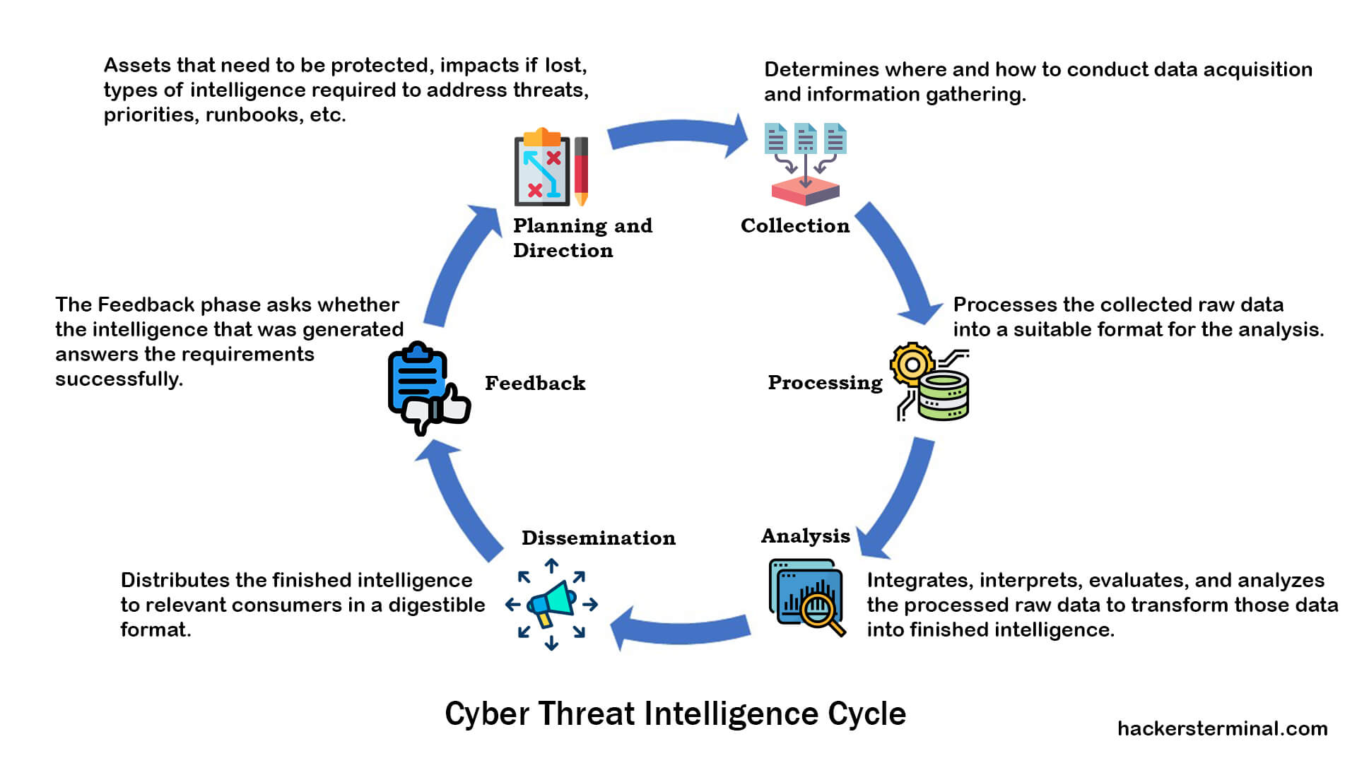
The Lifecycle - Intelligence

Slide 22
Threat Analysis
A process used to determine which components of the system need to be protected and the types of security risks (threats) they should be protected from

Slide 23
5 Steps
Determine the scope of your threat assessment
Collect necessary data to cover the full scope of your threat assessment
Identify potential vulnerabilities that can lead to threats
Analyse any threats you uncover and assign a rating
Perform your threat analysis

Slide 24
Breaking Down Risks, Vulnerabilities and Threats
Risks | Vulnerabilities | Threats
Risks are typically classified as either hazardous, financial, operational and strategic, and they have the potential for loss of anything in your care that has value, which might include people, information, money, facilities, equipment or reputation | Vulnerabilities are any weaknesses or gaps in your security programs that make it possible for threats to gain access to your assets | A threat to your organisation’s computing system is a warning that alerts you that an intruder is trying to infiltrate your system to exploit any possible vulnerabilities available to gain access to your assets to steal, damage or otherwise compromise them
Notes:
Breaking Down Risks, Vulnerabilities and Threats to Build the Best Possible Information Security Program
You work with risks, vulnerabilities and threats each day, constantly striving to break down and understand their relationship to each other to keep everything in check.

Slide 25
Types of Frequent Threats
Intentional Threats
Viruses
Malware
Denial of Service (DoS)
ransomware attacks
Accidental Threats
computer malfunction
employee lapse in protocol, judgment or memory
Natural Disasters
Flood
lightning strike
Earthquake
Fire
tornado
Internal Threats
intentional abuse of rights or policies
occupational fraud

Slide 26
Successful Threat Assessment
Determine the scope of your threat assessment
Collect necessary data to cover the full scope of your threat assessment
Identify potential vulnerabilities that can lead to threats
Analyse any threats you uncover and assign a rating
Perform your threat analysis

Slide 27
Determine the Scope
Very important step
The scope provides you with an outline of what is covered and what is not
The scope of your assessment can range to one small sector of your system to the entire network
During this step, you can also classify the sensitivity of what is being assessed, as well as the level and detail of the assessment
Check every possible avenue for threats and security gaps in your system

Slide 28
Collect Necessary Data
Gather all the data you will need to fulfil the assessment’s scope
Some of this data includes:
Company policies and procedures
Regulations, laws and policies set forth by an external governing body, such as PCI/DSS, ICO, GDPR, Acts of Parliament
Notes from interviews, questionnaires or surveys conducted with key personnel to identify assets and out-of-date or missing documentation
Additional details such as SLAs, OS information, Network applications running, cloud services

Slide 29
Identify Potential Vulnerabilities
Categorise or rate them according to their potential for loss:
Minor Severity and Exposure
Moderate Severity and Exposure
High Severity and Exposure
Use a threat matrix
Remember that a threat score is NOT a risk assessment

Slide 30
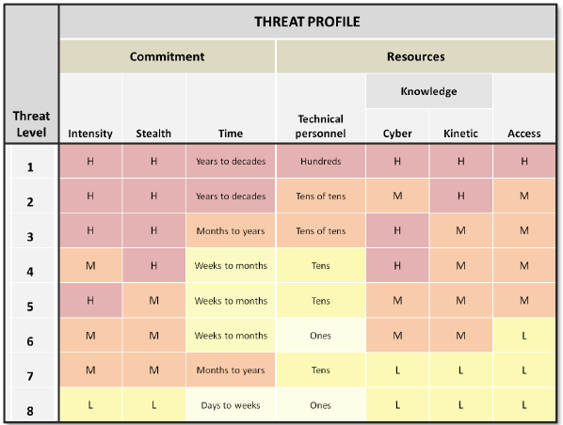
Threat Matrix

Slide 31
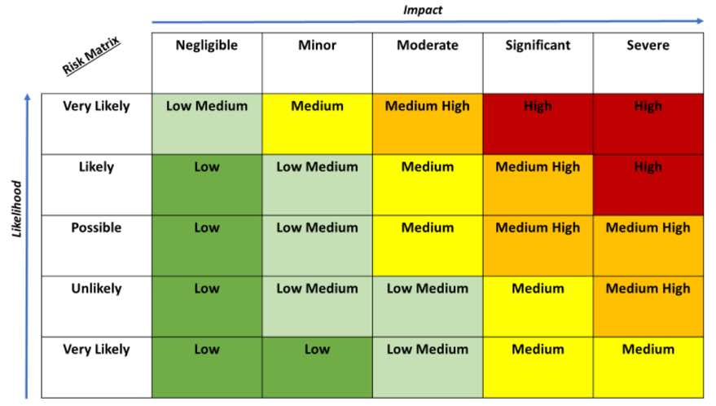
Risk Assessment
Very Unlikely

Slide 32
Analyse any Threats
Go through your findings to determine anything that may contribute to tampering, destruction or interruption of any service or item of value
Develop a strategy to remove these threats with measures that include:
installation of new software
tightening of security
implementing additional access controls
providing increased and improved staff training

Slide 33
Perform Regular Threat Assessments
Cyber criminals never rest, which means you can’t either

Slide 34
Perform Threat Analysis

Slide 35
Cyber Threats
Week 1
Monday
01
Tuesday
02
03
Wednesday
04
Thursday
05
Friday

