Slide 1
Operating Systems and Architecture
^{<computer architecture>}
(UFCFCU-30-1)

Slide 2
What outcomes we will cover
Explain the relationships between the hardware components and the sub systems in a computer system.
Memory
Storage

Slide 3
Main Memory devices
SRAM
DRAM
CACHE

Slide 4
RAM Types
Random Access Memory (RAM)
Dynamic RAM (DRAM)
Bit cell needs to be constantly refreshed (needs constant power source)
Synchronous Dynamic RAM (SDRAM)
Same sort of technology as DRAM but...
64-bit data bus
Timed to system clock

Slide 5
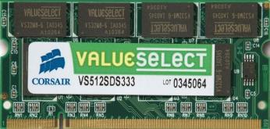
DDR SDRAM
Double Data Rate SDRAM (PC-xxxx)
DDR2 doubles bus speed (PC2-xxxx)
DDR3 quadruples bus speed (PC3-xxxx)
DIMM packaging
184-pin (DDR)
240-pin (DDR2 and DDR3 – keyed differently)
SODIMM packaging for laptops
Notes:
What is DDR 4 and 5?
SODIMM on other devices?

Slide 6
RAM Configurations (2)
Dual-channel
Feature of motherboard / CPU not memory modules
Controller can access two banks at the same time
Memory modules must be matched (use kits)
ECC
Detects / corrects errors
Generally only used on servers or workstations
Registered / Fully Buffered
Makes high density modules more reliable
Notes:
Ask questions around, dual channel / quad, ECC, registered.
Not sure why this memory is not working, I filed a notch in place to make it fit.

Slide 7
Main memory
Main memory (primary or internal memory):
Used for program and data storage during computer operation
Directly accessed by the CPU (microprocessor)
Semiconductor technology
Volatile memory
Alterable memory (RWM)
A random accessed memory
Every cell is connected to selection lines (bit line for RD / WR)
Every cell is connected to data lines (column bit lines for RD / WR)

Slide 8
Memory Hierarchy
Storage
Notes:
Main memory is RAM and so forth
Auxiliary Memory is along the lines of storage internal/ external

Slide 9
Types of locality
Temporal Locality (Locality in Time)
The location of a memory reference is likely to be the same as another recent reference
Programs tend to reference the same memory locations at a future point in time
Due to loops and iteration, programs spending a lot of time in one section of code
Spatial Locality (Locality in Space)
The location of a memory reference is likely to be near another recent reference
Programs tend to reference memory locations that are near other recently-referenced memory locations
Notes:
At any given time, data is copied only between two adjacent levels – Upper Level (the one closer to the processor) • Smaller, faster, and uses more expensive technology – Lower Level (the one further from the processor) • Bigger, slower, and uses less expensive technology

Slide 10
1-D addressing scheme
Notes:
N = 2 a
The CS (chip select) input is used to enable the device
This is an active low input, so it will only respond to its other inputs if the CS line is low.
The OE (output enable) input is used to cause the memory device to place the contents of the location specified by the address inputs onto the data pin
The WR (write enable) input is used to cause the memory device to write the internal location specified by the address inputs with the data currently appearing on the data
pins
– This is an active low signal, and the actual write occurs on the
rising edge when WR goes from low back to the high state

Slide 11
SRAM
Bipolar or unipolar technology
Operating cycles:
Read cycle
Write cycle
Every cell contain a latch (1 bit)
Access circuitry:
Decode the address word
Control the cell selection lines
Read and write cells
Control internal logic

Slide 12
SRAM
A general approach to reducing the access circuitry cost in random access memories is called matrix (array) organization
The storage cells are physically arranged as rectangular arrays of cells
– This is primarily to facilitate layout of the connections between the cells and the access circuitry
The memory address is partitioned into d components so that the address A of cell C becomes a d-dimensional vector (A , A , ..., address Ai of cell Ci becomes a d-dimensional vector (Ai,1, Ai,2, ..., Ai,d) = Ai
Each of the d parts of an address word goes to a different address decoder and a different set of address drivers
A particular cell is selected by simultaneously activating all d of its address lines
A memory unit with this kind of addressing is said to be a ddimensional memory

Slide 13
DRAM
DRAMs are currently the primary memory device of choice because they provide the lowest cost per bit and greatest density among solid-state memory technologies.
Every cell contain MOS capacitor(s)
DRAM - dynamic since needs to be refreshed periodically (≈8 ms, 1% time)
Addresses divided (address pins multiplexed) into 2 halves (Memory as a 2D matrix):
RAS or Row Address Strobe
CAS or Column Address Strobe
E.g. 222 cells = 4 Mbit, memory array 2048 x 2048 cells, number of address IC pins = 11
Operating cycles:
Read cycle
Write cycle
Refreshment cycle
Notes:
MOS Metal oxide semiconductor
For main memory, DRAM (dynamic random access memory) is the current standard. DRAM is a type of volatile memory, meaning it requires power to retain data. “Dynamic” refers to the slow discharge of the capacitor (data leakage), where the charge periodically needs to be refreshed to retain the data. This is less than ideal as it consumes extra power and requires high endurance (ability to read and write many times). “Random access” means it takes the same amount of time to reach any memory address. This provides efficient data access compared to the slower sequential (in the order data was stored) access of NAND flash and other storage-class technologies. Another speed advantage is that DRAM is bit-alterable, where new data can directly overwrite existing stored information (no erase step needed). DRAM is also bit-addressable, allowing access to individual bits of data and not just larger blocks (often called “page read”), which is important for main memory.

Slide 14
DRAM
Notes:
The memory cell is written to by placing a “1” or “0” charge into the capacitor cell. This is done during a write cycle by opening the cell transistor (gate to power supply or VCC) and presenting either VCC or 0V (ground) at the capacitor. The word line (gate of the transistor) is then held at ground to isolate the capacitor charge. This capacitor will be accessed for either a new write, a read, or a refresh.

Slide 15
DRAM
Research into why its important to have RAS and CAS and how they work. We will discuss this a group.
Notes:
First Step: Row Addresses Row addresses are present on address pads and are internally validated by the RAS (Row Address Access) clock. A bar on top of the signal name means this signal is active when it is at a low level. The X addresses select one row through the row decode, while all the other non-selected rows remain at 0V. Each cell of the selected row is tied to a sense amplifier. A sense amplifier is a circuit that is able to recognize if a charge has been loaded into the capacitor of the memory cell, and to translate this charge or lack of charge into a 1 or 0. There are as many sense amplifiers as there are cells on a row. Each sense amplifier is connected to a column (Y address). In this first step all the cells of the entire row are read by the sense amplifier. This step is long and critical because the row has a high time constant due to the fact that it is formed by the gates of the memory cells. Also, the sense amplifier has to read a very weak charge (approximately 30 femtoFarads or 30fF).
Second Step: Column Addresses Following the first step, column addresses are present on the address pads and are internally validated by the Column Address Access (CAS) clock. Each selected memory cell has its data validated in a sense amplifier. Column access is fast. This step consists of transferring data present in the sense amplifier to the Dout pin through the column decode and the output buffer. On memory data sheets, the access time from RAS is termed tRAC and the access time from CAS is listed as tCAC. On a typical standard DRAM of 60ns access time, tRAC = 60ns and tCAC = 15ns.
RAS – Row address access
CAS - Column address access

Slide 16
RAM Configurations
Chips
Module consists of nn chips of nn MB size (density)
Chip depth (number of rows and columns)
High density RAM needs to be registered or buffered
Banks
Width of memory bus
All modern CPUs are 64-bit
Dual-channel makes 128-bit
ECC adds 8 bits (or 16 bits if dual channel)
Double-sided
Physical location of chips on the module
OR (sometimes)
Number of ranks (dual-rank modules contain two sets of chips)
Controller can access one rank at a time
Controller is subject to maximum electrical load so may not be able to use dual-rank modules in all slots
Notes:
Need more detail into

Slide 17
DRAM Refresh
For standard DRAMs there are three ways to perform refresh cycles.
Look into the 3 different refresh cycles for DRAM
Notes:
RAS – Row address access
CAS - Column address access

Slide 18
Cache
Cache memory is an intermediate temporary memory unit
positioned between the processor registers and main memory
Large and slow main memory ↔ smaller and faster cache memory
The cache contains a copy of portions of main memory
Notes:
When the processor attempts to read a word of memory, a check is made to determine if the word is in the cache made to determine if the word is in the cache – If so, the word is delivered to the processor – If not, a block of main memory, consisting of some fixed number of words, is read into the cache and then the word is delivered to the processor • Because of the phenomenon of locality of reference, when a block of data is fetched into the cache to satisfy a single memory reference, it is likely that future references will be to other words in the block

Slide 19
Cache
Notes:
word is the natural unit of data used by a particular processor design. A word is a fixed-sized piece of data handled as a unit by the instruction set or the hardware of the processor. The number of bits in a word (the word size, word width, or word length) is an important characteristic of any specific processor design or computer architecture.

Slide 20
CACHE
A computer system has an L1 cache, an L2 cache, and a main memory unity connected as shown below. The block size in L1 cache is 4 words. The block size in L2 cache is 16 words. The memory access times are 2 nanoseconds, 20 nanoseconds and 200 nanoseconds for L1 cache, L2 cache and main memory unit respectively.
When there is a miss in L1 cache and a hit in L2 cache, a block is transferred from L2 cache to L1 cache. What is the time taken for this transfer?
(A) 2 nanoseconds (B) 20 nanoseconds (C) 22 nanoseconds (D) 88 nanoseconds
Notes:
c

Slide 21
Hit Ratio
Hit: Accessed data is found in upper level (for example Block A in level i)
Hit Rate = fraction of accesses found in upper level
Hit Time = Time to access the upper level = Memory access time + Time to determine hit/miss
Miss: Accessed data found only in lower level (for example Block B in level i+1)
Processor waits until data is fetched then restarts the access
Miss Rate = 1 – (Hit Rate)
Miss Penalty
Time to get block from lower level
+time to replace in upper level
+time to deliver the block the processor
Hit Time << Miss Penalty
Notes:
Cache L1 -> L2 -> Main Memory

Slide 22
Cache
Hit Ratio
The performance of cache memory can be given by a synthetic parameter, called hit ratio (HR)
Hit ratio determined running benchmarks
HR represents the ratio between the total numbers of hits in cache and the total number of memory accesses (hit + miss numbers)
If we get a miss in L1 we will see if we can get a hit in L2
Do some research into Hit Ratio and add this into your research documentation

Slide 23
Cache
We have looked at L1 and L2 Cache
There is a 3rd Layer of cache
Research the access time of L3 Cache
Create a diagram of how L1 to main memory flows with what the Hit rates and Miss rates should/could be for each section.
Notes:
Example:
L1-cache, 0.5 ns, 20%
L2-cache, 1.8 ns, 5%
L3-cache, 4.2 ns, 1.5%
Main memory, 70 ns, 0%

Slide 24
Storage
HDD-Non Volatile
SSD
Flash

Slide 25
Hard Drives
Hard Disk Drive (HDD)
Magnetic coated platters
Drive heads read and write to storage locations
Each platter divided into tracks and 512 byte sectors
3.5”, 2.5”, and 1.8” form factors

Slide 26
Hard Disk Performance
Spin speed
Revolutions Per Minute (RPM)
15000 / 10000 rpm
7200 rpm
5400 rpm
Access time / latency
Internal transfer rate
External transfer rate
Cache
Self-Monitoring Analysis and Reporting Technology (S.M.A.R.T.)

Slide 27
Hard Disk Performance
Access time / latency
Internal transfer rate
External transfer rate
Cache

Slide 28
Solid State Drive (SSD)
Drive using flash memory for solid state storage
SSD interfaces
SATA
PCIe (PCI Express)
SATAe (SATA Express)
Advanced Host Controller Interface (AHCI) versus Non-Volatile Memory Host Controller Interface Specification (NVMHCI) / NVM Express (NVMe)
SSD performance factors
eMMC
Hybrid and dual-drive configurations

Slide 29
NAND
NAND is a format of flash memory
Notes:
Die: Semiconductor wafers are cut from a block of electronic-grade silicon. The piece of wafer cut from the block is referred to as a die.
Plane: One die contains one to two planes. Planes can (generally) execute identical operations together.
Block: Planes contain varying numbers of blocks. NAND Flash cells can only be erased at the block level.
Page: Blocks usually contain around 128 pages. Pages are the smallest units that can be programmed (or written to).
Each page contains anywhere from 512 – 4,096 bytes (1 byte = 8 bits). Some cells hold just one bit, while others contain up to three depending on the SSD.

Slide 30
NAND
Notes:
There is not much difference between how your DRAM works and how NAND flash memory works

Slide 31
NAND
Each NAND Flash memory cell contains a Floating Gate Transistor, which is where the Program/Erase cycle of a NAND Flash cell takes place.
The floating gate transistor consists of five main elements:
Control Gate
Floating Gate
Insulator, or “Oxide Layer“
P-Substrate (Poly-Silicon)
Source and Drain
How do Electrons get into and out of the FG?
Notes:
The control gate opens and closes from voltage applied by the word lines. More specifically, the word line checks to see if the cell holds a charge (a “0”) or not (a “1”), also known as the cell’s bit state.
A cell registering as a “1” (no charge) indicates there are no electrons present in the Floating Gate (FG); if the cell’s bit state reads as a “0” (holding a charge), there are electrons in the FG.
How do electrons get into and out of the FG?
By applying a positive charge to the bit line and word line, electrons stored in the source get excited and plow through the P-Substrate field to the drain.
When this happens, some electrons squeeze through the “insulated” layer into the floating gate, a process called tunnel injection. Forcing electrons into a floating gate is how your drive writes data to a cell.
Writing — or programming — happens at the byte level, and sets individual bits from “1” to “0”.
Erasing data happens at the block level. A similar process called tunnel release forces electrons out of the floating gate, in turn changing the bit state to “1”.

Slide 32
NAND
Research how NAND stores your data and doesn’t lose it like RAM does.
Further research into how 3D NAND works

Slide 33
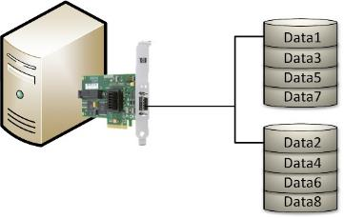
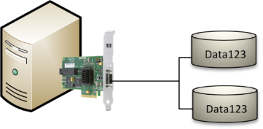
RAID Levels 0 and 1
RAID 0
Striping for performance
2 or more disks
No redundancy
RAID 1
Mirroring
2 disks
50% utilization

Slide 34
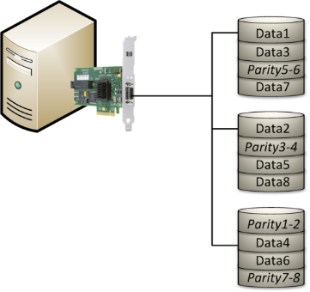
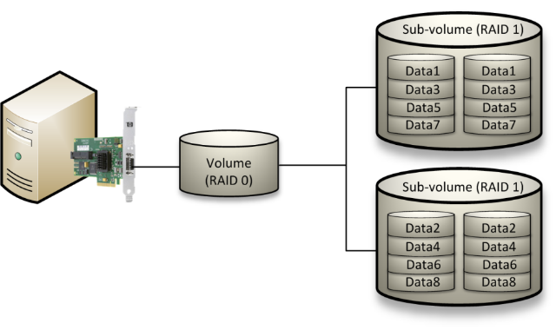
RAID Levels 5 and 10
RAID 5
Striping with parity
3 or more disks
Better than 50% utilization
RAID 1+0 (RAID 10)
Nested RAID
Logical striped (RAID 0) volume consisting of RAID 1 volumes
50% overhead
Can tolerate multiple simultaneous disk failures (1 in each sub-volume)

