Slide 1
Printers

Slide 2
Routine Printer Maintenance
Printers require quite intensive maintenance
User training
Overloading input trays or output trays (not collecting completed jobs promptly)
Using unsuitable media (for example, card stock or labels in an auto-feed tray)
Using creased, folded, or dirty paper
Breaking trays or covers
Inserting ink or toner cartridges incorrectly
Printing preferences / appropriate settings

Slide 3
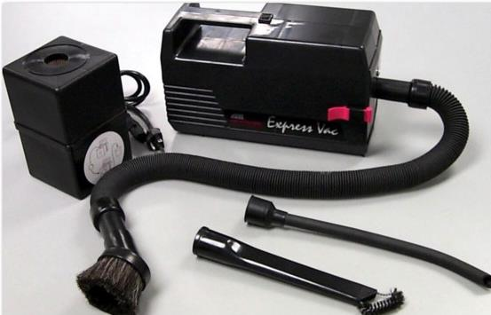
Laser Printer Maintenance
Cleaning
Disconnect from power
Components may be hot - take care
Use approved cleaning products
Dealing with toner spills
Paper
Use good quality paper designed for printer / print application
Do not overload
Do not use damaged media
Mr. PC Clean fine particle, ESD safe vacuum cleaner (mrpcclean.co.uk) Toner safe vacuum

Slide 4
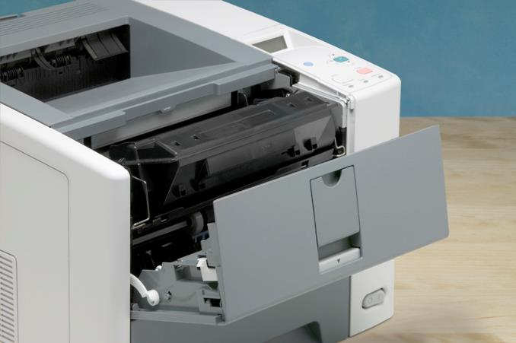
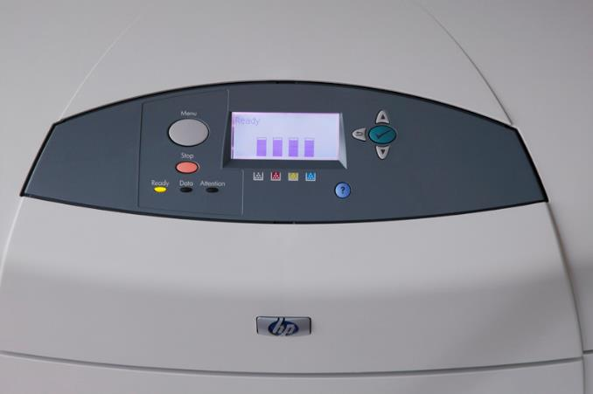
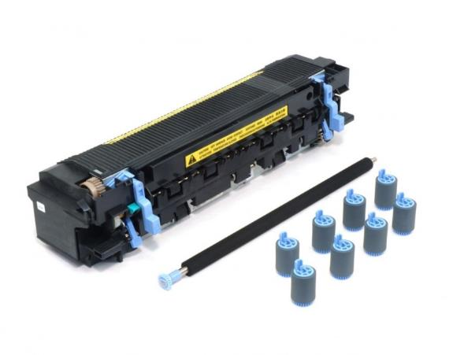
Laser Printer Maintenance
Replacing toner cartridge
Remove packing strips and recycle old cartridge
Replacing a maintenance kit
Pickup / Feed rollers, transfer roller, fuser
Alert after number of print cycles
Make sure old fuser is cooled down
Remove packing strips

Slide 5
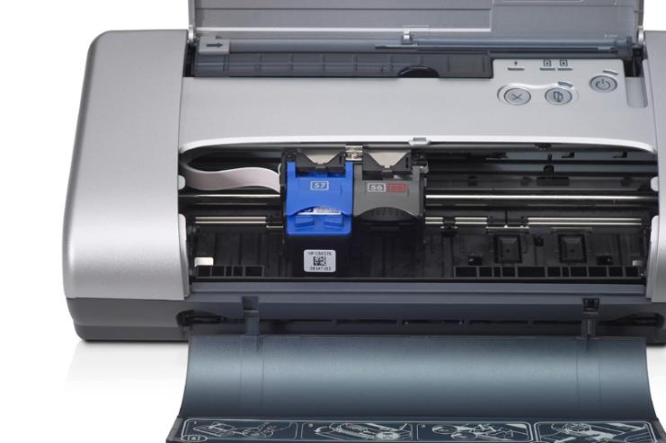
Inkjet Printer Maintenance
Replacing inkjet cartridges
Set to maintenance mode
Remove packing strip
Wait for charging / cleaning process
Refilling inkjet cartridges
Print head alignment and cleaning

Slide 6
Thermal and Impact Printer Maintenance
Thermal printers
Paper roll
Cleaning
Impact printers
Using tractor-fed paper
Replacing print head and ribbon

Slide 7
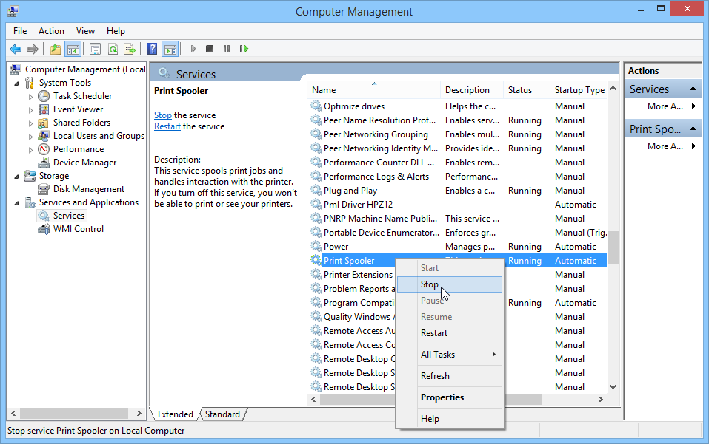
Troubleshooting Print Errors
No printer display image
No connectivity
Print test page
Check printer is online
Check jobs in printer queue
Memory low
Restart / Cancel
Cycle power on print device
Restart spooler service
Change spool format
Check spool folder
Check disk space

Slide 8
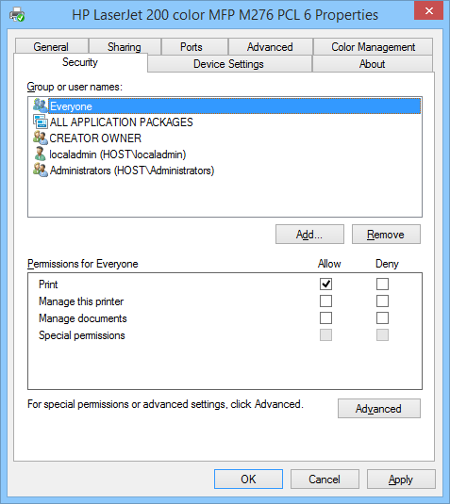
Troubleshooting Print Errors
Access denied
Unable to install printer

Slide 9
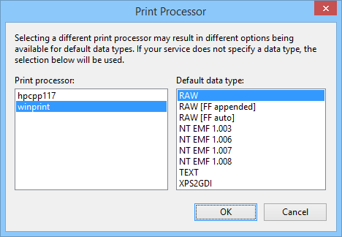
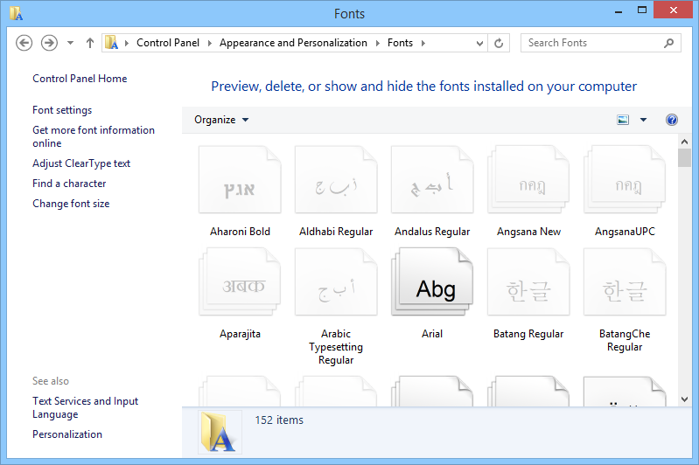
Troubleshooting Print Errors
Driver / garbled output
Print a different file
Print from a different application or print test page
Try different spool settings
Check for driver update / rollback driver or alternative driver
Check fonts are available

Slide 10
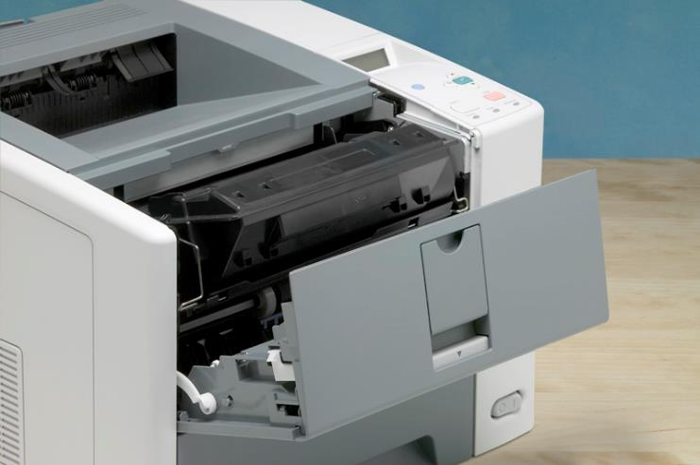
Troubleshooting Paper Jams
Remove paper carefully – release it from printer mechanism
Check paper specification
Check for badly loaded media
Replace maintenance kit

Slide 11
Troubleshooting Laser Problems
Faint print
Toner low
Print settings (draft mode)
Blank pages
Out of toner
Toner packing seals not removed
Transfer corona damaged
Software problem
Skewed output
White stripes
Shake toner cartridge
Clean / replace transfer corona wire
Black stripes and marks
Clean / replace primary corona wire
Clean / replace rollers
Damage to OPC drum
Toner specks
Repetitive defects
Easily smudged - damaged fuser unit
Wavy output
Ghost images
Color cast
Color missing
Paper jam
Check media
Check rollers
Static Eliminator Strip

Slide 12
Troubleshooting Inkjet Problems
Paper jams
Check feed tray
Poor quality
Check media (paper)
Clean print head
Incomplete letters
Clean print head
Update driver
Inconsistent darkness
Clean print head
Check ink
Faded print / inconsistent colors
Check ink
Check print settings (draft mode)
Consistent marks on print
Clean print head

Slide 13
Troubleshooting Dot Matrix Problems
Faint output
Check ink ribbon
Check platen gap
No print impression
Check print head
Check platen gap
Paper jam
Check media
Check paper feed
Persistent marks on print
Print head pin stuck in or out

