Slide 1
Understanding and Troubleshooting Networking
ICT Level 3

Slide 2
Understanding & Troubleshooting Networking
Recap
Monday
01
02
Wednesday
03
04
Tuesday
05
06
Thursday
Friday

Slide 3
K3: Principles of root cause problem solving using fault diagnostics for troubleshooting
K4: Principles of basic network addressing for example binary
K6: fundamental principles of virtual networks and components
K11: fundamentals of physical networks and components
K15: principles of remote operation of devices including how to deploy and securely integrate mobile devices into a network

Slide 4
K25: Principles of cloud and network architecture (including Wi-Fi)
K26: Principles of DNS / DHCP
K27: Awareness of Cloud platforms, such as AWS, Azure, or GCP
K28: Principles of LANs and WANs
K29: Approaches to virtualisation of servers, applications, and networks
K30: Principles of network protocols

Slide 6
1.0 Networking Concepts
23%
1.1 Explain the purposes and uses of ports and protocols
1.2 Explain devices, applications, protocols and services at their appropriate OSI layers
1.3 Explain the concepts and characteristics of routing and switching
1.4 Given a scenario, configure the appropriate IP addressing components
1.5 Compare and contrast the characteristics of network topologies, types and technologies
1.6 Given a scenario, implement the appropriate wireless technologies and configurations
1.7 Summarize cloud concepts and their purposes
1.8 Explain the functions of network services

Slide 7
1.1 Explain the purposes and uses of ports and protocols
Protocols and ports
SSH 22 Secure shell
DNS 53 Domain name system
SMTP 25 Simple mail transfer protocol
SFTP 22 Secure file transfer protocol
FTP 20, 21 File transfer protocol
TFTP 69 Trivial file transfer protocol
TELNET 23 Text oriented communication (insecure)
DHCP 67, 68 Dynamic host configuration protocol
HTTP 80 Hypertext transfer protocol
HTTPS 443 Hypertext transfer protocol secure

Slide 8
1.1 Explain the purposes and uses of ports and protocols
Protocols and ports
SNMP 161 Simple network management protocol
RDP 3389 Remote desktop protocol
NTP 123 Network time protocol
SIP 5060, 5061 Session initiation protocol
SMB 445 Server message block
POP 110 Post office protocol
IMAP 143 Internet message access protocol
LDAP 389 Lightweight directory access protocol
LDAPS 636 Lightweight directory access protocol secure
H.323 1720 Audio-visual communication protocol

Slide 9
Port ranges

Slide 10
Common port assignments
Protocol | Name | Description | Ports
HTTP | Hypertext Transfer Protocol | Used to retrieve data from web servers. | TCP 80
HTTPS | HTTP over TLS/SSL | Used for secure web pages and sites. Includes encryption services. | TCP 443
FTP | File Transfer Protocol | Used for transferring files between hosts. Contains basic authentication features. | TCP 20 (data) TCP 21 (control)
TFTP | Trivial File Transfer Protocol | Simpler, less secure file transfer protocol. Sometimes used for network boot software. | UDP 69
Telnet | Telnet | Used to log into remote systems via a virtual text terminal interface | TCP 23
SSH | Secure Shell | Encrypted replacement for Telnet and FTP. Includes Secure Copy Protocol (SCP) and Secure Shell FTP (SFTP) | TCP 22
SMTP | Simple Mail Transfer Protocol | Sends email to and between mail servers. | TCP 25
POP | Post Office Protocol | Retrieves email from mail servers. | TCP 110
IMAP | Internet Message Access Protocol | Retrieves email from mail servers. | TCP 143

Slide 11
Common port assignments (Cont.)
Protocol | Name | Description | Ports
SMB | Server Message Block | Used to share files and resources like printers. | TCP 139 & 445
RDP | Remote Desktop Protocol | Used for remote logins to Windows systems. | TCP 3389
NetBIOS | Network Basic Input/Output System | Provides name, datagram, and session services for networks using the NetBIOS API. | UDP 137 - 138 TCP 138 - 139
SNMP | Simple Network Management Protocol | Used to remotely manage and monitor network devices. | TCP/UDP 161, 162 (Trap)
LDAP | Lightweight Directory Access Protocol | Used for network directory services. | TCP 389
LDAPS | LDAP over SSL/TLS | Used for secured network directory services | TCP 636
DNS | Domain Name System | Resolves domain names into IP addresses. | TCP/UDP 53
DCHP | Dynamic Host Configuration Protocol | Dynamically assigns IP addresses and other network configuration on joining a network. | UDP 67, 68

Slide 12
Common port assignments (Cont.)
Protocol | Name | Description | Ports
NTP | Network Time Protocol | Used to synchronize device clocks with time servers. | UDP 123
MGCP | Media Gateway Control Protocol | Controls media gateways used to connect Voice over IP (VoIP) systems to conventional telephone networks. | TCP/UDP 2427, 2727
SIP | Session Initiation Protocol | Sends control information for multimedia communication sessions, like VoIP, video, and instant messaging. | TCP/UDP 5060, TCP 5061 (encrypted)
RTP | Real-time Transfer Protocol | Delivers streaming audio and video data over networks. | TCP/UDP 5004, 5005
H.323 | H.323 | Provides signaling and control for multimedia transmissions. | TCP/UDP 1720

Slide 13
1.1 Explain the purposes and uses of ports and protocols
Protocol types
ICMP Internet Control Message protocol – used to diagnose network communication issues in IP operations
Echo request and reply
Also known as ping, these diagnostic messages are exchanged to verify that a host is connected and responding on the Network layer.
Host unreachable
Signals when a router or host isn't responding.
Source quench
Signals that network congestion is making a router or host slow to respond and notifies the sender to slow down.
Redirect
Used by routers to notify the sender about a more efficient route to the remote host.
Time exceeded
Sent whenever a packet reaches its TTL and is dropped by a router, or when a fragmented packet isn't reassembled properly.
Router advertisement and solicitation
Used by routers to announce their presence on the network, and by hosts to find routers.

Slide 14
1.1 Explain the purposes and uses of ports and protocols
Protocol types
UDP User datagram protocol
Used for time-sensitive transmissions such as video playback or DNS lookups.
Does not establish a connection prior to transmission
Doers not check if data has arrived correctly
Faster than TCP
Applications using UDP must tolerate errors, loss and duplication
Datagrams have checksums so corrupt data can be discarded, but there's no reliability so it's not resent

Slide 15
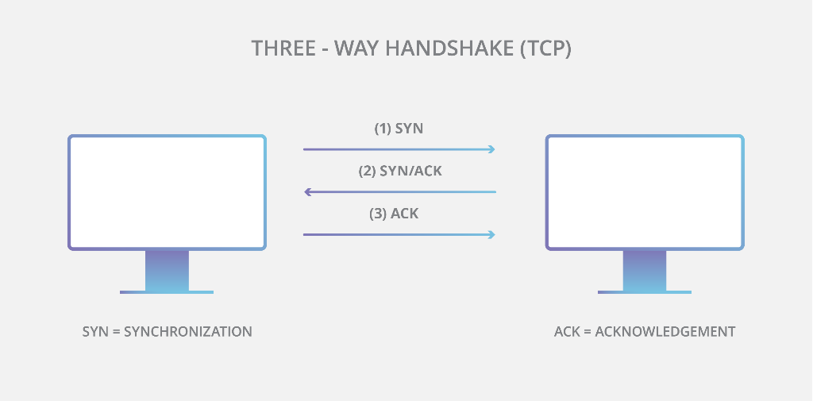
1.1 Explain the purposes and uses of ports and protocols
Protocol types
TCP Transmission control protocol
Used where data integrity is required
Enforces a connection
Ensures packet order
Retransmits if errors occur
More overhead, so slower than UDP
Handshaking protocol – transmission only starts after acknowledgement by receiver

Slide 16
1.1 Explain the purposes and uses of ports and protocols
Protocol types
IP Internet protocol
Connectionless – each packet is individually addressed and routed to its destination
Does not handle packet ordering or error checking (TCP function)
IP header has:
Source and destination address
Header length
Packet length
Time to live (TTL)
TCP or UDP being used
and others

Slide 17
1.2 Explain devices, applications, protocols and services at their appropriate OSI layers
Layer 1 – Physical
Layer 2 – Data link
Layer 3 – Network
Layer 4 – Transport
Layer 5 – Session
Layer 6 – Presentation
Layer 7 – Application

Slide 18
OSI model
Layer 7
Application
Open Systems Interconnection Reference Model
It’s a guide (thus the term “model”)
Don’t get wrapped up in the details
This is not the OSI protocol suite
Most of the OSI protocols didn’t catch on
There are unique protocols at every layer
You’ll refer to this model for the rest of your career
Layer 6
Presentation
Layer 5
Session
Layer 4
Transport
Layer 3
Network
Layer 2
Data Link
Layer 1
Physical
Notes:
All People Seem To Need Data Processing

Slide 19
OSI model
Layer 7
Application
Open Systems Interconnection Reference Model
Mnemonic
Please Do Not Throw Sausage Pizza Away
Layer 6
Presentation
Layer 5
Session
Layer 4
Transport
Layer 3
Network
Layer 2
Data Link
Layer 1
Physical

Slide 20
The OSI Layers
Application
The layer we see – Google Mail, Twitter, Facebook
Encoding and encryption
(SSL/TLS)
Presentation
Session
Communication between devices (Control protocols, tunnelling protocols)
The “post office” layer
(TCP segment, UDP datagram)
Transport
Network
The routing layer
(IP address, router, packet)
The switching layer
(Frame, MAC address, EUI-48, EUI-64, Switch)
Data Link
Signalling, cabling, connectors
(Cable, NIC, Hub)
Physical

Slide 21
OSI model

Slide 22
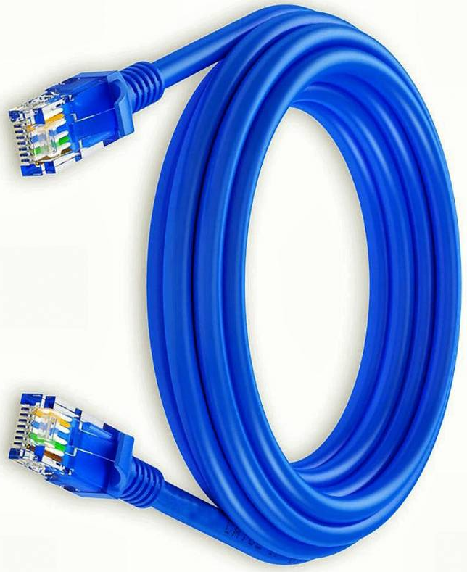
OSI Model – Layer 1: The Physical Layer
The physics of the network
Signalling, cabling, connectors
This layer isn’t about protocols
You have a physical layer problem
Fix your cabling, punch-downs, etc.
Run loopback tests, test/replace cables, swap adapter cards

Slide 23
OSI Model – Layer 1: The Physical Layer
From Data Link Layer
To Data Link Layer
110
1010101100001101
Physical Layer
110
1010101100001101
Transmission Medium
The physical layer is responsible for movements of individual bits from one hop (node) to the next

Slide 24
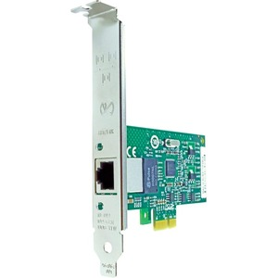
OSI Model – Layer 2: Data Link Layer
The basic network “language”
The foundation of communication at the data link layer
Data Link Control (DLC) protocols
MAC (Media Access Control) address on Ethernet
The “switching” layer
0
1
1
1
0
1
0
9C-35-58-5F-4C-D7
0C-9D-92-87-47-1E
Notes:
The Data Link Layer is referencing the MAC addresses that are communicating on the network.

Slide 25
OSI Model – Layer 2: The Data Link Layer
From Network Layer
To Network Layer
H2
Data
T2
H2
Data
T2
Data Link Layer
Data Link Layer
To Physical Layer
From Physical Layer
The data link layer is responsible for moving frames from one hop (node) to the next.
Notes:
H2 is the Header
Data is the packet from the network layer
The trailer includes error detection and the ending transmission data

Slide 26
Hop-to-Hop delivery

Slide 27
OSI Model - Layer 3: Network Layer
The “routing” layer
Internet Protocol (IP)
Fragments frames to traverse different networks

Slide 28
OSI Model - Layer 3: Network Layer
What is IP Fragmentation?
Fragments are always in multiples of 8 because of the number of fragmentation offset bits in the IP header

Slide 29
OSI Model – Layer 3: The Network Layer
From Transport Layer
To Transport Layer
H3
Data
H3
Data
Network Layer
Network Layer
To Data Link Layer
From Data Link Layer
The network layer is responsible for the delivery of individual packets from the source host to the destination host.
Notes:
H3 is the Header
Data is the packet from the transport layer

Slide 30
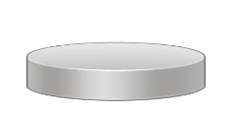
Source to Destination Delivery
Intermediate
system
Link
X
Link
Intermediate
system
C
D
Link
X
B
Intermediate
system
A
Link
X
Link
E
F
Hop-to-hop delivery
Hop-to-hop delivery
Hop-to-hop delivery
Data Link Layer
Source-to-destination delivery
A
B
E
F
Network
Network
Network
Data Link
Data Link
Data Link
Physical
Physical
Physical

Slide 31
OSI Model – Layer 4: Transport Layer
The “post office” layer
Parcels and letters
TCP (Transmission Control Protocol) and UDP (User Datagram Protocol)

Slide 32
Transport Layer
From Session Layer
To Session Layer
H4
Data
H4
Data
H4
Data
H4
Data
H4
Data
H4
Data
Transport Layer
Transport Layer
To Network Layer
From Network Layer
The transport layer is responsible for the delivery of a message from one process to another.

Slide 33
OSI Model – Layer 5: Session
Communication management between devices
Start, stop, restart
Half-duplex, full-duplex
Control protocols, tunnelling protocols

Slide 34
Session Layer
From Presentation Layer
To Presentation Layer
H5
H5
SYN
SYN
SYN
SYN
SYN
SYN
Session Layer
Session Layer
To Transport Layer
From Transport Layer
The session layer is responsible for dialog control and synchronization.

Slide 35
Session Layer
The session layer is responsible for dialog control and synchronization.

Slide 36
OSI Model – Layer 6: Presentation
Character encoding
Application encryption
Often combined with the Application Layer

Slide 37
OSI Model – Layer 6: Presentation
From Application Layer
To Application Layer
H6
Data
H6
Data
Presentation Layer
Presentation Layer
To Session Layer
From Session Layer
The presentation layer is responsible for translation, compression, and encryption.

Slide 38
OSI Model – Layer 7: Application
The layer we see - HTTP, FTP, DNS, POP3

Slide 39
OSI Model – Layer 7: Application
User:
Human or Program
User:
Human or Program
…
…
X.500
FTAM
X.400
X.500
FTAM
X.400
H7
Data
Message
H7
Data
Message
Application Layer
Application Layer
To Presentation Layer
From Presentation Layer
The application layer is responsible for providing services to the user.

Slide 40
Summary of Layers
Application
To allow access to network resources
To translate, encrypt and compress data
Presentation
Session
To establish, manage and terminate sessions
To provide reliable process-to-process message delivery and error recovery
Transport
Network
To move packets from source to destination; to provide internetworking
To organise bits into frames; to provide hop-to-hop delivery
Data Link
To transmit bits over a medium; to provide mechanical and electrical specifications
Physical

Slide 41
1.3 Explain the concepts and characteristics of routing and switching
Properties of network traffic
Broadcast domains
CSMA/CD
CSMA/CA
Collision domains
Protocol data units
MTU
Broadcast
Multicast
Unicast
Segmentation and interface properties
VLANs
Trunking (802.1q)
Tagging and untagging ports
Port mirroring
Switching loops/spanning tree
PoE and PoE+ (802.3af, 802.3at)
DMZ
MAC address table
ARP table

Slide 42
Transmission Media
The physical channel through which signals travel to allow nodes to communicate
All use electromagnetic radiation of type or the other
Electrical
Light
Radio signals
Transmission media can be classified as:
Cabled
wireless

Slide 43
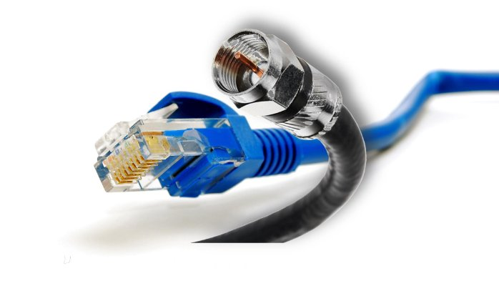
Transmission Media - Cabled
A physical signal conductor between two nodes
Cable types such as:
Copper
Fibre optic
Cabled media can also be described as bounded media

Slide 44
Transmission Media - Wireless
Uses free space between nodes
Types such as:
Microwave radio
Wireless media can also be described as unbounded media

Slide 45
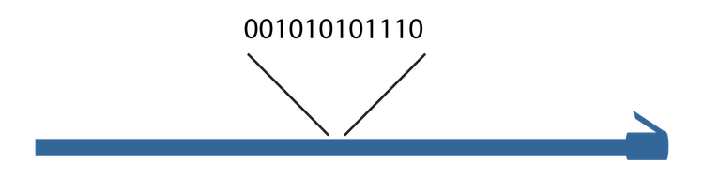
Signaling and modulation
Every kind of physical network needs to turn data into a signal that can be sent across the media.
The simplest way is by encoding it into a single binary signal and transmitting it along a wire or fiber optic cable
This is called digital baseband, or line coding, and is the method used by Ethernet cables among others
Notes:
Every kind of physical network needs to turn data into a signal that can be sent across the media. The simplest way is by encoding it into a single binary signal and transmitting it along a wire or fiber optic cable. This is called digital baseband, or line coding, and is the method used by Ethernet cables among others.
As you know, a cable, on which bits in the form of signals are transmitted, is busy with signals containing zeros and ones, and to distinguish between what bits are the actual travelled data and what bits are non-wanted noise is very difficult ; so a method to tell the difference is required. For that reason, control information is utilized. This information is in the form of zeros and ones that indicate where a frame start and where the frame ends.

Slide 46
Signaling and modulation (Cont.)
In other communication types, especially those used over long distances, data is combined with a signal called a carrier wave

Slide 47
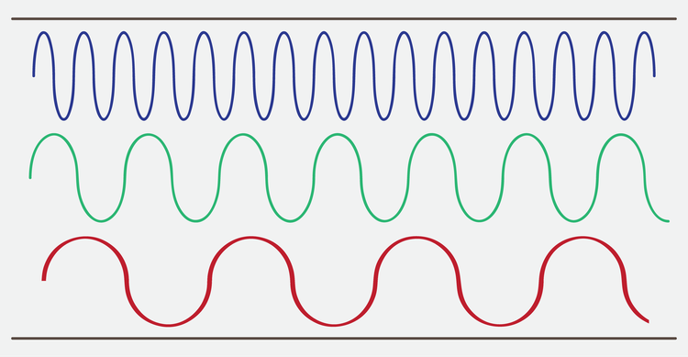
Signaling and modulation (Cont.)
Three channels in a broadband transmission

Slide 48
Signal Methods
Notes:
Three possible variations which are amplitude, frequency, and phase.

Slide 49
Bit rate and bandwidth
Bit rate, the number of bits carried per second
For example, the earliest popular Ethernet standards had a bit rate of ten megabits per second, abbreviated as 10 Mbps
Gross bit rate
Net bit rate or throughput
goodput
Notes:
Bandwidth means the amount of data that can be carried in a given amount of time; or, in other words, the capacity of a medium to carry data in a specific period of time. As stated previously, data transfer is measured using bits per second (bps). Thanks to the technological development, bandwidth is now commonly referred to in kilobits per second and megabits per second, and in case using highly sophisticated media, bandwidth can reach gigabits per second and terabits per second. These speeds can be achieved relying on the physical characteristics of media and the signalling method being applied. Thus if one is to calculate the bandwidth of a given medium, the physical properties as well as the signalling method must be taken into consideration.
Throughput can be defined as the real or actual data transfer rate in a given amount of time. We said that bandwidth is the capacity of a medium for data transmission, however, this capacity is hardly attained in real data transfer because of a variety of factors such as interference, noise, and errors in data transmission. For this reason, when we talk about bandwidth, we are actually taking about a theoretical rate of speed which is not same when data frames are really transmitted, whereas when we refer to the speed rate of a given medium using a throughput value, we are actually utilizing the real value at which data frames are carried. This means that throughput is bandwidth minus interference and errors, and therefore bandwidth is theoretical and throughput is practical.
Goodput denotes the transfer rate of the actual usable data bits; or, to put it another way, goodput measures the final data that the user benefits from or use, for data such as a picture, text, or video does not travel on media alone, but rather there is another control information, which is generally considered as data, or what is referred to as overhead. Its purpose is to make sure that data is safe, undamaged, unrepeated, and to guide data up to the destination. By and large, it can be said that goodput is throughput minus overhead traffic

Slide 50
Bit rate and bandwidth (Cont.)
A transmission using two-bit symbols

Slide 51
Multiplexing
Space-division multiplexing (SDM)
Frequency-division multiplexing (FDM)
Time-division multiplexing (TDM)
Notes:
Space-division multiplexing, also known as Space-division multiple access is the use of separate point-to-point electrical conductors for each transmitted channel. Examples include an analogue stereo audio cable, with one pair of wires for the left channel and another for the right channel, and a multi-pair telephone cable, a switched star network such as a telephone access network, a switched Ethernet network, and a mesh network.
Frequency-division multiplexing (FDM) is inherently an analogue technology. FDM achieves the combining of several signals into one medium by sending signals in several distinct frequency ranges over a single medium. In FDM the signals are electrical signals.
Time-division multiplexing (TDM) is a digital (or in rare cases, analogue) technology which uses time, instead of space or frequency, to separate the different data streams. TDM involves sequencing groups of a few bits or bytes from each individual input stream, one after the other, and in such a way that they can be associated with the appropriate receiver. If done sufficiently quickly, the receiving devices will not detect that some of the circuit time was used to serve another logical communication path.
Multiple low data rate signals are multiplexed over a single high data rate link, then demultiplexed at the other end

Slide 52
Media Access Control
Ethernet Media Access Control address
The “physical” address of a network adapter
The MAC address
Unique to a device
48 bits / 6 bytes long
Displayed in hexadecimal
00:0a:83
:
00:0a:83
Organisationally Unique Identifier (OUI)
Network Interface Controller-Specific
The manufacturer
The serial number
Notes:
A physical address corresponding to a particular network interface.
Ethernet's physical address format is a 48-bit number called a MAC address, MAC-48, or EUI-48.
MAC addresses are usually written as 12 hexadecimal digits. For readability, they're usually grouped into pairs, separated by dashes or colons; for example, 10:0D:7F:F3:CE:8F.
Sometimes you'll also see three groups of four separated by periods or full stops, such as 100D.7FF3.CE8F.

Slide 53
MAC addresses (Cont.)
MAC Address
0001101
00010000
01111111
00010010
11001110
00001101
0D
10
7F
12
CE
0D
0001101
00010000
01111111
11111111
11111110
00010010
11001110
00001101
0D
10
7F
FF
FE
12
CE
0D
EUI-64 Address

Slide 54
Unicast, broadcast, and multicast
An address corresponding to a specific recipient is called a unicast address.
A broadcast address is intended to be read by any node that receives it.

Slide 55
Unicast, broadcast, and multicast (Cont.)
Multicast addresses are intended to go to multiple nodes but not everywhere on the network
0001101
00010000
01111111
00010010
11001110
00001101
0D
10
7F
12
CE
0D

Slide 56
Media Access Control - Duplex
Half-duplex
Full-duplex
A device cannot send and receive simultaneously
All LAN hubs are half-duplex devices
Switch interfaces can be configured as half-duplex, but usually only when connecting to another half-duplex device
Data can be sent and received at the same time
A properly configured switch interface will be set to full-duplex

Slide 57
Ethernet Frames
There have been four different Ethernet frame types defined over the years
Only the Ethernet II frame type is used today
Every version of 802.3 Ethernet uses the same Ethernet II frame
Using frames addresses two networking issues
Frames prevent any single machine from monopolizing the shared bus cable
The process of retransmitting lost data is more efficient
Notes:
An Ethernet frame is a data link layer protocol data unit and uses the underlying Ethernet physical layer transport mechanisms

Slide 58
Ethernet Frame
Ethernet Type II Frame
(64 to 1518 bytes)
A8 A1 59 1D 79 8F
A8 A1 52 1D 21 98
08 00
IP, ARP, etc.
01 20 13 3A
Destination MAC Address
Source MAC Address
EtherType
Payload
CRC Checksum
MAC Header
(14 bytes)
Data
(46 - 1500 bytes)
4 bytes
EtherType values:
0x0800 signals that the frame contains an IPv4 datagram 0x0806 indicates an ARP frame
0x86DD indicates an IPv6 frame
0x8100 indicates the presence of an IEEE 802.1 Q tag
Notes:
The MAC header has 14 bytes and the payload can have from 46 to 1500 bytes. The checksum is 4 bytes which means that the Type II frame can therefore have from 64 to 1518 bytes

Slide 59
Ethernet Deployment Standards

Slide 60
802.3 Standards
The 802.3 committee defines wired network standards that share the same basic frame type and network access method
Here’s a small selection of 802.3 standards:
802.3i 10 Mbps Ethernet using twisted pair cabling (1990)
802.3a 10BASE2 10 Mbit/s (1.25 MB/s) over thin Coax (1985)
802.3ab Gigabit Ethernet over twisted pair (1999)
802.3by 25 Gigabit Ethernet over fibre (2016)
802.3u 100BASE-TX, 100BASE-T4, 100BASE-FX Fast Ethernet at 100 Mbit/s (12.5 MB/s) (1995)
Notes:
802.3a (1985) 10BASE2 10 Mbit/s (1.25 MB/s) over thin Coax (a.k.a. thinnet or cheapernet)
802.3u (1995) 100BASE-TX, 100BASE-T4, 100BASE-FX Fast Ethernet at 100 Mbit/s (12.5 MB/s) with autonegotiation

Slide 61
Address Resolution Protocol
A protocol used by the Internet Protocol (IP) [RFC826], specifically IPv4, to map IP network addresses to the hardware addresses used by a data link protocol
The protocol operates below the network layer as a part of the interface between the OSI network and OSI link layer
It is used when IPv4 is used over Ethernet
For ARP, we are talking about layer 2
Notes:
ARP stands for Address Resolution Protocol. When you try to ping an IP address on your local network, say 192.168.1.1, your system has to turn the IP address 192.168.1.1 into a MAC address. This involves using ARP to resolve the address, hence its name.

Slide 62
Address Resolution Protocol
There are four types of ARP messages that may be sent by the ARP protocol
These are identified by four values in the "operation" field of an ARP message
The types of message are:
ARP-Request (Broadcast, source IP address of the requester)
ARP-Reply (Unicast to requester, the target)

Slide 63
Address Resolution Protocol
The format of an ARP message is shown below:
Hardware type
Protocol type
HW LEN
Protocol LEN
Operation
Sender Hardware Address (octets 0-3)
Sender Hardware Address (octets 4-5)
Sender IP Address (octets 0-1)
Sender IP Address (octets 2-3)
Target Hardware Address (octets 0-1)
Target Hardware Address (octets 2-5)
Target IP Address (octets 0-3)
Notes:
Hardware (HW) Type: 1 is for Ethernet
Protocol Type: 0800₁₆ = IP address
Hardware Length and Protocol length allows arbitrary networks to be used
Operation: 1 = ARP request, 2 = ARP response, 3 = RARP request, 4 = RARP response
ARP messages are sent directly to MAC layer
ARP message is 28 octets long

Slide 64
Packet Sniffers
A packet analyser (also known as a packet sniffer) is a computer program or piece of computer hardware
Can intercept and log traffic that passes over a digital network or part of a network
A "Packet Sniffer" is a utility that sniffs without modifying the network's packets in any way
Packet sniffers merely watch, display, and log this traffic
Notes:
A packet analyser (also known as a packet sniffer) is a computer program or piece of computer hardware (such as a packet capture appliance) that can intercept and log traffic that passes over a digital network or part of a network
A "Packet Sniffer" is a utility that sniffs without modifying the network's packets in any way
Packet sniffers merely watch, display, and log this traffic
By comparison, a firewall sees all of a computer's packet traffic as well, but it has the ability to block and drop any packets that its programming dictates

Slide 65
Computer A
Computer B
Computer C
Computer C
is the recipient
of the data packet
Hub
Hub broadcasts data packet to all network computers
Data packet sent to computer C
Broadcast
Computer
Passive sniffing
Notes:
Passive sniffing is intercepting packages transmitted over a network that uses a hub. It is called passive sniffing because it is difficult to detect. It is also easy to perform as the hub sends broadcast messages to all the computers on the network.

Slide 66
Computer A
Computer B
Computer C
Computer C
is the recipient
of the data packet
Switch
Switch maps IP/MAC addresses to physical ports
Data packet sent to computer C
Broadcast
Computer
Active sniffing
Notes:
Active sniffing is intercepting packages transmitted over a network that uses a switch. There are two main methods used to sniff switch linked networks, ARP Poisoning, and MAC flooding.

Slide 67
Understanding & Troubleshooting Networking
Intro
Monday
01
02
Wednesday
03
04
Tuesday
05
06
Thursday
Friday

Slide 68
1.3 Explain the concepts and characteristics of routing and switching
Routing protocols (IPv4 and IPv6)
Distance-vector routing protocols
RIP
EIGRP
Link-state routing protocols
OSPF
Hybrid
BGP
Routing types
Static
Dynamic
Default
IPv6 concepts
Addressing
Tunneling
Dual stack
Router advertisement
Neighbor discovery

Slide 69
Routing
Routing enables us to interconnect individual LANs into WANs
Routers act as the interconnection points
They can inspect incoming packets and forward them toward their eventual LAN destination
Routers are, for the most part, automatic
They require very little in terms of maintenance
Notes:
Routing enables us to interconnect individual LANs into WANs
Routers act as the interconnection points
They have all the built-in smarts to inspect incoming packets and forward them toward their eventual LAN destination
The goal of this section is to take you into the world of routers and show you how they do this.
They require very little in terms of maintenance once their initial configuration is complete because they can talk to each other to determine the best way to send IP packets

Slide 70
How Routers Work
Any piece of hardware or software that forwards packets based on their destination IP address
Routers work:
at the Network layer of OSI
at the Internet layer of the TCP/IP model
Working connections are circled
One port leads to one network; the other leads to another network
Notes:
A router is any piece of hardware or software that forwards packets based on
their destination IP address. Routers work, therefore, at the Network layer of
the OSI model and at the Internet layer of the TCP/IP model.
Classically, routers are dedicated boxes that contain at least two
connections, although many routers contain many more connections.
The two “working” connections are circled. One port leads to
one network; the other leads to another network. The router reads the IP
addresses of the packets to determine where to send the packets.

Slide 71
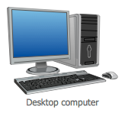
Diagrammatically
81.14.234.7
68.39.12.45

Slide 72
Notes:
The typical home router, however, serves multiple functions, often combining a router, a switch, and other features like a firewall (for protecting your network from intruders), a DHCP server, and much more into a single box.

Slide 73
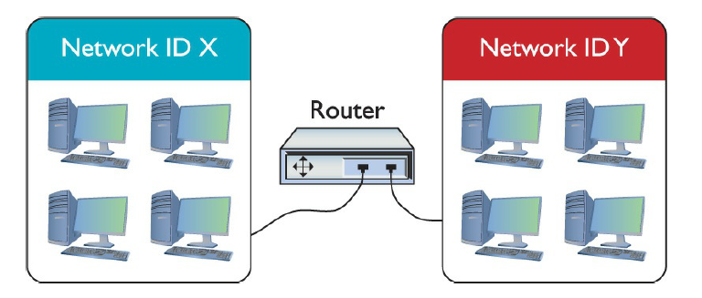
Commercial Router vs Home Router
Notes:
So, we see that with the home router, we are very limited in what we can do. Note that both boxes connect two networks. The big difference is that one side of the Linksys home router connects directly to a built-in switch. That’s convenient! You don’t have to buy a separate switch to connect multiple computers to the home router.
All routers - big and small, plain or bundled with a switch - examine packets and then send the packets to the proper destination.

Slide 74
End Systems and Intermediate Systems
All IP hosts are capable of functioning as routers
Workstations and server typically only have one network interface adapter connected to one network
Hosts with no capacity to forward packets to other IP networks are referred to as end systems.
Router s that interconnect IP networks and can perform the packet forwarding process are known as Intermediate systems
Notes:
All IP hosts are capable of functioning as routers.

Slide 75
Routing tables
Network address
Netmask
Gateway
Interface
Metric

Slide 76
Local route entries

Slide 77
The route command
Command | Description
route PRINT | Prints the current routing table.
route[-p] ADD destination MASK netmaskgateway | Adds a route to the specified destination and netmask, using the specified gateway. If the -p switch is used, the route is persistent even after rebooting. Otherwise, it is not preserved when the system restarts
route CHANGE destination MASK netmaskgateway | Changes an existing route to the specified destination and netmask,
route DELETE destination | Removes a route to the specified destination.
route -f | Clears all gateway entries to the routing table.

Slide 78
Remote routes
Broadly speaking, routing protocols can be separated into two categories according to their scope.
Interior gateway protocols are used to communicate routing information within an autonomous system - a network or series of networks that's controlled by a single administrative identity, using a unified routing policy. These are the most important protocols for determining routes within an organization's network.
Exterior gateway protocols are used to communicate routing information between autonomous systems. These are the protocols which allow the internet to function.

Slide 79
Interior gateway protocols
Interior gateway protocols tend to have an ultimate goal of network convergence, or a state where every router on the network has communicated with the others, and all are in agreement on the best path between any two points.
Interior protocols are further categorized by what information routers share and how they communicate it. The two traditional approaches are distance vector and link state, though some hybrid protocols combine elements of both.

Slide 80
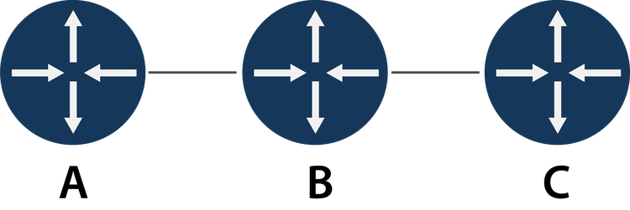
Distance vector routing protocols
In a distance vector routing protocol, routers exchange information in the form of vectors (arrays) of distance and direction to a given destination. Routers only exchange information with their immediate neighbors. By comparing information from different neighbors with its own local knowledge, the router can apply an algorithm to determine the best route from its own location.

Slide 81
Link state protocols
Link state protocols don't rely on timed advertisements. Instead, they communicate when they join the network, and monitor for topology changes.
To reduce traffic, they also don't share their full routing information every time, but only when the network state changes. This means routers send two types of messages.
Hello packets just contain a router's identity and location.
Link state advertisements (LSAs) contain routing information.

Slide 82
Exterior gateway protocols
Exterior gateway protocols have a wholly different set of concerns. They don't worry as much about end to end mapping of the entire network, but instead focus on finding routes between autonomous systems.
Border Gateway Protocol (BGP)

Slide 83
Autonomous systems
An AS can be classified into one of three categories, depending on how it connects to other networks and what kind of traffic it carries
A transit AS connects to multiple other networks and serves as an open conduit for traffic between them
Typically, a transit AS is an ISP or something similar
A multi-homed AS connects to multiple other networks, but doesn't carry external traffic; it just uses multiple connections for redundancy or load balancing
A stub AS only connects to one other AS, so to other networks it will appear to be just part of that "upstream" AS
Notes:
An AS can be classified into one of three categories, depending on how it connects to other networks and what kind of traffic it carries.
A transit AS connects to multiple other networks and serves as an open conduit for traffic between them. Typically, a transit AS is an ISP or something similar.
A multihomed AS connects to multiple other networks, but doesn't carry external traffic; it just uses multiple connections for redundancy or load balancing.
A stub AS only connects to one other AS, so to other networks it will appear to be just part of that "upstream" AS.

Slide 84
Multi-homing
The brute force method
Set your primary connection as the default route, and manually change it whenever there's an outage.
Use a first hop redundancy protocol (FHRP) to provide high availability

Slide 85
Multi-protocol routing
The first is what the router should do when it encounters two conflicting routes to a destination via two different protocols
The second problem is that if a router is using two protocols, that probably means it's connected on one interface to routers only using one protocol, and on another interface to routers only using the other
Route redistribution can be pretty complicated, since every protocol has its own set of metrics which might not be very compatible, its own way of communicating between routers, its own convergence rate, and so on. Successfully redistributing routes takes knowledge of the specific network, and careful configuration

Slide 86
Address translation

Slide 87
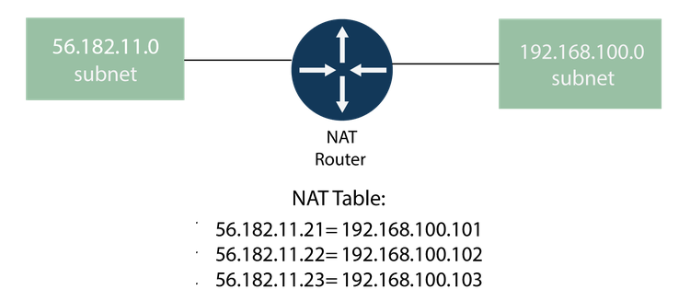
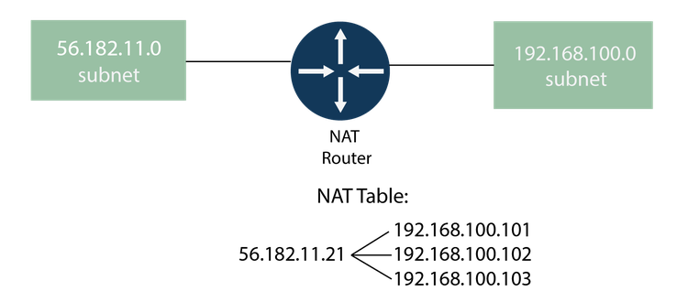
NAT methods
One-to-one
One-to-many

Slide 88
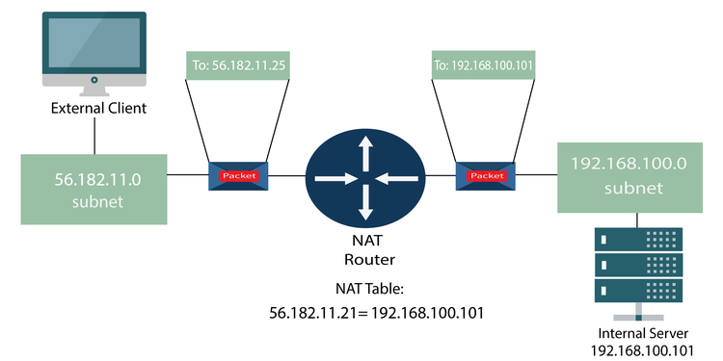
NAT methods (Cont.)
Source network address translation (SNAT)
Destination network address translation (DNAT)

Slide 89
PAT

Slide 90
NAT and IPv6
NAT64
NAT66
NPTv6

Slide 91
Exercise: NAT configuration

Slide 92
Assessment: Routing
Your company's network is too big to use static routing, but the topology is simple and doesn't change very often. What routing protocol would be the easiest to use while still meeting your needs? Choose the best response.
BGP
IS-IS
OSPF
RIP
D

Slide 93
Assessment: Routing
Your company network is a multihomed AS. What protocol would your gateway routers need to learn Internet paths? Choose the best response.
BGP
IS-IS
OSPF
RIP
A

Slide 94
Assessment: Routing
Even with modern routing protocols, you still might want to set static route entries. True or false?
True
False
True

Slide 95
Assessment: Routing
What might a router using PAT change on packets passing through? Choose all that apply.
Destination port for incoming packets
Destination port for outgoing packets
Destination address for incoming packets
Source address for incoming packets
Source port for incoming packets
Source port for outgoing packets
A, C, and F

Slide 96
Summary: Internetworking
You should now know how to:
Why switching loops can destroy network function, and how switching protocols optimize L2 performance while preventing loops.
How routers govern network traffic by learning and communicating optimal routes through the network, the relative benefits of different common routing protocols, and how network translation can connect two networks with different addressing schemes.

Slide 97
Internet Protocol
A set of rules governing the format of data sent over the Internet or other network
The Internet Protocol is the principal communications protocol in the Internet protocol suite for relaying datagrams across network boundaries
Its routing function enables internetworking, and essentially establishes the Internet

Slide 98
IPv4
Is a Network Layer Protocol
Provides logical host and network addressing, and routing
Provides a best effort delivery
Packet might be delivered out of sequence, lost entirely, duplicated, or delayed
Notes:
Internet Protocol version 4 (IPv4) is the fourth version of the Internet Protocol (IP). It is one of the core protocols of standards-based internetworking methods in the Internet and other packet-switched networks. IPv4 was the first version deployed for production in the ARPANET in 1983

Slide 99
IPv4 Address
The IP address is a unique identifier for each device on a network
IP provides
Specification of the exact format of all data
Performs routing functions
Includes a set of rules

Slide 100
IPv4 Address
A 32 bit numeric address divided into 4 parts
Each 8-bit block is known as an octet
Has a denary range of 0 to 255
IPv4 produces 4 billion unique addresses (4 x 10⁹)
Example: 192.168.1.5

Slide 101
IPv4 Address Conversion
.
.
.
8 Bits
8 Bits
8 Bits
8 Bits
When all bits are set to the value of 1 we get the sum of 255
.
.
.
11111111
1111111
1111111
11111111
2⁷ + 2⁶ + 2⁵ + 2⁴ + 2³ + 2² + 2¹ + 2⁰
128 + 64 + 32 + 16 + 8 + 4 + 2 + 1
=
255
Notes:
We have a representation of the format of IPv4
When all bits are set to the value of 1 we get the sum of 255

Slide 102
IPv4 Example
.
.
.
192
168
24
15
.
.
.
11000000
10101000
00011000
00001111
2⁷ + 2⁶ + 0 + 0 + 0 + 0 + 0 + 0
128 + 64
=
192

Slide 103
IPv4 Example
.
.
.
192
168
24
15
.
.
.
11000000
10101000
00011000
00001111
2⁷ + 0 + 2⁵ + 0 + 2³ + 0 + 0 + 0
128 + 32 + 8
=
168

Slide 104
IPv4 Example
.
.
.
192
168
24
15
.
.
.
11000000
10101000
00011000
00001111
0 + 0 + 0 + 2⁴ + 2³ + 0 + 0 + 0
16 + 8
=
24

Slide 105
IPv4 Example
.
.
.
192
168
24
15
.
.
.
11000000
10101000
00011000
00001111
0 + 0 + 0 + 0 + 2³ + 2² + 2¹ + 2⁰
8 + 4 + 2 + 1
=
15

Slide 106
IPv4 Datagram
20 to 65535 bytes
20 bytes
Header
Data

Slide 107
IPv4 Datagram
Header
Data
VER
4 bits
HLEN
4 bits
Service Type
8 bits
Total Length
16 bits
Identification (Fragment ID)
16 bits
Flags
3 bits
Fragmentation Offset
13 bits
Time to Live
8 bits
Protocol
8 bits
Header Checksum
16 bits
Source IP Address
Destination IP Address
Options
Notes:
The IP Version field (4 bits) contains the value 4, which in binary is “0100”
The Header Length field (4 bits) indicates how long the header is, in 32 bit “words”. The minimum value is “5” which would be 160 bits, or 20 bytes. The maximum length is 15, which would be 480 bits, or 60 bytes. If you skip that number of words from the start of the packet, that is where the data starts (this is called the “offset” to the data). This will only ever be greater than 5 if there are options before the data part (which is not common).
The Type of Service field (8 bits) is defined in RFC 2474, “Definition of the Differentiated Services Field (DS Field) in the IPv4 and IPv6 headers”, December 1998. This is used to implement a fairly simple QoS (Quality of Service). QoS involves management of bandwidth by protocol, by sender, or by recipient.
The Total Length field (16 bits) contains the total length of the packet, including the packet header, in bytes. The minimum length is 20 (20 bytes of header plus 0 bytes of data), and the maximum is 65,535 bytes (since only 16 bits are available to specify this). All network systems must handle packets of at least 576 bytes, but a more typical packet size is 1508 bytes. With IPv4, it is possible for some devices (like routers) to fragment packets (break them apart into multiple smaller packets) if required to get them through a part of the network that can’t handle packets that big. Packets that are fragmented must be reassembled at the other end. Fragmentation and reassembly is one of the messy parts of IPv4 that got cleaned up a lot in IPv6.
The Identification (Fragment ID) field (16 bits) identifies which fragment of a once larger packet this one is, to help in reassembling the fragmented packet later.
The next three bits are flags related to fragmentation. The first is reserved and must be zero. The next bit is the DF (Don’t Fragment) flag. If DF is set, the packet cannot be fragmented (so if such a packet reaches a part of the network that can’t handle one that big, that packet is dropped). The third bit is the MF (More Fragments) flag. If MF is set, there are more fragments to come. Unfragmented packets of course have the MF flag set to zero.
The Fragment Offset field (13 bits) is used in reassembly of fragmented packets. It is measured in 8 byte blocks. The first fragment of a set has an offset of 0.
The Time To Live (TTL) field (8 bits) is to prevent packets from being shuttled around indefinitely on a network.
The Protocol field (8 bits) defines the type of data found in the data portion of the packet. Protocol numbers are not to be confused with ports.
Some common protocol numbers are:
1 ICMP Internet Control Message Protocol (RFC 792)
6 TCP Transmission Control Protocol (RFC 793)
17 UDP User Datagram Protocol (RFC 768)
41 IPv6 IPv6 tunneled over IPv4 (RFC 2473)
83 VINES Banyan Vines IP
89 OSPF Open Shortest Path First (RFC 1583)
132 SCTP Streams Control Transmission Protocol
The Header Checksum field (16 bits). The 16-bit one’s complement of the one’s complement sum of all 16 bit words in the header.
The Source Address field (32 bits) contains the IPv4 address of the sender (may be modified by NAT).
The Destination Address field (32 bits) contains the IPv4 address of the recipient (may be modified by NAT in a reply packet).
Options (0 to 40 bytes) Not often used. Rarely if ever seen “in the wild”. These are not relevant here. If you want the details, read the RFCs.

Slide 108
IPv4 Limitations
Limited number of IP addresses (4 billion)
No provision for authentication
Security issues
No provision for routing
Does not work well with large networks
Notes:
4 billion addresses, but more than 7 billion people with multiple devices

Slide 109
Common Internet protocols
TCP/IP (Transmission Control Protocol/Internet Protocol) is a stream protocol.
Any data transmitted between these two endpoints is guaranteed to arrive, thus it is a so-called lossless protocol.
It is also called a peer-to-peer protocol.
HTTP (HyperText Transfer Protocol) is the protocol used to transmit all data present on the World Wide Web.
It is the protocol used to transmit HTML, the language that makes all the fancy decorations in your browser. It works upon TCP/IP.
FTP (File Transfer Protocol) is the protocol used to transmit files between computers connected to each other by a TCP/IP network, such as the Internet
TCP/IP
HTTP
FTP
UDP (User Datagram Protocol) is one of the core members of the Internet protocol suite.
UDP uses a simple connectionless communication model with a minimum of protocol mechanisms.
UDP
Notes:
TCP/IP (Transmission Control Protocol/Internet Protocol) is a stream protocol. This means that a connection is negotiated between a client and a server. Any data transmitted between these two endpoints is guaranteed to arrive, thus it is a so-called lossless protocol. Since the TCP protocol (as it is also referred to in short form) can only connect two endpoints, it is also called a peer-to-peer protocol.
HTTP (HyperText Transfer Protocol) is the protocol used to transmit all data present on the World Wide Web. This includes text, multimedia and graphics. It is the protocol used to transmit HTML, the language that makes all the fancy decorations in your browser. It works upon TCP/IP.
FTP (File Transfer Protocol) is the protocol used to transmit files between computers connected to each other by a TCP/IP network, such as the Internet
UDP (User Datagram Protocol) is one of the core members of the Internet protocol suite. UDP uses a simple connectionless communication model with a minimum of protocol mechanisms

Slide 110
The TCP/IP Protocol Suite
A protocol suite is a collection of protocols that are designed to work together
Application
SMTP, FTP, HTTP, POP3, IMAP4, SNMP
Presentation
Application
Session
Transport
Transport
TCP &UDP
Networking
Networking
IP
Datalink
Datalink and Physical
Physical
Ethernet
OSI
TCP/IP
Protocols
Notes:
Note: The OSI model is an idealised networking model, whereas the TCP/IP model is a practical implementation.
What is important to understand is that the interfaces between the interfaces are well defined so that it is theoretically possible to replace a particular protocol with another one that operates at that level.
For example you should theoretically be able to replace the IP networking protocol with the IPX networking protocol without affecting how the application e.g. POP3 works.
Although this doesn’t always apply the application protocols like SMTP ,POP3 etc will work Okay across different data link protocols like Ethernet,Token ring etc.

Slide 111
Internetworking
Internetworking is the process or technique of connecting different types of networks by using intermediary devices such as routers or gateway devices in order to exchange packets
Internetworking ensures data communication among networks owned and operated by different entities using a common data communication and the Internet Routing Protocol
An internetworking device is a widely-used term for any hardware within networks that connect different network resources
Key devices that comprise a network are routers, bridges, repeaters and gateways

Slide 112
IPv4 Addressing
IP addresses are 32-bit binary values: for readability purposes they're usually written as four octets in dotted decimal location
It's not just a serial number though: each address has two parts
The network ID identifies a unique subnet on the wider network, while the host ID identifies a specific host on that subnet.
192.168.
133.178
Network ID
Host ID
Notes:
IP addresses are 32-bit binary values: for readability purposes they're usually written as four octets in dotted decimal location. It's not just a serial number though: each address has two parts
The network ID identifies a unique subnet on the wider network, while the host ID identifies a specific host on that subnet.

Slide 113
IPv4 addresses (Cont.)

Slide 114
Classful and classless addressing
Class | First octet | First bits | # of subnets | # of hosts | Subnet mask | Mask prefix
A | 0.-127. | 0 | 128 | 16,777,216 | 255.0.0.0 | /8
B | 128.-191. | 10 | 16,384 | 65,536 | 255.255.0.0 | /16
C | 192.-223. | 110 | 2,097,152 | 256 | 255.255.255.0 | /24
D | 224.-239. | 1110 | * | * | * | *
E | 240.-254. | 1111 | * | * | * | *
Classless interdomain routing (CIDR)

Slide 115
Problems with class-based IP addressing
The old method of IP addressing came with inefficiencies that exhausted the availability of IPv4 addresses faster than it needed to
The classful routing system included classes A, B, and C:
Class A - Over 16 million host identifiers
Class B - 65,535 host identifiers
Class C - 254 host identifiers
Notes:
The problem would commonly occur when an organization required more than 254 host machines and therefore would no longer fall into class C but rather class B.
This means that the organization would use a class B license even though they had far less than 65,535 hosts.
Therefore if an organization only required 2,500 hosts, they would be wasting about 63,000 hosts by holding a class B license which would greatly decrease the availability of IPv4 addresses unnecessarily.

Slide 116
Classless interdomain routing (CIDR)
An IP addressing scheme that improves the allocation of IP addresses
It replaces the old system based on classes A, B, and C
This scheme also helped greatly extend the life of IPv4 as well as slow the growth of routing tables
Notes:
How does CIDR work?
CIDR is based on variable-length subnet masking (VLSM). This allows it to define prefixes of arbitrary lengths making it much more efficient than the old system. CIDR IP addresses are composed of two sets of numbers. The network address is written as a prefix, like you would see a normal IP address (e.g. 192.255.255.255). The second part is the suffix which indicates how many bits are in the entire address (e.g. /12). Putting it together, a CIDR IP address would look like the following:
192.255.255.255/12

Slide 117
Map of Regional Internet Registries

Slide 118
Variable-length subnet masking
The simplest way to subnet is to use fixed length subnet masking (FLSM), which divides a network into multiple subnets with the same mask prefix number.
The alternative is variable length subnet masking (VLSM), which allows you to subnet a network in multiple "passes", breaking it into subnets of variable size and thus variable subnet length.

Slide 119
Special IPv4 addresses
0.0.0.0 is a non-routable address which can either mean the current network, the default route, any address at all, or a specific error condition, depending on context.
255.255.255.255 is the broadcast address to the currently configured subnet.
The entire Class A network 127.0.0.0 is reserved for loopback addresses, which as the name implies simply point right back to the local host.

Slide 120
Special IPv4 addresses
Three private network ranges are defined for internal LANs.
10.0.0.0/8, or the single Class A network with addresses 10.0.0.0 - 10.255.255.255
172.16.0.0/12, or the 16 contiguous Class B networks with addresses 172.16.0.0 - 172.31.255.255.
192.168.0.0/16, or the 256 contiguous Class C networks with addresses 192.168.0.0 - 192.168.255.255.
The 169.254.0.0/16 network is reserved for link-local or automatic Private IP addressing (APIPA) addresses.

Slide 121
IPv4 subnetting
The main things to remember are that every IPv4 address is split into network ID and host ID, that each part consists of a contiguous series of bits in the binary address, and that both together are 32-bits
When you subnet an address, that means you borrow bits from the host ID portion, meaning fewer possible hosts, in exchange for making more subnets.

Slide 122
Understanding & Troubleshooting Networking
Intro
Monday
01
02
Wednesday
03
04
Tuesday
05
06
Thursday
Friday

Slide 123
IPv6 Addressing
Internet Protocol v6 - 128-bit address
340,282,366,920,938,463,463,374,607,431,768,211,456 addresses (340 undecillion)
6.8 billion people could have 5,000,000,000,000,000,000,000,000,000 addresses each

Slide 124
IPv6 Address Compression
Your DNS will become very important!
Groups of zeros can be abbreviated with a double colon ::
Only one of these abbreviations allowed per address
Leading zeros are optional

Slide 125
IPv6
IPv6 uses a 128-bit address: this allows 2¹²⁸ addresses
It allows easier network configuration, more efficient routing and data flow, and even improved security
The primary drawback is that it's a much different protocol from IPv4 and isn't backwards-compatible

Slide 126
IPv6 addresses
Instead of dotted decimal, they're written as 32 hexadecimal digits, broken into eight groups of four separated by colons
fe80:0000:0000:0000:c249:3765:00c0:9b22

Slide 127
Ipv6 Rules
Leading zeros in a group don't need to be displayed, so :00c0: can be displayed as :c0: instead.
A group consisting entirely of zeros can be displayed as :0:
Once per address, multiple consecutive groups of zeros can be replaced with a double-colon.
This means :0000:0000:0000: can be written as :: instead.
Using this method, the same address could be written as follows:
fe80::c249:3765:c0:9b22

Slide 128
IPv6 Addresses (Cont.)
In a typical IPv6 address, the first 64 bits is the network prefix, while the last 64 bits is the device identifier
Network
Node
Global Routing Prefix
Subnet ID
Device Identifier
fe80 : d18 : 0000
: 12c0 :
5d18 : cffd : 0000 : fef3
16 bits
=
2 bytes
=
2 octets
128 bits = 16 bytes
Notes:
In a typical IPv6 address, the first 64 bits is the network prefix, while the last 64 bits is the device identifier.
This can be divided into:
a global routing prefix
A subnet ID
And a device identifier

Slide 129
IPv6 Address Types & Scope
Global Unicast Address
Unique Local
Link Local
Three
types
Scope Internet
Routed on Internet
Scope Internal
Network or VPN internally routable, but NOT routed on Internet
Scope network link
Not Routed internally or externally
Notes:
IPv6 addresses have three types:
Global Unicast Address –Scope Internet- routed on Internet
Unique Local — Scope Internal Network or VPN internally routable, but Not routed on Internet
Link Local – Scope network link- Not Routed internally or externally.

Slide 130
IPv6 Addressing - Global and Public Addresses
Global addresses are routable on the internet and start with 2001
These addresses are known as global Unicast addresses and are the equivalent of the public addresses of IPv4 networks
The Internet authorities allocate address blocks to ISPs who in turn allocate them to their customers
Notes:
Global and Public Addresses
Global addresses are routable on the internet and start with 2001:
These addresses are known as global Unicast addresses and are the equivalent of the public addresses of IPv4 networks.
The Internet authorities allocate address blocks to ISPs who in turn allocate them to their customers.

Slide 131
IPv6 Addresses - Internal Addresses
Start with fe80
Restricted to a link and are not routed on the Internal network or the Internet
Link Local addresses are self assigned i.e. they do not require a DHCP server
A link local address is required on every IP6 interface even if no routing is present
Meant to be used inside an internal network
They are routed on the Internal network but not routed on the Internet
The address space is divided into two /8 spaces: fc00::/8 for globally assigned addressing, and fd00::/8 for locally assigned addressing
For manually assignment by an organisation use the fd00 prefix
Two Internal Address Types
Link Local
Unique Local
Notes:
Internal Addresses- Link Local and Unique Local
In IPv4 internal addresses use the reserved number ranges 10.0.0.0/8, 172.16.0.0/12 and 192.168.0.0/16 and 169.254.0.0/16.
These addresses are not routed on the Internet and are reserved for internal networks.
IPv6 also has two Internal address types.
Link Local
Start with fe80
Restricted to a link and are not routed on the Internal network or the Internet
Link Local addresses are self assigned i.e. they do not require a DHCP server.
A link local address is required on every IP6 interface even if no routing is present
Unique Local
Meant to be used inside an internal network
They are routed on the Internal network but not routed on the Internet
They are equivalent to the IPv4 addresses are 10.0.0.0/8, 172.16.0.0/12 and 192.168.0.0/16
The address space is divided into two /8 spaces: fc00::/8 for globally assigned addressing, and fd00::/8 for locally assigned addressing
For manually assignment by an organisation use the fd00 prefix.

Slide 132
Using IPv6 Addresses in URLs
On IPv4 networks you can access a network resource e.g. a web page using the format http://192.168.1.21/webpage
URL’s don’t recognise colons
IPv6 addresses contain a colon as separator and so must be enclosed in square brackets
http://[IPv6 address]/webpage

Slide 133
IPv6 Loop Back
The IPv6 loopback address is ::1. You can ping it as follows:
ping ::1
Ping ::1 -6
Force IPv6

Slide 134
IPv6 migration
In dual stack operation, a host or router simply runs IPv4 along with IPv6, using the newer protocol when it can and the older when it must.
IPv4
IPv6
IPv4
IPv6
IPv4
IPv6
IPv4
Only
6
6
4
6
4
4
IPv4
IPv6
IPv4
Only
Router
IPv4 & IPv6

Slide 135
IPv6 migration (Cont.)
Translation uses gateway protocols like NAT64 to connect an IPv6 network to an IPv4 network, much like conventional NAT.
IPv6
IPv6
IPv6
IPv6
6
IPv4
WAN
6
6
>
4
IPv6
Router
NAT64
Notes:
NAT64 is an IPv6 transition mechanism that facilitates communication between IPv6 and IPv4 hosts by using a form of network address translation (NAT). The NAT64 gateway is a translator between IPv4 and IPv6 protocols,[1] for which function it needs at least one IPv4 address and an IPv6 network segment comprising a 32-bit address space. The "well-known prefix" reserved for this service is 64:ff9b::/96.
An IPv6 client embeds the IPv4 address it wishes to communicate with using the host part of the IPv6 network segment, resulting in an IPv4-embedded IPv6 addresses (hence the 32-bit address space in the IPv6 network segment), and sends packets to the resulting address. The NAT64 gateway creates a mapping between the IPv6 and the IPv4 addresses, which may be manually configured or determined automatically

Slide 136
IPv6 migration (Cont.)
Tunneling allows two IPv6 networks to communicate over an IPv4 network by means of tunnel brokers, devices which encapsulate IPv6 packets into IPv4 packets.
IPv6
IPv6
IPv6
IPv6
6
6
4
6
6
IPv6
IPv6
IPv6
IPv6
Tunnel
Broker
IPv4
WAN
Tunnel
Broker
Notes:
A tunnel broker is a service which provides a network tunnel. These tunnels can provide encapsulated connectivity over existing infrastructure to another infrastructure.
There are a variety of tunnel brokers, including IPv4 tunnel brokers, though most commonly the term is used to refer to an IPv6 tunnel broker as defined in RFC:3053.

Slide 137
1.3 Explain the concepts and characteristics of routing and switching
Performance concepts
Traffic shaping
QoS
Diffserv
CoS
NAT/PAT
Port forwarding
Access control list
Distributed switching
Packet-switched vs. circuit-switched network
Software-defined networking

Slide 138
Performance concepts - QoS
Quality of Service (QoS) describes the strategies used to manage and increase the flow of network traffic
QoS features enable administrators to predict bandwidth use, monitor that use, and control it to ensure that bandwidth is available to the applications that need it
These applications generally can be broken into two categories:
Latency sensitive: These applications need bandwidth for quick delivery where network lag time impacts their effectiveness. This includes voice and video transfer. For example, Voice over IP (VoIP) would be difficult to use if there were a significant lag time in the conversation
Latency insensitive: Controlling bandwidth also involves managing latency-insensitive applications. This includes bulk data transfers such as huge backup procedures and File Transfer Protocol (FTP) transfers

Slide 139
Quality of Service
QoS achieves more efficient use of network resources by differentiating between latency-insensitive traffic such as fax data and latency-sensitive streaming media
Two important components of QoS are DSCP and CoS

Slide 140
Performance concepts: DiffServ
Differentiated services code point (also known as Diffserv) is an architecture that specifies a simple and coarse-grained mechanism for classifying and managing network traffic and providing QoS on modern networks

Slide 141
Performance concepts: CoS
Class of service (CoS) is a parameter that is used in data and voice to differentiate the types of payloads being transmitted

Slide 142
Performance concepts: Traffic Shaping
A packet shaper essentially performs two key functions: monitoring and shaping
Monitoring includes identifying where usage is high and the time of day
Administrators can then customise or shape bandwidth usage for the best needs of the network

Slide 143
Performance concepts: Traffic Shaping
Ensure adequate bandwidth is available for mission-critical applications while few resources are dedicated to spam or peer-to-peer downloads
Need to monitor network traffic to ensure that data flows as you need it to
Describes the mechanisms used to control bandwidth usage on the network
Administrators can control who uses bandwidth, for what purpose, and what time of day bandwidth can be used
Establishes priorities for data traveling to and from the Internet and within the network

Slide 144
Address translation

Slide 145
NAT methods
One-to-one
One-to-many

Slide 146
NAT methods (Cont.)
Source network address translation (SNAT)
Destination network address translation (DNAT)

Slide 147
PAT

Slide 148
1.4 Given a scenario, configure the appropriate IP addressing components
Private vs. public
Loopback and reserved
Default gateway
Virtual IP
Subnet mask
Subnetting
Classful
Classes A, B, C, D, and E
Classless
VLSM
CIDR notation (IPv4 vs. IPv6)
Address assignments
DHCP
DHCPv6
Static
APIPA
EUI64
IP reservations

Slide 149
Internet Protocol
A set of rules governing the format of data sent over the Internet or other network
The Internet Protocol is the principal communications protocol in the Internet protocol suite for relaying datagrams across network boundaries
Its routing function enables internetworking, and essentially establishes the Internet

Slide 150
IPv4
Is a Network Layer Protocol
Provides logical host and network addressing, and routing
Provides a best effort delivery
Packet might be delivered out of sequence, lost entirely, duplicated, or delayed
Notes:
Internet Protocol version 4 (IPv4) is the fourth version of the Internet Protocol (IP). It is one of the core protocols of standards-based internetworking methods in the Internet and other packet-switched networks. IPv4 was the first version deployed for production in the ARPANET in 1983

Slide 151
IPv4 Address
The IP address is a unique identifier for each device on a network
IP provides
Specification of the exact format of all data
Performs routing functions
Includes a set of rules

Slide 152
IPv4 Address
A 32 bit numeric address divided into 4 parts
Each 8-bit block is known as an octet
Has a denary range of 0 to 255
IPv4 produces 4 billion unique addresses (4 x 10⁹)
Example: 192.168.1.5

Slide 153
IPv4 Address Conversion
.
.
.
8 Bits
8 Bits
8 Bits
8 Bits
When all bits are set to the value of 1 we get the sum of 255
.
.
.
11111111
1111111
1111111
11111111
2⁷ + 2⁶ + 2⁵ + 2⁴ + 2³ + 2² + 2¹ + 2⁰
128 + 64 + 32 + 16 + 8 + 4 + 2 + 1
=
255
Notes:
We have a representation of the format of IPv4
When all bits are set to the value of 1 we get the sum of 255

Slide 154
IPv4 Example
.
.
.
192
168
24
15
.
.
.
11000000
10101000
00011000
00001111
2⁷ + 2⁶ + 0 + 0 + 0 + 0 + 0 + 0
128 + 64
=
192

Slide 155
IPv4 Example
.
.
.
192
168
24
15
.
.
.
11000000
10101000
00011000
00001111
2⁷ + 0 + 2⁵ + 0 + 2³ + 0 + 0 + 0
128 + 32 + 8
=
168

Slide 156
IPv4 Example
.
.
.
192
168
24
15
.
.
.
11000000
10101000
00011000
00001111
0 + 0 + 0 + 2⁴ + 2³ + 0 + 0 + 0
16 + 8
=
24

Slide 157
IPv4 Example
.
.
.
192
168
24
15
.
.
.
11000000
10101000
00011000
00001111
0 + 0 + 0 + 0 + 2³ + 2² + 2¹ + 2⁰
8 + 4 + 2 + 1
=
15

Slide 158
IPv4 Datagram
20 to 65535 bytes
20 bytes
Header
Data

Slide 159
IPv4 Datagram
Header
Data
VER
4 bits
HLEN
4 bits
Service Type
8 bits
Total Length
16 bits
Identification (Fragment ID)
16 bits
Flags
3 bits
Fragmentation Offset
13 bits
Time to Live
8 bits
Protocol
8 bits
Header Checksum
16 bits
Source IP Address
Destination IP Address
Options
Notes:
The IP Version field (4 bits) contains the value 4, which in binary is “0100”
The Header Length field (4 bits) indicates how long the header is, in 32 bit “words”. The minimum value is “5” which would be 160 bits, or 20 bytes. The maximum length is 15, which would be 480 bits, or 60 bytes. If you skip that number of words from the start of the packet, that is where the data starts (this is called the “offset” to the data). This will only ever be greater than 5 if there are options before the data part (which is not common).
The Type of Service field (8 bits) is defined in RFC 2474, “Definition of the Differentiated Services Field (DS Field) in the IPv4 and IPv6 headers”, December 1998. This is used to implement a fairly simple QoS (Quality of Service). QoS involves management of bandwidth by protocol, by sender, or by recipient.
The Total Length field (16 bits) contains the total length of the packet, including the packet header, in bytes. The minimum length is 20 (20 bytes of header plus 0 bytes of data), and the maximum is 65,535 bytes (since only 16 bits are available to specify this). All network systems must handle packets of at least 576 bytes, but a more typical packet size is 1508 bytes. With IPv4, it is possible for some devices (like routers) to fragment packets (break them apart into multiple smaller packets) if required to get them through a part of the network that can’t handle packets that big. Packets that are fragmented must be reassembled at the other end. Fragmentation and reassembly is one of the messy parts of IPv4 that got cleaned up a lot in IPv6.
The Identification (Fragment ID) field (16 bits) identifies which fragment of a once larger packet this one is, to help in reassembling the fragmented packet later.
The next three bits are flags related to fragmentation. The first is reserved and must be zero. The next bit is the DF (Don’t Fragment) flag. If DF is set, the packet cannot be fragmented (so if such a packet reaches a part of the network that can’t handle one that big, that packet is dropped). The third bit is the MF (More Fragments) flag. If MF is set, there are more fragments to come. Unfragmented packets of course have the MF flag set to zero.
The Fragment Offset field (13 bits) is used in reassembly of fragmented packets. It is measured in 8 byte blocks. The first fragment of a set has an offset of 0.
The Time To Live (TTL) field (8 bits) is to prevent packets from being shuttled around indefinitely on a network.
The Protocol field (8 bits) defines the type of data found in the data portion of the packet. Protocol numbers are not to be confused with ports.
Some common protocol numbers are:
1 ICMP Internet Control Message Protocol (RFC 792)
6 TCP Transmission Control Protocol (RFC 793)
17 UDP User Datagram Protocol (RFC 768)
41 IPv6 IPv6 tunneled over IPv4 (RFC 2473)
83 VINES Banyan Vines IP
89 OSPF Open Shortest Path First (RFC 1583)
132 SCTP Streams Control Transmission Protocol
The Header Checksum field (16 bits). The 16-bit one’s complement of the one’s complement sum of all 16 bit words in the header.
The Source Address field (32 bits) contains the IPv4 address of the sender (may be modified by NAT).
The Destination Address field (32 bits) contains the IPv4 address of the recipient (may be modified by NAT in a reply packet).
Options (0 to 40 bytes) Not often used. Rarely if ever seen “in the wild”. These are not relevant here. If you want the details, read the RFCs.

Slide 160
IPv4 Limitations
Limited number of IP addresses (4 billion)
No provision for authentication
Security issues
No provision for routing
Does not work well with large networks
Notes:
4 billion addresses, but more than 7 billion people with multiple devices

Slide 161
Common Internet protocols
TCP/IP (Transmission Control Protocol/Internet Protocol) is a stream protocol.
Any data transmitted between these two endpoints is guaranteed to arrive, thus it is a so-called lossless protocol.
It is also called a peer-to-peer protocol.
HTTP (HyperText Transfer Protocol) is the protocol used to transmit all data present on the World Wide Web.
It is the protocol used to transmit HTML, the language that makes all the fancy decorations in your browser. It works upon TCP/IP.
FTP (File Transfer Protocol) is the protocol used to transmit files between computers connected to each other by a TCP/IP network, such as the Internet
TCP/IP
HTTP
FTP
UDP (User Datagram Protocol) is one of the core members of the Internet protocol suite.
UDP uses a simple connectionless communication model with a minimum of protocol mechanisms.
UDP
Notes:
TCP/IP (Transmission Control Protocol/Internet Protocol) is a stream protocol. This means that a connection is negotiated between a client and a server. Any data transmitted between these two endpoints is guaranteed to arrive, thus it is a so-called lossless protocol. Since the TCP protocol (as it is also referred to in short form) can only connect two endpoints, it is also called a peer-to-peer protocol.
HTTP (HyperText Transfer Protocol) is the protocol used to transmit all data present on the World Wide Web. This includes text, multimedia and graphics. It is the protocol used to transmit HTML, the language that makes all the fancy decorations in your browser. It works upon TCP/IP.
FTP (File Transfer Protocol) is the protocol used to transmit files between computers connected to each other by a TCP/IP network, such as the Internet
UDP (User Datagram Protocol) is one of the core members of the Internet protocol suite. UDP uses a simple connectionless communication model with a minimum of protocol mechanisms

Slide 162
The TCP/IP Protocol Suite
A protocol suite is a collection of protocols that are designed to work together
Application
SMTP, FTP, HTTP, POP3, IMAP4, SNMP
Presentation
Application
Session
Transport
Transport
TCP &UDP
Networking
Networking
IP
Datalink
Datalink and Physical
Physical
Ethernet
OSI
TCP/IP
Protocols
Notes:
Note: The OSI model is an idealised networking model, whereas the TCP/IP model is a practical implementation.
What is important to understand is that the interfaces between the interfaces are well defined so that it is theoretically possible to replace a particular protocol with another one that operates at that level.
For example you should theoretically be able to replace the IP networking protocol with the IPX networking protocol without affecting how the application e.g. POP3 works.
Although this doesn’t always apply the application protocols like SMTP ,POP3 etc will work Okay across different data link protocols like Ethernet,Token ring etc.

Slide 163
Internetworking
Internetworking is the process or technique of connecting different types of networks by using intermediary devices such as routers or gateway devices in order to exchange packets
Internetworking ensures data communication among networks owned and operated by different entities using a common data communication and the Internet Routing Protocol
An internetworking device is a widely-used term for any hardware within networks that connect different network resources
Key devices that comprise a network are routers, bridges, repeaters and gateways

Slide 164
IPv4 Addressing
IP addresses are 32-bit binary values: for readability purposes they're usually written as four octets in dotted decimal location
It's not just a serial number though: each address has two parts
The network ID identifies a unique subnet on the wider network, while the host ID identifies a specific host on that subnet.
192.168.
133.178
Network ID
Host ID
Notes:
IP addresses are 32-bit binary values: for readability purposes they're usually written as four octets in dotted decimal location. It's not just a serial number though: each address has two parts
The network ID identifies a unique subnet on the wider network, while the host ID identifies a specific host on that subnet.

Slide 165
IPv4 addresses (Cont.)

Slide 166
Understanding & Troubleshooting Networking
Intro
Monday
01
02
Wednesday
03
04
Tuesday
05
06
Thursday
Friday

Slide 167
Classful and classless addressing
Class | First octet | First bits | # of subnets | # of hosts | Subnet mask | Mask prefix
A | 0.-127. | 0 | 128 | 16,777,216 | 255.0.0.0 | /8
B | 128.-191. | 10 | 16,384 | 65,536 | 255.255.0.0 | /16
C | 192.-223. | 110 | 2,097,152 | 256 | 255.255.255.0 | /24
D | 224.-239. | 1110 | * | * | * | *
E | 240.-254. | 1111 | * | * | * | *
Classless interdomain routing (CIDR)

Slide 168
Problems with class-based IP addressing
The old method of IP addressing came with inefficiencies that exhausted the availability of IPv4 addresses faster than it needed to
The classful routing system included classes A, B, and C:
Class A - Over 16 million host identifiers
Class B - 65,535 host identifiers
Class C - 254 host identifiers
Notes:
The problem would commonly occur when an organization required more than 254 host machines and therefore would no longer fall into class C but rather class B.
This means that the organization would use a class B license even though they had far less than 65,535 hosts.
Therefore if an organization only required 2,500 hosts, they would be wasting about 63,000 hosts by holding a class B license which would greatly decrease the availability of IPv4 addresses unnecessarily.

Slide 169
Classless interdomain routing (CIDR)
An IP addressing scheme that improves the allocation of IP addresses
It replaces the old system based on classes A, B, and C
This scheme also helped greatly extend the life of IPv4 as well as slow the growth of routing tables
Notes:
How does CIDR work?
CIDR is based on variable-length subnet masking (VLSM). This allows it to define prefixes of arbitrary lengths making it much more efficient than the old system. CIDR IP addresses are composed of two sets of numbers. The network address is written as a prefix, like you would see a normal IP address (e.g. 192.255.255.255). The second part is the suffix which indicates how many bits are in the entire address (e.g. /12). Putting it together, a CIDR IP address would look like the following:
192.255.255.255/12

Slide 170
Map of Regional Internet Registries

Slide 171
Variable-length subnet masking
The simplest way to subnet is to use fixed length subnet masking (FLSM), which divides a network into multiple subnets with the same mask prefix number.
The alternative is variable length subnet masking (VLSM), which allows you to subnet a network in multiple "passes", breaking it into subnets of variable size and thus variable subnet length.

Slide 172
Variable Length Subnets
Say we have a Network of
LAN 1 – 75 Hosts
Wan1
WAN2
LAN 2 – 50 Hosts
Mask | 128 | 192 | 224 | 240 | 248 | 252 | 254 | 255
Bits | /25 | /26 | /27 | /28 | /29 | /30 | /31 | /32
Hosts | 128 | 64 | 32 | 16 | 8 | 4 | 2 | 1
Subnets | 2 | 4 | 8 | 16 | 32 | 64 | 128 | 256
Notes:
IP Range is 192.168.1.0/24 [Write the 192.168.1.0/24 onto board on the WAN link
We need to split this into 3 subnets
The table shows what subnets we can divide the current /24 into by using the remaining bits

Slide 173
Special IPv4 addresses
0.0.0.0 is a non-routable address which can either mean the current network, the default route, any address at all, or a specific error condition, depending on context.
255.255.255.255 is the broadcast address to the currently configured subnet.
The entire Class A network 127.0.0.0 is reserved for loopback addresses, which as the name implies simply point right back to the local host.

Slide 174
Special IPv4 addresses
Three private network ranges are defined for internal LANs.
10.0.0.0/8, or the single Class A network with addresses 10.0.0.0 - 10.255.255.255
172.16.0.0/12, or the 16 contiguous Class B networks with addresses 172.16.0.0 - 172.31.255.255.
192.168.0.0/16, or the 256 contiguous Class C networks with addresses 192.168.0.0 - 192.168.255.255.
The 169.254.0.0/16 network is reserved for link-local or automatic Private IP addressing (APIPA) addresses.

Slide 175
IPv4 subnetting
The main things to remember are that every IPv4 address is split into network ID and host ID, that each part consists of a contiguous series of bits in the binary address, and that both together are 32-bits
When you subnet an address, that means you borrow bits from the host ID portion, meaning fewer possible hosts, in exchange for making more subnets.

Slide 176
IPv6 Addressing
Internet Protocol v6 - 128-bit address
340,282,366,920,938,463,463,374,607,431,768,211,456 addresses (340 undecillion)
6.8 billion people could have 5,000,000,000,000,000,000,000,000,000 addresses each

Slide 177
IPv6 Address Compression
Your DNS will become very important!
Groups of zeros can be abbreviated with a double colon ::
Only one of these abbreviations allowed per address
Leading zeros are optional

Slide 178
IPv6
IPv6 uses a 128-bit address: this allows 2¹²⁸ addresses
It allows easier network configuration, more efficient routing and data flow, and even improved security
The primary drawback is that it's a much different protocol from IPv4 and isn't backwards-compatible

Slide 179
IPv6 addresses
Instead of dotted decimal, they're written as 32 hexadecimal digits, broken into eight groups of four separated by colons
fe80:0000:0000:0000:c249:3765:00c0:9b22

Slide 180
Ipv6 Rules
Leading zeros in a group don't need to be displayed, so :00c0: can be displayed as :c0: instead.
A group consisting entirely of zeros can be displayed as :0:
Once per address, multiple consecutive groups of zeros can be replaced with a double-colon.
This means :0000:0000:0000: can be written as :: instead.
Using this method, the same address could be written as follows:
fe80::c249:3765:c0:9b22

Slide 181
IPv6 Addresses (Cont.)
In a typical IPv6 address, the first 64 bits is the network prefix, while the last 64 bits is the device identifier
Network
Node
Global Routing Prefix
Subnet ID
Device Identifier
fe80 : d18 : 0000
: 12c0 :
5d18 : cffd : 0000 : fef3
16 bits
=
2 bytes
=
2 octets
128 bits = 16 bytes
Notes:
In a typical IPv6 address, the first 64 bits is the network prefix, while the last 64 bits is the device identifier.
This can be divided into:
a global routing prefix
A subnet ID
And a device identifier

Slide 182
IPv6 Address Types & Scope
Global Unicast Address
Unique Local
Link Local
Three
types
Scope Internet
Routed on Internet
Scope Internal
Network or VPN internally routable, but NOT routed on Internet
Scope network link
Not Routed internally or externally
Notes:
IPv6 addresses have three types:
Global Unicast Address –Scope Internet- routed on Internet
Unique Local — Scope Internal Network or VPN internally routable, but Not routed on Internet
Link Local – Scope network link- Not Routed internally or externally.

Slide 183
IPv6 Addressing - Global and Public Addresses
Global addresses are routable on the internet and start with 2001
These addresses are known as global Unicast addresses and are the equivalent of the public addresses of IPv4 networks
The Internet authorities allocate address blocks to ISPs who in turn allocate them to their customers
Notes:
Global and Public Addresses
Global addresses are routable on the internet and start with 2001:
These addresses are known as global Unicast addresses and are the equivalent of the public addresses of IPv4 networks.
The Internet authorities allocate address blocks to ISPs who in turn allocate them to their customers.

Slide 184
IPV6 Task
Compression
fd00:0040:0000:c298:0000:0000:0000:c200
fd19:0b00:0100:0000:0000:0001:0000:001c
fd00:0000:0005:0700:0083:002c:8200:0000
Expansion
fd00:11:83:0:1022:8a:c4:0
fd00:9100:20::
fd10:10:0:604a::4000:0
Notes:
Compress the first IP range
Rules
[First Octect must be wrote fully}
Any octet after the start that starts with a 0 followed by a letter or number can be wrote without the zeros Example
Any contiguous 0000:0000:0000 can be wrote as :: for example FD00:0000:0000:0001 can be FD00::1
Any 0000:0000 after a :: can be wrote as FD00::ABCD:0:1
Use an example of fd00:0000:0000:0041:0000:4300:0004:0000 {answer is fd00::41:0:4300:4:0}
1st Answer = fd00:40:0:c298::c200
2nd Answer = fd19:b00:100::1:0:1c
3rd Answer = fd00:0:5:700:83:2c:8200:0
^{4th} Answer = FD00:0011:0083:0000:1022:008a:00c4:0000
^{5th} Answer = fd00:9100:0020:0000:0000:0000:0000:0000
6th Answer = fd10:0010:0000:604a:0000:0000:4000:0000

Slide 185
1.5 Compare and contrast the characteristics of network topologies, types and technologies
Wired topologies
Logical vs. physical
Star
Ring
Mesh
Bus
Wireless topologies
Mesh
Ad hoc
Infrastructure
Types
LAN
WLAN
MAN
WAN
CAN
SAN
PAN
Technologies that facilitate the Internet of Things (IoT)
Z-Wave
Ant+
Bluetooth
NFC
IR
RFID
802.11

Slide 186
Understanding & Troubleshooting Networking
Intro
Monday
01
02
Wednesday
03
04
Tuesday
05
06
Thursday
Friday

Slide 187
Topologies
A term used in the description of the schematic depiction of the arrangement of a network
It is used to describe the various ways in which nodes are connected

Slide 188
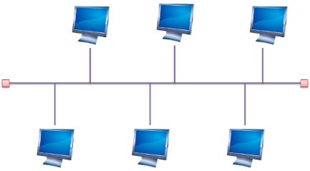
Topologies: Bus
A bus network is an arrangement in a local area network (LAN) in which each node (workstation or other device) is connected to a main cable or link called the bus
Simple and reliable
Transmission of data in only one direction
If one node fails to operate, all the rest can still communicate with each other
For a major disruption to take place, the bus itself must be broken somewhere
Bus networks are easy to expand
Additional nodes can be added anywhere along the bus

Slide 189
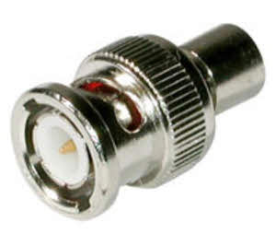
Topologies - Bus
There are several limitations to the bus network topology
The length of the bus is limited by cable loss
A bus network may not work well if the nodes are located at scattered points that do not lie near a common line
In situations like this, a ring network, mesh network, or star network may prove more flexible and more cost effective
Requires terminators
Limited to 10Mbps

Slide 190
Topologies - Bus
Advantages of the Bus Topology
The bus topology as we know it is very cost-effective
This topology system makes use of the least amount of cable, unlike the others
This is sufficient for small networks
A layperson can easily understand this system
You can also quickly expand on this network

Slide 191
Topologies - Bus
Disadvantages of the Bus Topology
Once there is a problem in one part of the cable, the whole network is down
At the advent of traffic on the network, the entire network will have a slowed-down performance
Collisions occur in the network resulting in packet loss
There is a limit to the strength of the cable
This topology is not as speed effective as the ring topology
It is difficult to isolate faults in the network

Slide 192
Topology - Bus
https://www.bbc.co.uk/bitesize/guides/z7mxh39/revision/6

Slide 193
Topologies: Star
Star topology (or ‘star network’) is the most widely used network for LANs
First popularized by ARCnet, before being adopted by Ethernet
Each node (such as a computer or printer) within the company or team is connected to one central network device (which could be a hub, a switch, or a computer) via a cable
When the nodes (or computers) want to communicate with each other, they pass the message on to the central server hub, which then forwards that message back on to the different nodes

Slide 194
Topologies: Star
Advantages of a Star topology
If one node or connection breaks, the rest of the network remains unaffected
Other computers and their connections can continue working with zero downtime
It’s highly scalable: new computers/machines can be added or removed without disturbing the whole network
Star networks can accommodate lots of different machines, which means it’s possible to create a large network
Star networks are safer in the event of a cyber attack
Notes:
Star networks are safer in the event of a cyber attack. Let’s say you run a bank with several branches. If one branch or office comes under attack, the server will be notified and prevent a second. One branch goes down, but the others continue running in complete safety

Slide 195
Topologies: Star
Disadvantages of a Star topology
Each cable is individually connected to the central node, which means you’re going to need A LOT of cables
The hub (central node) is a single point of failure, which means that if it stops, it brings the whole lot down
In reality, there are only so many machines you can connect to a central server before you start running out of cable length and ports
Notes:
Each cable is individually connected to the central node, which means you’re going to need A LOT of cables
And that doesn’t come cheap. Although it’s worth noting that the upfront cost of cables is a fraction of the cost of downtime in the event of a total system failure. Most network designers think this benefit far outweighs the cable cost.
The hub is a single point of failure, which means that if it stops, it brings the whole lot down.
In reality, there are only so many machines you can connect to a central server before you start running out of cable length and ports. One way to get around this is to extend the star topology into multiple stars with a new central server in the middle. In this situation, messages from each system are transferred to its star, which then transfers it to the core server, then back out to the star and then to the destination system.

Slide 196
Topologies: Ring
Computers are connected to each other in a circular format
Every device in the network will have two neighbours and no more or no less
Ring topologies were commonly used in the past but you would be hard pressed to find an enterprise still using them today
The first node is connected to the last node to link the loop together
As a consequence of being laid out in this format packets need to travel through all nodes on the way to their destination
Within this topology, one node is chosen to configure the network and monitor other devices
Ring topologies are half-duplex but can also be made full-duplex
To make ring topologies full-duplex you would need to have two connections between network nodes to form a Dual Ring Topology

Slide 197
Topologies: Ring
Disadvantages of a ring topology:
If any of the nodes fail, the ring is broken and data cannot be transmitted
It is difficult to troubleshoot a ring network topology
Because all nodes are wired together, the network must be temporarily stopped to add additional nodes

Slide 198
Topologies: Ring
Advantages of a ring topology:
Data passes around the network in one direction, there are no network collisions
Adding additional nodes has very little impact on bandwidth

Slide 199
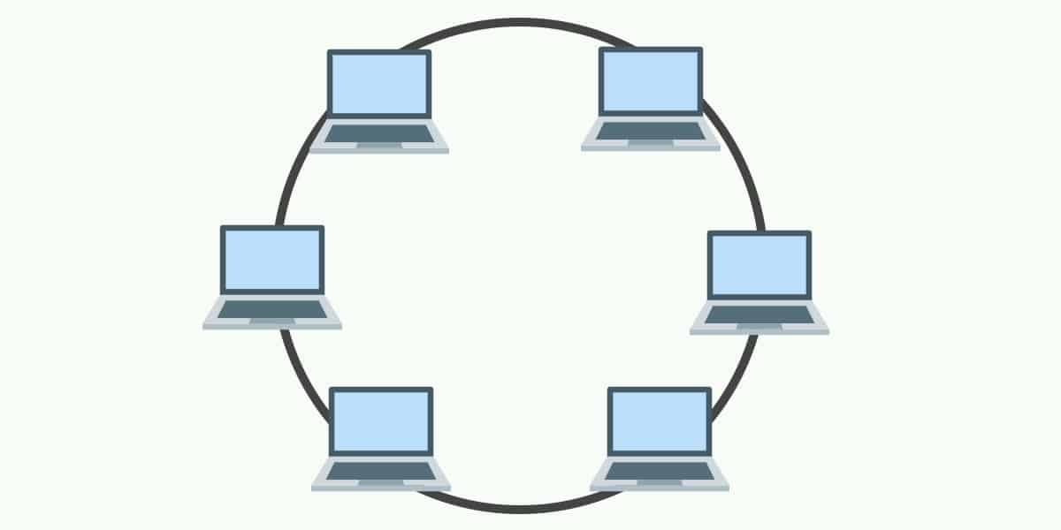
Topologies: Ring
Single – half-duplex
Dual – full-duplex

Slide 200
Topologies - Ring

Slide 201
Topologies: Mesh
Each computer and network device is interconnected with one another, allowing for most transmissions to be distributed even if one of the connections go down
It is a topology commonly used for wireless networks
Each node has a dedicated point-to-point link to every other node
A fully connected mesh network having ‘n’ number of nodes has a total of n(n-1)/2 number of links
Example: 6 nodes = (6(6-1))/2 = 15 links

Slide 202
Topologies - Mesh
Full Mesh
Every node has a circuit connecting it to every other node in the network
Yields greatest redundancy, so if one node fails, network traffic can be redirected to any of the other nodes
Usually reserved for backbone networks since it is very expensive

Slide 203
Mesh

Slide 204
Topologies - Mesh
Partial Mesh
Some nodes are organized in a full mesh scheme but others are only connected to 1 or 2 in the network
Common in peripheral networks connected to a full meshed backbone
Less expensive to implement
Yields less redundancy

Slide 205
Partial Mesh
Notes:
Nodes 1 and 2 are connected to every other node

Slide 206
Topologies: Ad Hoc or Hybrid
No pre-existing infrastructure
Devices communication amongst themselves
Can be a mixture of topologies
Multiple physical topologies are combined to form one large network
Each topology has its own strengths and weakness
Objective: total strength improves the network performance

Slide 207
Topologies: Infrastructure
All devices communicate through an access point
The most common wireless communication mode

Slide 208
Topologies: Wireless Mesh
Advantages
Scalability
Robustness
Redundancy
Notes:
. Scalability
One of the advantages of a mesh topology is that (in theory) you don’t need to add routers to the network, as each node can act as a router. If you’re working on a mesh network for the lighting in your office building, and you want to add a light in a particular room, you should be able to add the light and have it automatically connect to the network. There isn’t a lot of extra management that needs to happen, which makes the network scalable.
2. Robustness
Another benefit of a mesh network topology is that if one of the nodes goes down, it doesn’t necessarily bring the entire network down. The network can heal itself around a bad node if other nodes can complete the mesh. Additionally, if you need to get more range out of a mesh system, you can add another node and the messages can hop through the mesh back to the gateway—which is why some believe mesh networks are more robust.
Because all nodes in a mesh are receiving and translating information, there is some redundancy in a mesh topology; however, you can also gain speed with the excess bandwidth. If one route happens to be slow, a mesh network could potentially find a better route and optimize itself.

Slide 209
Topologies: Wireless Mesh
Ad hoc devices work together to form a mesh “cloud”
Self form and self heal

Slide 210
Topologies: Wireless Mesh
Disadvantages
Complexity
Network Planning
Latency
Power Consumption
Notes:
Disadvantages Of A Mesh Topology
1. Complexity
Each node needs to both send messages as well as act as a router, which causes the complexity of each node to go up pretty significantly. Let’s say you’re making a small, low-power device—like a room occupancy sensor—and you are looking to get better range out of your system. The nodes have to now keep track of messages from five or 10 of their ‘neighbors,” which exponentially increases the amount of data that node has to deal with in order to pass along a message. Thus, if you add additional sensors to the mesh just to benefit the range, you’re naturally making the system more complex.
2. Network Planning
As we mentioned previously, mesh networks are often considered highly scalable, and adding a node to the network typically isn’t very involved. But planning the network as a whole is a different story. Let’s say you have poor latency in one area of your building (which we’ll discuss below), and you need a particular light to turn on faster than it currently turns on. With a mesh network, you’d need to add a dedicated node that only forwards messages. But this complicates your network planning, because you now have to deploy a piece of equipment just to get your messages properly routed in a reasonable amount of time.
3. Latency
As mentioned, latency—the time it takes a message to get from a node to the gateway—can impact your mesh network planning. Interestingly, you may improve some latency by using a mesh network with a larger scale system with more bandwidth, memory, and power. But latency becomes an issue in smaller low power, wide-area networks (LPWANs) because it doesn’t have the processing capability to handle the messaging. Thus, if you have a WiFi mesh, messages will likely be translated much quicker than a ZigBee mesh. This is something to consider based on the protocol you’ll be using and the latency your application requires.
4. Power Consumption
Because each node in a mesh has to act as an endpoint and a router, it has to draw more power to operate. Thus, if you have battery-powered, low-power nodes, a mesh may be difficult to deploy without a lot of network planning.
Let’s say you have battery-powered nodes in windows and doors for your smart security system. The customer keeps the control panel in the basement, but all of the sensors are on the first and second floor. So while a second-floor window may be low power, because it only transmits messages, the sensors on the first floor will have to handle messages from the second floor windows and doors. In other words, you’re compounding the amount of data each node has to handle in a mesh, and so batteries on some nodes are likely to die faster.

Slide 211
Physical and Logical Topology
Physical topology defines how the systems are physically connected
Logical Topology - How devices are connected to the network through the actual cables that transmit data
The logical topology defines how the systems communicate across the physical topologies

Slide 212
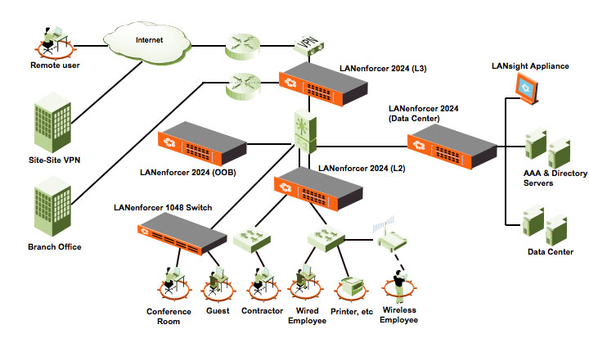
NETWORK TOPOLOGY (LOGICAL TOPOLOGY)

Slide 213
Physical – Logical Topology
Inside, the ports of the hub are wired in a circle. Data packets travels in a ring – not as a star!
Each computer connects
to the central hub

Slide 214
Infrastructure and design
We define the structure of our networks based on the reach and functionality of the data flows
Here you’ll learn about WAN, MAN, LAN, WLAN, PAN, SCADA, and Medianet infrastructures.

Slide 215
WAN
Wide Area Network
A Wide Area Network (WAN) is where the workstations are 'further apart' from each other compared to a LAN
For example, the computers may be spread out over a town, a country or the world (like the Internet is).
WANs are usually a number of LANs that are connected up over some distance
The connections are frequently made using the normal telephone cables but they might involve fibre optic connections, wireless, microwave or satellite, for example

Slide 216
LAN
A Local Area Network (LAN) is a network where the workstations are 'close' together
It isn't strictly defined in terms of an exact distance but it is usually thought of as computers in the same room, or building or even in a number of buildings which are next to each other, such as a school or hospital
The different parts of the network might be connected together using wireless signals or they may be physically connected together using cables such as a type known as CAT 5 or using a fibre optic cable.

Slide 217
LAN
With computers and computer equipment connected together in a LAN, users can do a number of things:
They can log on using a login name and password - this stops unauthorised users from getting access to the network.
They can use any computer on the LAN, even if their most convenient one isn't working.
They can easily share files and resources with other users. You only need one printer for all the users, for example.
They can easily communicate with other users in their organisation by sending them email or by using an internal Internet known as an Intranet. Intranets are like the Internet but they are only accessible by people in the organisation. Using the Intranet, you can send messages, set up bulletin boards, web pages

Slide 218
Differences between LANs and WANs
LANs are spread over a smaller area whereas WANs are spread over a larger area
WANs are usually made up of LANs connected together
LANs are usually much faster than WANs
LANs can usually send much bigger volumes of data in a second (known as 'bandwidth') than a WAN
Users generally share hardware on a LAN
On a WAN, however, the focus is all on communicating and sharing data

Slide 219
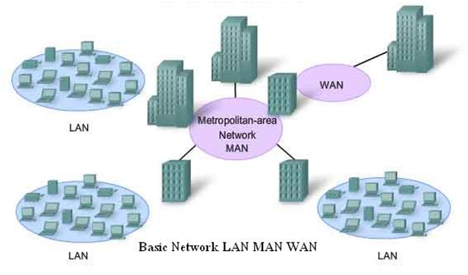
MAN
A metropolitan area network (MAN) is a computer network that interconnects users with computer resources in a geographic region of the size of a metropolitan area

Slide 220
WLAN
A wireless LAN (WLAN) is a wireless computer network that links two or more devices using wireless communication to form a local area network (LAN) within a limited area such as a home, school, computer laboratory, campus, or office building
This gives users the ability to move around within the area and remain connected to the network
Through a gateway, a WLAN can also provide a connection to the wider Internet
Most modern WLANs are based on IEEE 802.11 standards and are marketed under the Wi-Fi brand name
Wireless LANs have become popular for use in the home, due to their ease of installation and use
They are also popular in commercial properties that offer wireless access to their employees and customers

Slide 221
PAN
A PAN is a Personal Area Network
This is a network that revolves around one person or a small group of people
For example, it might involve just a laptop, a phone and perhaps some wearable technology
PANs can be wired but often, they are wireless networks
The most common wireless technology used to create a PAN is Bluetooth but other wireless technologies can be used, such as infra-red or NFC
The typical radius of a PAN is only about 10 metres so it is very much a network for use in a small area

Slide 222
SCADA
SCADA is an acronym for supervisory control and data acquisition, a computer system for gathering and analysing real time data
SCADA systems are used to monitor and control a plant or equipment in industries such as telecommunications, water and waste control, energy, oil and gas refining and transportation.

Slide 223
SCADA

Slide 224
MediaNet
A medianet is a network optimized for rich media - not only voice and video, but the mixing together of videos and documents, webpages, text, and many other forms of media
The applications must be able to query the network for services and information in order to offer users a better experience

Slide 225
1.6 Given a scenario, implement the appropriate wireless technologies and configurations
802.11 standards
a
b
g
n
ac
Cellular
GSM
TDMA
CDMA
Frequencies
2.4GHz
5.0GHz
Speed and distance requirements
Channel bandwidth
Channel bonding
MIMO/MU-MIMO
Unidirectional/omnidirectional
Site surveys

Slide 226
Wireless
Uses radio to connect network nodes
Avoids costly cabling
Works at the physical layer (1)
Bluetooth, NFC, Wi-Fi or Cellular (GSM)
Bluetooth
Low power, short range
Mice, keyboards, smartphone, headsets
Built into OS
NFC (Near field communication)
4cm range
Contactless payment (smartphone)
Data sharing(smartphone)

Slide 227
Wi-Fi
 | 802.11 | 802.11a | 802.11b | 802.11g | 802.11n | 802.11n IEEE Specification | 802.11ac Wave 1 | 802.11ac Wave 2 | 802.11ac IEEE Specification | 802.11ax
Band | 2.4GHz | 5.8GHz | 2.4GHz | 2.4GHz | 2.4GHz and 5GHz | 2.4GHz and 5GHz | 5GHz | 5GHz | 5GHz | 2.4GHz and 5GHz
Max Speed | 1.2Mbps | 54Mbps | 11Mbps | 54Mbps | 450Mbps | 600Mbps | 1.3Gbps | 2.34GHz – 3.47GHz | 6.9GHz | 10Gbps
MIMO | Single User | Single User | Single User | Single User | Single User | Single User | Single User | Multi User | Multi User | Multi User

Slide 228
1.7 Summarize cloud concepts and their purposes
Types of services
SaaS
PaaS
IaaS
Cloud delivery models
Private
Public
Hybrid
Connectivity methods
Security implications/considerations
Relationship between local and cloud resources

Slide 229
Types of Services
SAAS
PAAS
IAAS

Slide 230
Cloud Infrastructure as a Service (IaaS)
Provides processing, storage and networks
The consumer is able to deploy and run arbitrary software, which can include operating systems and applications
The consumer does not manage or control the underlying cloud infrastructure, but has control over
operating systems
storage
deployed applications
selected networking components (e.g., host firewalls)
Examples are:
Microsoft Azure
Amazon Web Services
Google Cloud

Slide 231
Cloud Infrastructure as a Service (IaaS)

Slide 232
Cloud Platform as a Service (PaaS)
The consumer deploys onto the cloud infrastructure consumer-created or acquired applications created using programming languages and tools supported by the provider
The consumer does not manage or control the underlying cloud infrastructure but has control over the deployed applications
Examples are:
server space for web pages such as Rackspace or GoDaddy
Google App engine

Slide 233
Cloud Platform as a Service (PaaS)

Slide 234
Cloud Software as a Service (Saas)
The ability to use the provider’s applications running on a cloud infrastructure
The applications are accessible from various client devices through a thin client interface, such as a Web browser
The consumer does not manage or control the underlying cloud infrastructure including network, servers, operating systems, storage, or even individual application capabilities
Examples are: Google Docs, Office365, Gmail, Dropbox, Slack

Slide 235
Cloud Software as a Service (Saas)

Slide 236
Cloud Delivery Models
Public
Private
Community
Hybrid

Slide 237
Public Cloud
The cloud infrastructure is provisioned for open use by the general public
It may be owned, managed, and operated by a business, academic, or government organization, or some combination of them
It exists on the premises of the cloud provider
Under most circumstances, a public cloud is owned by the cloud provider, and it uses a pay-as-you-go model
A good example of a public cloud is webmail or online document sharing/collaboration

Slide 238
Private Cloud
The cloud infrastructure is provisioned for exclusive use by a single organization comprising multiple consumers (e.g., business units). It may be owned, managed, and operated by the organization, a third party, or some combination of them, and it may exist on or off premises
Under most circumstances, a private cloud is owned by the organization, and it acts as both the provider and the consumer
It has a security-related advantage in not needing to put its data on the Internet

Slide 239
Hybrid Cloud
The cloud infrastructure is a composition of two or more distinct cloud infrastructures (private, community, or public) that remain unique entities, but are bound together by standardized or proprietary technology that enables data and application portability (e.g., cloud bursting for load balancing between clouds)
A hybrid can be any combination of other delivery models
Not only are public and private listed in the definition, but also community

Slide 240
Community Cloud
CompTIA no longer includes the community cloud delivery model on the Network+ exam (but does require you to know it for its cloud-focused certifications)
For real-world purposes, you should know that the key to distinguishing between a community cloud and other types of cloud delivery is that it serves a similar group
There must be joint interests and limited enrolment

Slide 241
Connectivity Methods
Most cloud providers offer a number of methods that clients can employ to connect to them
It is important, before making an investment in infrastructure, to check with your provider and see what methods it recommends and supports

Slide 242
Connectivity Methods
One of the most common is to use an IPsec, hardware VPN connection between your network(s) and the cloud providers
This method offers the capability to have a managed VPN endpoint that includes automated multidata centre redundancy and failover
A dedicated direct connection is another, simpler, method
You can combine the dedicated network connection(s) with the hardware VPN to create a combination that offers an IPsec-encrypted private connection while also reducing network costs

Slide 243
IPSec and VPN
IPSec Internet Protocol Security
Encrypts IP packets
VPNs use IPSec to establish and run encrypted connections
Adds headers and trailers to the packet data payload (50-60 bytes), may require MTU adjustments
Authenticates each packet
Uses UDP to get through firewalls
In tunnel mode the original IP addresses are encrypted and new IP headers added. The tunnel exists between the source and destination routers
In transport mode the original IP headers are in the clear
IPSec uses port 500

Slide 244
Security Implications/Considerations
Security is one of the most important issues to discuss with your cloud provider
Cloud computing holds great promise when it comes to scalability, cost savings, rapid deployment, and empowerment
When so much control is removed risks are involved
Each risk should be considered carefully to identify ways to help mitigate it
The responsibilities of both the organisation and the cloud provider vary depending on the service model chosen
Ultimately the organisation is accountable for the security and privacy of the outsourced service
Notes:
Security is one of the most important issues to discuss with your cloud provider.
Cloud computing holds great promise when it comes to scalability, cost savings, rapid deployment, and empowerment.
As with any technology where so much is removed from your control, though, risks are involved.
Each risk should be considered carefully to identify ways to help mitigate it.
Naturally, the responsibilities of both the organization and the cloud provider vary depending on the service model chosen, but ultimately the organization is accountable for the security and privacy of the outsourced service.

Slide 245
Relationship Between Local and Cloud Resources
Cloud offers the ability to store more and more data on it and to let a provider worry about scaling issues instead of local administrators
From an economic perspective, this can be a blessing
From an administrative point, though, it can present some issues
To minimise problems, be sure that files are kept current, and synchronisation between local and remote files is always running

Slide 246
1.8 Explain the functions of network services
DNS service
Record types
A, AAAA
TXT (SPF, DKIM)
SRV
MX
CNAME
NS
PTR
Internal vs. external DNS
Third-party/cloud-hosted DNS
Hierarchy
Forward vs. reverse zone
DHCP service
MAC reservations
Pools
IP exclusions
Scope options
Lease time
TTL
DHCP relay/IP helper
NTP
IPAM

Slide 247
DHCP
Dynamic Host Configuration Protocol (DHCP) is a network management protocol
A DHCP server enables computers to request IP addresses and networking parameters automatically from the Internet service provider (ISP)
In the absence of a DHCP server, a computer or other device on the network needs to be manually assigned an IP address, or to assign itself an APIPA address
A DHCP server dynamically assigns an IP address
Notes:
Dynamic Host Configuration Protocol (DHCP) is a network management protocol used on Internet Protocol (IP) networks, whereby a DHCP server dynamically assigns an IP address and other network configuration parameters to each device on the network, so they can communicate with other IP networks.
A DHCP server enables computers to request IP addresses and networking parameters automatically from the Internet service provider (ISP), reducing the need for a network administrator or a user to manually assign IP addresses to all network devices.[1] In the absence of a DHCP server, a computer or other device on the network needs to be manually assigned an IP address, or to assign itself an APIPA address, the latter of which will not enable it to communicate outside its local subnet.

Slide 248
DHCP
The DHCP server assigns addresses using leases, which are temporary but renewable assignments
Addresses can be assigned dynamically, or by reservation
Assigned addresses are leased for a fixed amount of time, after which they must be renewed
Lease time can be configured on the server
The DHCP server can assign additional network settings, called DHCP options.
When a DHCP client connects to the network, it looks for a DHCP server using a broadcast packet
If a DHCP server is not on the client's local segment, routers can be configured as DHCP relay agents

Slide 249
The DHCPv4 Leasing Process
Client
DHCP Server
DHCPDISCOVER
Time
DHCPOFFER
DHCPREQUEST
DHCPACKNOWLEDGE
Notes:
Each message may be either a broadcast or a unicast, depending on the DHCP client capabilities.

Slide 250
DHCP process
Step 1:
Discover - Client to DHCP Server
Find all of the available DHCP Servers
Step 2:
Offer - DHCP Server to client
Send some IP address options to the client
Step 3:
Request - Client to DHCP Server
DHCP server sends an acknowledgment to the client
Step 4:
Acknowledgment - DHCP Server to client
Client chooses an offer and makes a formal request

Slide 251
The DHCPv6 leasing process
DHCPv6 uses a DHCP Unique Identifier (DUID) for address allocations and client/server identification during the leasing process
DHCPv6 allows two configuration methods, stateless and stateful

Slide 252
APIPA
APIPA is short for Automatic Private IP Addressing
A feature of Windows operating systems, meant for non-routed small business environments, usually less than 25 clients
With APIPA, DHCP clients can automatically self-configure an IP address and subnet mask
Used when a DHCP server isn't available
IP address range (from 169.254.0.0 - 169.254.255.255)
Reserved by the Internet Assigned Numbers Authority (IANA) for that purpose
Notes:
APIPA is short for Automatic Private IP Addressing, a feature of Windows operating systems, meant for non-routed small business environments, usually less than 25 clients
With APIPA, DHCP clients can automatically self-configure an IP address and subnet mask when a DHCP server isn't available.
The computer selects an IP address from a range of addresses (from 169.254.0.0 - 169.254.255.255) reserved by the Internet Assigned Numbers Authority (IANA) for that purpose

Slide 253
APIPA
If a system that does not support APIPA cannot get an address from a DHCP server, it typically assigns itself an IP address of 0.0.0.0.
Keep this in mind when troubleshooting IP addressing problems on non-APIPA platforms

Slide 254
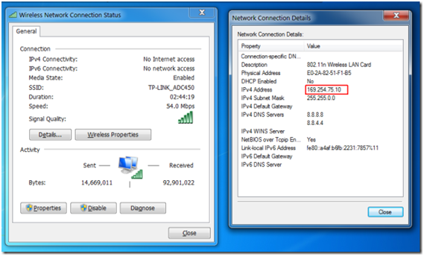

Slide 256
Configuring DHCP
DHCP configuration is relatively straightforward
Server exclusions can be set up

Slide 257
Scope properties
IP address range
And excluded addresses
Subnet mask
Lease durations
Other scope options
DNS server, default gateway, WINS server

Slide 258
DHCP Pools
Grouping of IP addresses
Each subnet has its own scope
192.168.1.0/24, 192.168.2.0/24, 192.168.3.0/24, etc.
A scope is generally a single contiguous pool of IP addresses
DHCP exceptions can be made inside of the scope

Slide 259
A range of addresses to be reserved for allocation

Slide 261
IPAM systems
IP address management (IPAM) software that integrates DNS and DHCP and allows you to centrally manage both services across your network.
Keeping an inventory of IP address pools and subnets, both for DHCP and static addresses.
Keeping an inventory of available host and domain names.
Tracking current DHCP and DNS assignment.
Keeping DHCP and DNS services aware of each other's status. For example, if a named host has its IP address changed, IPAM can make sure the host name points to the new IP address.

Slide 262
Understanding & Troubleshooting Networking
Intro
Monday
01
02
Wednesday
03
04
Tuesday
05
06
Thursday
Friday

